Slide 1
A new layout (proposal) 14-09-2018

Slide 2
Some new requirement
Avoid any dependence on filling and cooling between det#1 and det#2
Test complete double APA (+electronics and PD) or CRP just before inserting it into the cryostat
Det #1 in cavern 1
Det #2 in cavern 2
Cold tests in dedicated cold boxes in the cavern clean room
Cold boxes for double APA
or
Cold boxes for individual CRPs

Slide 3
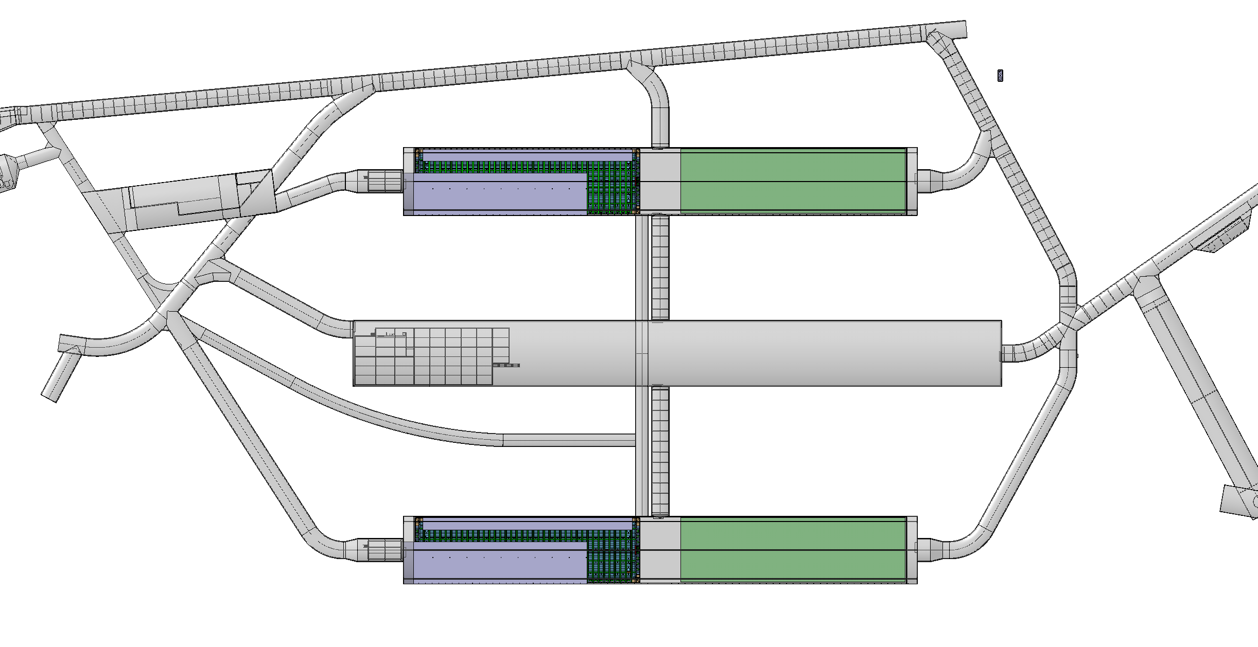
Det#1
Det#3
Det#2
Det#4

Slide 4
Two caverns implications
Cavern 2 beneficial occupancy after the warm vessel det #1 is assembled (t0+9m). This means cavern 2 beneficial occupancy 8-12 months after cavern 1 has been released.
Cavern 2 equipped with general services (HVAC, electricity, light, …). This means adding ~4-5M$ to the initial investments by CF
Advantages:
Det#1 cooling independent from det#2 status/progress. This will have important implication on the overall schedule
Might allow parallel activities and schedule independency
For the first two detectors more space available for storage and assembly work organization
More quality controls before last step of installation
This might liberate resources from the ITF facility
Problems:
Number of people underground
Schedule of the second cavern

Slide 5
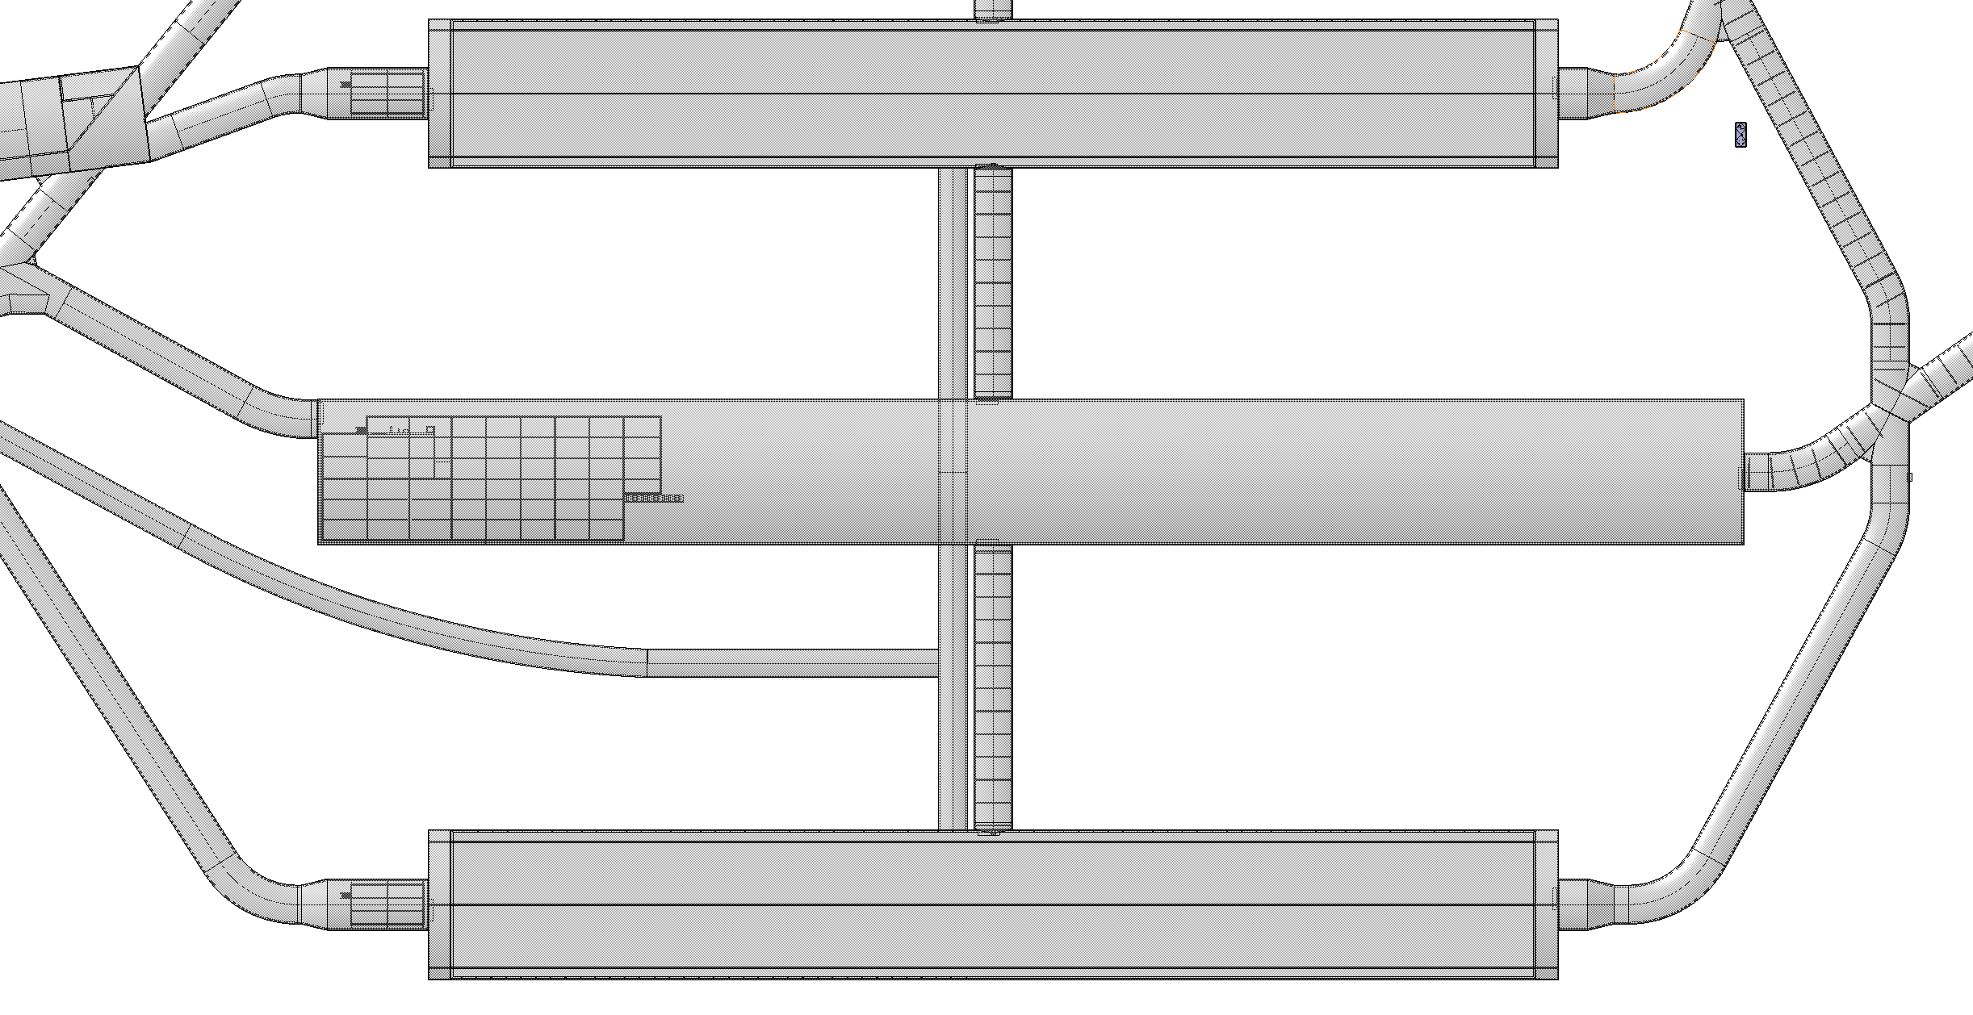
STEP#0
T=T0
beneficial occupancy cavern 1
excavation cavern 2

Slide 6
STEP#1
T=T0+9m
Det#1 warm vessel assembled
steel material
people : 40
people : 20?
excavation cavern 2
total people : 60

Slide 7
STEP#2
T=T0+9m+3m
Det#1 warm vessel assembled
people : 5
people : 20?
beneficial occupancy cavern 2
total people : 25

Slide 8
STEP#3
T=T0+9m+12m
Det#1 cold vessel assembled + cryo mezzanine
material / boxes
people : 35
people : 40
steel material
total people : 75
Det#2 warm vessel assembly

Slide 9
STEP#4
T=T0+9m+12m+12m
Det#1 installation
material
people : 34
people : 35
material / boxes
total people : 69
Det#2 cold vessel assembly + cryo mezzanine

Slide 10
STEP#5
T=T0+9m+12m+12m+12m
Det#1 cooling
people : 10
people : 34
material
total people : 44
Det#2 installation

Slide 11
STEP#6
T1=T0+45m →T0=Jan-2023 ->T1=Sep 2026
Det#1 commissioning/operation start
people : 15
people : 10
total people :20
Det#2 cooling

Slide 12
STEP#6
T2=T0+57m →T0=Jan-2023 ->T2=Sep 2027
Det#1 in operation
people : 15
people : 15
total people : 30
Det#2 cooled and start commissioning

Slide 13
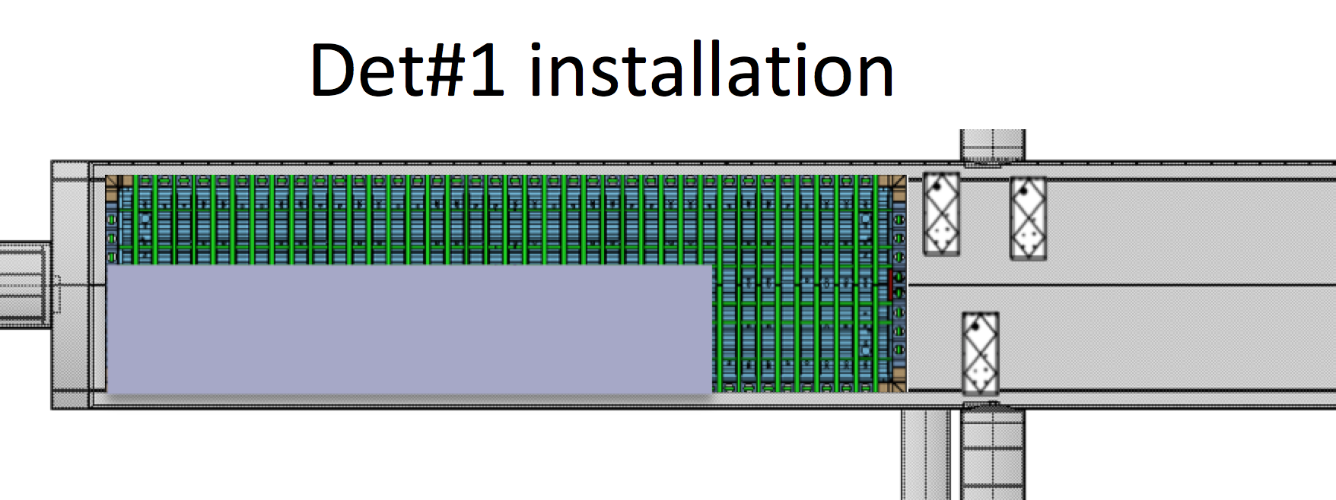
3 cold boxes : ~14m high, N2 gas cooling
Integration of the photon detectors bars
Final integration of the electronics
Final cabling of the 2 APAs
Test with final DAQ
Integration of the FC/cathode
Use bridge crane for manipulations
Local storage
Material SAS
Clean room
to be optimized
total people max in any period : ~ 70p/cavern

Slide 14
Detector 3 and 4
Probably different technology
Lesson learned, will make it easier
Yes, more difficult because of less space

