Slide 1
LBNF Nitrogen System Status & Schedule
David Montanari
LBNF/DUNE FS Interface Meeting
1 November 2018

Slide 2
Scope
Design-Build project (Engineering, Procurement, Construction - EPC) consisting of all items and costs for labor, equipment, transportation, overhead, bonding, safety oversight, QC oversight and supervision for the engineering, design, fabrication and mobilization required to procure, install and commission a Nitrogen System composed of a LN2 Refrigeration System and LN2 Storage.
LN2 Refrigeration System (inclusive of capital spares and 2-year operational spares):
Nitrogen Compression (4 GN2 compressors, above ground).
Nitrogen Refrigeration (4 units, comprised of cold boxes and expanders, each one 100 kW cooling, underground).
LN2 Storage:
52,834 gal (200 m³) of buffer backup storage underground.
Argon condensers (supplied by Others):
To condense/recondense Argon via heat evaporation of LN2 in heat exchangers. Underground.
LN2/GN2 Interconnecting Piping (supplied by FRA).
GN2 from above ground to underground.
LN2 from buffer storage to condensers.
GN2 from condensers back to Nitrogen Refrigeration System
All supplied by FRA.
Notes:
READ.

Slide 3
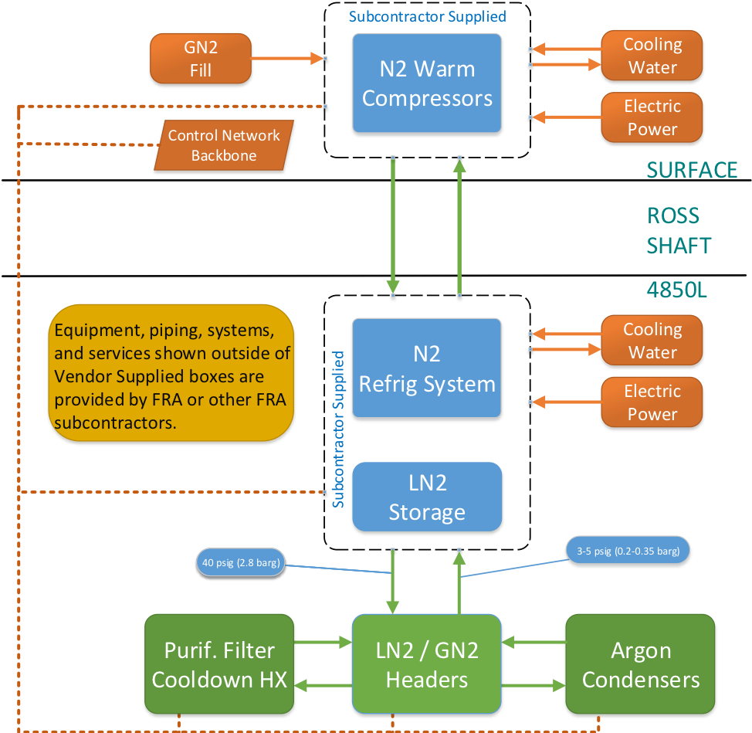
Nitrogen System Block Diagram
Notes:
READ.

Slide 4
Cryogenics Process Flow Diagram
Infrastructure
NO cryogenics in the shaft.
Proximity
Internal

Slide 5
Solicitation to Award Timeline – Estimated
10/31/18 – DOE RFP Approvals Complete. (within days)
11/9/18 – Solicitation Posted. (doable if DOE within days)
105 days for Offerors to Submit Proposals.
Mandatory Site Visit in early December (tentatively Dec 11-12).
2/22/19 – Proposals Due
4/23/19 – Evaluation Complete (60 days)
6/24/19 – DOE Award Approvals Complete (60 days)
6/28/19 – Subcontract Award

Slide 6
Current Procurement Approach & Timeline
Goal: to be ready for beginning of Ops: Q2 CY 2026 (May-2026).
Solicitation expected in Nov 2018 with award expected Q2 CY 2019.
Phase 1 – Design (Full system):
Preliminary and Final Design (Compression, Refrigeration, Storage)
Start Q2 CY 2019 (upon contract award). (Driven by CD-2)
Completed NLT Q2 CY 2020.
Phase 2 – Fabricate, Install, Commission First 3 units Nitrogen Refrigeration and LN2 storage (Detectors #1, #2).
Start NET Q1 CY 2021 (Jan-2021). (Driven by DOE Funding Profile)
Completed NLT Q2 CY 2026 (May-2026). (Driven by beginning of Ops)
Phase 3 – Fabricate, Install, Commission 4th unit Nitrogen Refrigeration (Detectors #3, #4).
Start NET Q2 CY 2023 (Feb-2023). (Arbitrary, depends on Non-DOE partner)
Completed NLT Q2 CY 2027. (Driven by beginning of cryo Ops for Detector #3)

Slide 7
Thanks

Slide 8
Backup

Slide 9
DOE Approvals
Acquisition Plan
1/30/17 – Submitted to FSO
4/19/18 – Approved by FSO
5/30/18 – Approved by IRB
6/5/18 – Approved by HCA
6/8/18 – Approved by MA
Subcontract Award
TBD – Submitted to FSO
TBD – Approved by FSO
TBD – Approved by IRB
TBD – Approved by HCA
TBD – Approved by MA
Solicitation Package
7/19/18 – Submitted to FSO ✓ ︎
8/27/18 – Approved by FSO ✓
10/24/18 – Approved by IRB ✓
TBD – Approved by HCA (Expected within days).
TBD – Approved by MA (Expected within days).

Slide 10
Refrigeration loads

Slide 11
Timeline to support DUNE-SP Cold Box test Underground
Goal: to be ready by Start of SP cold box test: Q2 CY 2024 (Apr-2024).
Solicitation expected in Nov 2018 with award expected Q2 CY 2019.
Phase 1 – Design:
Preliminary and Final Design (Compression, Refrigeration, Storage)
Start Q2 CY 2019 (upon contract award). (Driven by CD-2)
Completed NLT Q2 CY 2020. (Can stay unchanged)
Phase 2 – Fabricate, Install, Commission First 3 units Nitrogen Refrigeration and LN2 storage
Start NET Q4 CY 2021. (Can stay unchanged, but advanced procurement may be needed)
Completed NLT Q1 CY 2024. (1 year after Beneficial Occupancy)
Phase 3 – Fabricate, Install, Commission 4th unit Nitrogen Refrigeration.
Unchanged.

Slide 12
Comments
Functional specs: good. No changes.
Procurement Schedule: would actually work better with vendors. Preferred method is from design to commissioning without interruptions. Vendors not expecting it now, so would need to inform for resource planning. 1 year faster than schedule before re-estimate.
Current funding profile:
Procurement is ok.
Installation needs to be moved up: Obligations for Installation / Commissioning in Q4 CY 2024 (Dec-2024). Would need to start installation in Q2 CY 2023. (8 mo installation + 3 mo for commissioning. The latter could be shortened to 1.5-2 mo according to preliminary conversations with vendors).
Current installation schedule of GN2 piping in the shaft: does not work. Scheduled to be completed in Q2 CY 2026. Would need to be moved up to Q1 CY 2024.
Alternative ways of supplying cryogens to the cold boxes underground (see talk in ITF Workshop).

Slide 13
Current Procurement Approach & Timeline (Before re-estimate)
Goal: to be ready for beginning of Ops (Q4 CY 2027)
Solicitation expected in Nov 2018 with award expected Q2 CY 2019.
Phase 1 – Design:
Preliminary and Final Design (Compression, Refrigeration, Storage)
Start Q2 CY 2019 (upon contract award). (Driven by CD-02)
Completed NLT Q2 CY 2020.
Phase 2 – Fabricate, Install, Commission First 3 units Nitrogen Refrigeration and LN2 storage
Start NET Q3 CY 2021. (Driven by Funding Profile)
Completed NLT Q3 CY 2025. (Driven by beginning of Ops)
Phase 3 – Fabricate, Install, Commission 4th unit Nitrogen Refrigeration
Not affected.

