Slide 1
Pre-excavation and Excavation
Doug Pelletier, Josh Willhite, Elaine McCluskey
LBNF Project
1 November 2018

Slide 2
Start of Construction work at Far Site
1st construction work is Pre-excavation construction to put facilities in place required for excavation
  Scope includes:
    Underground rock handling at bottom of shaft (ore passes, skip loading, temporary grizzly, rock spill collection system)
    Rock crushing system at surface to accommodate conveyor
    Installing surface rock conveyor to Open Cut
    Ross Headframe structural reinforcement to allow larger loads and update to building codes
    Shaft utilities: fiber optic (Yates & Ross) and power cables, water piping (Ross only)
    Electrical service on the surface from substation to the shaft
  ~23.3 months starting in December if contract can be awarded in November – currently in DOE approval process

Slide 3
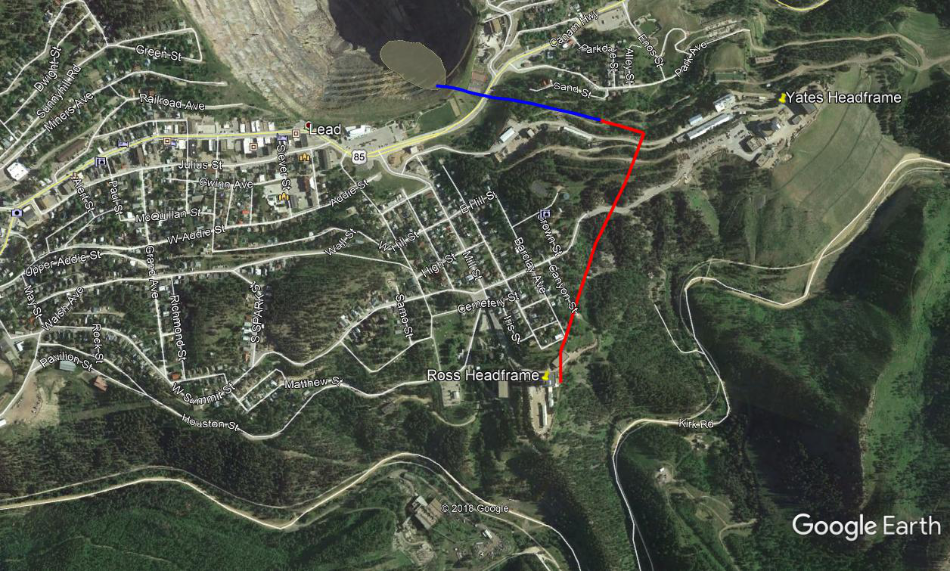
Start of Construction at Far Site
875,000 tons of rock will be transported to the surface and deposited in the Open Cut using a series of systems from blast area to the base of Ross Shaft, then into skips for movement to a surface crusher and conveyor system.
Ross
Shaft

Slide 4
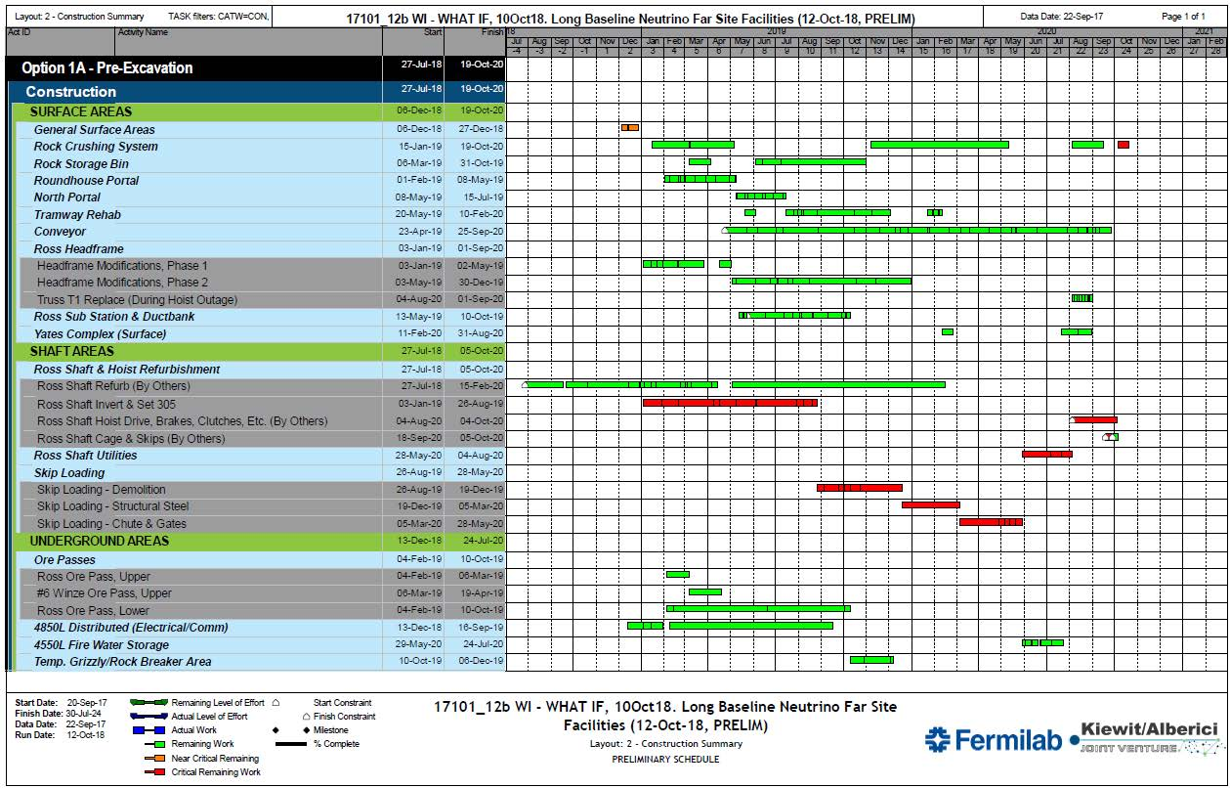
Preliminary CM/GC CPM schedule to excavation start

Slide 5
Beyond Pre-Excavation to Excavation Work
Have received Arup 30% final design submittal
Early excavation involves
  opening pathways in drifts
  creating initial support spaces for contractor equipment
  Establishing ventilation required for excavation
Cavern excavation then able to start
60% Final EXC design will be received tomorrow and distributed for review and comment. BSI will be received on November 16 and distributed. Presentation will be given on November 28. All comments must be received by December 5, 2018. Design will be frozen.
All open Requirements must be finalized by end of November. Any changes to the requirements after this date will have large impacts to cost and schedule.

Slide 6
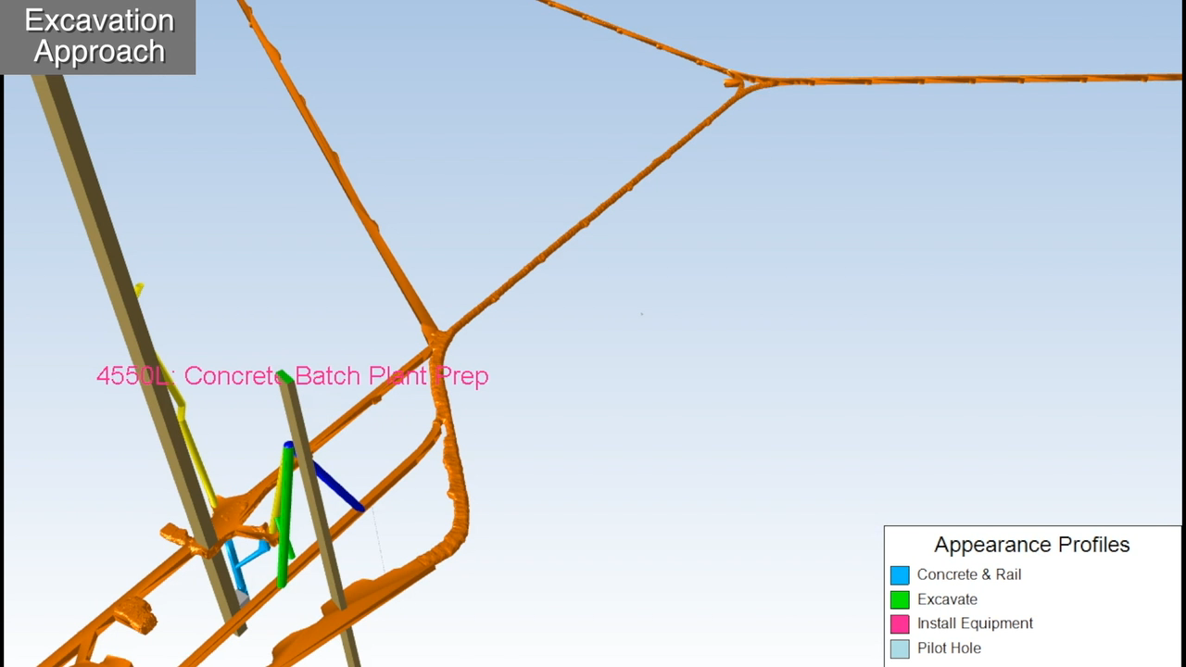
30% Final Design – Excavation Sequencing

