Slide 1
Egress paths from 4850 to 4910 level
J Fowler

Slide 2
Egress from 4850 to 4910 level
At beneficial occupancy, there needs to be one code compliant egress path from 4850 to the 4910 level.
This can be a permanent or temporary path that meets FLS requirements.
Currently there is the design of a permanent set of stairs in the FSCF scope. This design is being performed by ARUP.
When these permanent stairs are installed is still a question
A code compliant set of temporary stairs could be installed in order to receive beneficial occupancy.
It is understood that only one egress path is needed if the occupancy of the 4910 level is less than 50 people.

Slide 3
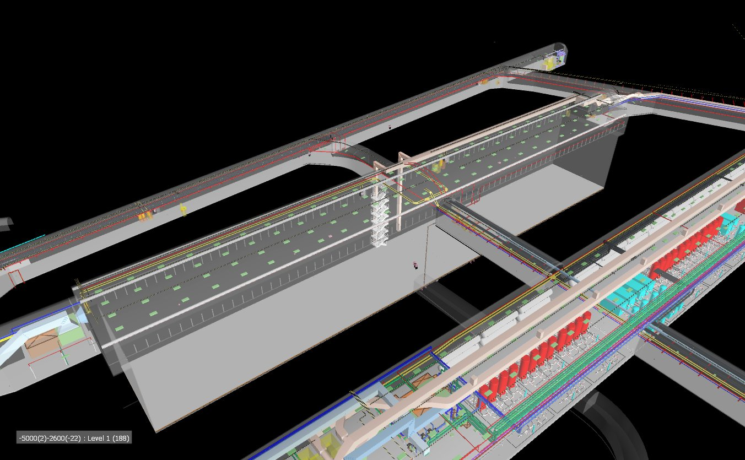
North cavern at beneficial occupancy

Slide 4
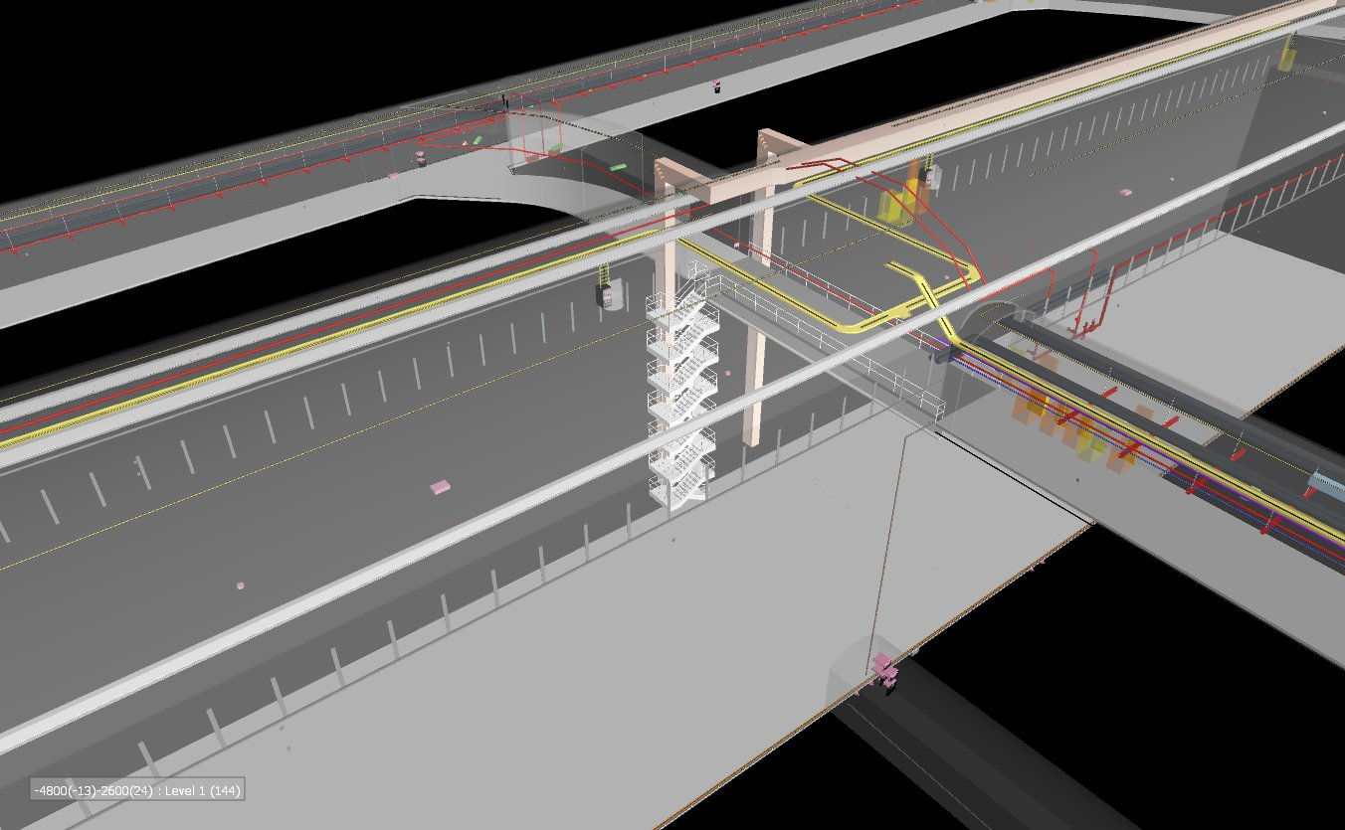
Very constrained space available for permanent egress paths

Slide 5
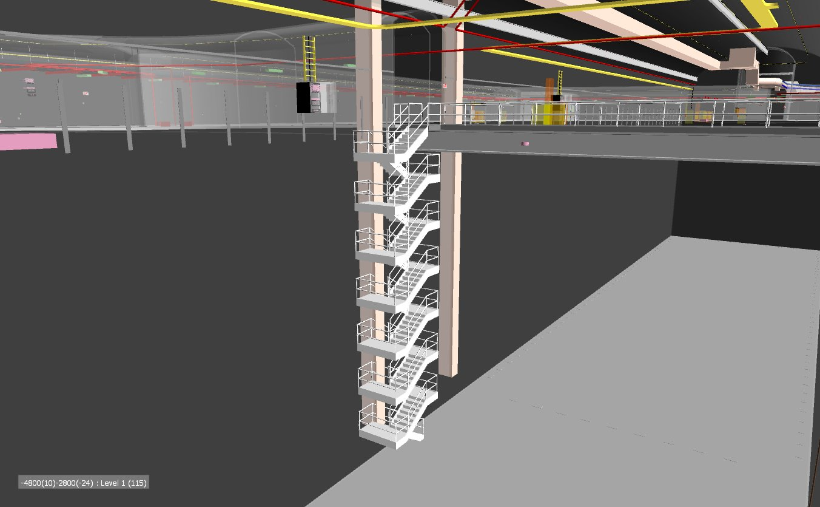
Integration into CF design

Slide 6
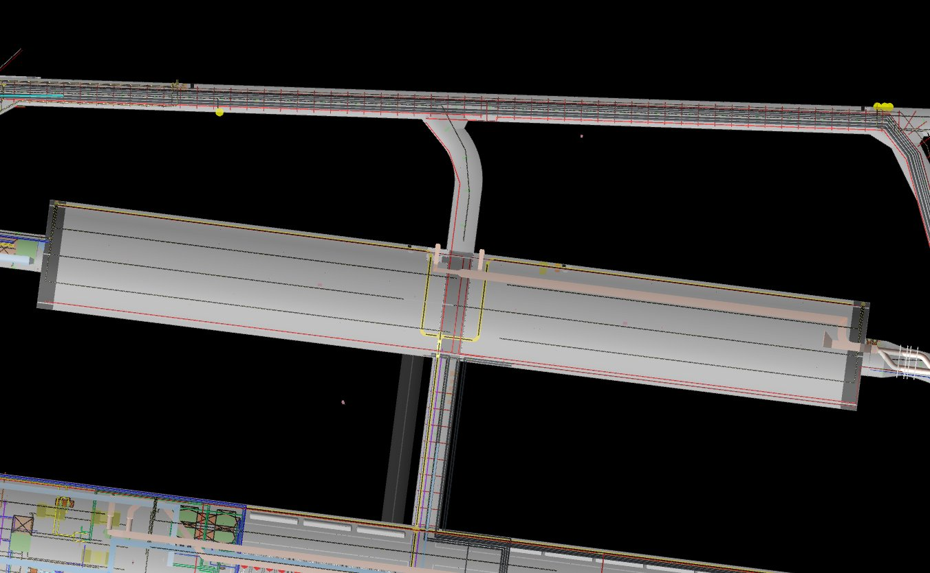
Position of permanent stairs in N cavern

Slide 7
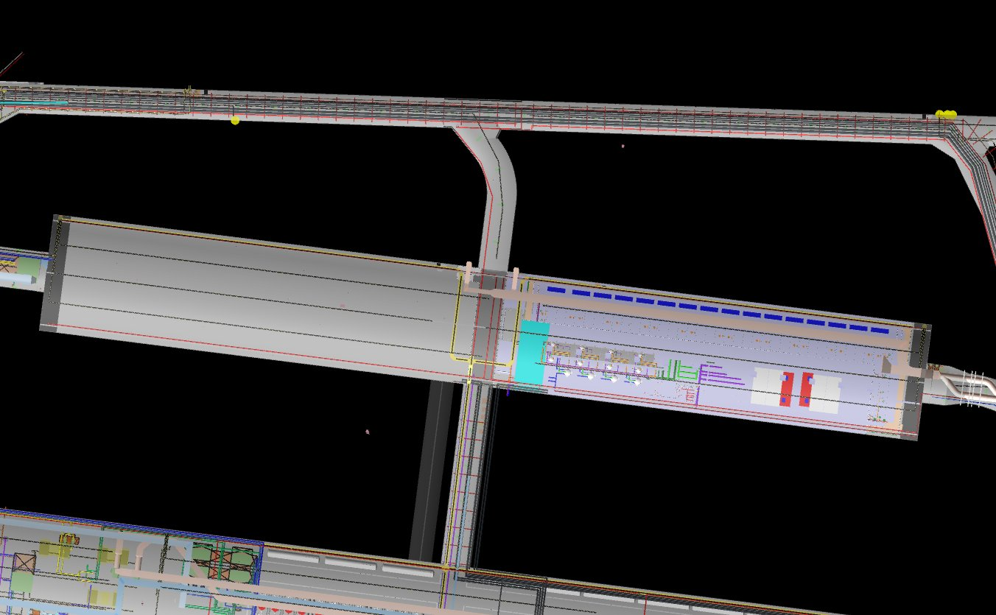
The west end of the cavern will be used as storage for installation
Temp stairs would be added and an alimak near the west entrance. These could stay until cryostat 3 construction begins.

Slide 8
Conclusions
The location of the permanent stairs will be transmitted to ARUP for final design. (unless objections)
When this will be installed is still to be determined.
Temporary stair towers and alimaks will be the responsibility of others to be added after CF is complete.

