Slide 1
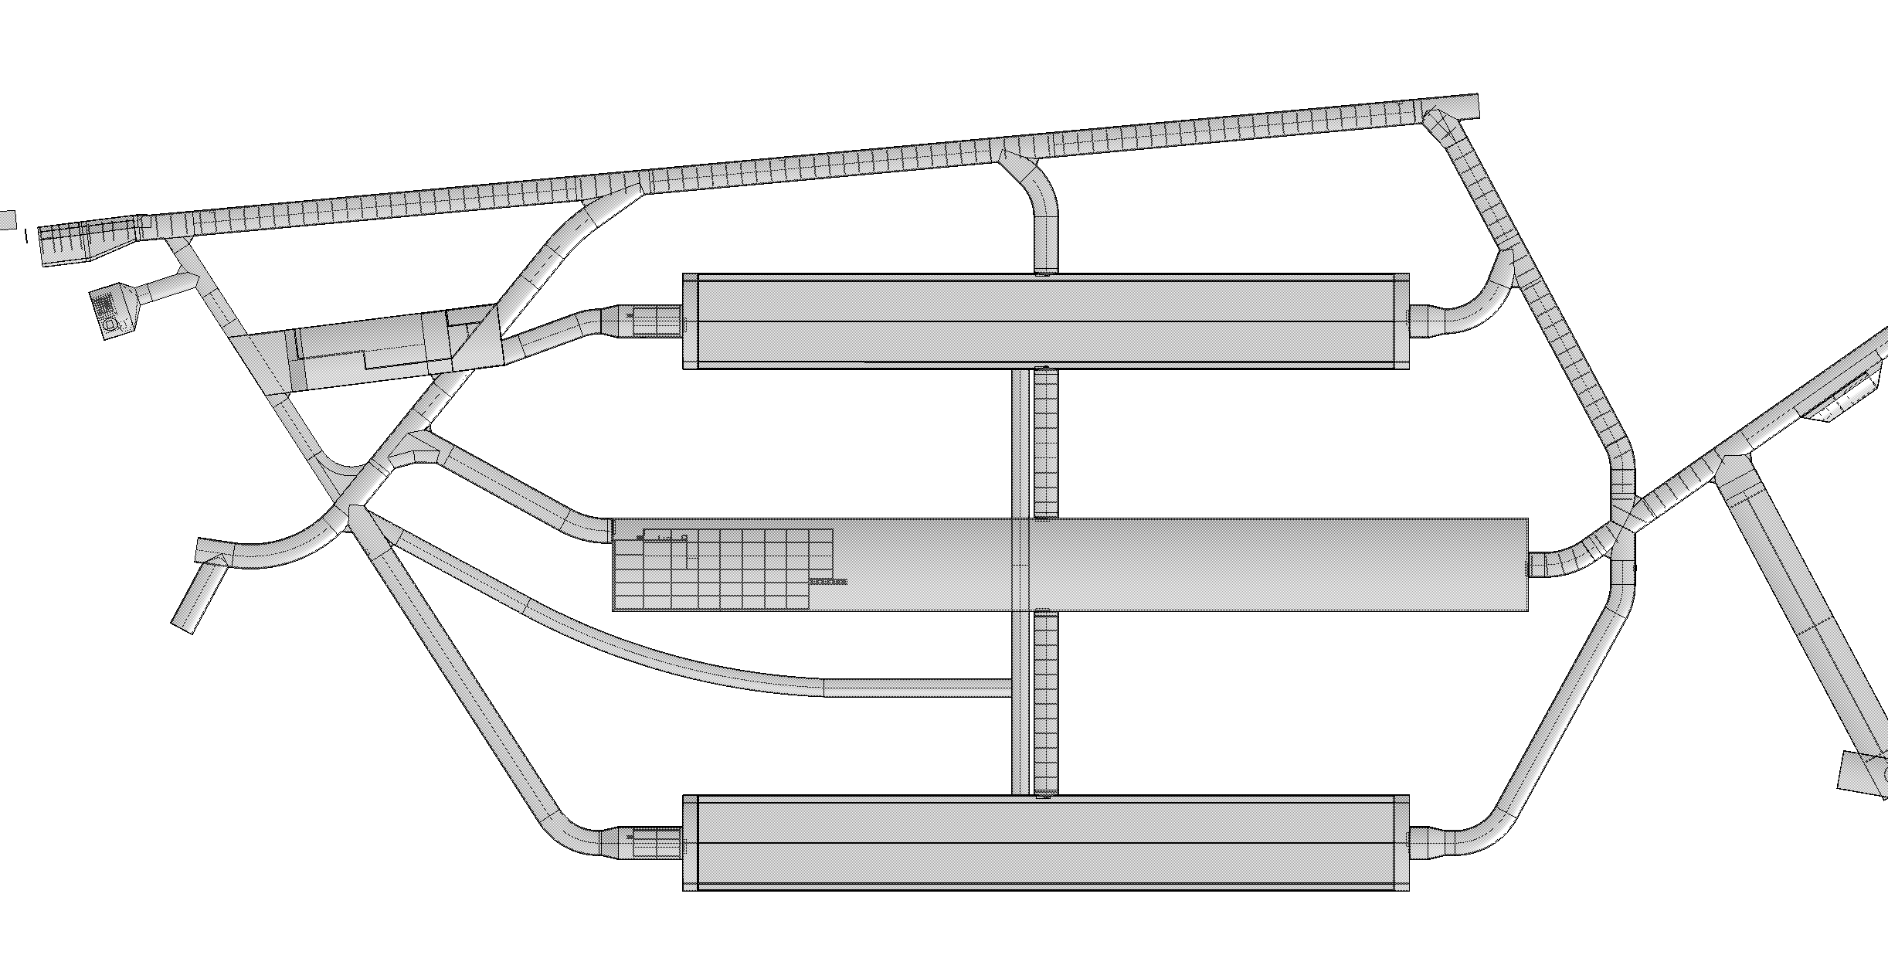
Det#3
Det#1
Det#4
Det#2
Marzio’s presentation

Slide 2
Layout 1
Det1
Det3
Layout 2
Det3
Det1
Jack’s model

Slide 3
Installation - Detector 1

Slide 4
Layout 2
Det3
Det1

Slide 5
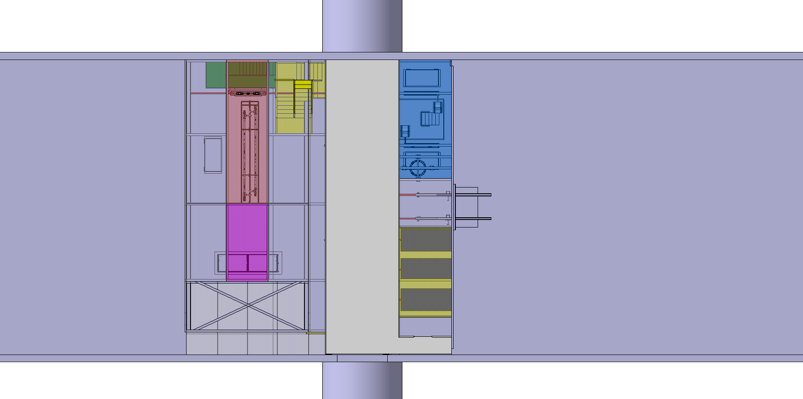
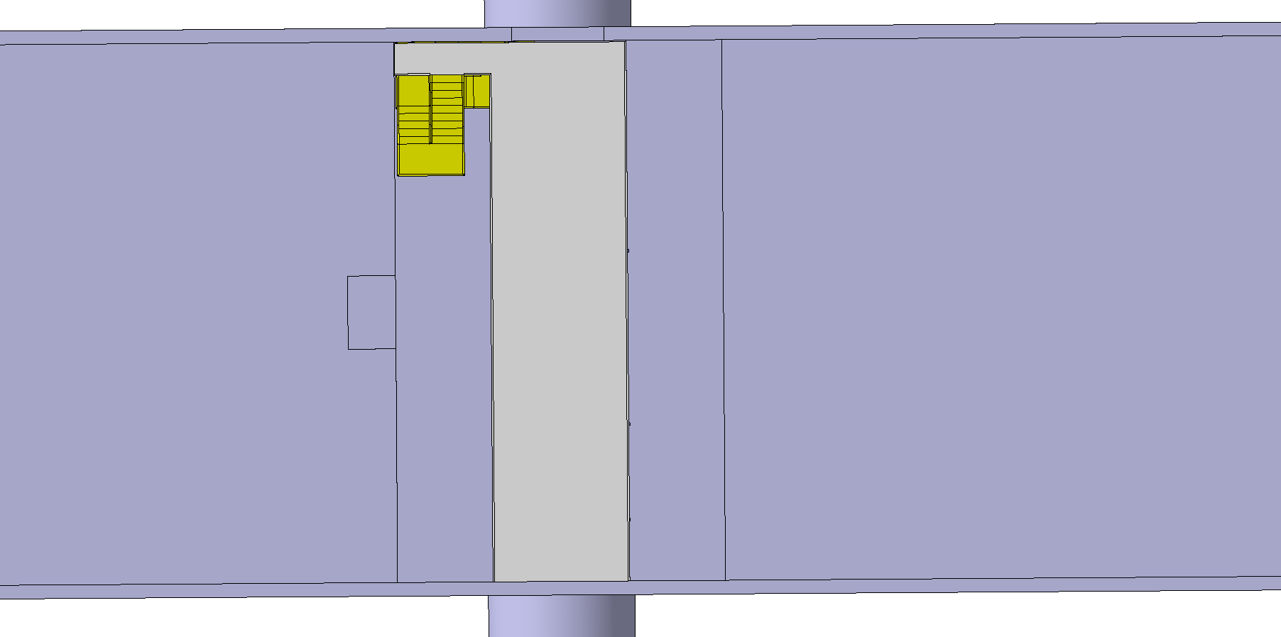
Layout 2
Det3
Det1
Layout 2 – Possible Changes
Det3
Det1

Slide 6
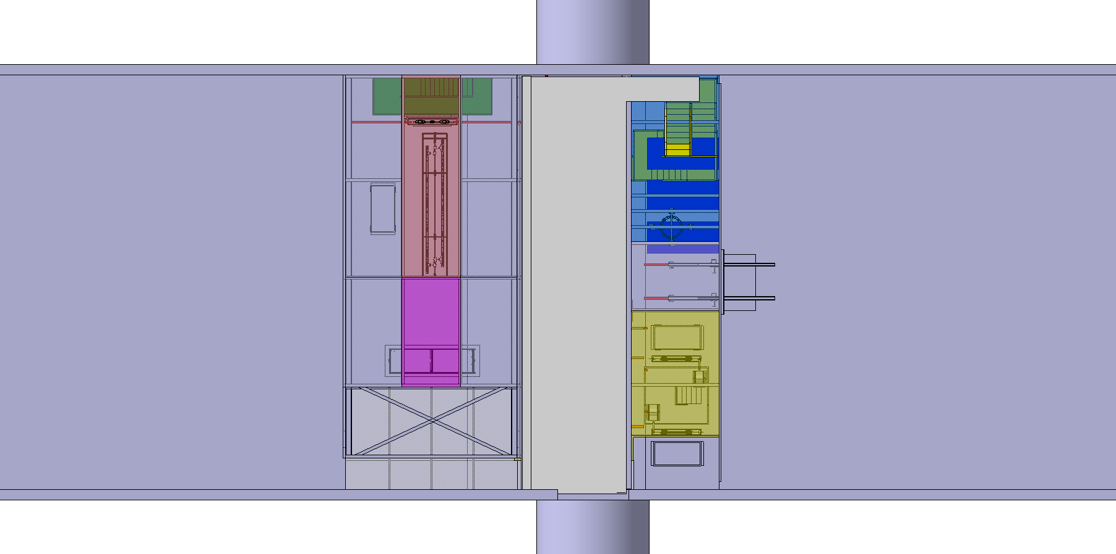
Layout 2
Det3
Det1
Layout 3 → Move stairs to the other side-top
Det3
Det1

Slide 7
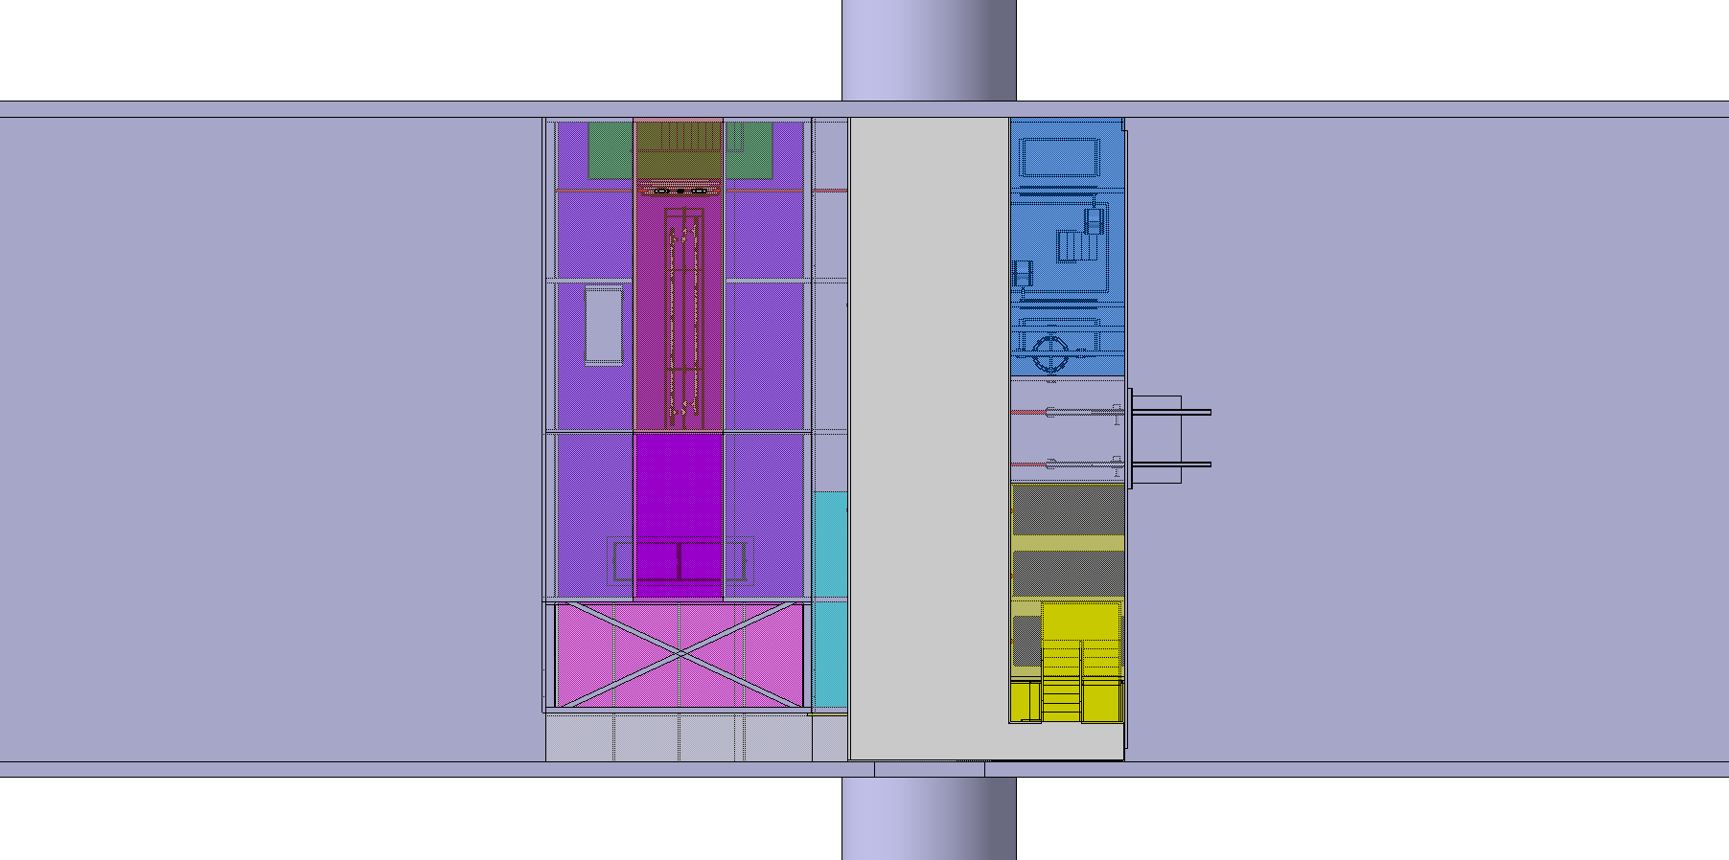
Layout 2
Det3
Det1
Layout 4 → Move stairs to the other side-bottom(current design)
Det3
Det1

Slide 8
Installation - Detector 3

Slide 9
Layout 2
Det3
Det1

Slide 10
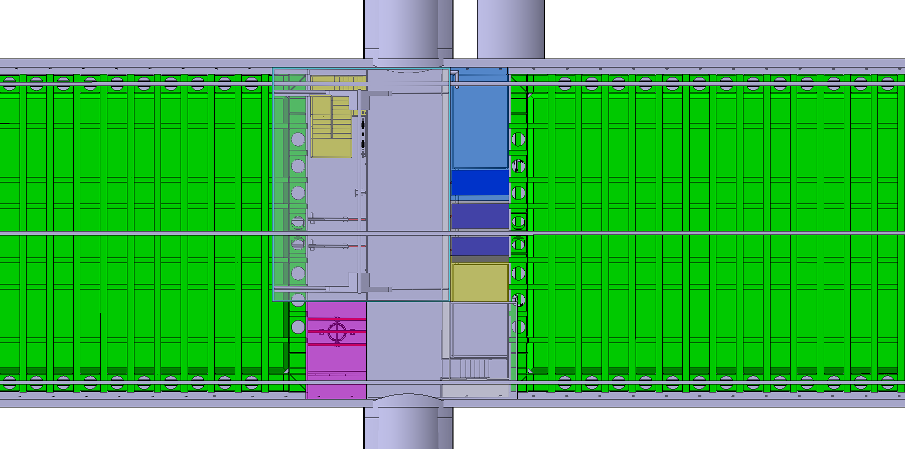
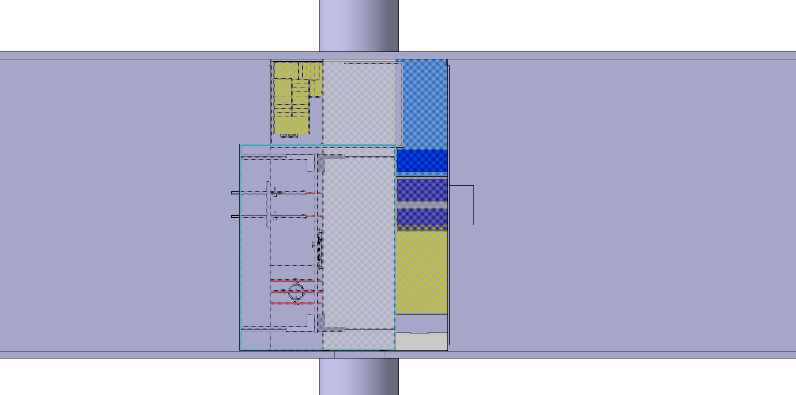
Layout 2
Det3
Det1
Layout 2 – Possible Changes on the concept
Swap the position of the clean room and the SAS
Det3
Det1

Slide 11
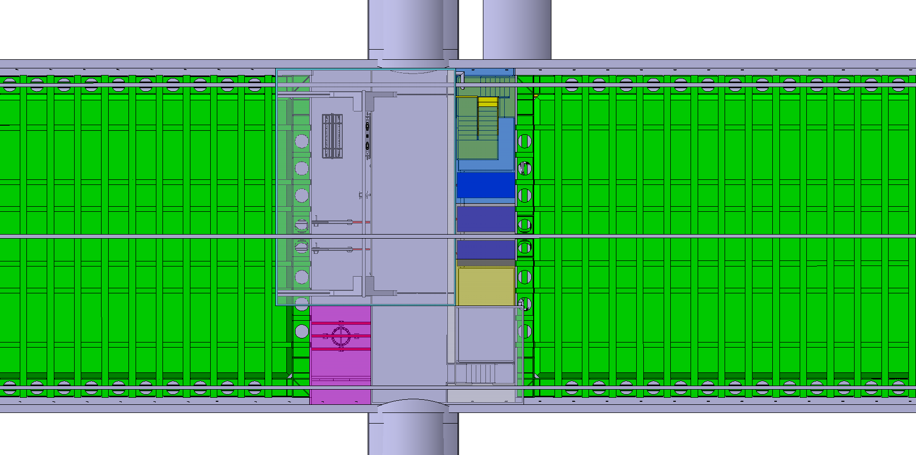
Layout 2
Det3
Det1
Layout 3 → Move stairs to the other side-top
Det3
Det1

Slide 12
Layout 2
Det3
Det1
Layout 4 → Move stairs to the other side-bottom(current design)
Det3
Det1

