Slide 1
CF discussions
1/11/2018

Slide 2
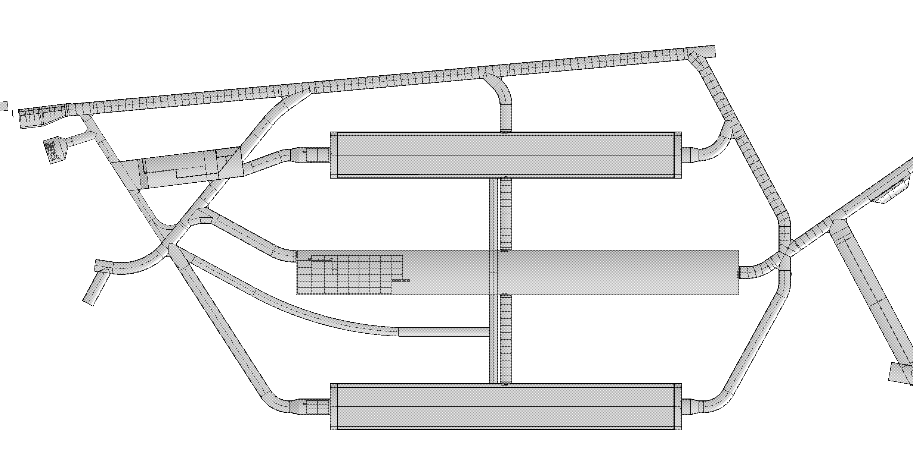
Bridges
Det#3
Det#1
Det#4
Det#2
?

Slide 3
door
Det#3
Cables and cryo services
Det#1
Det#4
Det#2

Slide 4
The doors
0.5m

Slide 5
Nord bridge requirements
Support part of the clean room
Passage of goods to the CUC. What are the maximal weights and dimensions?
Does it supports services?
Should the dimension match the door size + handrails?

