Slide 1
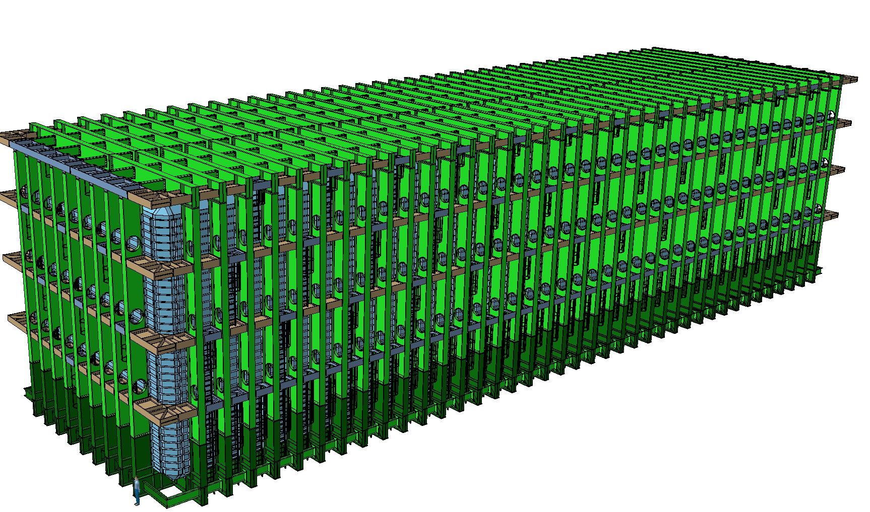


LBNF – Crane requirements and interfaces
Dimitar MLADENOV & The entire CERN Team
LBNF/DUNE interface meeting
SURF, 29-31 October 2018

Slide 2
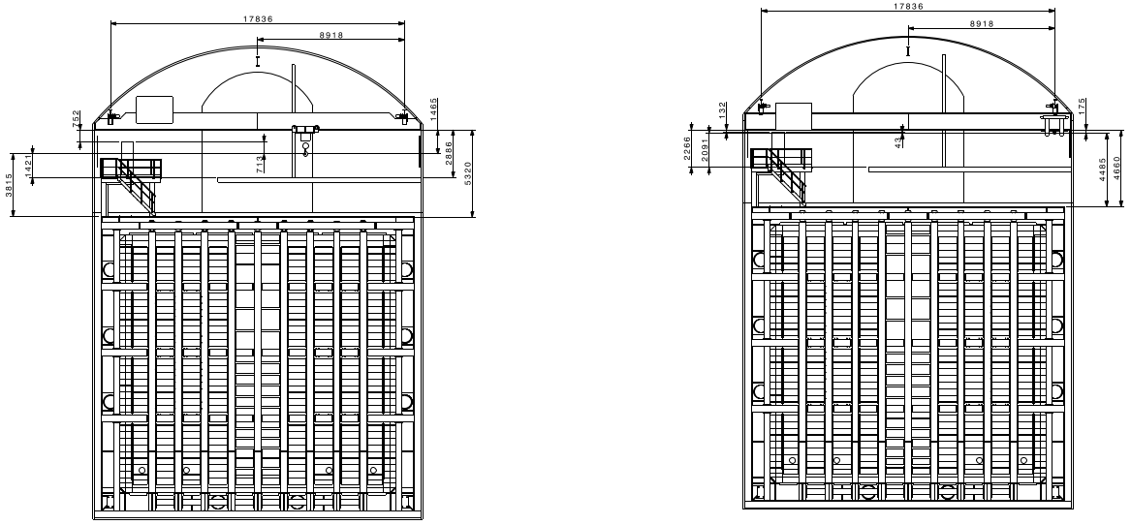
LBNF – Current Crane envelopes

Slide 3
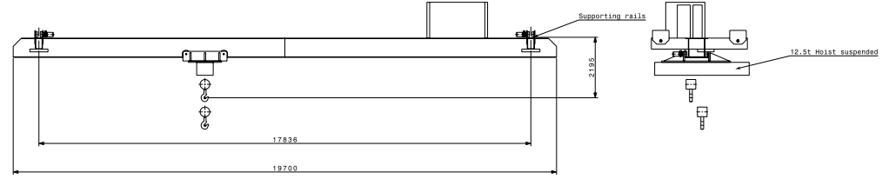
LBNF – Crane Interfaces with the cavern rails

Slide 4
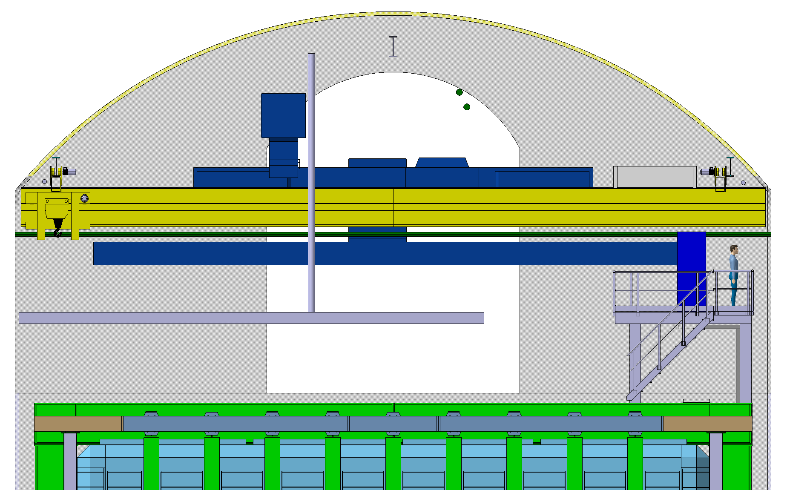
LBNF – Crane proposition

Slide 5
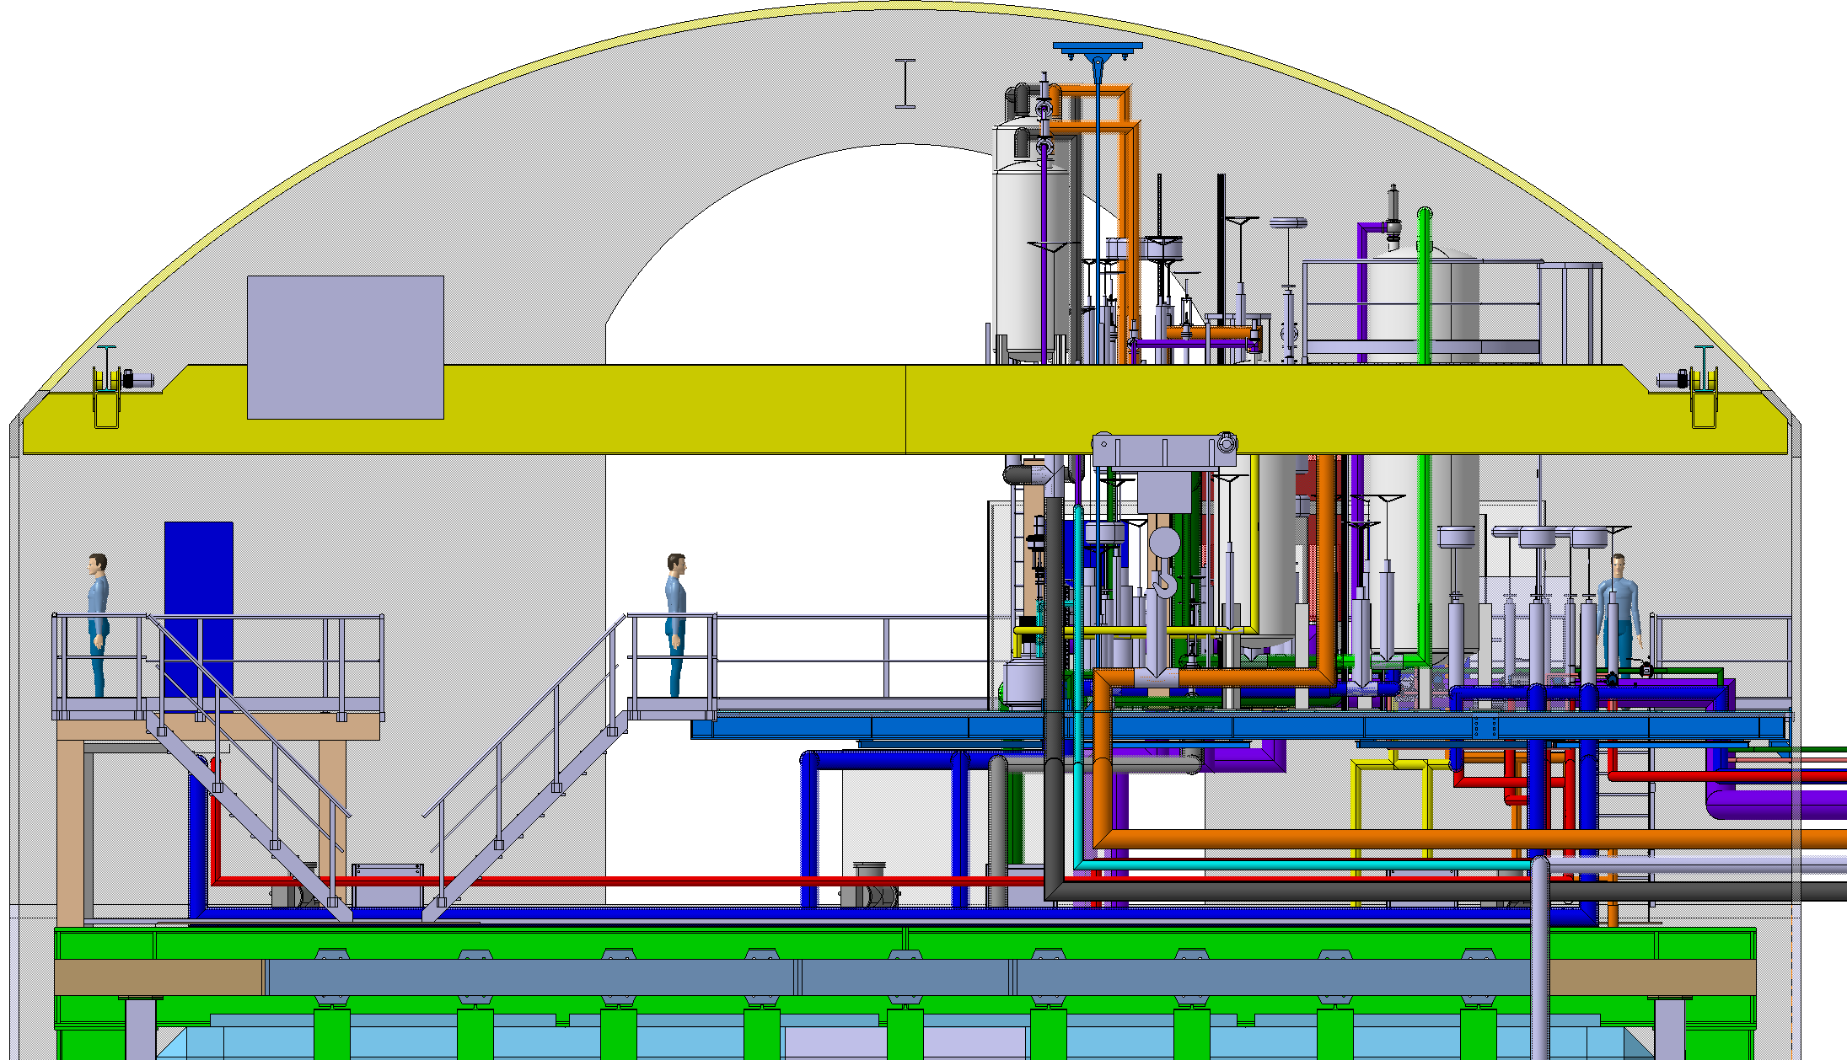
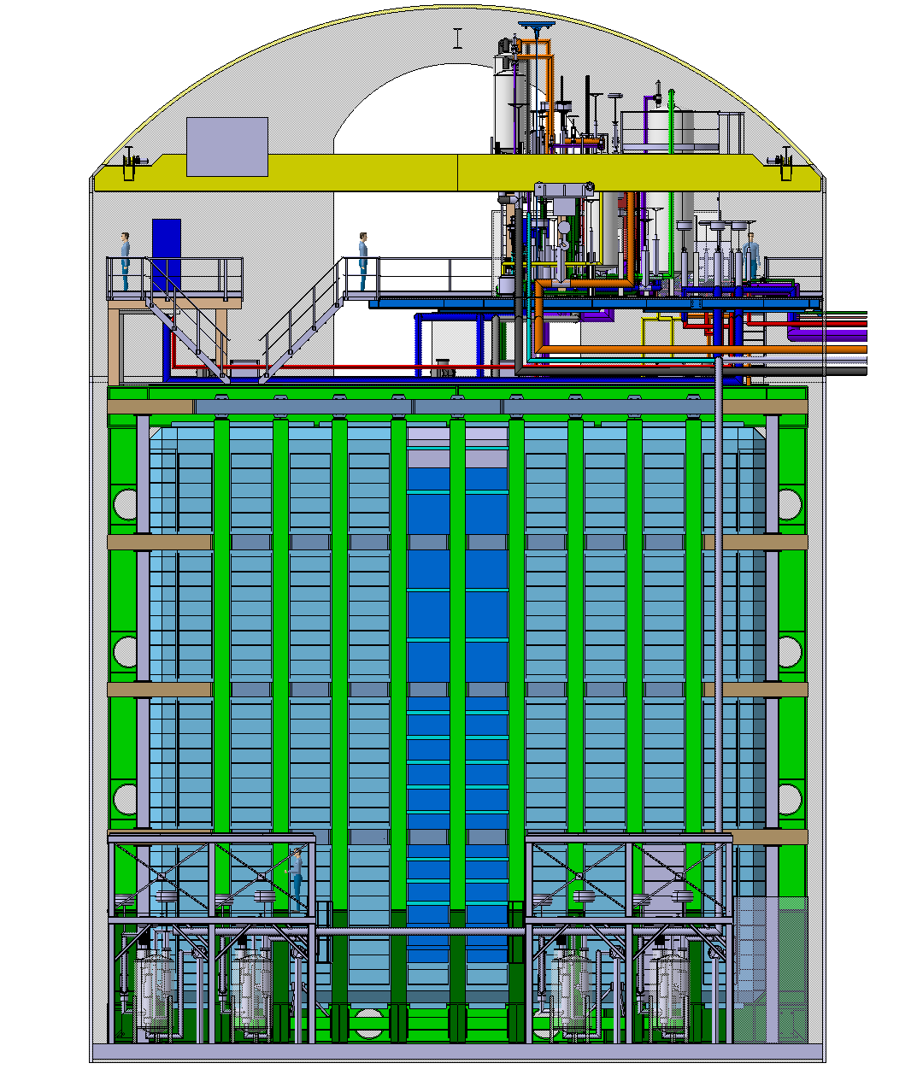
LBNF – Latest Crane Design

Slide 6
LBNF – Crane preliminary requirements 1
Main
 | Building | SURF
 | Installation type | Cavern
 | Project type | New crane with new feeding line
 | Use | Service crane for cavern
 | Design temperature [°C] | 0 / + 50
 | Type | Single girder suspended crane
 | Working load limit [ton] | 12.5
 | Span S [mm] | 19700
 | Main hoist range of lift [mm] | 22000
 | Lifting speed [m/min] | 0.2 - 10 variable speed range with frequency converter
 | Cross travel speed [m/min] | 0.6 - 12 variable speed range with frequency converter
 | Long travel speed [m/min] | 0.7 - 15 variable speed range with frequency converter
 | Total installed power [kW] (not to be exceeded) | 35 to be confirmed by the contractor
 | Main hook left approach [mm] | 700
 | Main hook right approach [mm] | 700
 | Longitudinal distance from axis of main hook to end buffer [mm] | 1500
 | Height of rail above floor [mm] | 21500
 | Clearance under girder from ground level [mm] | 21500
 | Clearance under main hook from ground level [mm] | 21500
 | Crane height from top of rail [mm] | 1250
Rails
 | Type and size of rail | IPE /IPN to be defined
 | End-stops | to be supplied
 | Max static vertical reaction per wheel [KN] | 29
 | Max static horizontal transverse reaction per end cariage [KN] | 23
 | Max static horizontal longitudinal reaction per rail [KN] | 17
Bridge structure
 | Number of girders | 1
 | The supply shall include proper means to avoid derailment of the crane in case of seismic event | applicable
 | Number of motorized wheels per end-carriage | 1
Long-travel mechanisms
 | New mechanism shall be supplied (see "Gen. Requirements" section 3.5.2) | applicable
 | Number of motorized wheels | 2
 | Number of motors | 2

Slide 7
LBNF – Crane preliminary requirements 2
Catwalks and access to crane
 | Number of catwalks on bridge | 1
 | Access to the crane | to be defined
Trolley structure
 | The contractor shall supply a new trolley structure | applicable
 | Proper means to avoid derailment of the trolley in case of seismic event or sudden release of the load shall be provided | applicable
 | Number of motorized wheels | 2
 | Lamp maintenance platform | applicable
Hoist
 | Number of ropes coming out of the drum | 2
 | Bad winding of rope | detected and the lifting movement stopped
 | Acceptable acceleration/deceleration with nominal load | ±0,5 g
 | Hook type | Single (DIN 15401)
 | Hook size / material | 12 / material to be communicated by contractor
Feeding line and cubicles
 | Crane feeding line | contractor shall supply and install a new line including its steel supports
 | Building-mounted main switch | supplied by contractor
 | Fixed electrical installation from switch to crane feeding line | supplied by contractor
 | Crane feeding line | sliding contacts,
 | Position of main switch | to be defined
 | Lenght of feeding line [m] | 150
 | Trolley feeding line | cable festoon
 | Cubicles position | on the crane girder
Controls - safety
 | Control system performance level | C
 | Main operator control | remote control
 | Emergency control | remote control
 | Remote control storage cubicle | applicable
 | Load measurement and display | applicable
 | Time counter | applicable
 | Safety zones | applicable; it shall be possible to define an adjustable rectangular area (in long and cross travel direction) where crane can access only if the hook is above a certain height; controlled with limit switches

Slide 8
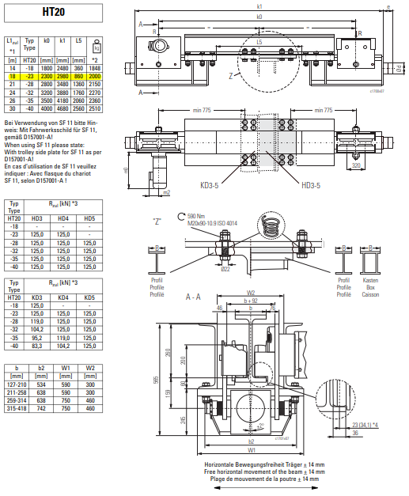
LBNF – Crane version
Diameter of the wheel 200mm
Point of contact at 23mm from the side of the profile (in case of a flat rail)
Number of wheels / end carriage : 8 (16 in total for the whole crane)
vertical Load/ end carriage | 237 | KN
vertical Load/ boggie | 118 | KN
vertical Load/ wheel | 29 | KN
tranversal load | 23 | KN (1/10 of vertical load)
longitudinal load | 17 | KN (1/7 of vertical load on driving wheels)

Slide 9
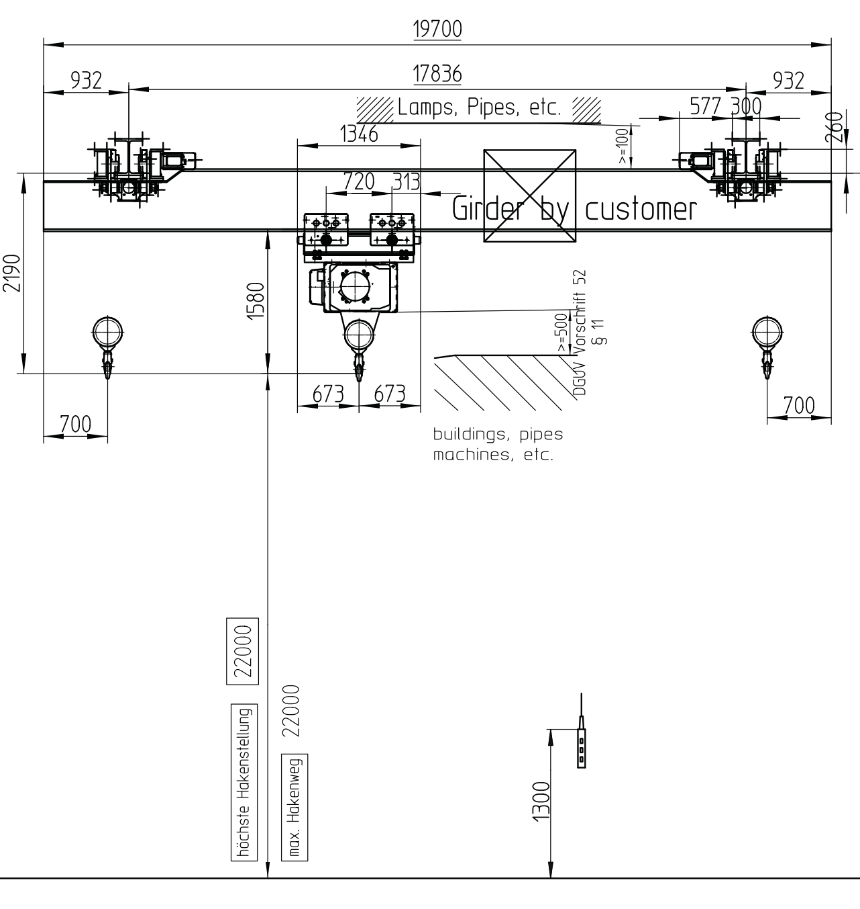
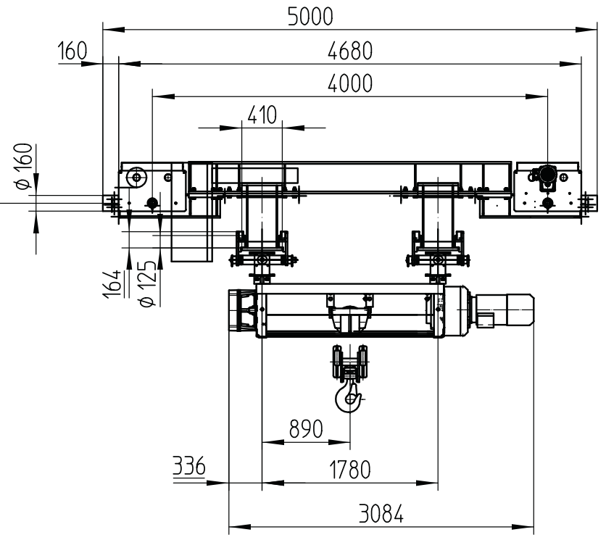
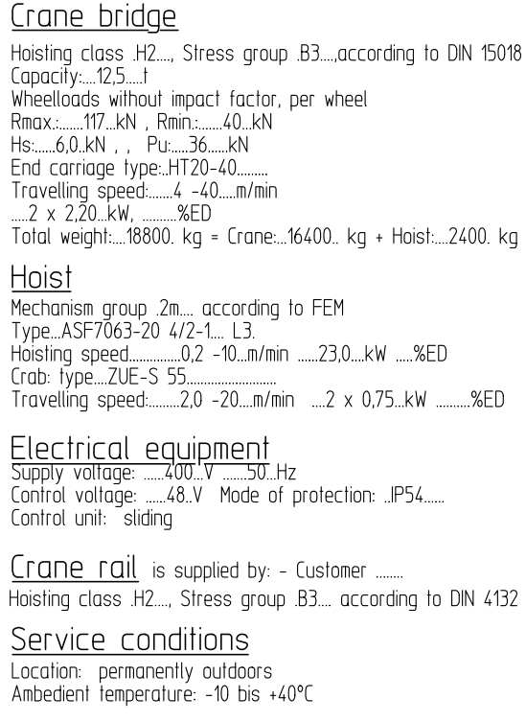
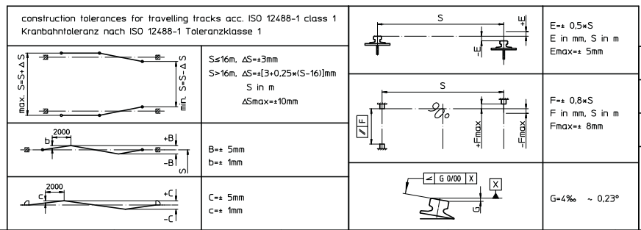
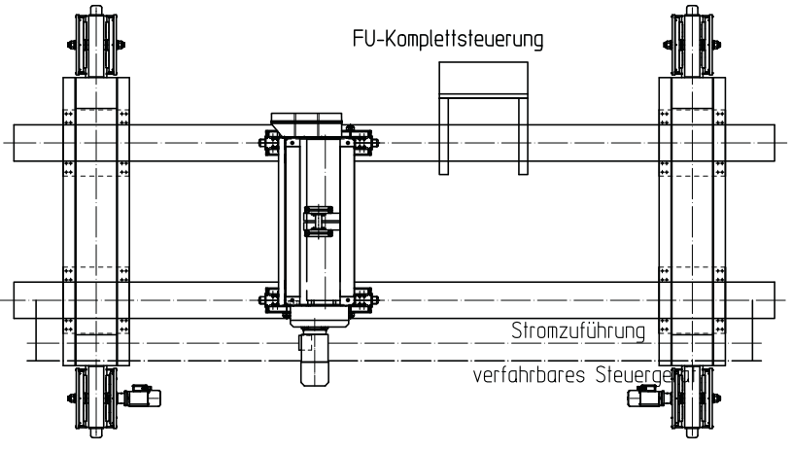
LBNF – Crane Versions

Slide 10
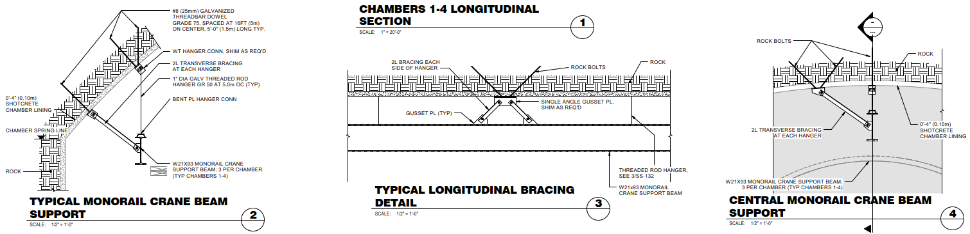
ARUP – Original Proposition for Crane Rail

Slide 11
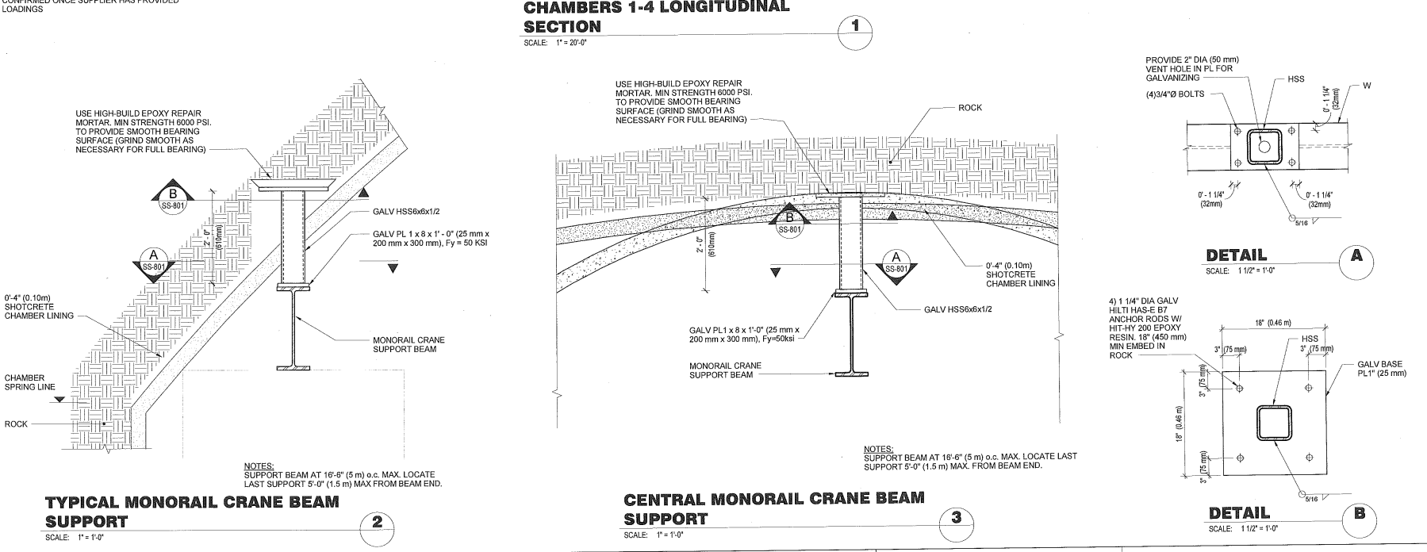
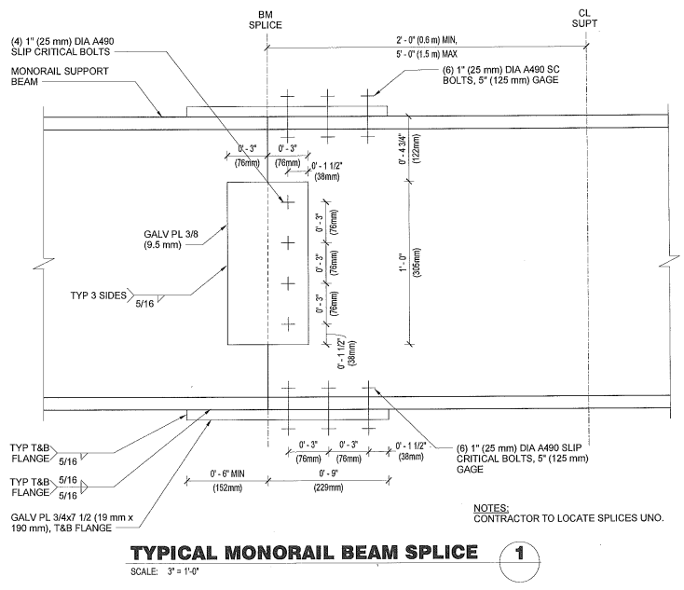
ARUP – Current proposition for Crane Rail
Rail Splice connection
To be discussed

Slide 12
Thank you!

