Slide 1
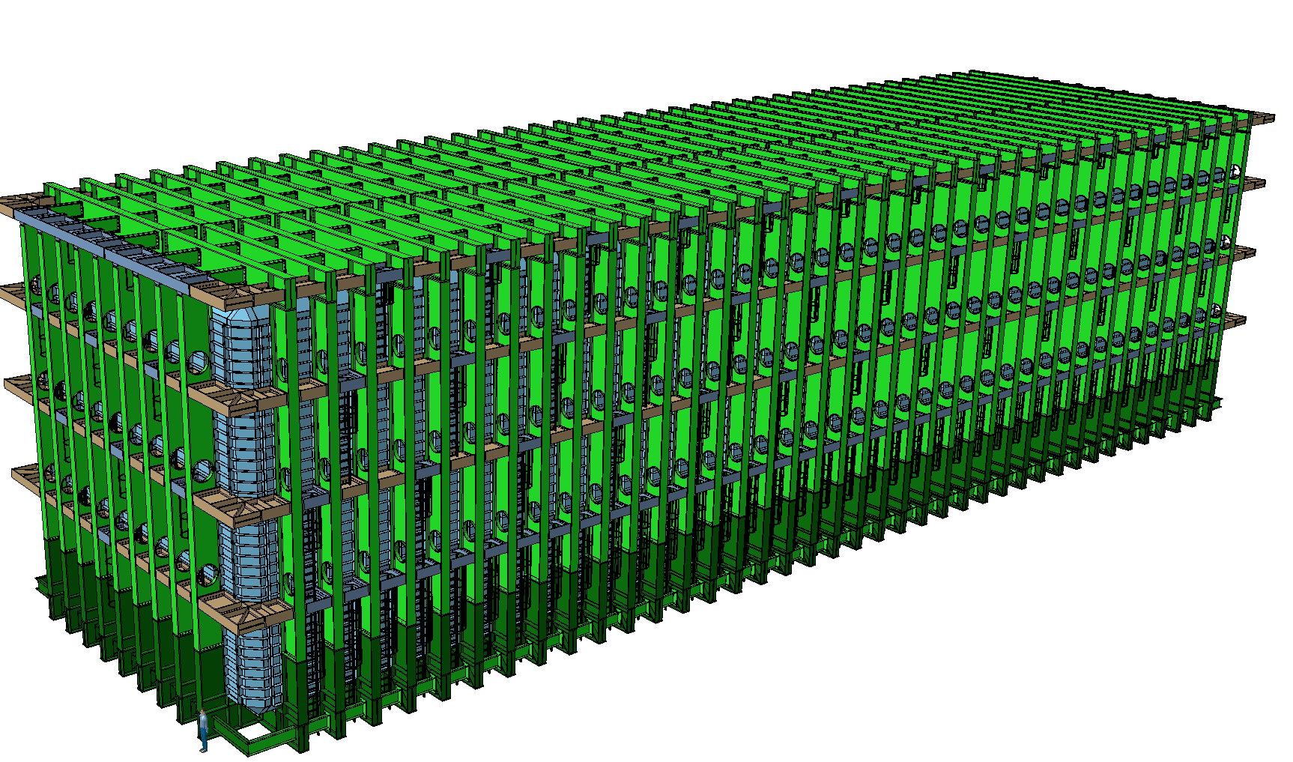


LBNF - Update on cavern floor loading interface
Dimitar MLADENOV - CERN EP/NU
LBNF/DUNE interface meeting
SURF, 01-02 November 2018

Slide 2
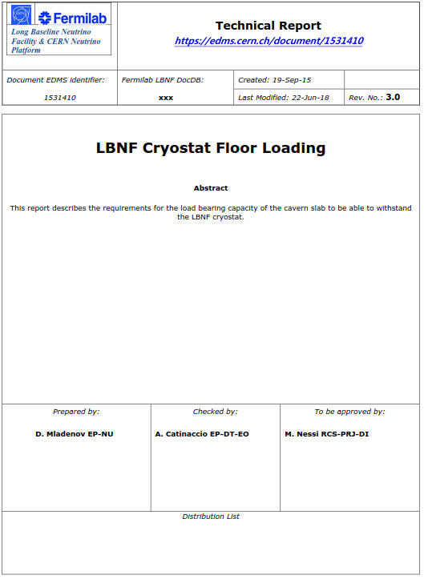
LBNF – Floor Loads - Document
LBNF - Weight summary
Steel Structure: 3’800 T
  Steel profiles & Steel plate: 3’300 T
  Insulation and membrane: 500 T
LAr: 18’000 T (full no gas)
Detector wet weight: 200 T
Detector services: unknown
Total: 22’000 T
(excluding a detector and services on the roof)

Slide 3
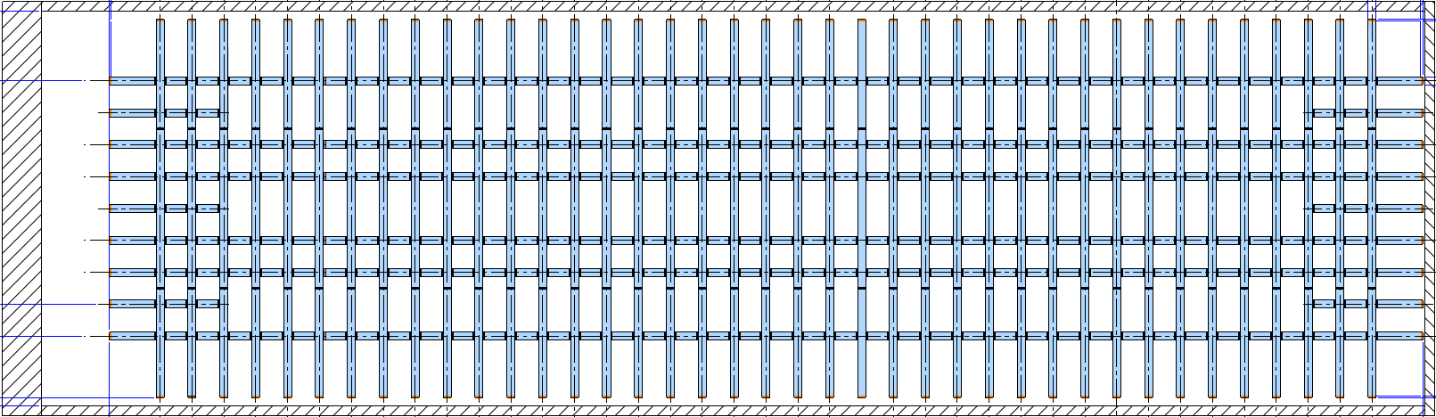
LBNF – General and Specific Loading requirements
Footprint of the Cryostat floor beams
Floor beam edge
Cavern walls

Slide 4
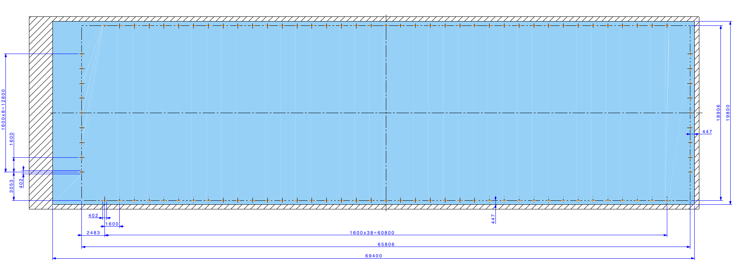

LBNF – General and Specific Loading requirements
5 MPa
200 T
The 5 MPa is a general requirement for the load bearing capacity of the cavern floor
In addition to the general requirement some areas shall be reinforced for the 200 T line loads
  There will be 96 such line loads
  The nominal width of each of the line loads is 402mm
  They are positioned on the nominal line of the load, but due to manufacturing and installation tolerances, it shall be expected that the line loads can move by 250mm in transversal and longitudinal direction.

Slide 5
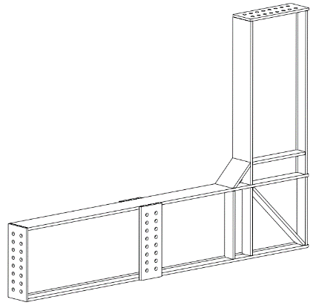
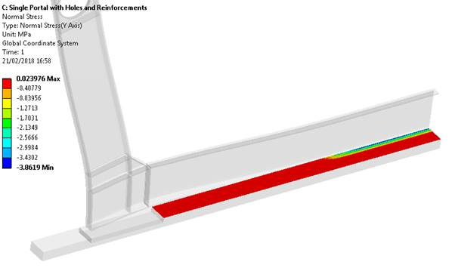

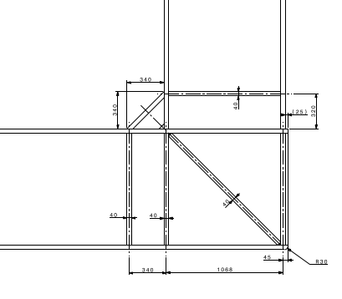
LBNF – Load distribution under the floor beams
5 MPa
200 T
2 MN line load along the corner edge

Slide 6
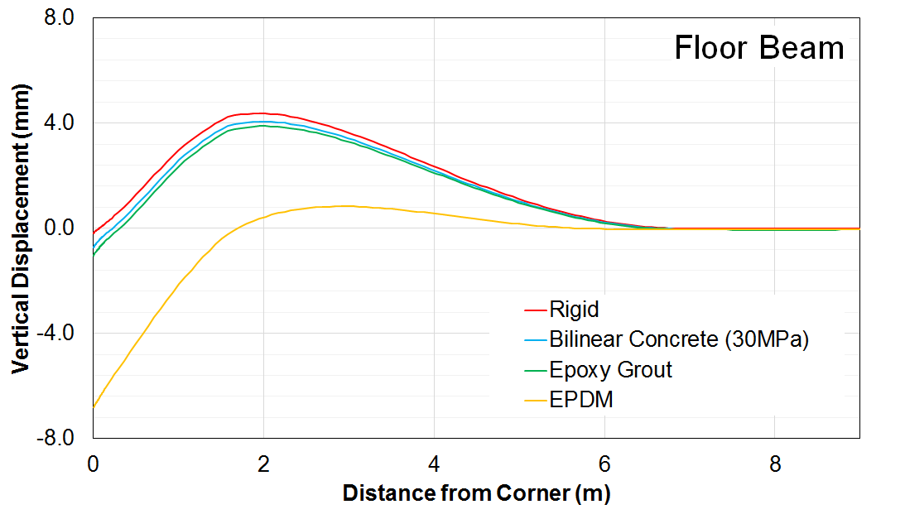
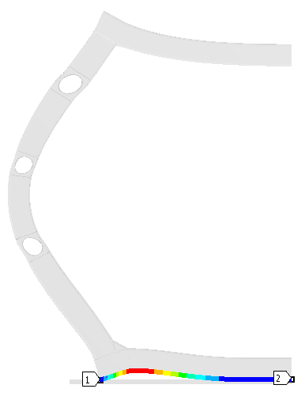
LBNF – “Lifting” of the floor beams
To be noted:
In the first 5m to 6m after the edge, the floor beams will observe a reduced contact with the slab

Slide 7
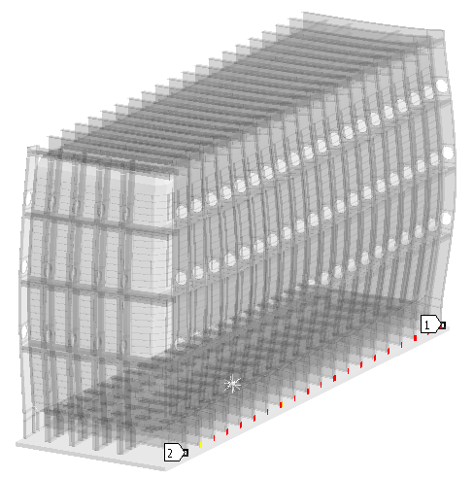
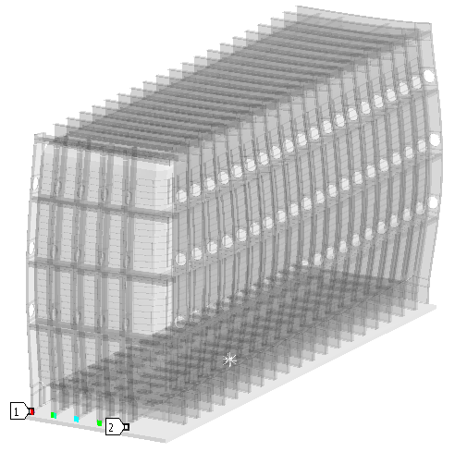
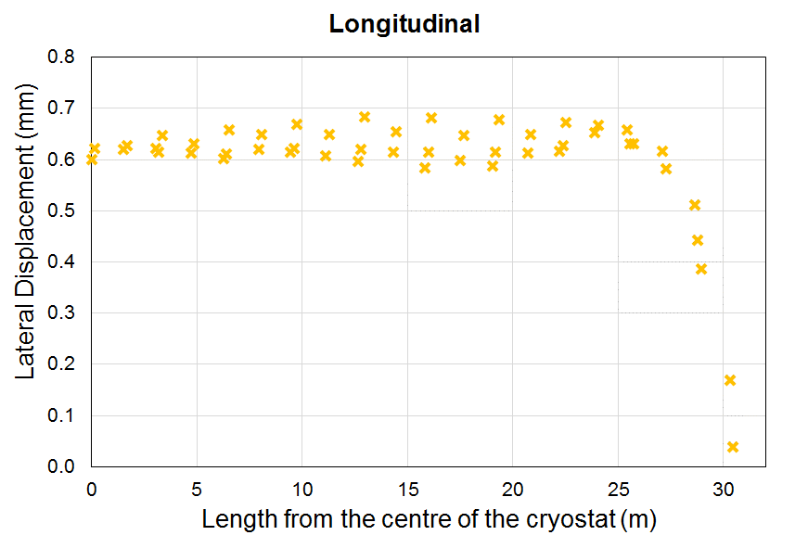
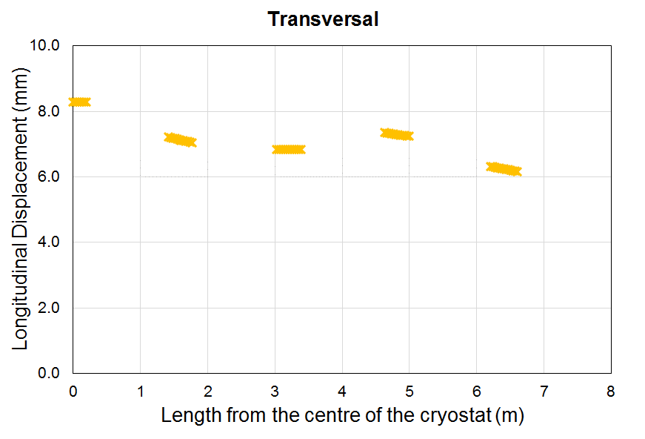
LBNF – Deflections and movements of cryostat on concrete slabs
The cryostat will experience lateral movements with respect to the slab, due to the hydrostatic load.
The calculated values shows that the cryostat is expected to slide up to 10mm in each direction.
This should be taken into account when defining the position of the reinforced concrete areas.

Slide 8
LBNF – Point Loads on the Floor
During the installation phase, additional point loads might appear, for example from the levelling screws, but the calculated values are well below the 5 MPa general requirement for the slab

Slide 9
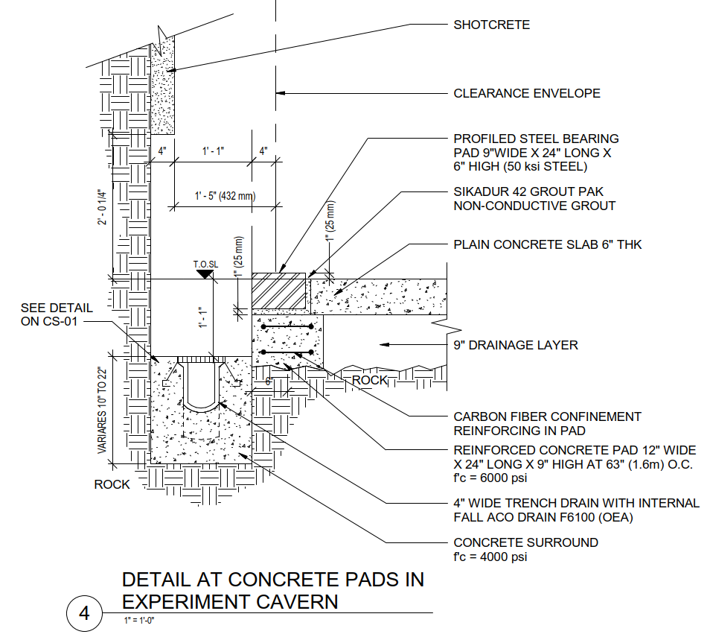
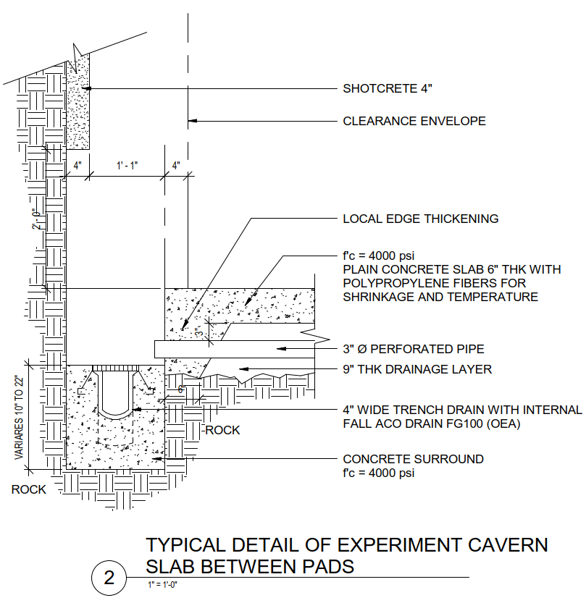
LBNF – ARUP Original Proposition
345MPa
200MPa …
28MPa
14MPa ???
40MPa

Slide 10
LBNF – CERN Proposition
345MPa
200MPa …
28MPa
~14MPa?
40MPa

Slide 11
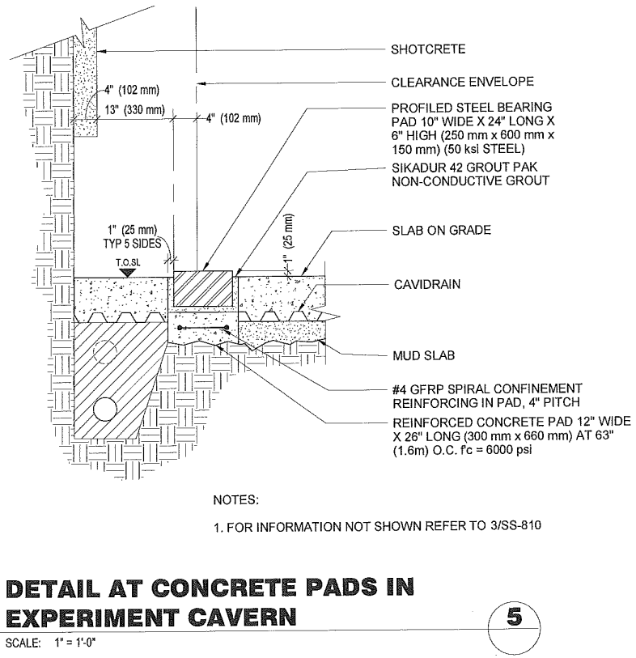
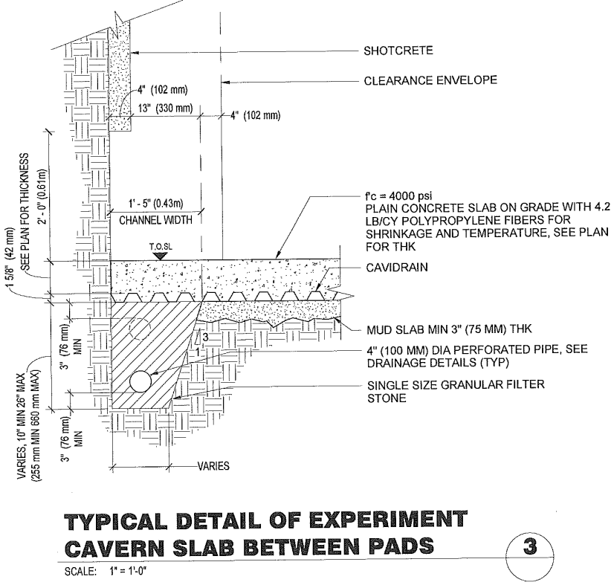
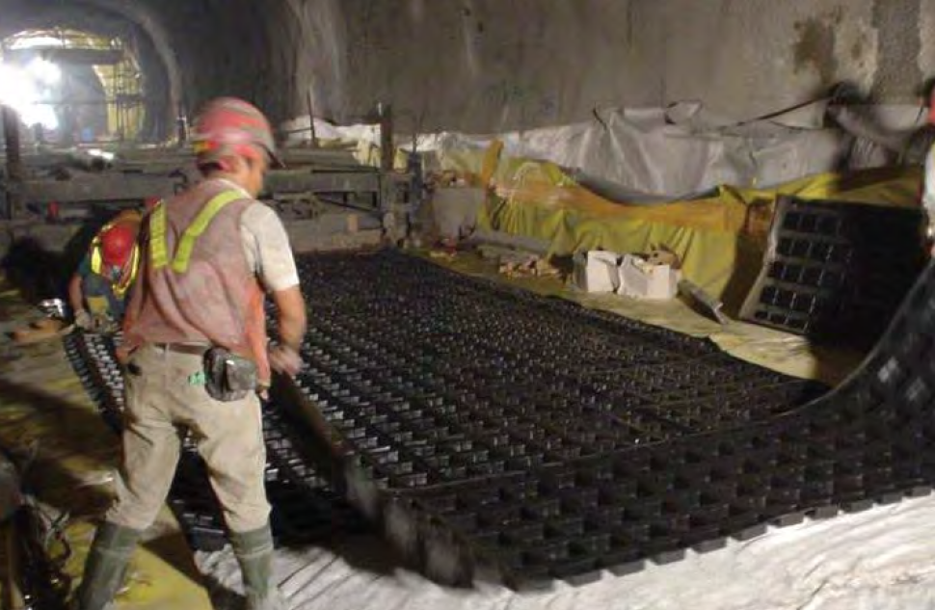
LBNF – ARUP Latest Design

Slide 12
LBNF – ARUP Latest Design
Load distribution trough the steel plate

Slide 13
LBNF – ARUP Latest Design
Profiling the “pad” for better load distribution
Inserting an Elastomer

Slide 14
LBNF – ARUP Latest Design
“ Space Holder “
Future optimizations

Slide 15
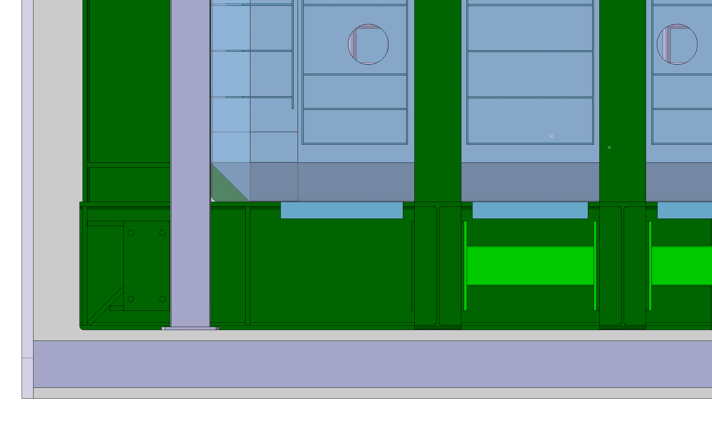
LBNF – Cryostat Floor Interface

Slide 16
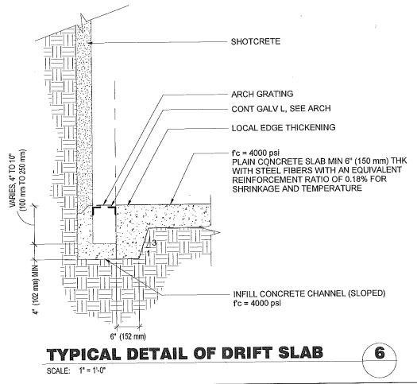
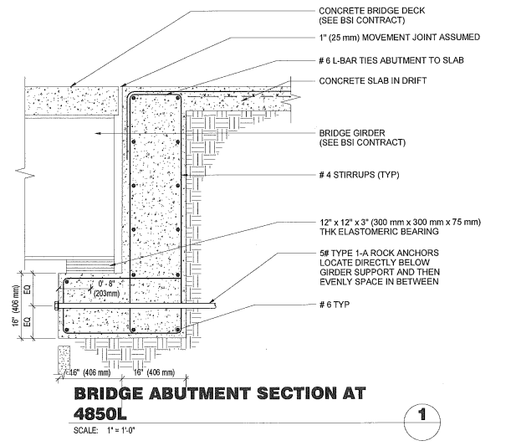
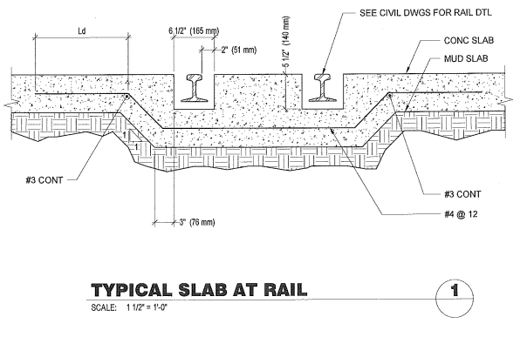
LBNF – ARUP current proposition for Drifts, Crossing Bridge and Rails

Slide 17
Thank you!

