Slide 1
Ducts to 4910 for ODH and to control condensate on warm structure

Slide 2
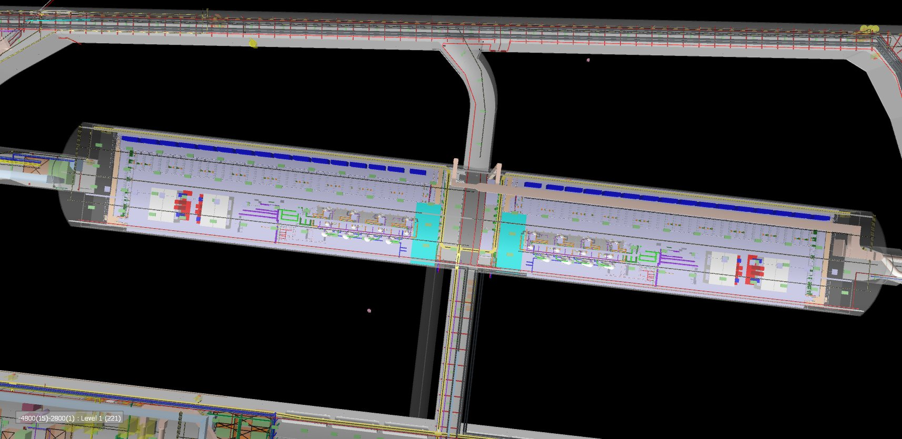
#1

Slide 3
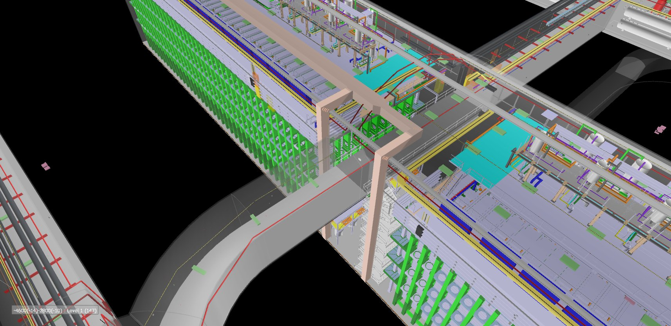

Slide 4
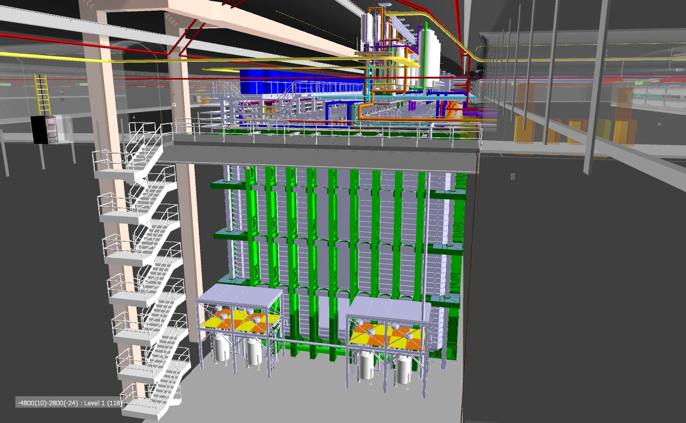

Slide 5
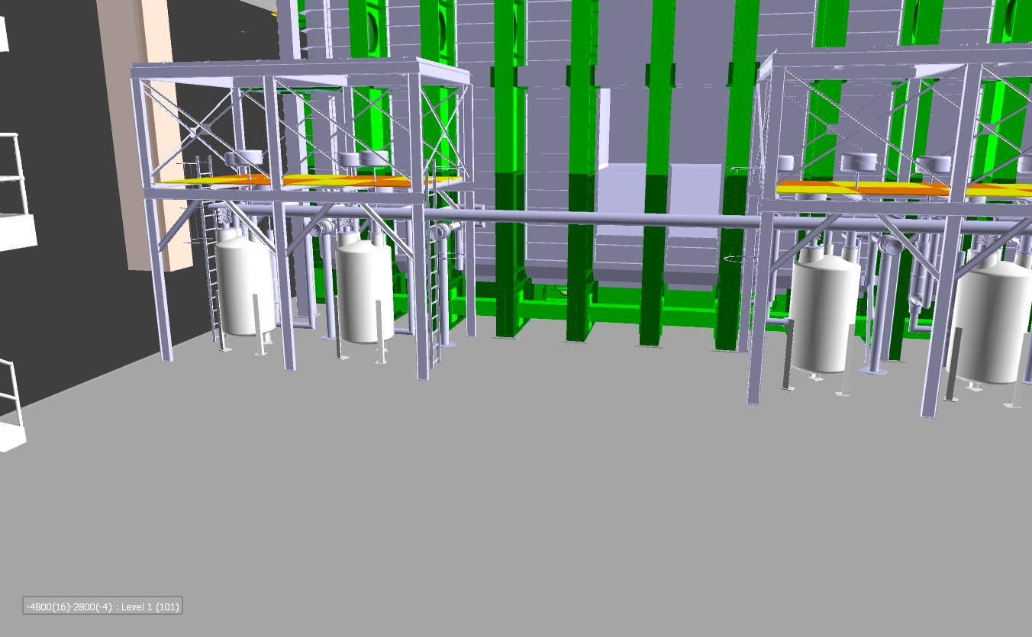
Air flow paths

Slide 6
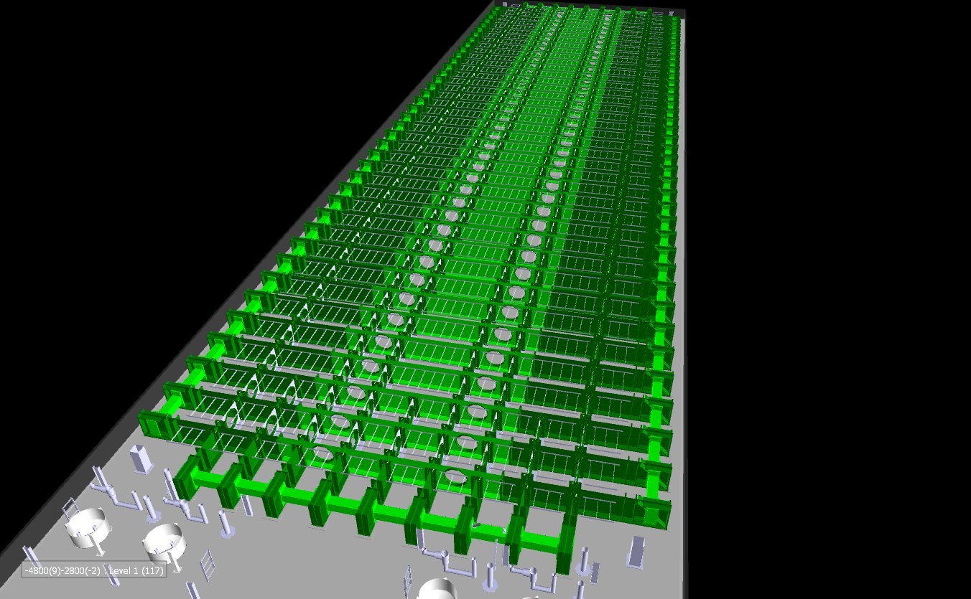
Air flow path

Slide 7
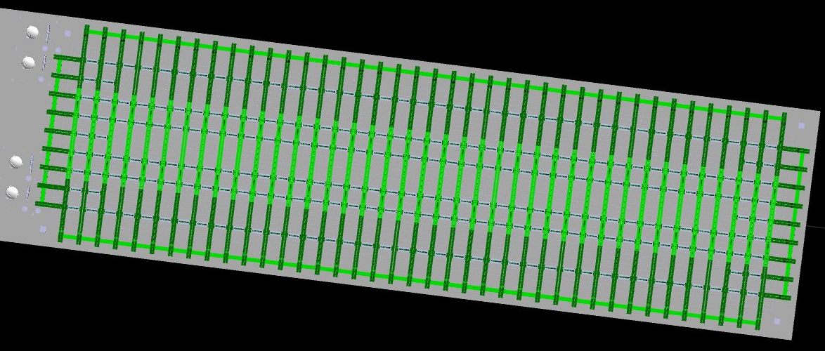
Plan view of concept

Slide 8
Summary
If ARUP supplies the current 2 ducts sized for 15000 cfm each from the 4910 level. Is this all we need from CF?
How do we implement?
Responsibility for design, procurement and installation?
Integrate into the space so that it is included in the installation concepts for detectors 3 and 4.

