Slide 1
OVERVIEW OF ARGONNE NATIONAL Laboratory
GREG Halder
Midwest ASTFP - Dec 5, 2018
Business Development Executive
TECHNOLOGY Commercialization & Partnerships Division

Slide 2
Part Of the department of energy National Laboratory System
Pacific Northwest National Laboratory
Fermi National Accelerator Laboratory
Ames Laboratory
Idaho National Laboratory
National Energy Technology Laboratory
Sandia National Laboratories-Livermore
National Renewable Energy Laboratory
SLAC National Accelerator Laboratory
Brookhaven National Laboratory
Princeton Plasma Physics Laboratory
Thomas Jefferson National Accelerator Facility
Lawrence Berkeley
National Laboratory
Oak Ridge National Laboratory
Lawrence Livermore National Laboratory
Savannah River National Laboratory
Argonne National Laboratory
Sandia National
Laboratories-Albuquerque
Los Alamos National Laboratory

Slide 3
Argonne by the numbers (FY18)
$1B
3,300
1,600
operating budget
employees
scientists & engineers
300
8,000
Postdoctoral researchers
FACILITY USERS

Slide 4
NATIONAL User facilities
Advanced Photon Source (APS)
Argonne Leadership Computing Facility (ALCF)
Argonne Tandem Linear Accelerator System (ATLAS)
Center for Nanoscale Materials (CNM)

Slide 5
ARGONNE’s RESEARCH ORGANIZATIONS
Photon Sciences
Computing, Environment, and Life Sciences
Physical Sciences & Engineering
Energy & Global Security
Home of the Advanced Photon Source, which provides the brightest storage ring-generated x-ray beams in the Western Hemisphere to more than 5,000 scientists worldwide.
Integrates research in the life sciences with environmental and computing sciences; and home of the leadership computing facility.
Houses scientists in five physical science research divisions as well as researchers from Argonne’s battery hub, the Joint Center for Energy Storage Research (JCESR).
Expertise in science, engineering, and information systems to deliver environmentally sound solutions to major challenges in energy access and global security.

Slide 6
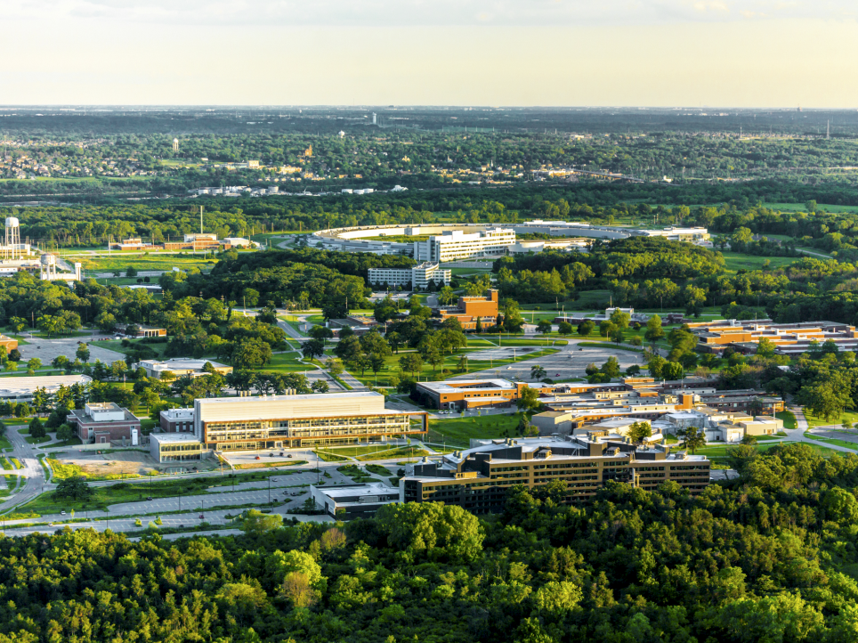
Argonne research interests
NUCLEAR & PARTICLE PHYSICS
PROTEIN CHARACTERIZATION
X-RAY SCIENCE
IMAGING
TRANSPORTATION & COMBUSTION
NANOMATERIALS
NUCLEAR ENGINEERING
CHEMISTRY
MATERIALS FOR ENERGY
GLOBAL SECURITY
ACCELERATOR TECHNOLOGY
ENERGY STORAGE
HIGH-PERFORMANCE COMPUTING
NUCLEARENERGY
BIOLOGY & ENVIRONMENT
MOLECULAR ENGINEERING
COMPUTATIONAL SCIENCE
BIG DATA

Slide 7
ACCELERATOR R&D PROGRAMS AT ARGONNE
Physics
HIGH ENERGY PHYSICS
Argonne Tandem Linear Accelerator System (ATLAS)
Accelerator R&D Group
Superconducting RF Technologies
Accelerator Technology Group
Argonne Wakefield Accelerator (AWA)
PHOTON SCIENCES
ENERGY & GLOBAL SECURITY
Advanced Photon Source (APS)
APS Upgrade Project
Accelerator Systems Division
Superconducting Undulator Technologies
Experimental Operations & Facilities (EOF) Division
Low Energy Accelerator Facility (LEAF)
Intermediate Voltage Electron Microscope (IVEM) Tandem Facility
Isotope Production
Notes:
ATLAS is a superconducting linear accelerator for heavy ions in an energy range best suited to study the properties of the nucleus. ATLAS can provide beams of essentially all stable isotopes as well as a variety of radioactive beams, low-mass beams and heavier neutron-rich isotopes.
AWA is an electron accelerator with the world’s highest bunch charge to carry out fundamental accelerator research with an emphasis on wakefield acceleration. The mission of the program is to develop the science and technology of electron beam-driven wakefield acceleration to enable performance breakthroughs for future linear colliders and other advanced accelerators applications.
LEAF (low energy accelerator facility): includes a LINAC and a Van der Graff (VDG) electron accelerator. Isotope production, such as Mo-99 and Cu-67. VCG used for to test equipment and materials for radiation hardness and stability.
IVEM-Tandem is a dual-ion beam facility for in situ TEM studies of defect structures in materials under controlled ion irradiation/implantation and sample conditions.

Slide 8
day two HIGHLIGHTS at Argonne – DEC. 6th
KEYNOTE
The Role of Accelerators in Medicine James S. Welsh, MD, MS, FACRO Northwestern Medicine Chicago Proton Center
Accelerator SCIENCE PRESENTATIONs & facility TOURS
Superconducting Undulators Yury Ivanyushenkov, Accelerator Systems Division
Isotope Production Sergei Chemerisov, Experimental Operations & Facilities Division
Superconducting RF Technologies Michael Kelly, Physics Division
Argonne Wakefield Accelerator (AWA) John Power, High Energy Physics Division
Accelerator Design and Simulation Michael Borland, Accelerator Systems Division

Slide 9
Working with Argonne
Partnership models
Cooperative R&D Agreement (CRADA)
Strategic Partnership Projects (SPP)
Non-disclosure Agreements
Licenses
User Agreements
Technical Service Agreements
Material Transfer Agreements
Leverage co-funding opportunities:
FOAs
SBIR/STTR
Small Business Voucher (SBV)
GAIN Vouchers
Touch-points
Programmatic Divisions
User Facilities
S&T Partnerships and Outreach
Cross-cut Centers

Slide 10
RESOURCES
Working with Argonne: https://www.anl.gov/work-us
APS: https://www.aps.anl.gov/
ATLAS: https://www.phy.anl.gov/atlas
AWA: https://www.anl.gov/awa
LEAF: https://www.ne.anl.gov/facilities/leaf/
IVEM-Tandem: https://www.ne.anl.gov/ivem/
Business Contact – X-ray Science & Accelerator Technologies:
Greg Halder Email: halder@anl.gov Phone: 630-252-5382

