Slide 1
Fermilab SRF Facilities
Sam Posen
Accelerator Stewardship Workshop
5 Dec 2018

Slide 2
World Class SRF Facilities – Full Spectrum
Cavity processing/preparation
  Electropolishing, centrifugal barrel polishing, high pressure ultrapure water rinsing, assembly in semiconductor-grade cleanroom, particle-free vacuum pumping
Cavity measurements
  vertical and horizontal test
Cryomodule assembly
Cryomodule test stands
Materials Science Lab
  TOF-SIMS, SEM/EDX/EBSD, LCSM, PPMS (magnetometry, electrical transport, thermal transport), cryo AFM/MFM, Instron
Ultralow Temperature Measurements Facility (dilution refrigerator)

Slide 3
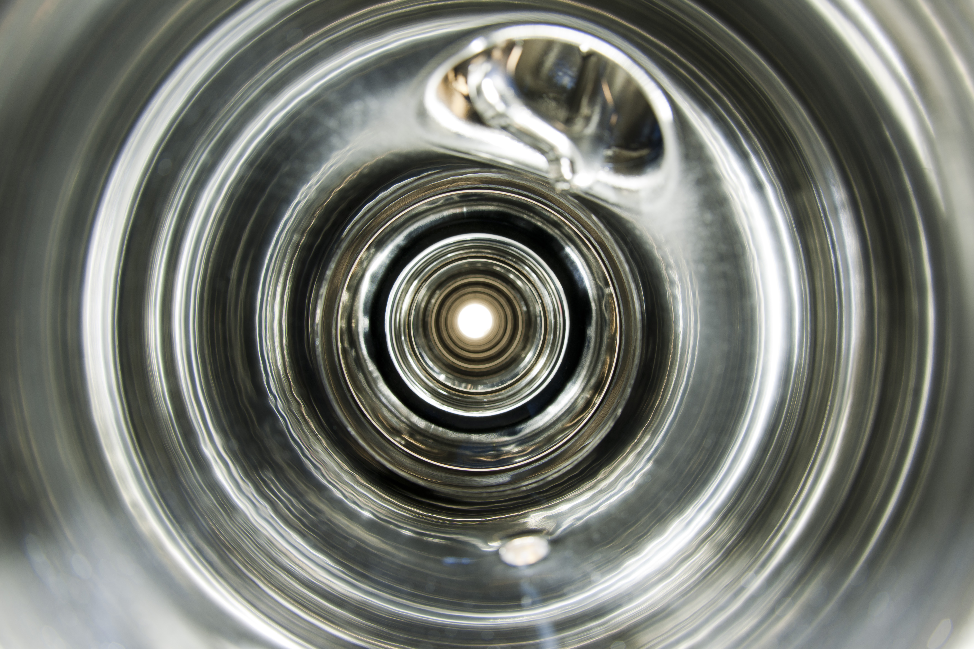
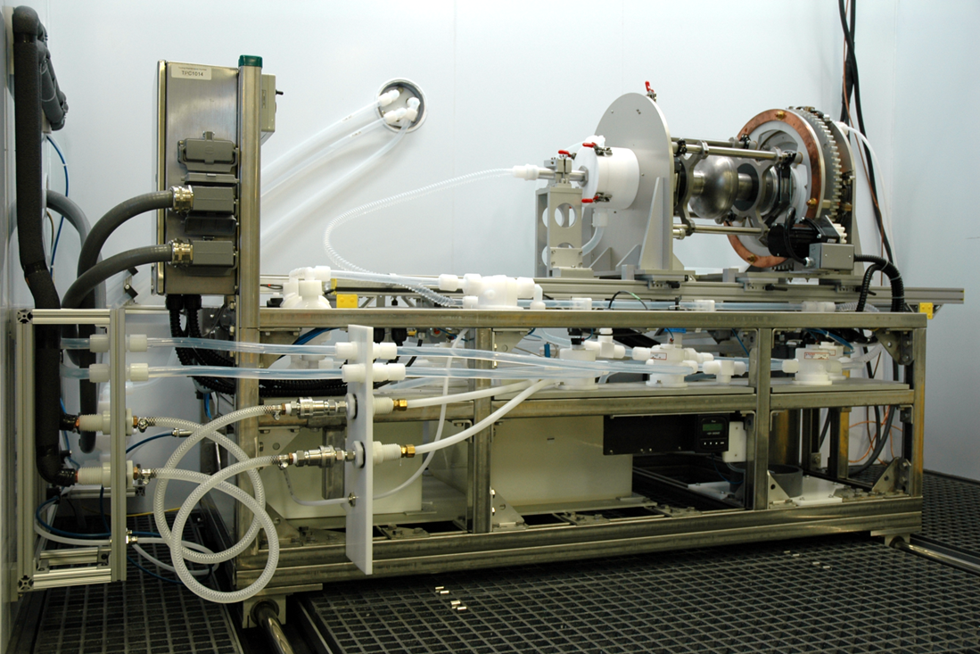
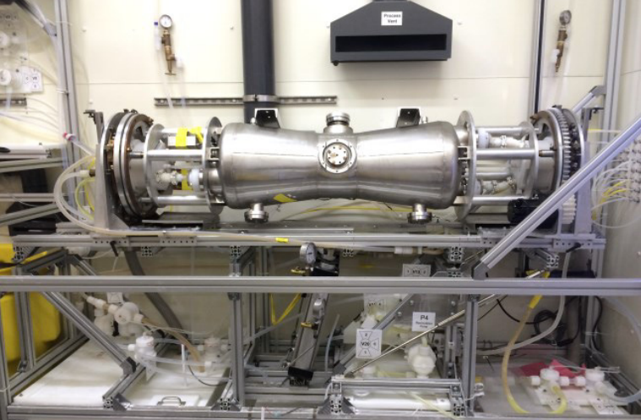
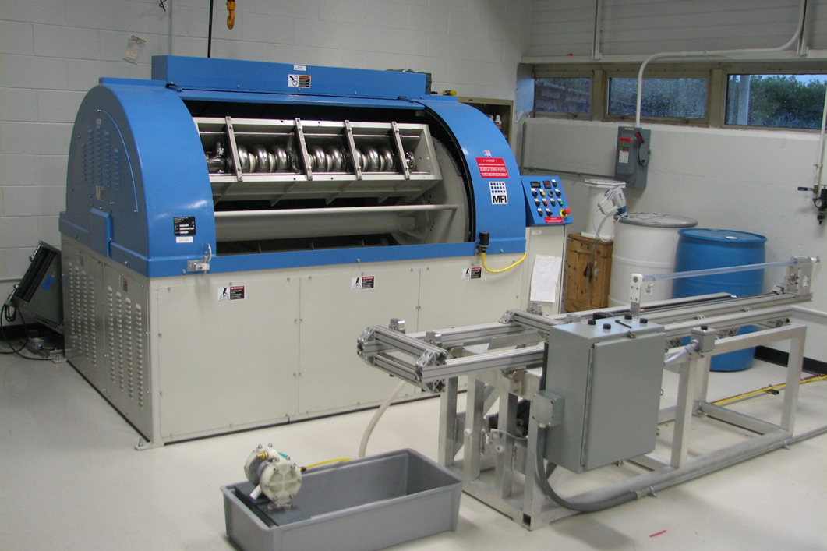
Cavity Material Removal
Processing for sub-μm smooth interior cavity surfaces for high gradients and high Q₀
Single cell cavity electropolishing in IB4
Multicell cavity EP at joint facility with Argonne
Centrifugal barrel polishing (single and multicells) in IB4
CPL Electropolishing
ANL EP and BCP
CPL Mechanical Polishing

Slide 4
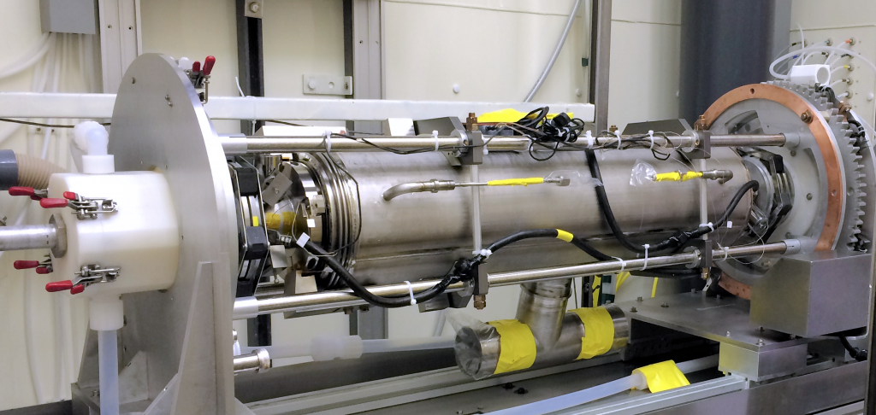
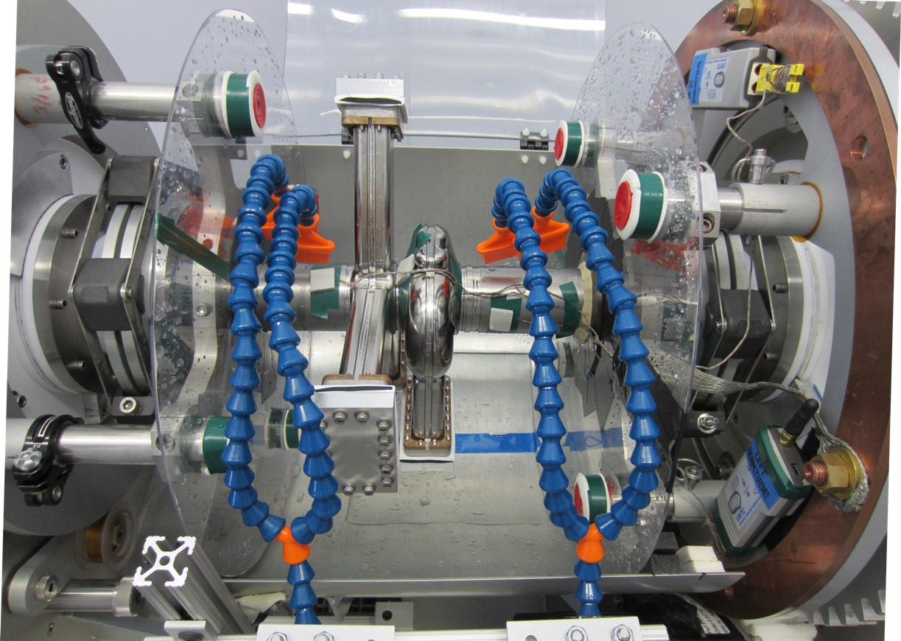
Unique Capabilities of Electropolishing Facilities
EP of 1.3 GHz multicell cavity with helium vessel
ANL/FNAL joint facility: EP with large complex geometries
2.8 GHz ANL SPX Cavity #1
CPL facility: high frequency cavities; precise temperature control for very uniform removal over the cavity.

Slide 5
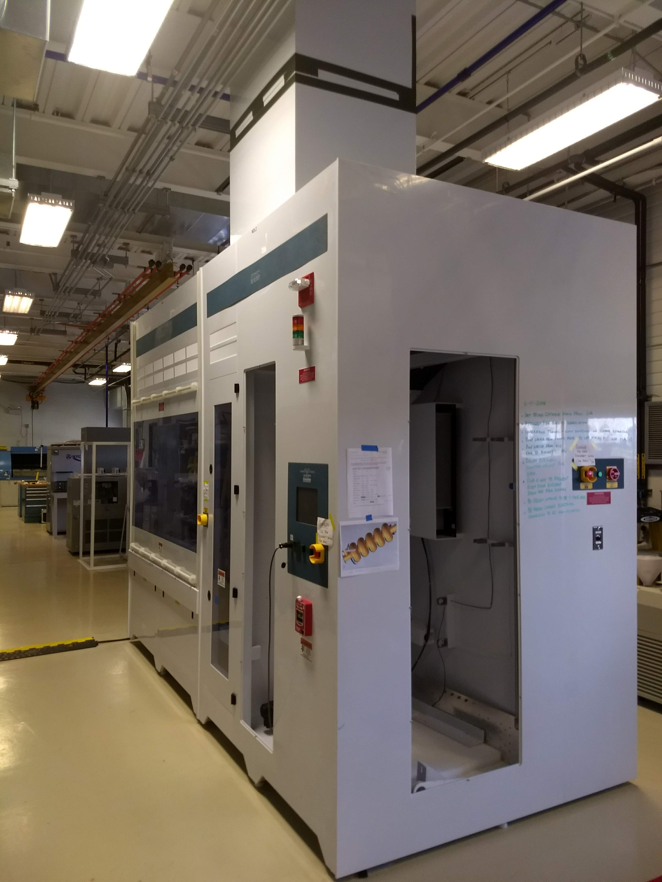
Large Electropolishing Tool Commissioning at CPL
Large EP tool is currently in commissioning
When operational, capable of EP’ing even the largest cavities under study at Fermilab, 650 MHz 5-cells for PIP-II

Slide 6
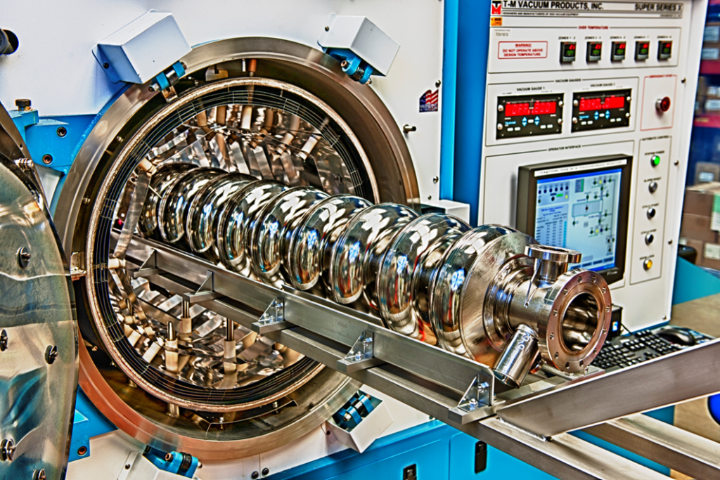
High Temperature Furnaces
Facilities used for: high temp treatment of cavities – enabled development of N-doping, N-infusion procedures at Fermilab
These discoveries in turn have helped develop understanding of physics of superconductors in RF fields
Ultra-clean IB4 furnace: possible to RF test immediately after furnace without chemistry

Slide 7
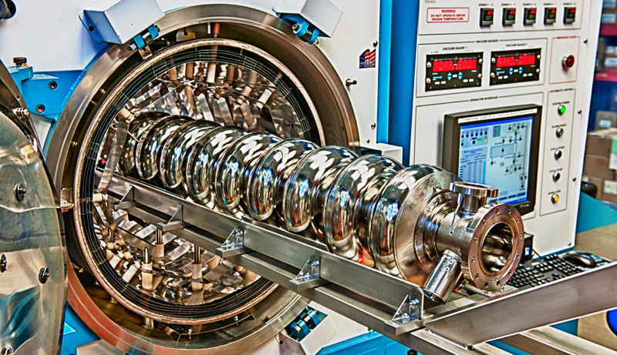
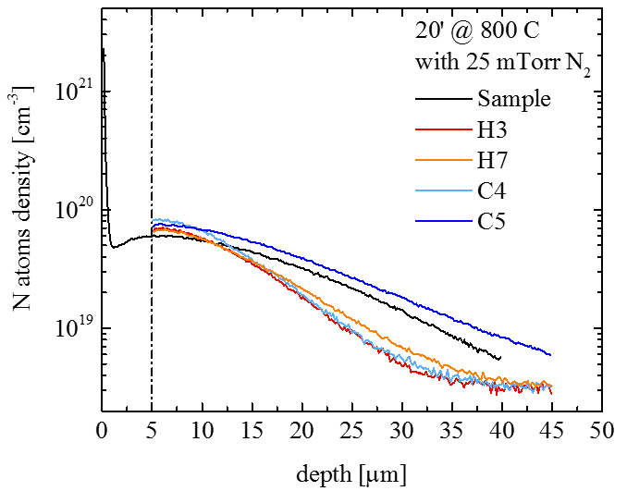
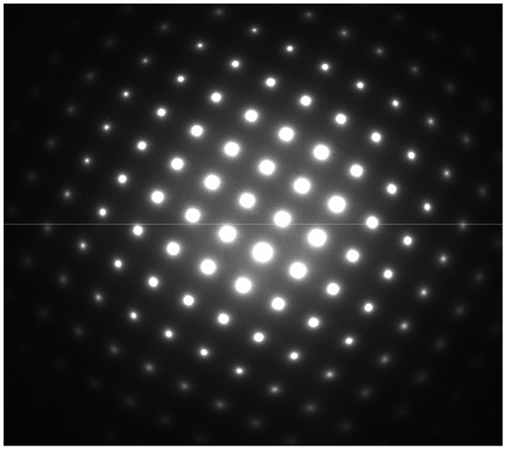
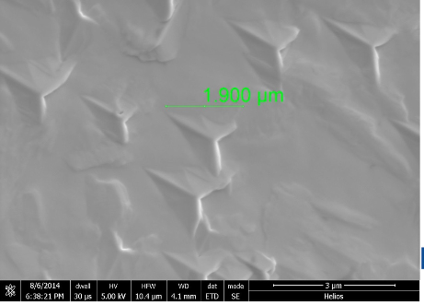
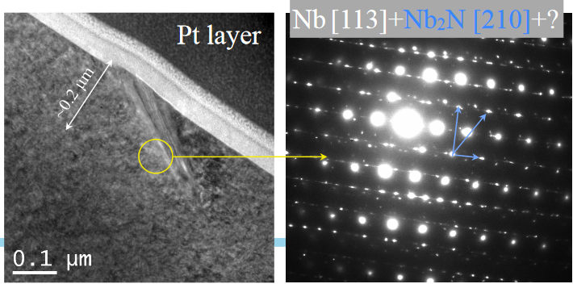
N-doping treatment
800C N₂
p = 25 mTorr 2 minutes
800C UHV, 3 hours
800C N₂
p = 25 mTorr 2 minutes
UHV cooling
800C UHV, 6 minutes
UHV cooling
800C UHV, 6 minutes
5 um EP
5 um EP
Y. Trenikhina et Al, Proc. of SRF 2015
N₂
Nb_{x}N_{y}
Final RF Surface
Nb
N
N Interstitial
Y. Trenikhina et al, Proc. of SRF 2015
Slides adapted from M. Martinello

Slide 8
High Temperature Furnaces
Facilities used for: high temp treatment of cavities – enabled development of N-doping, N-infusion procedures at Fermilab
These discoveries in turn have helped develop understanding of physics of superconductors in RF fields
Ultra-clean IB4 furnace: possible to RF test immediately after furnace without chemistry

Slide 9
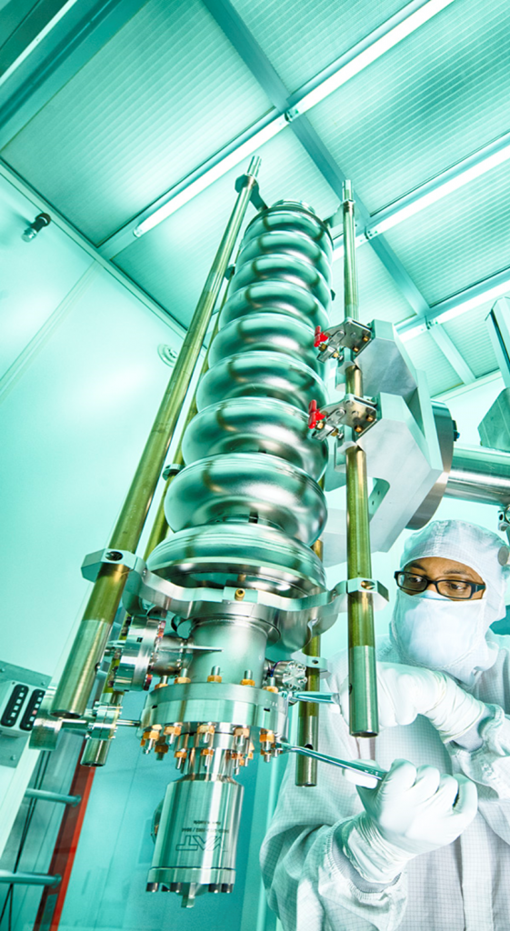
High Pressure Rinse / Vacuum Assembly
CPL HPR stand is compatible with 8 cavity frequencies
Facilities used for: particulate free assembly in class 10 semiconductor-grade cleanroom
Interior treatment with 16 MΩ ultrapure water at 100 bar critical step for field emission mitigation

Slide 10
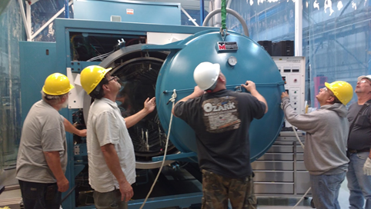
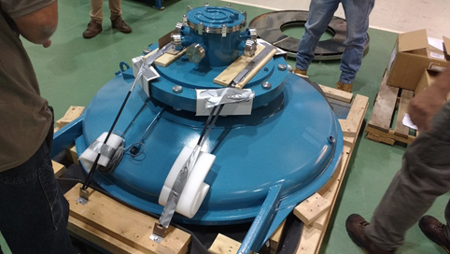
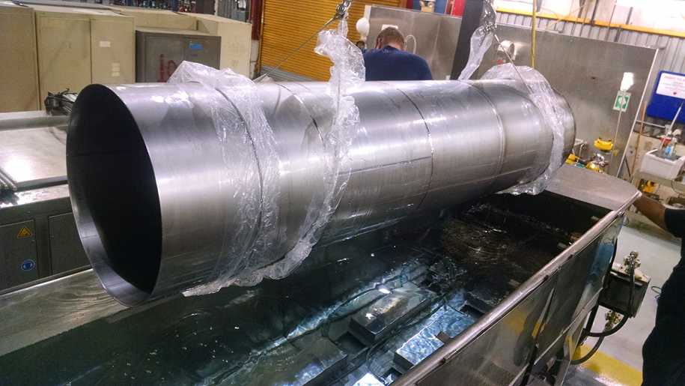
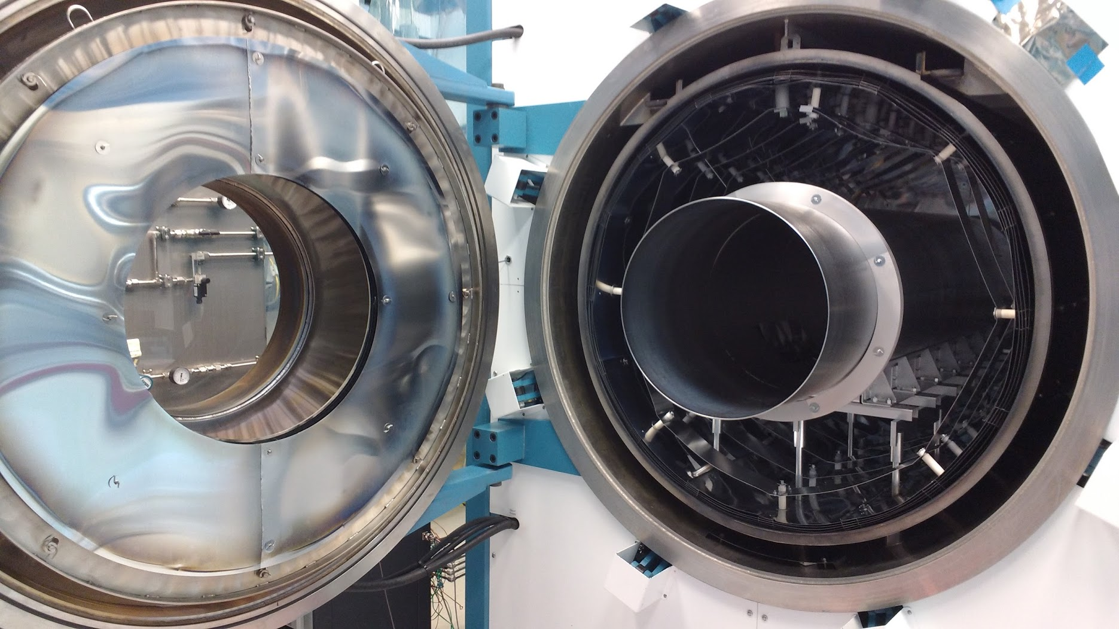
2016 - MP9 Furnace Modification for Nb₃Sn Coating
20” diameter, 82” long Nb₃Sn coating chamber
MP9 vacuum furnace: large enough for Nb₃Sn coating chamber with 650 MHz multicell cavity

Slide 11
Statistics of Usage
2018 projection

Slide 12
Vertical Test Stand
Two main functions:
  1) test new cavity treatments for R&D (as well as new instrumentation etc.)
  2) qualify cavities for accelerator operation
3 dewars
Capacity ~1400 L of 2 K LHe
Radiation shielding block

Slide 13
Vertical Test Instrumentation
Instrumentation is crucial to characterize cavities
  RF power cables
  Thermometers
  Fluxgate magnetomers
  Helmholtz coils
  Second sound transducers
  Temperature mapping system

Slide 14
Vertical Test Facility (VTS) Extremely High Usage
Over last several years have been squeezing facilities to allow as much throughput as possible
x3

Slide 15
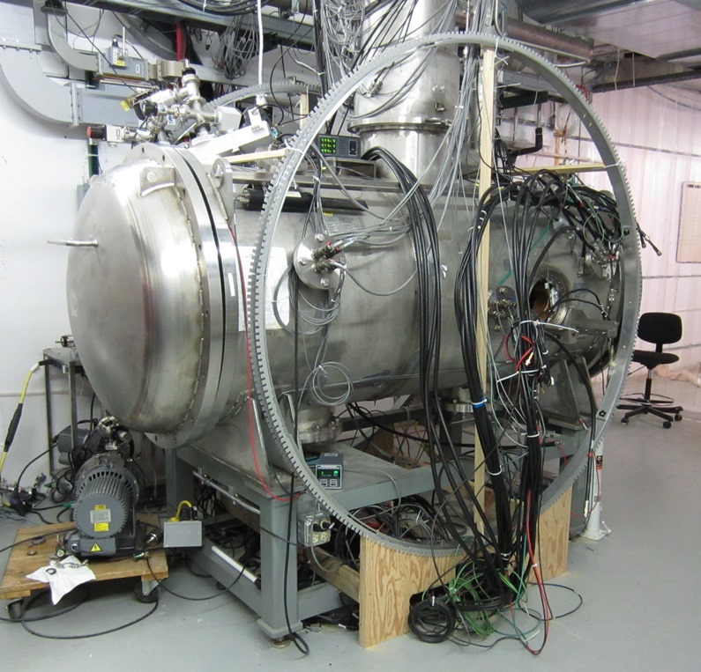
Horizontal Cavity Test Stands
Validates transfer of fundamental R&D concepts to accelerator scale structures, integrating cavities with cryomodule components; very heavily used by projects

Slide 16
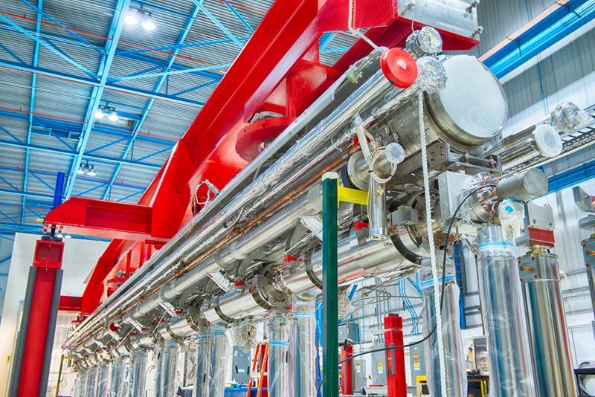
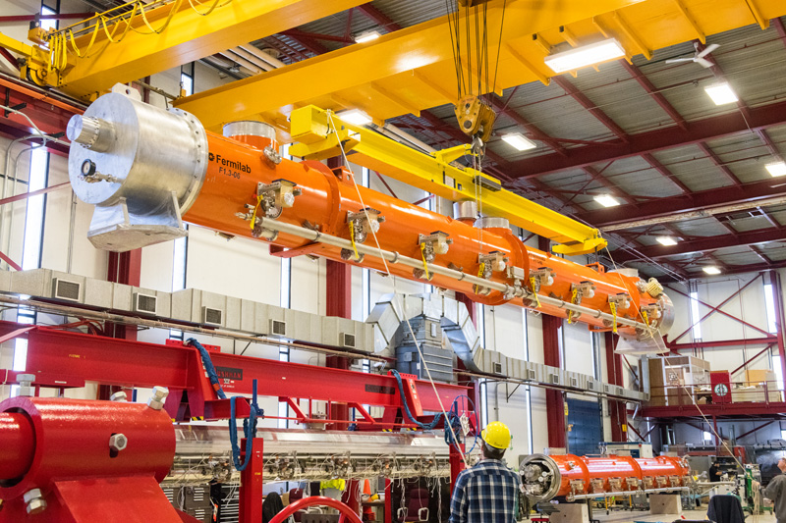
Cryomodule Assembly
Facilities used for: clean assembly of cryomodules, from individual cavities to accelerator-ready module
Projects/Programs served: LCLS-II, PIP-II, future SRF accelerator projects
Uniqueness of facility: one of two major cryomodule assembly facilities in the US, ~4 of this scale in the world

Slide 17
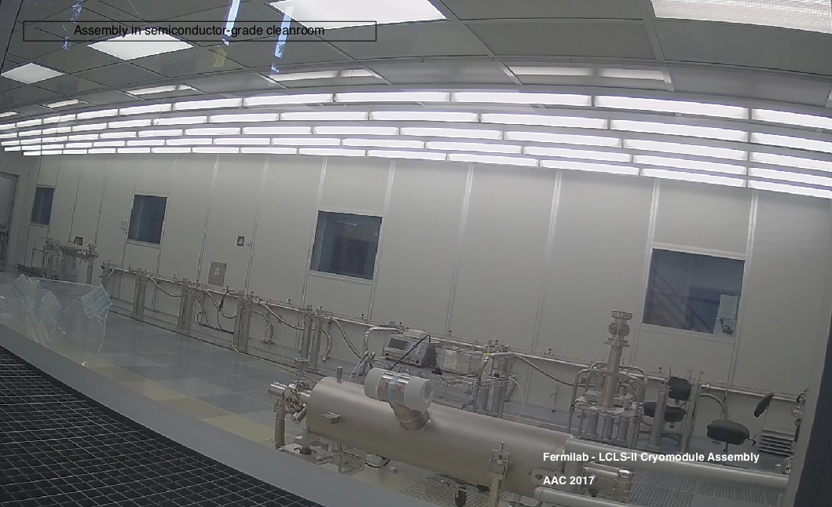
Example: LCLS-II Cryomodule Assembly

Slide 18
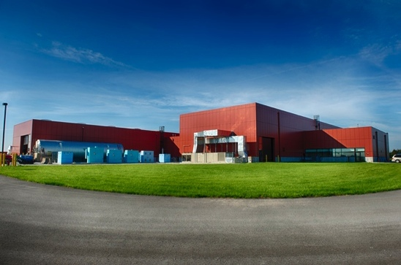
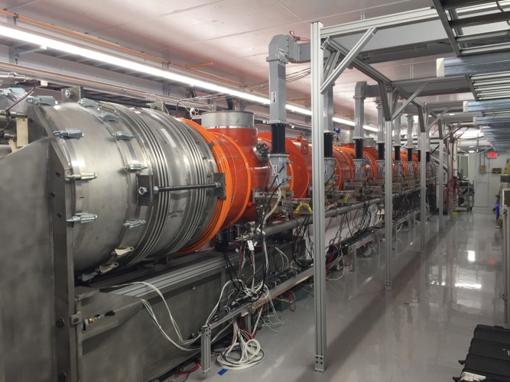
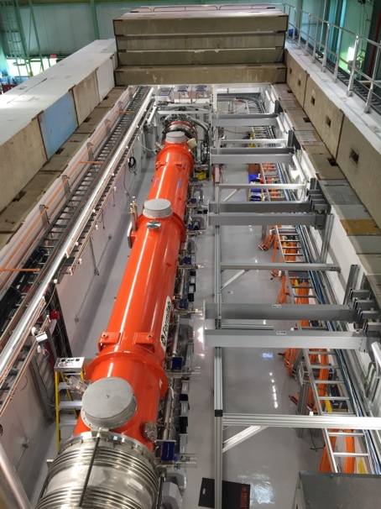
Cryomodule testing
CMTF Facility
CMTF facility/CMTS1 SRF cryomodule test stand
  CMTS1 - 13 SRF cryomodules have been cold-tested at CMTS1 for the LCLS-II project on a test cycle of 28 days/cryomodule
CMTS1 Test Stand at CMTF
CMTS1

Slide 19
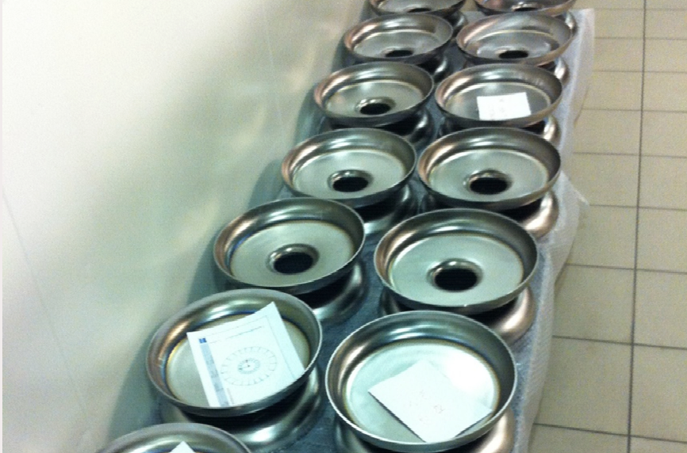
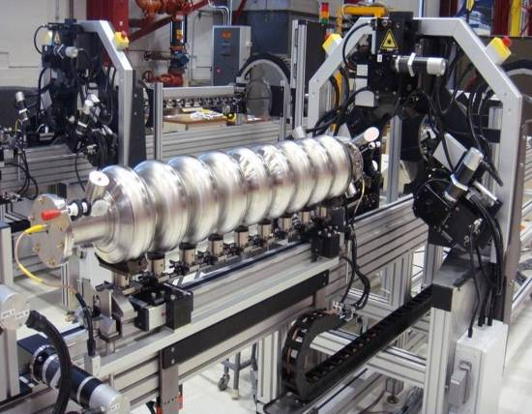
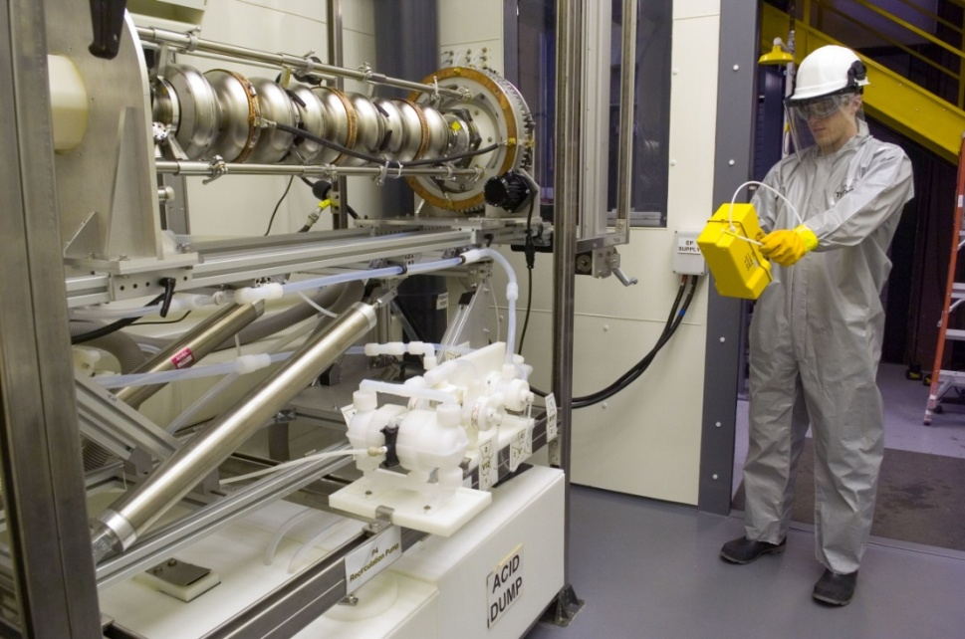
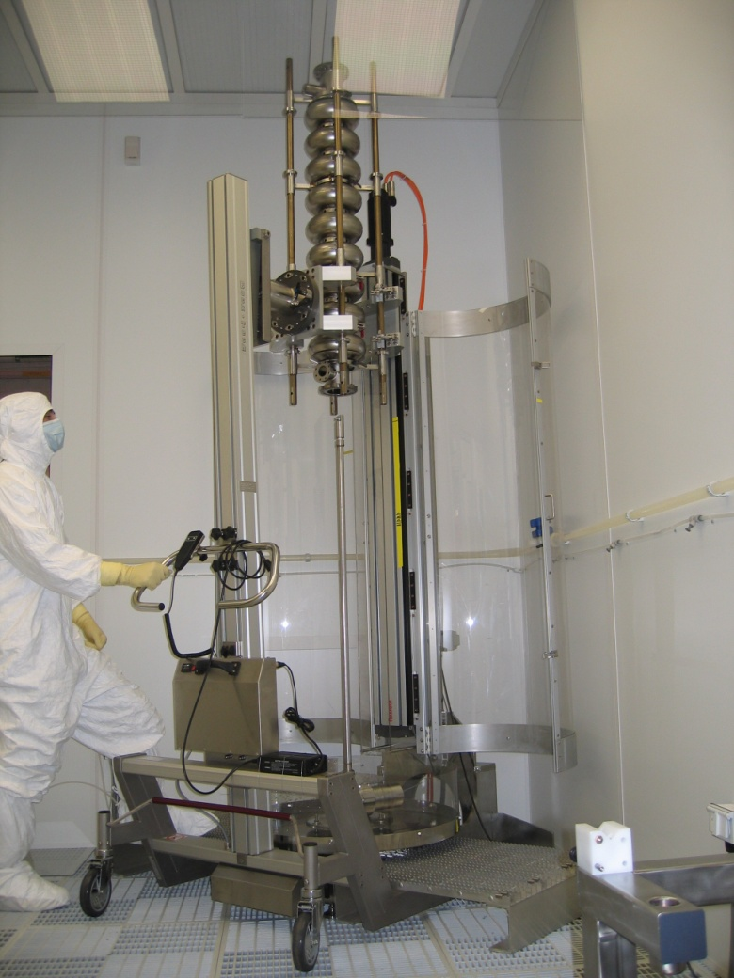
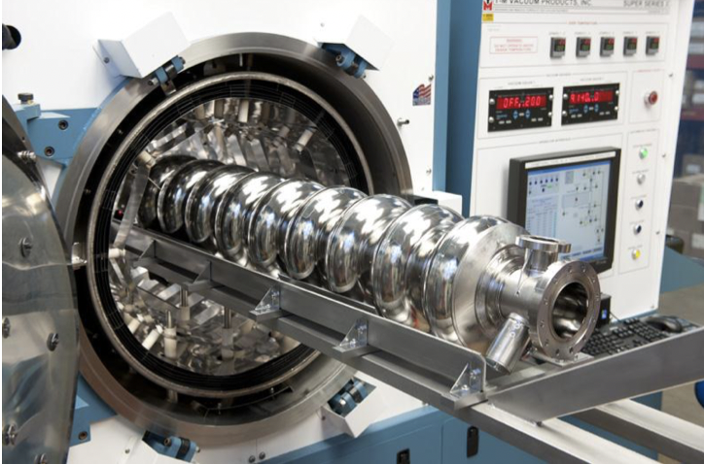
Major SRF Cavity Processing Steps – R&D
Mechanical fabrication (industry)
RF tuning
Cryogenic RF testing (“vertical test”)
Characterize performance and surface after R&D process, reset surface with EP, then apply new process
Electropolishing
Final cleaning (high pressure
water rinsing) and vacuum assembly in class 10 clean room
Furnace treatment

Slide 20
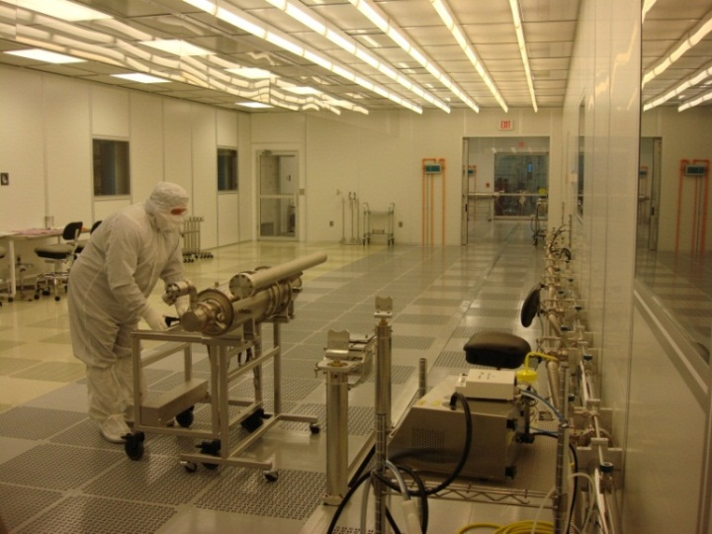
Major SRF Cavity Processing Steps – Large Project
Mechanical fabrication (industry)
RF tuning (industry)
Cryogenic RF testing (“vertical test”)
Electropolishing (industry)
Final cleaning (high pressure
water rinsing) and vacuum assembly in class 10 clean room (industry)
Cryomodule assembly and testing
Furnace treatment (industry)

Slide 21
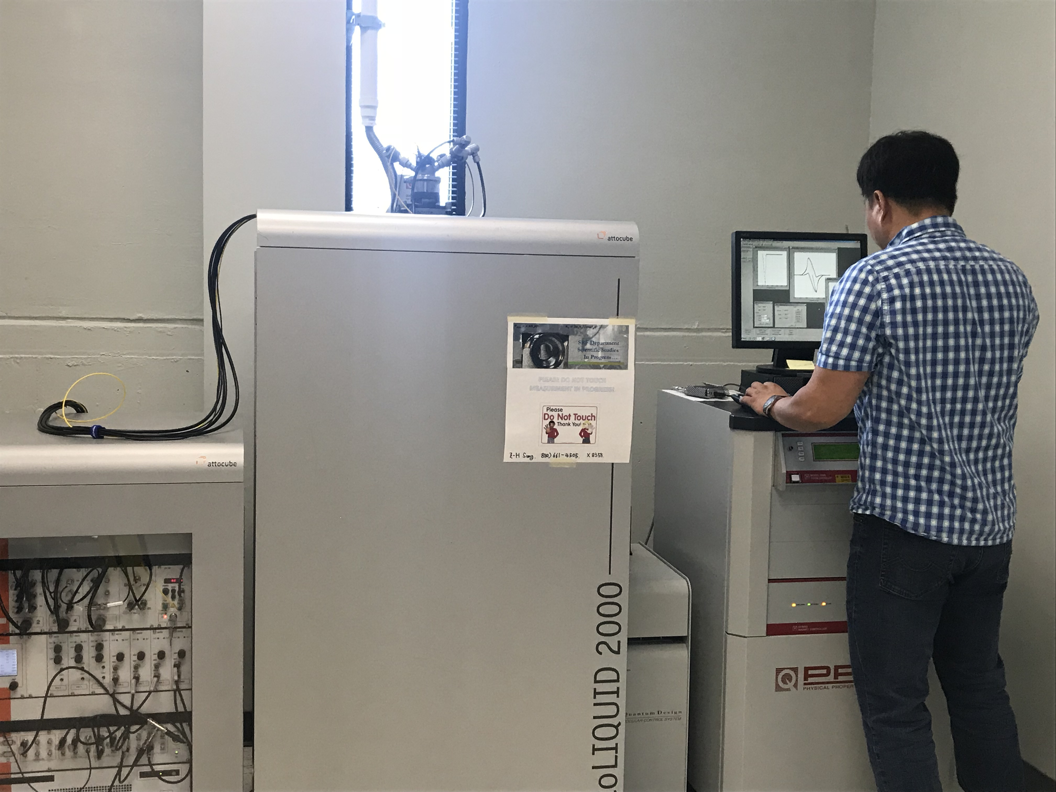
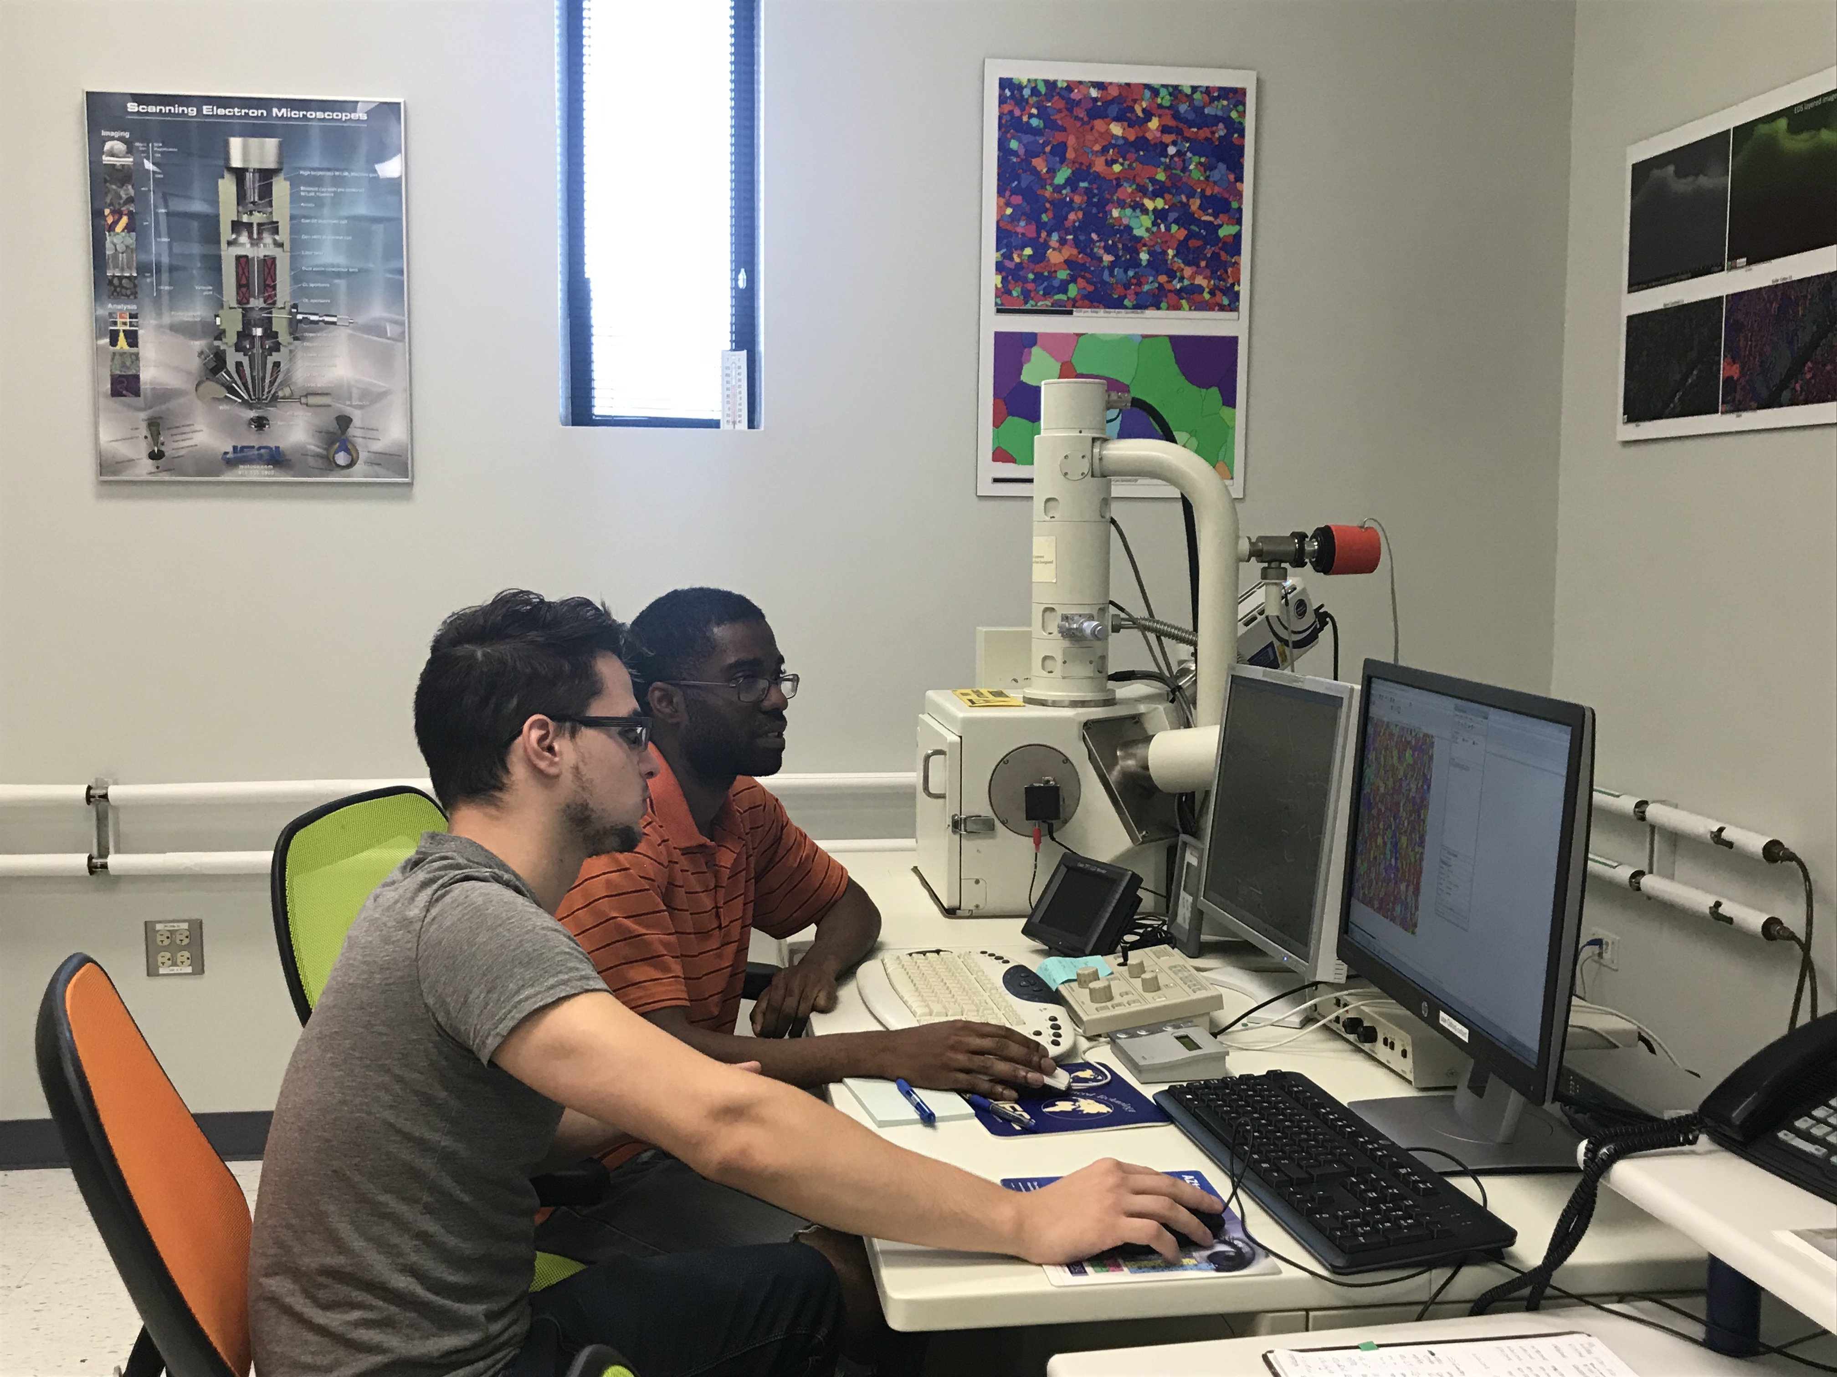
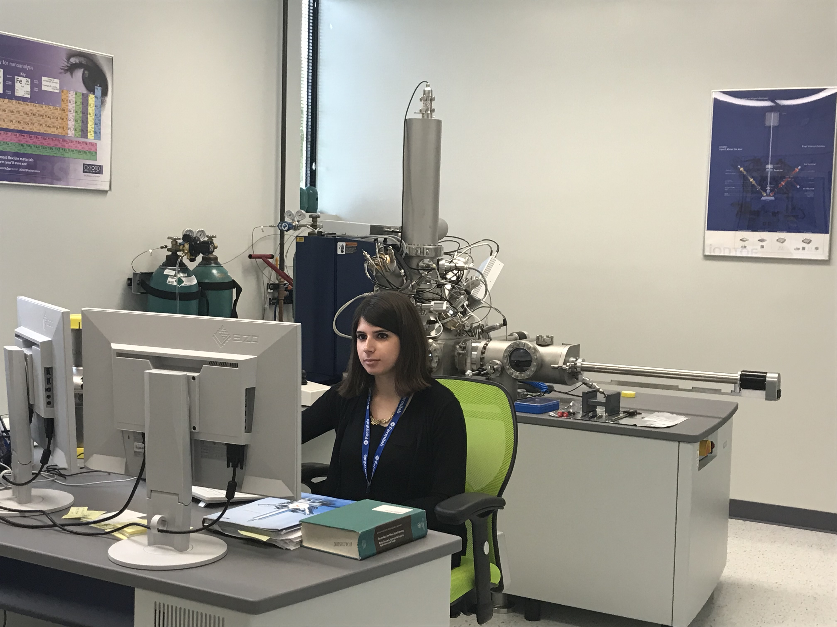
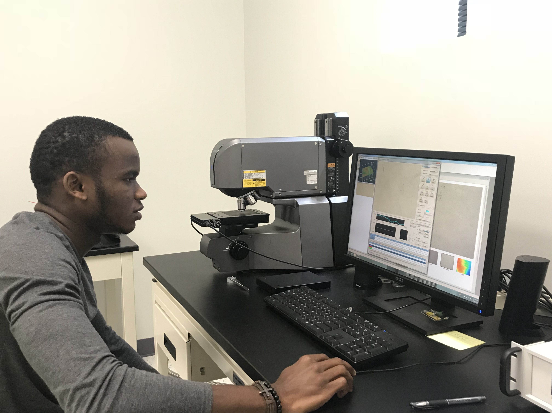
Fermilab Materials Science Laboratory – Understanding how to push performance through investigation of microstructure
PPMS-AFM/MFM – cryogenic magnetization and surface measurements, imaging of vortices in superconductors
SEM-EDX-EBSD – imaging, composition, grain orientation
TOF-SIMS – ultra-high resolution compositional analysis
LCMS – 3D light profilometry
Notes:
I would say that making the connection between cavity performance and surface analysis is an area of focus and a real strength of the Fermilab SRF R&D program. We have a dedicated materials science laboratory, where you can see there’s lots of opportunity for student involvement. We analyze the 3D geometry of the surface, composition, effect of grain orientation, magnetization curves of samples, and more to try to understand why a given treatment gives the performance it does and look for ways to push to the next level

Slide 22
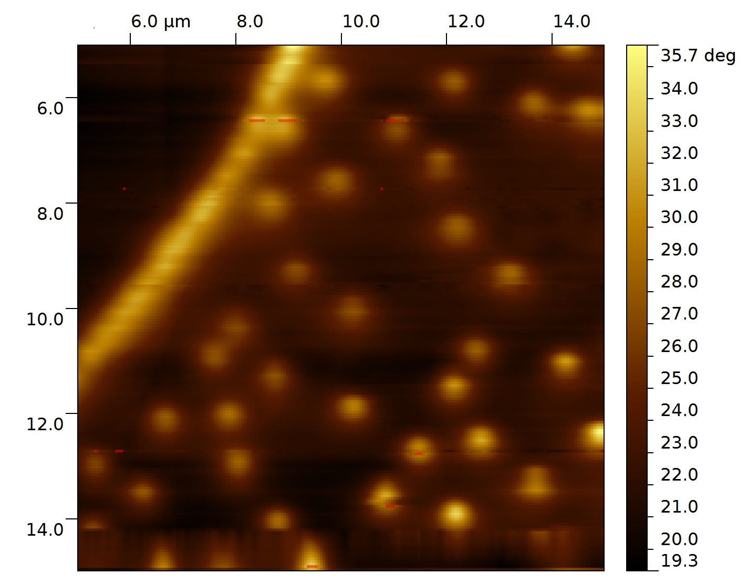
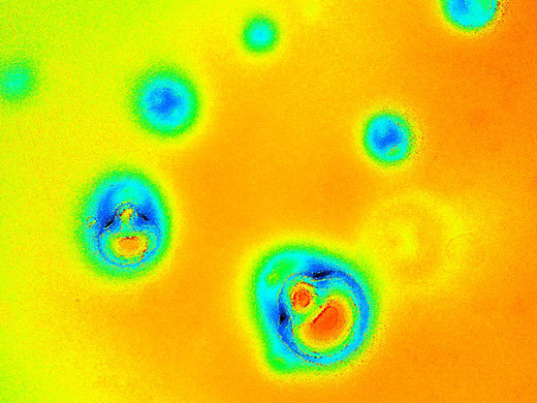
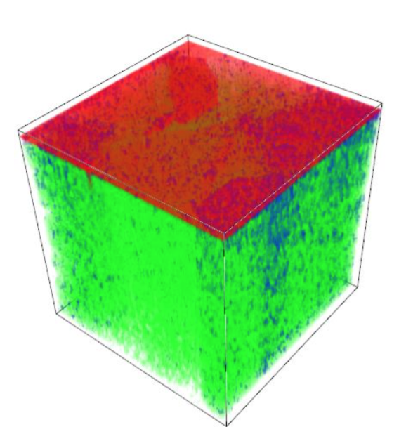
Fermilab Materials Science Laboratory – Understanding how to push performance through investigation of microstructure
PPMS-AFM/MFM – cryogenic magnetization and surface measurements, imaging of vortices in superconductors
SEM-EDX-EBSD – imaging, composition, grain orientation
TOF-SIMS – ultra-high resolution compositional analysis
LCMS – 3D light profilometry
Notes:
I would say that making the connection between cavity performance and surface analysis is an area of focus and a real strength of the Fermilab SRF R&D program. We have a dedicated materials science laboratory, where you can see there’s lots of opportunity for student involvement. We analyze the 3D geometry of the surface, composition, effect of grain orientation, magnetization curves of samples, and more to try to understand why a given treatment gives the performance it does and look for ways to push to the next level

Slide 23
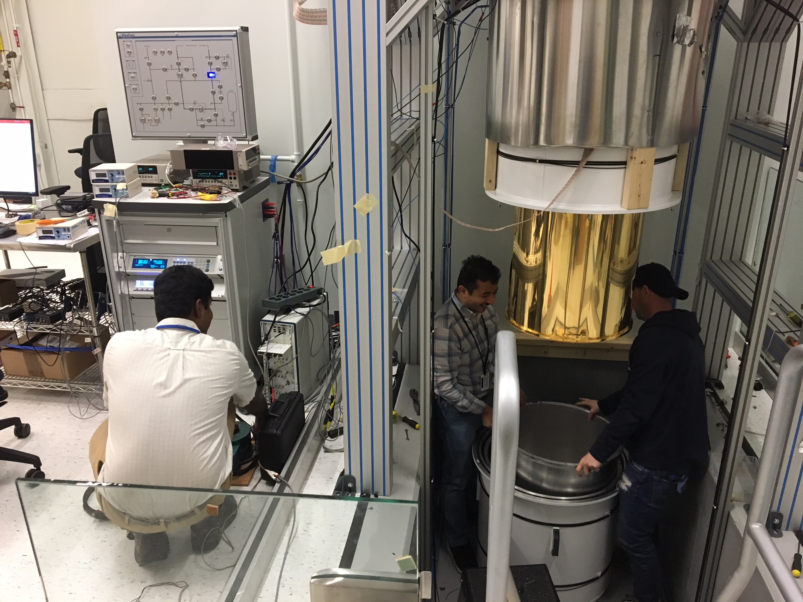
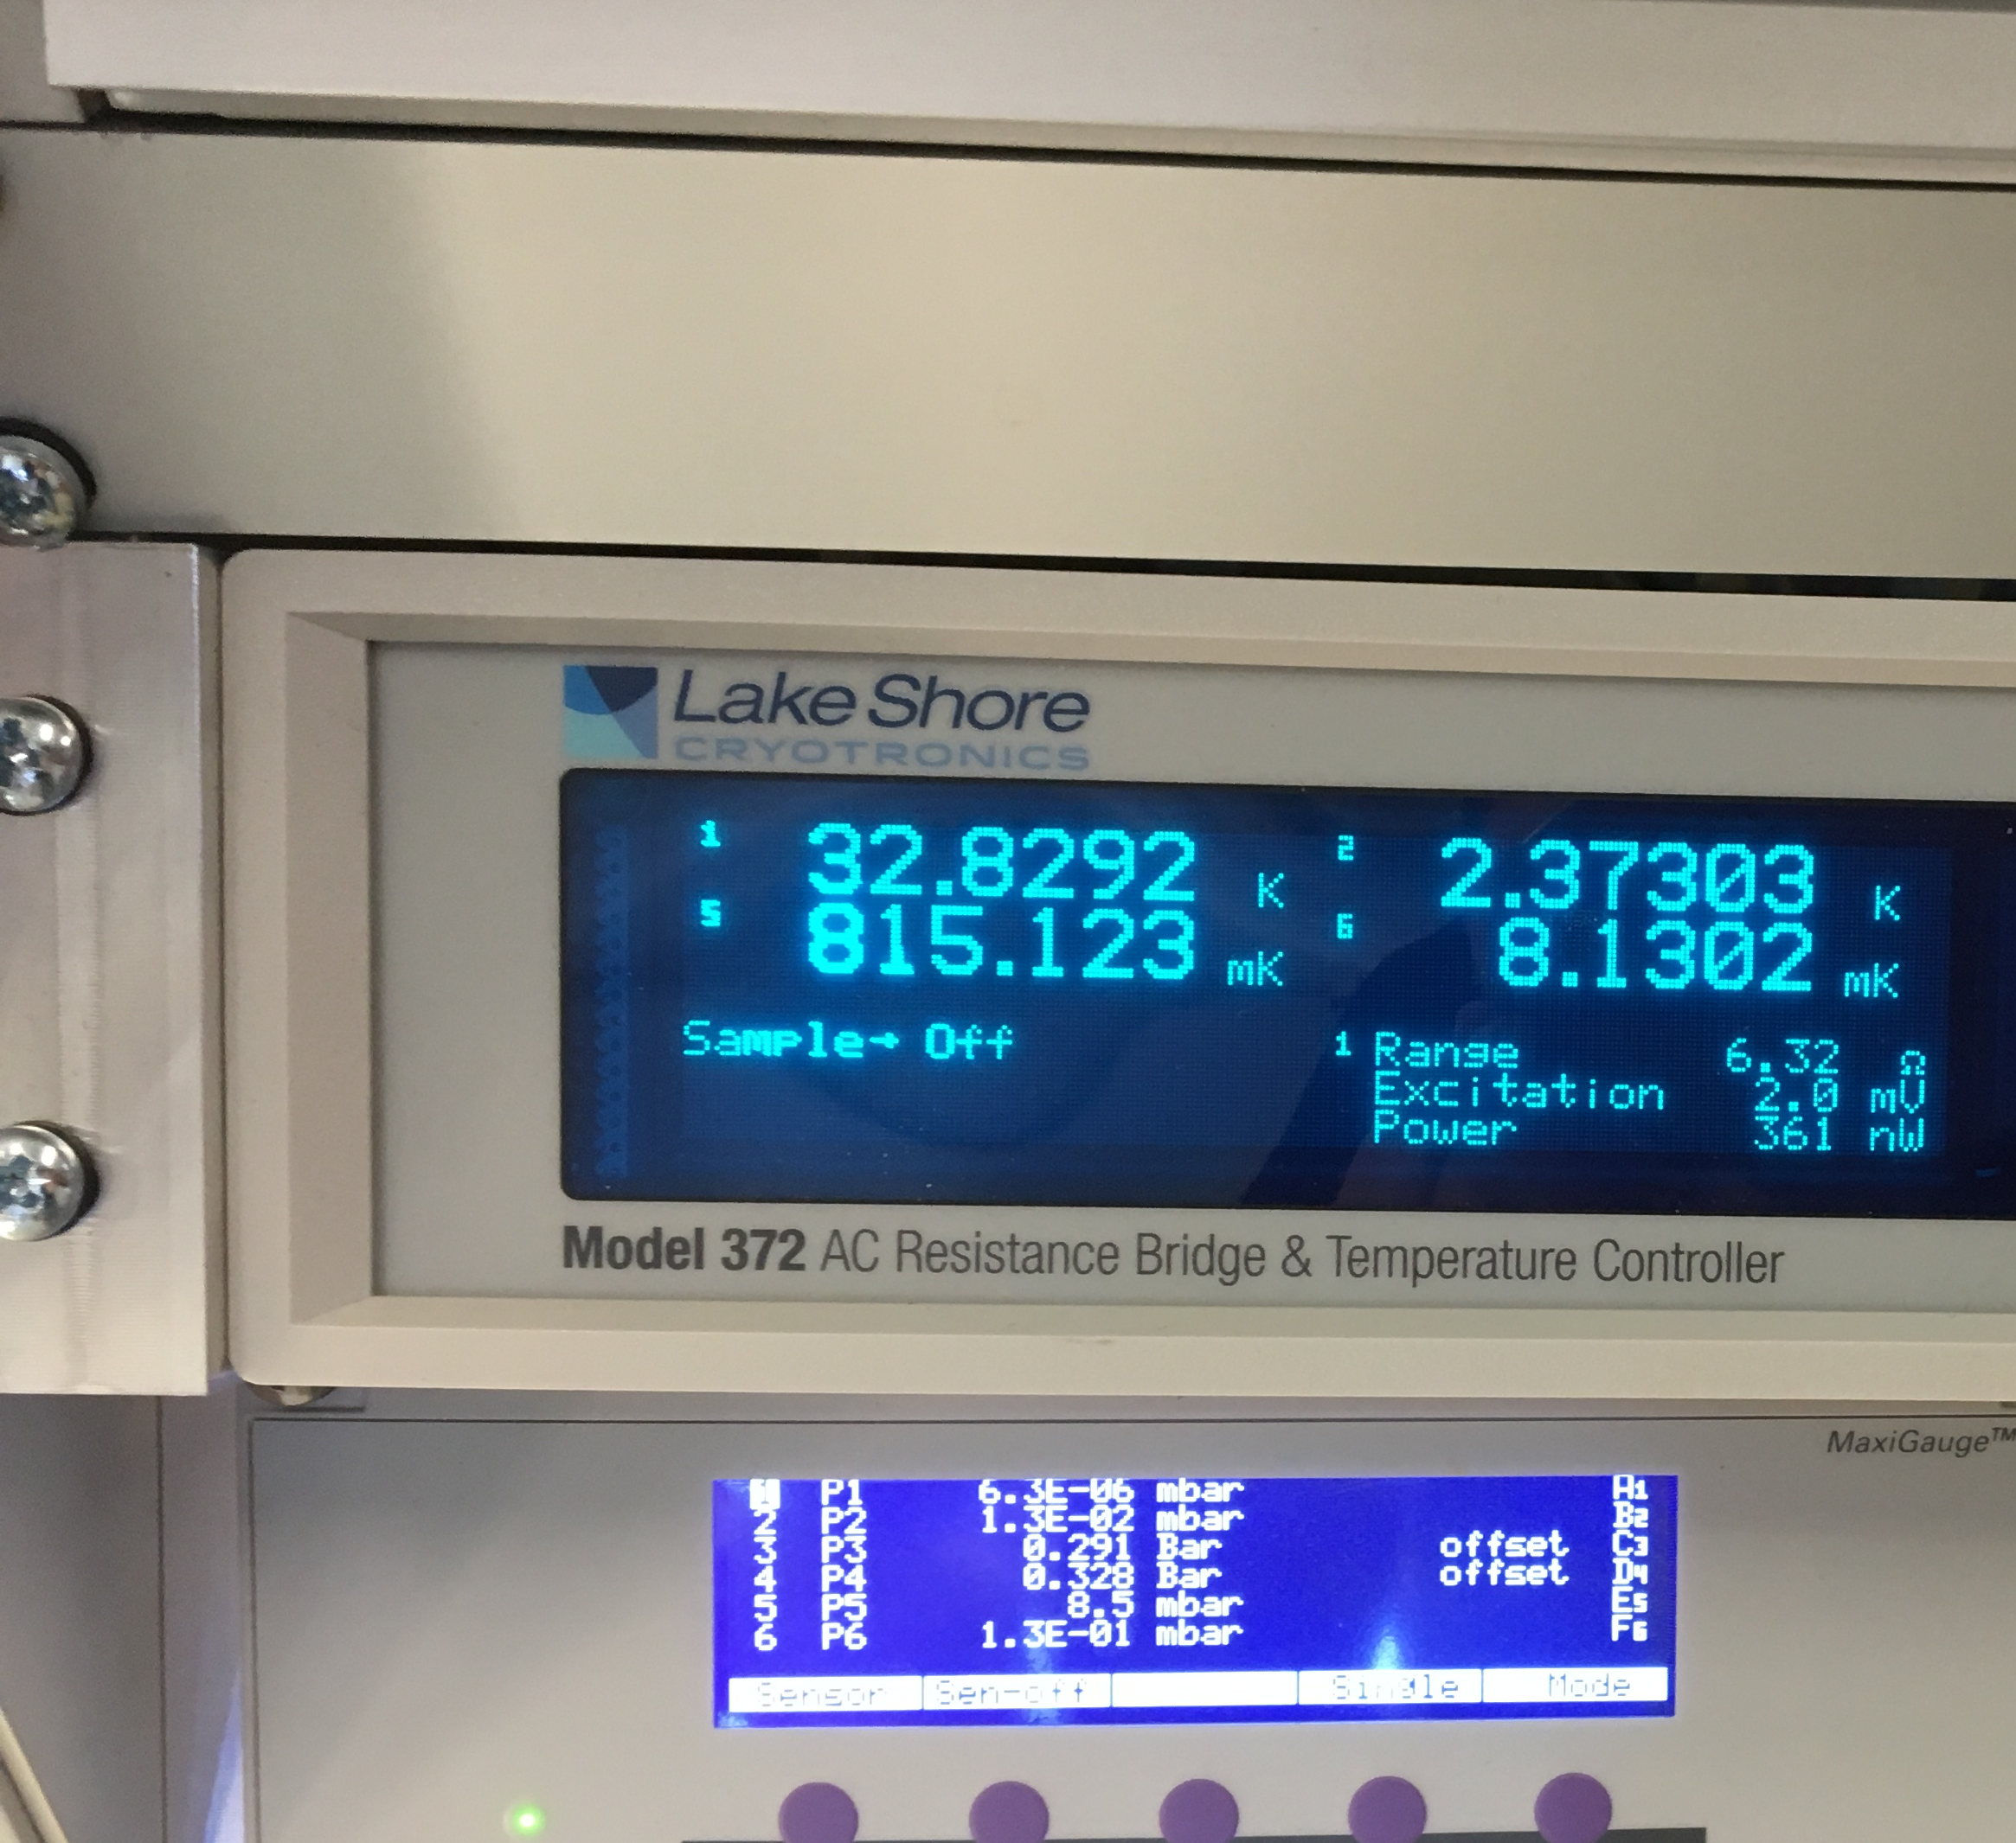
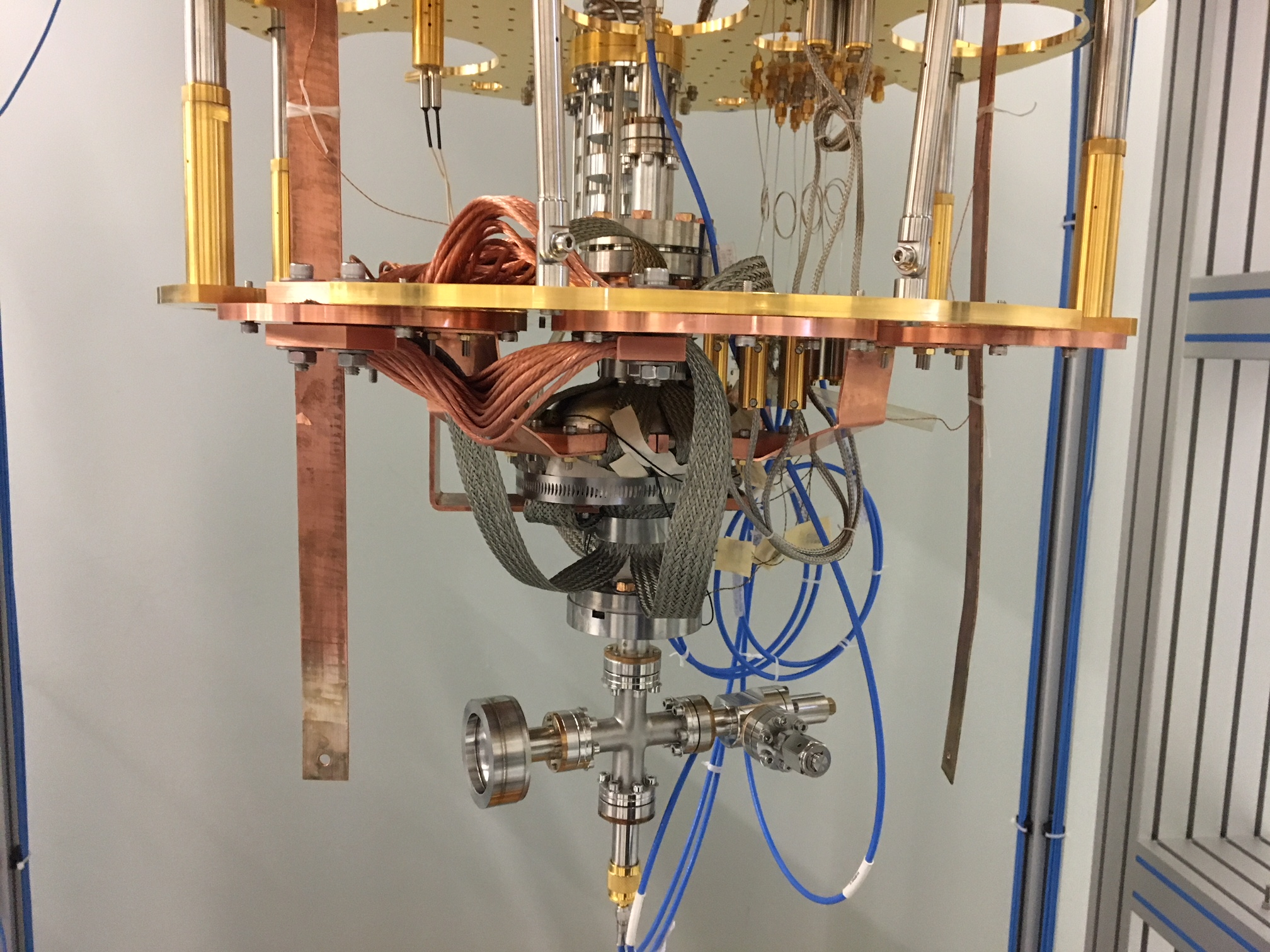
Ultralow Temperature Facility - NEW
2.6 GHz 1-cell cavity

Slide 24
World Class SRF Facilities – Full Spectrum
Cavity processing/preparation
  Electropolishing, centrifugal barrel polishing, high pressure ultrapure water rinsing, assembly in semiconductor-grade cleanroom, particle-free vacuum pumping
Cavity measurements
  vertical and horizontal test
Cryomodule assembly
Cryomodule test stands
Materials Science Lab
  TOF-SIMS, SEM/EDX/EBSD, LCSM, PPMS (magnetometry, electrical transport, thermal transport), cryo AFM/MFM, Instron
Ultralow Temperature Measurements Facility (dilution refrigerator)

