Slide 1
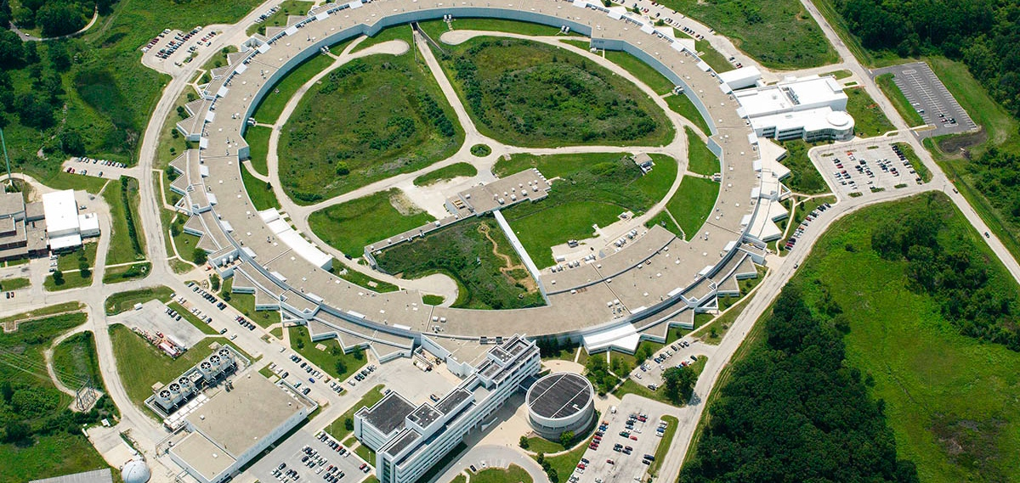
Argonne Accelerator facilities and test stands
erhtjhtyhy
John Byrd
Director, Accelerator Systems Division
Photon Sciences Directorate
2018 Midwest Regional Workshop on Accelerator Stewardship Test Facility Program, 6 Dec. 2018

Slide 2
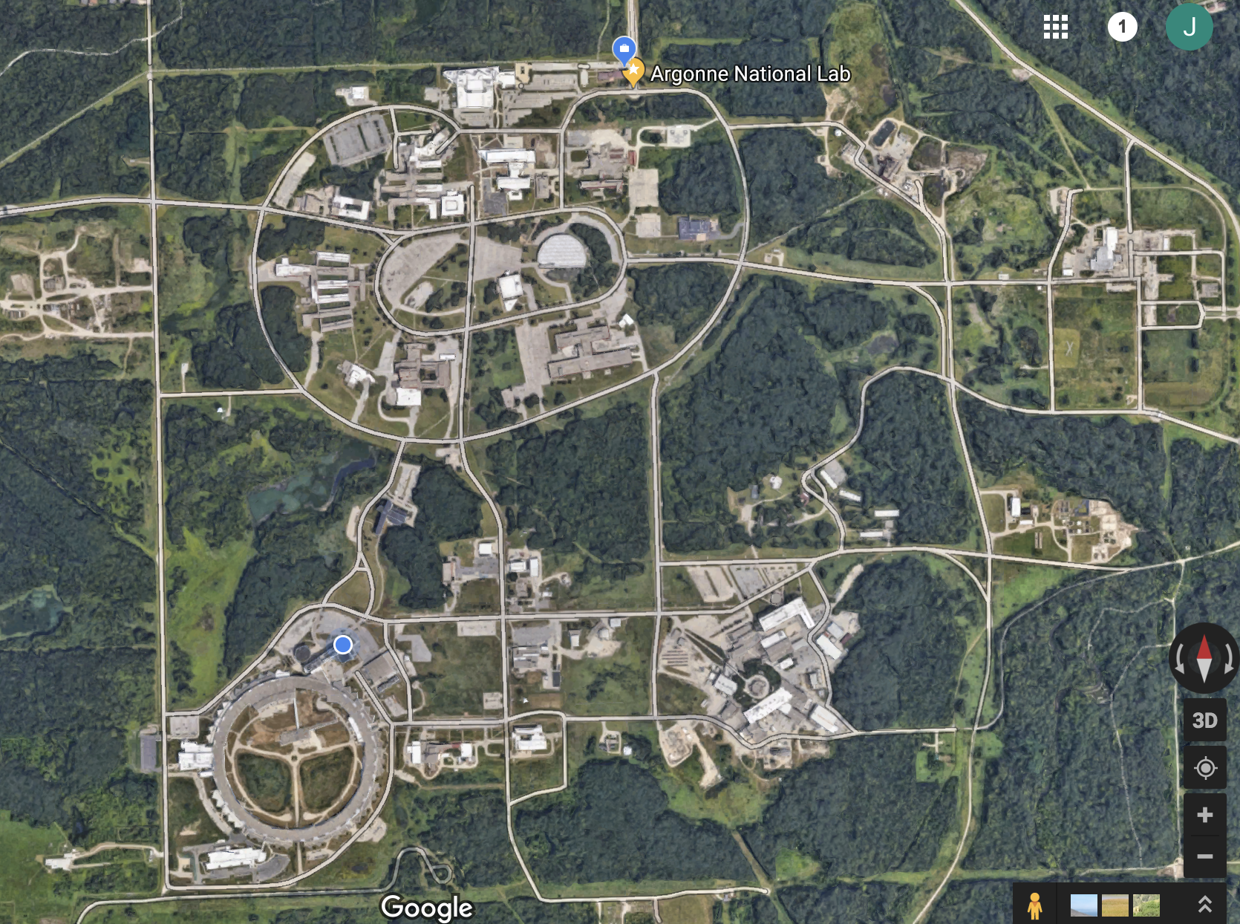
Argonne’s accelerator Facilities
Deeply invested in accelerator technologies for further DOE mission
Argonne Tandem Linac
Accelerator System (ATLAS)
Low Energy Accelerator
Facility (LEAF)
Advanced Photon Source
Argonne Wakefield Accelerator

Slide 3
The Advanced photon source
World-class hard x-ray synchrotron light source with over 5000 users
Provides very bright photon beams over a wide energy range (up to 100 keV)
Serves many scientific disciplines all at the same time ranging from surface chemistry to biology to advanced manufacturing.
$0.8B upgrade to ring planned for operation in 2023 as world’s brightest light source.

Slide 4
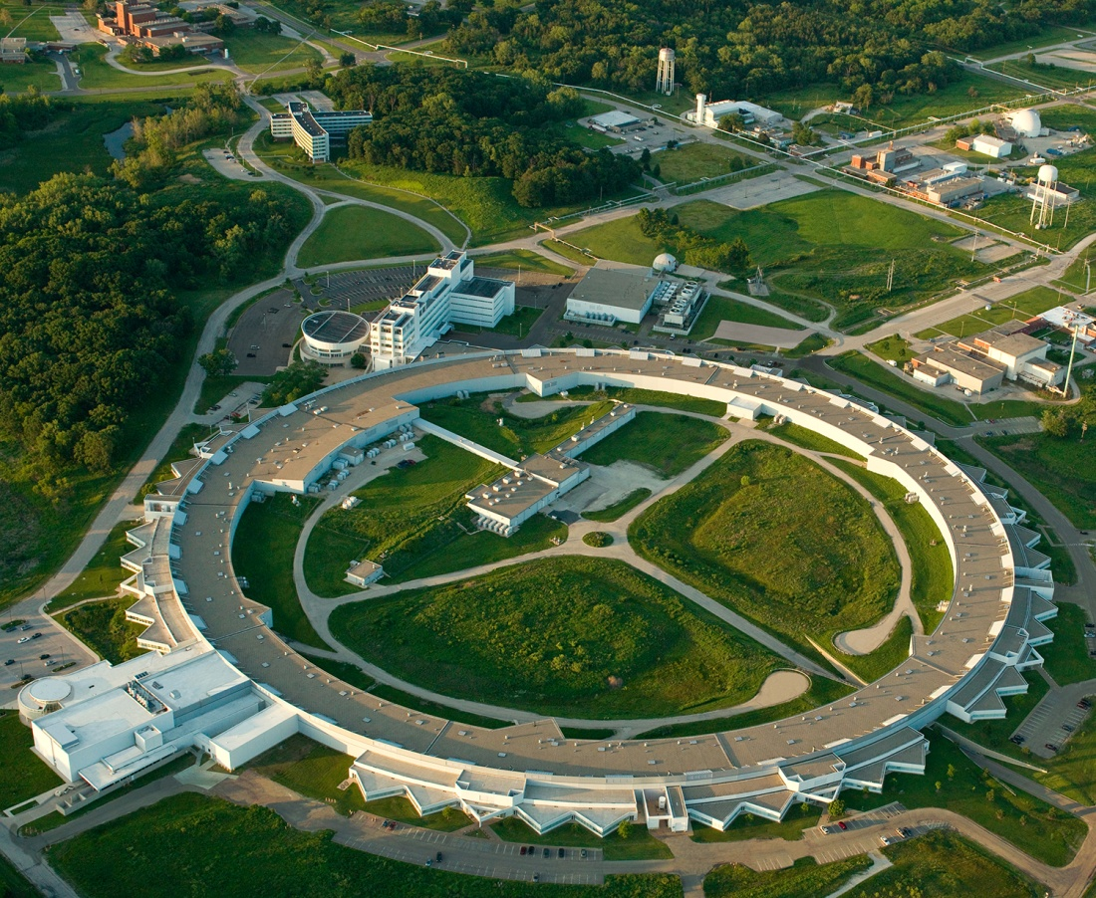
APS Accelerator Complex
7 GeV, 100 mA, 46 ID, 21 bend magnet BL,
3 fill patterns
Linac: S-band, 0.38 GeV, 30 Hz
Booster: 0.38-7 GeV, 2 Hz
PAR: 0.38 GeV, 2 Hz, 1-4 nC
Linac extension
area
The APS Upgrade (APS-U) will replace the main storage ring but keep the radio-frequency (rf) system. Injector systems will be reused and require increased performance.

Slide 5
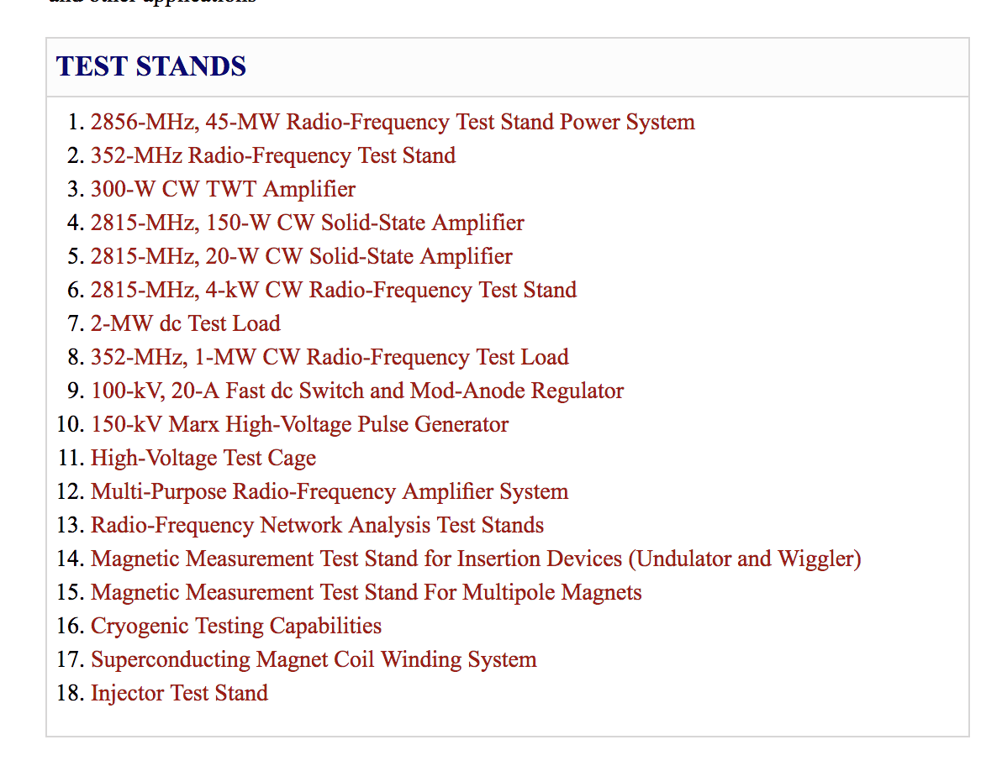
APS beam and RF TEST stands
A number of test stands are maintained for operations and accelerator research

Slide 6
ATLAS: Superconducting RF systems
World leader in low β accelerating structures for ions
Mike Kelly

Slide 7
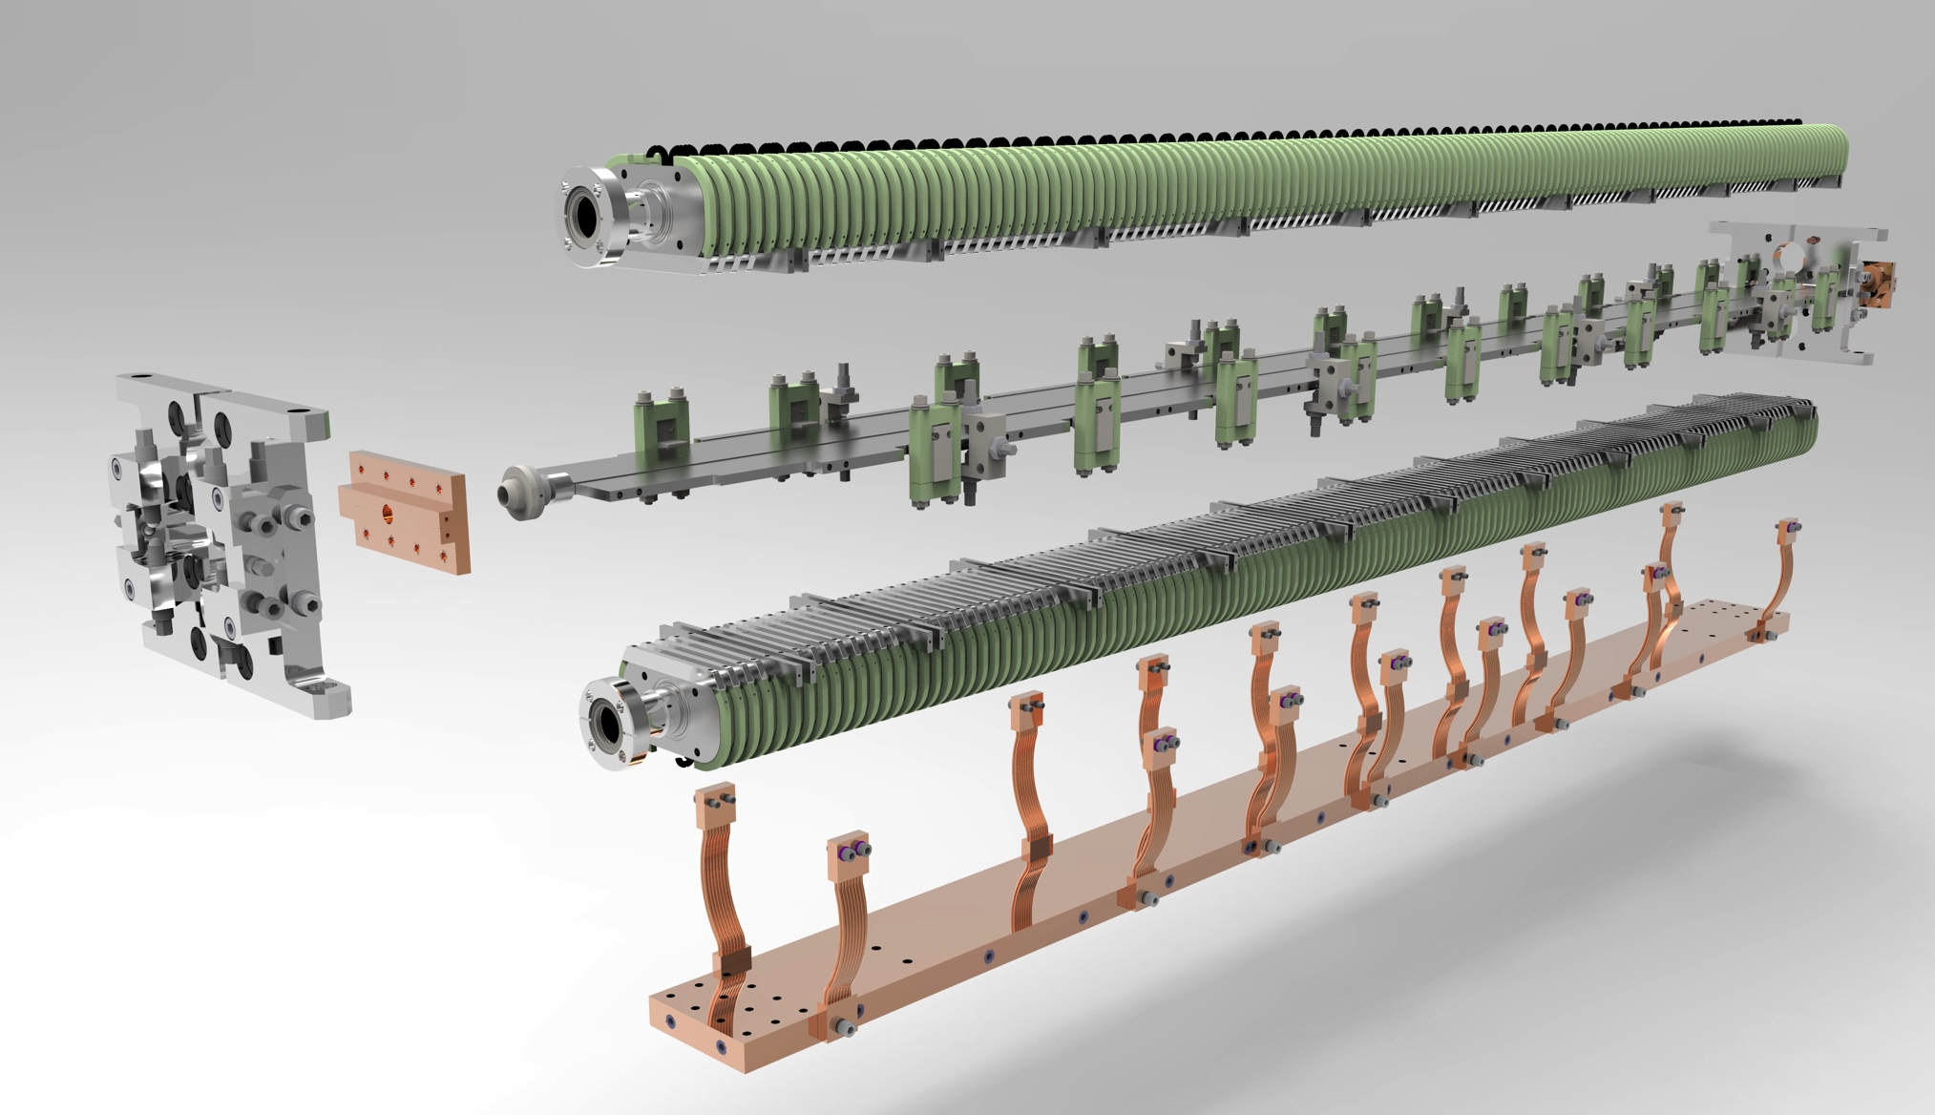
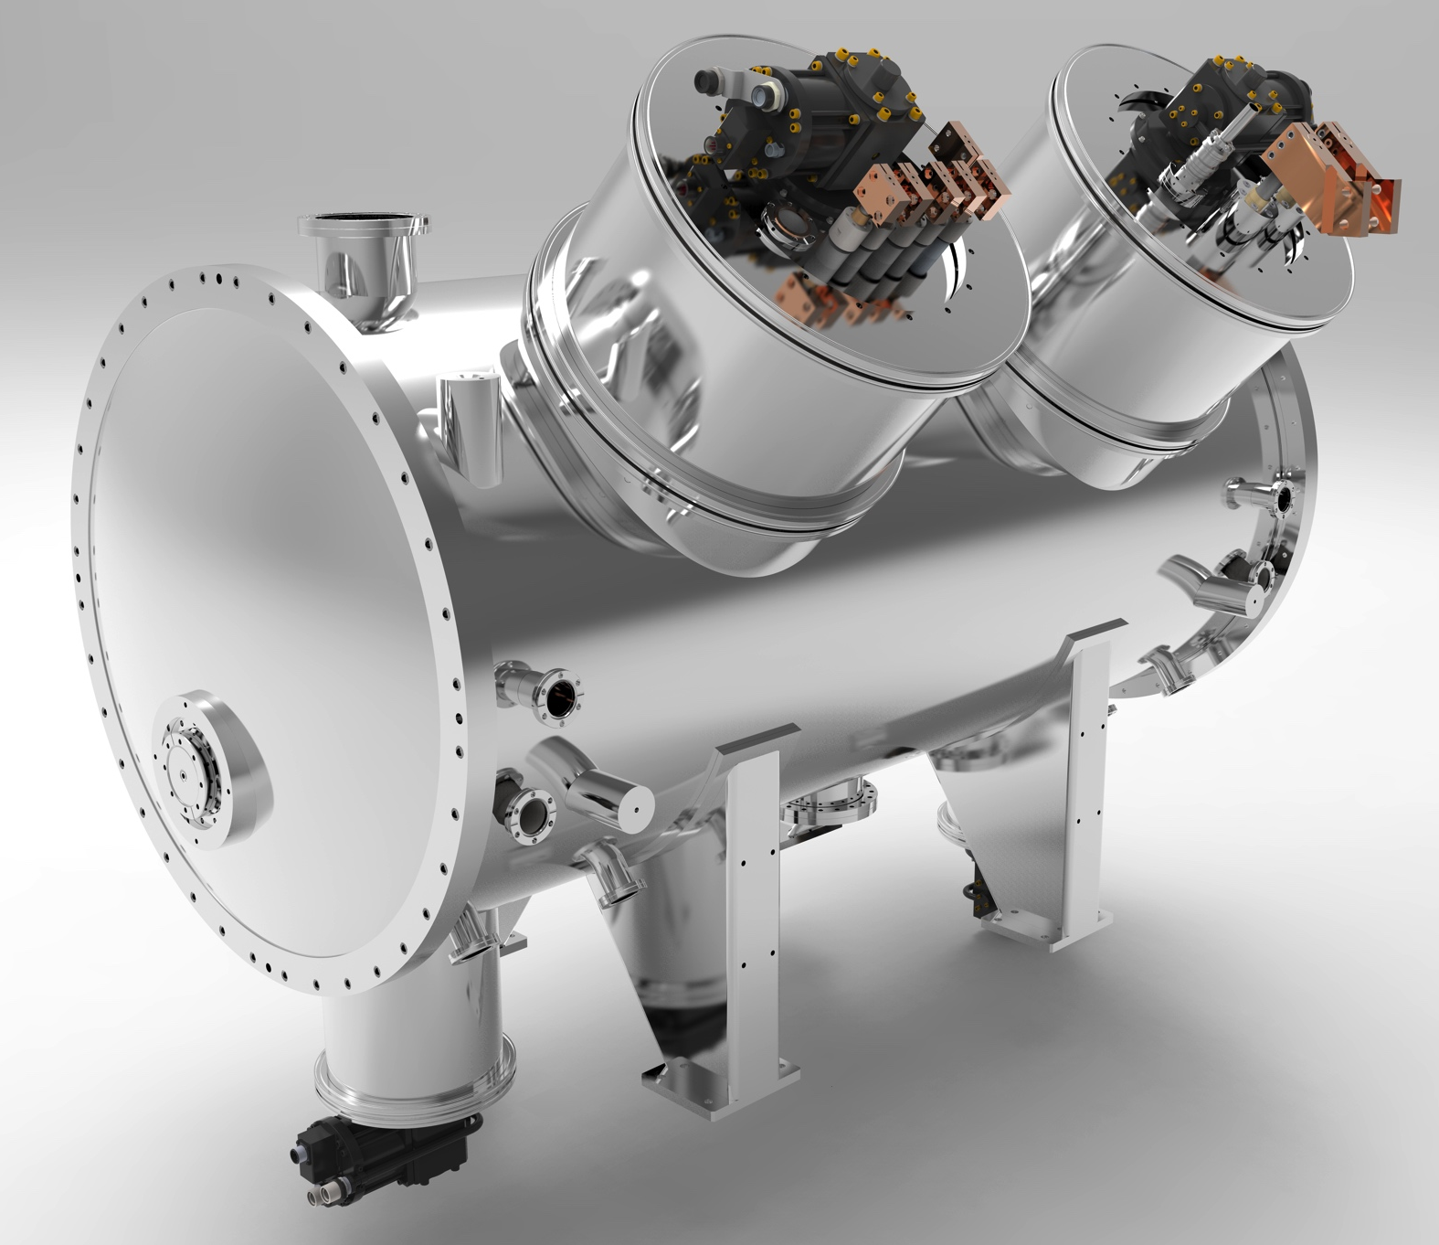
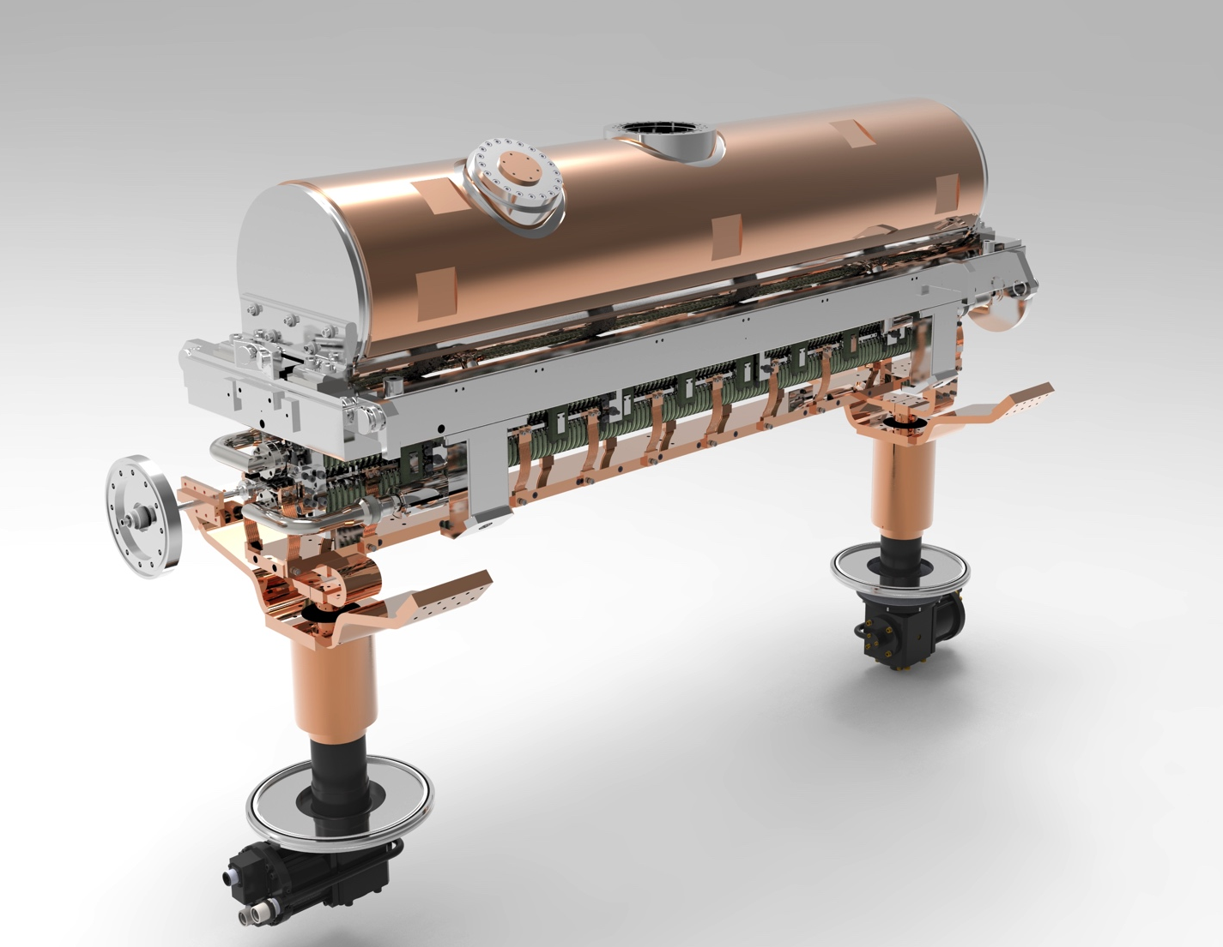
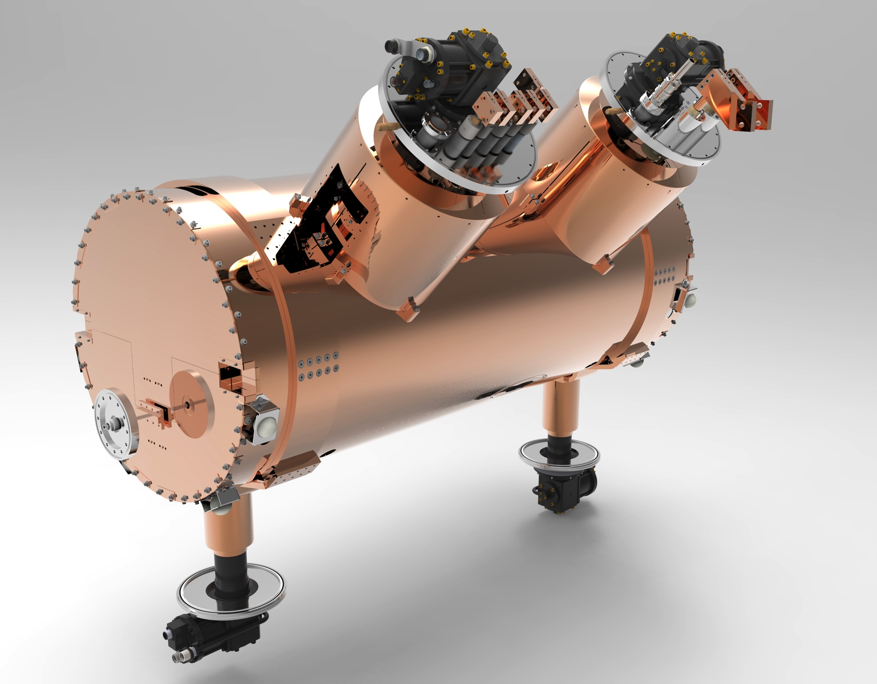
APS: Superconducting undulators
World-leading program for making brighter light sources with superconducting magnets
Basic undulator wiggles
electron beam
Yury Ivanyushenkov
Beam vacuum chamber
Magnet cores

Slide 8
The Argonne Wakefield Accelerator
Looking to the future of acceleration
70 MeV linac with high charge capability
Highly instrumented beamlines for sophisticated beam characterization.
RF photocathode test stand
Manoel Conde

Slide 9
LEAF: isotope production
Meeting critical national needs for health and security
General Applications
  Radioisotope separation and purification method development
  Radioisotope production
  Targetry
  Radiation testing and material response to received dose
  Material activation

Slide 10
Accelerator modeling and simulation
Using the latest tools to design our sources
Modern accelerators are designed and engineered using the latest computing codes and platforms.
Argonne maintains multiple licenses for many codes such as CST, Ansys, etc.
Argonne authors and maintains several beam dynamics codes such at TRACK and elegant.
Michael Borland

Slide 11
Argonne maintains many accelerator technology test stands
Electron, ion, photon beams and a number of technology test stands
Many of these capabilities are available for industrial collaboration.
Multiple avenues for collaboration are available (SBIR, STTR, etc.)
For more information for working with Argonne Accelerators, contact the Accelerator Institute (aai@anl.gov)
Enjoy the talks and tours.

