Slide 1
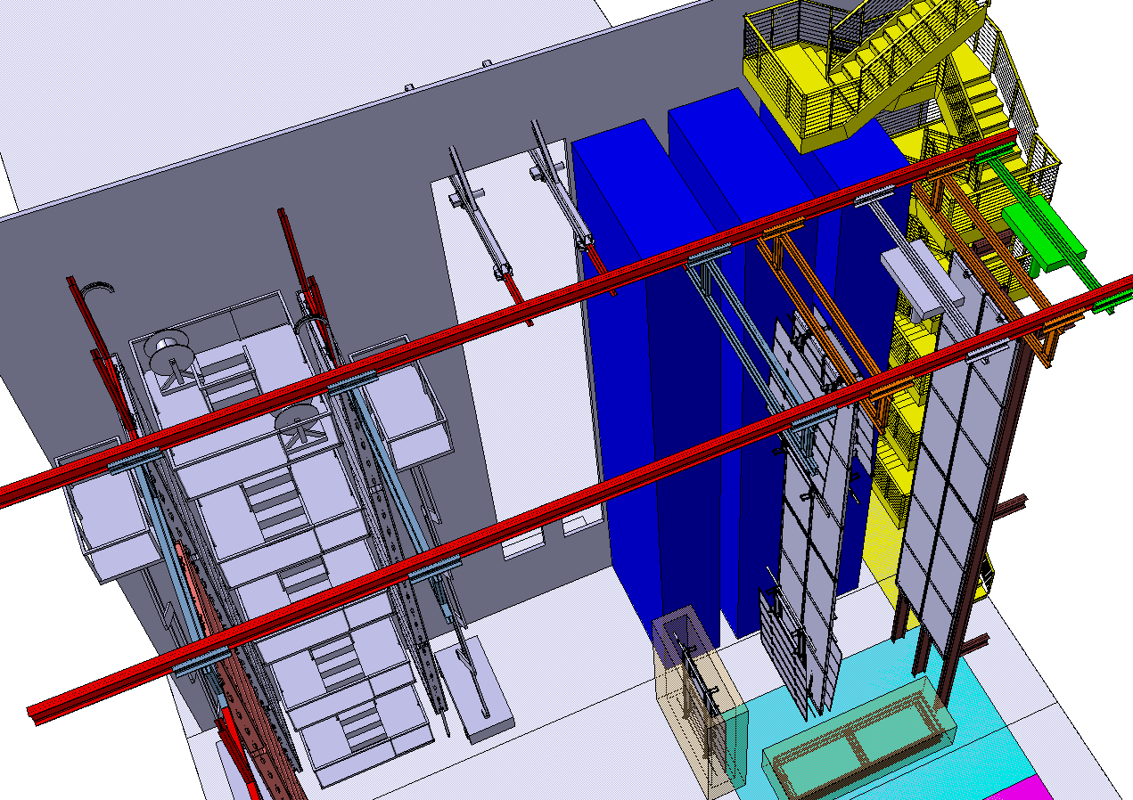
Cold Boxes Underground and Width of Bridge
Diamanto Smargianaki
William Miller
October 30th, 2018v3
Position of Cold Boxes in cleanroom for Detector #1

Slide 2
Status of Cold Boxes
The current design of in all of Diamanto’s snap shots show two ProtoDUNE cold boxes stacked on top of each other. No structural work has been done on this yet.
We have an interference with the current concept of the stairs which could be corrected by narrowing the bridge by ~50cm. This also helps with the depth of the cold box which we believe does not give us enough room for temperature sensors and some sort of cable harness
Using the current size with a 50cm gap between each box they do fit in the area between the pumps for construction of Detector # 3-See Separate Talk

Slide 3
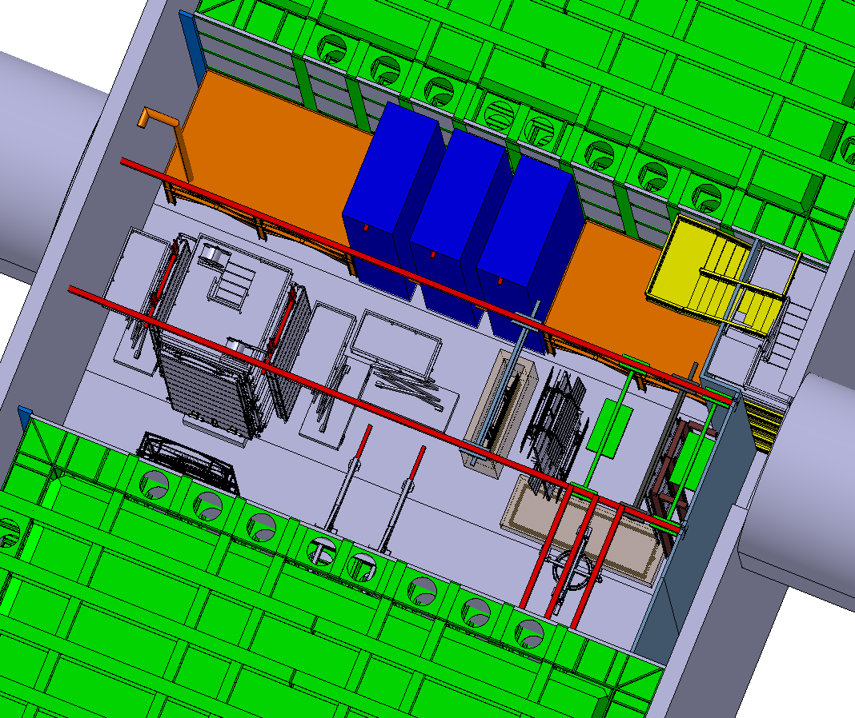
Features of Cold Boxes
Draft document of Cold Box functionality is posted with this talk
Key features:
Three boxes are needed for current installation schedule
A completed APA pair with final cables and cable trays fit in the box, along with all needed sensors and cryogenic plumbing
To eliminate opening the roof and using the cavern overhead crane like in ProtoDUNE the doors are on a hinge
Cable, cooldown, test, warm up and un-cable is done over a 4 day period
Cryogenic system is designed so that work does not have to stop in cleanroom during cool down (as in ProtoDUNE)
The boxes can be moved from the current location to in front of the TCO for Detector #3
Layout of cleanroom cold boxes, cryo pumps for Detector #3

Slide 4
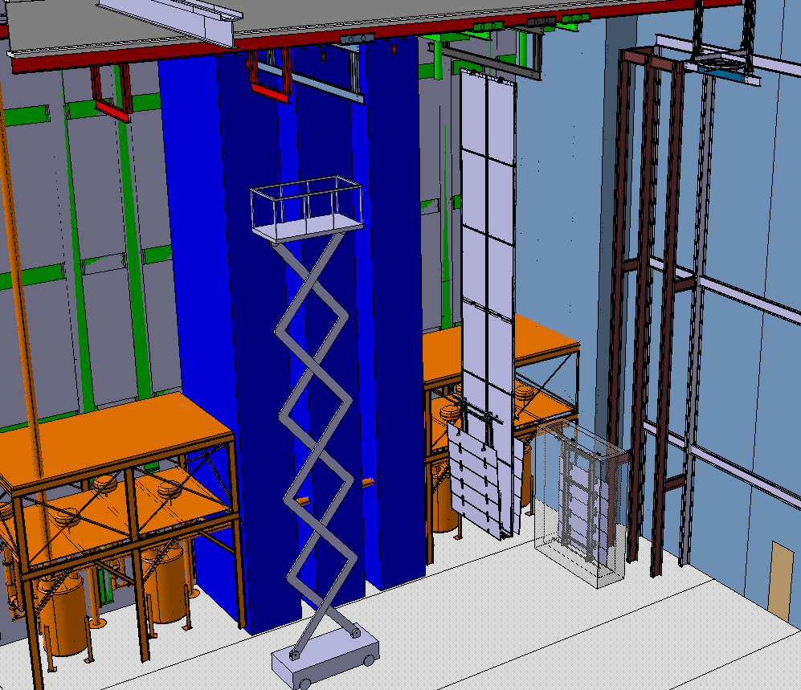
Future position of Cold Boxes
When the first SP detector is completed we could move the cold boxes in front of the TCO of the completed detector between the pumps
This gives us enough space to assembly Detector #3 assuming it is Single Phase
This has not been optimized yet but it looks like it fits.
See talk on Detector #3 Installation

Slide 5
Bridge Width and Stairs

Slide 6
Bridge Beam Width
We were asked if it was possible to reduce the bridge width by ~50cm on the side of the bridge were the permanent stairs are located.
This actually helps the new proposed layout of the cleanroom as we had several interferences:
The top section of stairs would force us to move the cold boxes to the North
With the depth of the cold boxes increasing it would be difficult to build or move them with the cavern overhead crane without additional space
Allows is to move cold boxes once the detector is completed
4.5m

Slide 7
Current Stair location
The top flight of stairs interferes with the southern most cold box.

Slide 8
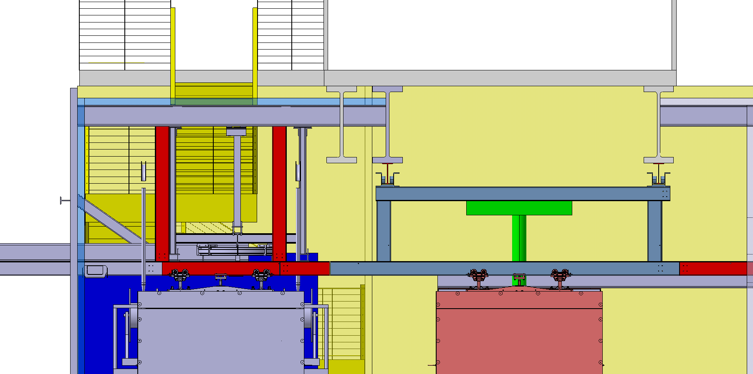
Depth of cold boxes not defined
There is only a conceptual design of the cold box but it appears it is extremely tight with only 3.5m space between the warm structure and the bridge beam
Allows use of crane to build cold box
New Bridge Width

Slide 9
