Slide 1
APA Plane
Alberto Marchionni
Integration Test Facility & Installation Workshop
30 October 2018

Slide 2
APAs: from factories to South Dakota
Ship 2 APAs at a time (a top and a bottom APAs, to form an APA doublet)
Current concept: use a single transport box for the 2 APAs from the factories to the ITF and from the ITF to SURF down the shaft
Keep the 2 APAs inside the transport box for all integration operation, remove APAs from the box only in front of the cryostat
The design of the transport box is still at a conceptual level

Slide 3
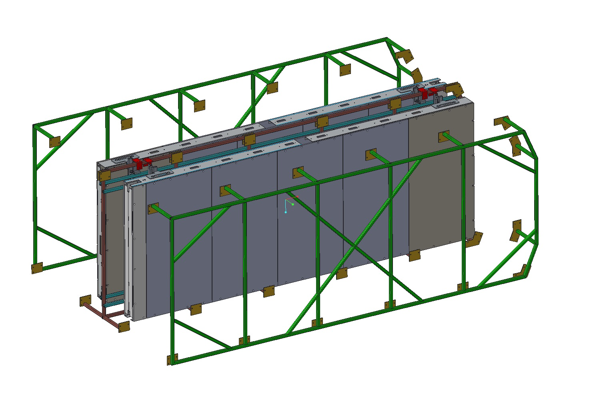
Frame layout

Slide 4
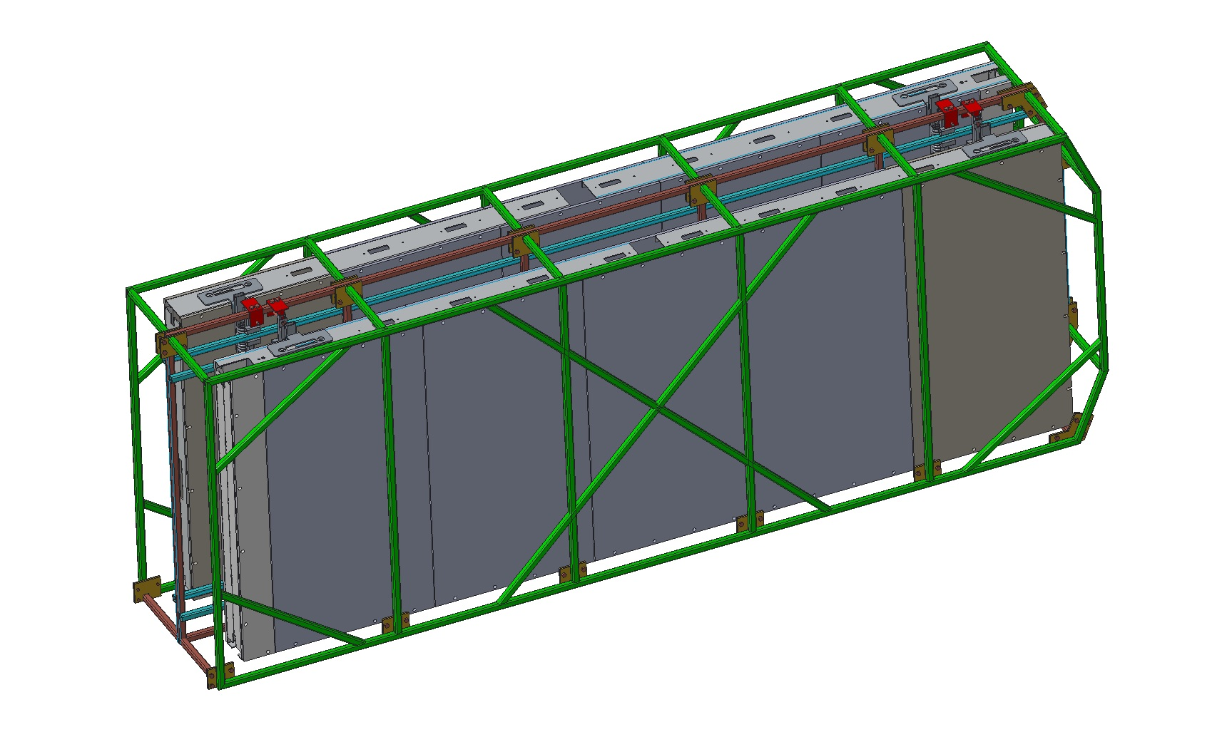
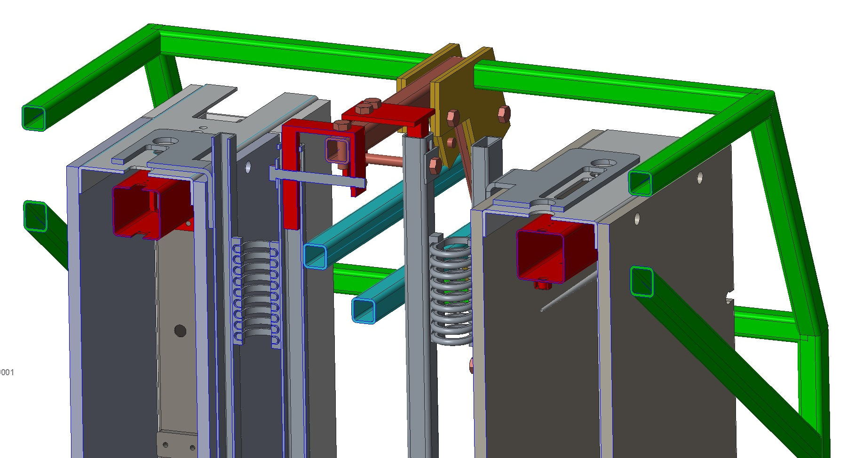
Two APA attached to frame

Slide 5
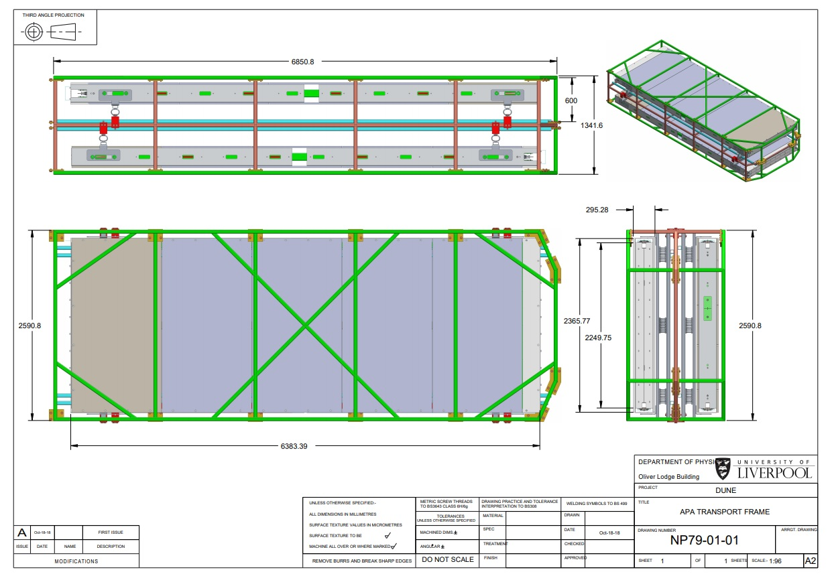
Dimensions of APA transport frame
Overall Dimensions:
6.85m long
2.591m high
1.342m deep
If we try hard I think we could just squeeze the APAs into a high cube container
Speaking to DT moving, it is recommended that this is not done.
We definitely could not fit 2 pairs of APAs in one container.

Slide 6
APAs: @ ITF
Bias voltage test
Measurement of wire tension (all wires?)
Integration with CE and PD
the transport box will need to be rotated from the vertical to the horizontal position for the insertion of the photon detectors
CE boxes need to be connected
Need to define load points on the frame to lower inside the shaft

