Slide 1
Detector #1 Cleanroom and Morph into Detector #3 Cleanroom
Diamanto Smargianaki
William Miller
October 30th, 2018v1
View of Detector #1 Cleanroom
View of Detector #3 Cleanroom

Slide 2
Detector #1 cleanroom and SAS
Key features:
Allows use of Detector #3 location for staging of TPC components of Detector #1
Final Cold Box test of completed APA Pair
3 independent APA Assembly stations
1 CPA assembly station (which could be designed to handle APAs)
Shuttle Beam/Crane System at same elevation of TCO beam:
Hoist for lifting CPA panels and cable bundles to APA Assembly station
Allows movement of APA and CPA pairs to TCO, Assembly Stations and SAS
Allows access to TCO for cold structure materials during cleanroom and cold box construction plus HV and cable bundle access to cleanroom during installation
Allows movement of cold boxes to new location after completion

Slide 3
New Layout of #1 Cleanroom and SASs
Materials SAS
Clean
Room
Personnel SAS
Materials SAS
Top View with roof framing
October 30, 2018

Slide 4
Access #1
Since occupancy is less that 50 FTE/shift access is via one permanent stairway. A second temporary one can be located on the east end of Cavern #1
Permanent stairs are located outside the cleanroom and stairs next to the bridge in the “dirty” area
APA access is thru a removable panel in the roof
Personnel access is via man-door into the personnel SAS, a second emergency man-door exit could be at the bottom of the stairs
Fork-lift access is thru doors located in Materials Handling SAS
APA Access
Materials Handling SAS
Personnel SAS
Man-door into Personnel SAS

Slide 5
Materials Handling Access from Ross Shaft
Materials Access for Detector #1 and #3 are shown in Red
Access to Detector #2 and #4 are shown in Blue
ALL materials are moved by SURF from the headframe area to detector halls or a location to be determined
Delivery schedule is controlled and managed by SURF, carefully logistics management is required during ALL phases of DUNE
A ~1 week DUNE materials buffer underground will help

Slide 6
Materials Handling SAS
The Materials SAS has several important features
Easily removable roof section
APA pairs are completely covered except for access to pick points
Assembly Tower allows stair access to make connections in the middle and the top access to the other side is via scissor lift
Sliding barn door (or similar) for APA pair access to cleanroom
CPA boxes moved into SAS and moved via cleanroom fork lift into cleanroom
If needed this could be a separate corridor to keep APA area cleaner

Slide 7
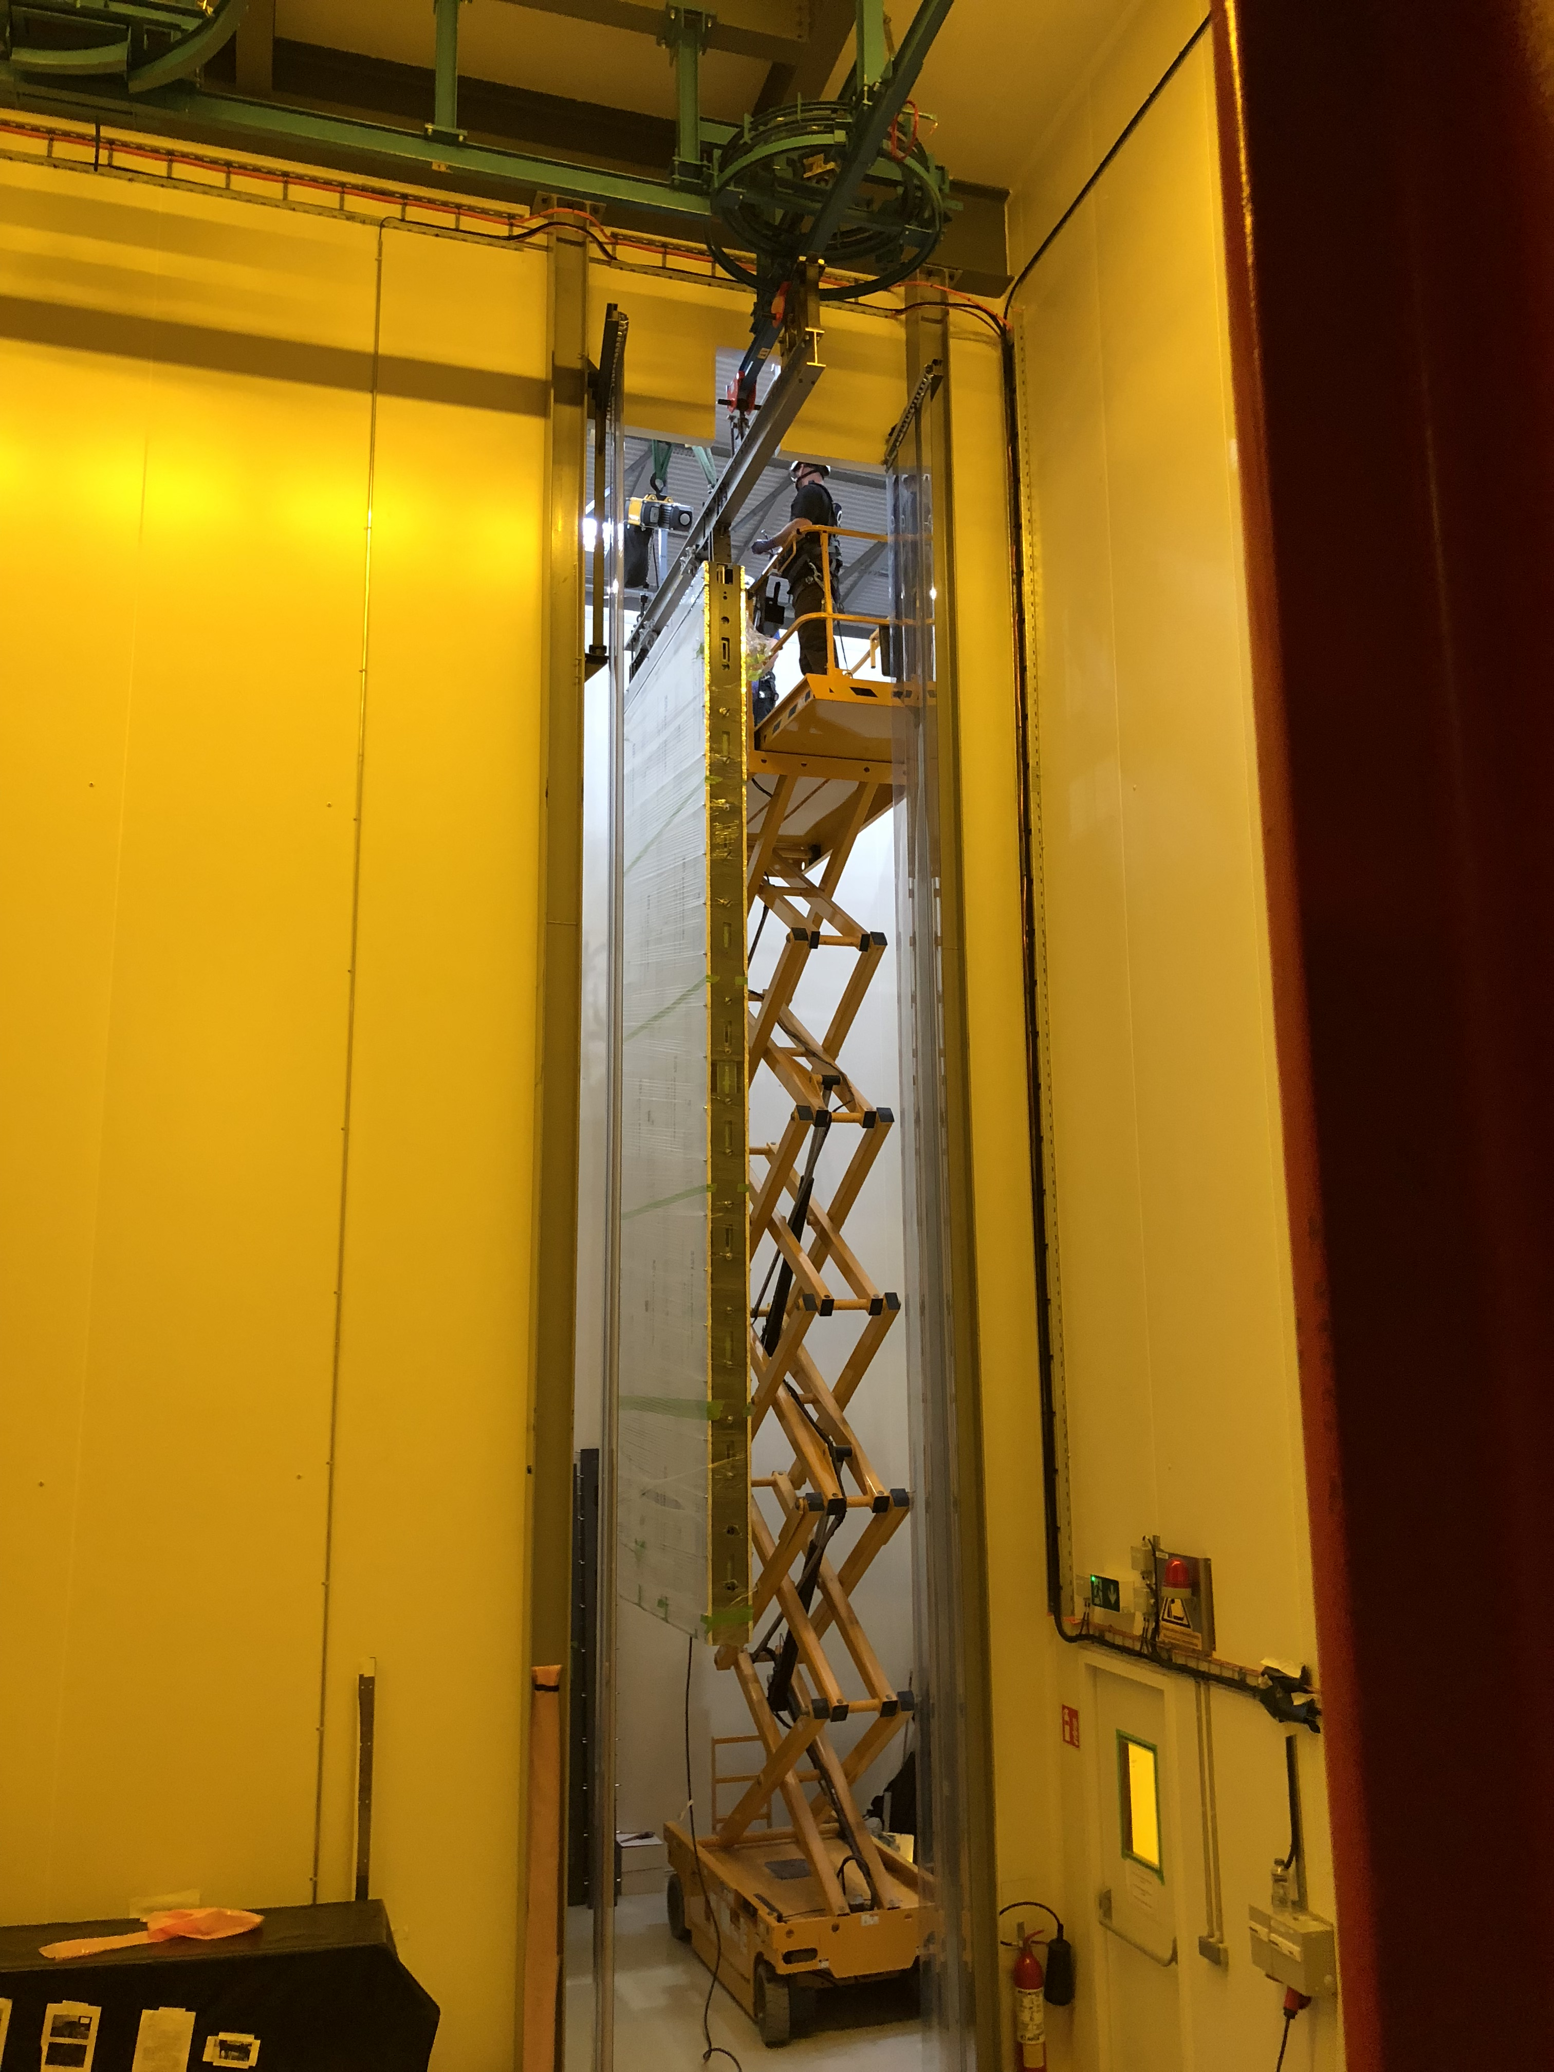
Cleanliness in SAS and Cleanroom
Maintaining a class 100,000 cleanroom
Early in the design process we need to better define procedures and requirements
We failed miserable at this for ProtoDUNE
Roof getting opened when TPC components exposed
No cleaning schedule-monthly at best
Materials delivered need to be bagged and cleaned at the ITF or institution that is sending materials

Slide 8
APA Assembly stations Detector #1
To meet the installation schedule of 3 APAs and 2 CPA pairs per week at the full rate we have 2 APA assembly towers and 1 CPA assembly tower
Assembly Tower 1-APA
This is where the 2 single APAs are loaded onto the assembly tower using the cavern bridge crane
The two APAs are joined after PD testing and rolled into cleanroom
Assembly Tower 2-APA
Has 2 work stations designed for cabling and testing APA pairs-Repair spot for failed APAs coming out of cold box
Assembly Tower 3-CPA (APA?)
Uses hoist on shuttle beam/crane to move CPA components in place
Tower could be designed to hold APA if needed

Slide 9
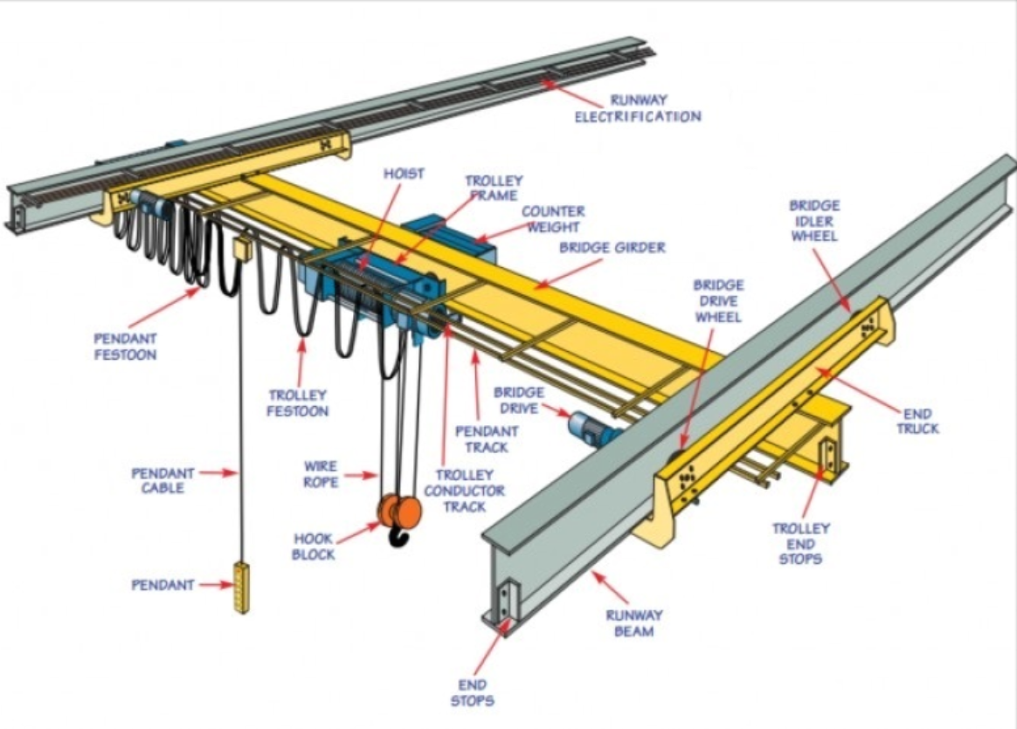
Cleanroom #1 Shuttle Beam/Crane
The cleanroom rail system is based on a standard bridge crane with one hoist and ~3 shuttle beams at the same elevation as the DSS
It allows transport of trolleyed equipment
Capacity of crane not defined

Slide 10
Cleanroom/SAS Detector #1 comments
The design shown in the model is still very conceptual. All the equipment has been sized with the information we have at hand
No optimization of layout so that this cleanroom can morph into Detector #3 has been done except for moving cold boxes and APA Assembly tower #2.
Cleanroom walls and structure and all connections are just conceptual, everything would have to be bolted so it can be moved
Optimization of Shuttle/crane and how the different beams connect needs some serious work. It is based on what we did at ProtoDUNE which worked but was very time consuming and will only be harder at 12m
Access via aerial lift must be done with a custom lift, standard lifts only go to 12m we need ~14m. We are getting some quotes for a taller one. Functional Documentation for an Underground Aerial lift has been drafted

Slide 11
Detector #3 Cleanroom and SAS-Top of Detector

Slide 12
Detector #3 Cleanroom and SAS
Since we have lost the space required for a Materials and Personnel SAS with the 3rd detector warm structure we are forced to use the bridge for this it is tight but very doable. Egress to the CUC becomes difficult since you have to go thru the cleanroom
The Personnel SAS is located by CUC entrance
The cleanroom on the bridge is directly above the “toaster area” and uses a gantry crane to lower materials down and Assemble the APA pair
The shuttle beam/crane from Detector #1 is used in the same manor as before
The materials SAS in the north drift is used to remove outside of APA boxes and CPA boxes and materials are moved into cleanroom- It is also used as personnel egress

Slide 13
Cold Box & Stair Design Features
Personnel SAS
In this layout the egress stairs are now part of the personnel SAS
While the Cold Box has not been designed yet one of the key features is that they can move to the area between the cryogenic pumps

Slide 14
Installation Rate Dec #3
This is similar to the old version 7 installation plan
While we were able to add a 3rd work station to the APA assembly tower 3.5m the Toaster Area is very congested.
In theory you could assume roughly the same rate but there is so little work space you may have to do CPA and APA work more linear. It is not clear there is room for 20 FTE/shift. Best guess would be ~25% slower
See talk on Detector #3 installation

