Slide 1
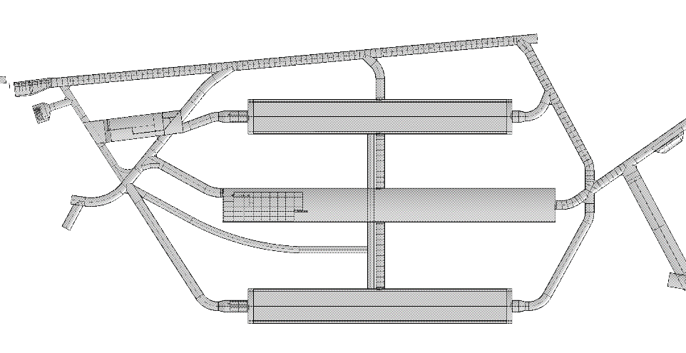
DUNE SP TPC Installation & Schedule for Detector #3 with Cold Boxes Underground
Det#3
Det#1
Diamanto Smargianaki
William Miller
October 30th, 2018v1
Det#4
Det#2

Slide 2
Installation Sequence for SP Detector #3
Detector #3 only has a working area of ~8m wide since the cryogenic pumps, cold boxes and stairs take up the ~4m wide area against Detector #1
Because of the limited work area more of the tasks will have to happen linearly with a smaller crew size

Slide 3
Gantry Crane & Clean Room
N
APA #1 on North side of assembly tower must be picked up with gantry crane and moved on shuttle beam system to the South on the Assembly Station
Gantry crane needs to have two hoists to rotate APA frame into position both hoists need to be rated ~5 tons (weight of APA frame and APAs not known)
Cleanroom and gantry crane needs go far enough onto Detector #3 warm structure so that the gantry crane has full access to the “Toaster Area”. It appears there is enough room to stay clear of feed-thru’s
Cavern crane does not have enough clearance for this work clean room needs to be tall enough for gantry crane

Slide 4
Bringing APAs to the APA Assembly Tower
APA in M. SAS
Cover removed
APA pair frame is moved into the cleanroom and picked up with gantry crane
APA pair frame is rotated as it is lowered using dual hoists on the gantry crane to the 4910 level

Slide 5
Joining APAs into a completed pair
Bottom APA placed and PDs checked
Top APA placed and PDs checked and pair mated
APA pair is picked up by gantry crane, placed on shuttle system
APA pair is cabled and moved to cold box

Slide 6
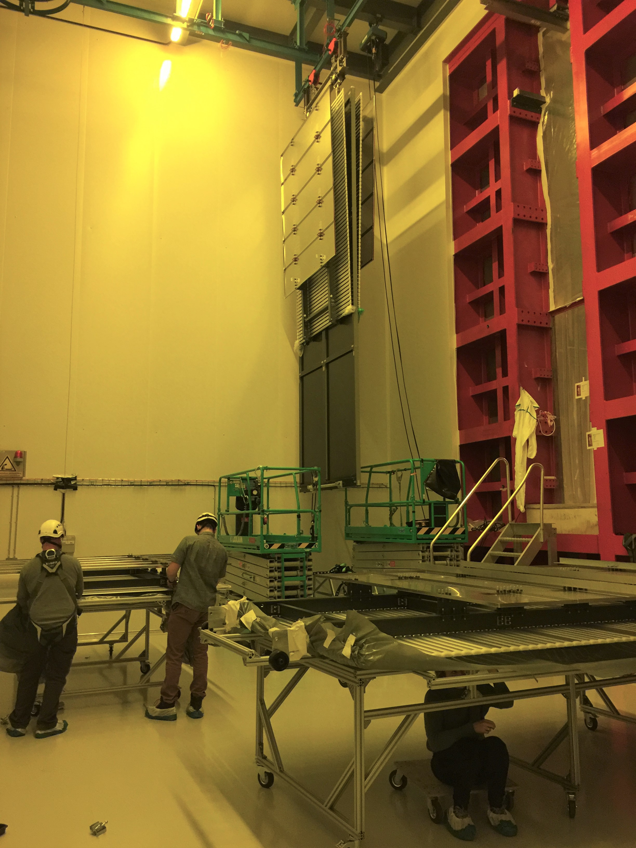
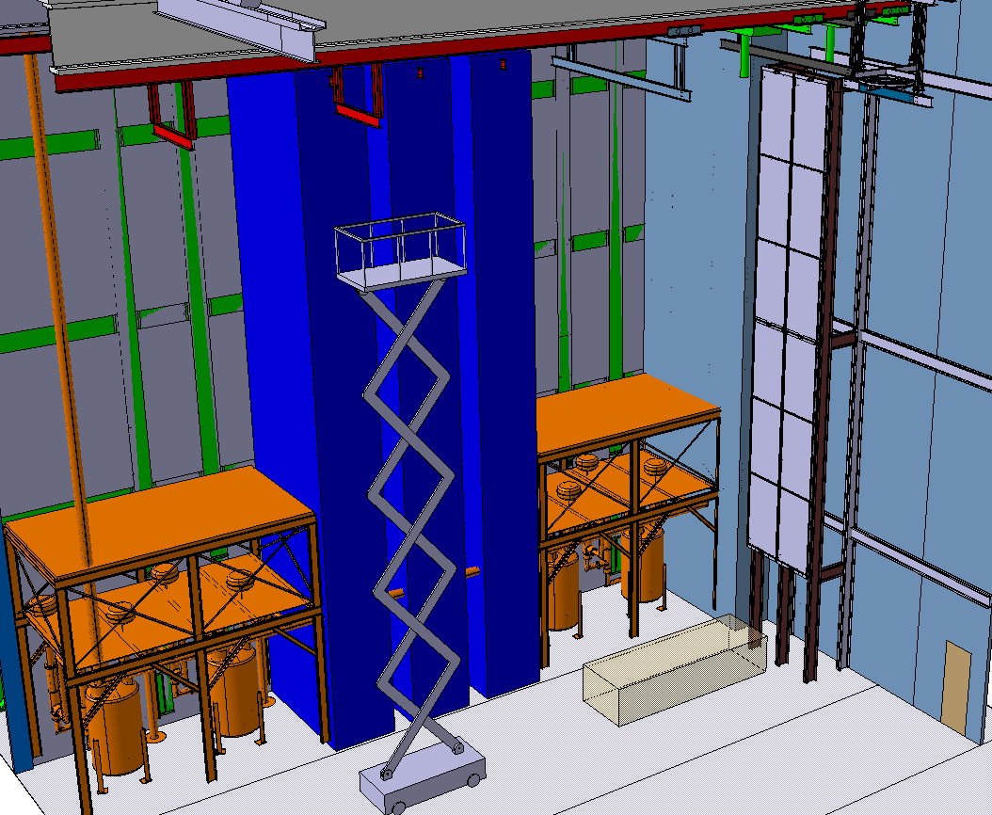
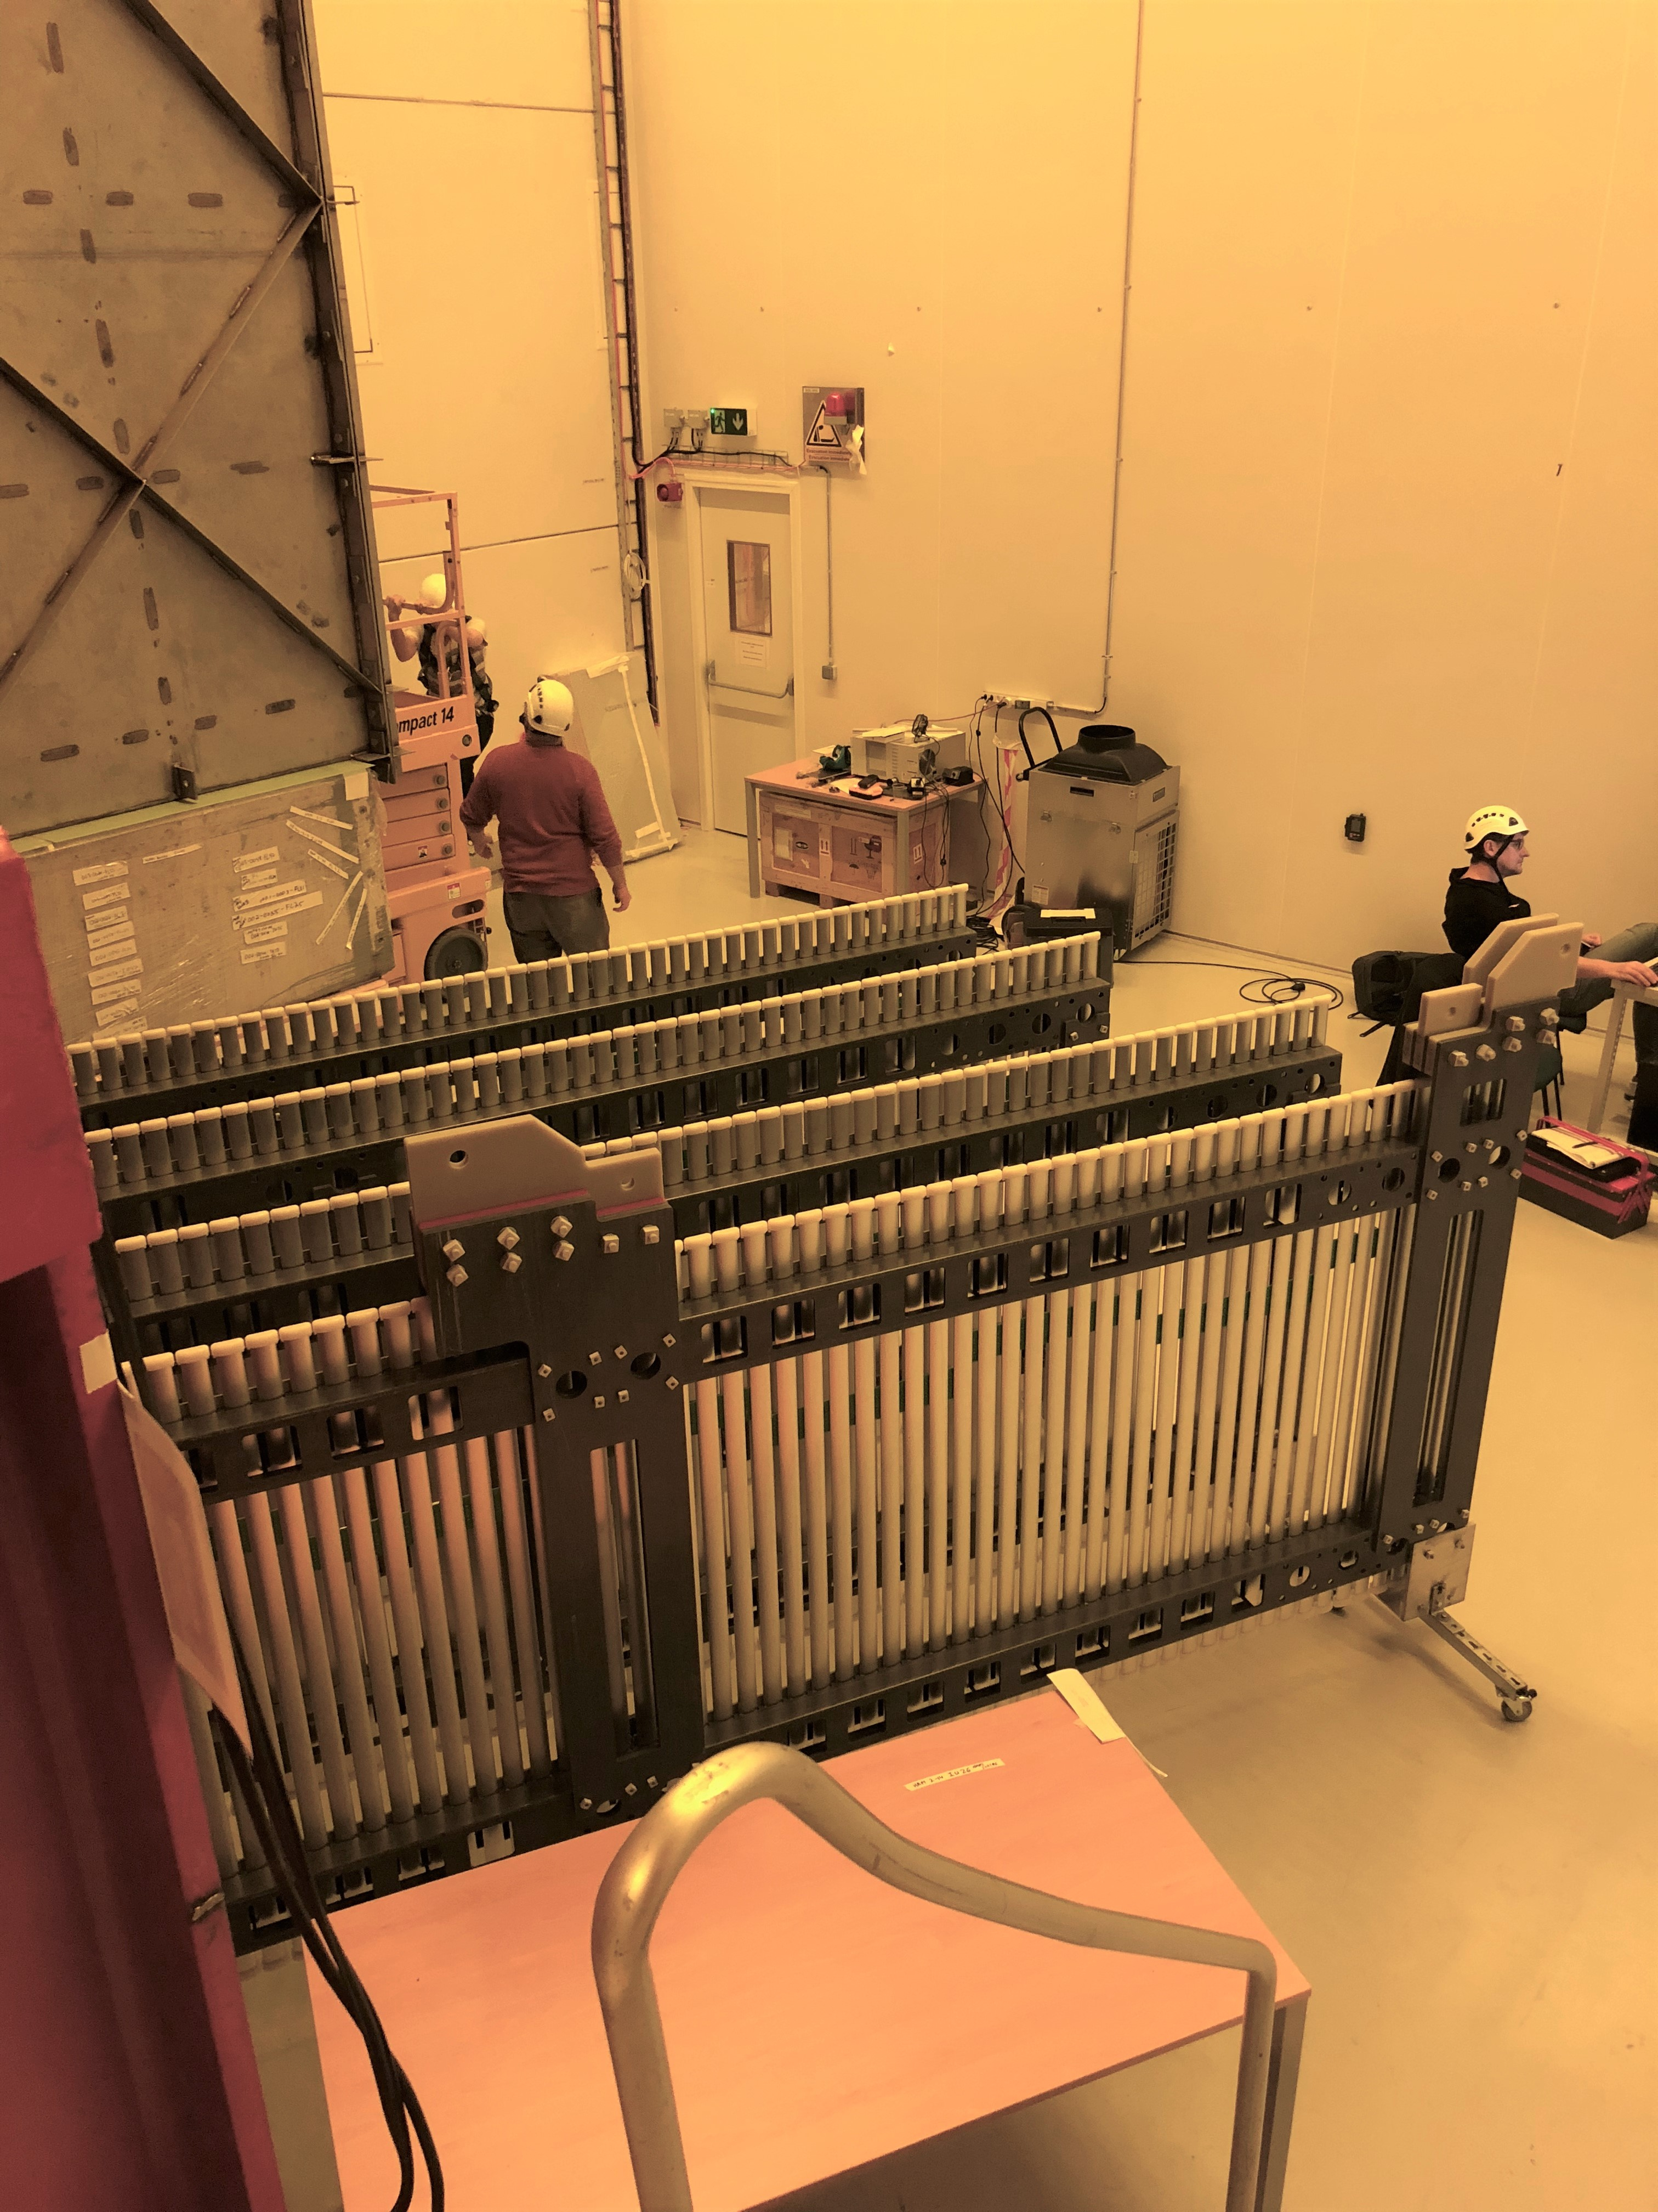
CPA assembly
Especially the same as for Detector #1 but with limited area in the clean room keeping the sequence flowing will be harder.
For scale it the cleanroom in ProtoDUNE was 108 sq. m and this cleanroom is ~139 sq. m. In
ProtoDUNE we typically only had 1-2 work areas with people. With DUNE Detector #3 we would have 4 work areas plus access to 3 cold boxes.
HV Assembly Area

Slide 7
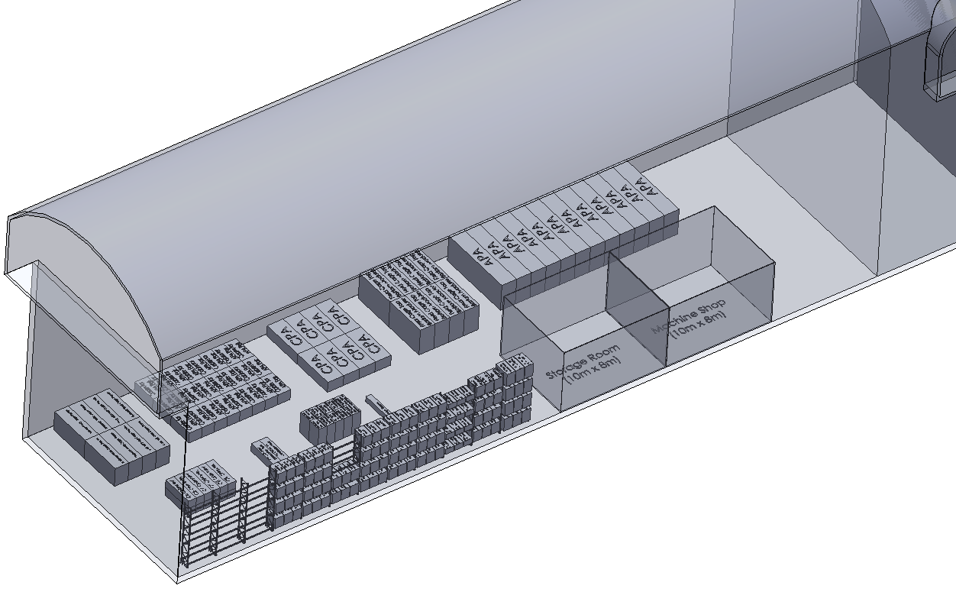
Problem will be storage/staging
For detector #1 and #2 we will have a most empty detector hall to stage ~ 1 month of TPC components underground
For detector #3 and #4 we will have to use more just in time delivery with the extra buffer on the surface.
Need to think about the total storage area needed on the surface
The same goes for the warm structure and the cold structure and their construction requirements.
Det#3
Det#1
Det#4
Det#2

Slide 8
Extra slides

Slide 9
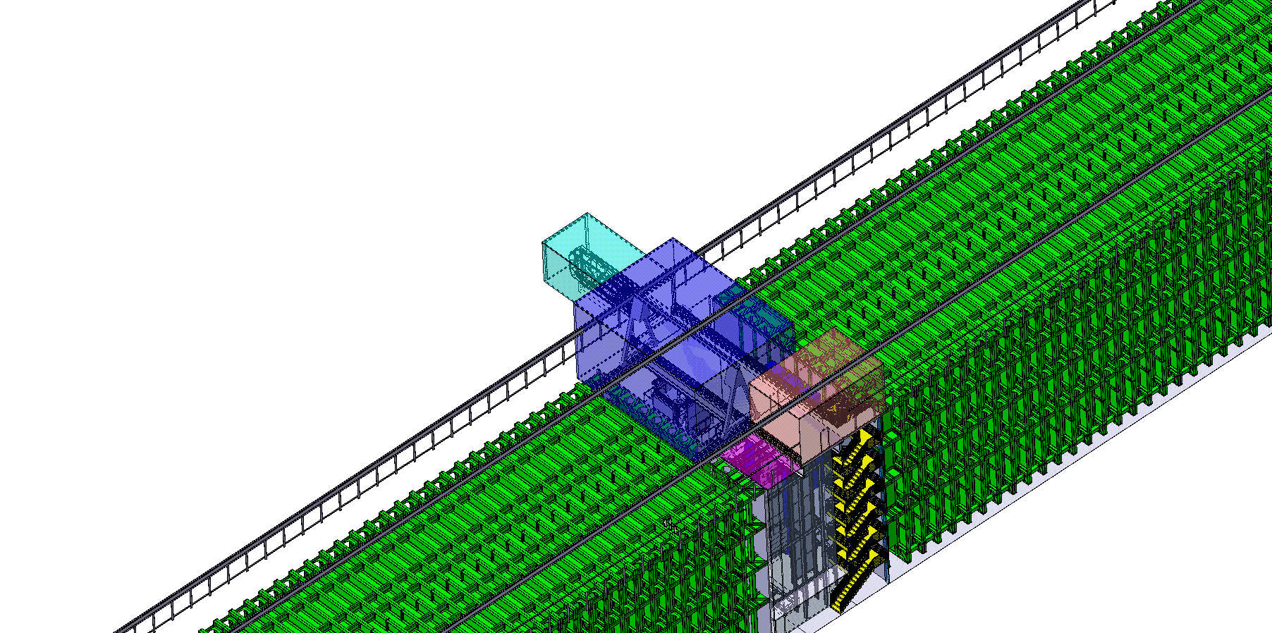

Slide 10
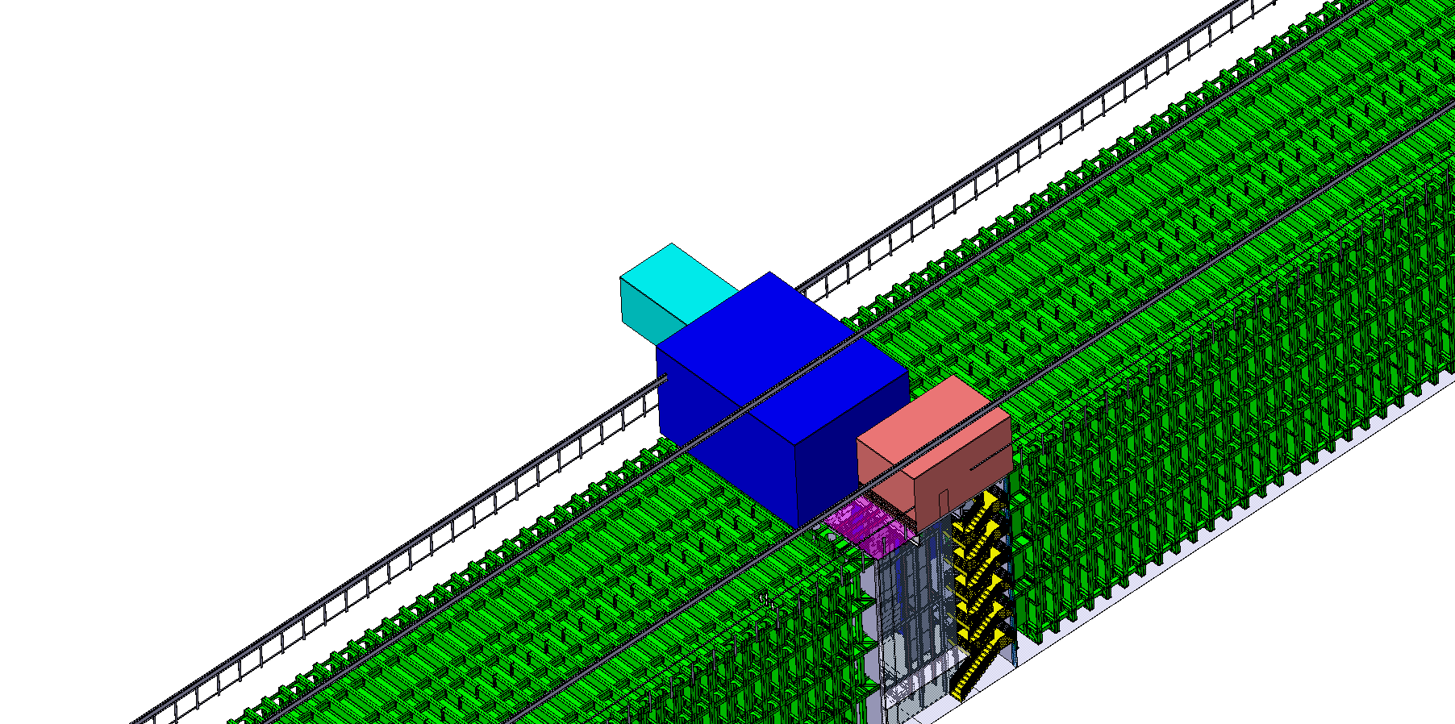

Slide 11
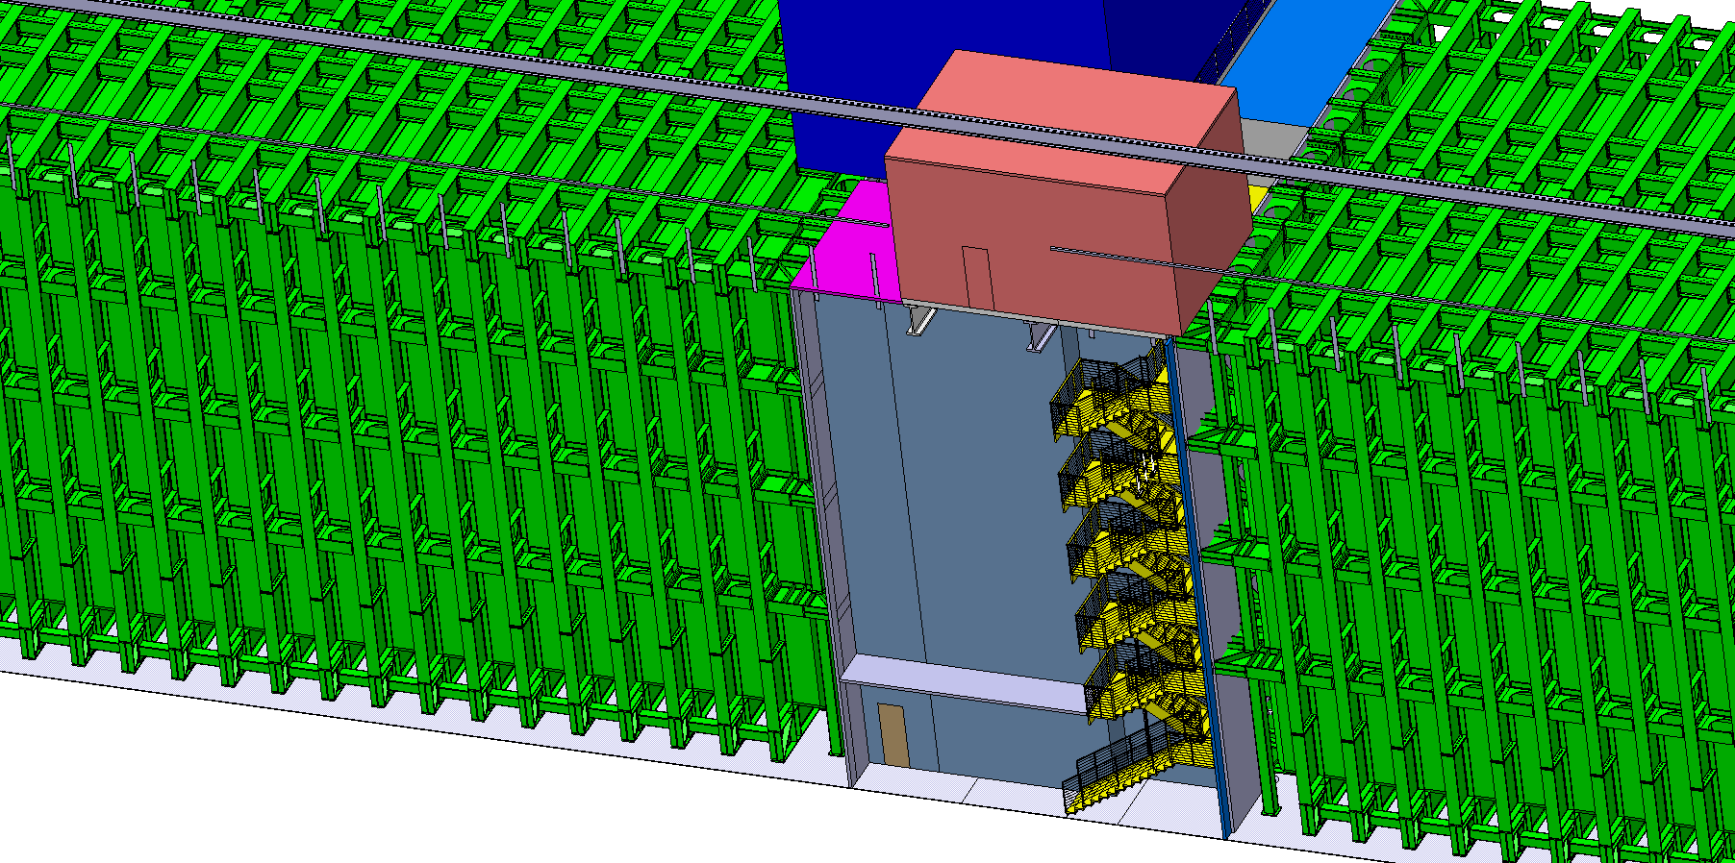

Slide 12
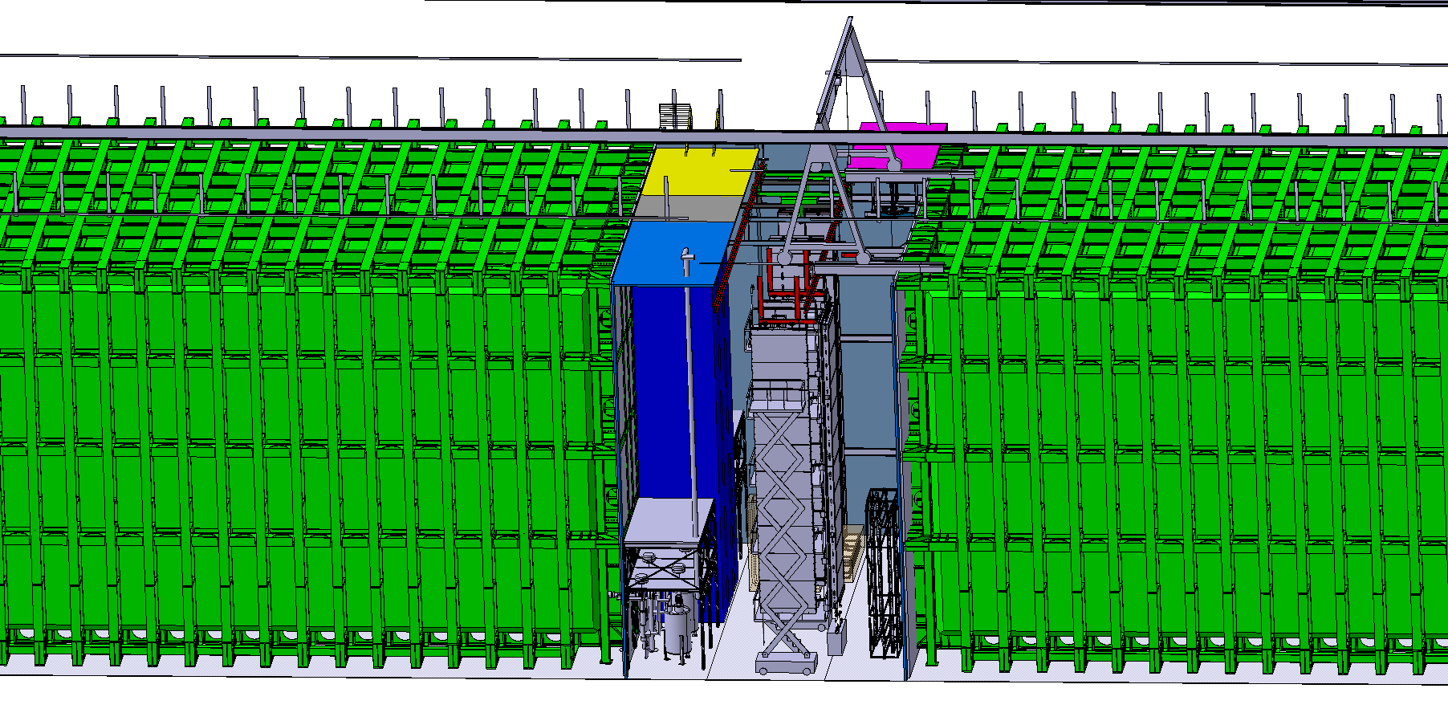

Slide 13
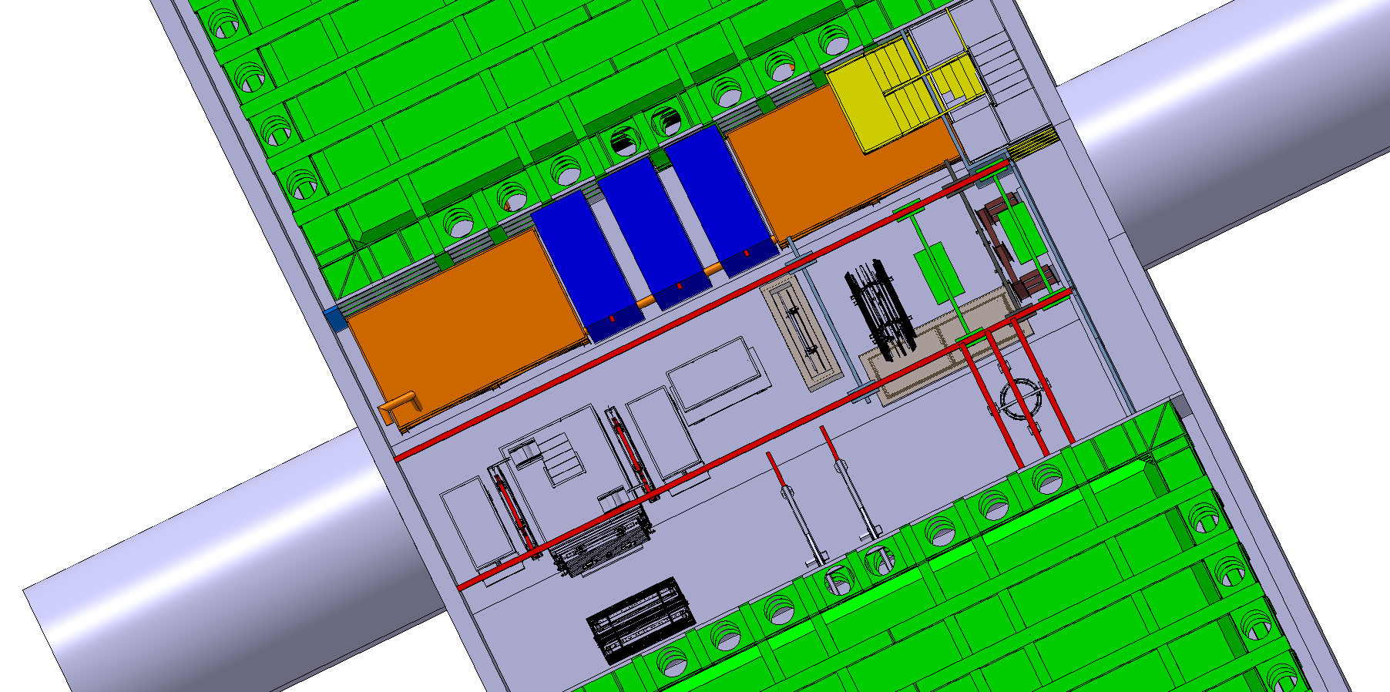

Slide 14
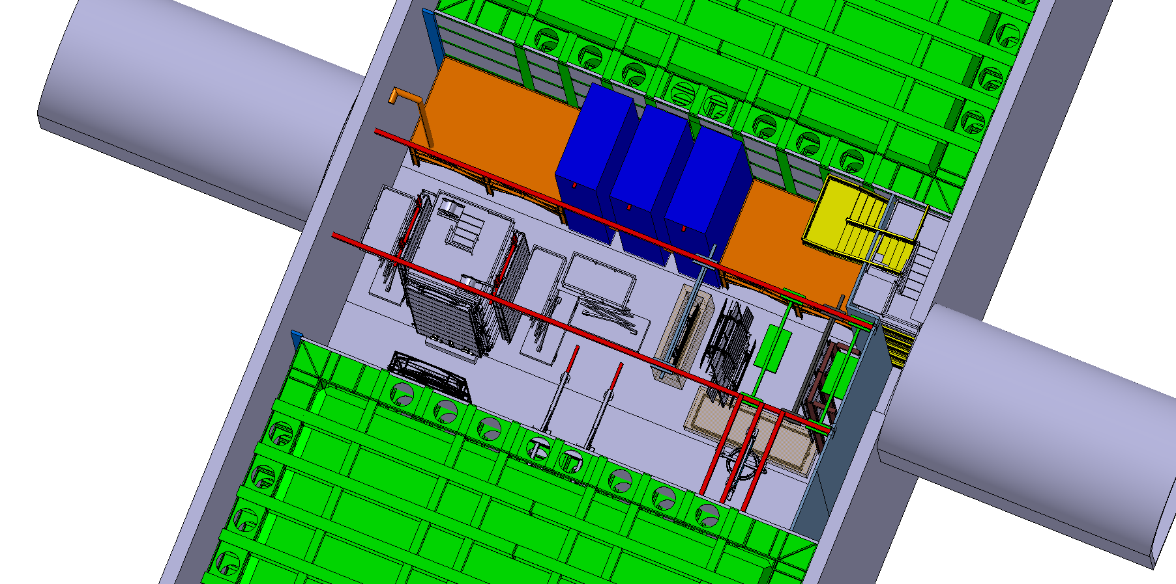

Slide 15
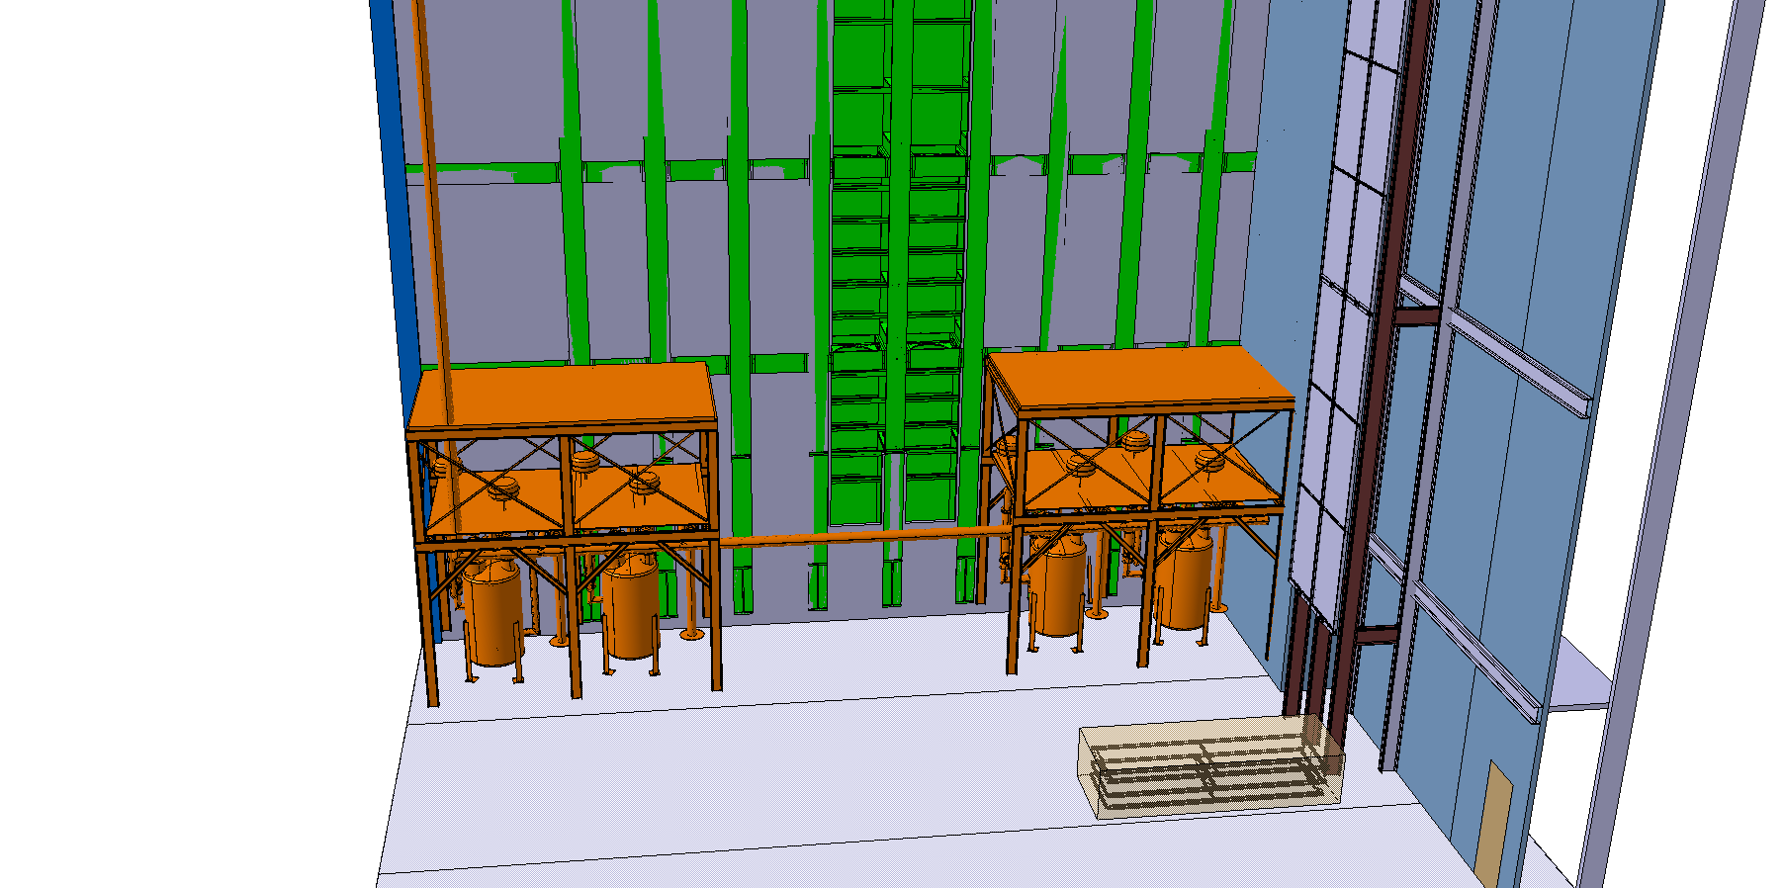
Cryo pipe

Slide 16
Cryo pipe interference with cold boxes

Slide 17
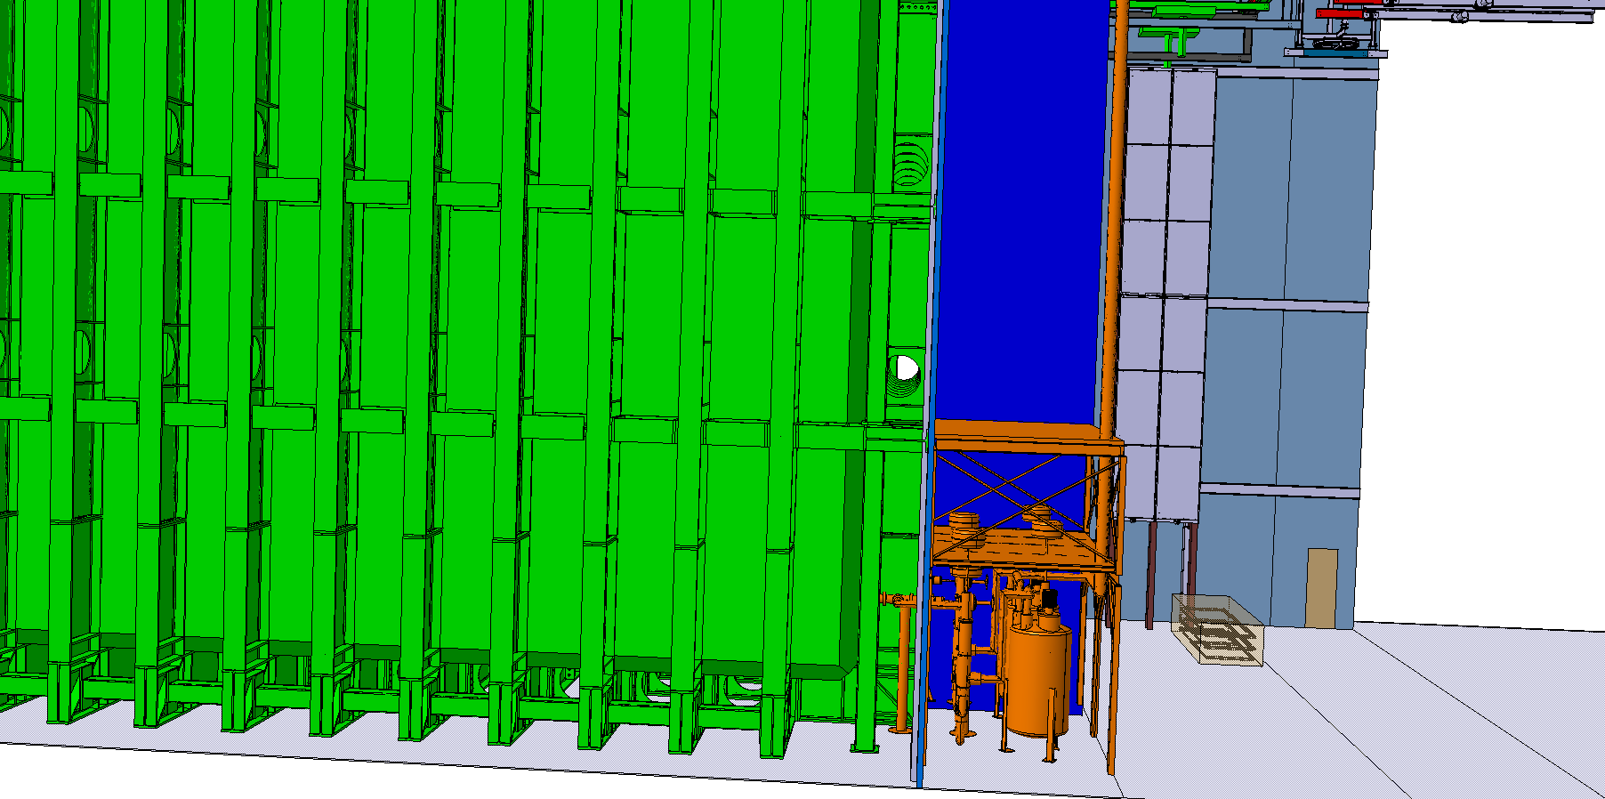
Pass the cryo pipe in the back

