Slide 1
A new layout (proposal) MNe, JF, JS, BM, DM, DMo

Slide 2
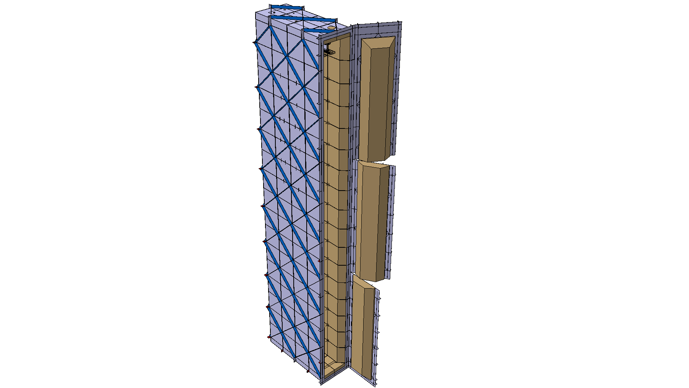
Some new requirements have been discussed
Avoid any dependence on filling and cooling between det#1 and det#2 (accepted in the last EFIG meeting)
Test complete double APA (+electronics and PD) or CRP just before inserting it into the cryostat (still to be optimized)
Det #1 in cavern 1
Det #2 in cavern 3
Cold tests in dedicated cold boxes in the cavern clean room
Cold boxes for double APA
or
Cold boxes for individual CRPs

Slide 3
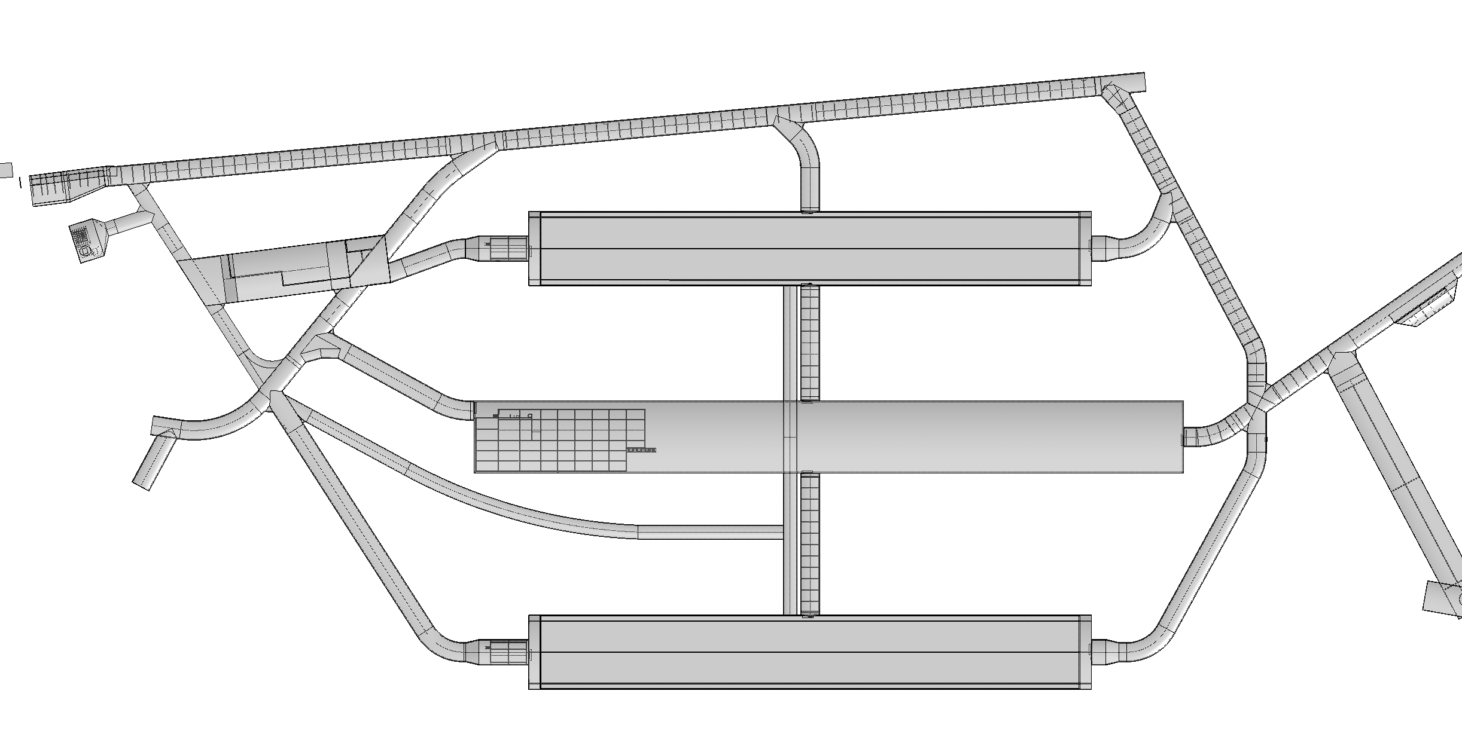
Det#3
Det#1
Det#4
Det#2

Slide 4
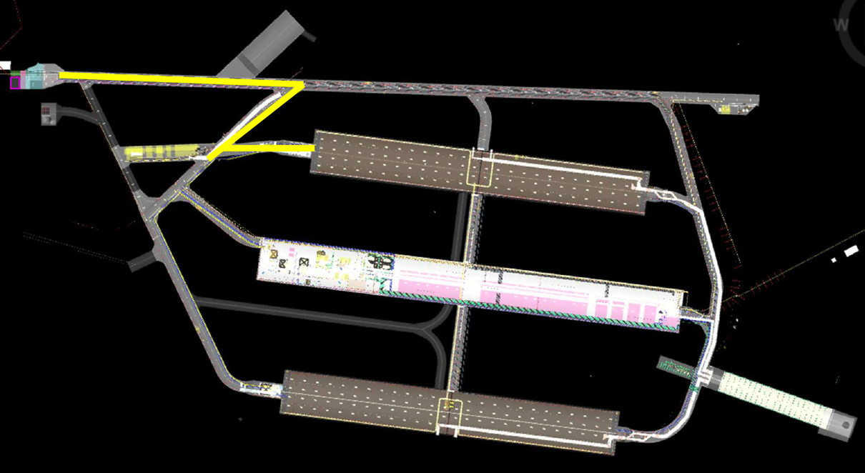
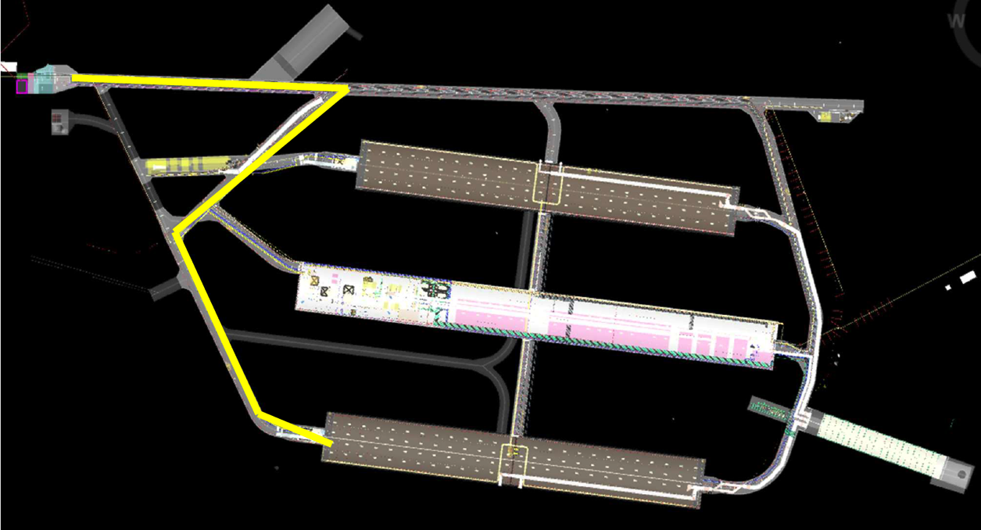
Material income (for cryostats and detector 1 and 2)

Slide 5
Strategy
Assemble detector#1 in Cavern 1, chamber 2
Assemble detector#2 in Cavern 3, chamber 2
Chambers 1 available for material storage with direct delivery from the left drifts
During assembly of det 1 and 2, more freedom to organize space and learn from the difficulties
Large cold boxes in place in front of the TCOs (double APAs test boxes). Part of the N2 plan must be available at this moment
Keep the same level of difficulties as today for detector#3 and #4

Slide 6
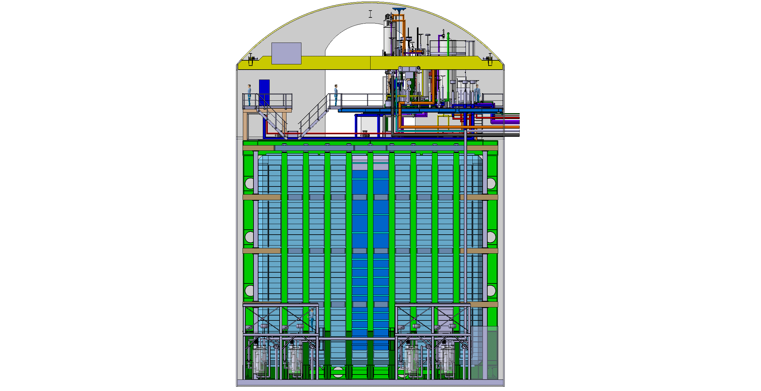
Detector TCO view
to CUC

Slide 7
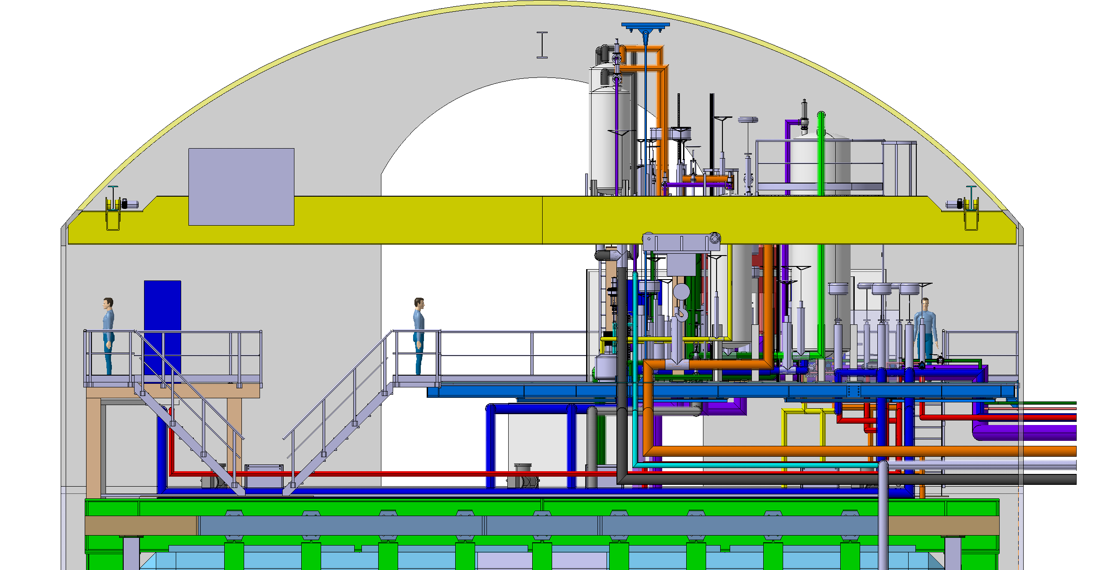
Detector roof front view
monorails ~20T
bridge crane ~12T
detector mezzanine
cable trays
to CUC

Slide 8
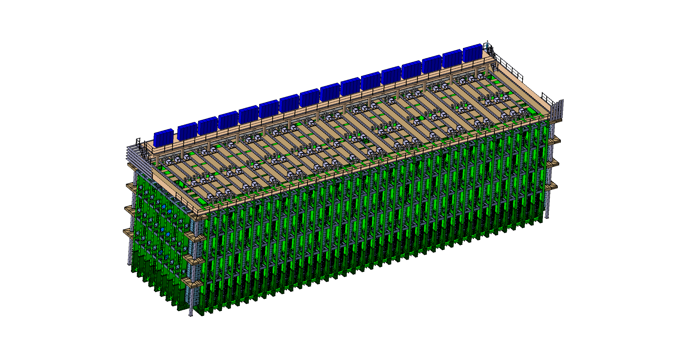
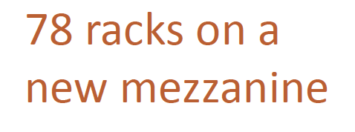
New detector mezzanine
Each rack 2400-3400 Watts
(see T.Shaw presentation)

Slide 9
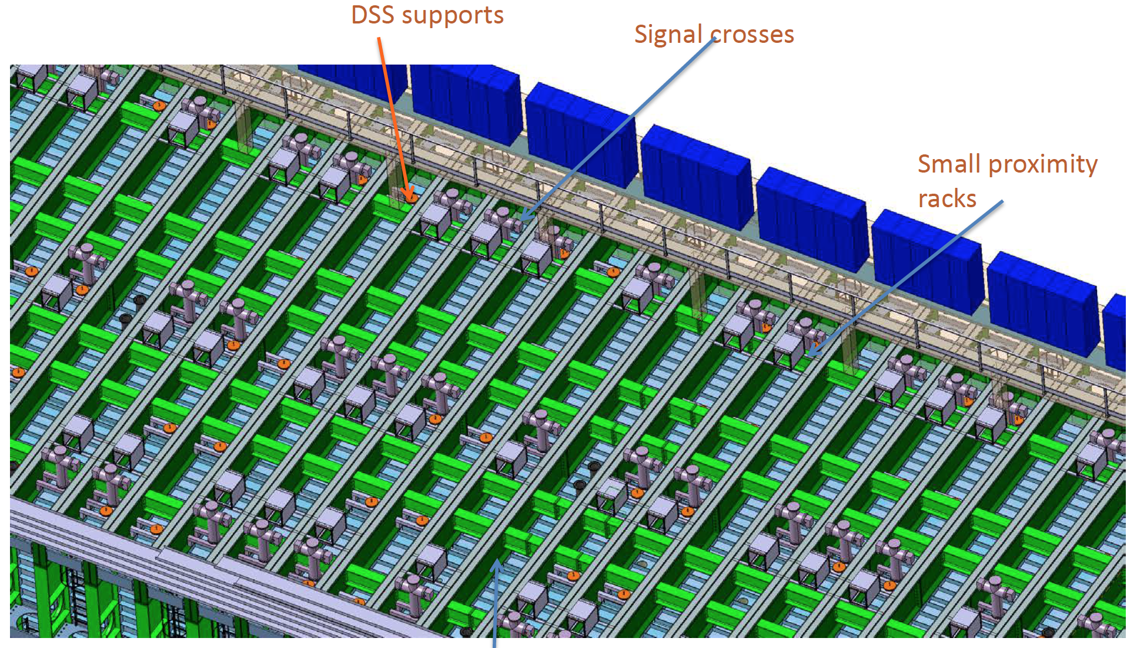
Detector roof
Cable trays

Slide 10
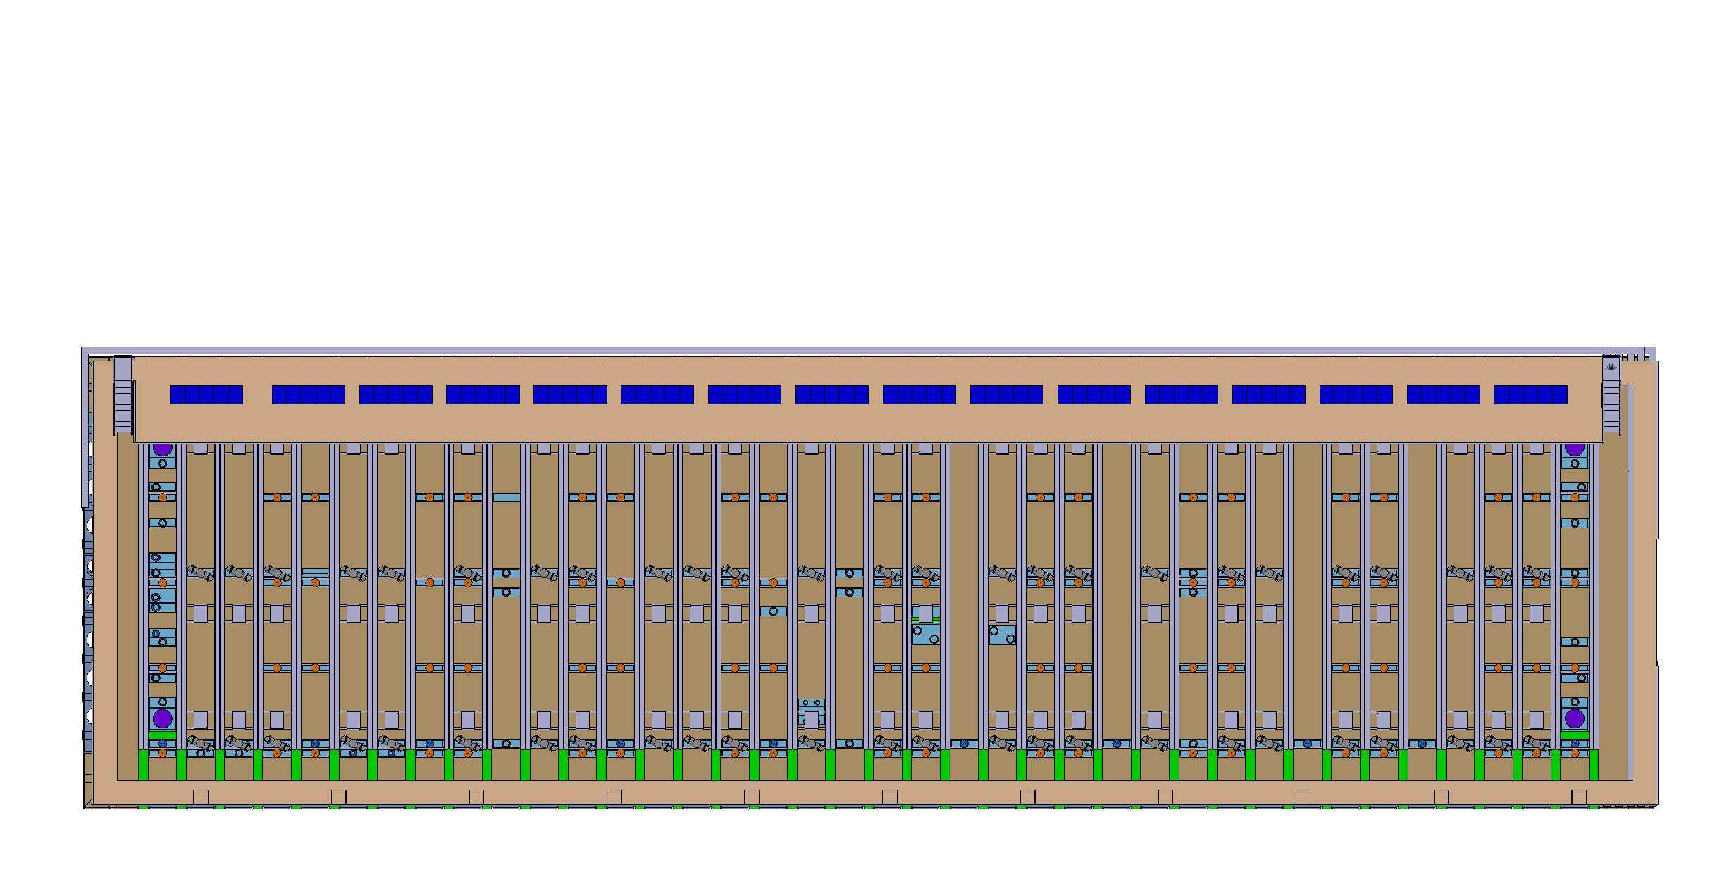
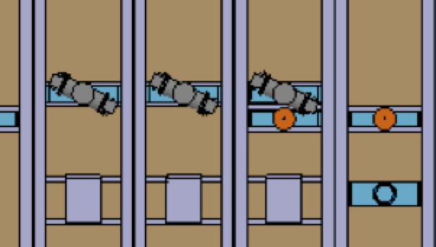
Detector roof

Slide 11
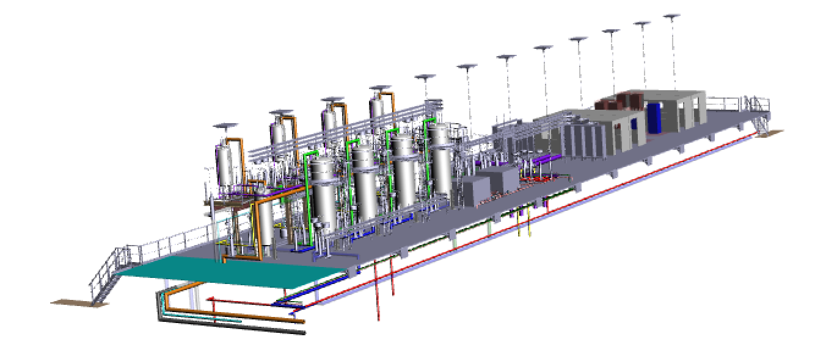
Revisited cryogenics mezzanine covering the entire length of the cryostat
removable floor
support rods to the cavern roof
el. isolated stairs
more space for counting rooms/control rooms
piping and services to the CUC

Slide 12
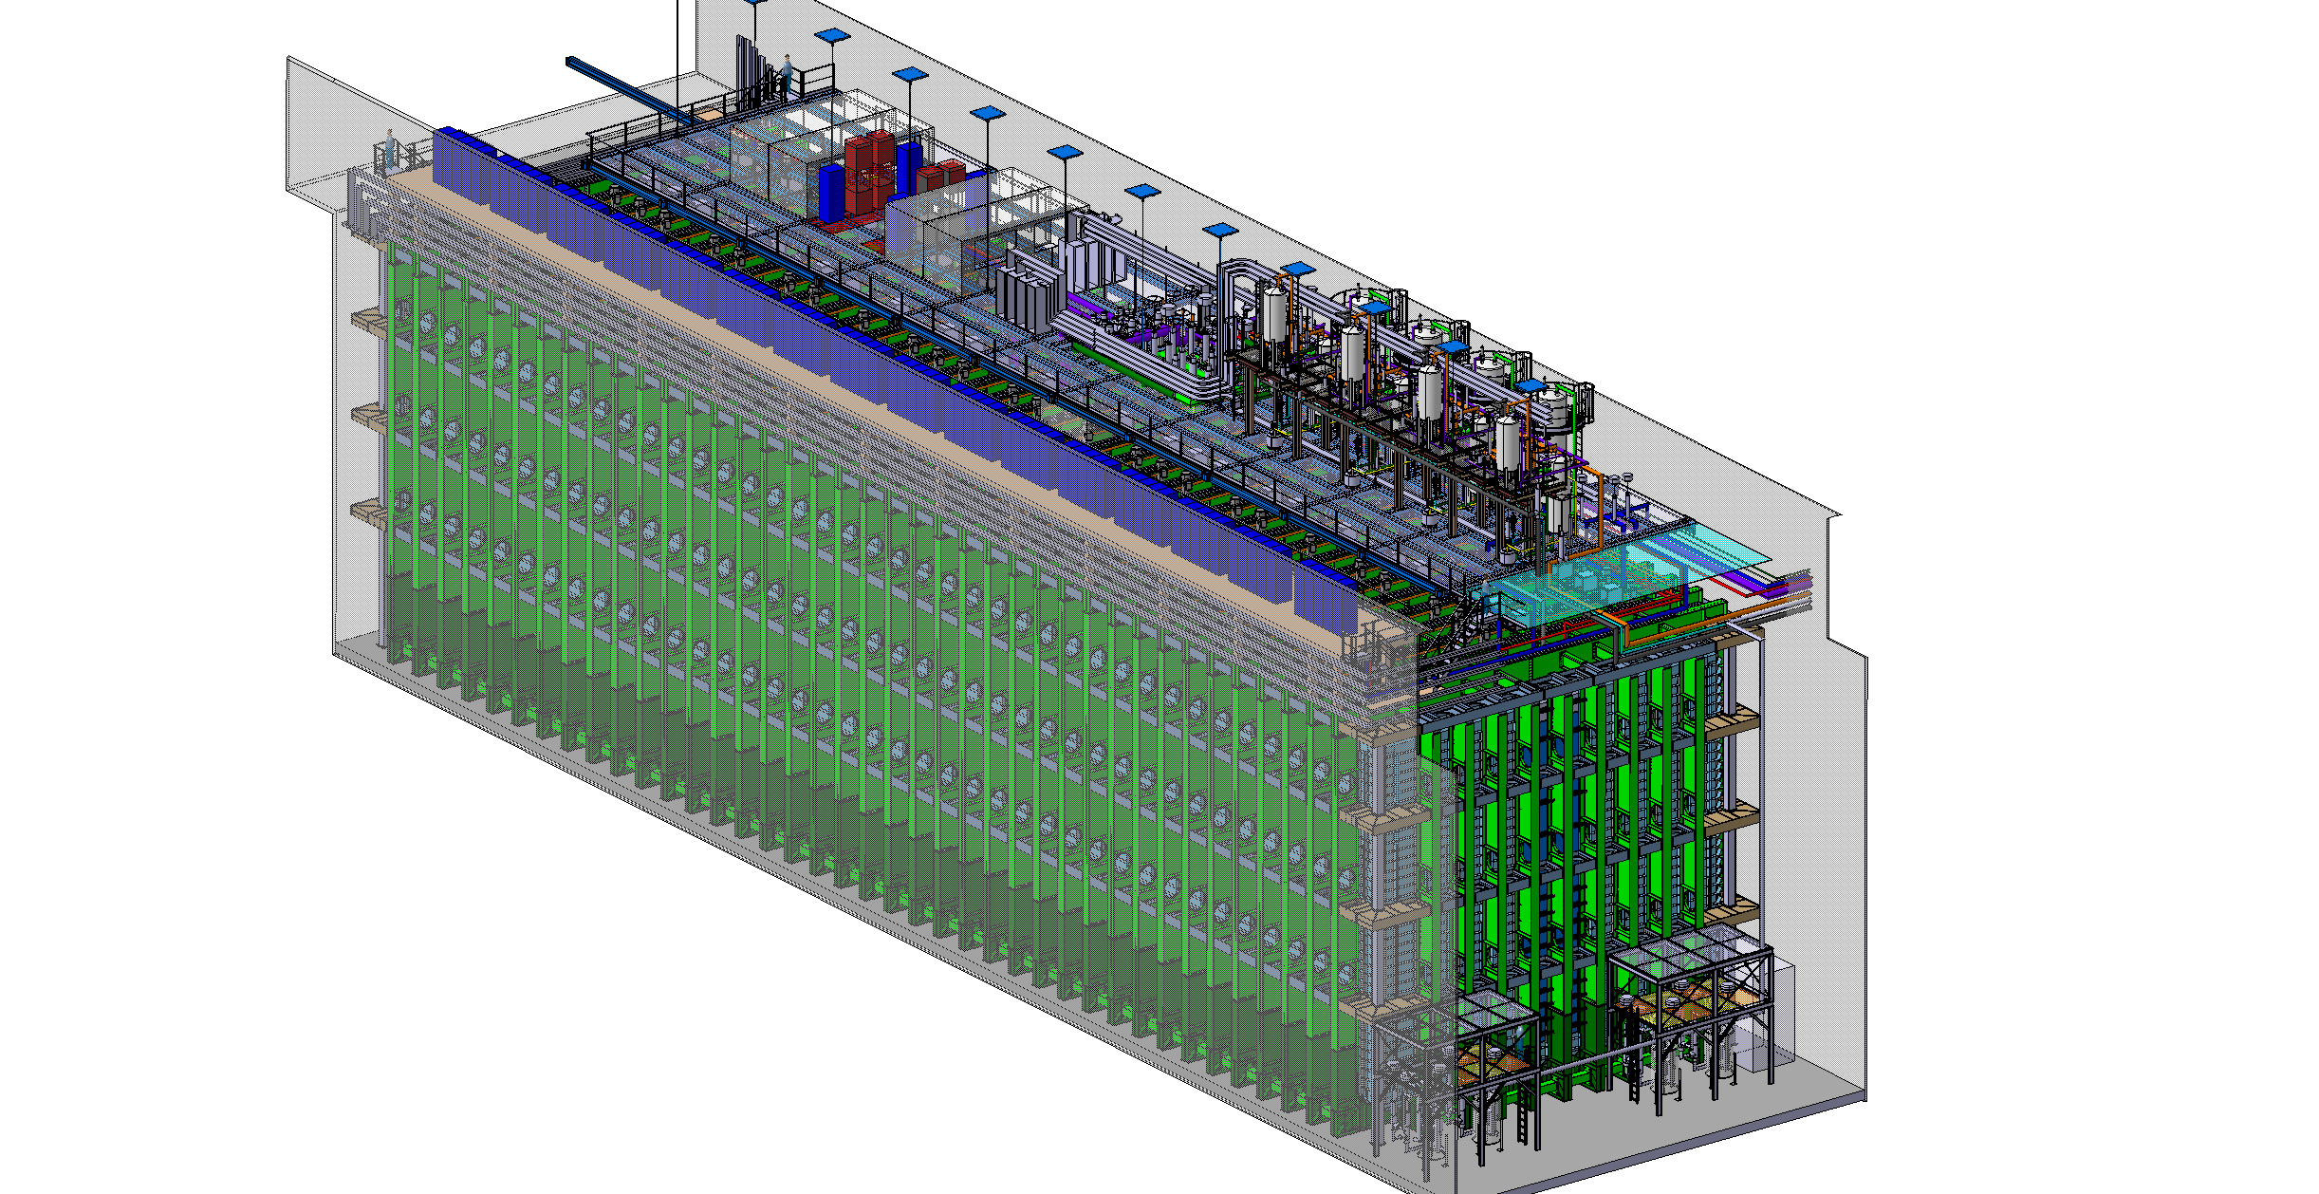
3D view

Slide 13
Cryostats and detector installation
Central Utility
Nord Cavern
X
North Cavern BO
South Cavern
X
South Cavern BO
9
Det1 warm str.
12
Det1 cold str.
52 months
12
Det1 install
3
Det1 closing.
4
Det1 flushing and cooling.
12
Det1 filling.
9
Det2 warm str.
12
Det2 cold str.
12
Det2 install
Det2 closing.
3
4
Det2 flushing and cooling.
13
Det2 filling.
FY18
FY19
FY20
FY21
FY22
FY23
FY24
FY25
FY26
FY27
FY28
FY29
FY30
End July 2027
End August 2028

