Slide 1
Rules and regulation for LBNF Equipment validation strategy
O. Beltramello – 31.10.2018

Slide 2
LBNF equipment validation process and configuration control
We need to agree on the standards and regulations for all equipment brought to SURF and installed in the LBNF caverns
We need to check that the regulations are met
We need to check that the equipment installed are conform and safe .

Slide 3
How do we approach this problematic at CERN ? … and what are the problems ?
Up to very recently, the approach was the following (very summarised)
But we are experiencing more and more difficulties with this scheme especially in the mechanical domain (but not only).
1. Declaration of new equipment or experiment
Experiment
EP + HSE
2. List of rules and regulations + organizational documents
3. Equipment documentation (CE or full documentation)
4. Agreement to install

Slide 4
This validation process is complex and time consuming A good example: NP04 experiment Safety File

Slide 5
This validation process is complex and time consuming A good example: NP04 experiment Safety File

Slide 6
How do we approach this problematic at CERN ? … and what are the problems ?
The mechanical calculations we receive are regularly:
very partial - missing some load cases (seismic, transport and installation loading cases, …), connections calculations
not referring to any standards (calculations values compared directly to material properties without any safety factors)
missing material certificates or welding procedures/inspection certificates
As consequences:
this creates large amount of interactions with the experiments
it is an unsafe process.
sometimes it delays the project (we are simply not delivering the permit to operate if we are not satisfied).

Slide 7
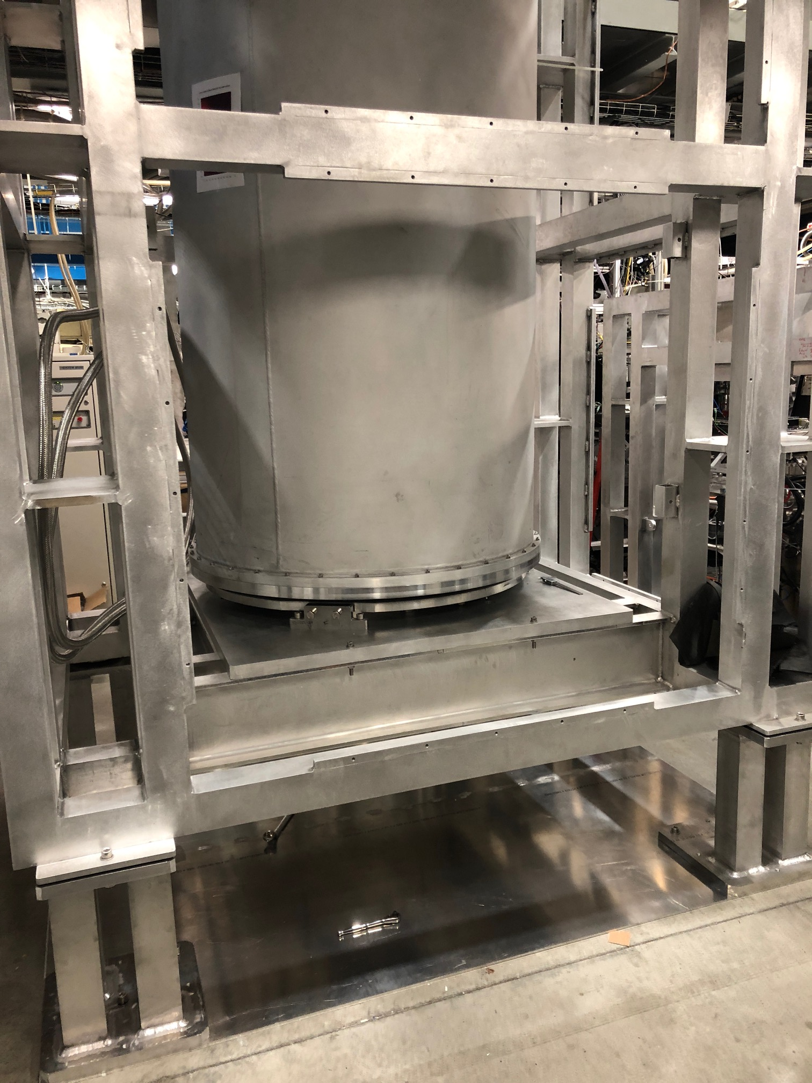
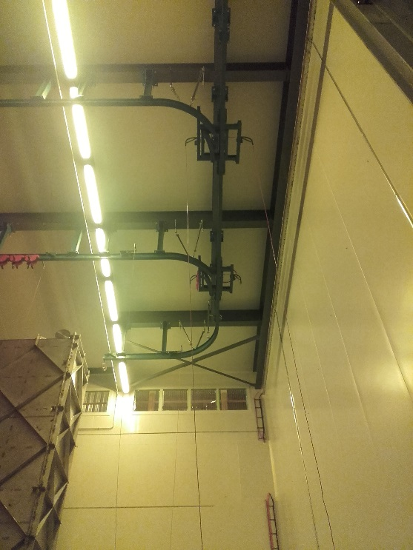
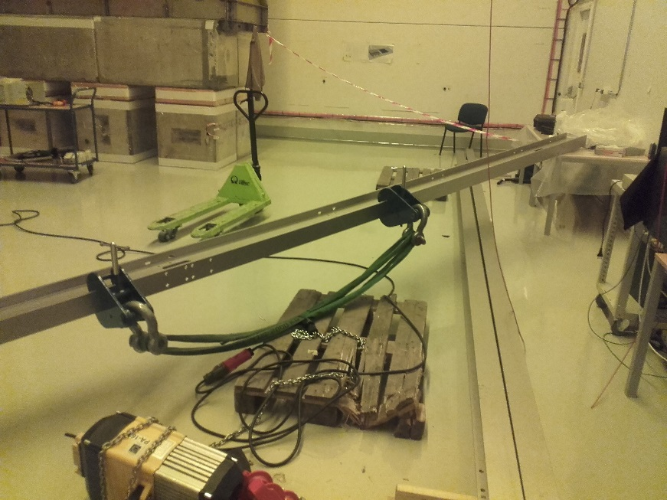
How do we approach this problematic at CERN ? … and what are the problems ?
Sometimes, we have to redo ourselves the calculations
or the inspections or even recently the welding.
We have also experienced that we should not trust
systematically CE Certificates.
01.09.2017 accident in EHN1:
bar following from the carry beams while testing.
The calculations provided were not conformed to the installed equipment
The safety devices were missing on the installed equipment

Slide 8
We (EP safety office and HSE Unit) act on two different ways :
1. we are reinforcing the configuration control of the experiments and equipment that we have to agree on before they are installed or loaded :
- We run systematic co-inspections
- We are now checking carefully the documentation we received with CE certificates
2. We have decided to create a working group to :
remind the European standards and rules to be followed for the design and the execution of the structural elements.
list the type of calculations methods allowed to check the design (for example analytical or advanced computational analyses like FEA)
determine the mandatory checks to be performed on the structure under the different load conditions (for example, seismic, static, etc.)
list the documentation required (FEA models, 3D/2D models, structural assessment, execution certificates, etc.)

Slide 9
The working group will also provide instructions to the designers on how to perform mechanical assessment by means of FEA analyses, in compliance with the European Standard framework
We cooperate directly with the European Committee for Standardization - group Finite Elements – a new set of rules will be issued soon by the Committee on this matter.
The aim is finally to define a set of uniformed methods and, including a unique set of calibrated partial safety factors to be used in the structural assessment.
The use case used for this study is ProtoDUNE ! (work on going already)
The results of the various ProtoDUNE and later DUNE mechanical testing campaigns will
be used as a validation of the safety margins
We are convinced that this can be adapted to US standards
Finally, the working group will perform a comparison between the US and the EU standards
In a second step of this project, the working group will define a harmonized mechanical design methodology (EU/US) mutually recognized by CERN and Fermilab/DoE.
This work could be directly use and adapted if required to the DUNE project.

Slide 10
The working group is composed (for the moment) of
- CERN
- University of Geneva
- University of Napoli “Federico II”
- Budapest university of Technology and Economics
- University of Coimbra
with experts in the following domains :
- Mechanical and structural analyses
- European standards and US standards
- Mechanical measurements methods
We obviously would like to extend this to the configuration control and the validation process of the equipment of LBNF.
We would like to invite experts from Fermilab/ DoE to participate to this working group.

