Slide 1
LBNF/DUNE ESH Update
Mike Andrews
William Miller
October 31, 2018

Slide 2
ESH Governance
LBNF/DUNE Operations
DOE 10CFR851: Worker Safety and Health Program
Fermilab Environmental, Safety, and Health Manual
Work planning and Hazard Analysis (Chapter 2060)
Applicable Mechanical, Cryogenic, and Structural 5000 Series Chapters
Membrane Cryostats (Chapter 5031.7), Piping Systems (Chapter 5031.1)
Cryogenic System Review (Chapter 5032)
Applicable Electrical Safety 9000 Series Chapters
Electrical Utilization Equipment Safety (Chapter 9110)
Applicable Material Handling & Transportation 10000 Series Chapters
Overhead Cranes and Hoists (Chapter 10100)
Below-The-Hook Lifting Devices (Chapter 10110)

Slide 3
ESH Governance
LBNF-DUNE Integrated ESH Management Plan (DocDB 291)
LBNF Construction Safety and Health Plan (DocDB 559)
DUNE Installation Safety and Health Plan (TBD)
Support/Production Factory Facilities
Follow home institutions ESH Program

Slide 4
Work Planning and Control Process

Slide 5
Site Access & Training
Fermilab access & training requirements non-Fermilab personnel
On-line registration through the FNAL Users Office
Fermilab on-line training through Users Office
Fermilab/CERN Training Equivalency
Fall Protection, Confined Space, Arial Lift
Fermilab personnel will follow the ITNA & training plan process
SURF Site Access & Training
Surface & Underground Safety Orientation
Unescorted Access training for the 4850 & 4910 levels
Guide training (one guide required on each working level)
SURF ID badge for site access & brass required for underground access

Slide 6
Status of Code Equivalency for DUNE
Component Type | National Consensus Code | International Code
Pressure Vessels | ASME BPVC VIII | EN13445
Process Piping | ASME B31.3 | EN13480
Pressure Relief Devices | ASME BPVC VIII | EN4126
Structures | IBC/ASCE7,AISC360, ADM1 | Eurocode EN1990, EN1991, EN1993, and EN1998
There is still work in progress on remaining code issues. No progress has been made on EN13458. Information provided by Mike White, Chair of the Fermilab Mechanical Support Committee
Purchased equipment must have both CE and OSHA ratings, in some cases with proper documentation approval can be giving if they do not have both

Slide 7
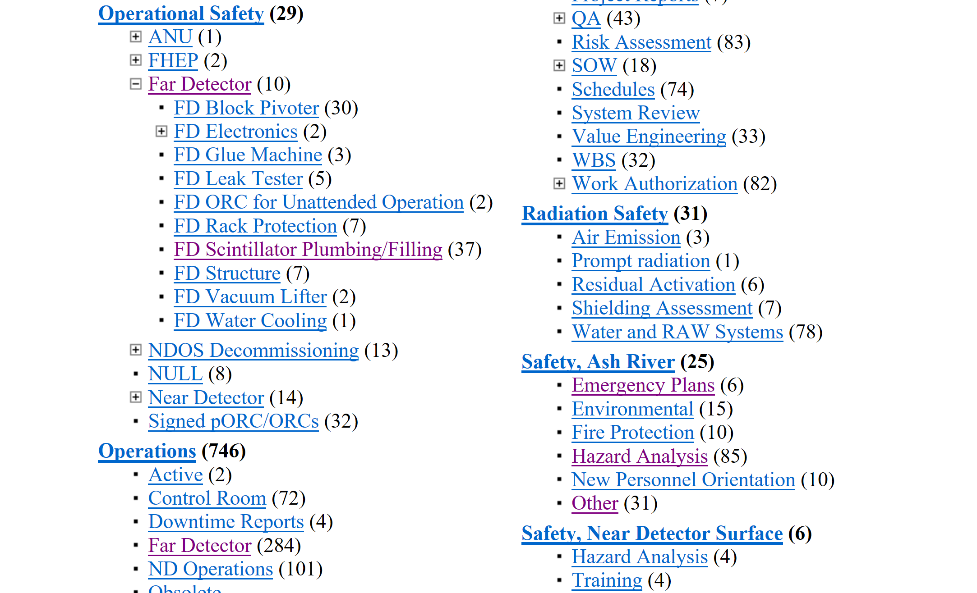
Example 1: Safety Documentation (DocDB)

Slide 8
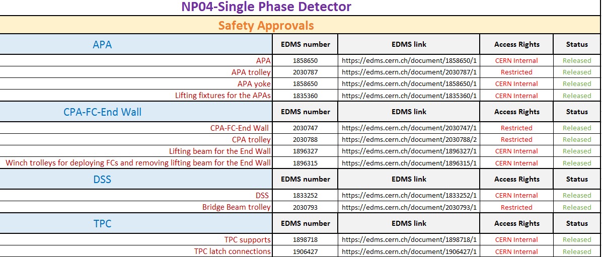
Example 2: Safety Documentation (EDMS)

