Slide 1
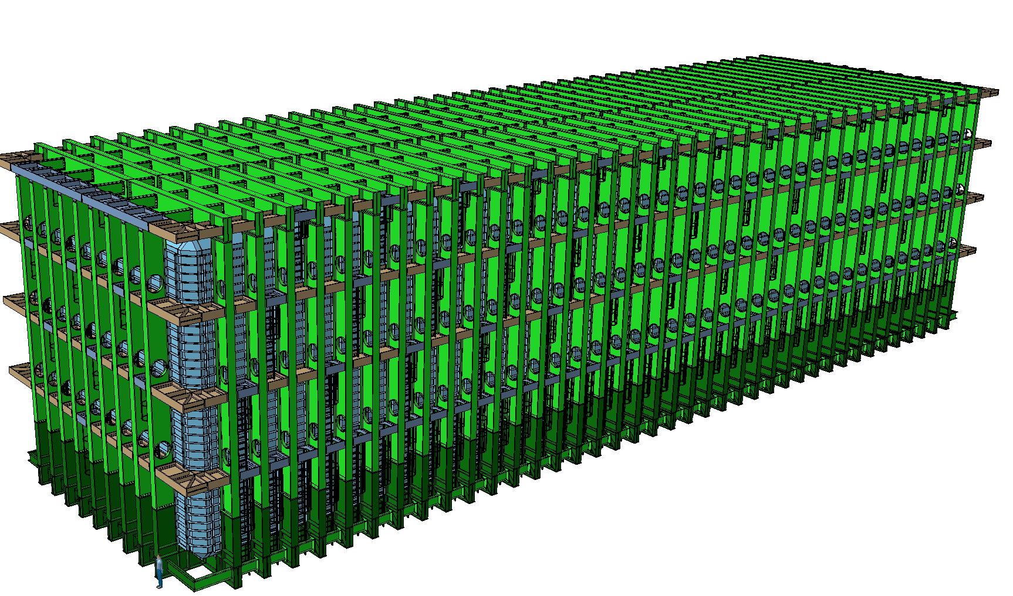


LBNF - Thoughts on storing material for cryostat (warm and cold) construction in the west end of the north cavern, how much, access, material handling, buffer space required
Dimitar MLADENOV & The entire CERN Team
LBNF/DUNE interface meeting
SURF, 29-31 October 2018

Slide 2
List of components
Cage Load 240 x 60min
240 hours
10 days
Skip Load 300 x 60 min
300 hours
13 days
In addition to this:
125t of Bolts 1 day
4’000 boxes of insulation
We need to transport 1’800 components
600 pcs with weight 0.1t ÷ 0.5t
900 pcs with weight 0.5t ÷ 1.0t
120 pcs with weight 1.0t ÷ 5.0t
120 pcs with weight 5.0t ÷ 7.0t
60 pcs with weight 7.0t ÷ 7.5t
Beam 1 13'130mm 78 pc
Beam 2 13'643mm 18 pc
Beam 3 9'498mm 78 pc
Beam 4 8'000mm 39 pc
Beam 5 5'946mm 4 pc
Corner 1 3608x5498mm 78 pc
Corner 2 3608x2302mm 18 pc
Corner 3 2352x2482mm 16 pc

Slide 3
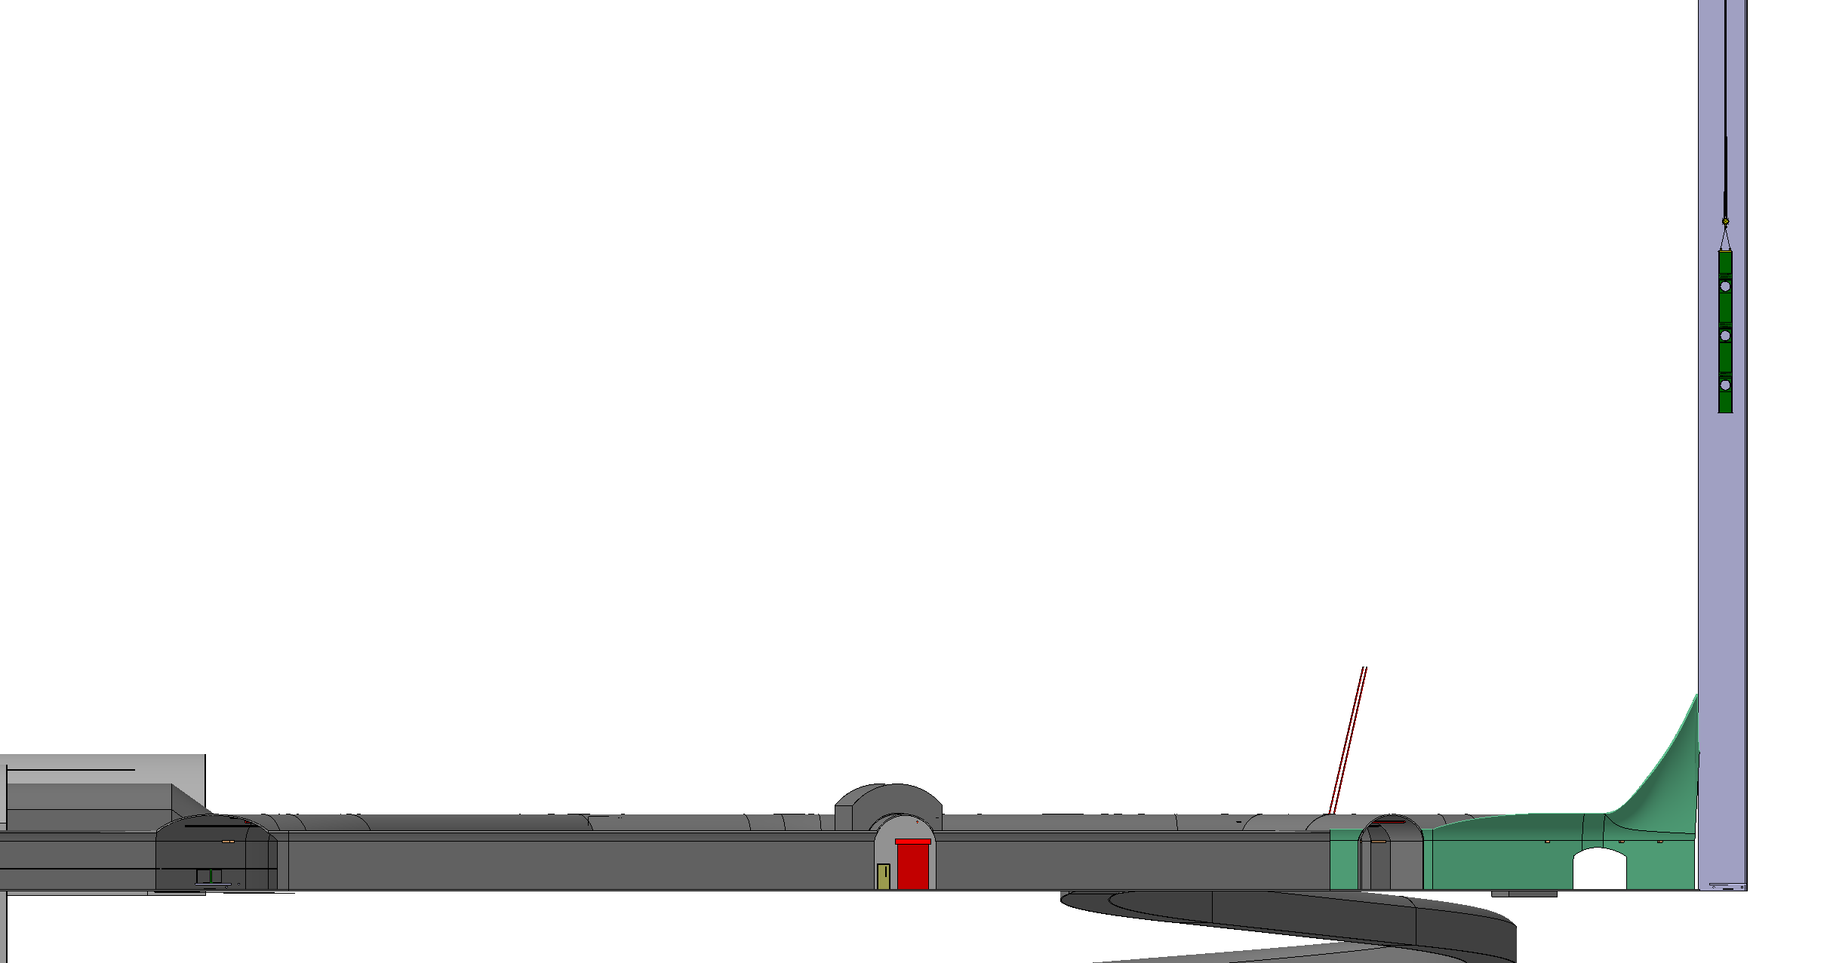
Shaft Parameters (2015)

Slide 4
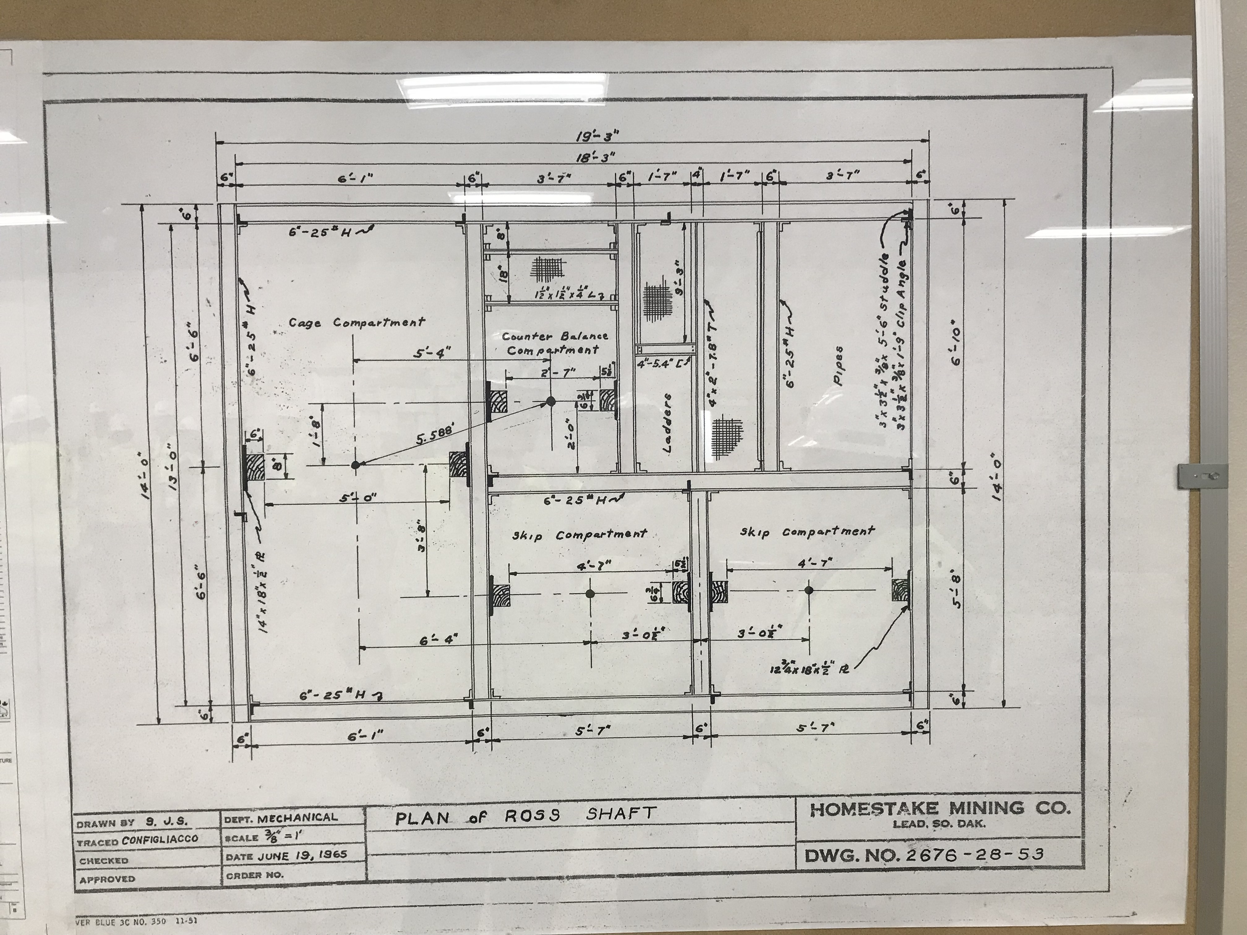
Shaft Parameters (2015)
3962.4mm
We also need reliable model
of the headframe

Slide 5
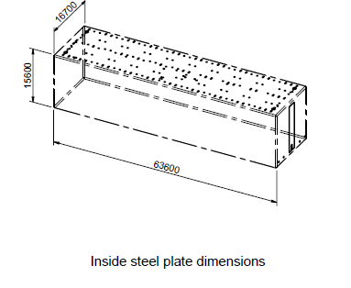
Cold Cryostat – Containment system – Number of Boxes
GST project - 12500m³ th. 790mm - CERN Volume estimation
 |  | Volume (m³) | 40" container number
Insulation pannels and pads | Flat pannels | 3823.71 | 80.93
 | Corner Pieces | 449.56 | 9.51
 | Bridge Pad | 281.64 | 5.96
 | Trihedre | 107.77 | 2.28
 | Erection on Board | 5.62 | 0.12
 |  | 53.89 | 1.14
Membrane | Membrane | 521.61 | 11.04
 | Angle Piece | 12.08 | 0.26
 | End Corrugation | 0.32 | 0.01
Glasswool elements | FJ | 278.70 | 5.90
Plugs | PG | 29.54 | 0.63
Secondary barriers | SB | 7.18 | 0.15
Thermal Protection | TP | 2.42 | 0.05
Load bearing Mastic | Mastic | 47.94 | 1.01
Adhesive for primary blocks and TBP Bonding | Adhésif | 10.39 | 0.22
Glue for secondary barrier | Glue | 4.07 | 0.09
Studs | studs | 26.04 | 0.55
 | TOTAL | 5662.50 | 119.84
TANK DIMENSIONS
 | S229
 | L (m) | l (m) | h (m) | surface (m2) | volume (m3)
Secondary | 63.58 | 16.68 | 15.58 | 4,621.93 | 1,848.77
Primary | 62.78 | 15.88 | 14.78 | 4,319.08 | 1,684.44
At membrane level | 62.00 | 15.10 | 14.00 | 4,031.20
Area needed to store the flat panels | m2 | 4780
Number of boxes for the flat panels | ideal boxes | 1512
Number of boxes for the flat panels | real boxes | 1890
Number of boxes for the rest | real boxes | 873
All boxes | real boxes | 2’763
Most likely “box” size:
3’500mm x 1’500mm x 1’200mm

Slide 6
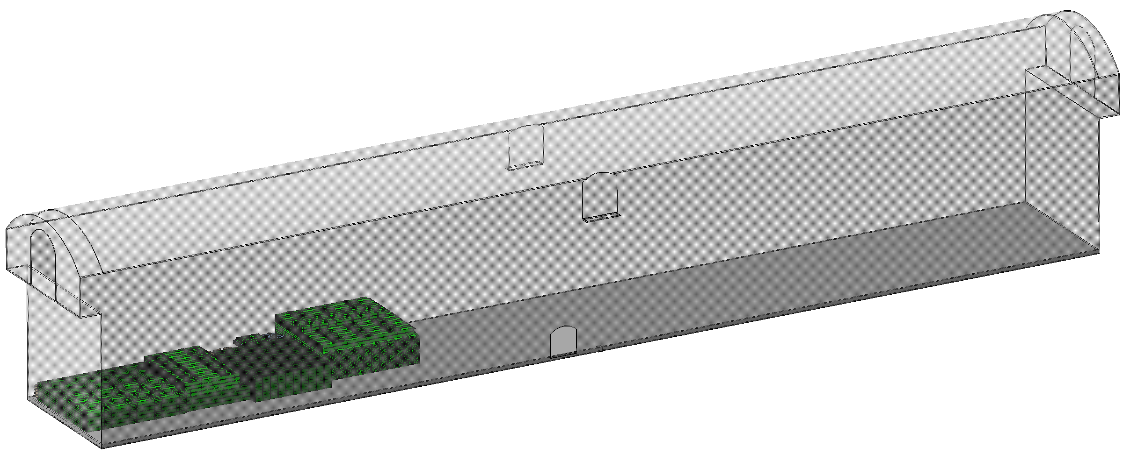
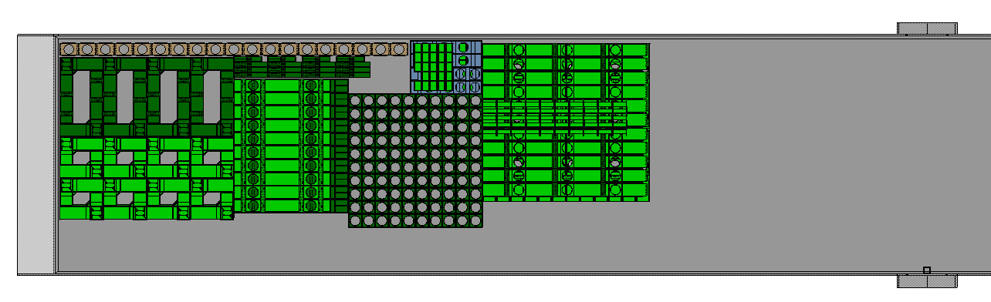
Some ideas for storing material in the cavern
This is all the main material needed for a single warm cryostat.

Slide 7
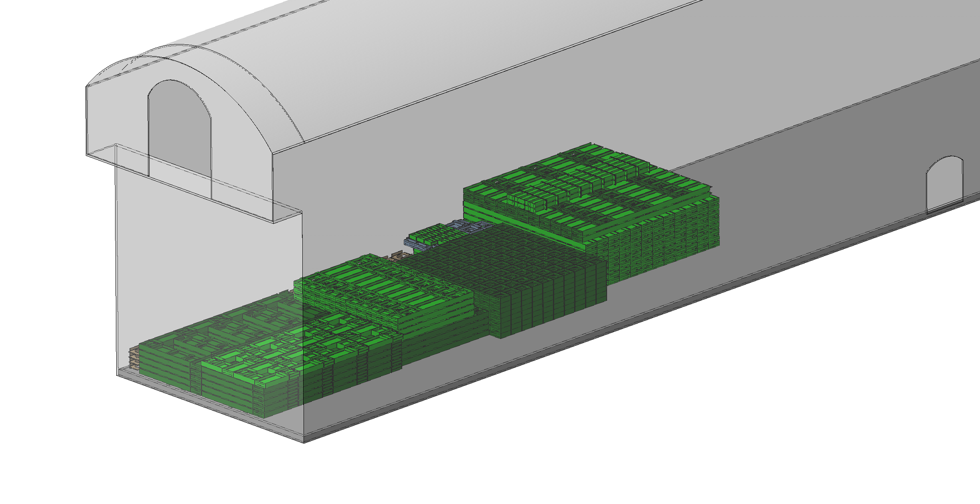
Some ideas for storing material in the cavern
This is all the main material needed for a single warm cryostat.

Slide 8
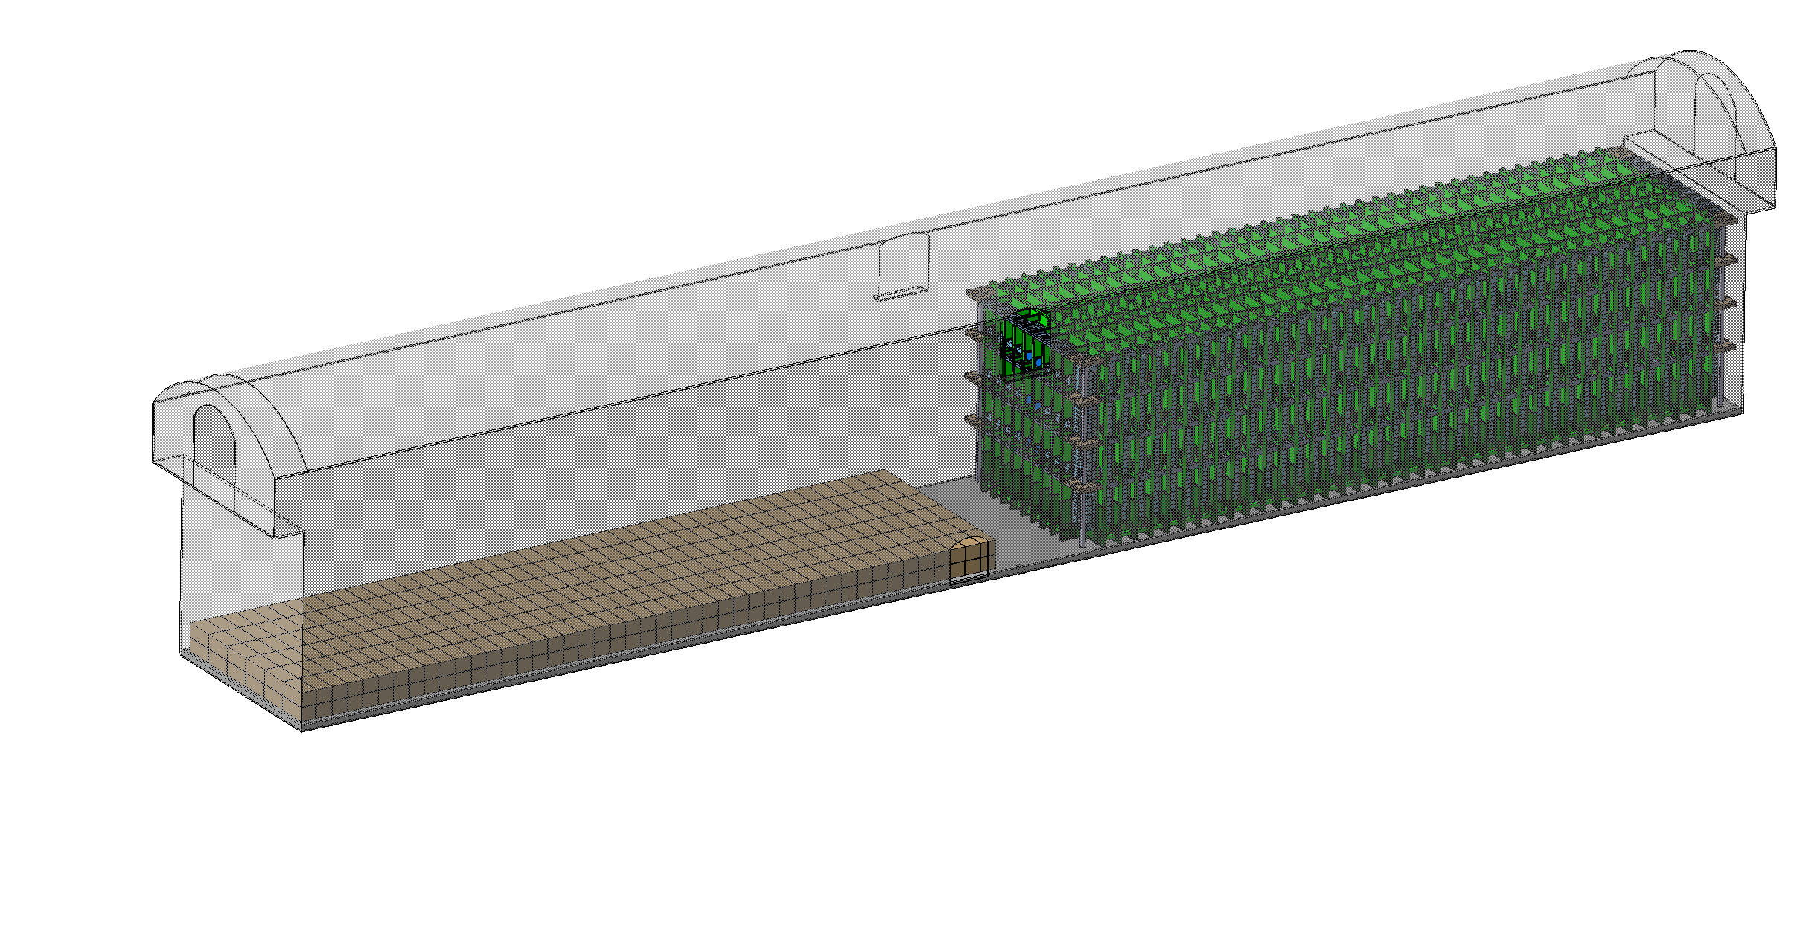
Some ideas for storing material in the cavern
450 “Boxes”

Slide 9
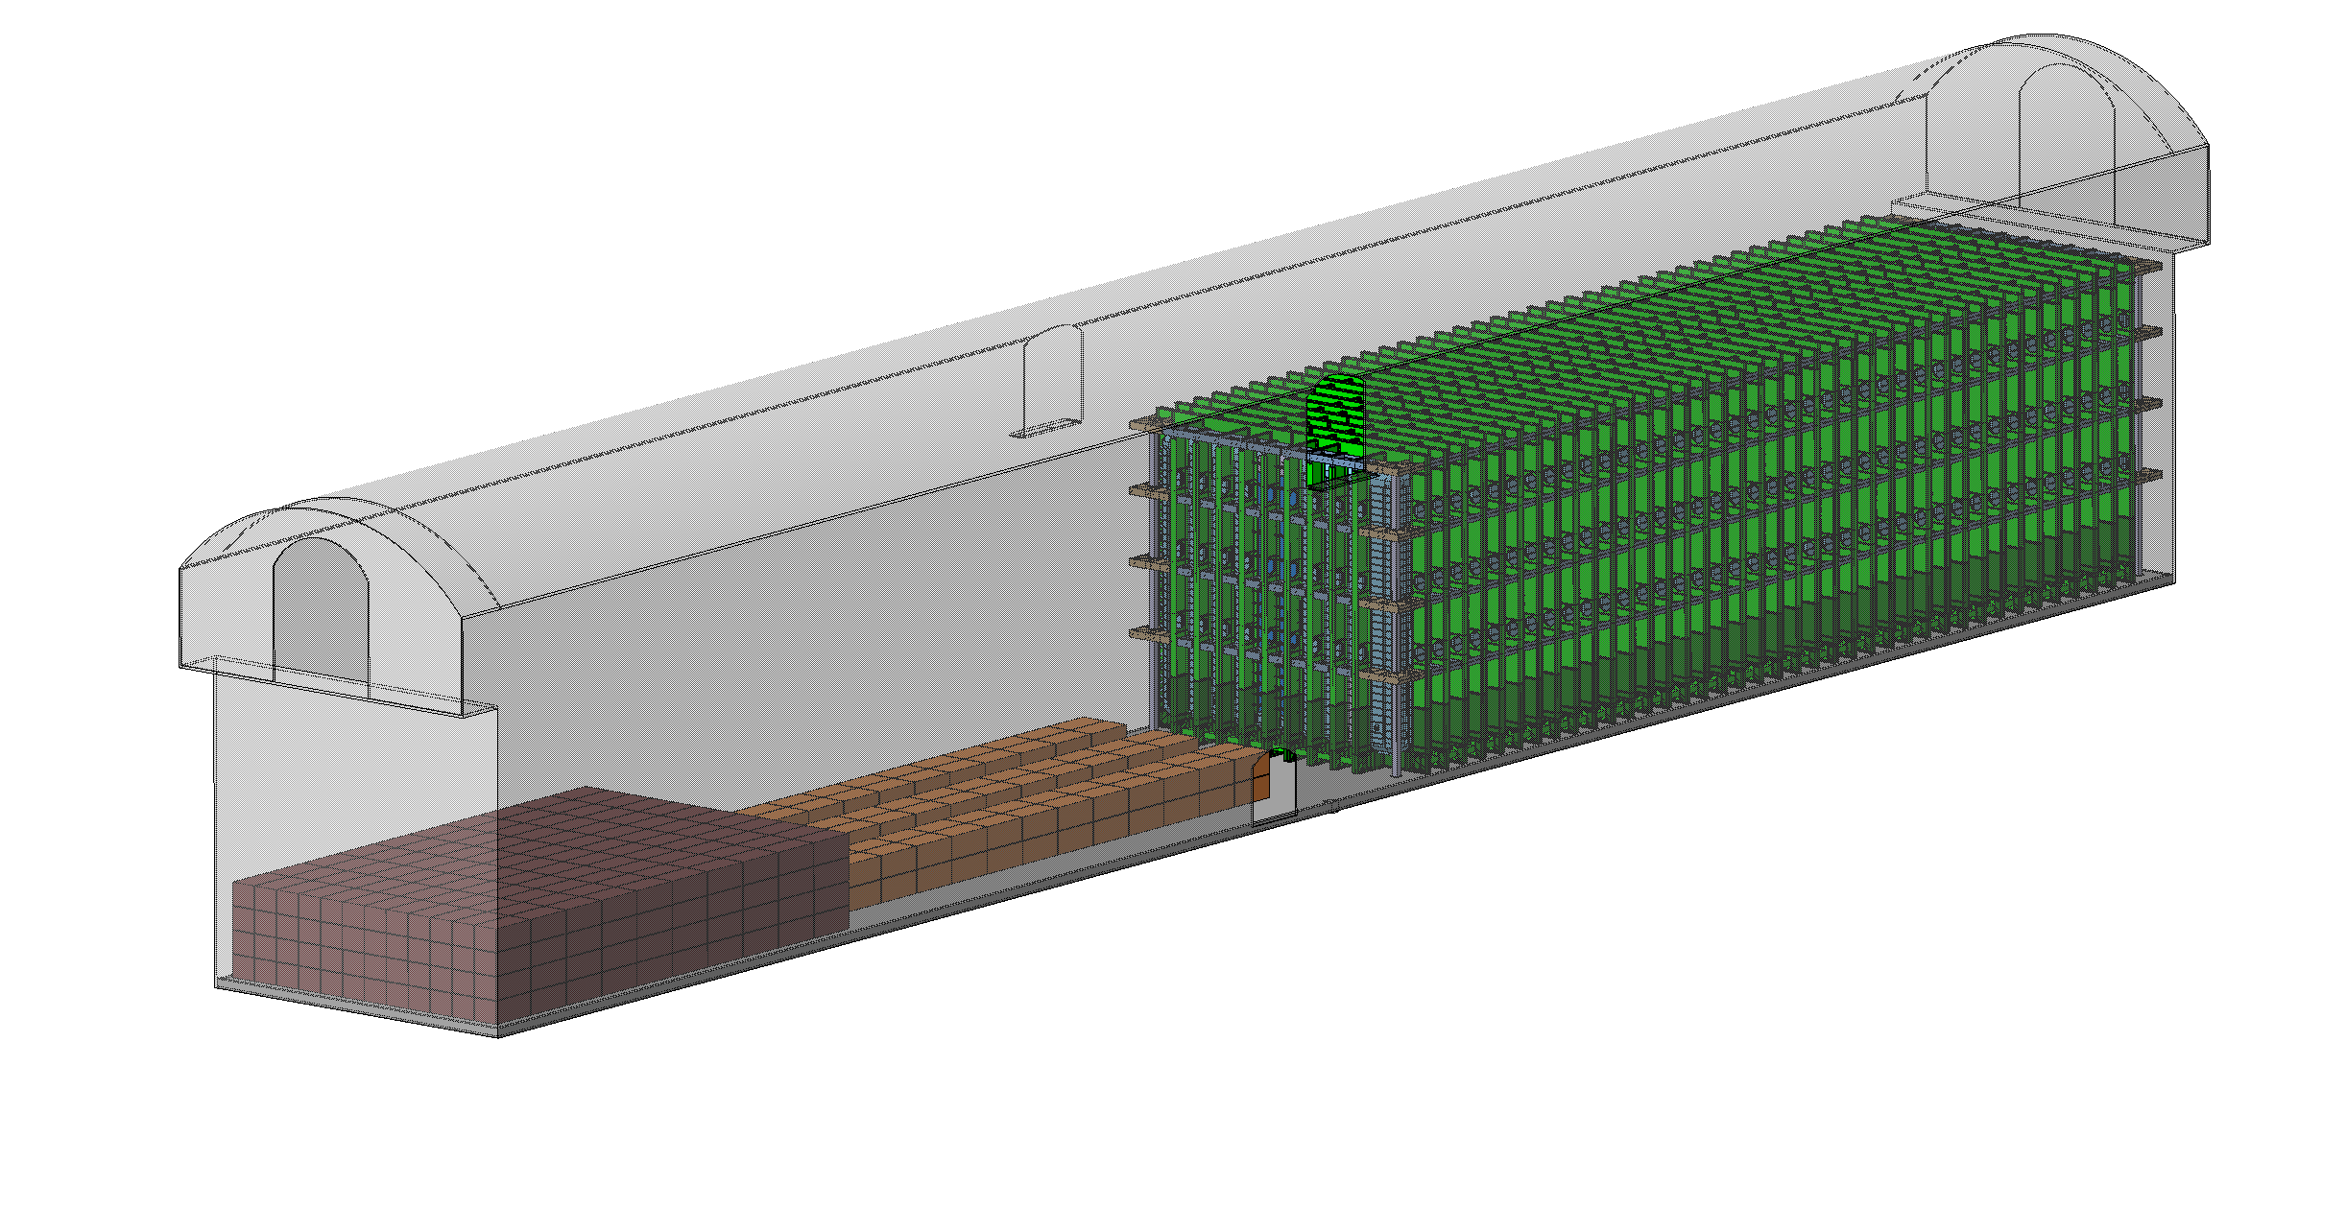
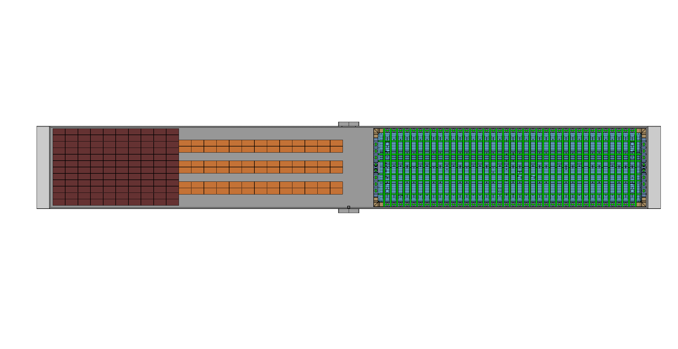
Some ideas for storing material in the cavern
480 Flat Panel Boxes (interchangeable)
+
156 Specific Boxes (corners, glass wool, membrane, etc.)

Slide 10
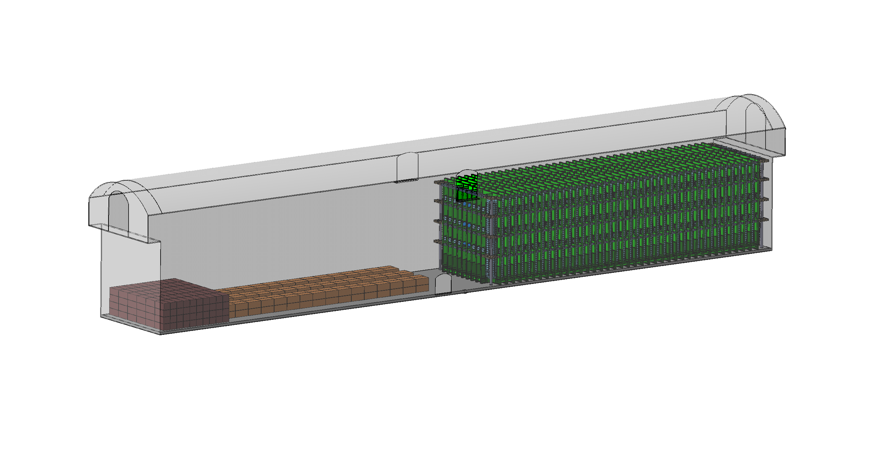
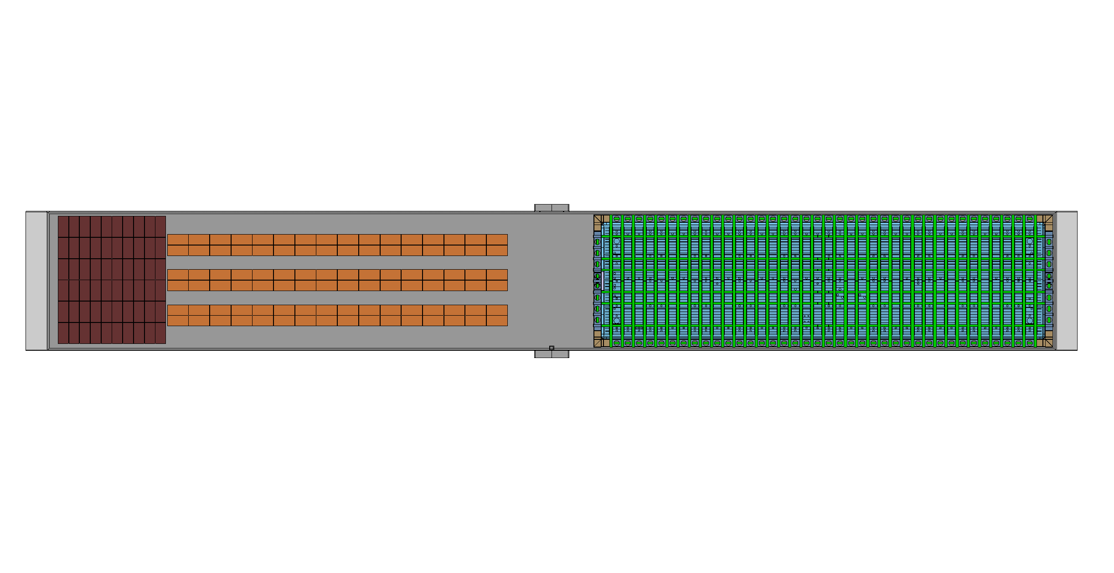
Some ideas for storing material in the cavern
240 Flat Panel Boxes (interchangeable)
+
192 Specific Boxes (corners, glass wool, membrane, etc.)

Slide 11
Thank you!

