Slide 1
Thoughts on Storing Material for the SP Detector
October 29 2018
Stewart - Zhao

Slide 2
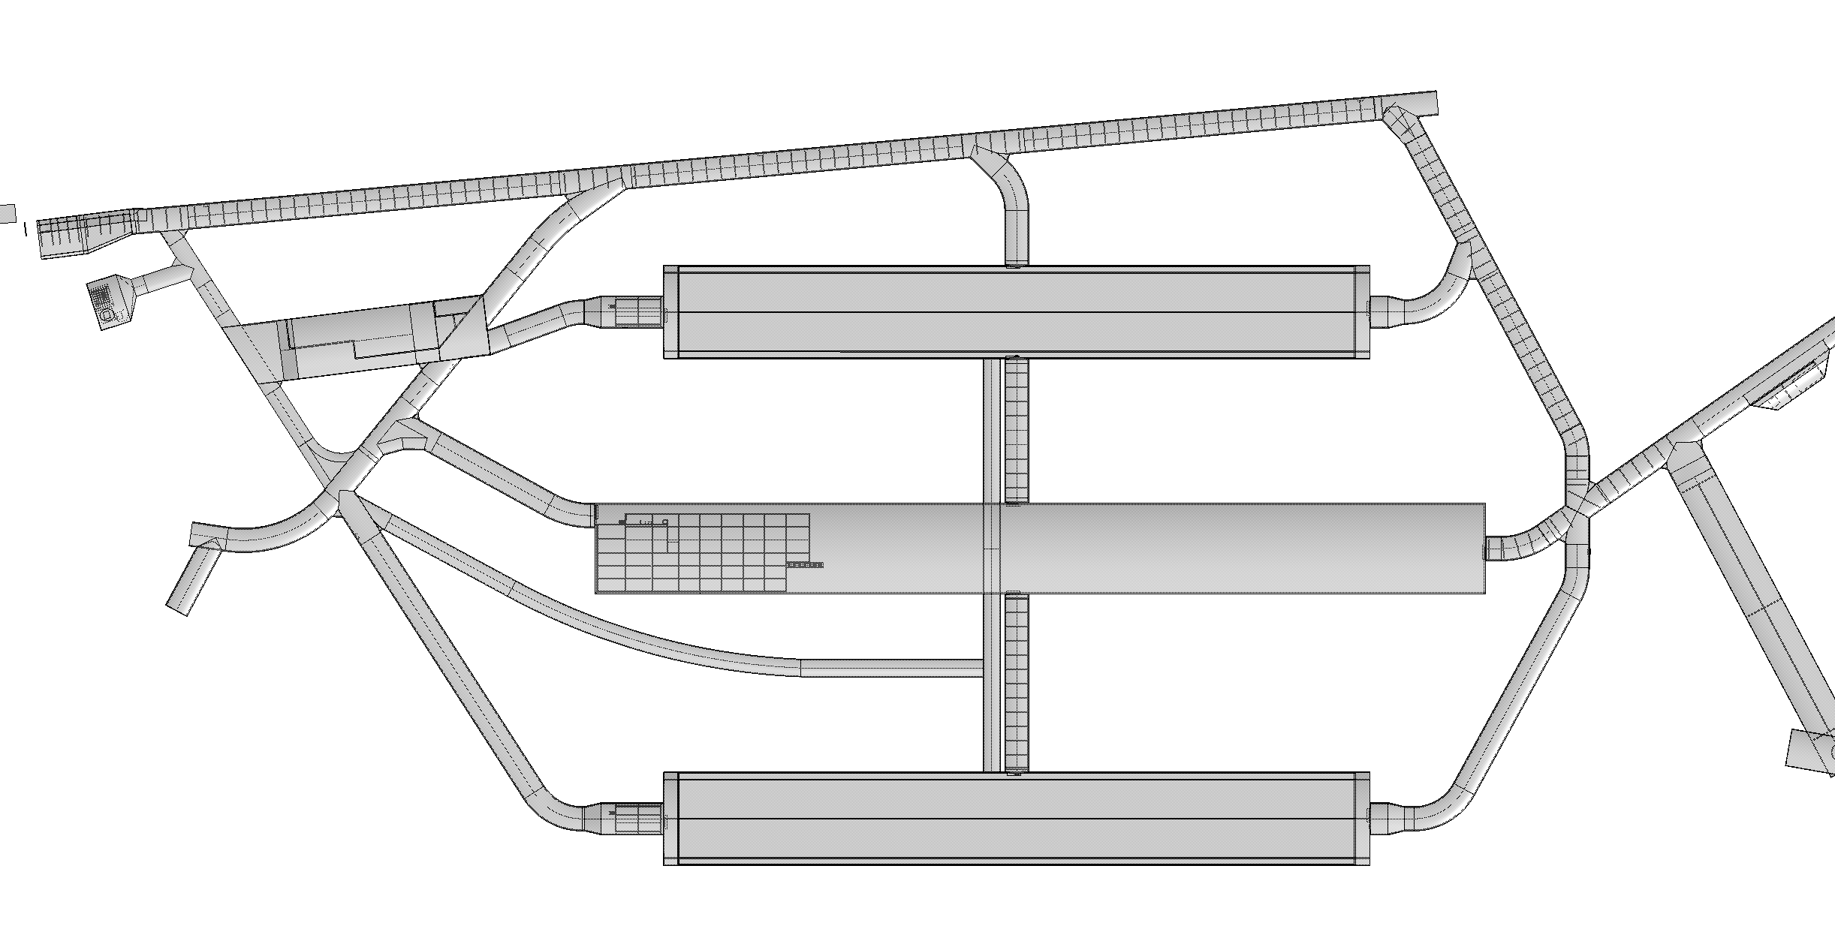
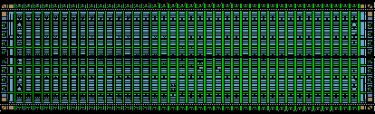
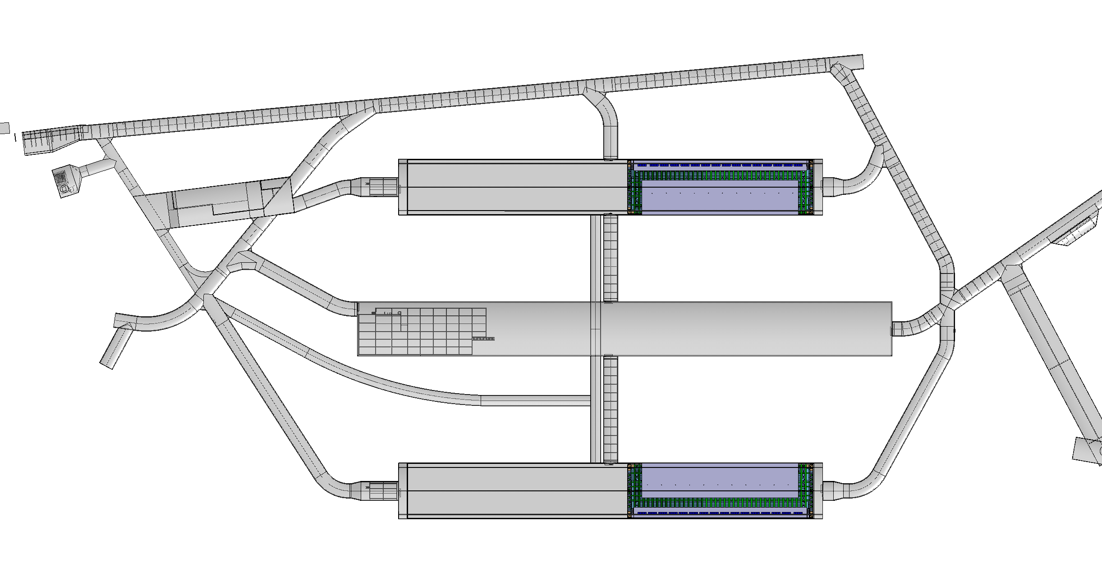
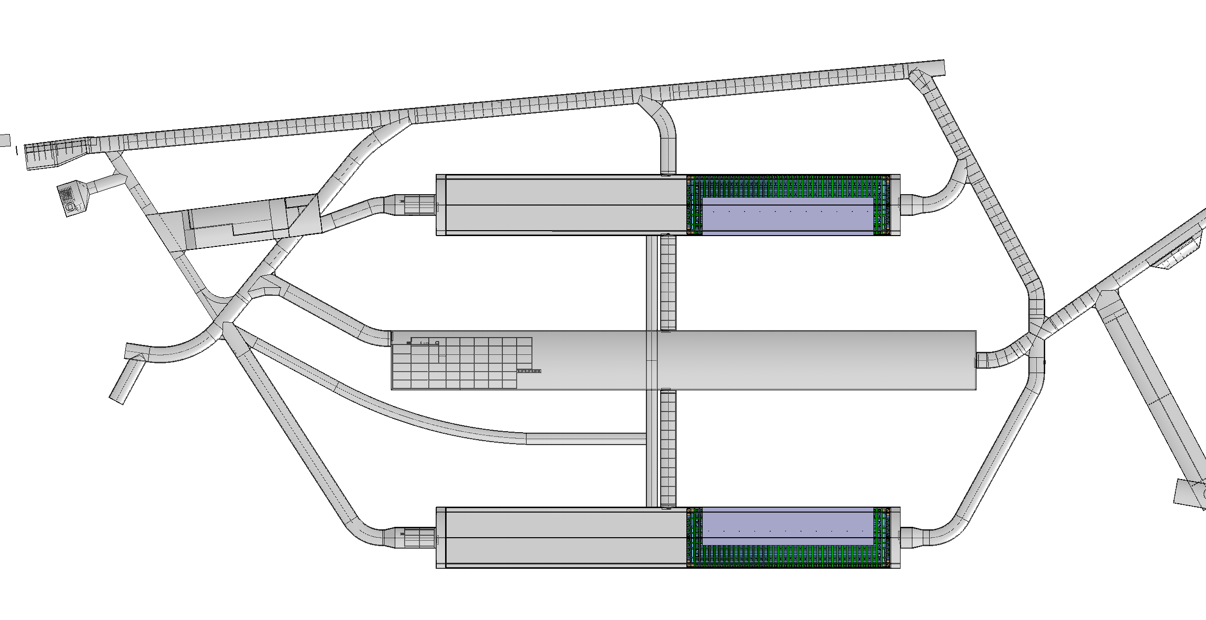
Det#3
Det#1
Det#4
Det#2

Slide 3
Starting Assumptions
The installation of the Cryostat, Cryogenics, and Detectors will be one coordinated effort.
Both detector caverns will be used. Detector1 East end of excavation#1 and Detector#2 in the East end of excavation#3
All 4,000 crates for the membrane installation will be in SD before starting the insulation installation.
All storage facilities must be within 1-2h drive of SURF.

Slide 4
Additional Assumptions
Underground machine shop and storage areas will be in excavation#1 for detector 1 installation.
  CUC is not available at the start of Det1 installation
Both measure 8mx10m
Storage

Slide 5
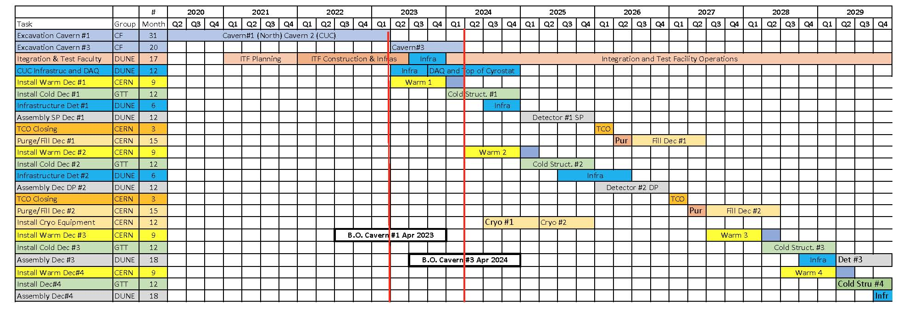
Installation Schedule v2
Install detector1
Setup detector1 installation
Start cryostat cold#1
Define critical times where the need for storage is maximal. Then evaluate the space needs at that time.
Start of Cryostat#1 cold structure
Start setup of Detector#1 installation
Start Detector#1 Installation

Slide 6
Start of Cryostat#1 cold structure
Starting conditions
  CUC is available for use.
  Some storage for cryostat crates is available in the excavation outside the cryostat.
  excavation#3 is not available at the start.
Challenges
  Need to store 4,000 1.5m by 3m by 1.5m wood crates with access.
Assumptions
  Assume the machine shop and storage area are in place.

Slide 7
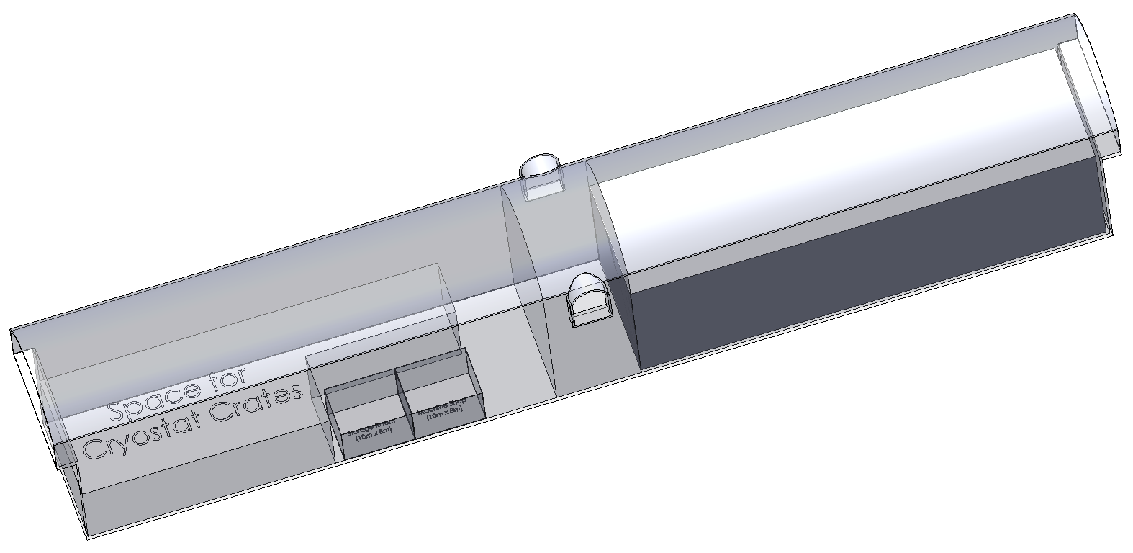
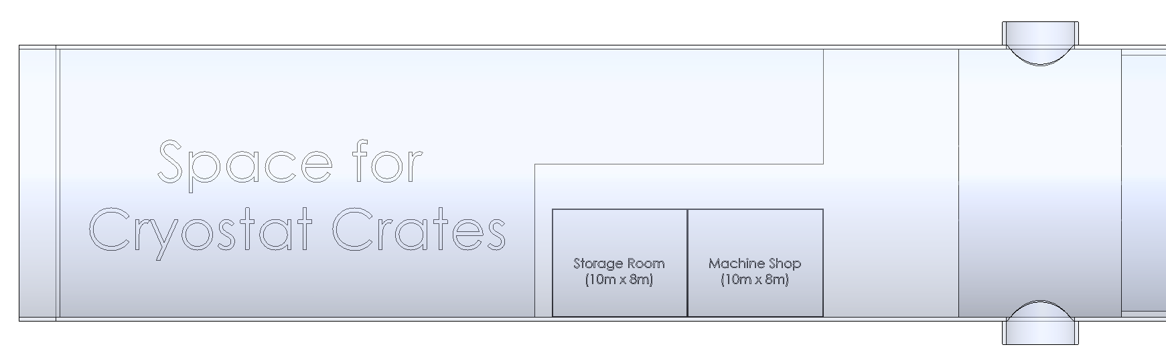
Configuration
Image of the hall at the start of cryostat installation
Reserved space for cryostat crates
56m
12m
8.5m
19.8m
10mx8m
10mx8m
10m
35m

Slide 8
Start of Detector1 Installation Setup
Starting conditions
The cold structure for cryostat1 is half complete. Need to store 2,000 1.5x3.0x1.5 crates
Cavern2 CUC is available
½ of Cavern#3 is available for storage while the warm structure is being installed in the other half.
The Detector installation setup phase is 6 months, but may be shifted some not to overlap the cryostat work as much.
  Assume 1/3 of the materials needed for the setup are available on hand at the start of the setup work. This will give a 2 month buffer with some flexibility for shuffling work.

Slide 9
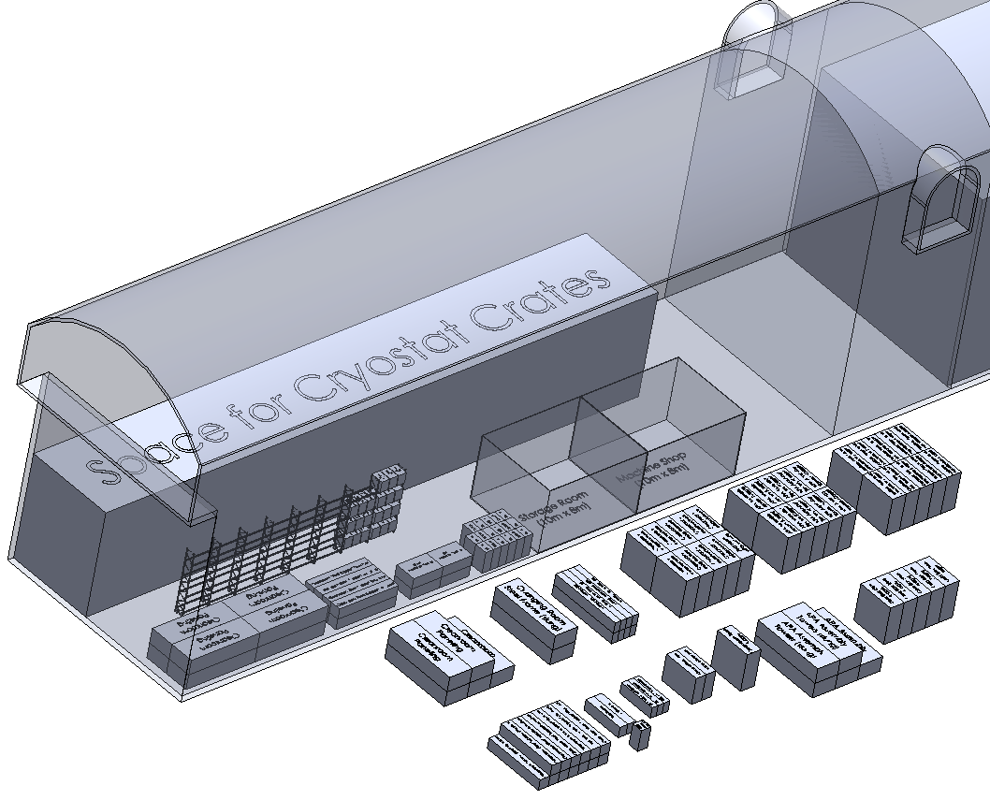
Configuration
Starting Conditions
Reserved space for cryostat crates
1/3 of parts for setup phase
Some are placed inside the carven
the others to be stored somewhere else
Equipment that needs to be stored on the surface or cavern #3

Slide 10
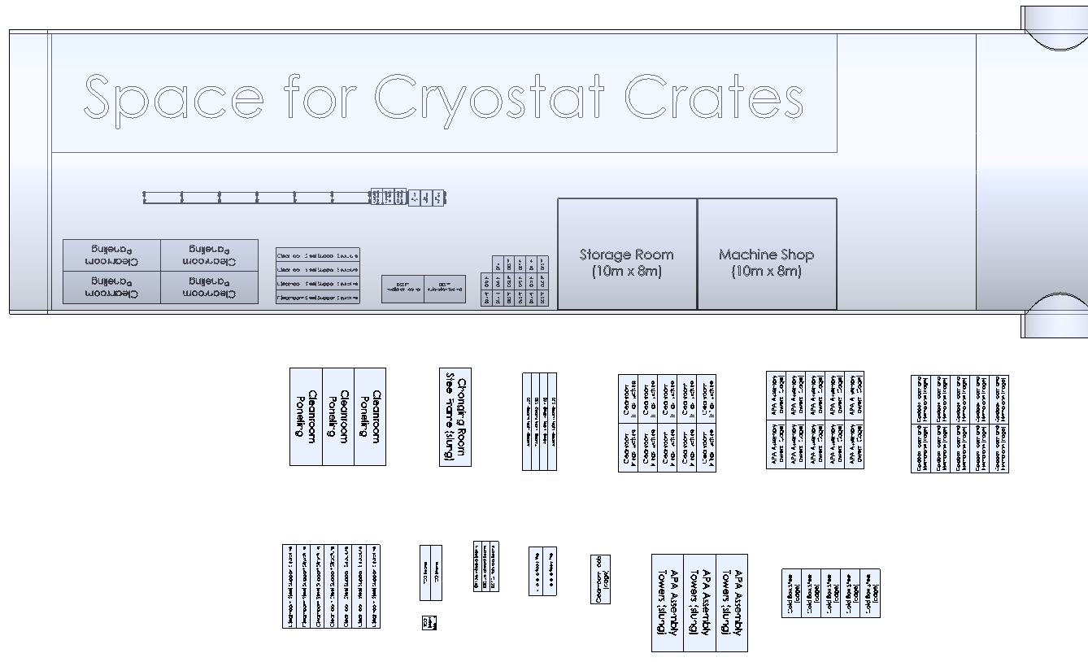
56m
8.5m
20m
50m
50m x 20m space for parts that can’t fit in the carven is ample.
A one month buffer would be half this. This will fit in half Cavern#3

Slide 11
Start Detector 1 installation
Starting conditions
The start of Det#1 corresponds to the start of Cryostat cold #2. 4,000 boxes must be in SD
The cryogenic system for detector 1 is 50% installed.
Assume 1 month buffer of APAs ready to install
Assume 100% of the end wall #1 is in SD
Assume a 1 month buffer (5 weeks) for all other components.
  20 Cathode modules
  40 FC modules

Slide 12
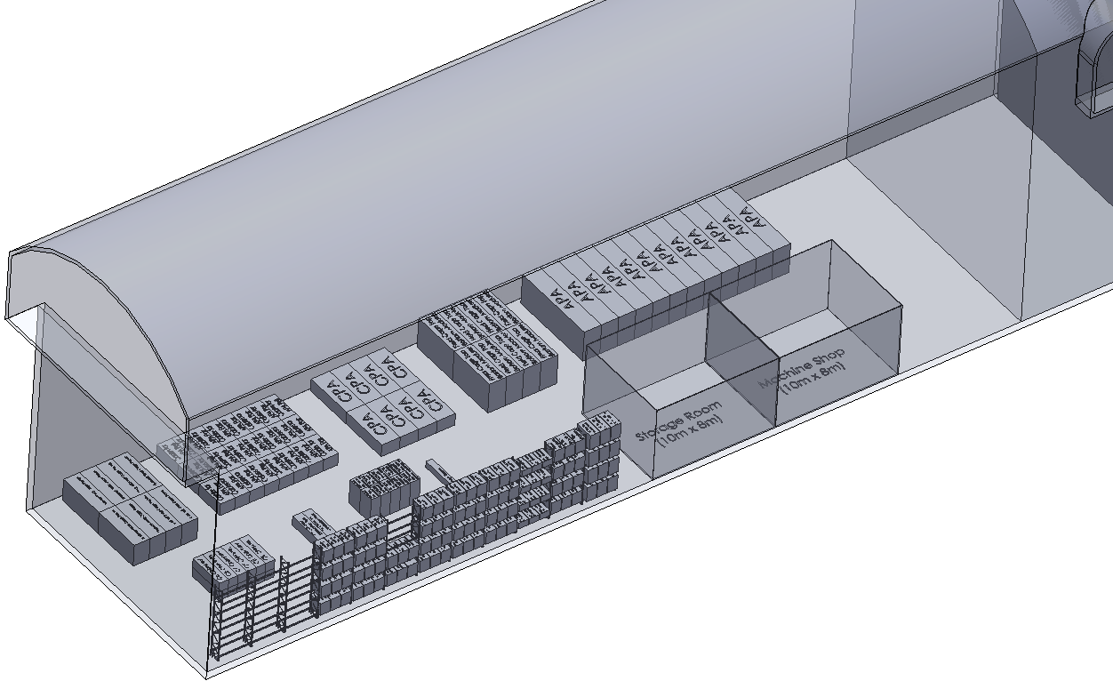
Configuration
Starting Conditions
One month supplies for SP installation phase fits in the carven.

Slide 13
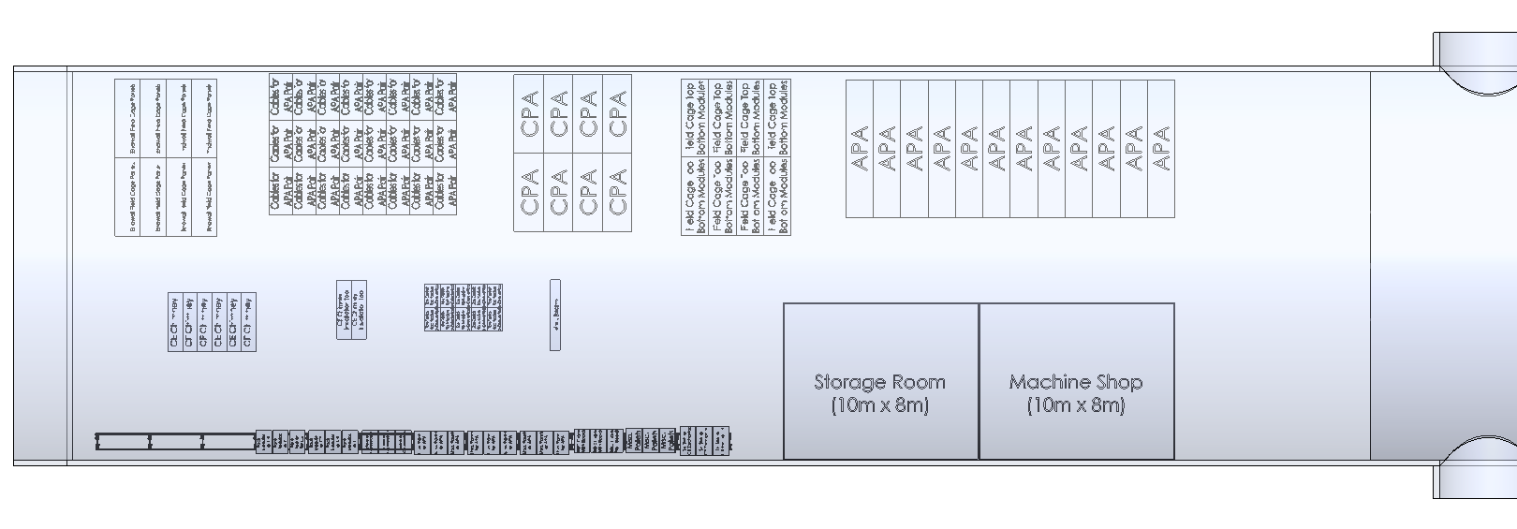
One month supplies for SP installation phase fits in the carven.
Logistics center needs the ability to receive and repackage goods. A buffer of 1 week is needed to consolidate shipments and manage days when no deliveries will be possible due to high CF load.

Slide 14
Logistics Conclusions
The underground space is sufficient for a reasonable materials buffer of 1 month.
  This estimate does not include possible storage on top of the cryostat
The logistics center does not need to serve as a short term material buffer.
The requirements should be driven by the receiving, inventory and shipping needs.
Building a coherent logistics plan needs to now include the cryostat and cryogenics.

Slide 15
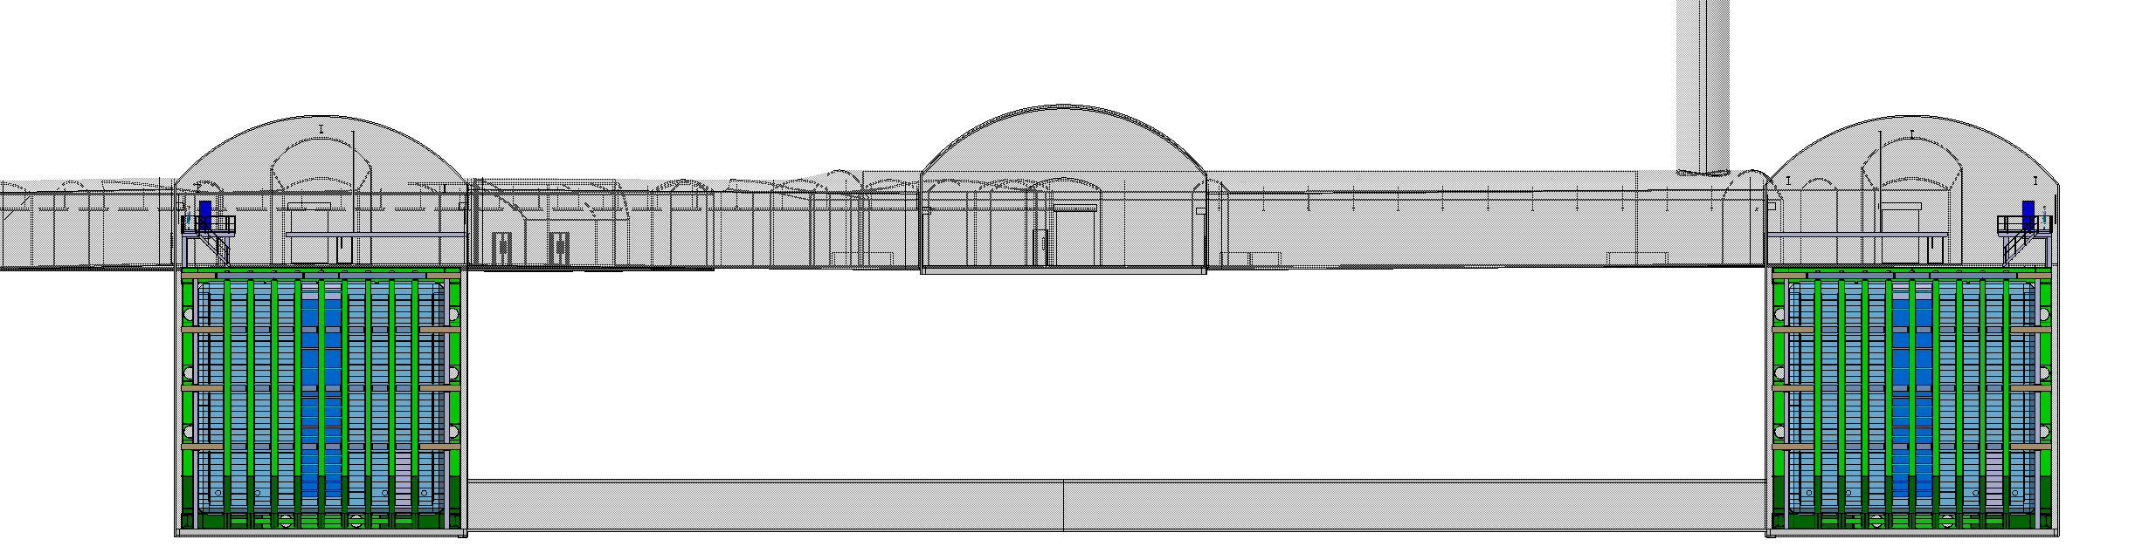
Should DUNE consider temporarily outfitting the mucking drift segment connecting excavation 1 and 3?
This would simplify moving material between excavation 1 and 3.
Would require lighting, ventilation and a 100m long concrete pad at a min.
Det#3
Det#1
Det#4
Det#2

Slide 16
Backup

