Slide 1
TYPICAL SLUNG LOAD PROCEDURE
A GENERAL OVERVIEW OF THE METHODS AND PROCESS NECESSARY TO ENGINEER A SLUNG LOAD
Prepared by Mike Johnson 10/26/2018

Slide 2
SLUNG LOADS
The allowable sizes and weights of loads headed underground have all been well documented. Several reports have been produced showing the size of loads that will fit inside the cage as well as the size and length of loads that can be slung under the cage and/or even in the skip compartment. This slide show shows an overview of what must be done to set up these slung loads.
First, a few questions must be asked about the load.
Where is its center of gravity? A symmetrical piece will hang true and straight and is much preferred over one that hangs off center. Loads off center may require both an extra sling and guide shoes.
How close are components of the load in comparison to the set steel? It is certain, the slings will allow the load to swing a small amount. One should allow roughly three inches clearance for swing. If the load is larger, then guide shoes must be added.

Slide 3
SLUNG LOADS
Does the load have fragile pipe or other fittings that protrude from the basic load envelope? If so, then perhaps a bullet shaped protective self guiding sleeve might need to be built up around the equipment. Here, the sleeve’s length must be long enough to overlap at least one to two sections of set steel or timbers.
It is always preferable to utilize a pair of slings attached to the cage lugs on its centerline with the guides. The inherent nature of the pair eliminates twist and also cuts down on its swing. The sling length should always be as long as is possible, with the shortest being 12’ long.
The following slides show typical examples of various loads being slung to go underground.

Slide 4
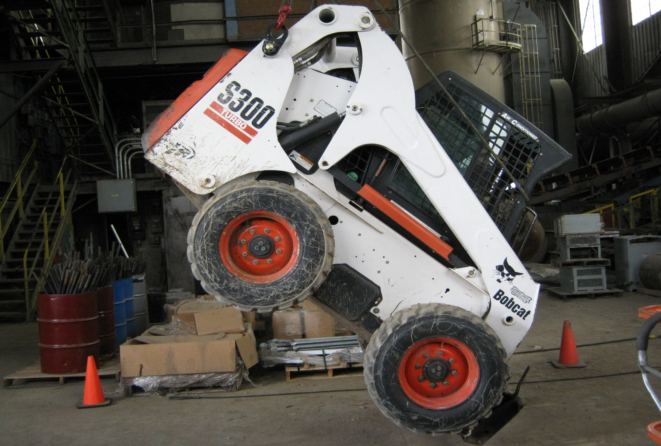
CHECKING THE LOAD BALANCE POINTS
Here the Bobcat is being picked up by the bridge crane in the crusher room.

Slide 5
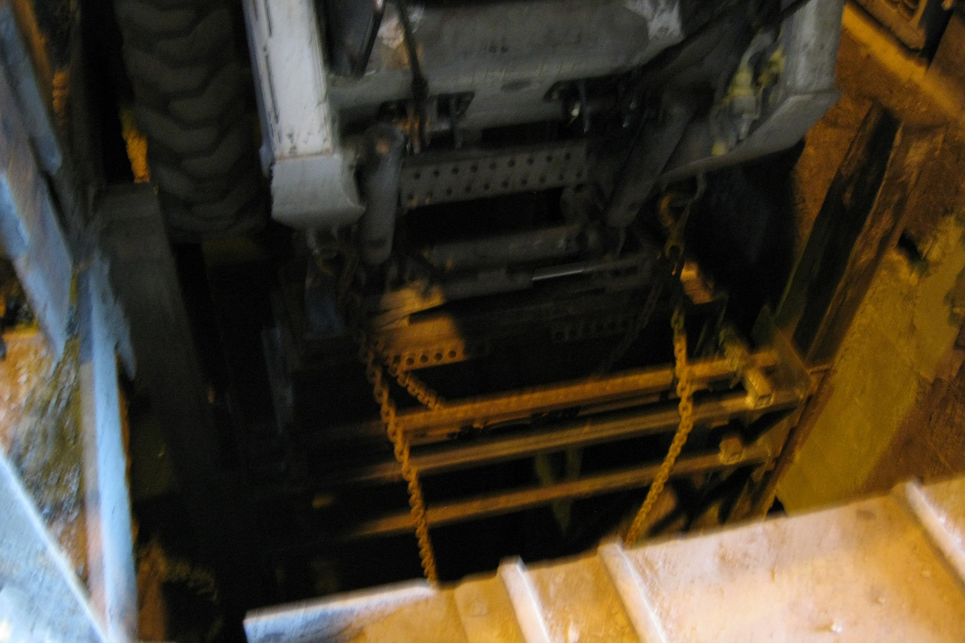
CHECKING THE LOAD BALANCE POINTS
A decision was made to install the guide shoes at the bottom of the load.

Slide 6
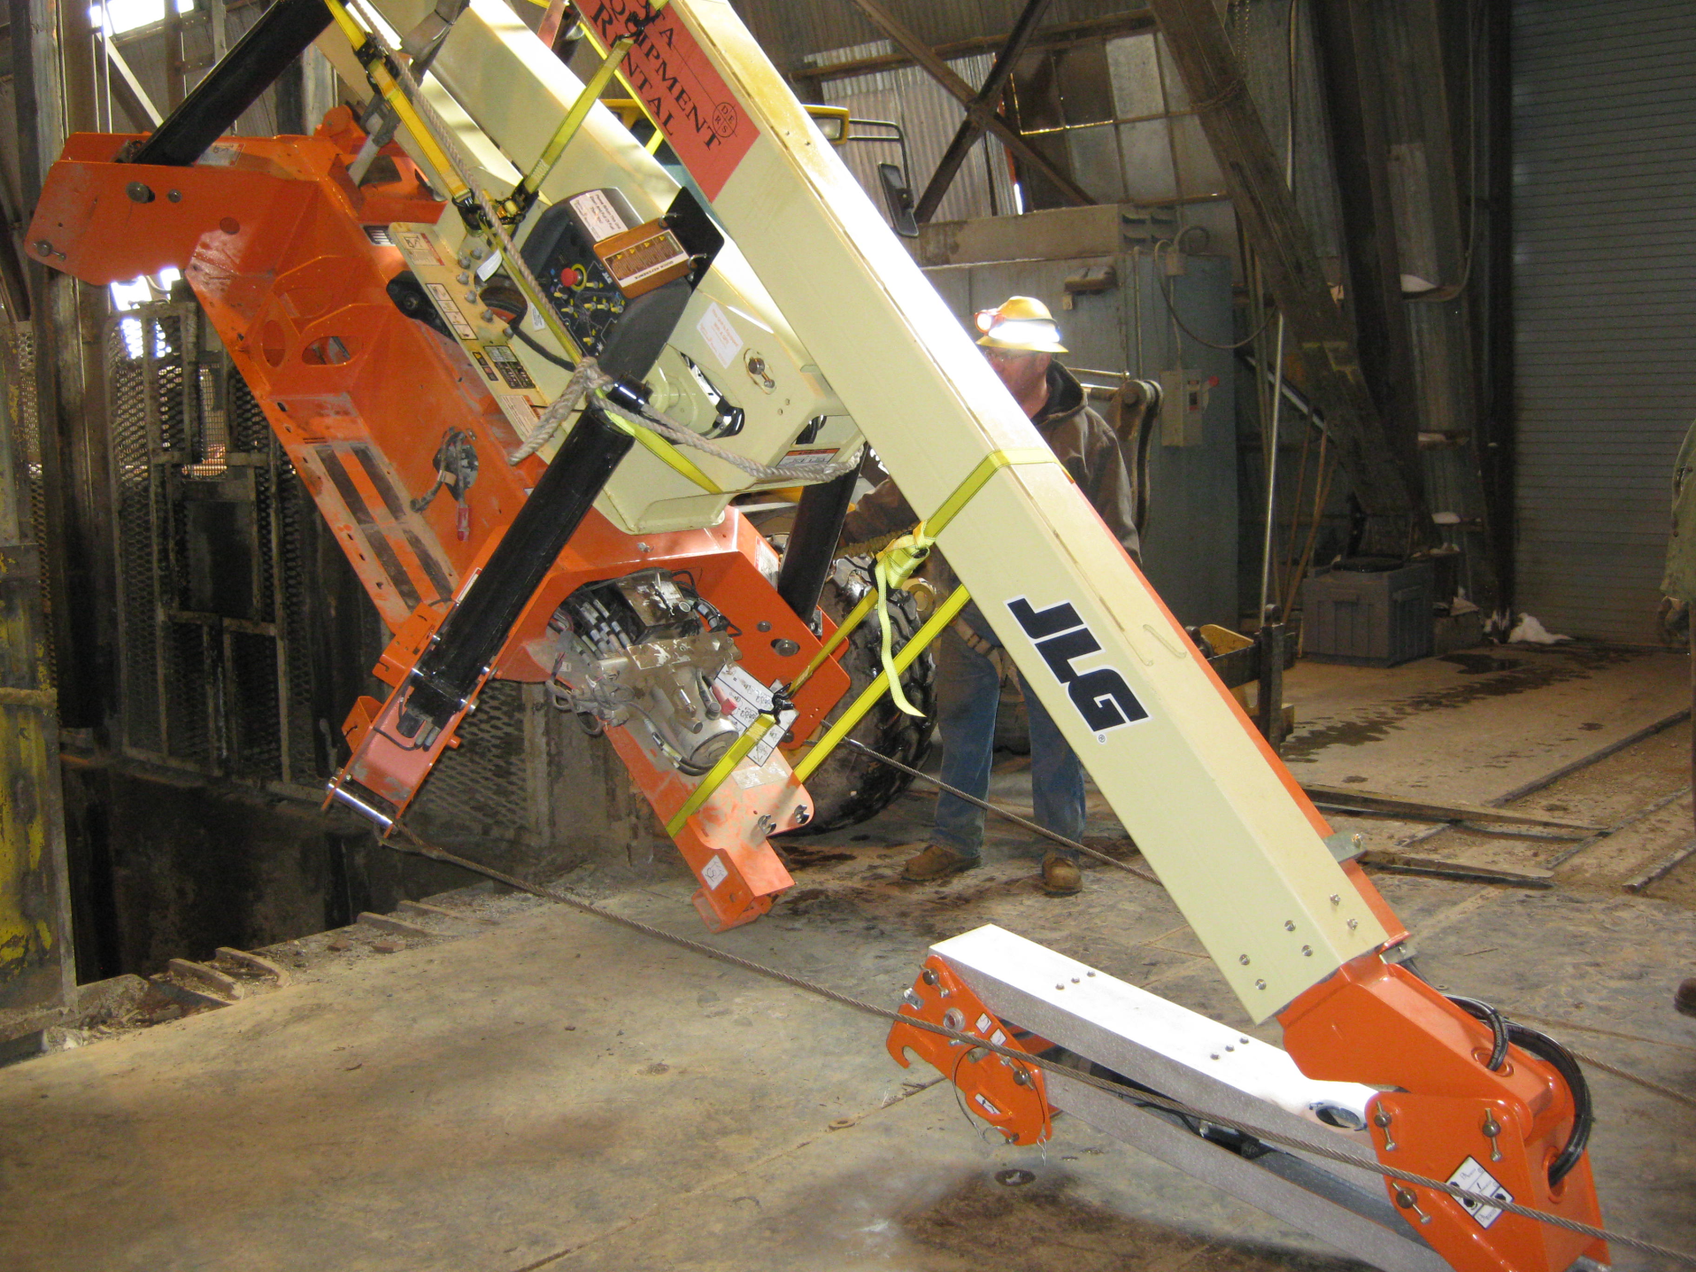
OTHER EQUIPMENT BEING SLUNG
The complete machine is lifted off the floor. The tail winch keeps the object under controlled swing into the shaft.

Slide 7
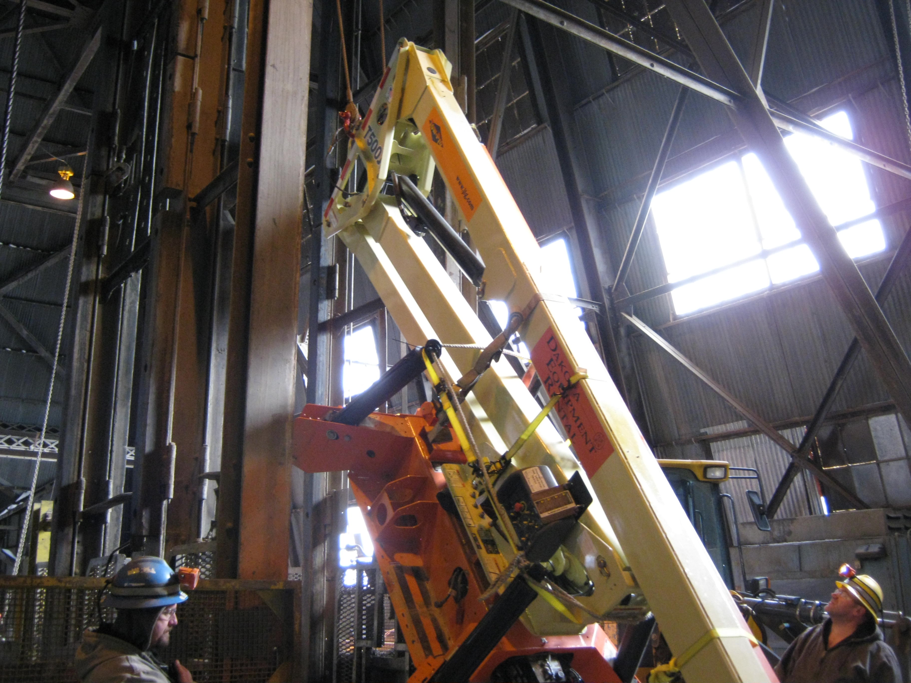
OTHER EQUIPMENT BEING SLUNG

Slide 8
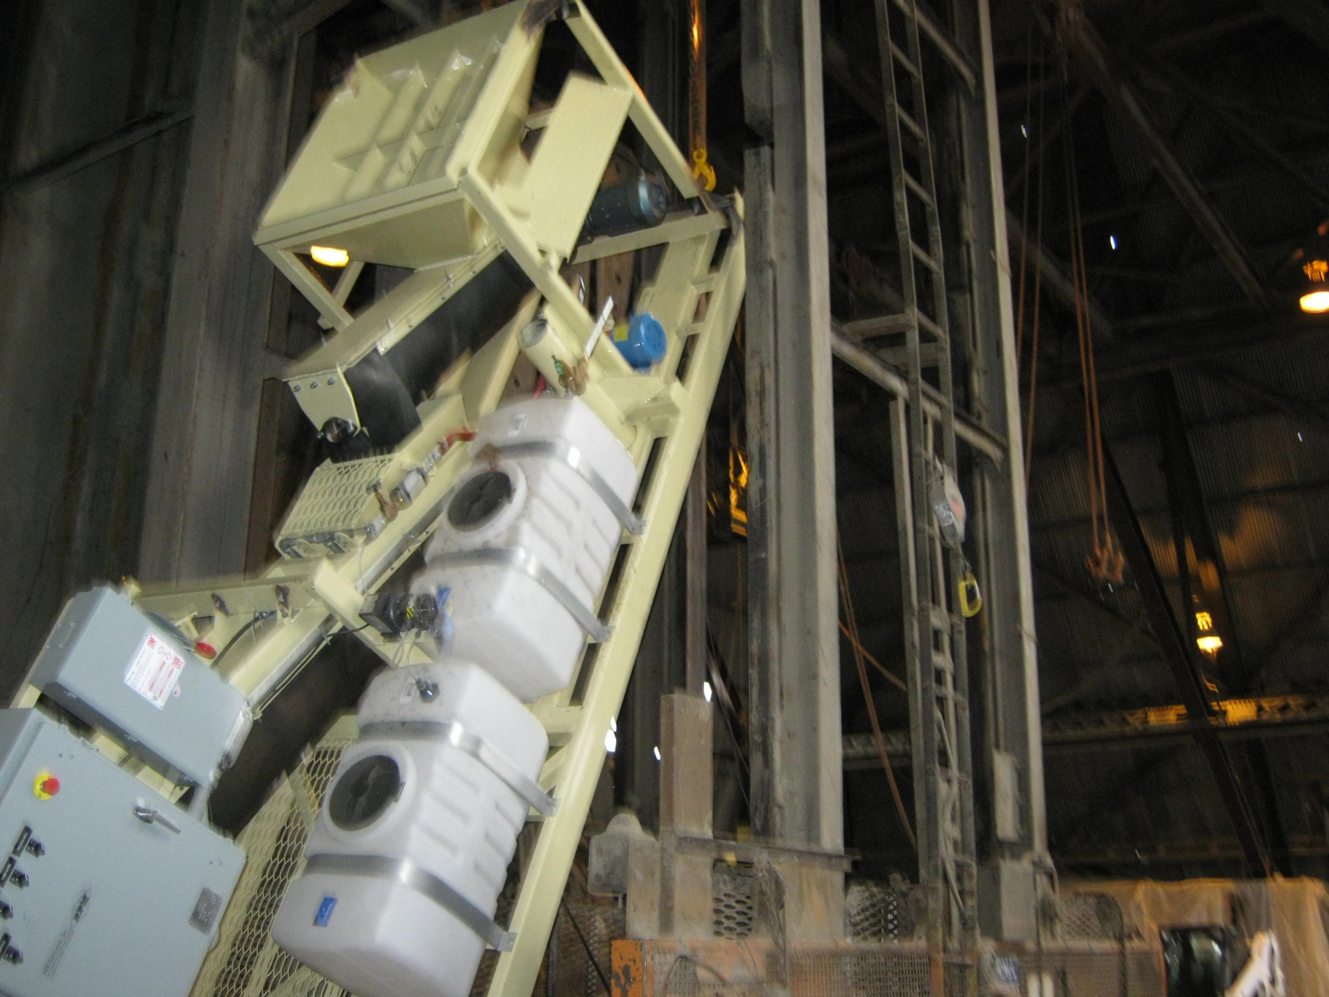
OTHER EQUIPMENT BEING SLUNG
Shotcrete continuous batch plant being lowered to the 4850L.

Slide 9
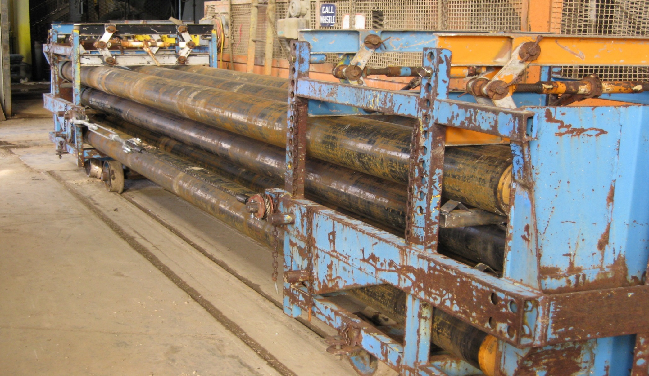
ZIMMERMAN TRUCKS FULL OF 8” PIPE
Here, this pipe is 8” Sch40 in random lengths, generally no greater than 22’ long. Rail in 30’ lengths has been lowered in the Yates shaft by these Zimmerman cars.

Slide 10
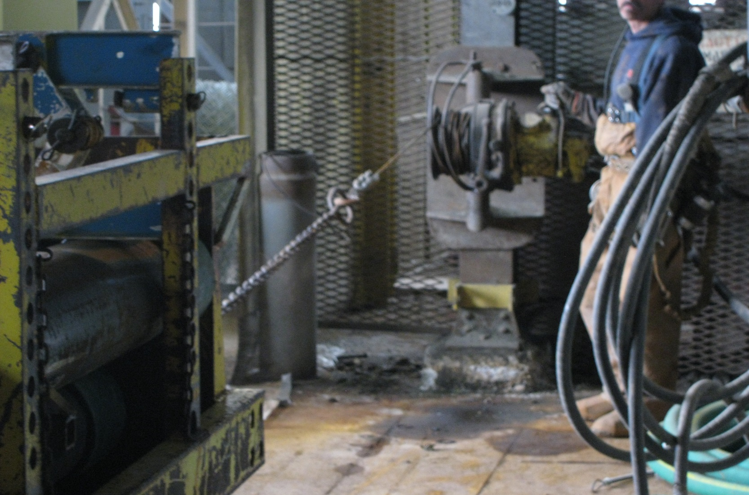
ZIMMERMAN LOAD
A tail winch must always be attached to control the bottom of the load.

Slide 11
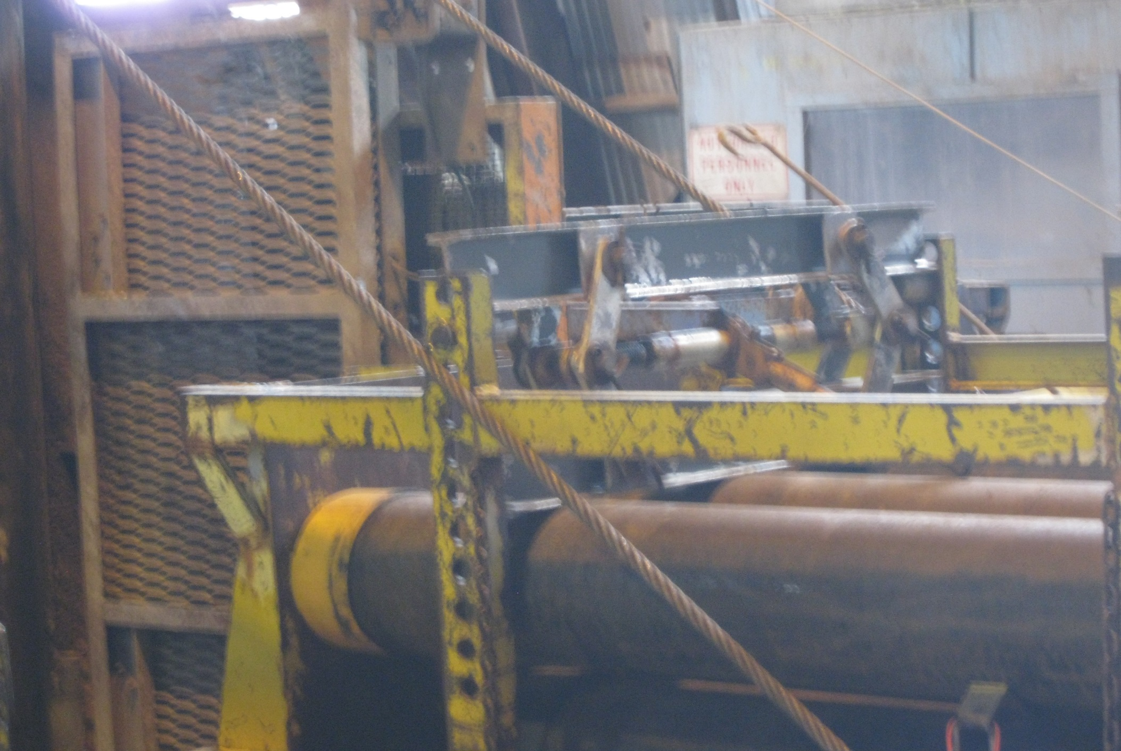
ZIMMERMAN LOAD

Slide 12
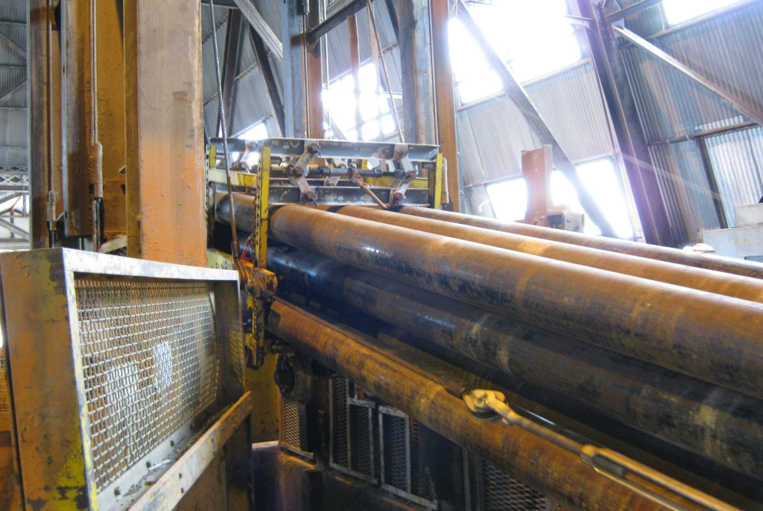
ZIMMERMAN LOAD

Slide 13
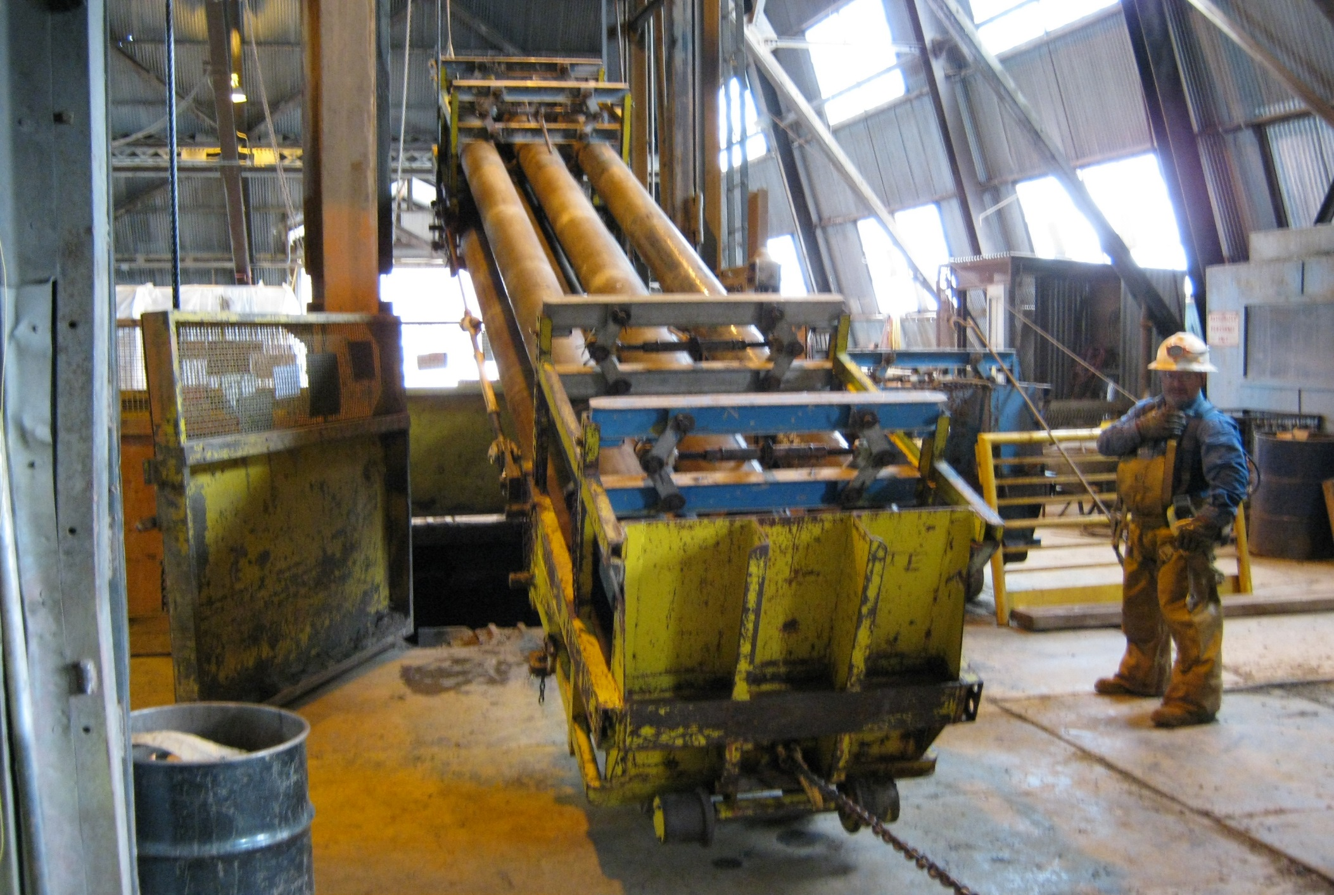
ZIMMERMAN LOAD

Slide 14
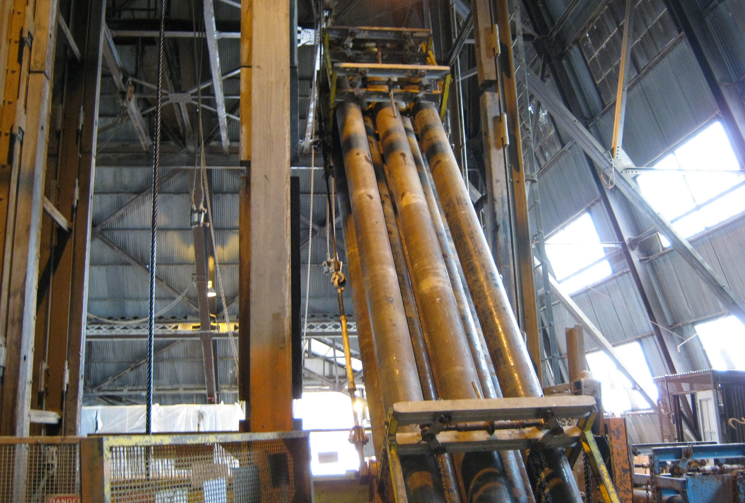
ZIMMERMAN LOAD

Slide 15
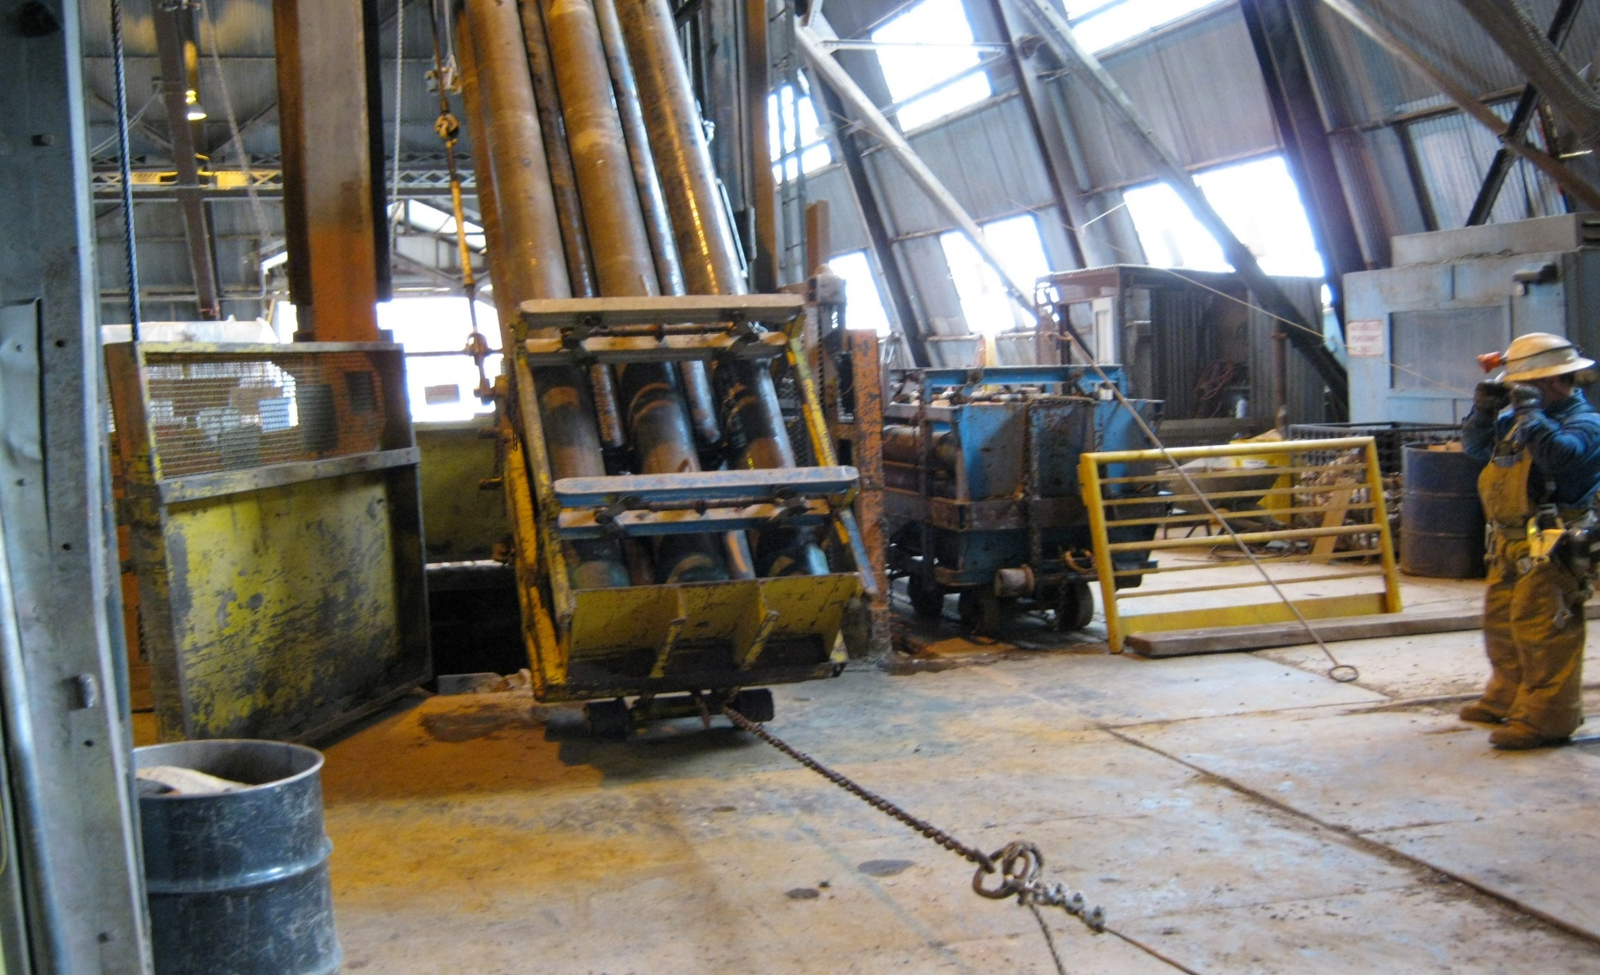
ZIMMERMAN LOAD
The attached chain stays with the load and will be hooked by the shaftman at the 4850 Level and the bottom will be pulled out to begin the unloading process.

Slide 16
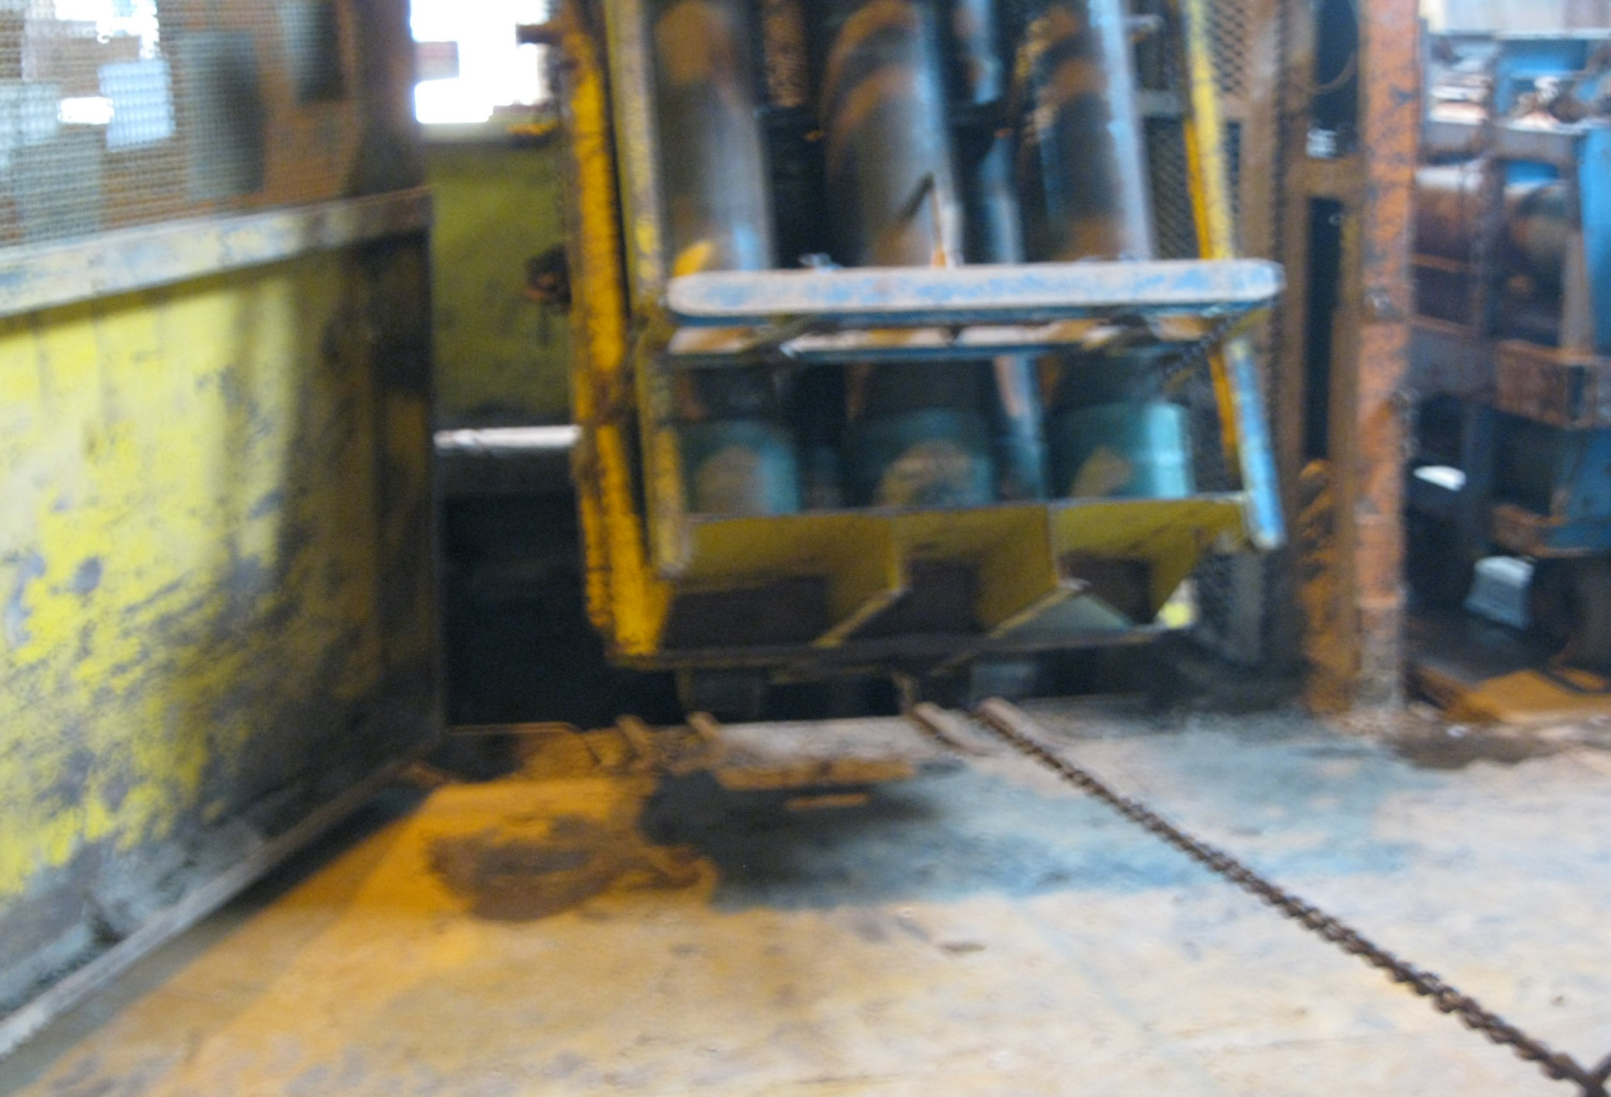
ZIMMERMAN LOAD

Slide 17
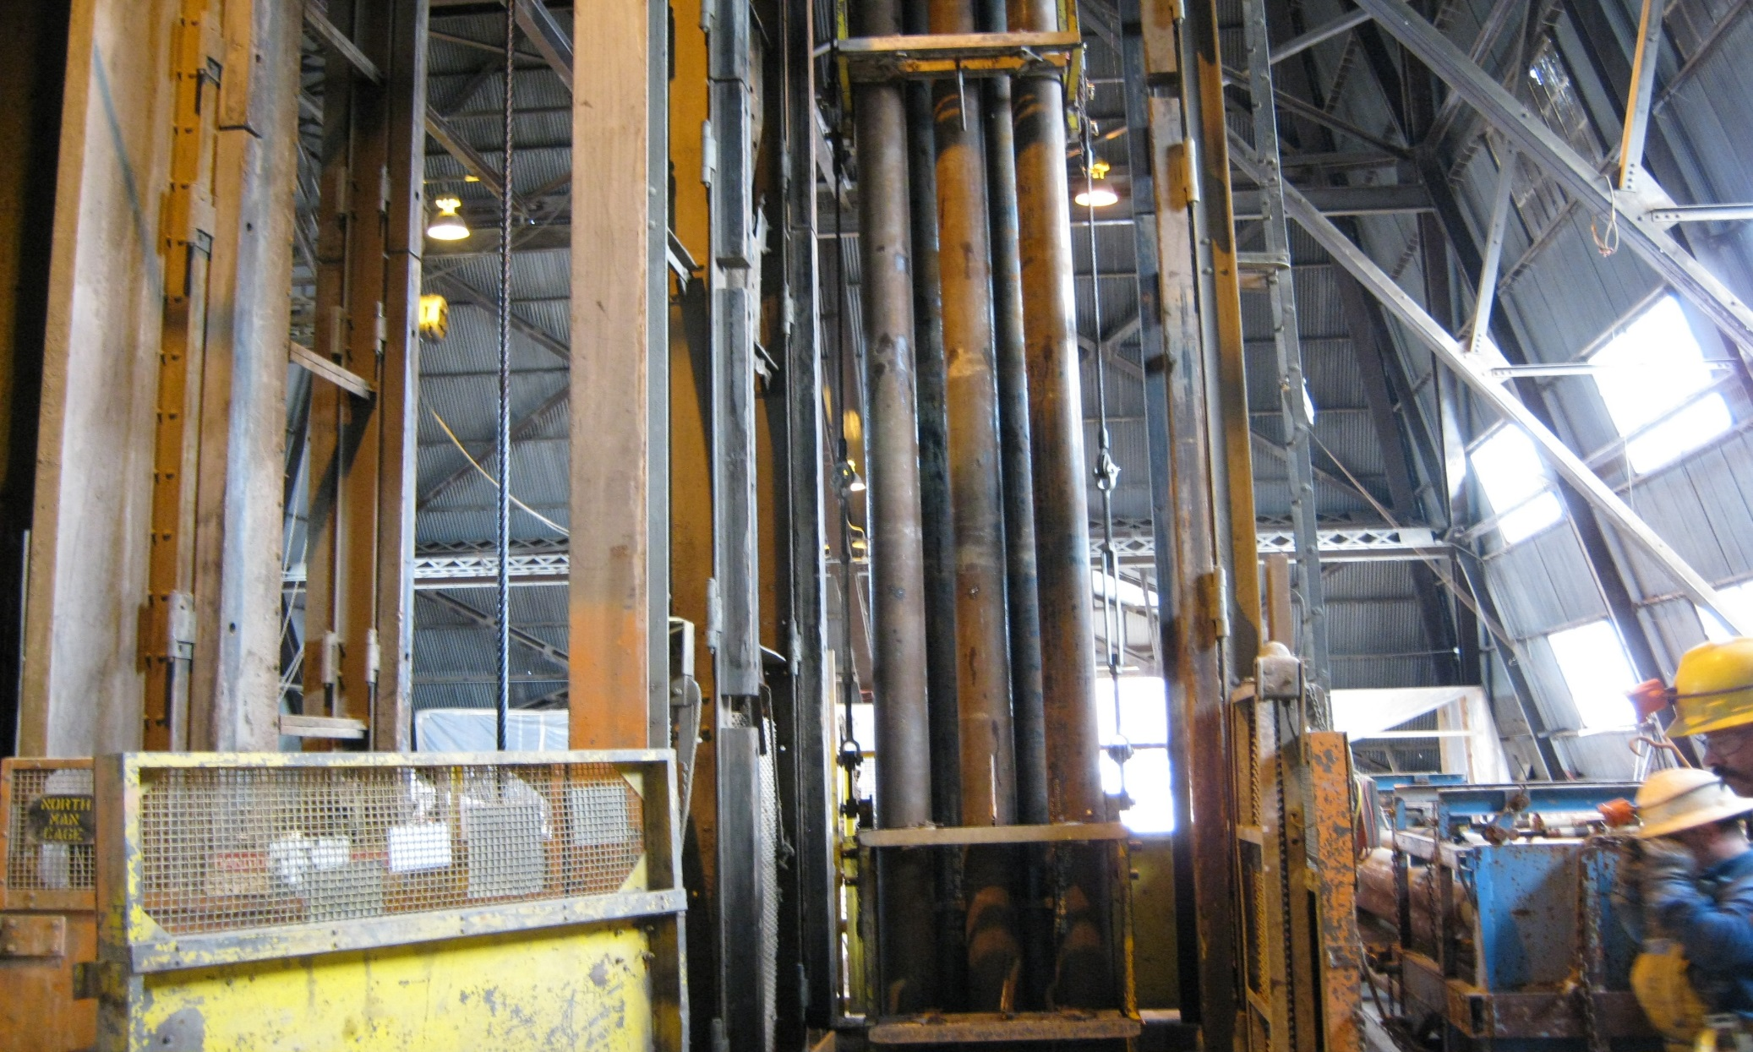
ZIMMERMAN LOAD
Ready to be lowered to the 4850L.

Slide 18
POSSIBLE CRYOSTAT BEAM
With a few critical lift items, no slings will be used. These beams will attach to the skip rope thimble while utilizing pins, a swivel, and steel links.

