Slide 1
Technical Coordination Placement of TPC in SP Cryostat
Farshid Feyzi
29 October, 2018

Slide 2
Considerations in Placement of TPC in SP Cryostat
Vertical
Overall height of double APA stack with CE boxes and cable trays
Height of TCO and placement of TCO with respect to cryostat floor and roof
Height of cryostat membrane corrugations
Cryogenic distribution pipes on the floor
Allowance for service floor between distribution pipes and TPC
Insertion beam to protrude through TCO and align with DSS beams
Horizontal (east to west)
Pitch distance between the APAs
Cryogenic down tubes
Access to end walls and HV feedthroughs
Instrumentation
Horizontal (north to south)
Centered

Slide 3
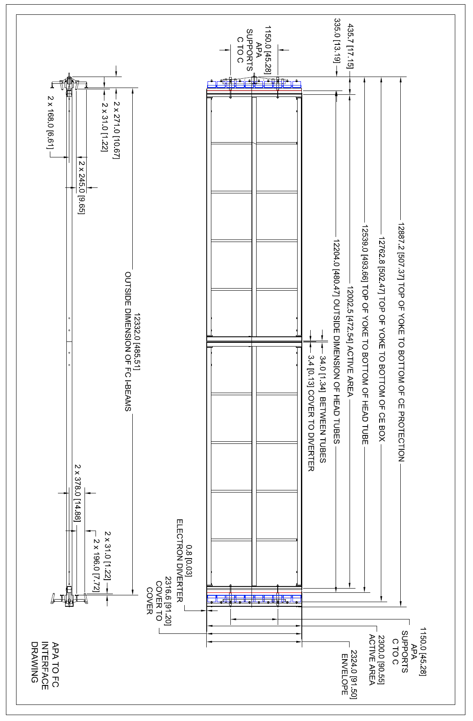
Double APA Stack
APA interface drawings with CE boxes and cable tray at the bottom (pdf files in meeting site)

Slide 4
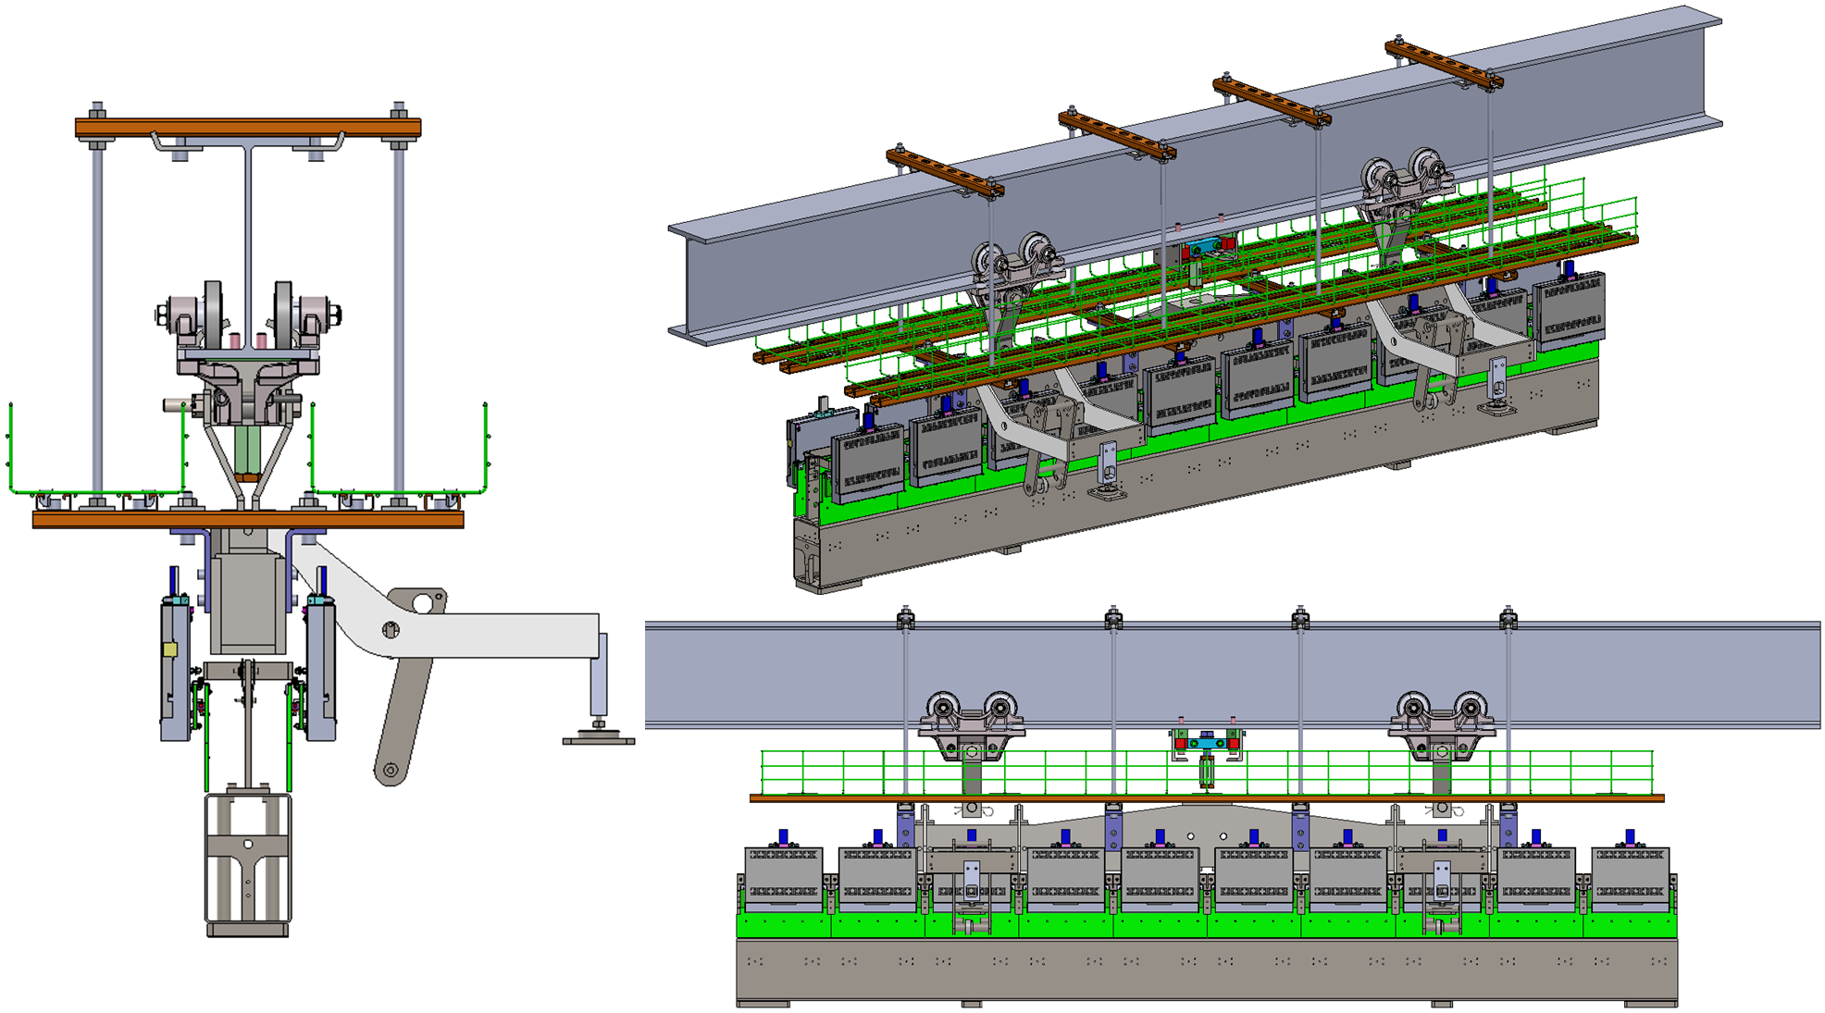
Cable Trays at Top of Double-APA stack
Attached to APA top
Weight transferred to DSS beam after installation
M. Zhao

Slide 5
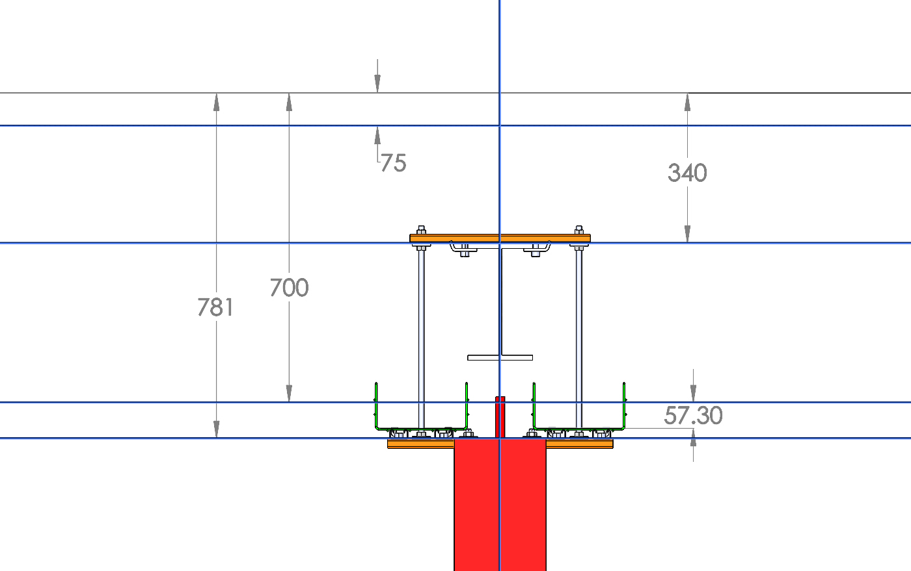
Interface at Top
These parameters define the top and are fixed
Top membrane
Corrugation allowance
Top of DSS beam
Nominal 95% fill
Top of APA yoke
APA envelope

Slide 6
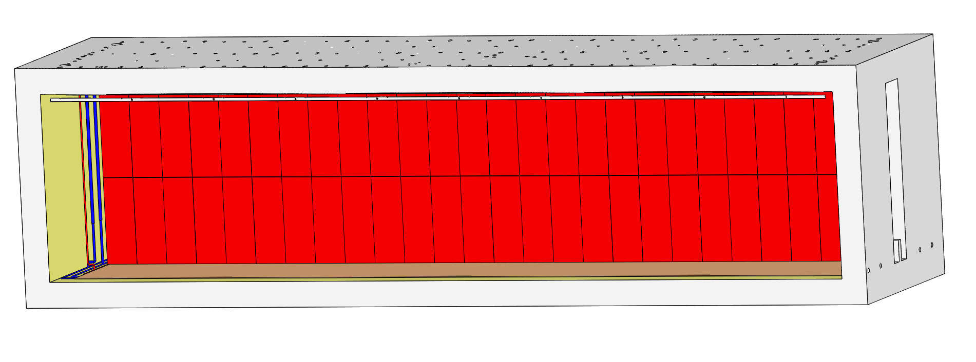
Cryo Distribution Pipes and Service Floor Interface
Service Floor
TOP flush with TCO bottom
Corrugation allowance
Bottom membrane

Slide 7
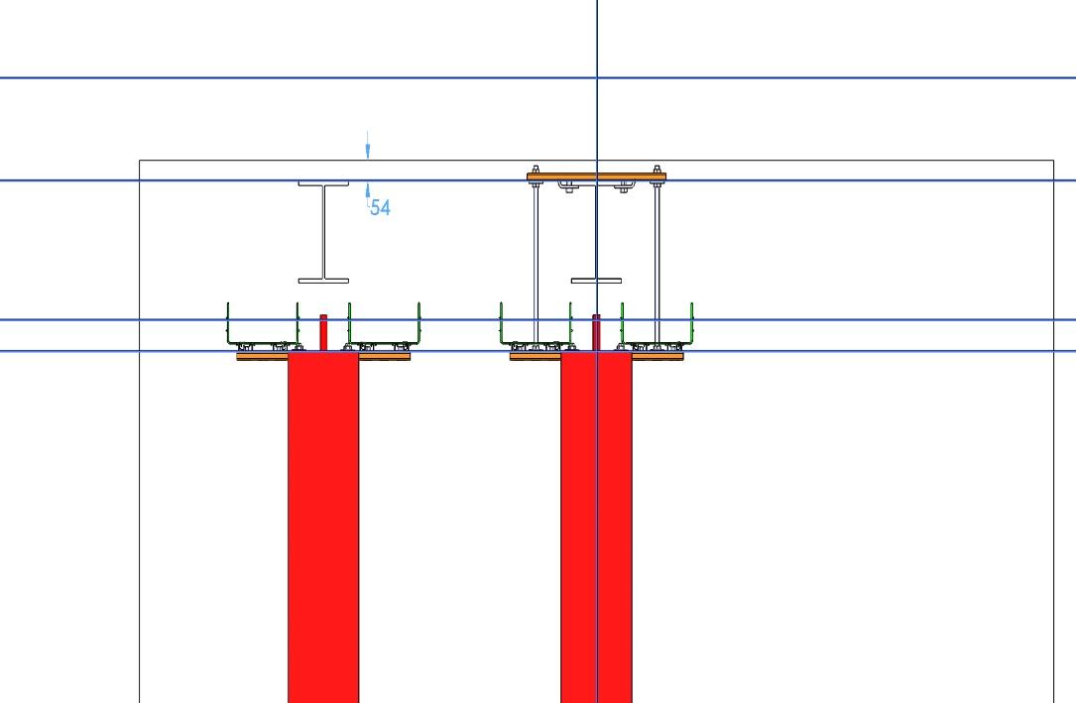
Interface to TCO
54 mm clearance top of insertion beam to TCO
TCO per CENBNFCR0073
45.8 mm clearance bottom of APA to TCO and service floor

Slide 8
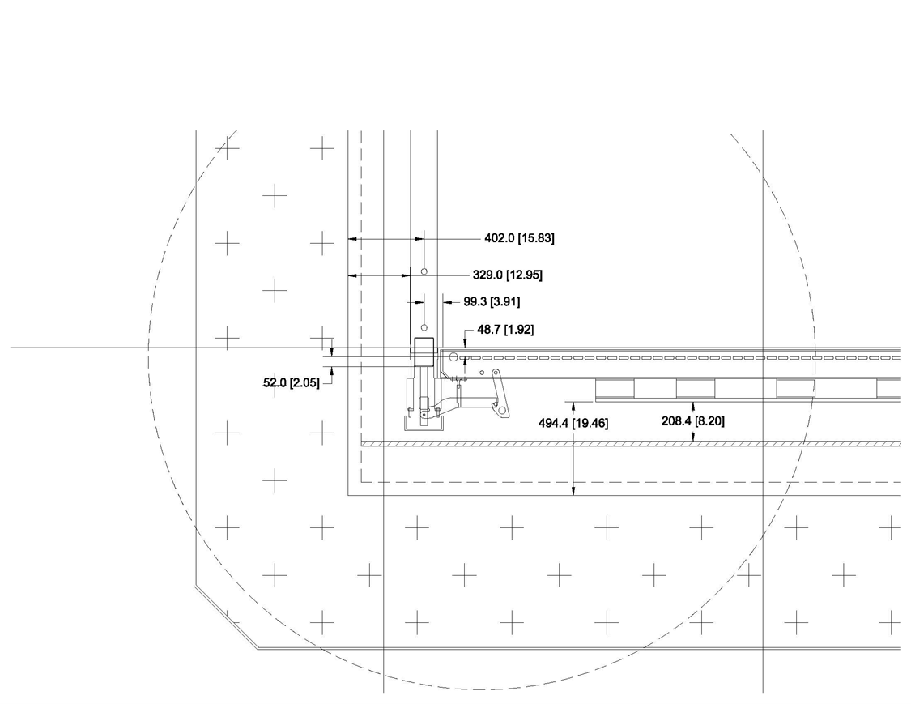
Details at Bottom Corners

Slide 9
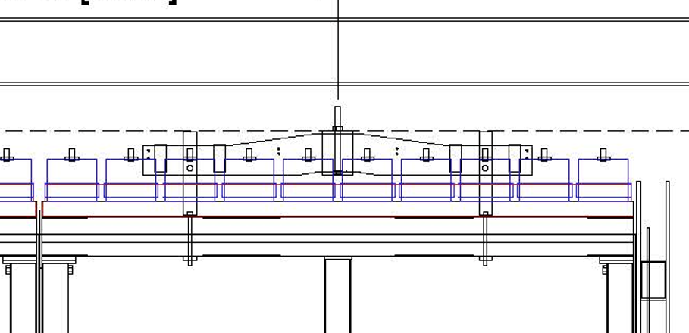
APA Pitch
APA design width is 2316.6 mm
APA double stack envelope width 2324 mm, estimate, including top and bottom misalignment
APA active area width is 2300 mm
APA yoke centering tolerance ±1 mm (estimate)
DSS beam and hanger cumulative tolerance ±1 mm (estimate)
Set pitch at 2328 mm
DSS beam shrinkage ~17 mm
Physical gap:
In warm state: 4 mm nominal (0 mm min to ? mm max, because we don’t know APA min width)
In cold state for APA on same beam: same as above
In cold state for APA on adjacent beams: ~21 mm nominal (17 min to ? mm max)
Gap in active area:
In warm state: 28 mm nominal (24 mm min to 32 mm max)
In cold state for APAs on same beam: same as above
In cold state for APAs on adjacent beams: ~ 45 mm nominal (41 mm min, 49 mm max)

Slide 10
Summary
TPC vertical placement fixed
Clearances must be maintained
All tolerances must be minus, not plus i.e. minimum material condition
Horizontal placement east and west not fixed
APA pitch of 2328 needs verification
Access to endwall and HV feedthoughs need more work
Horizontal placement north and south fixed-centered

