Slide 1
New ITF Requirements
J Stewart
October 30 2018

Slide 2
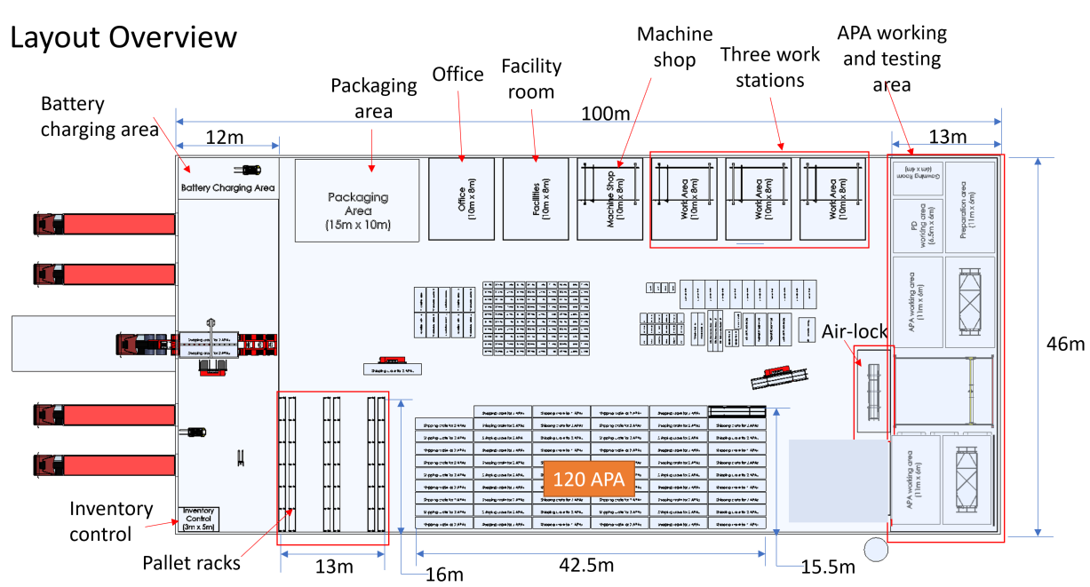
Original Integration and Test Facility Layout

Slide 3
Primary Impact of the Changes to the Underground Configuration on ITF
Storage areas exist underground outside the cryostat sufficient to provide a 1 month material buffer.
The cold testing will happen directly in front of the cryostat directly before inserting the components.
The mezzanine size is enlarged and provision is now for several barracks similar to ProtoDUNE
Waste will be disposed of directly from the Ross

Slide 4
Logistics Requirements

Slide 5
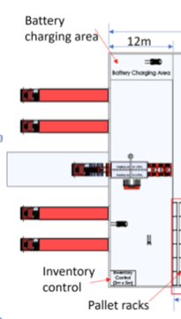
Logistics Requirements
The ITF must receive repackage and ship equipment to SURF.
  There is no space at SURF to construct buildings with multiple loading docks and flexible truck access.
A drive in truck bay is required
  Both APA and CRP will arrive on lowboy or flatbed trucks as these loads will not fit in a normal trailer.
  The drive in bay is also needed for loading flatbed/curtain-side trailers that can be easily unloaded at SURF.
Shipments to SURF need unloaded with equipment at SURF, where there is no loading dock.
At least two loading docks are required to receive shipments.
  Most material will arrive in crates and pallets at the loading docks. The arrival times will be random.
With the load data available one truck per day will be needed to go to SURF.
  Requirement needs evaluated by logistics manager.
  Delivery times driven by the CF schedule.
40 ft
46 m 150 ft

Slide 6
Material Flow Overview
List of loads for the Ross shaft has been revised
Summary
Total trips 1,636
Cage loads 1,356
Slung loads 280
(40 hoist days in 2 years)
Loads are sorted by installation phase
CUC Setup
Det#1 Setup
Det#1 Installation
Det#2 Setup
Det#2 Installation
The load list should be considered part of the logistics requirements.
Are other fields needed?

Slide 7
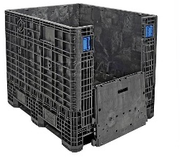
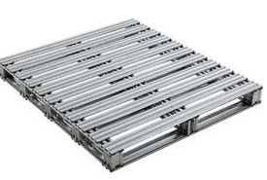
Additional Logistics Requirements
1-2 weeks of storage is needed in the logistics enter and the rest is underground.
  Sufficient buffer is needed to be able to consolidate shipments related to work packages.
  Required to work around weather and the CF schedule.
Equipment capable for loading and unloading all the loads is necessary.
  Crates, Pallets, long loads (I-Beam), APA and CRP …
Dedicated pallet storage facility is suggested.
All equipment entering the ITF must be inventoried.
  The inventory must be capable of tracking individual components in the underground area.
Hoist time is critical at SURF so an efficient method for repackaging smaller parcels into large units for underground transport is required.
  Halogenated material is not allowed underground.
  Fibrous material is not allowed in the cleanroom
Crane
toilet
Office
8x10
Inventory
Repackaging
Staging
10m by 15m
Wide forklift suitable for narrow paths

Slide 8
Logistics Summary
Two loading docks
Truck drive in bay
Capacity to process the material in the load list at the needed time.
Sufficient buffer capacity to consolidate loads related to single work packages (eq. Cleanroom construction)
An inventory system that tracks parts at the component level.
Equipment to unload standard trailers and large loads.
Equipment to load trucks suitable for SURF
Repackaging capability.

Slide 9
Integration

Slide 10
Impact on Integration Process
Cold testing underground is superior to the cold test in the ITF and could replace it.
  Need to decide this at this meeting.
The cold testing underground can only begin when the APA installation starts so the testing must be as fast as the installation process.
  Need enough cold boxes to keep up with installation.
The start of integration could be delayed to the start if cold testing is the integration can keep up with installation. This should be possible.
  This relaxes the delivery schedule for the non-APA parts.
  Reduces the number of transport boxes for underground.
The APA may be stored ~2 years after fabrication so the qualification process at the factory must be excellent.
  Need to review the qualification process

Slide 11
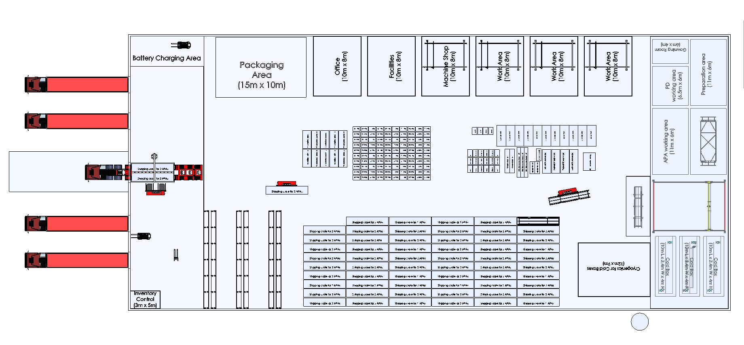
Integration Space Needs
13m (42.7’)
ISO8 cleanroom
  Material airlock & changing room
PD work area - 2 scanners, computers and storage 6.5m x 6m
General work area 11m x 6m
Two 11mx6m area for CE-PD-APA integration
34m (110.5’)
Material handling 12m by 13m
  Transfer APA to process cart
  Pack for underground transport
Total area 500 m2 or 5,400 sqft
Assumes no cryogenics at the integration site.
Packaging and material handling
airlock
Does not take into account storage of APAs. A buffer sufficient to keep the installation going is needed.

Slide 12
APA Long-term Storage

Slide 13
APA Long-term Storage
APA production is much slower then APA installation so a significant long-term buffer is needed somewhere.
  4 APA per month over 2 years to get 96 APA in-hand
  Install at a rate of 6 per week
660 m^2 or 7,100 sqft of warehouse space is needed even if the APA are close packed.
  A tent with filtered air is desired.
120 APA
42.5m
15.5m

Slide 14
APA Storage Considerations
If the APA-CE-PD integration is done roughly in time with the installation and cold testing then a large number of underground transport boxes are not needed.
The crates and shipping containers may be packed with more than 2 APA so the storage requirements may be relaxed.
The amount of warehouse space needed is time dependent.
Local warehousing of APA crates and storage containers should be possible near the production sites: Liverpool, Chicago, New York.
  Investigating alternate APA storage options should be done.
APA storage in the ITF should be considered a desire not a requirement.

Slide 15
Work Areas in ITF

Slide 16
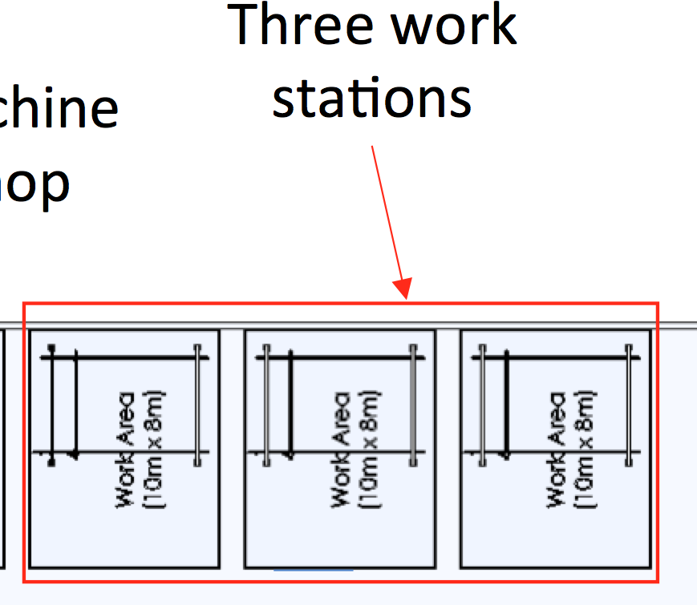
Workstation and Shop
Present ITF plan calls for 3 work stations each 10x8m.
Groups requesting space in the work areas are TC, CISC, SP-CE, DP-PD and DP-Elect
Numerous requests were driven by the lack of space available at SURF and underground.

Slide 17
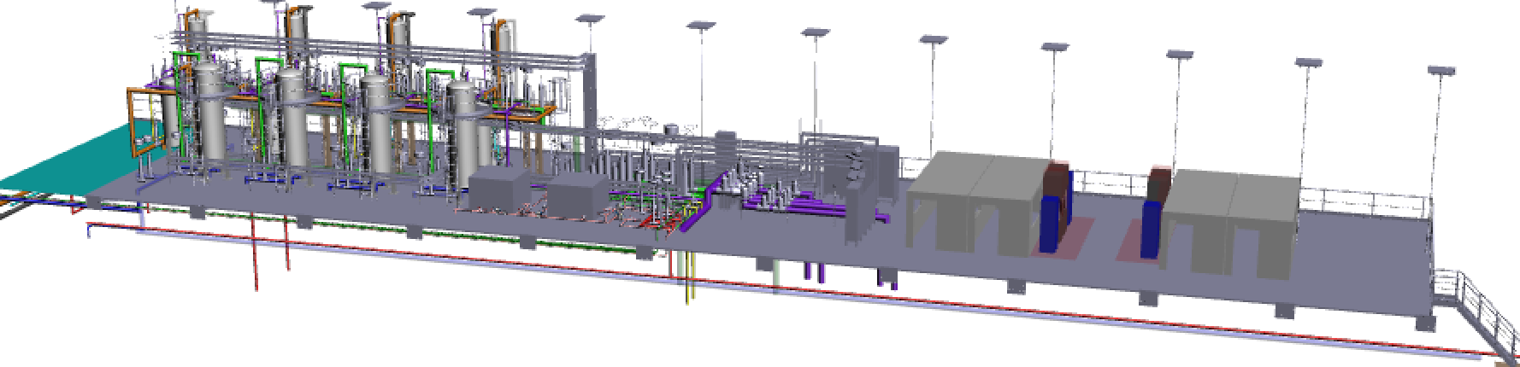
Impact of changes underground to the work-area planning
The cryogenic mezzanine has been enlarged to add two new barracks. This will give some space for light work underground.
  Electronics, grounding/diagnostics, CISC?
  Underground occupancy remains a big concern
Surface locations at SURF for light work exist and should be investigated.
The integration cleanroom may be slightly larger to make space for the work planned in the workstations.
Cryogenics
DUNE
New Extended Cryogenics Mezzanine
Extension

Slide 18
Workstation Conclusions
As the workstations are relatively small several options may exist either on the surface or underground.
  The option to increase the large cleanroom in the ITF a small amount for these tasks should be considered.
The requirements for the workstations should be removed and other options investigated.

Slide 19
Additional ITF Requirements
The building must be heated and dry
Office space is required for building management
  Experience at Ash River indicates 8m x 10m is required.
Wifi is necessary
Basic machining capabilities are required either in the ITF or at a nearby facility.
Sufficient toilet facilities are required.

Slide 20
Discussion
Are any requirements missing?

Slide 21
Backup

Slide 22
Space required for Logistics Center?
Assume only 1-2 weeks of storage is needed in the logistics enter and the rest is underground.
Assume roughly 1 truck per day to the Ross
A truck will hold 24 pallets or 8 cage loads
Total area 1,200m^2
13,000 sqft is a minimum
Assume several times the truck space is needed to receive-repackage-and stage shipments.
Assume 3-5 people
Truck width
toilet
What about Cryostat and cryogenics?
Office
8x10
Inventory
Repackaging
Staging
10m by 15m
30m
(100ft)
40m (130ft)

