Slide 1
Some points from this integration meeting to be taken as action and/or decisions summary SURF 31/10/2018

Slide 2
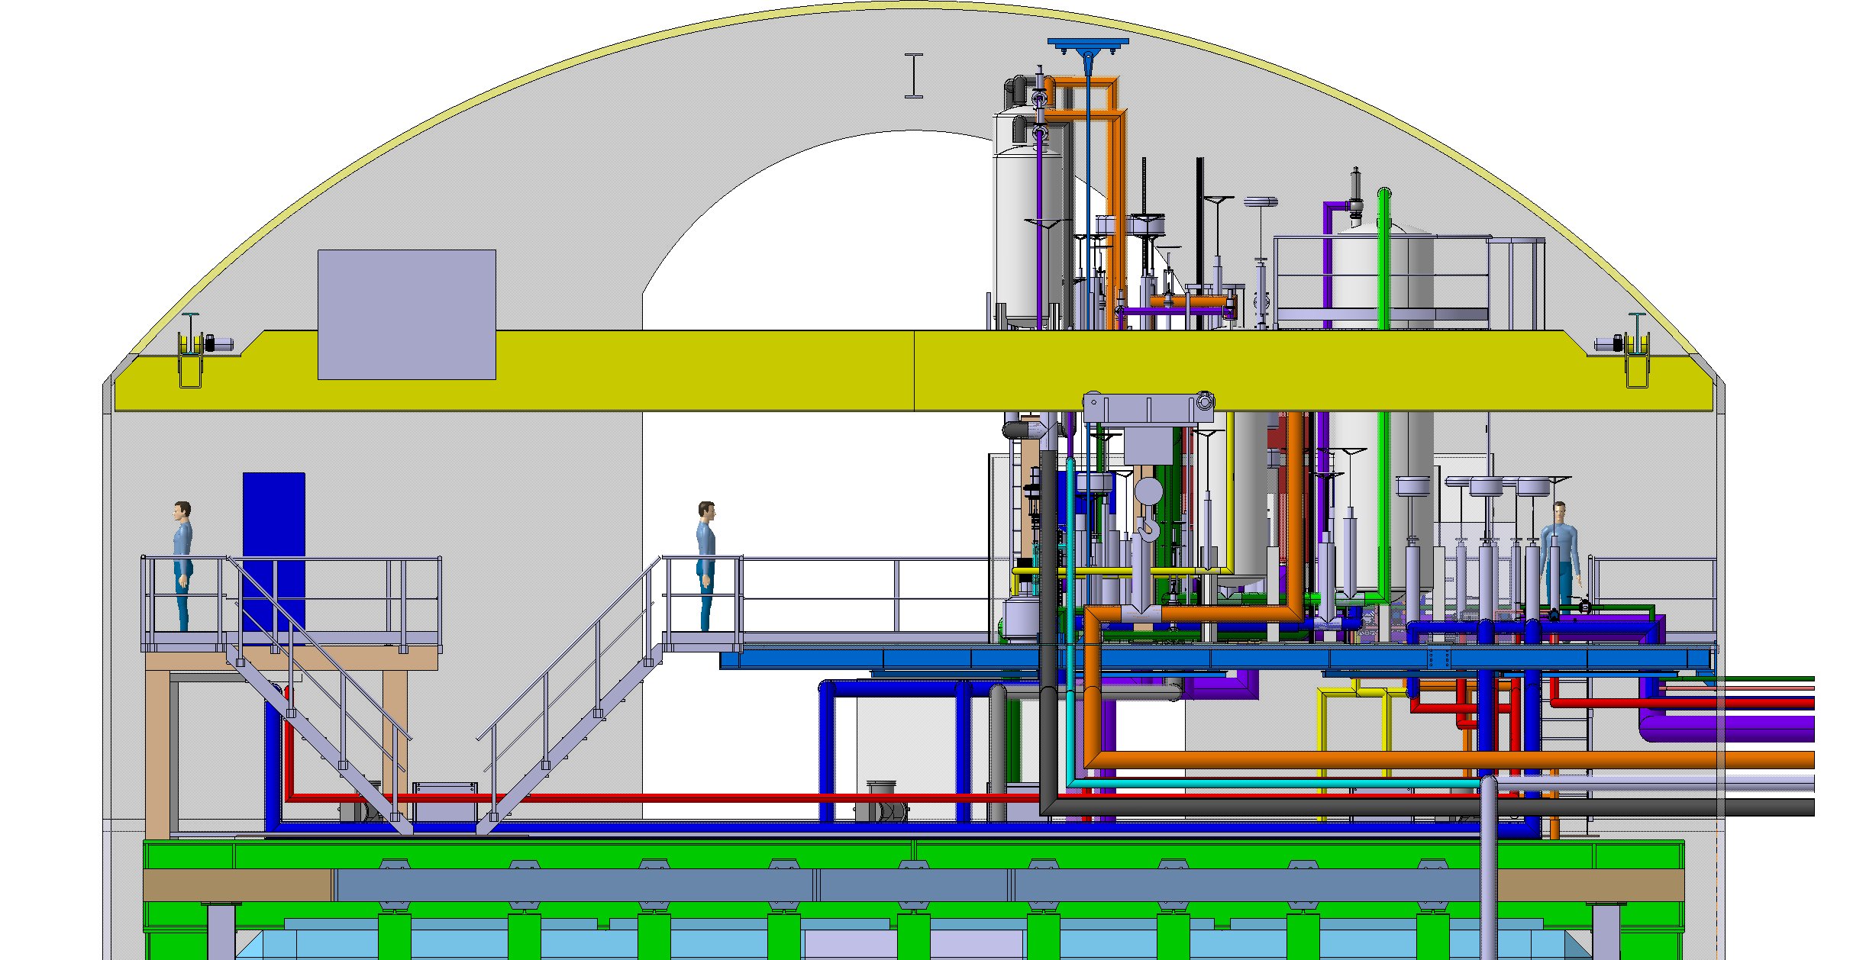
New layout of the top of the cryostat
monorails ~20T
bridge crane ~12T
detector mezzanine
cable trays
to CUC

Slide 3
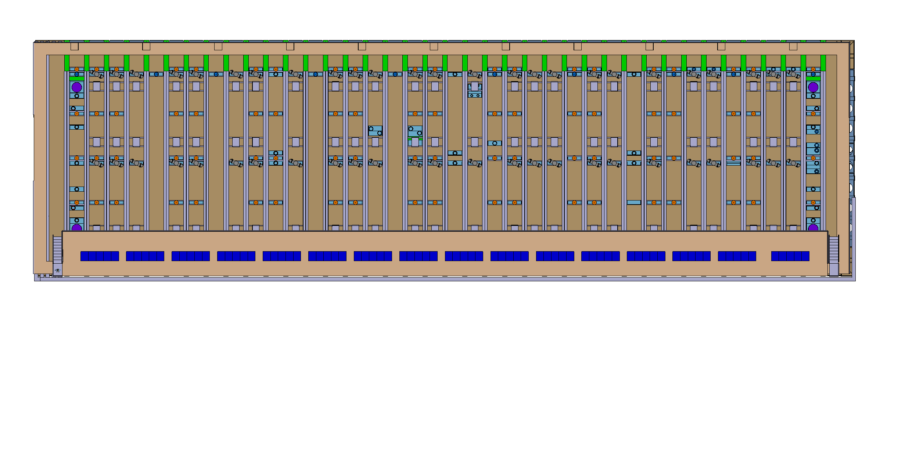
New layout of the top of the cryostat

Slide 4
New layout of the top of the cryostat
Need to finalyse the routing of all cables/fibers to CUC
The cooling of the power racks
Eventual interference with special feedthroughs (calibration, laser, Neutron source…)
Dimitar and Jack to provide a new set of integrated models with as much details as possible

Slide 5
SP cryostat top penetrations
Reorganize the penetrations for the DSS
Reorganize a few penetrations for the inner cryogenics in front of the TCO
And swap the position of the TCO
Marzio, Dimitar and Jack to issue a new drawing and get it approved by GTT

Slide 6
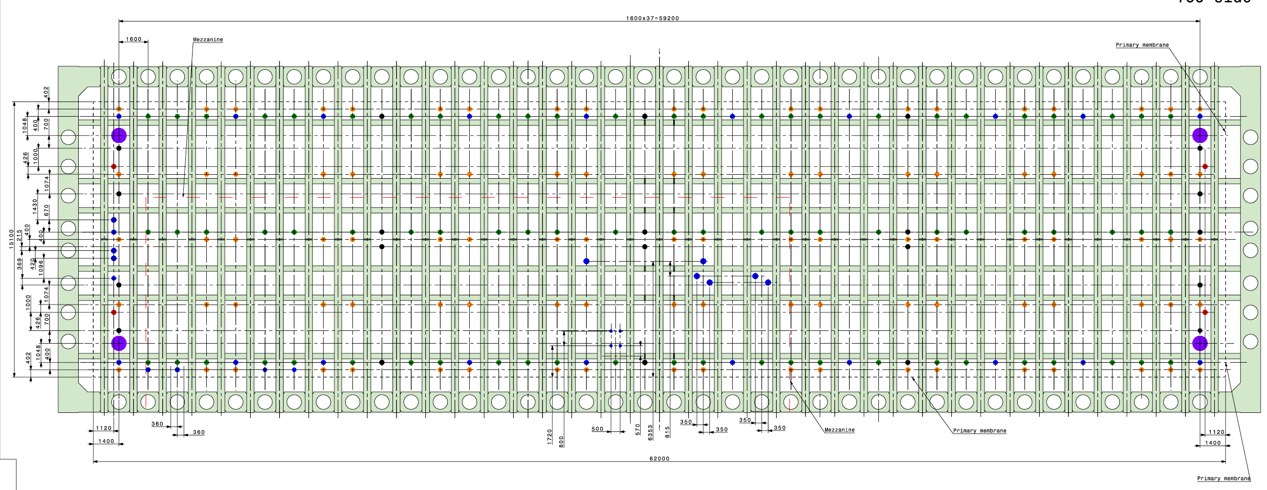
DSS penetrations to be mirrored, all at 20cm diameter?
x
x
x
x

Slide 7
cryo penetrations reorganization in front of the TCO
TCO

Slide 8
Cryogenics
No possibility to have the N2 plant in place for the cold boxes. Impossible to install the pipes in the shaft in time?
Need an alternative solution
Schedule for the installation of the internal cryogenics pipes
Before we position the wooden floor (at least partially)
In parallel to the last phase of the cold cryostat construction and the initial part of the detector installation
In parallel to the detector assembly (vertical pipes)

Slide 9
Double APA vertical dimension
We might still have just 4 cm of clearance at the level of the TCO
We need to go to more details and see if it possible to given more vertical space in the TCO opening (action on Dimitar and Farshid)
David has to lower as much as possible the pipes on the floor.

Slide 10
Moving the big beams and APAs down the shaft
A more detailed engineering done by experts is necessary
We need to organize a working meeting with the experts at SURF and a CERN engineer specialized on this.
To be organized by Marzio and Patrick
Still the responsibility remains with the host lab for all manipulation in the shafts and underground
Necessary to create a scenario on how to handle the organization of all transports underground and define the responsibilities
This is valid for all cranes operations in general. We need professional riggers support

Slide 11
Logistics
Good to have a clear reference point
Need help from FNAL to have an homogeneous transports and shipping organization with clear rules (also for small boxes)
We need a PBS with a clear label convention and a database which covers from production to physics. This cannot be just procured in the marked, need a group behind.

Slide 12
Dust in the cryostat
Bring inside the cryostat air just coming from the main ventilation (filtered already)
Importance to keep cleaning the wall of the cryostat
150kg of dust/year looks to be a lot, relook at the scenario adding necessary actions and steps in the process

Slide 13
CLEAN room and integration facility in the cavern (det 1)
Large progress done
Need now to go to details
Ok for Alimak on the west entrance
Insert more realistic cold box design (door opening) and latest cryostat and services models
Move CPA assembly away from cold boxes
Clarify which type of APA transport boxes
Bill to keep organizing integration meetings on the subject

Slide 14
Installation of APAs and CPAs in the cryostat
Clarify which FC deployment sequence
Clarify tools needed inside (lifts, floor removal, FC deployment, for cables …)
Clarify temporary door on TCO
Clarify lighting
Can we weld cryo pipes near TCO during installation of APAs?
Model TCO closing scenario (internal clean room, material inside, ….)

Slide 15
Passive storage requirements on the surface (ITF or elsewhere) m2
Cryostat warm : in the preparation firm in SD, then movement underground directly
Cold cryostat : 20-25% in the cavern, 75% as repetitive material in simple storage areas (~5000m2)
Internal cryo pipes : storage on top of the cryostat
APA stored in the cavern ~16% =120m²
APA stored on the surface ~80% = 600m²
HV stored in the cavern ~20%=140m²
HV stored on the surface ~20% = 140m²
EL+cables+crates stored in the cavern ~20%=70m² +120 pallets
El+cables+crates stored on the surface ~40% = 140m²+240pallets
Does not include floor space for access.

Slide 16
Passive storage requirements on the surface (ITF or elsewhere) m2
FD stored in the cavern ~10%=120m²
FD stored on the surface~30% =800m²
Mezzanine Cryogenics stored on surface = ?
Cryogenics in CUC stored on surface = ?
Total on surface = 1680m2 +5000m2
Might be a 5000m2 passive storage is enough?

Slide 17
ITF active space requirements
Electronics: m2=40m²
FEMBs test + DAQ + Cryo (here?)
Cables on spools (here?)
APAs: m2=600m²
Wires tension test
Insert PDs (horizontal?) + continuity test
Install the FEMBs on the APAs and perform quick test
HV/CPA : none
PD: m2=included in the APA space
Scan test (clean room)
Do we need a cold box for individual sampling tests ?

Slide 18
Racks requirements
Ok
Can we lower at some point the final amount of power needed?
Is the ventilation of the cavern absorbing all this?
We will have a dust problem in the racks

