Slide 1
PIP-II Project Manager’s Report
Marc Kaducak
Project Management Group
19 Sep 2018

Slide 2
Outline
Staffing/Organization
Funding, financials
International Updates
Technical Updates
CD-2/3a Preparations

Slide 3
Staffing
Project Controls Manager position still open.
  Note: we have a functioning project controls team. Thanks to OPSS for continued support.
Procurement Manager and Administrator – interviewing
  Current procurements supported by central procurement group
QA Manager
  Jemila Adetunji fully engaged as QA manager and has initiated a search for a longer term QA manager.
Risk Manager
  Working with OPSS and IPPM on possible solutions
  Lucas Taylor available for guidance/training

Slide 4
Funding Profile and Milestones
Corresponds to FY19 PBR. We are planning to $35M = $15M OPC + $20M TEC.
Milestone | Planned | Actual or Forecast
CD-0 | Q1 FY2016 | November 12, 2015 (A)
CD-1 | FY2017 | July 23, 2018 (A)
CD-2/3a | FY2019 | Q3FY2019
CD-3 | FY2020 | Q4FY2020
CD-4 | FY2026 | Q3FY2027

Slide 5
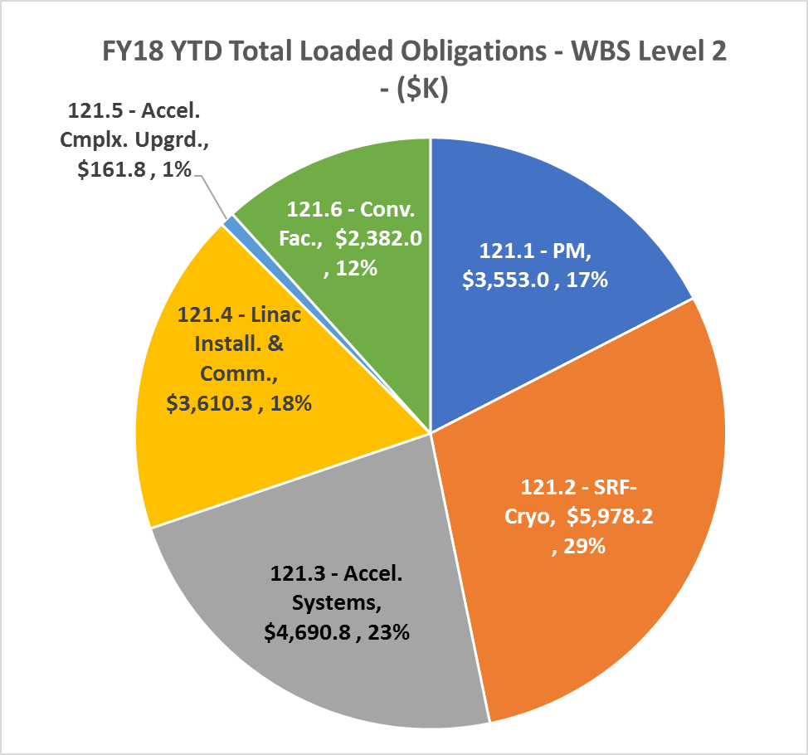
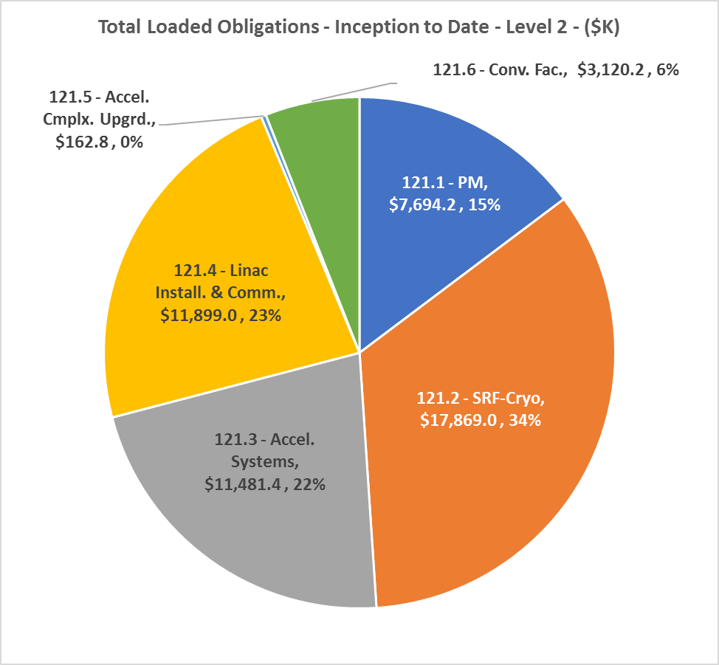
FY18 Financials thru August 2018
Year to Date | Inception to Date

Slide 6
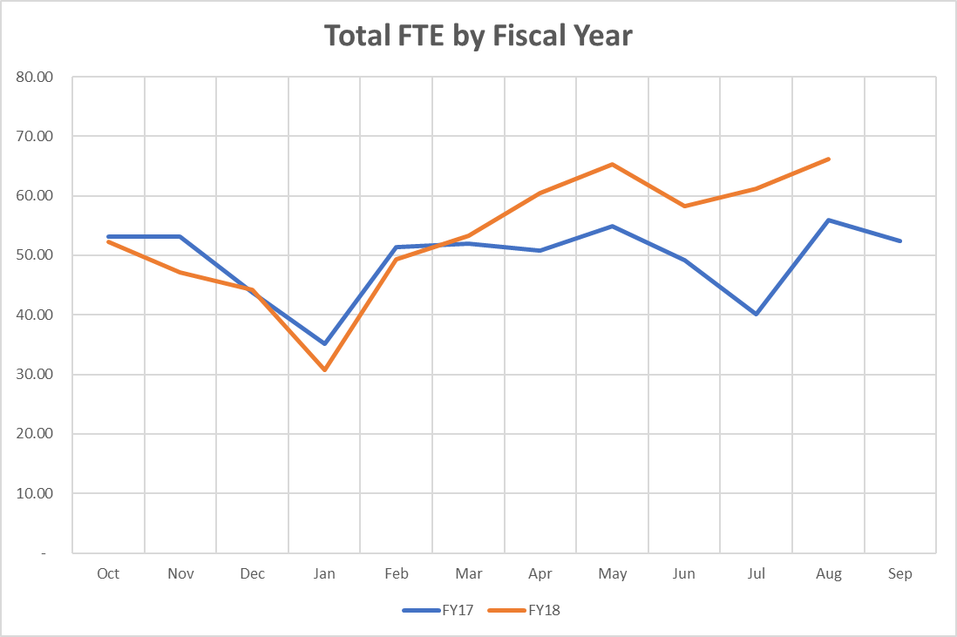
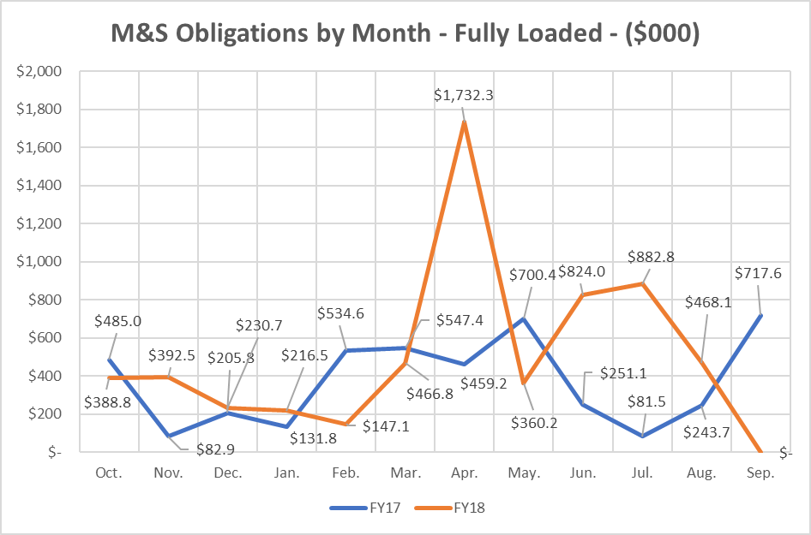
Labor and M&S Trends
~10 FTE increase since March 2018
Expect to obligate ~$8.3M M&S for FY 2018

Slide 7
Updates - International Partnerships, In-kind Contributions
Agreements
  Project Planning Document (PPD) template for partner IKC sent to DOE-OHEP. Has been reviewed by General Counsel.
  Project Annex with INFN expected to be signed in December 2018.
  Proposed India construction deliverables discussed with IIFC Technical & Principal Coordinators - Working on estimating corresponding values in “DOE” accounting.
  CEA planning internal review of scope, cost, and schedule of potential contributions at end of September 2018.
Events
  CM workshop & PC/TC meeting at BARC, Sept 3-8.
  Contingents from Wroclaw University visited this week, IFJ-PAN in November
  UK visitors Sept 27-28

Slide 8
ESH&Q Update
Addressing DOE Council comments for the draft public release EA
  Anticipate EA public comment period starting in October
Submitted ESH section for the PIP-II PDR
Finalizing the PIP-II Safety by Design Implementation guidance document
Updating the PIP-II PHAR for the upcoming IPR
Developing the PIP-II Construction Safety and Health Plan
ESH&Q Radiation Physics Science Department is reviewing the updated PIP2IT Shielding Assessment

Slide 9
WBS 121.2 SRF Updates – HWR Cryomodule
HWR Cavities (9.7 MV/m, Q0 = 5e9)
Transportation PDR completed.
Status review completed. Assembly preparation is in progress.
  Committee found that HWR could not likely be completed before end of April 2019, which was considered an aggressive schedule.
  ANL has formed a committee to ensure that resources are available in a timely way and that the project can move efficiently through the lab’s ESH processes.

Slide 10
WBS 121.2 SRF Updates – SSR Cryomodules
SSR1 Cavities (Specification 10 MV/m, Q0 = 6e9)
SSR1: Six cavities ready for string assembly. String assembly preparation is in progress
SSR2: RF model finalization is in progress.
Couplers all qualified. Spare unit is available for SSR2 coupler validation.

Slide 11
WBS 121.2 SRF Updates – 650 Cryomodules
HB650 5-cell Cavities (Specification 19 MV/m, 3.0e10)
HB650 R&D: Doping was completed for 1-cell cavity B9AS-PAV-104. Test is scheduled.
Coupler: Low loss coupler cleaned and ready for particulates test and assembly procedure validation
Tuner prototype qualified.
LB650: Cavity mechanical design was completed. Prototype cavity is being procured in partner lab

Slide 12
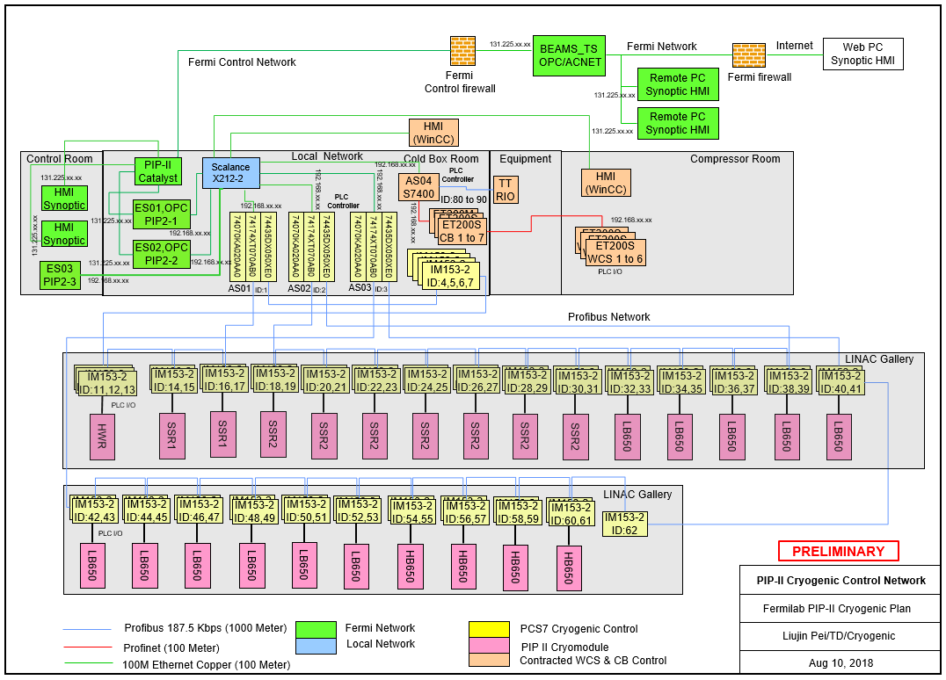
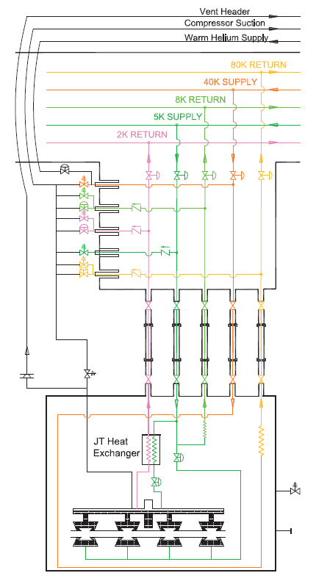
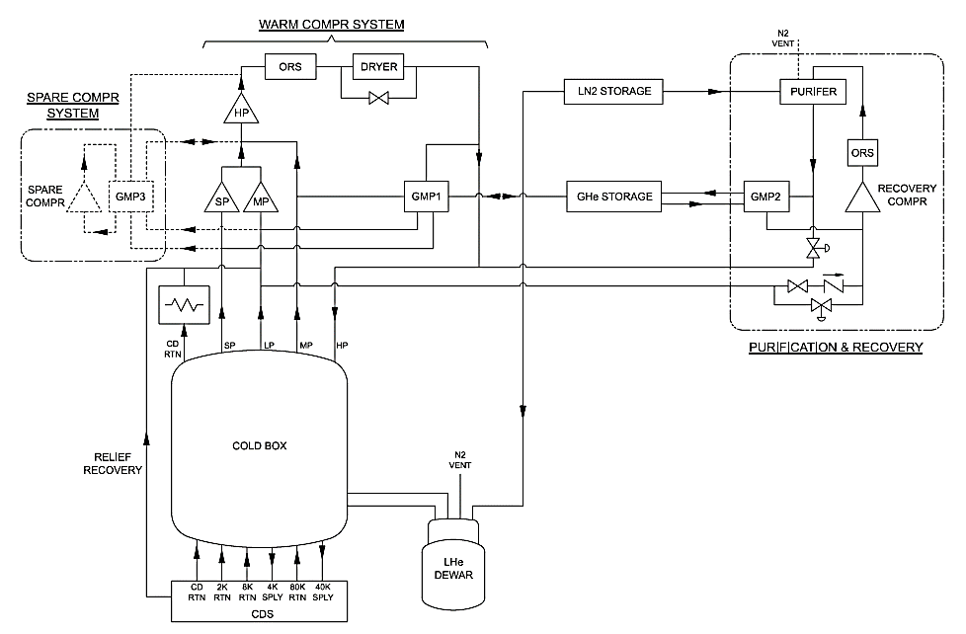
WBS 121.2 SRF Updates - Cryogenics
A preliminary Controls Architecture was developed.
Location of CDS transfer line connection from the Cryoplant Building to the Linac Tunnel was conceptualized.
Total heat load is being reviewed.
Simplified Flow Schematic of PIPII Cryoplant
Preliminary PIPII Cryogenic Controls Architecture
Simplified Schematic of typical Linac segmented distribution system

Slide 13
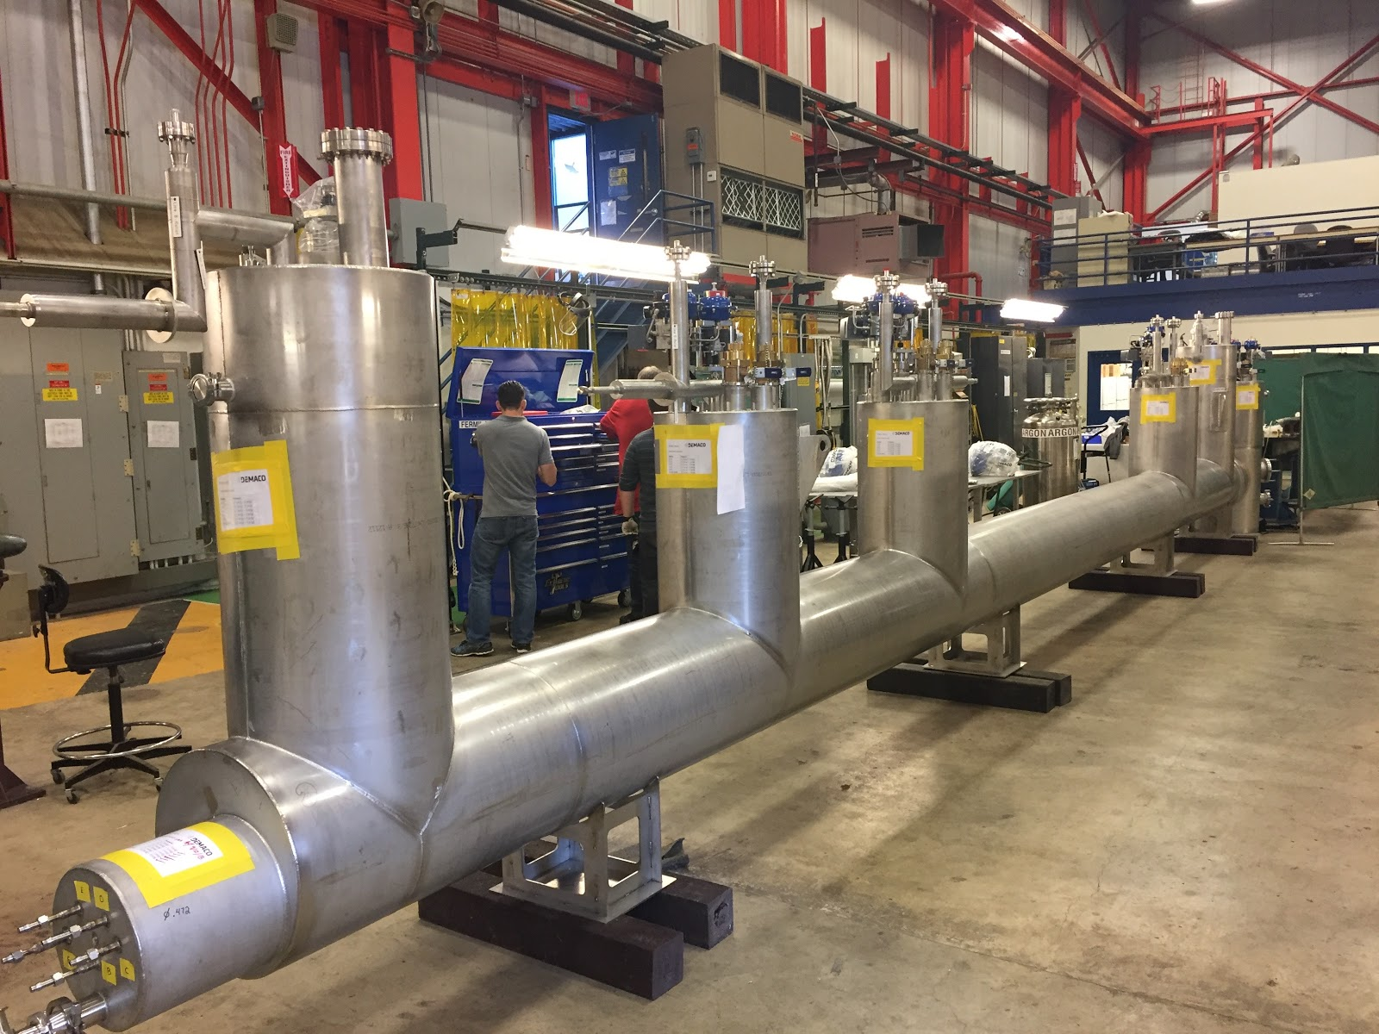
Updates - WBS 121.4 Linac Installation and Commissioning (1 of 2)
Test Infrastructure
Progress continues with the PIP2IT cave expansion
    Internal CTL from Demaco released from Customs and arrived at Fermilab.
    Going through QC checks at MW9
    Warm transferline installation work began at PIP2IT
Building Infrastructure
  Room Data Sheet template has been released for a pilot period – feedback received and incorporated into final version
    Regular meetings have being held with FESS new-hire Electrical Engineer and AD counterpart
      Need a long-term solution for this position,
          Great opportunity for early career enthusiastic engineer who can work side-by-side with the Senior Eng. to learn and carry on during the project life-cycle

Slide 14
Updates - WBS 121.4 Linac Installation and Commissioning (2 of 2)
Installation
  Team continues to evaluate lattice-to-CAD import
  Continued progress on the cryomodules stands
  Major effort this past month to revise and define all warm section lengths for the next iteration of linac lattice
Commissioning
  Started structuring the preliminary Beam Commissioning Plan
WFE
  Started design of HEBT section of PIP2IT in order to support HWR/SSR1 beam commissioning

Slide 15
Conventional Facilities
Site Prep Design
  Preliminary Design Review (~60% complete) Completed;
  Cost/Schedule Update
    Initial review shows a ~13% increase over conceptual estimate;
    Meeting on 19SEP18 to review and identify areas of concern;
  Four construction packages:
    Site Clearing: Erosion Control, Topsoil Stockpile, Tree Removal, Temporary Road
    Utilities Package: Electrical Feeder, Utility Corridor
    Site Work: Final Grading, Roadwork, Pond Rework
    Site Restoration: Final Paving, Landscaping, Roadway Lighting
  Design Completion scheduled for December 2018.
  Site Clearing work is planned to have purchase order in place for March 2019 groundbreaking.
  Siting meeting planned for 10-Oct-2018. Intended to be final validation of PIP-II site location.

Slide 16
Conventional Facilities
Cryo Plant Building Technical Requirements
  Design work continues;
  Completion in October 2018.
A/E Re-compete
  Request for Proposal issued on August 24th;
  Source Evaluation Board in place;
  Proposals Received on September 14th;
  Eight (8) proposals received;
  Evaluations underway.
  A/E Selection likely impacting completion of Cryo Plant Building.

Slide 17
Systems Engineering Update
CD-2 Design Readiness Plan – is being finalized;
Design Deliverables Document – is being finalized;
Requirements and Interfaces Verification – conducting the FRSs and ICDs review
L3 Interface Control Documents – completed consolidation of all interfaces in a single database;
Preliminary Design Report – finalizing first draft
Assessed the effectiveness of the SEMP and DRP – post mortem meetings

Slide 18
RLS Development Status (https://pip-ii-evms-tracking.fnal.gov/)
Steady progress, but still much work to go. Need to revisit schedule for EVMS implementation.
Next steps are updating BOEs, adjusting to funding profile

Slide 19
Upcoming Events
UK visitors - 27-28 Sept 2018
P2SPAC - Tue 30 Oct 2018
ESS Mechanical Engineering Group Leader visit 5-6 Nov 2018
DOE IPR - 4-6 Dec 2018
P2MAC - 25-27 March 2019

Slide 20
Summary
CD-2/3a preparations continue to be the highest priority:
  Good progress but behind with respect to CD-2/3a goals
  RLS efforts moving toward EVMS in earnest (CTC creation, Control Account identification)
  Next major effort is updating BOE.
  Systems engineering team leading PDR development, exercising design review plan.
A/E award forecast is December 2018 (delayed from Sept. 2018). Current site prep and cryoplant requirements contract work proceeding on schedule. Site clearing still planned for March 2019.
Continued engagement with international partners, scope/cost/schedule for contributions is converging.

