Slide 1
Future of High Energy Physics in Japan
Yasuhiro Okada
Executive Director, KEK
The 40th Anniversary Symposium of the US-Japan S&T Cooperation Program in High Energy Physics
April 16, 2019, Est-West center, University of Hawaii

Slide 2
Contents
Strategy on future projects by Japanese Association of High Energy Physicists (JAHEP)
KEK Roadmap 2013 Update
KEK research programs
Status of the ILC project

Slide 3
JAHEP strategy update in 2i017
JAHEP is an association representing the HEP community in Japan (900 members with 200 students)
JAHEP regularly updated its strategy. The report of the committee on future projects in HEP was endorsed by JAHEP in September 2017, updating the previous report in February 2012.
http://www.jahep.org/files/20170906-en.pdf
During the update process in July 2017, JAHEP proposed early realization of the 250 GeV ILC as a Higgs factory.
The ILC250 Committee’s report
http://www.jahep.org/files/ILC250GeVReport-EN-FINAL.pdf
The JAHEP statement
http://www.jahep.org/files/JAHEP-ILCstatement-170816-EN.pdf

Slide 4
Final report on Future Projects in HEP

Slide 5
Final report on Future Projects in HEP (Cont.)

Slide 6
Timeline of ongoing and future projects

Slide 7
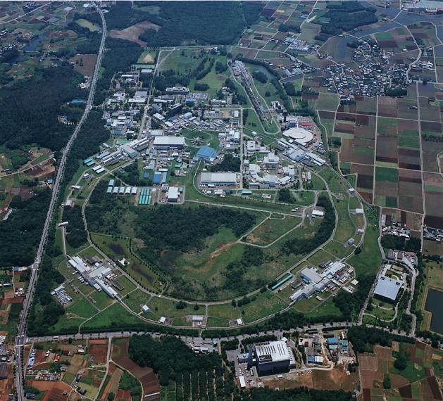
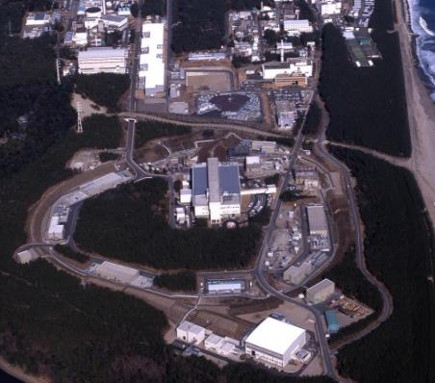
KEK and its Roadmap
KEK was established in 1971 as National Laboratory for High Energy Physics.
Now, KEK covers a wide area of scientific fields from particle and nuclear physics to materials and life sciences by constructing and operating large accelerator facilities.
Tsukuba Campus
Tokai Campus
Super KEKB, Photon Factory, STF, ATF, cERL
J-PARC (Joint project with JAEA)

Slide 8
KEK Roadmap 2013 Update
KEK has released its research Roadmap (5-year plan) since 2007 as a basic strategy of researches in KEK.
This is a bottom-up process since KEK is an Inter-University Research Institute Corporation. We took into account inputs from relevant science communities, the input from JAHEP is one of them.
In 2017-2018, we decided to make a minor update of the KEK Roadmap 2013, anticipating that a major update is necessary in a few years.
KEK Roadmap 2013 Update will be released very soon. The Update was endorsed by the KEK Science Advisory Committee held on March 2019
The KEK Project Implementation Plan (KEK-PIP) was produced in June 2016 in order to proceed with the research projects set out in the Roadmap with clear funding sources and priorities.

Slide 9
KEK Roadmap 2013 Update (DRAFT)
1. Preamble
2. Long-Term Prospects and KEK’s Role for Each Research Area
Update of the Strategy for Next Five Years (2014-2018)
3.1 J-PARC
3.2 SuperKEKB/Belle II
3.3 LHC/ATLAS
3.4 ILC
3.5 Photon Science (Synchrotron Radiation Research)
3.6 New Development of Accelerator and Detector Technologies
4. Summary
KEK Roadmap and KEK-PIP
https://www.kek.jp/en/About/Roadmap/

Slide 10
J-PARC (HEP-related part)
At the neutrino facility, a significant improvement in the measurement precision of the T2K experiment will be pursued. In addition, preparatory studies are pushed forward to materialize the next generation of long-baseline neutrino oscillation experiments.
In research activities at the Hadron Experimental Facility, experiments at the present and new primary proton beam lines will be steadily advanced, a new target capable of withstanding high intensity beams will be developed and introduced, and additional efforts will be made toward future extension of the facility.
Regarding J-PARC’s accelerator systems, a high-priority item is to rapidly meet the design beam intensity goals, that is, a 1 MW-class beam, which exceeds the design intensity of 750 kW, with fast extraction, and a 100 kW or higher-power beam with slow extraction. In addition, the next stage upgrade plans for the facility will be prepared to achieve a major increase in the beam intensity.

Slide 11
Super KEKB, LHC, ILC
The goal at SuperKEKB/Belle II is to complete the construction of the accelerator and detector facilities, and then to achieve the design luminosity performance on schedule and to initiate in-depth exploration of new physics.
The main agenda at LHC/ATLAS is to continually participate in the experiment and to take a proactive initiative in upgrade programs within the international collaboration at both the accelerator and detector facilities.
KEK will play a central role in creating an international preparatory group and will lead the effort on advanced R&D, the engineering design of the apparatus and facility, and the organizational design toward early groundbreaking for the linear collider project to be hosted in Japan, within the framework of a global collaboration.
Full physics experiments has just started in March 2019.
The HL-LHC project is officially stared from the FY2019 budget.
The KEK-ILC action plan was released in January 2016.

Slide 12
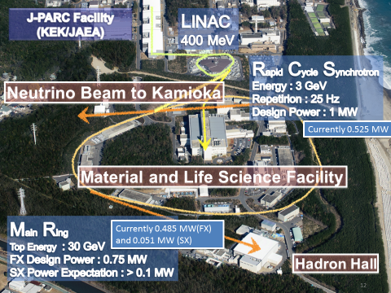
J-PARC

Slide 13
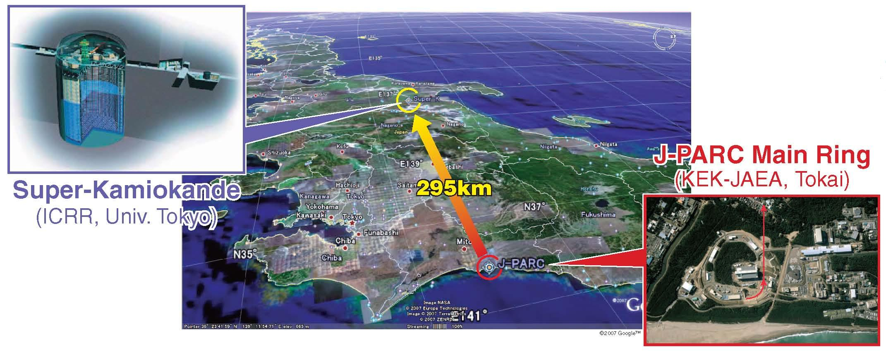
T2K (Tokai to Kamioka) experiment
2010~ (Running)
High intensity ν_{μ} beam from J-PARC MR to Super-Kamiokande
Observation of ν_{μ} → ν_{e} (2013)
Updated goals
  Precise measurement of ν_{e} appearance
  Precise meas. of ν_{μ} disappearance
  ➔ Measure CPV phase, contribution to mass hier. determ.

Slide 14
T2K experiment: Recent results
Latest T2K CP Violation Search Result
T2K fit with reactor constraint
Best fit point : δ_{CP} = -1.885 rad in normal hierarchy.
CP conserving values (0,π) fall outside of 2σ CL intervals.
- Suggestive, but need more data.

Slide 15
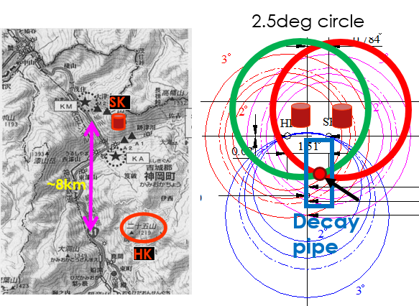
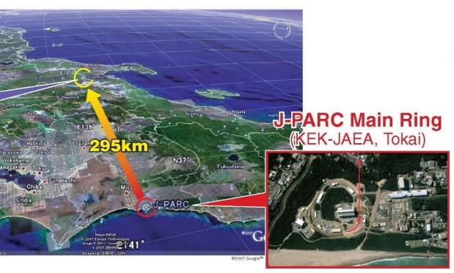
Hyper-Kamiokande (U. of Tokyo)
Next-generation Water Cherenkov detector
  260kt (190kt fid. mass) x 2
  Staging
Detector location (candidate)
  ~8km south of SK
  295km from J-PARC, @ same off-axis angle
  650m overburden (1755m W.E.)
Physics goals
  Accelerator neutrino
    CPV in neutrino
  Non-accelerator/Astroparticle
    Discovery of proton decay
    Atm-nu
    Solar-nu
    Supernova (relic) nu
ICRR/UT will take primary responsibility
Listed in the 2017 MEXT Roadmap of the Large Research Infrastructure
A decision by MEXT to be made in 2019.

Slide 16
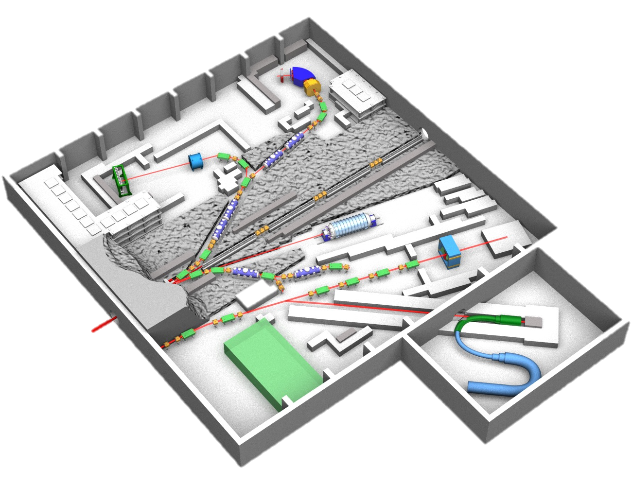
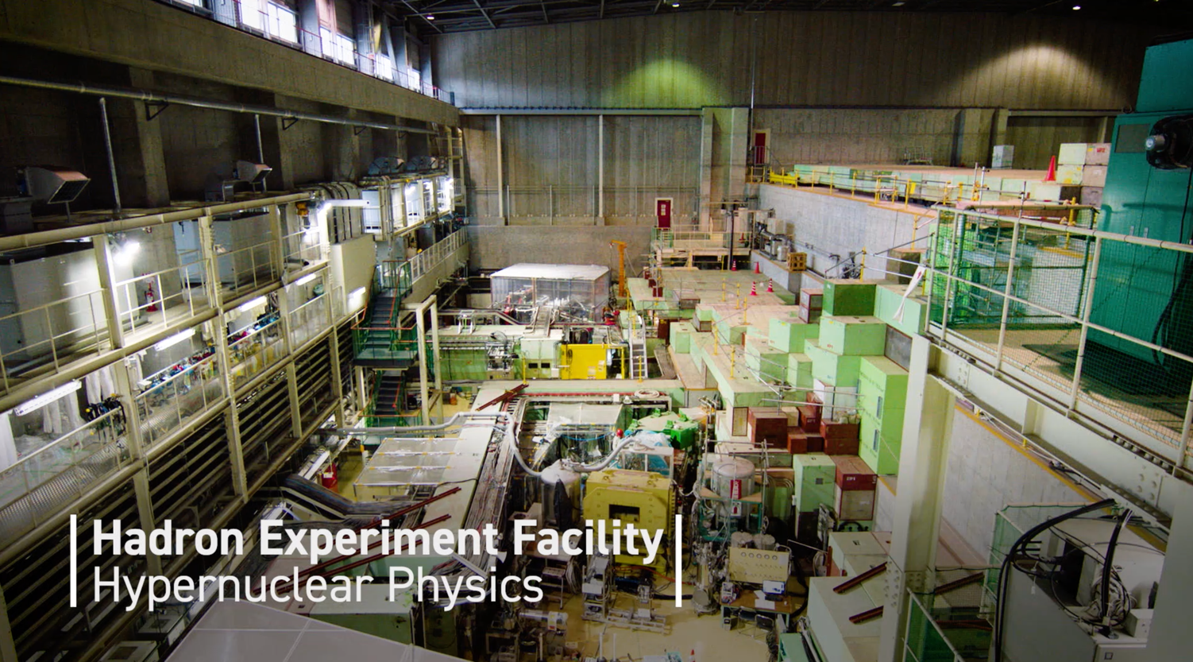
Hadron Experiment Facility
K1.8
Strangeness Nuclear Physics
K1.8BR
Hadron Physics
K Rare Decay (CP violation）
KL
High Momentum Beamline
Hadron Mass Shift
COMET Beamline
mu-e Conversion Search

Slide 17
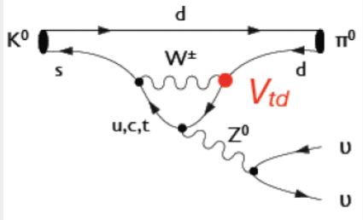
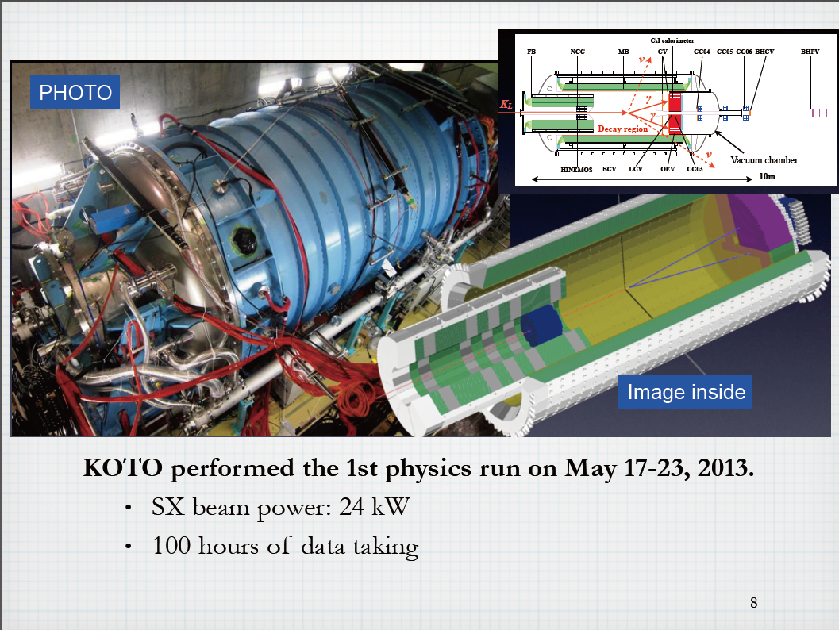
KOTO Experiment

Slide 18
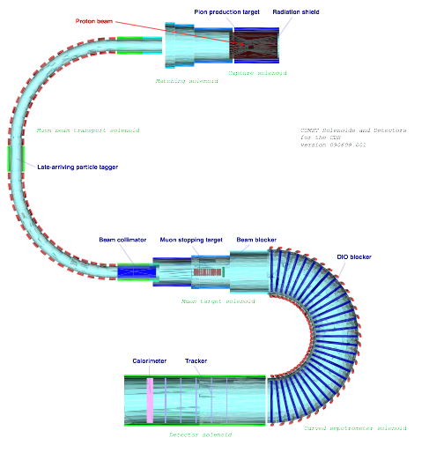
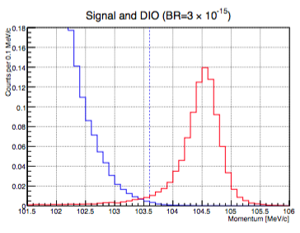
COMET Experiment
Search for LFV in muonic atoms
μ
−
+
(
A
,
Z
)
→
e
−
+
(
A
,
Z
)
Phase I
Phase II
nuclear muon capture
Muon decay in orbit
μ
−
+
(
Α
,
Ζ
)
◊
ν
μ
+
(
Α
,
Ζ
−
1
)
μ
−
◊
e
−
ν
ν
Two Stage Approach
Phase I
  Detailed understanding of the beam background and achieving the sensitivity of < 10⁻¹⁴ (100 better than the current limit)
  8GeV, 3.2kW beam, ~110-days DAQ (Graphite as a primary target)
Phase II
  8GeV, 56kW beam, 1-year DAQ (Tungsten as a primary target)
  COMET final goal Sensitivity < 10⁻¹⁶
COMET Collaboration
  212 members from 38 institutes in 16 countries
Phase I background
0.02 BG expected
In 9.5x10⁶ sec running time
103.6MeV/c

Slide 19
Muon g-2/EDM at H-line of MLF
Stage -2 approval from both IPNS and IMSS

Slide 20
Projected Schedule of MR new PS and RF

Slide 21
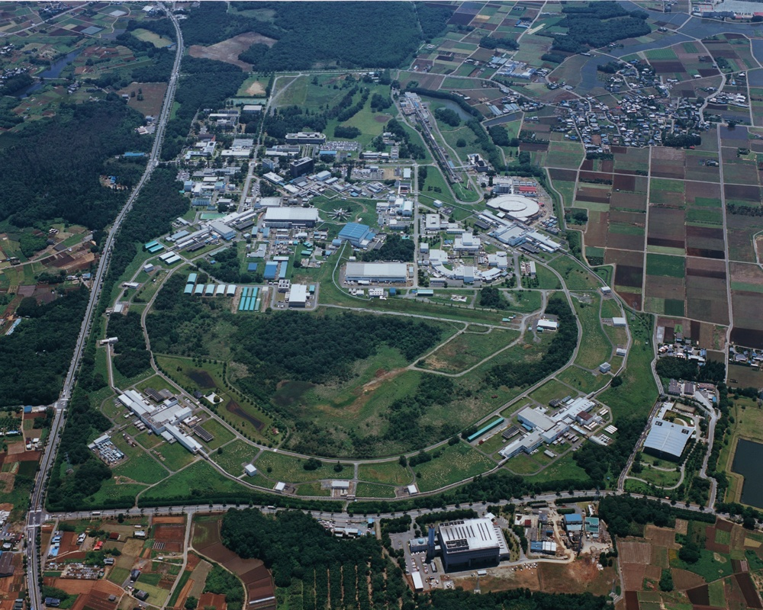

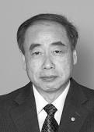
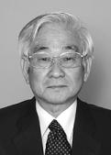
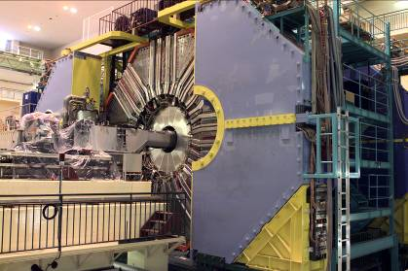

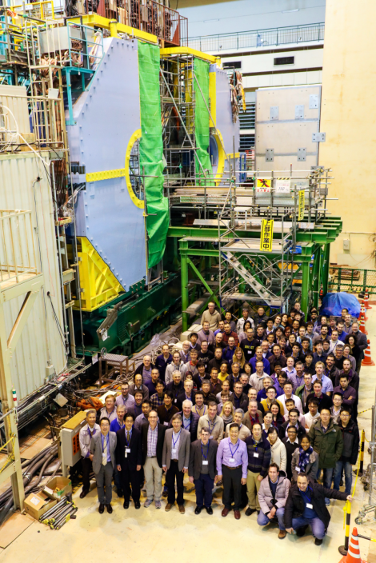
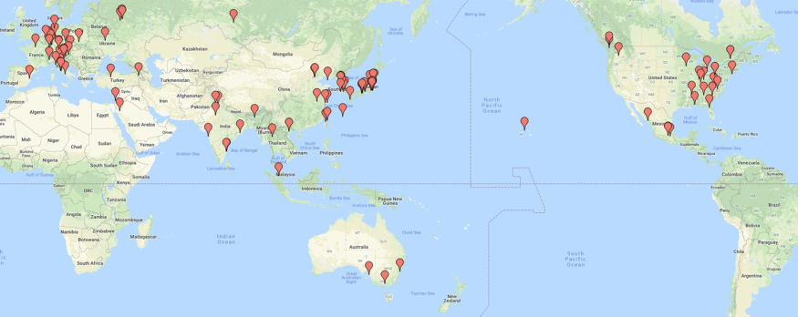
SuperKEKB and Belle II
2008 Nobel Physics prize
Dr.Kobayashi Dr.Maskawa
Bell and BaBar discovered CP violation in B mesons, and confirmed Kobayashi-Maskawa theory.
The apparatus has been upgraded to search for new physics beyond this theory.
SuperKEKB accelerator
Belle II detector and members
(Feb. 2017)
>900 scientists from 26 countries (Feb. 2019)

Slide 22
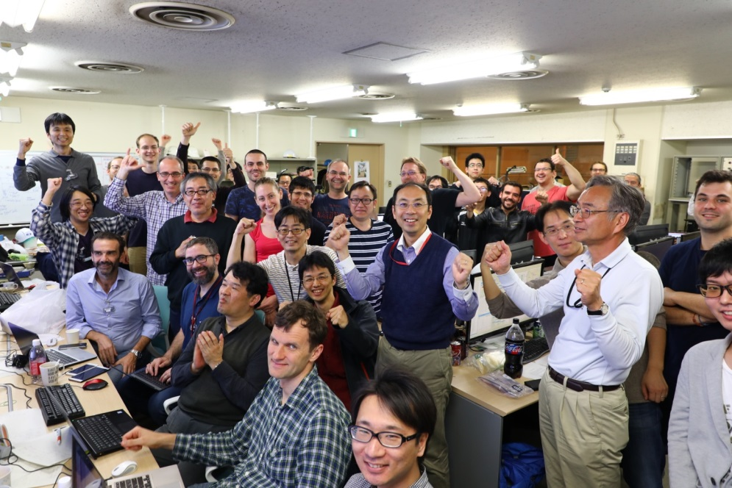
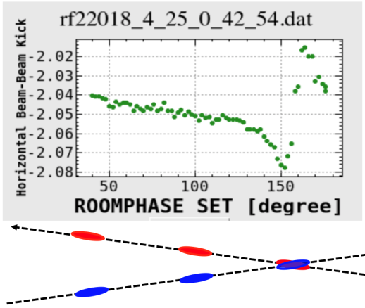
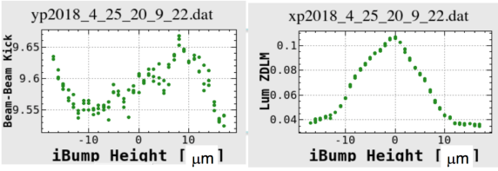
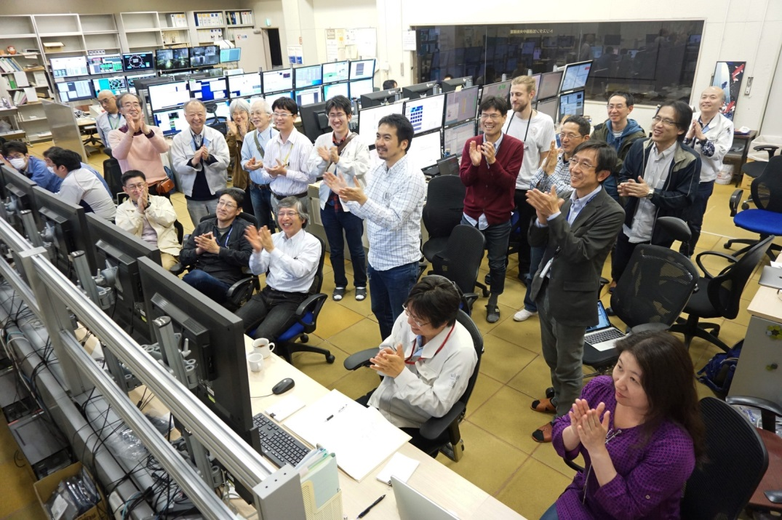
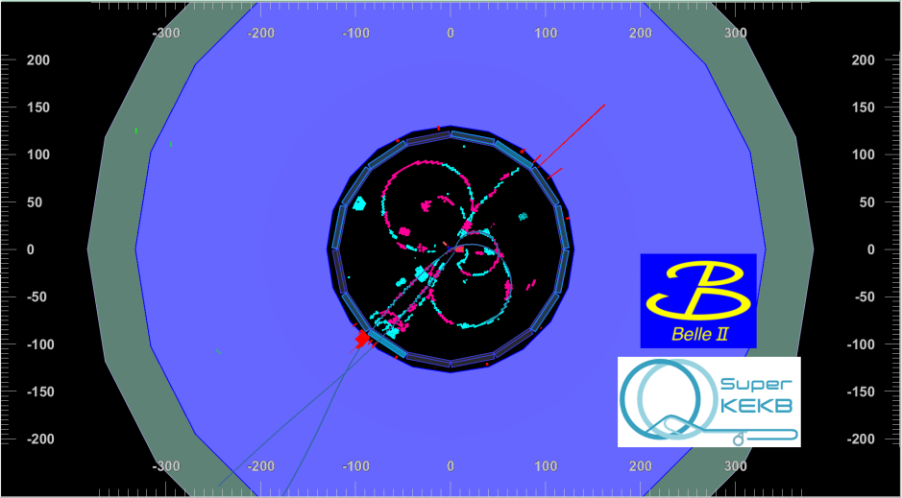
First Collision
Apr. 26, 2018
Vertical beam-beam kick
Horizontal beam-beam kick
Belle II control room
First hadronic event observed by Belle II
SuperKEKB control room

Slide 23
Luminosity profile and potential discoveries
$$×{10}^{35}$$
$$S(K_{S}^{0}π^{0}γ)$$
$$S({φK}_{S}^{0})$$
$$X_{s}ℓ^{+}ℓ^{−}, C_{9}^{NP}$$
${P_{5}^{′}}_{ee}/$ ${P_{5}^{′}}_{μμ}$
$5σ$ (observation)
$$S(η^{′}K^{0})$$
$$B→τν$$
Integrated luminosity $[ab^{−1}]$
$3σ$ (evidence)
I$nstantaneous luminosity[cm^{−2}s^{−1}]$
$$S(ρ^{0}γ)$$
$$I_{sumrule}(Kπ)$$
$$20ab^{−1}$$
$$R(Dτν)$$
$$10ab^{−1}$$
$$R(D^{∗}τν)$$
[日/月/年]
Assuming:
8 months operation per year
4 years to achieve design luminosity
Current central values

Slide 24
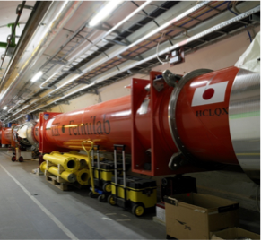
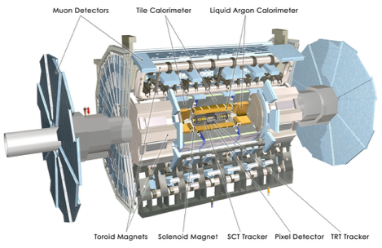
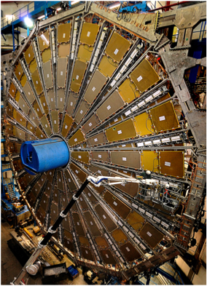

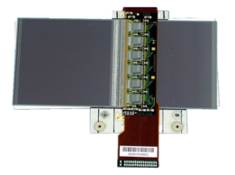

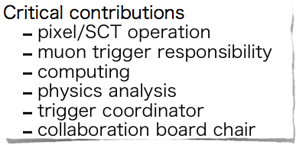
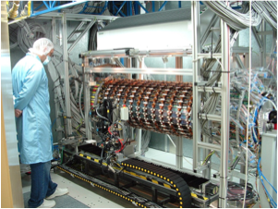
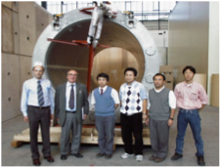


Japanese Activities at LHC/ATLAS
100%
20%

Slide 25
Contribution to HL-LHC D1 magnet

Slide 26
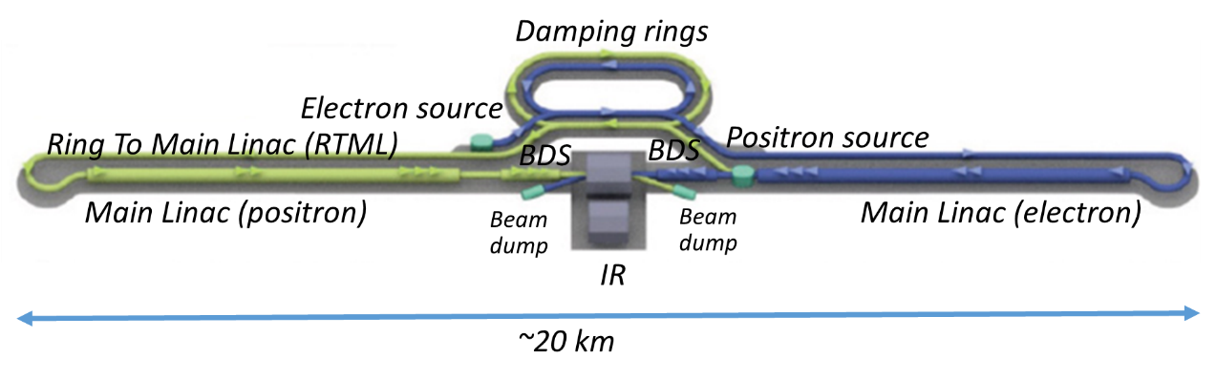
International Linear Collider (ILC)
The next energy-frontier electron-positron collider to explore physics laws in the early Universe.
Collisions of 125 GeV electrons and positrons
in a 20 km tunnel. (250 GeV ILC)
It can produce a large number of the Higgs particles (a Higgs factory).
It has a good potential to discover new particles such as dark matter.

Slide 27
Developments of the ILC project
SRF technology was chosen by ICFA in2014. GDE completed ILC-TDR in 2013.
The Japanese HEP community proposed to host ILC in Japan in Oct. 2012. Serious investigations started in Science Council of Japan (SCJ) and MEXT. Worldwide HEP communities welcomed the proposal. ex the European Strategy for Particle Physics (2013) and the US Particle Physics Project Prioritization Panel (P5) report (2014).
After the 13TeV run of the LHC experiment, the worldwide HEP community reached a consensus that the ILC should be built as a Higgs factory (250GeV ILC) while keeping energy extendibility in Nov. 2017.
The MEXT ILC Advisory Panel’s report in July 2018. The SCJ report in Dec. 2018.
MEXT’s views in regard to the ILC was explained in the ICFA/LCB meeting on March 7, 2019.
“MEXT has not yet reached declaration for hosting the ILC in Japan at this moment.”
“MEXT will continue to discuss the ILC project with other governments while having an interest in the ILC project.”
Also, ILC Federation of Diet Members presented supplemental message.

Slide 28
ICFA statement on March 21, 2019
“ICFA views the statement of continuing interest in the ILC within MEXT and related ministries and agencies as an important milestone along the path to the ILC”
“ICFA notes with satisfaction the great progress of the various options for Higgs factories proposed across the world. All options will be considered in the European Strategy for Particle Physics Update and by ICFA. ”
KEK will make all efforts to realize the ILC as an international project hosted in Japan with the worldwide HEP community.

Slide 29
Actions to be done by KEK
Organize the international working group with close consultation with MEXT.
Promote activities to gain a better understanding of the broader academic community in Japan.
  Propose the ILC project to the SCJ Master Plan
  Organize a symposium
Cooperate MEXT to establish the governmental level discussion groups with France and Germany. Also, we need to strengthen the discussion group with the US DOE.
Conducts R&D program at ATF, STF and CFF facilities collaborating with the international teams.
… and so on.
    Report on
    International share of the remaining technical development
    Organization and governance of the ILC Laboratory
    Model of international cost-sharing for construction and operation
    (Target day, September 2019)
US-Japan ILC cost reduction R&D, and more.

Slide 30
Presented by KEK at LC Community Meeting in Lausanne, April 8, 2019
Processes and Approximate Timelines Toward Realization of ILC (Physicists’ view)
2018.12
2019.3
2020.5
2024-
Announcement
by Japanese government
Discussion among governments
Exchange of information
Agreement on governance,
operation, sharing of cost
and human resources
Start negotiations among governments
on international sharing
Strengthen US-Japan Discussion Group, cost reduction R&D,
governance discussion
Start construction of ILC
Full-scale negotiation among
governments – specification of
conditions and processes
Final agreement among governments
on construction
Government Level
MEXT
panel
Summarize
opinions of
relevant
ministries
Establish Discussion Group with
the European partners
Critical decision
process
MOU among research labs on start of
the preparation phase under approval by each government
Oct. 2019
Next Roadmap
by MEXT
SCJ committee on ILC
SCJ Master Plan
3/7
Physicists Level
LCB/ICFA mtgs. @ Tokyo
EPPSU submitted to CERN
ILC pre-lab
(4 years)
European Particle Physics Strategy Update
Establish KEK International WG
Produce draft for international sharing of
human and material resources
Draft proposal by researchers
on international cost sharing
Talks with other countries
Good enough design for the final approval of construction, resolution of remaining technical issues
＊ICFA: international organization of researchers consisting of directors of world’s major accelerator labs and representatives of researchers
＊ILC pre-lab: International research organization for the preparation of ILC based on agreements among world’s major accelerator labs such as KEK, CERN, FNAL, DESY etc.

Slide 31
Collaboration between KEK and FNAL/JLAB/Cornell
KEK will: a) explore the parameter space of highQ/highG treatment
b) evaluate the exchanged cavity performance with FNAL
c) apply highQ/highG treatment to the 9-cell cavity and install it to STF-2.
Since only FNAL suceeded the application to the 9-cell cavity, the technical support from FNAL will be the essential for the KEK’s successful application of highQ/highG. The cavity exchange program between FNAL and KEK worked very well to confirm the performance of the cavities.
FNAL will: a) explore the parameter space of highQ/highG on single and nine cell cavities; b) re-baseline some of the nine-cell cavities (ILC qualified); c) continue the field emission study.
JLAB/Cornell University will: a) continue single cell highQ/highG research; b) give the qualified 9-cell cavities a highQ/highG exposure and vertical test;
Application to 9-cell cavities and field emission study are necessary for the high performance cavity development.

Slide 32
Summary
The Japanese HEP community and KEK regularly update their strategy on future projects.
Particle physics program at J-PARC, SuperKEKB /Belle II and participation in the LHC project including HL-LHC are current main projects.
KEK is also preparing for future. KEK is making all efforts to realize the ILC as a Higgs factory with worldwide HEP communities.

