Slide 1
US-Japan Program Status
The 40th Anniversary Symposium of the US-Japan Science and Technology Cooperation Program in High Energy Physics
April 15-16, 2019
EAST-WEST CENTER, University of Hawaii
Takashi Kobayashi
US-Japan program scientific secretary
IPNS/J-PARC, KEK

Slide 2
Contents
Look back 30th anniversary in 2010
Development of the US-Japan program since then
  Reformulated the program under new chain of agreements/arrangements
  Completion of participations to (big) experiments in US
    SLAC(SLD,..), BNL(nu, K, RHIC), FNAL (CDF, K, nu)
  Shift from “traditional” contributions to construction/operation of experiments in US to
    Pillar type
    Seed type R&D
  Start of the bi-lateral funding from FY2017
    Funding for the US-Japan program from DOE started
  Had two external reviews in Japan (FY2013, FY2018)
  Started “special fund” to foster new proposals
  Started Ozaki Exchange Program from JFY2019

Slide 3
30th anniversary (Oct.2010) @ Hawii
https://digital.library.unt.edu/ark:/67531/metadc839325/m2/1/high_res_d/1013528.pdf
Program/presentations: https://www.bnl.gov/usjphep/

Slide 5


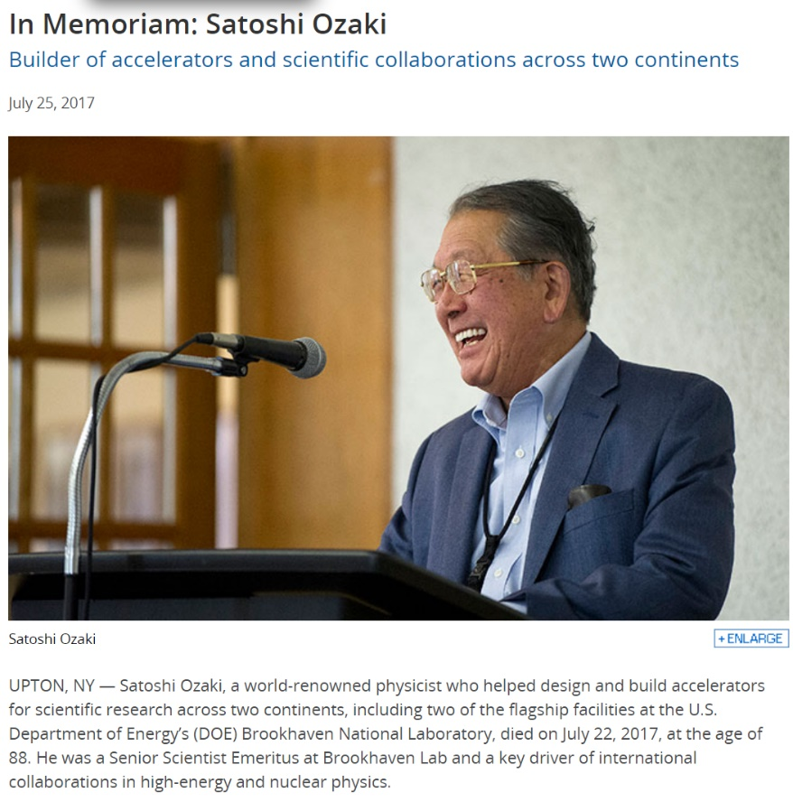
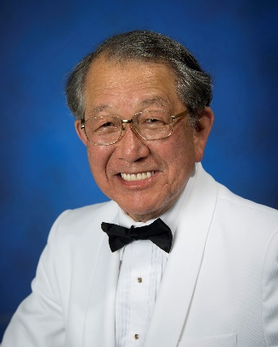
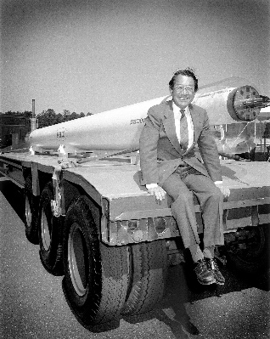

Satoshi Ozaki (1929-July22,2017)
https://www.bnl.gov/newsroom/news.php?a=112384
“Since 1978, Ozaki was also involved in the initiation and oversight of an Agreement on High Energy Physics between the Japanese and U.S. governments. This highly fruitful program fostered relationships among scientists in the two nations and laid the groundwork for large-scale collaborative projects. ”
“In 2012, he received a commendation from the Consul General of Japan, which was followed in 2013 with Japan’s prestigious Order of the Sacred Treasure, Gold Rays with Neck Ribbon, conferred by Emperor Akihito of Japan—both recognizing Ozaki’s outstanding contributions in physics through high-energy and nuclear physics studies, as well as his significant contributions to the promotion of Japan-U.S. cooperation in physics.”

Slide 6
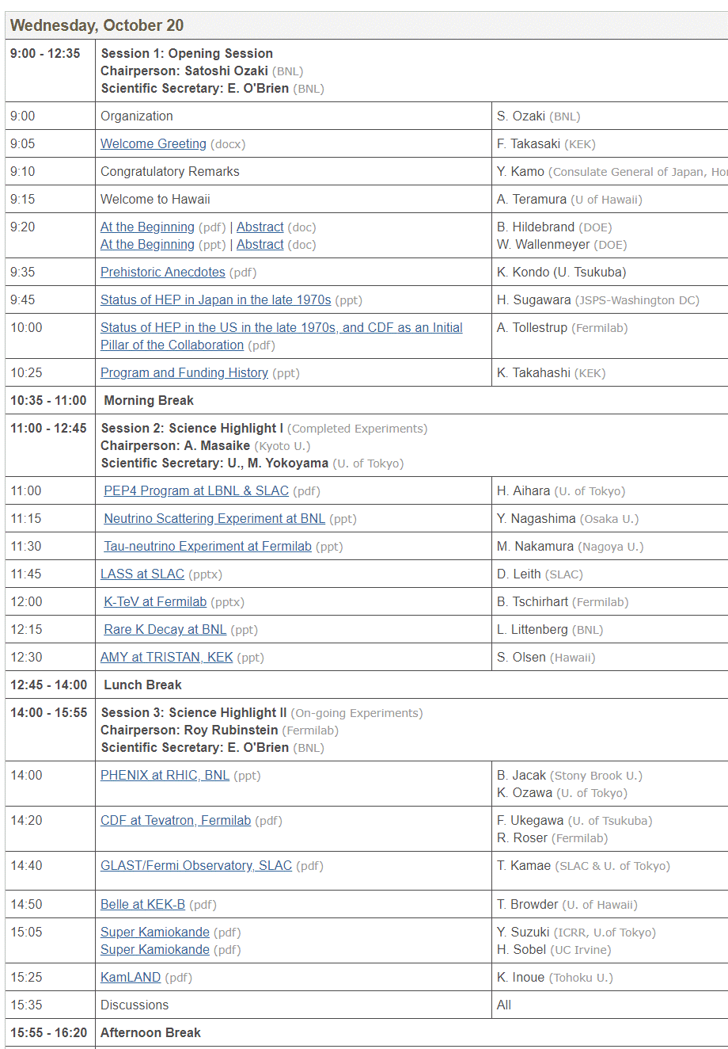
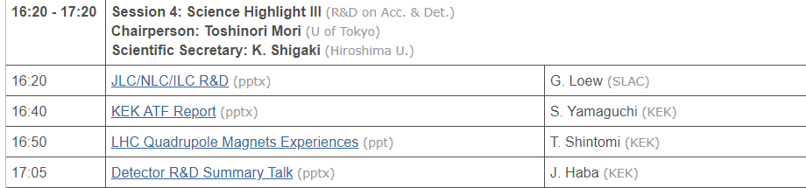
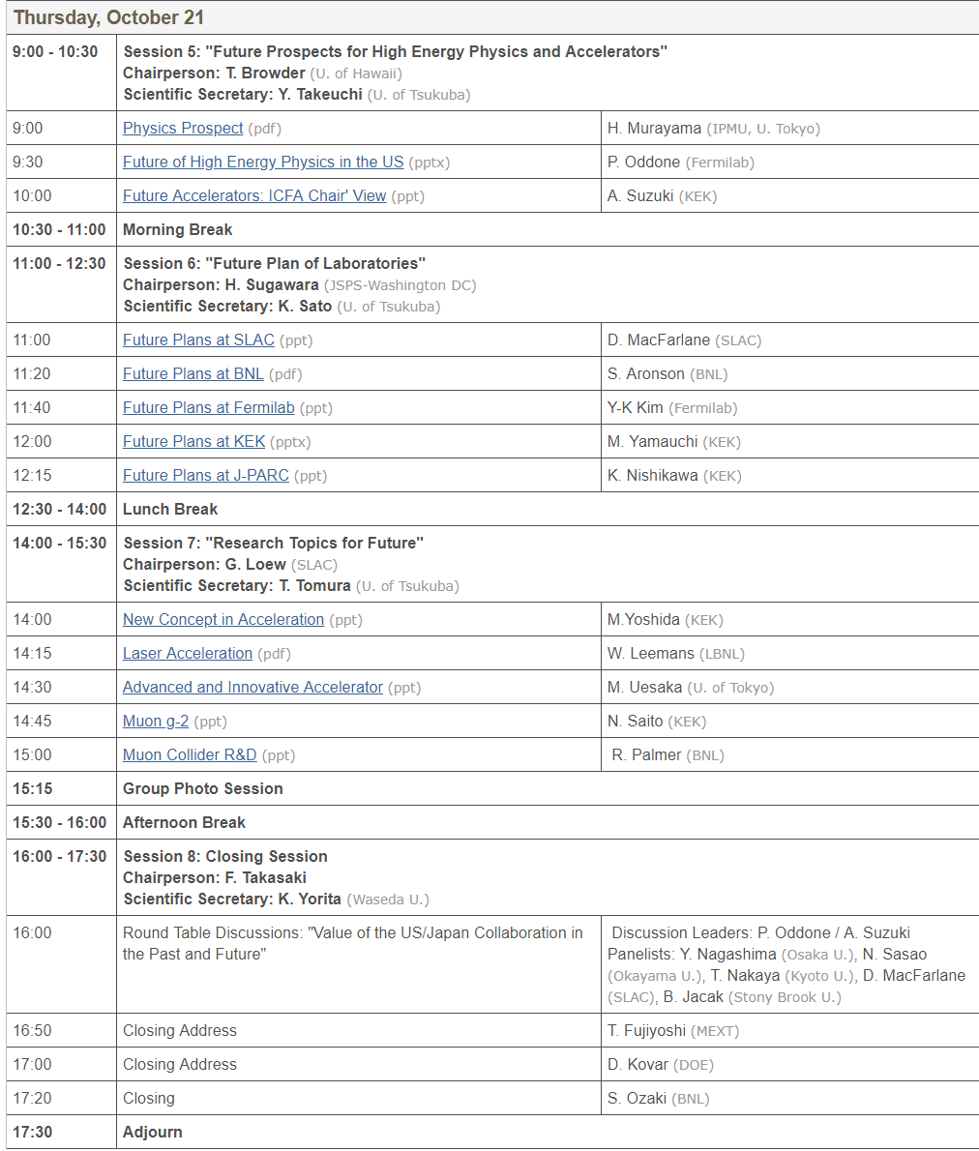
US-based experiments
US-based experiments
JP-based experiments
US-based experiments
JP-based experiments

Slide 7
Contents
Look back 30th anniversary in 2010
Development of the US-Japan program since then
  Reformulated the program under new chain of agreements/arrangements
  Completion of participations to (big) experiments in US
    SLAC(SLD,..), BNL(nu, K, RHIC), FNAL (CDF, K, nu)
  Shift from “traditional” contributions to construction/operation of experiments in US to
    Pillar type
    Seed type R&D
  Start of the bi-lateral funding from FY2017
    Funding for the US-Japan program from DOE started
  Had two external reviews in Japan (FY2013, FY2018)
  Started “special fund” to foster new proposals
  Started Ozaki Exchange Program from JFY2019

Slide 8
Recent activities
※更新の必要
2010.9-2011.1: TF for a reciprocal framework, which allows us to spend KEK’s US-Japan fund for the Japan-based programs
2011.7: 33rd Joint committee @U of Chicago
  the Joint Committee agreed that Japan-based projects should also be supported by the U.S.-Japan Cooperation Program as well as U.S.-based projects. Concerning the program selection and funding, the Committee came to an agreement to continue discussion considering different decision making and funding system in the U.S. and Japan.
FY2012: WG to discuss future US-Japan program
FY2013: “Special fund” started to support pre-discussion to make good proposal
FY2017: DOE side funding for this program started

Slide 9
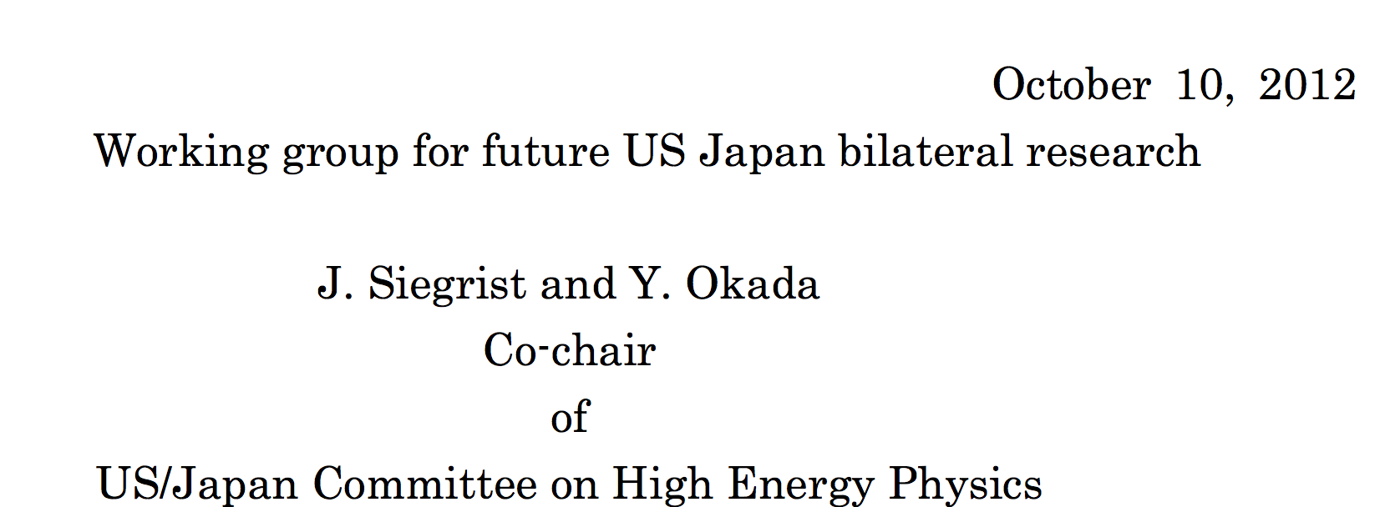
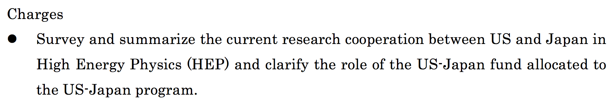
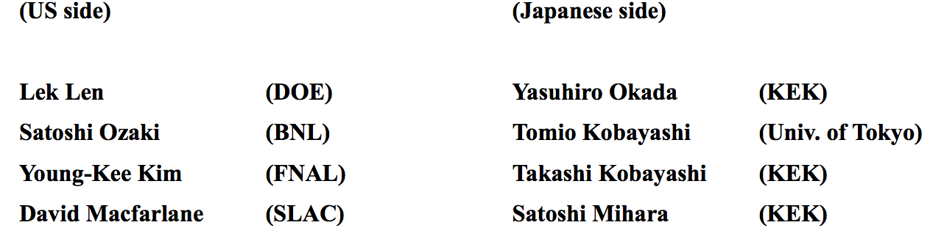

Slide 10
Summary of the discussion
Reported in 35th joint com.
As possible improvements on the future US-J program, the following 3 points were raised and agreed upon;
  Flagship items or fields with clear objective are necessary.
    Example: "ILC/Project X", "neutrinos", "rare processes"
  Supporting “seeds” type new projects rather than continuing to support running experiments is also important
  Fostering young researchers should be considered.
Other points of discussion include (not in order)
  It is recognized that the treatment of US-Japan fund support in the multi-lateral collaboration needs clarification.
  Merit of being supported by this US-J program from the view point of US side is explained. Being supported by the US-J program could be a trigger for obtaining funding in the US. In that sense, it is also important to support “seeds” type project.
  It is also important to review entire program. In the past the program had been reviewed every 5 years. In 2013 such a review is planned.

Slide 11
Start of US DOE side funding for the US-Japan program
&
Joint call for proposal
(From FY2017)

Slide 13
HEP ex
Acc tech
Detector for HEP

Slide 15
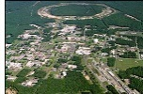

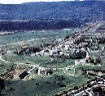


Framework of US-Japan program（~2016）
“Agreement .. on Cooperation in R. and D. in Energy and Related Fields” (1979-2005)
US gov.
Japanese gov.
"the Agreement .. on Cooperation in R. and D. in S. and T.“ (1986~)
DOE
MEXT
Implementing Arrangement .. Concerning Cooperation in R. and D. in Energy and Related Fields (Apr30,2013)
Office of High Energy Physics
KEK
Project Arrangement .. Concerning Cooperation in R. and D. in Energy and Related Field Concerning H. E. P. (Oct.6 2015)
Only from Japanese side
BNL
Collaboration Projects
Japanese Project Leaders
Proposal
FNAL
Joint committee meeting
(Final approval of funding allocation)
US-J Research Planning committee
Chair: Yasuhiro Okada
(recommendation of approval)
Annual plan
SLAC
結果通知
External review (every 5yr)
LBNL
Fund only from Japan
1st 1987.5
2nd 1994.1
3rd 1999.2
4th 2004.1
5th 2008.2
6th 2014.2
Japanese PI
PNNL
Research/budget
DOE lab/univ.
Japanese inst.

Slide 16
New framework（2017～）
Started bi-lateral funding
"the Agreement .. on Cooperation in R. and D. in S. and T.“ (1986~)
US gov
JP gov
DOE
Implementing Arrangement .. Concerning Cooperation in R. and D. in Energy and Related Fields (Apr30,2013)
MEXT
Office of High Energy Physics
Project Arrangement .. Concerning Cooperation in R. and D. in Energy and Related Field Concerning H. E. P. (Oct.6 2015)
KEK
US-side Project Leaders
DOE・KEK
Parallel call for proposal
JP side Project Leaders
Proposal
Proposal
Office of High Energy Physics
USJapan Joint Panel Meeting
(1/yr, 3 from each)
US-JP research planning
committee
Annual plan
Annual plan
Recommendation
US-Japan Joint Committee Meeting
(1/yr, endorse JPM recommendation)
External review (report)
DOE budget (FY2017)
1,830,000 USD
JP budget (FY2017)
Equip.：302,940kYen
Travel:： 46,751kyen
1st 1987.5
2nd 1994.1
3rd 1999.2
4th 2004.1
5th 2008.2
6th 2014.2
7th 2019
結果通知
US Project Leaders
JP Project Leaders
JP inst
DOE labs/univ
Execute program

Slide 17
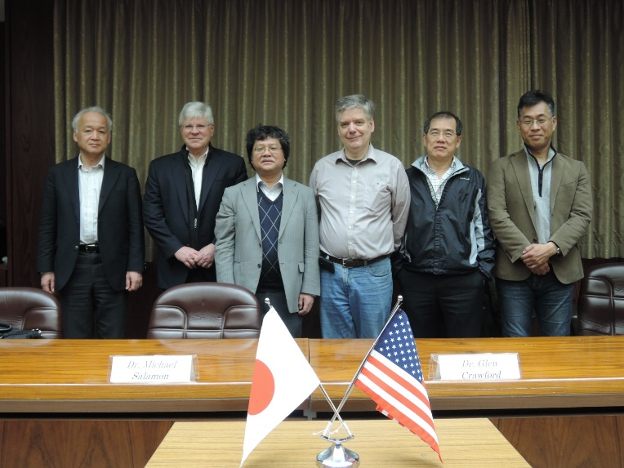
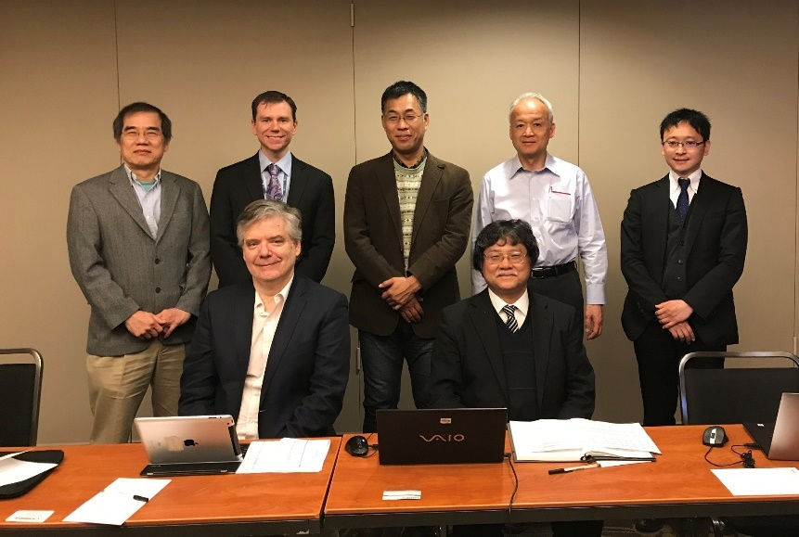
Joint panel meeting（2017~）
Guideline of the U.S.-Japan Joint Review Panel
This is the guideline for the U.S.-Japan Joint Review Panel on High Energy Physics (hereinafter referred to as “the Panel”) decided to be established for the proposals review of the joint call at the special meeting of U.S.-Japan Joint Committee on October 25, 2016 (EST) / October 26, 2016 (JST)
(Tasks)
The Tasks of the Panel are:
to submit a draft of the list of activities to the U.S.-Japan Joint Committee;
to submit review comments on the proposals to U.S.-Japan Joint Committee;
(Organization)
The Panel is composed of the representatives of both parties. Each party appoints at members as Panel members and notifies the names of its members to the other party.
US-Japan Joint Review Panel in KEK, US, April 2017
US-Japan Joint Review Panel in Rockville, US, April 2018

Slide 18
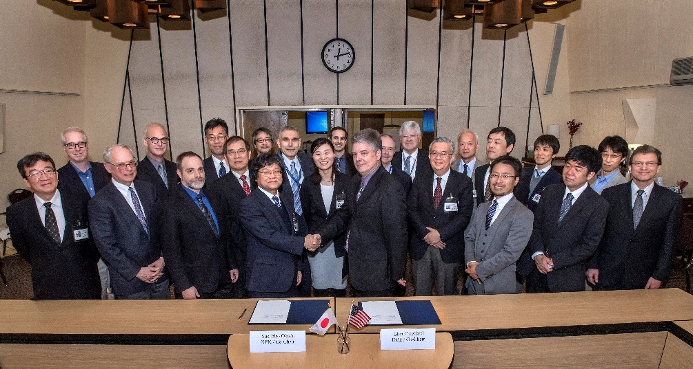
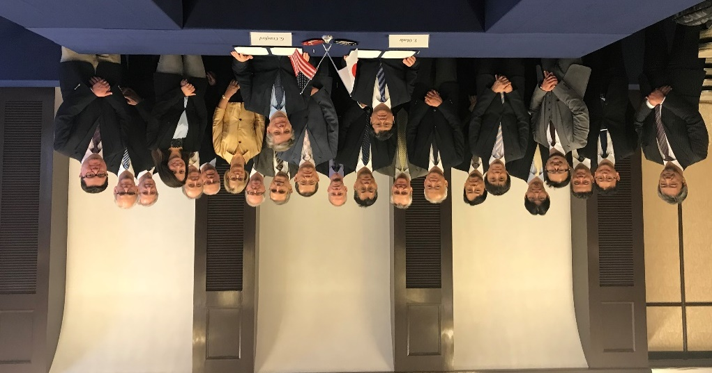
Joint committee meeting
(Duties)
The Committee is established in order to facilitate the implementation and coordination of cooperative activities in the area of high energy physics under the Project Arrangement. As stipulated in the paragraph E of Section 5 of the Project Arrangement, the duties of the Committee are:
to monitor progress of cooperative activities under the Project Arrangement;
to review and to formulate proposals for new cooperative activities under the Project Arrangement;
to take such other action to ensure the efficient and effective implementation of the Project Arrangement.
US-Japan Committee in BNL, US, April 2017
US-Japan Committee in Tokyo, Japan, April 2018

Slide 19
Programs executed during 2003-2007
(reviewed by 5th exernal reviews)
A (ILC)
E(CDF)
A
E(PHENIX)
A
A
E(K decay@BNL)
A
E(K0 decay@FNAL)
A
E(K0 decay@BNL
A
E(DONut@FNAL)
A
D(LBL)
A
D(Kamland)
A
D(GLAST)
A
D/E(SciBooNE)
D (KOTO@J-PARC)
Soft(PDG)
D (mu@J-PARC)
Traditional US-Japan style support to experiments in US: 7
Detector development: 6
Accelerator/beam development: 11
Soft dev.: 1

Slide 20
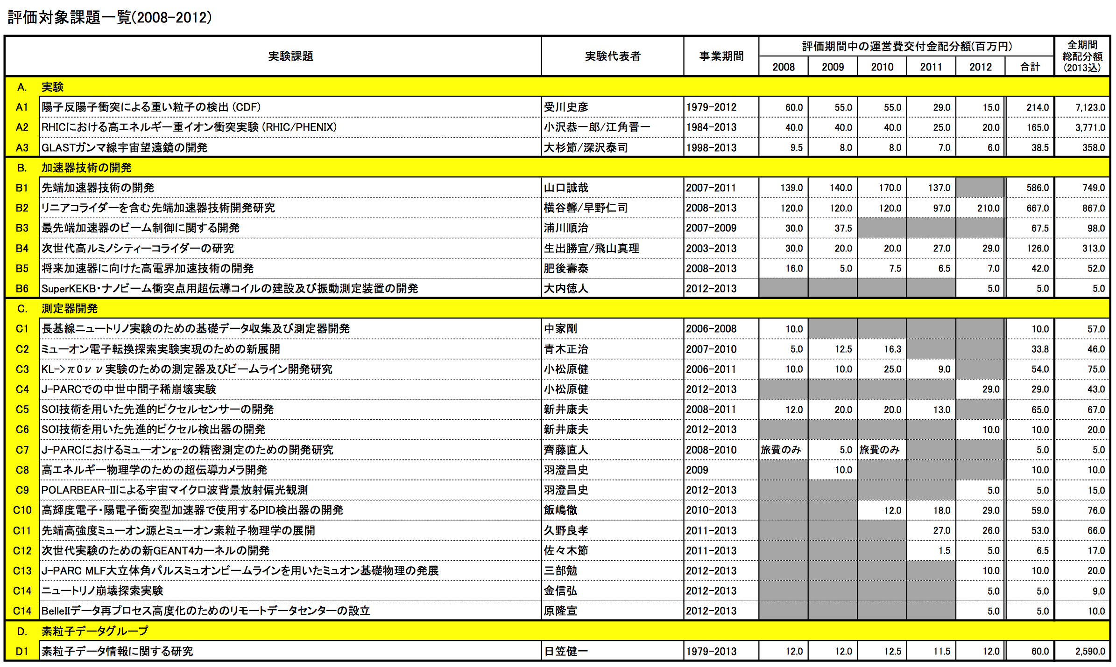
Research programs (2008-2012)
(reviewed by 6th exeternal review)
E(CDF)
E(PHENIX)
E(GLAST)
A
A (LC)
A
A
A
A
D/E(nu)
D(mu)
D (KOTO@J-PARC)
E (KOTO@J-PARC)
D (pix sensor)
D (pix sensor)
D (mu g-2)
D (SC camera for CMB)
E(CMB)
D (PID for B2)
D (mu)
Soft(G4)
D(nu)
D(mu)
Soft(BII)
Soft(PDG)
US-based HEP experiment decreased (4)
Acc/beam: 6, Detector dev: 12, Soft: 2

Slide 21
Recent research programs (FY2014)
E(RHIC)
E(GLAST)
CDF finished
Total 19 approved programs
  Acc/beam development: 6
  Detector devel: 6
  Soft devel: 3
  Running/constructing experiments:5
  Theory: 0
E(CMB)
A
A
A
D
Soft(G4)
D
E(KOTO)
D
D
Soft(BII)
D
“Soft”
E(BelleII)
A
A/D
A

Slide 22
Recent research programs (FY2015)
Total 20 approved programs
  Acc/beam development: 7
  Detector devel: 4
  Soft devel: 4
  Running/constructing experiments:5
  Theory: 1
E(RHIC)
E(GLAST)
E(CMB)
A
A
A
A
Soft(G4)
E(KOTO)
D(mu)
Soft(BII)
D (SiD)
E(BelleII)
A/D (nu)
“Soft”
A (LC)
T
Soft(BII)
D (sterile nu@J-PARC)
A (horn)

Slide 23
Recent research programs (FY2016)
E(RHIC)
Last year of only Japanese-side funding
Total 24 approved programs
  Acc/beam development: 8
  Detector devel: 6
  Soft devel: 3
  Running/constructing experiments: 5
  Theory: 2
More R&D type programs
E(GLAST)
E(CMB)
A
A
A
A
A
Soft(G4)
E(KOTO)
D
D
D
A
T
D
D
A
“Soft”
D
E(RHICf)
Soft(BII)
T
A

Slide 24
Recent research programs (FY2017)
E(GLAST)
A
A
A
Soft(G4)
D
A/D
A
A
A
A
A
A
A
First year of bi-lateral funding
Last year of PHENIX
Total 30 approved programs
  Acc/beam development: 15
  Detector devel: 9
  Soft devel: 3
  Running/constructing experiments: 4
More R&D type programs
Few support for “traditional” running/constructing projects
  G4/RHIC/RHICf are supported only from Japan side
A
A
“Soft”
E(KOTO)
E(RHICf)
E(RHIC)
A
D
D
D
D
D
D
D
Soft(BII)
A

Slide 25
Recent research programs (FY2018)
D
A
A
E(KOTO)
E(GLAST)
D
Soft(BII)
D
D
T
A
PHENIX finished
Second year of bi-lateral funding
Total 28 approved programs
  Acc/beam development: 16
  Detector devel: 7
  Soft devel: 3
  Running/constructing experiments: 2
  Theory: 1
More R&D type programs
Few support for “traditional” running/constructing projects
  G4/KOTO/GLAST are only supported from Japan side
“Soft”
A
A
A
A
A
A
A
A/D
A
A
D
Soft(G4)
A
D
A
A

Slide 26
History of US-Japan program
Allocated Budget
(M JPY)
Number
of proposal
Number
of proposal
Year (19XX/20XX)

Slide 27
Travel budget from JSPS
(Myen)
(件数)

Slide 28
(Recent) US-Japan budget
112Yen/$
+59%
+73%
+54%

Slide 29
History of # of programs
Bi-lateral support

Slide 30
Statistics (FY2017JP)

Slide 31
Special fund (FY2013~)
Category(1): Support travel for Japanese researchers to participate Snowmass discussions (Only FY2013)
  11 researchers supported
Category(2): Supper travel to discuss possibility of new US-Japan collaboration and make good proposal
Category 2
Request
Supported
Lead to real prop.
Approved
FY2014
JCM minutes

Slide 32

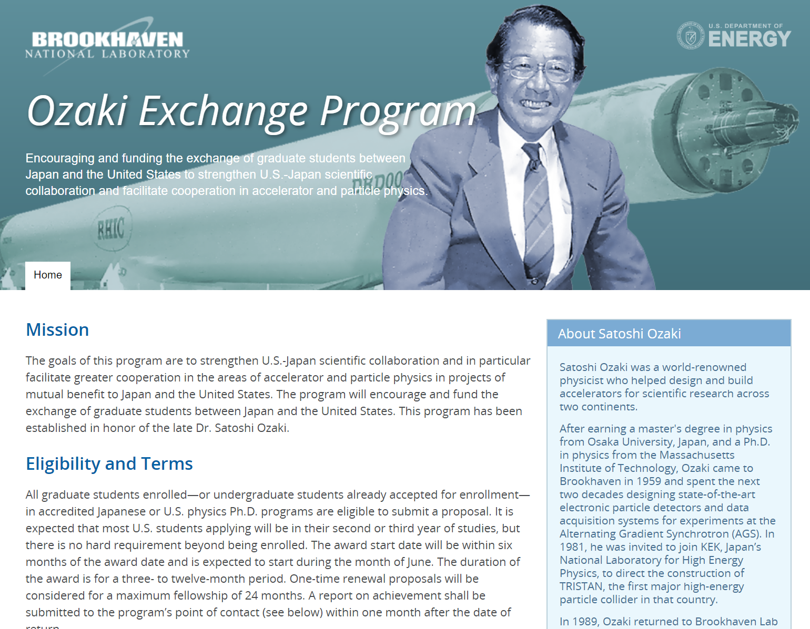
Ozaki Exchange Program (FY2019~)
https://www2.kek.jp/kokusai/us_japan/ozaki_exchange_program/
https://www.bnl.gov/ozaki/
Sending type: Country sending students select students/cover expenses
Elibibility: Graduate course students
Research area: High energy physics, Accelerator and Beam Physics and related field
Stay period: 3~12month
Host: DOE labs (US), KEK/Universities (Japan)

Slide 33
Selected students
2 from Japan to US
CMB
CMB
4 from US to Japan
Kyoto/KEK, T2K
KEK, Belle II
KEK, SRF
KEK, Belle II

Slide 34
Summary
Development of the US-Japan program
  Reformulated the program under new chain of agreements/arrangements
  Completion of participations to (big) experiments in US
    SLAC(SLD,..), BNL(nu, K, RHIC), FNAL (CDF, K, nu)
  Shift from “traditional” contributions to construction/operation of experiments in US to
    Pillar type
    Seed type R&D
  Start of the bi-lateral funding from FY2017
    Funding for the US-Japan program from DOE started
  Had two external reviews in Japan (FY2013, FY2018)
  Started “special fund” to foster new proposals
  Started Ozaki Exchange Program from JFY2019

Slide 35
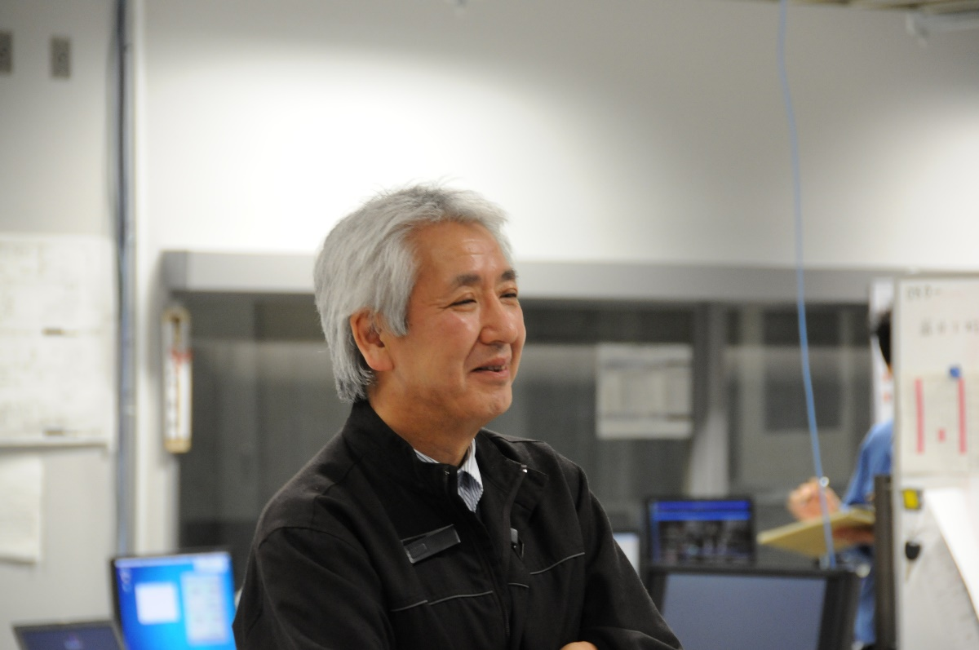
Koichiro Nishikawa (1949-Nov. 28, 2018)
Memorial symposium : Sept. 27, 2019 @ KEK
Kyoto U→U Tokyo → Phd student at Northwestern (1974-1979), Chicago (1979-1985), Stony Brook (1985-1987)
Pioneer of accelerator-based long baseline neutrino experiment
Founding spokesperson of K2K and T2K
Former director of IPNS, KEK
Former deputy director of J-PARC center
Kept as a player in and seeded US-Japan collaborations developed especially in neutrino and Kaon experiments
Web page not ready. If you wanted be informed, please mail to me: takashi.kobayashi@kek.jp

