Slide 1
40 years of US-Japan Collaboration in High Energy Physics
Personal Review by H. Sugawara
40th Anniversary Symposium of the US-Japan Science and Technology Cooperation Program in High Energy Physics
15-16 April 2019, Honolulu, Hawaii

Slide 2
Introduction to the
“Achievement Report of Japan/US Cooperation in the Field of High Energy Physics (1979-1986)” by Tetsuji Nishikawa, Director General, KEK
* Discussion between Japan and US scientists started in 1973 at the time of the US-Japan Symposium on High Energy accelerator held in Japan,
especially between T. Nishikawa and J. P. Blewett, BNL.
* Fukuda-Carter meeting May 12, 1978 http://www.chunichieigasha.co.jp/?p=18130
The Agreement on US-Japan Collaboration in Energy Research
became effective on May 2, 1979, and continued until 2005.

Slide 3
The agreement included fusion physics and high energy physics, among other research areas.
The Implementation Agreement in the field of High Energy physics was signed in November 1979 at the time of the First US-Japan Collaboration Meeting, held at SLAC.

Slide 4
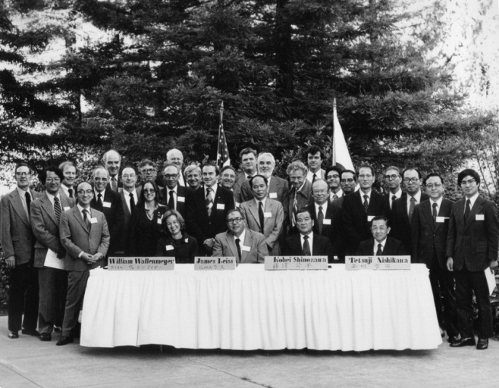

Slide 5
First committee members
US
J. Leiss (DOE), R. Birge (LBL), L. Lederman (FERMILAB),
W. Panofsky (SLAC), R. Rau (BNL), J. Sandweiss (Yale)
Japan
T. Nishikawa (KEK) , K. Shinozawa (MEXT), T. Fujii (U. Tokyo),
K. Kikuchi (KEK), T. Kitagaki (Tohoku U.), G. Takeda (Tohoku U.)

Slide 6
Allocated Budget
(M JPY)
Number
of proposal
Number
of proposal
Year (19XX/20XX)

Slide 7
Seven high energy physics projects started at the initial stage in US:
Collider Detector Facility (CDF) at Fermilab
L. M. Lederman (R. Schwitters) , T. Kondo
Spin physics at the Tevatron
A. Yokosawa , A . Masaike
Emulsion-Counter hybrid system for charm physics at the Tevatron
N. W. Reay, K. Niu

Slide 8
Seven high energy physics projects started at the initial stage in US (con’t)
R&D of TPC for PEP4 , UC Berkley, SLAC
D. Nygren , T. Kamae
Large Aperture Superconducting Solenoid (LASS) experiment at SLAC
D. Leith, R. Kajikawa
Neutrino Scattering experiment at BNL AGS
D.H. White, Y. Nagashima
Neutrino experiment using bubble chamber at AGS
N. Samios, T. Kitagaki

Slide 9
Some of the R&D projects for accelerator technology
Nb3-Sn/Cu dipole magnet R&D (BNL, Fermilab, KEK)
A. D. McInturff , H. Hirabayashi
Superconducting Cavity R&D (SLAC, KEK)
G. Loew, M. Tigner , Y. Kojima
High Power Klystron R&D (SLAC, KEK)
G. Konrad, J. Tanaka
Lasertron (SLAC, KEK)
C. Sinclair , G. Horikoshi

Slide 10
1980s: TRISTAN project at KEK
The earlier US projects mentioned above were very important for the development of TRISTAN,
the first large scale high energy physics project in Japan.
The international experimental group “AMY” was formed.
Co-spokespersons: S. Olsen (Rochester/Hawaii), K. Maki (KEK)
Later TRISTAN was turned into a B-factory with an even larger international participation.

Slide 11
Note the growing role in HEP during the 80s of
international HEP collaboration within Japan and
Japan-US HEP collaboration in general
In her book Beamtimes and Lifetimes: the World of High Energy Physics (Harvard Press, 1988; Chinese translation, 2003) Sharon Traweek asked,
“How do different cultures affect the way basic science is performed?”
She argued that American and Japanese practices shaped the US-Japan HEP collaboration over the last 40 years in various ways through their leadership styles, career paths, decision making processes, government organizational structures, and funding infrastructures. These different practices emerged within collaborations and addressing them strengthened the collaborations.

Slide 12
For the future of US-Japan collaboration and global laboratories it is important to realize that participating countries’ culture is reflected on the way basic science is performed. Global laboratory such as ILC Laboratory can become a cultural "melting pot” thus contributing to the world peace as our friend late Denis Perret-Gallix anticipated.

Slide 13
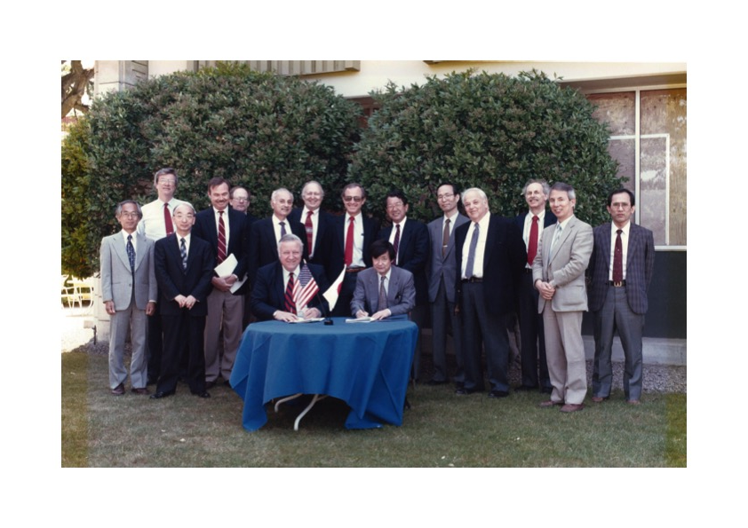

Slide 14
SSC saga ( with my personal viewpoint)
Immediately after I became DG of KEK, I got involved (as a member of the SSC Science Advisory Committee) in dealing with SSC matters in Japan and the US.
On Japan’s participation in the SSC:
US President G.W.H. Bush wrote a letter to PM Kaifu
Mr. Bush visited Japan and discussed the matter with PM Miyazawa
PM Miyazawa delegated the matter to the Science Academy of Japan and to the Science and Technology Committee
Monbusho (current MEXT), Tsuusansho (current METI) and Gaimusho (Ministry of Foreign Affairs) were involved, too
One way or another Japan was on the way to participation in the SSC

Slide 15
In the US I met informally with not only high energy physicists, but also scientists from other fields, DOE officials, and politicians in order to discuss the SSC and convey a Japanese perspective.
It was a very interesting experience. I may never talk about that openly because of privacy concerns.

Slide 16
According to a Wikipedia summary of studies about the SSC cancellation, there were many factors, including these 5:
rising cost estimates (to $12bn);
poor management by physicists and US Department of Energy officials;
-the end of the need to prove the supremacy of American science with the collapse of the former Soviet Union;
-the belief that many smaller scientific experiments of equal merit could be funded for the same cost;
-the US Congress’ desire to reduce spending (the US was running a $255bn budget deficit)
https://en.wikipedia.org/wiki/Superconducting_Super_Collider

Slide 17
One comment:
Some people argue that the failure to convey to the US a final decision by the Japanese Government about funding for the SSC was the cause of the cancellation of the SSC.
It is not reasonable to claim Japan is responsible for the SSC demise, given the 5 factors listed on the previous slide.

Slide 18
Some notable additions to
the Japan-US HEP collaboration in 1990-1993:
KTeV at Fermilab
Y. B. Hsiung, T. Yamanaka
Particle Data Group at UC Berkeley
M. Barnett, Y. Oyanagi
Muon Storage Ring at BNL
V. Hughes, Y. Mizumachi

Slide 19
Further additions to
the Japan-US HEP collaboration in the mid-1990s:
SLD experiment at SLAC
M. Bleidenbach, C. Baltay, K. Abe
R&D for Linear Collider at SLAC and KEK
G. Loew, K. Takada
R&D for B-factory detector
(Fermilab, Hawaii, Princeton, Virginia Tech)
F. Takasaki

Slide 20
After the mid-1990s
KEK started a B-factory and
Japan decided to participate in the LHC ($200M).
Inside Japan the relative importance of the US-Japan HEP collaboration was substantially reduced.

Slide 21
Since the mid-1990s there have been two additional (and important) US-Japan collaboration (and competition) projects:
R&D effort in X-band linear collider technology
Eventually this technology was not accepted for the ILC
Collaboration and competition in B-factories:
BaBar and Belle detectors
high luminosity accelerator technology

Slide 22
The Japan-US Energy Agreement ended in 2005,
but was continued in high energy physics, owing to Article 10 of the Agreement which says that unfinished projects can be continued.
Independently of the Energy Agreement, another Agreement on US-Japan collaboration in Science and Technology was signed in 1988.
DOE and MEXT agreed to sign an Implementation Agreement in 2013 based on the 1988 Agreement.
KEK and DOE signed on to the Project Agreement in 2013, based on the Implementation Agreement
The current budget is nearly 1/3 of the initial allocation.

Slide 23
The future of US-Japan collaboration in high energy physics depends very much upon the future of high energy physics.

Slide 24
My personal view
When the SSC was terminated, L. Lederman lamented by mentioning that “the Higgs is God’s particle”. I agree with his prophetic remark in the following sense:
If we understand the detailed properties of the Higgs particle, including its interaction with neutrinos, then we understand the physics all the way up to the Planck scale, the highest energy.
We do not need a higher energy machine than a Higgs factory.
God has been kind to us!
Higgs factory
Neutrino factory (after muon factory)

Slide 25
I will explain the physics behind this viewpoint in an April 17 seminar at the University of Hawaii physics department; the title of my talk is:
“Flavor Moonshine”

