Slide 1

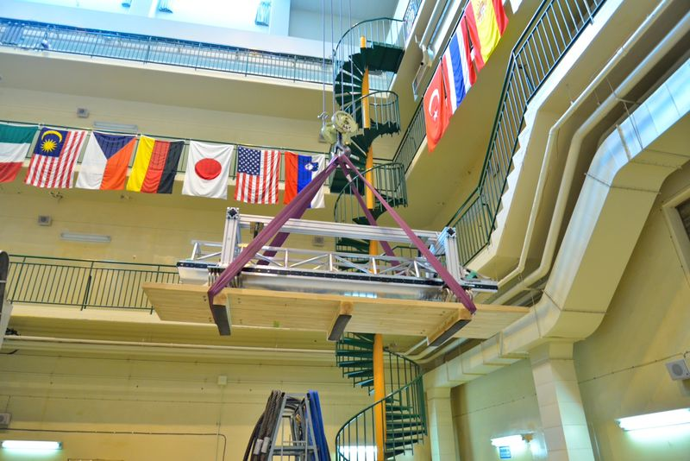
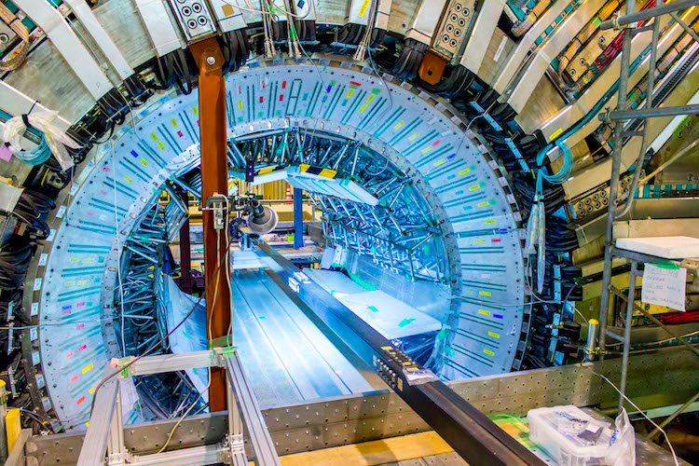
Belle II (incl. the TOP detector system)
US-Japan
日米
Tom Browder, University of Hawai’i at Manoa
History, Role of US-Japan (Nichibei) cooperation on Belle II
Belle II detector and its “pilot run” in 2018 (Phase 2)
The TOP detector system and its performance in Phase 2
What’s ahead in Phase 3 (physics run)
First TOP module arriving at Tsukuba Hall
Other related talks: M. Tobiyama on SuperKEKB, I. Ueda on GRID computing, Alan Schwartz on flavor physics
TOP detector system installed
Notes:
The top figure shows the first TOP module arriving in Tsukuba Hall. The second figure is the fully assembled TOP detector system.

Slide 2

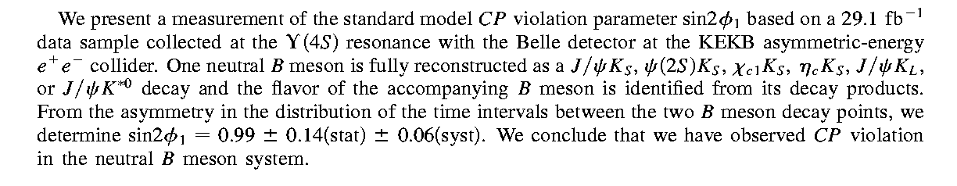
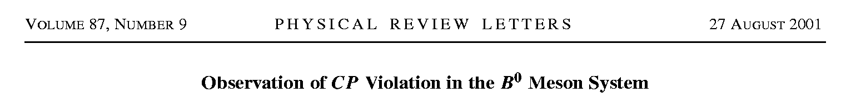
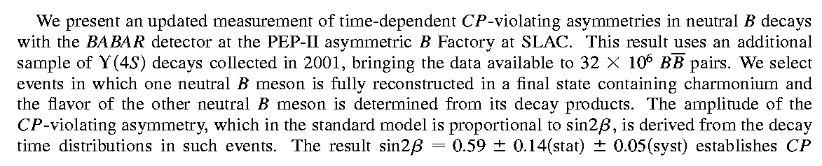
Some history: Summer of 2001
Belle:
BaBar:
The first example of CP Violation outside of the kaon (strange quark) system. CP Violating Effects of O(1) rather than O(10⁻³)

Slide 3
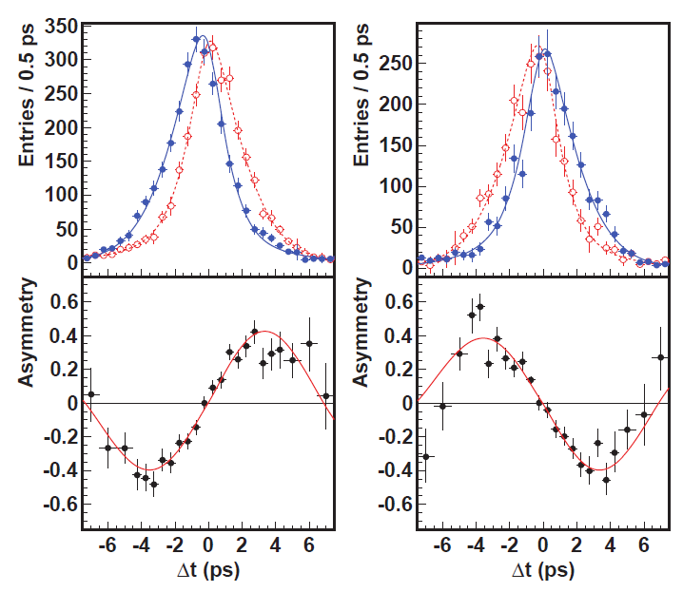
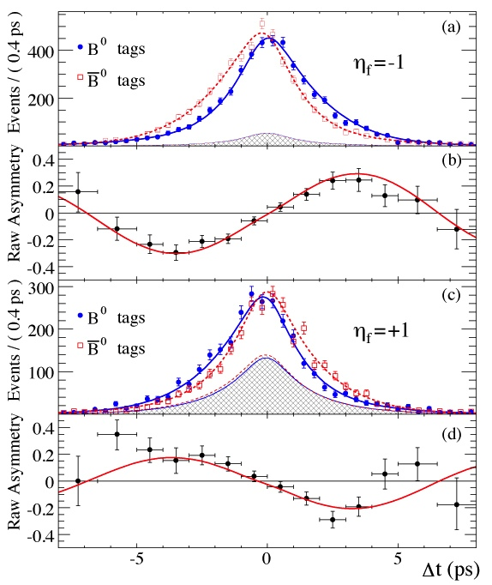

History: Measurement of sin(2φ₁)/sin(2β) in B→Charmonium K⁰ modes
(cc)K_{S}
J/ψK_{S}
J/ψK_{L}
J/ψK_{L}
sin2φ ₁=0.667±0.023±0.012
A_{f}=0.006±0.016±0.012
PRL108,171802 (2012)
sin2φ₁=0.687±0.028±0.012
A_{f}=-0.024±0.020±0.016
PRD79,072009 (2009)
Overpowering evidence for CP violation (matter-antimatter asymmetries). >>>> The phase of V_{td} is in good agreement with Standard Model expectations. This is the phase of B_{d} mixing.

Slide 4

2008:
Critical Role of the B factories in Japan and the US in the verification of the Kobayashi-Maskawa hypothesis was recognized and cited by the Nobel Foundation
A single irreducible phase accounts for all the matter-antimatter asymmetries in particle physics.
CP violating effects in the B sector are O(1) rather than O(10⁻³) as in the kaon system.
Notes:
The Glory of the Past.

Slide 5
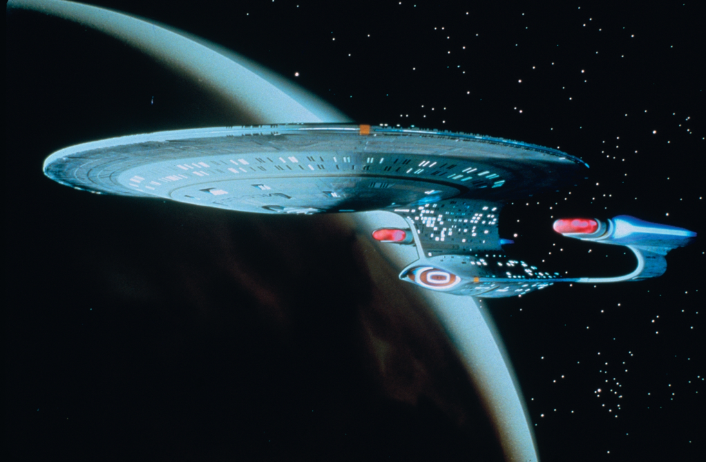
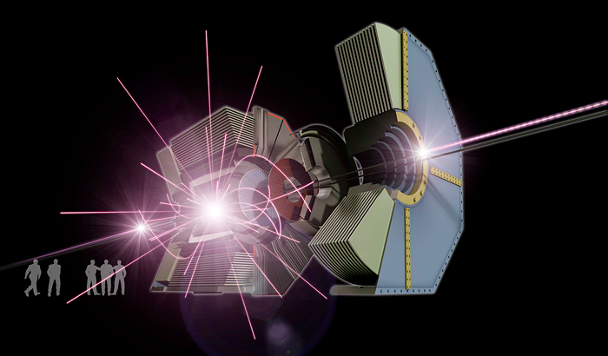
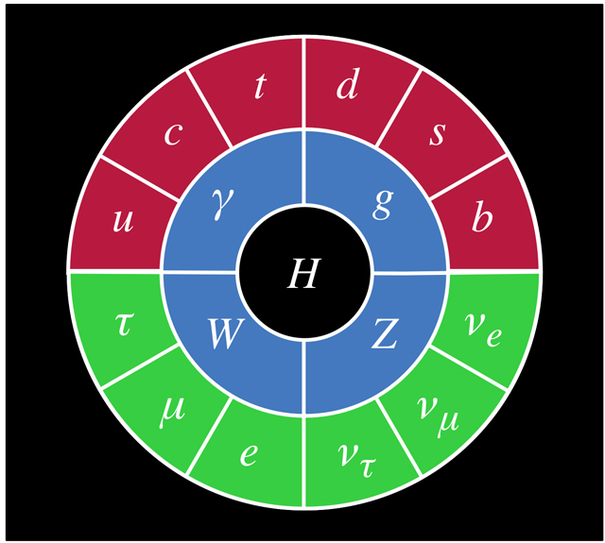
The Next Generation of Research
Belle II/SuperKEKB (Japan), LHCb (Europe)
1964: discovery of CP violation (matter-antimatter asymmetry) with kaons (strange quarks)
2001: discovery of CP violation (matter-antimatter asymmetry) with B’s
US P5 report: “Explore the unknown: new particles, new interactions, and physical principles”
Since the P5 report, flavor physics has clearly emerged as a major alternate path to NP.
Notes:
The path to the future.

Slide 6
US-Japan
日米
Some Nichibei History
In FY2012, tried to start Belle II TOP construction (US was in a continuing budget resolution, so no new projects allowed).
US-Japan (Nichibei +DG Suzuki) stepped in and allowed us to start the TOP (initial quartz bars) and the KLM scintillator upgrade.
FY2010 - FY2013 "Development of PID detector for a High Luminosity e+e- Collider” (PI’s: D. Asner (PNNL), T. Iijima (Nagoya))
FY2014-2016 "Improvement of the Belle II detector to search for new physics”
This is one more example of Nichibei of “saving the day”. What a good and wise investment ! (just like Belle).
Many more technical and financial obstacles that had to be overcome to complete the TOP detector, a few failed beam tests, firmware crises, tense reviews, many twists and turns, many times when we thought it would never work…….
Notes:
Some Nichibei history.

Slide 7
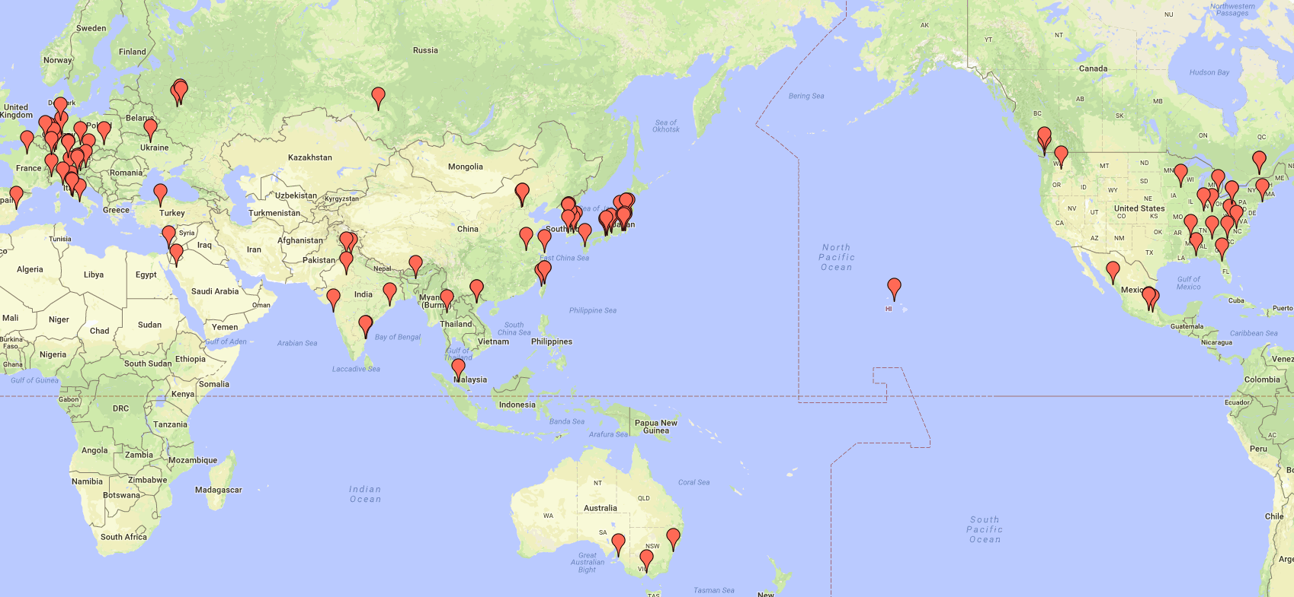
The Geography of the International Belle II collaboration
Intense level of interest world-wide in flavor physics
Belle II now has grown to ~900 researchers from 26 countries
This is rather unique in Japan. The only comparable example is the T2K experiment at JPARC, which is also an international collaboration
Youth and potential: There are 267 graduate students in the collaboration
Notes:
High level of physics interest-→The collaboration is growing rapidly.

Slide 8
US Institutes and Roles
The US Belle II construction project went through the full DOE CD process and cost about 16 million dollars. It was managed by PNNL and completed in 2016. Following construction, there is about 7.5 M/year in US DOE support.
18 Belle II institutes, 120 US collaborators (28 faculty, 28 postdocs, 27 technical staff, 15 Phd students, 7 Master students, 13 undergraduates) [~4.5M/year in DOE programmatic funding)
Brookhaven National Laboratory
Carnegie Mellon University
Duke University
Indiana University
Kennesaw State University
Luther College
Pacific Northwest National Laboratory (PNNL)
University of Cincinnati
University of Florida
University of Hawaii
University of Louisville
University of Mississippi
University of Pittsburgh
University of South Alabama
University of South Carolina
Virginia Tech
Wayne State University
US Belle II has now transitioned to the operations stage, managed by BNL and focused on detector operations and GRID computing. (~3M/year)
Notes:
Annual funding for programmatic research at universities and labs AND operations funding at BNL.

Slide 9

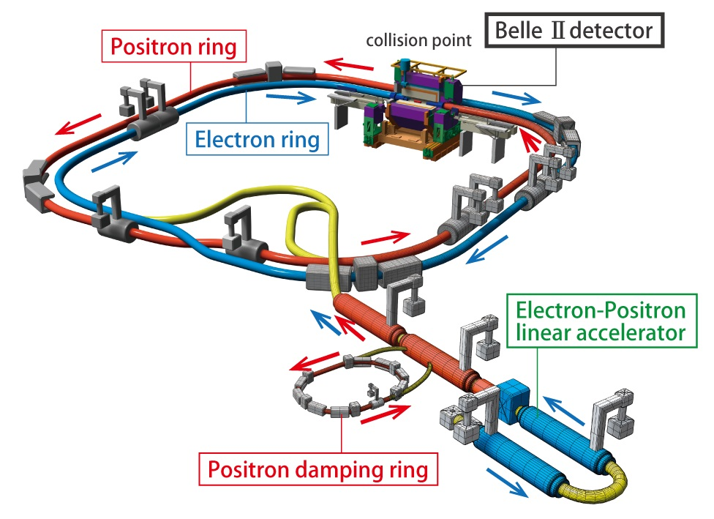
SuperKEKB, the first new collider in particle physics since the LHC in 2008 (electron-positron (e⁺e⁻) rather than proton-proton (pp))
Phase 1:
Background, Optics Commissioning Feb-June 2016
Phase 2: Pilot run
Superconducting Final Focus, First Collisions
April 27-July 17, 2018
Phase 3: Feb 11,2019-→ physics run
Cooperation with Japanese industrial partners (Hitachi, Mitsubishi etc). US-Japan cooperation-→ to be discussed by Tobiyama-san.
Notes:
This ~400 million dollar upgrade was provided entirely by KEK and Japan. Cooperation with Hitachi and Mitsubishi is essential.

Slide 10
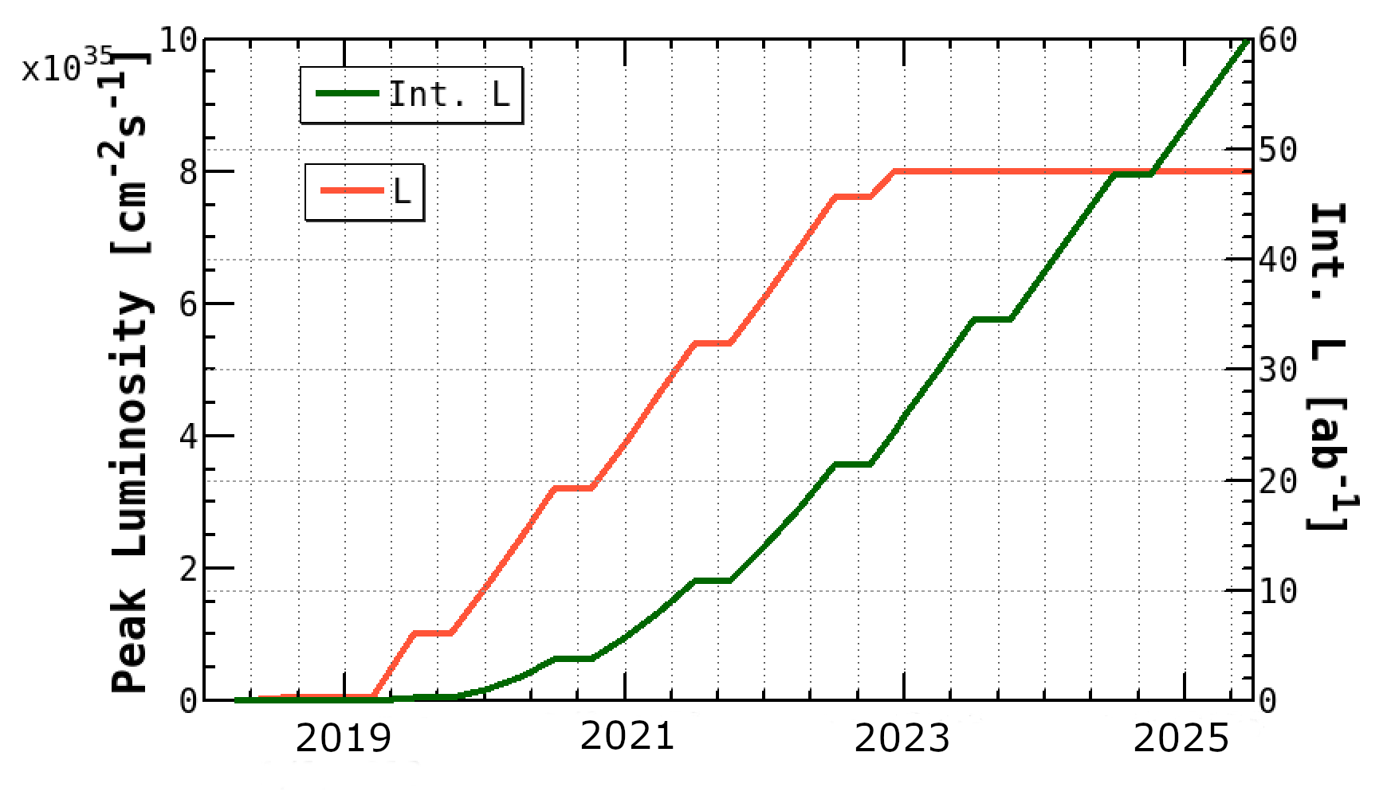
SuperKEKB/Belle II Luminosity Profile
Belle/KEKB recorded ~1000 fb⁻¹ . Now have to change units on the y-axis to ab⁻¹
Beam currents only a
factor of two higher
than KEKB (~PEPII)
“nano-beams” are the key; vertical beam size is 50nm at the IP
[Needs full operation and some international collaboration on the accelerator, including the US and Europe e.g. BNL built the corrector coils for the SuperKEKB superconducting final focus]
→to be discussed by Tobiyama-san.
Notes:
And full funding of operations is needed !

Slide 11


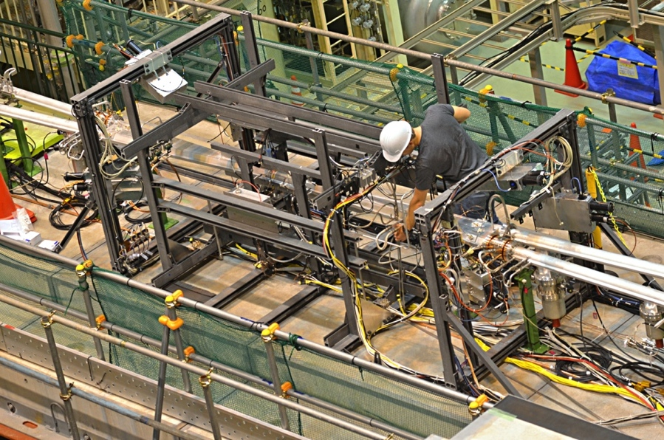
Some Belle II jargon (Phase 1, Phase 2, Phase 3)
Phase 1: Simple background commissioning
detector (diodes, diamonds TPCs, crystals…) BEAST II.
No final focus. Only single beam background studies possible [started in Feb 2016 and completed in June 2016].
off
Comprehensive study of beam bkgs published in Jan 2019 issue of
NIMA, vol 914, 69 (2019)
This was followed by Phase 2 in 2018

Slide 12
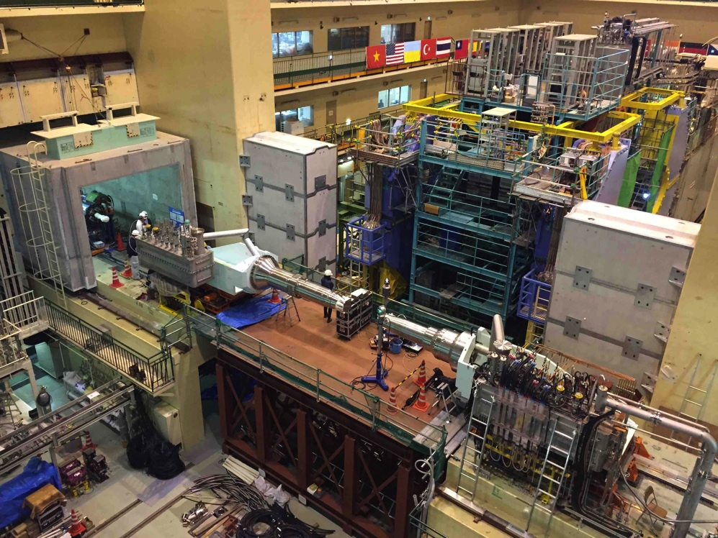
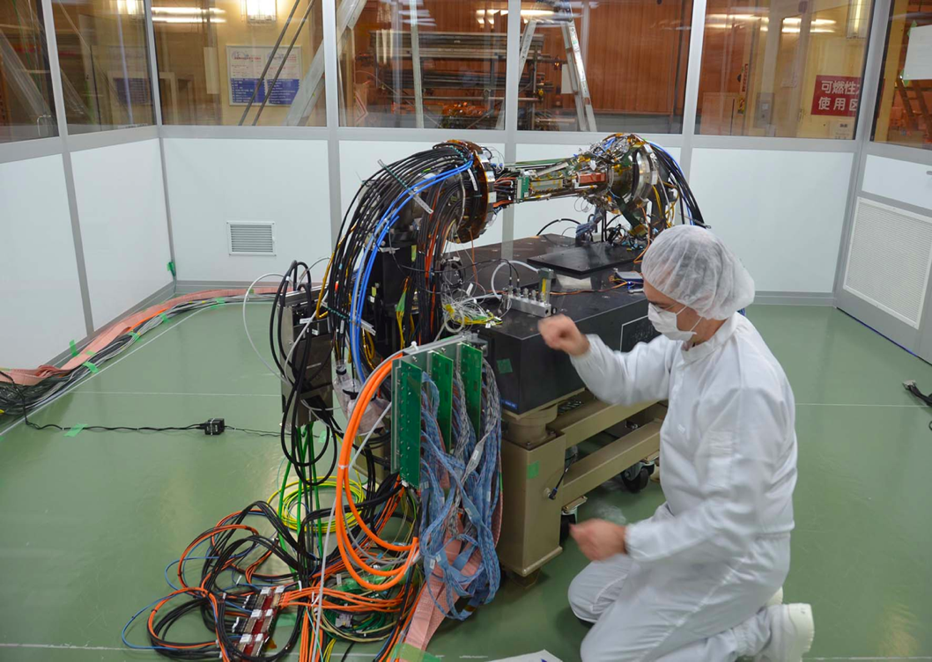
Some Belle II jargon (Phase 2, Phase 3)
Phase 2: A pilot run with a more elaborate inner background commissioning detector (VXD samples). Full Belle II outer detector. Full superconducting final focus. No vertex detectors. Collisions ! [Phase 2 collisions: April 26-July 17, 2018]
Phase 3: Install the VXD in Belle II. Physics Run with the full Belle II detector [started March 11, 2019]

Slide 13
Belle II Detector
BEAST (Background commissioning detector)
KLong and muon detector:
Resistive Plate Chambers (barrel outer layers)
Scintillator + WLSF + SiPM’s (end-caps , inner 2 barrel layers)
EM Calorimeter:
CsI(Tl), waveform sampling (barrel+ endcap)
Particle Identification
iTOP detector system (barrel)
Prox. focusing Aerogel RICH (fwd)
electrons (7 GeV)
Beryllium beam pipe
2cm diameter
Vertex Detector
2 layers DEPFET + 4 layers DSSD
positrons (4 GeV)
Central Drift Chamber
He(50%):C2H6(50%), small cells, long lever arm, fast electronics (Core element)
Major US DOE construction in BEAST, BKLM, and TOP
Notes:
Belle II is a universal spectrometer, which can detect charged particles, neutral particles and neutrinos (missing energy). It can distinguish kaons from pions and identify muons, electrons and neutral Klongs.
Belle II reuses the structure, solenoid and CsI(Tl) crystals and part of the barrel RPCs from the original Belle detector. Most other components are new. We must prepare for backgrounds a factor of 10-20 higher. Each detector subsystem involves collaboration among several nations. I will come back to this point later.

Slide 14
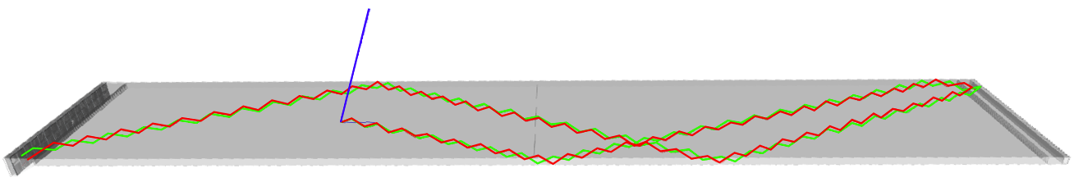
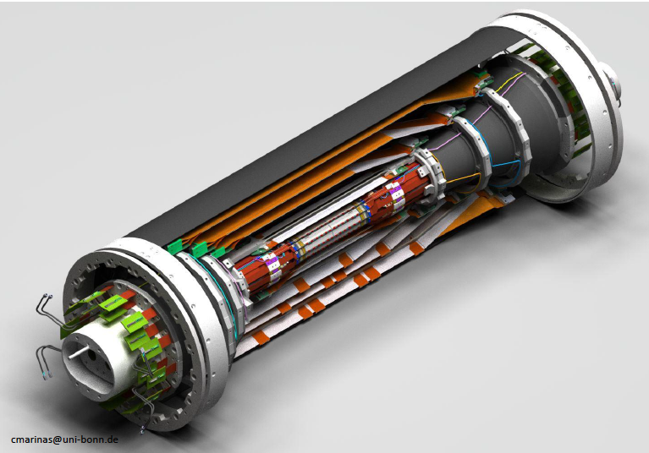
Barrel Particle Identification (uses Cherenkov radiation)
US-Japan
日米
The paths of Cherenkov photons from a 2 GeV pion and kaon interacting in a TOP quartz bar. (Japan, US, Slovenia, Italy)
Incoming track
Optics from US Belle II
Readout from US Belle II
US Companies: Corning, Zygo, IIT
Vertexing/Inner Tracking
Beampipe r= 10 mm
DEPFET pixels (Germany, Czech Republic…)
Layer 1 r=14 mm
Layer 2 r= 22 mm
DSSD (double sided silicon detectors)
Layer 3 r=38 mm (Australia)
Layer 4 r=80 mm (India)
Layer 5 r=115 mm (Austria)
Layer 6 r=140 mm (Japan)
FWD/BWD Italy
+Poland, Korea
Notes:
Pion is green and kaon is red. First discuss vertexing and then PID.

Slide 15
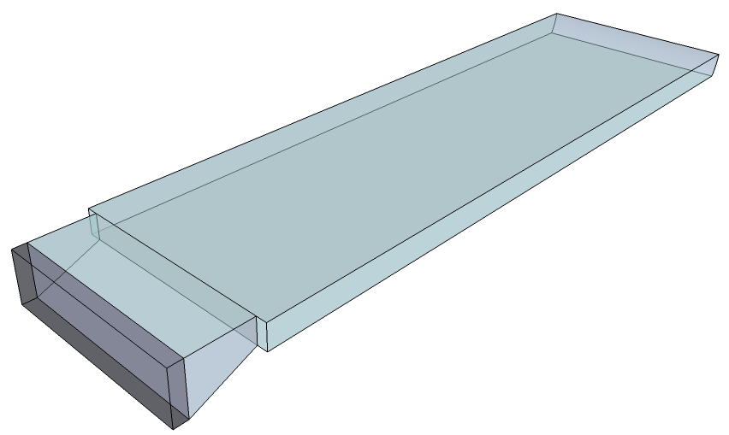
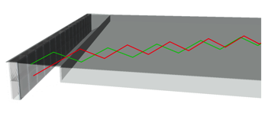
US-Japan （日米）collaboration on the Belle II TOP detector system
Cherenkov ring imaging using precision timing (σ_{TTS} < 50ps/photon).
Very compact, suitable for collider geometry.
Focusing mirror for correcting chromatic dispersion effect. Nagoya
Imaging w/ expansion block + 2-layer MCP-PMT. Hawaii
Nagoya, Hawaii, Slovenia etc
Design optimization
Nagoya, Hawaii, Cincinnati, PNNL + IJS
Focusing mirror
MCP-PMT
Nagoya
Readout Electronics
Hawaii, PNNL, Indiana
Quartz radiators
Cincinnati, Nagoya, PNNL
Mechanical Issues
Nagoya, KEK, Hawaii, PNNL
Expansion block
+ MCP-PMT array
Collaboration of
Japan (Nagoya, KEK) + US (PNNL, Cincinnati, Hawaii, Indiana, Pittsburgh, South Carolina) + Slovenia (IJS) + Italy (Padova, Torino)
Notes:
A close collaboration between the US and Japan.

Slide 16

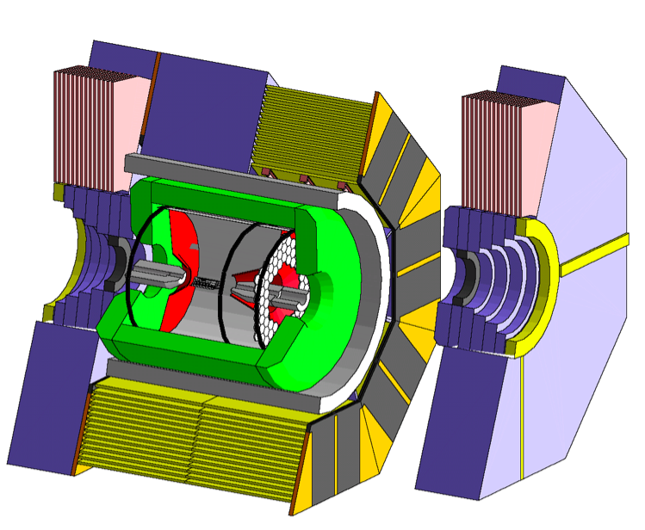

Belle II upgrade to the KLM required upgrading the electronics of layers – new scintillators and but reuse most RPCs in barrel
(
US-Japan
(日米) provided “startup” for barrel part of the KLM
Barrel KLM
Entire endcap and inner two layers of barrel KLM have been replaced with scintillator-based detectors readout with SiPM’s.
RPC’s are kept for the outer 13 layers of barrel KLM, but need to be equipped with new readout electronics.
  2 x 8 octants x 13 layers = 208 modules
  About 19K readout channels
VPI (BKLM), Hawaii (readout), KEK, and for the RPCs (Roma Tre, Frascati). Recently Fudan University has joined the effort.
Endcap KLM
Russia (Lebedev Institute) did the Endcap KLM (EKLM) hardware

Slide 17
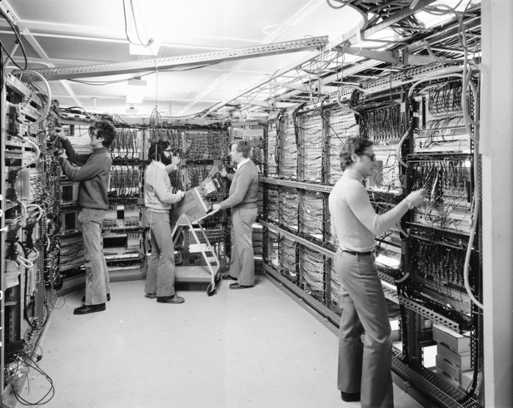



Advanced & Innovative Technologies used in Belle II
Pixelated photo-sensors play a central role
MCP-PMTs in the TOP
HAPDs in the ARICH
SiPMs in the KLM
USS Kobayashi-Maskawa
Collaboration with
Industry [Hamamatsu]
DEPFET pixel sensors
[Siemens]
Waveform sampling with precise timing is “saving our butts”.
Front-end custom ASICs (Application Specific Integrated Circuits) for all subsystems
→ DAQ with high performance network switches, large HLT software computer farm
→ a 21st century HEP experiment.
KLM (TARGETX ASIC)
ECL (New waveform sampling backend with good timing)
TOP (IRSX ASIC)
ARICH (KEK custom ASIC)
CDC (KEK custom ASIC)
SVD (APV2.5 readout chip adapted from CMS)
New methods of neutron detection with TPC’s for the background.
Directions !
https://arxiv.org/abs/1901.06657
See poster by H. Ishiura (Kobe)
Notes:
Only read the underlined points. Remember the pixelated photo-sensors from Japanese industry.

Slide 18
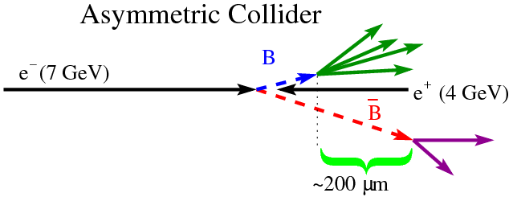
The B-anti B meson pairs at the Upsilon(4S) are produced in a coherent, entangled quantum mechanical state.
Need to measure decay times to observe CP violation (particle-antiparticle asymmetry).
One B decays →collapses the flavor wavefunction of the other anti-B. (N.B. One B must decay before the other can mix, exercise)
Exercise: Why is there a minus sign ?
Not to scale
The beam energies are asymmetric (7 on 4 GeV)
The decay distance is increased by around a factor ~7
Notes:
B meson pairs are produced in an entangled quantum mechanical state. This leads to the requirement that the time difference between the two decays.

Slide 19
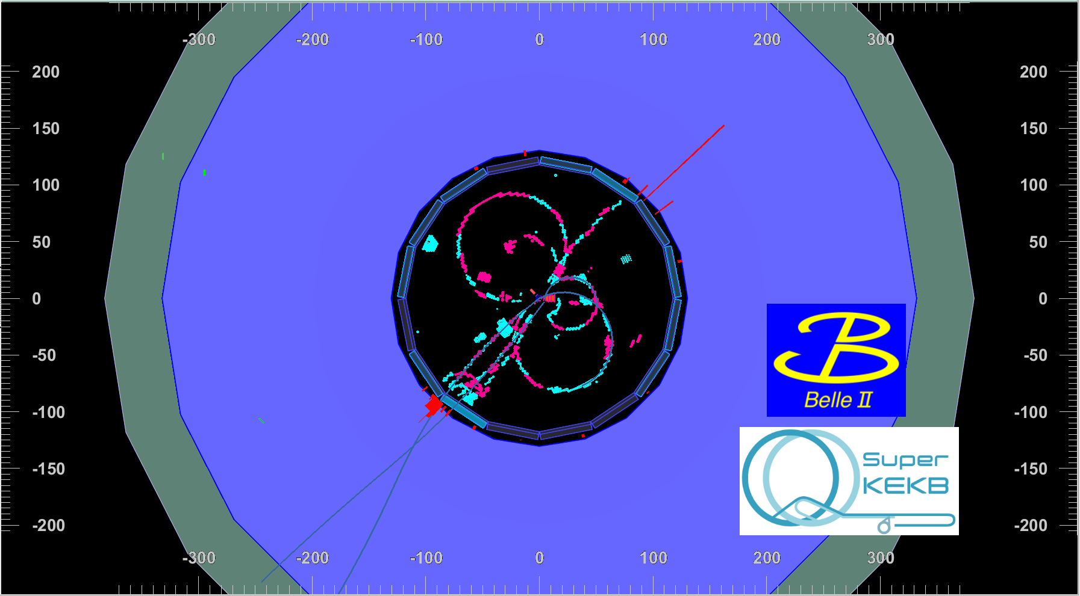
Antimatter-matter annihilation in Tsukuba, Japan
IP size: 400 µm in X, 4 µm in Y
Peak Luminosity : 7-9·10³¹ cm⁻²s⁻¹
Probably
Notes:
This brings us back home to Tsukuba, Japan.

Slide 20
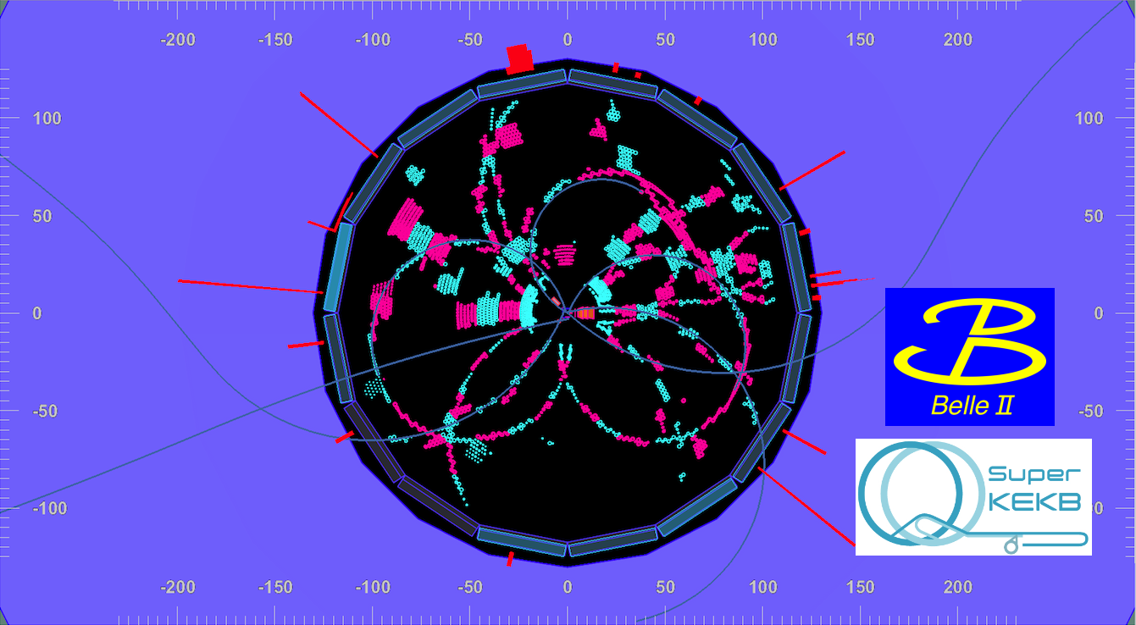
More matter-antimatter annihilation in Tsukuba:
Another event from Belle II’s first evening
A potential e+ e- →B anti-B candidate

Slide 21
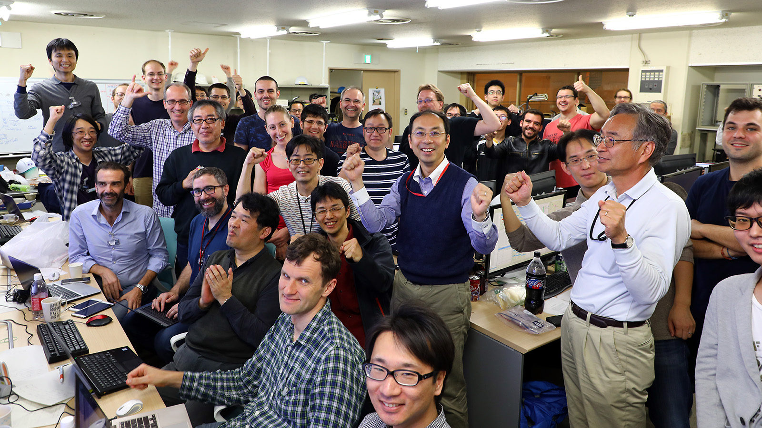
The scene at the experimental control room in Tsukuba Hall B3
This is scientific history in the making: SuperKEKB/Belle II joins DORIS/ARGUS, CESR/CLEO, and PEP-II/BaBar and KEKB/Belle
Notes:
A celebration at Tsukuba B3

Slide 22
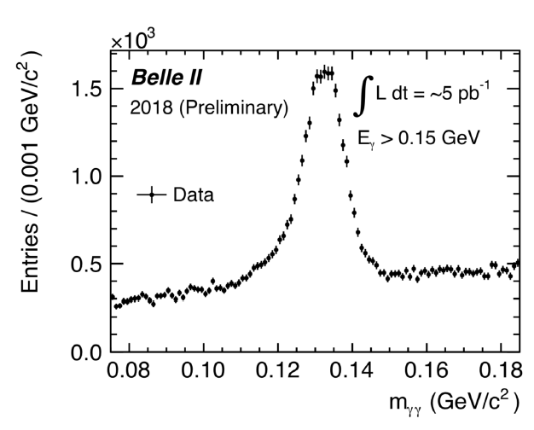
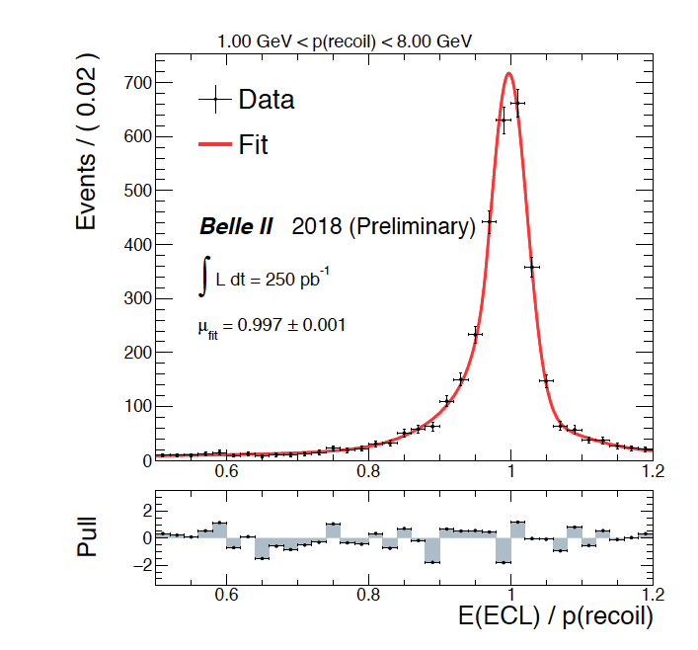
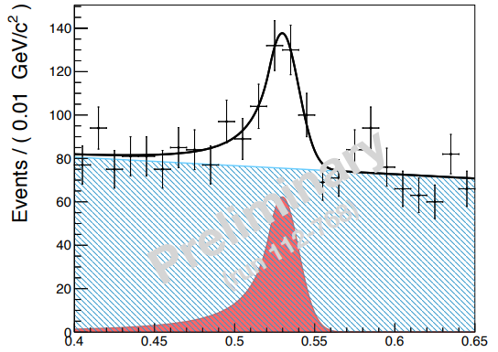
All the Belle II detector subsystems are working fairly well. Some nice (but incomplete) signals involving photons.
Single Photon Lines
We are ready for the dark sector e.g.
e+e⁻→γ + nothing and
e+e- →γ(γγ) [ALPS]

Slide 23
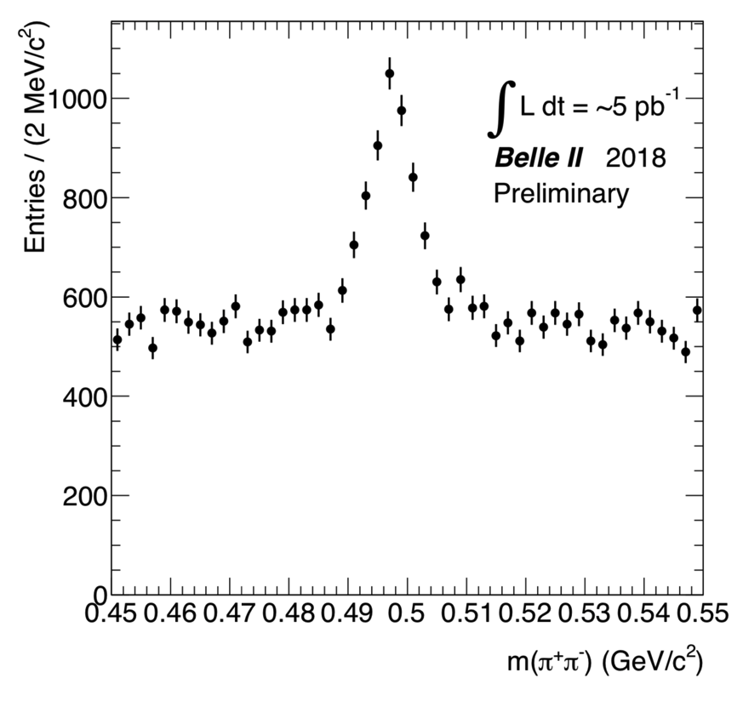
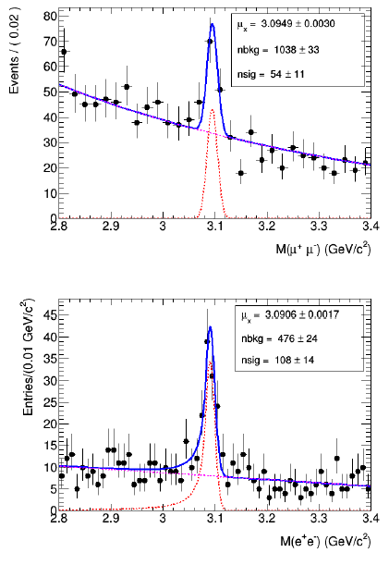
Most of the Belle II detector subsystems are working well.
Here are some signals involving charged tracks.
US-Japan
日米
No vertex cuts
Barrel muons
Notes:
Barrel KLM muons only

Slide 24

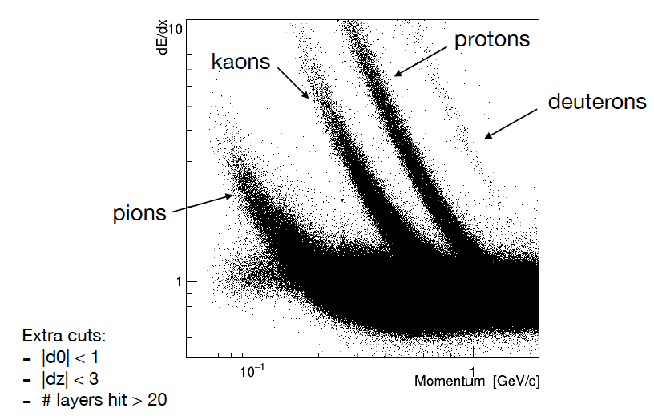
Performance of CDC dE/dx particle identification with early calibrations in the hadronic event sample.

Slide 25
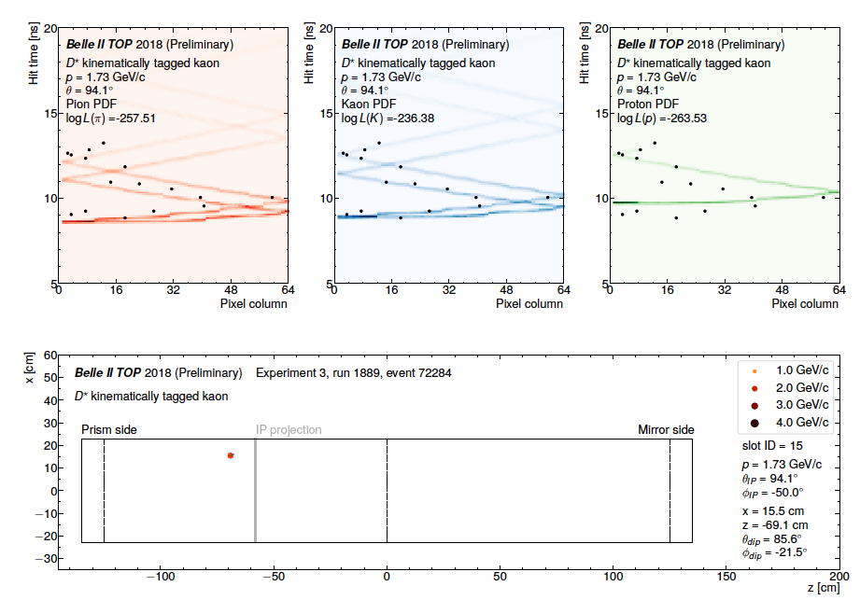
TOP Particle Identification.
N.B. The charge correlation with the slow pion determines which track is the kaon (or pion)
Kinematically identified kaon from a D^{*+} in the TOP;
Cherenkov x vs t pattern (mapping of the Cherenkov ring)
Notes:
Kaon in a kinematically tagged D*+ →D^0 pi+, D^0->K- pi+ decay. Note the charge correlation tags the kaon.

Slide 26
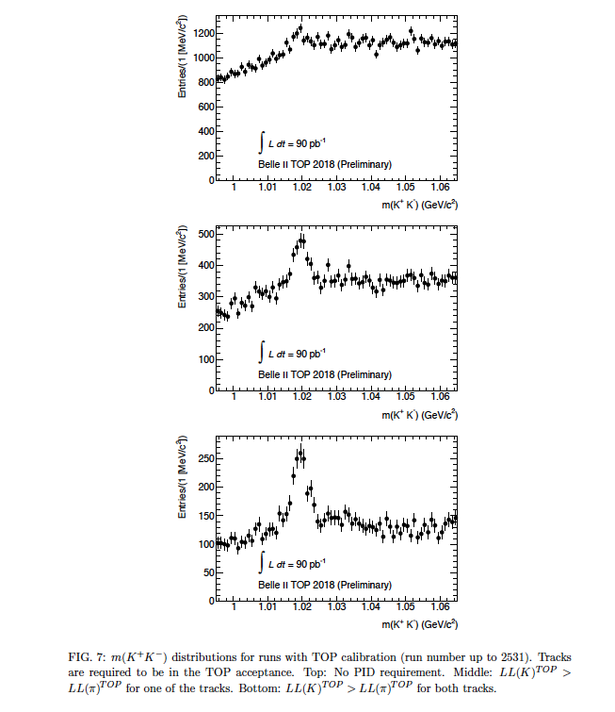
No kaons identified
One kaon identified in the TOP.
Another example of TOP particle identification with early calibration and alignment.
Both kaons identified in the TOP.

Slide 27
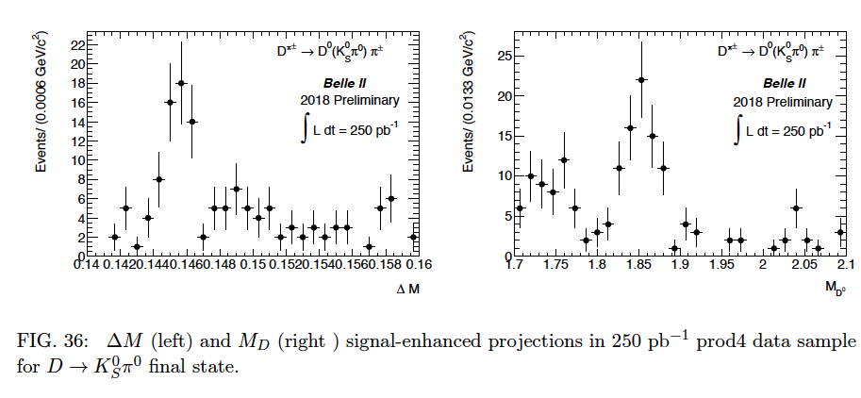
Example of unique capabilities in the Phase 2 pilot run
Need a pair of pions with a displaced vertex and two photons measured with good resolution and low background
Comment from LHCb colleagues:
“This would be impossible at LHCb.”

Slide 28
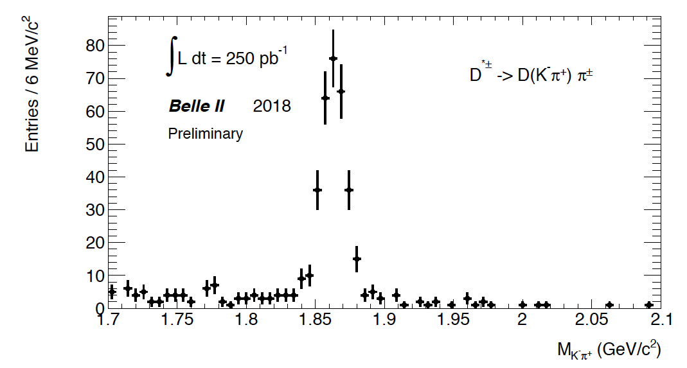
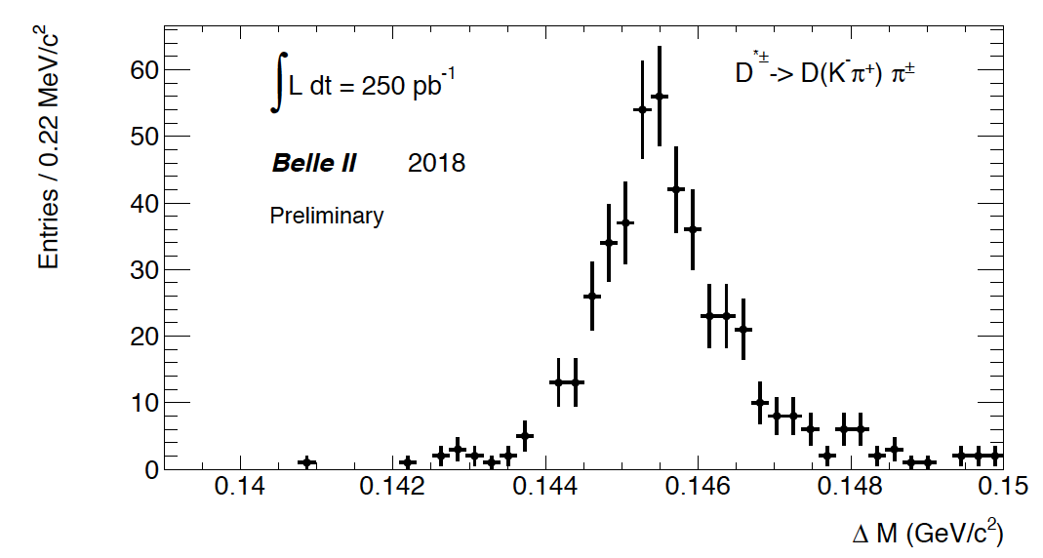
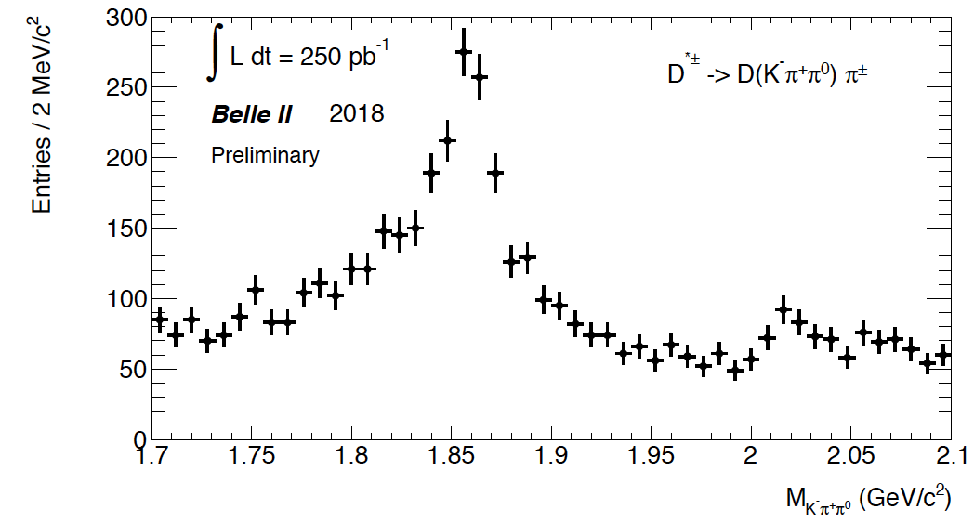
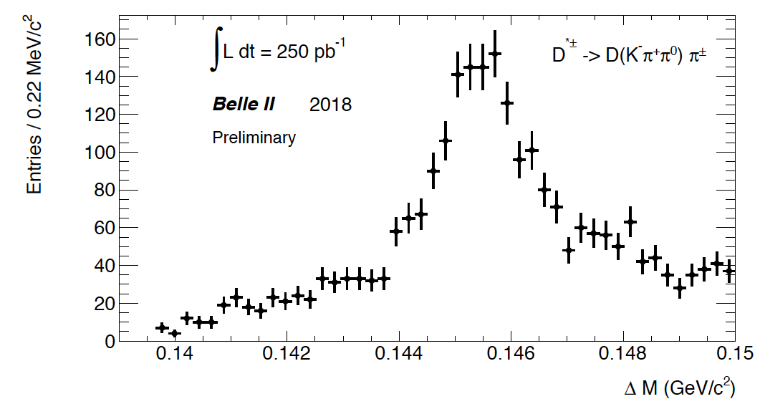
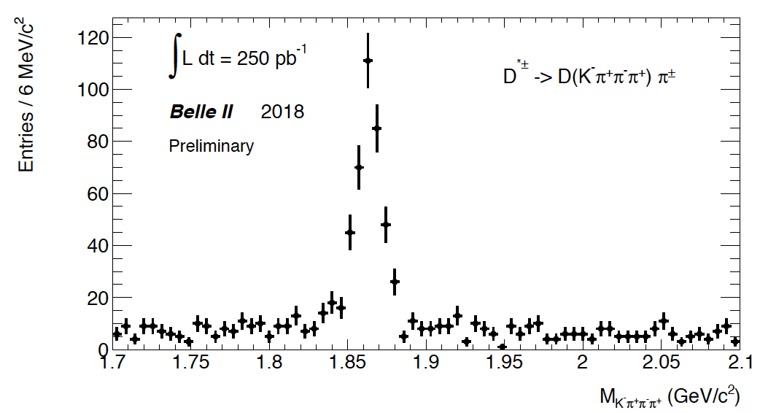
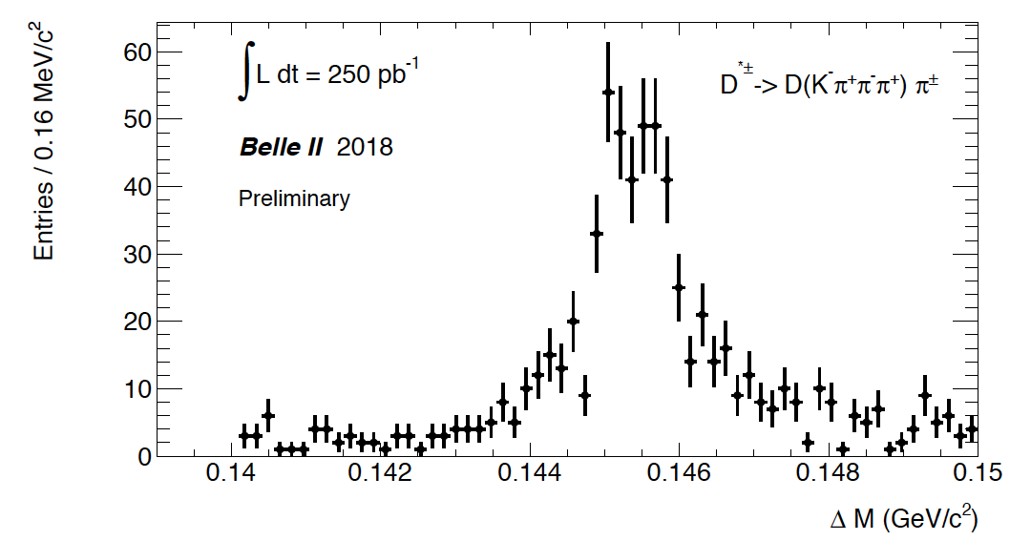
The signal peaks are charmed particles
Clearly illustrates the capabilities of Belle II and the potential for charm physics and the building blocks of B mesons.
Notes:
Demonstrates the Belle II capabilities for charged and neutral modes as well the potential for charm physics.
These are look-back plots i.e. M_D with a cut on Delta M or Delta M with a cut on M_D. Particle identification has been used.

Slide 29

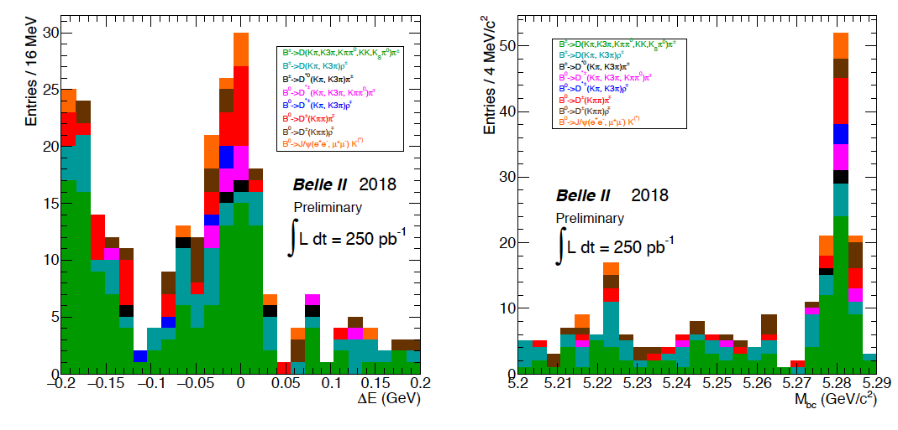
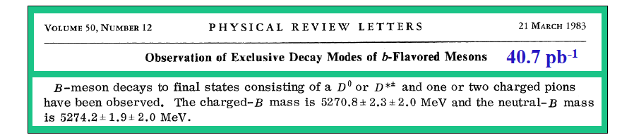
We have rediscovered the B meson !
.
History
1983:
Notes:
Mbc = sqrt(E_cm/2^2 – p_rec^2), Delta E = Ecm/2 – E_rec. The resolution in M_bc is dominated by the beam energy spread rather than by detector resolution.

Slide 30
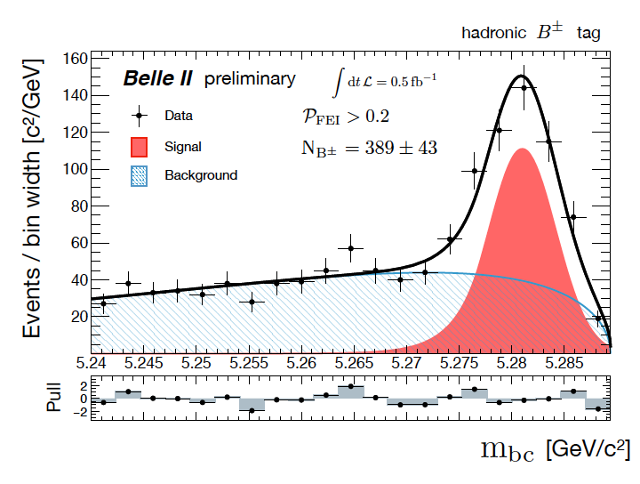
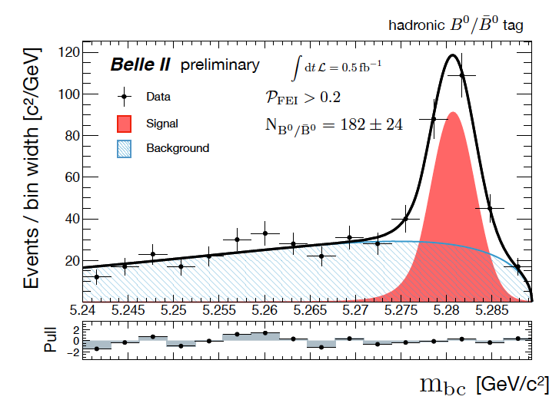
Now use the full Phase 2 pilot run dataset and apply the FEI (Full Event Interpretation) technique based on boosted decision trees (BDTs, a machine learning technique)
We now observe ~571 fully reconstructed B mesons (389+182) or an improvement of a factor of ~O(3.6) in overall efficiency by using this advanced analysis method that covers many more decay channels.
Further improvement (X 2) is definitely possible (PID, low p tracking will play a major role).
B2NOTE-2018-031-1,
W. Sutcliffe, F. Bernlochner

Slide 31
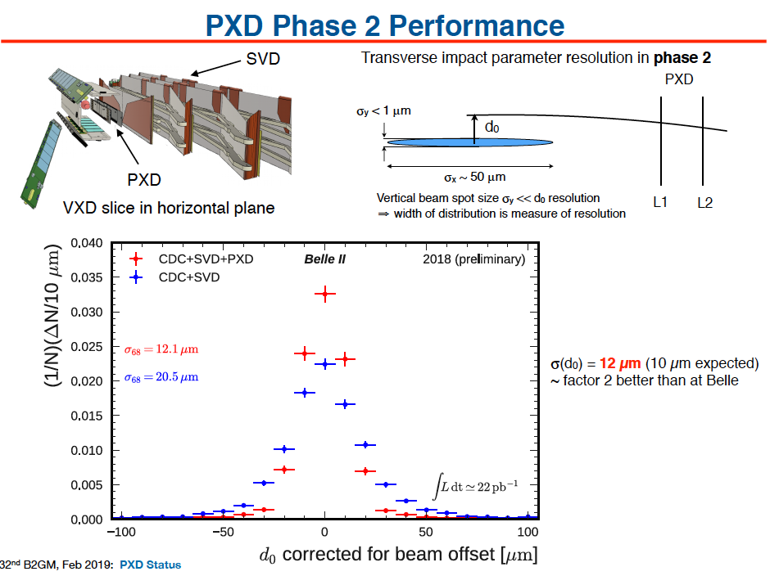
Notes:
Demonstration of PXD performance in Phase 2

Slide 32
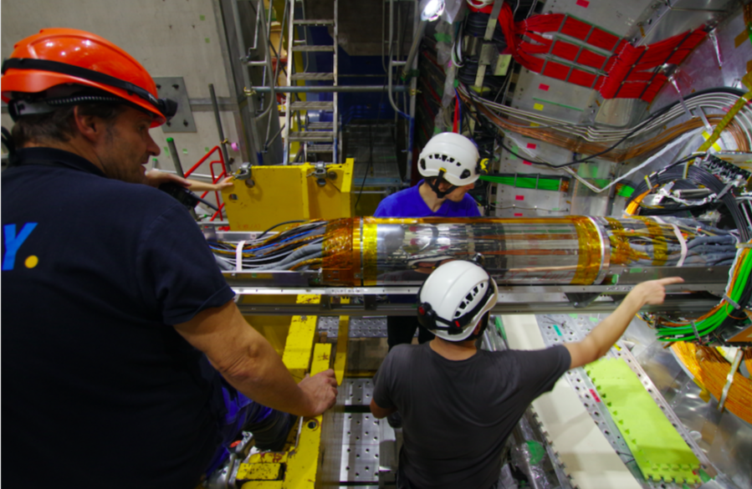
Full VXD installation, fall of 2018
VXD installed on Nov 21, 2018. (PXD L1 and two ladders of L2.)
Notes:
DESY installing the VXD team.

Slide 33
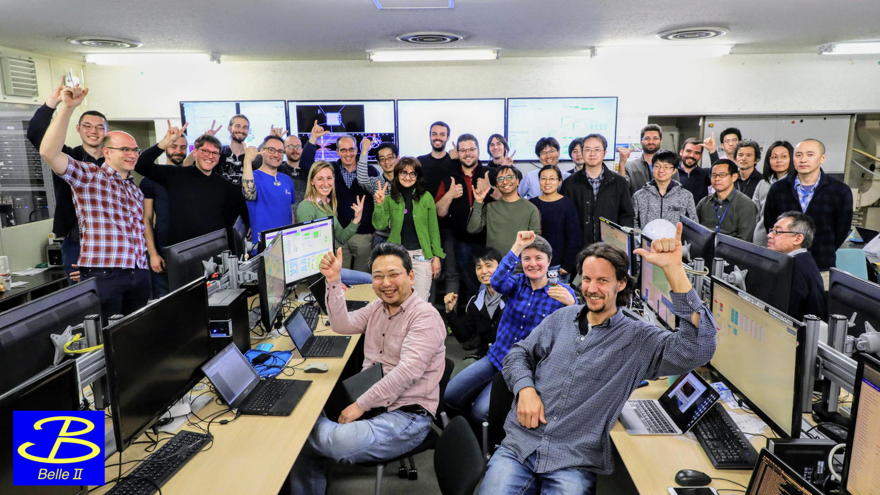
First Collisions in the Phase 3 Physics Run, March 25, 2019
The detector is complete (VXD is installed)
Notes:
Joy in Belle II control as Phase 3 launches.

Slide 34

Early Phase 3 Physics (March-June, 2019) Plan
We assume a plausible scenario with three months in which we integrate luminosity: (2 fb⁻¹, 4 fb⁻¹, 4 fb⁻¹) + 1 fb⁻¹ continuum or ~11 fb⁻¹ for Lepton-Photon 2019 in Toronto, Canada. All detector subsystems, DAQ and trigger will be operating well. Software, calibrations and computing will be ready.
Semileptonic
- B→ π l ν and ρ l ν untagged (CLEO saw a signal with 2.66 fb⁻¹)
Time Dependent Measurements (Mixing, Lifetimes)/Charm
- D lifetimes (2 fb⁻¹ )
- Doubly Cabibbo suppressed D⁰ → K⁺ π⁻, D⁰ → K⁺ π⁻ π⁰ (10 fb⁻¹)
- B lifetimes (2-10 fb⁻¹)
- Time dependent B-anti B mixing (10 fb⁻¹)
Radiative/Electroweak Penguins
- B→K* γ (b→s) (2 fb⁻¹) rediscover penguins
- B→Xs γ (b→s) (~10 fb⁻¹ depending on off-resonance data taking)
Hadronic B decays (not time dependent)
- B→K π (b→u) (10 fb⁻¹)
- B→ Φ K (b→s) (10 fb⁻¹)
- B→J/ψ K (with more significance 2-10 fb⁻¹)
Demonstrate VXD physics performance
++ Dark Sector Physics Publications
Notes:
Can have physics at LP2019 in Toronto if we run SuperKEKB. Do not read all points !

Slide 35
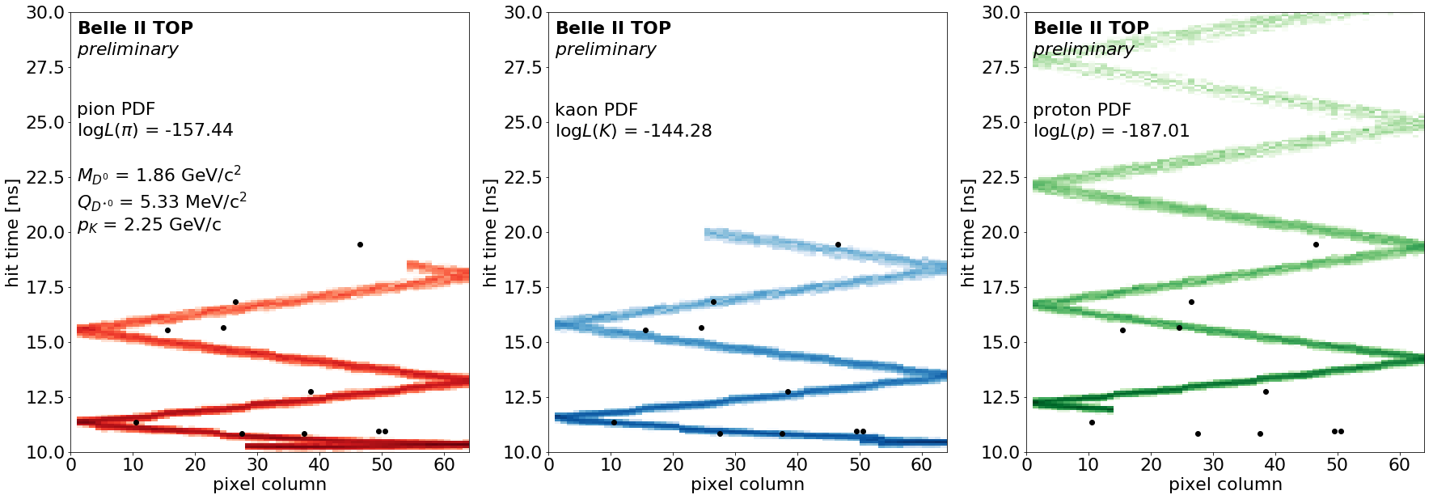
Nichibei 日・米 (US-Japan) provided the startup funding for this great physics enterprise (launch of TOP detector, BKLM upgrade) and collaboration.
Belle II will explore New Physics on the Luminosity or Intensity Frontier. This is different and complementary to the LHC high p_{T} experiments, which operate on the Energy Frontier. Perhaps time for a paradigm shift. Competition and complementarity with LHCb
Belle II has just started a long physics run in the Super B Factory mode (Phase 3) in March 2019. To succeed high-efficiency data-taking by Belle II and extensive running by Super KEK-B, soon to be the world’s highest luminosity accelerator are required.
The world is waiting for our results. (First ones expected at LP2019)
There are excellent opportunities ahead for US-Japan in Belle II to meet the challenges of high luminosity (L>10³⁵/cm²/sec).
Notes:
A few conclusions to take home.

Slide 36
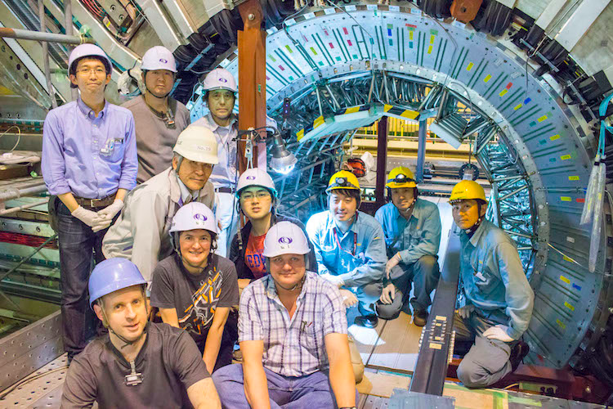
Backup Slides

Slide 37

https://arxiv.org/abs/1808.10567
Outcome of the B2TIP (Belle II Theory Interface) Workshops
Emphasis is on New Physics (NP) reach.
Good participation from theory community,
lattice QCD community and Belle II experimenters.
689 pages, published by Oxford University Press

Slide 38

Spin-offs from Belle II: Innovative TPCs for neutron and dark matter directional detection.

Slide 39


Rediscovery of Ds→φπ⁺,
with φ→K⁺ K⁻
No PID
Two identified charged kaons.

Slide 40

Quartz Production

Slide 41



Onwards to Phase 3 and the Physics Run
SVD +x half-shell, Jan 2018
The VXD will be installed in Phase 3.
Restart Belle II data taking in February 2019.
SVD -x half-shell, July 2018
PXD layer 1 ladders
First PXD half-shell being tested at DESY

Slide 42



“Tsukuba, we have a Problem”
(apologies to Tom Hanks, Apollo 13)
KM Theoretical prediction
WMAP
data
The CP Violation (matter-antimatter asymmetry) predicted by Kobayashi and Maskawa is too small by ~10 orders of magnitude in the Standard Model.
What does this mean ?
New Physics

Slide 43




Quantum Mechanical (QM) Finesse versus Brute Force
Energy conservation ?
Banking Analogy (may be easier to understand):
At the Heisenberg Quantum Mechanical bank, customers with no collateral may take out billion Euro loans if they return the full loan within a billionth of a second.
If a beautiful but rare customer takes out such huge loans very frequently, the bank will take notice.
N.B. Sometimes it is much better to have a large collateral and pay back the loan directly after a longer time.
Werner Heisenberg, Physicist and QM banker
Notes:
How to detect new particles ?
Now we compare the intensity frontier and the energy frontier approaches to finding new physics. The energy frontier is currently led by the LHC at CERN, while Belle II and LHCb are two of the leading experiments on the intensity frontier. Werner Heisenberg (1901-1976)

Slide 44



Science Magazine
Red Hot Flavor Physics
The stakes are getting higher
Science Magazine, April 20, 2017
Notes:
Now let me briefly turn to the most important and surprising result in flavor physics. First some pedagogical introduction.

Slide 45


Belle example➔Conclusion: “We need more data !”
Note that di-muons and di-electrons are equally good. Measured a new lepton flavor angular violating observable.
Signal of ~312 events in B→K* l⁺ l⁻
P₅’
Belle I data. S. Wehle et al. (Belle collab)
arXiv: 1612.05014, published in PRL 121, 232001(2018)
Notes:
To find out whether there are new physics couplings in the weak interaction, we need more data.

Slide 46

Examples of Physics Competition and Complementarity
Use publicly available LHCb projections.

Slide 47

NP in b→s l⁺l⁻
Prepared by D. Straub et al. for the Belle II Physics Book (edited by P. Urquijo and E. Kou)
Belle II can do both inclusive and exclusive.
Equally strong capabilities for electrons and muons.
NP Wilson Coefficient for electrons
New Physics Wilson Coefficient for muons
Notes:
This is much more to discuss.

