Slide 1
The 40th Anniversary Symposium of the US-Japan Science and Technology Cooperation Program in High Energy Physics
US-JP Collaboration Memory
&
Silicon-On-Insulator Pixel R&D
April 15, 2019 @ Univ. of Hawaii
Yasuo Arai
High Energy Accelerator Research Organization (KEK)
yasuo.arai@kek.jp, http://rd.kek.jp/project/soi/

Slide 2
US-JP Collaboration
Preamble

Slide 3
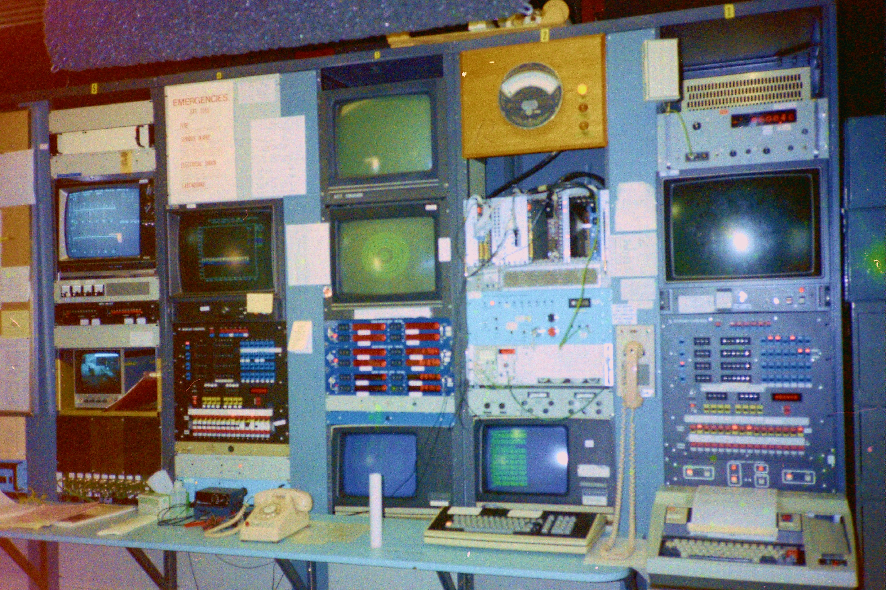
My First Memory of the US-JP Program
1982 Visit Mark-II group at SLAC for studying FASTBUS system
Martin Breidenbach
Mark-II Control Room

Slide 4
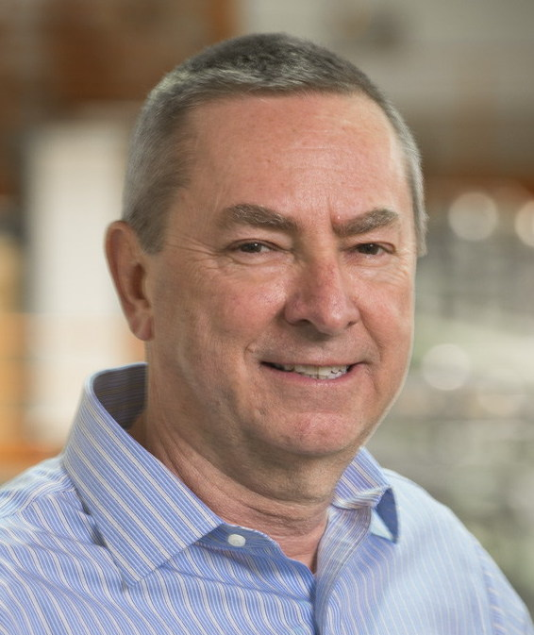
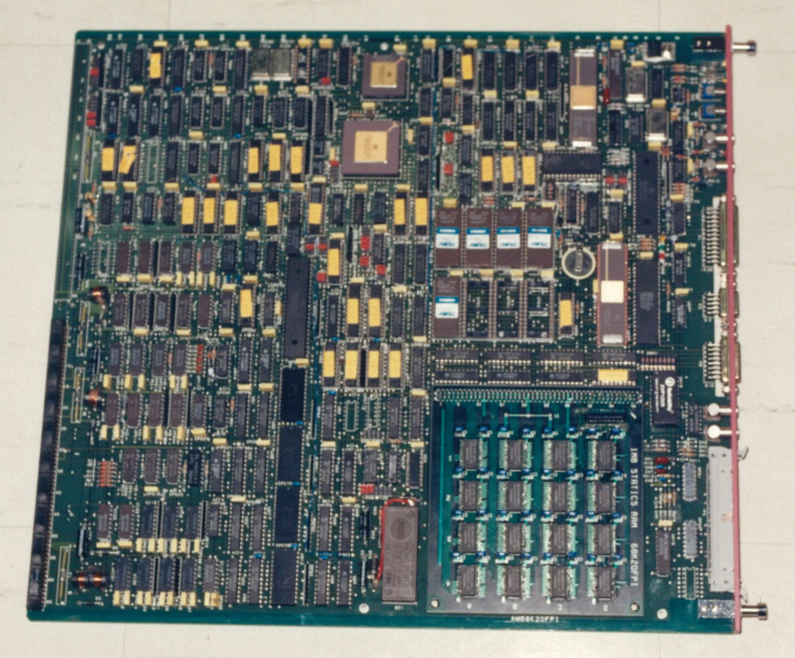
Roommate at SLAC
Andy Lankford
Nigel Lockeyer
Marc Ross
Success in TRISTAN FASTBUS DAQ System
MC68000 FASTBUS Master Module

Slide 5
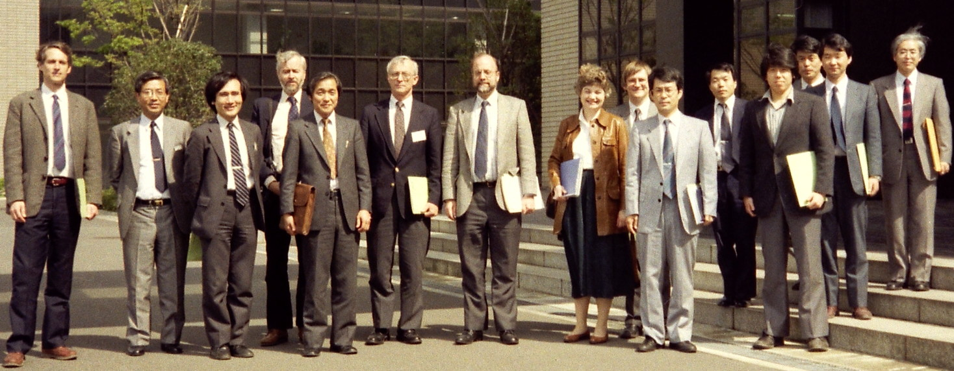
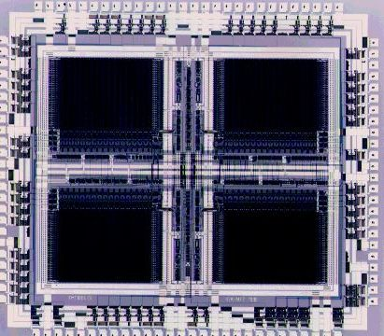
1986~1994 (SSC Era)
R&D for High Rate Tracking Detector & Readout LSI
Brig Williams
Jay Chapman
G. Hanson
H. Ogren
1990 visit NTT LSI Lab.
Used in ATLAS Muon Readout
Time Memory Cell (TMC) LSI

Slide 6
Development of Advanced Pixel Detectors in SOI Technology
US-JP program: FY2009-2014
Japanese Central Researcher: Yasuo Arai High Energy Accelerator Research Organization (KEK)
and
US Central Researcher: Marco Battaglia University of California at Santa Cruz & LBNL

Slide 7
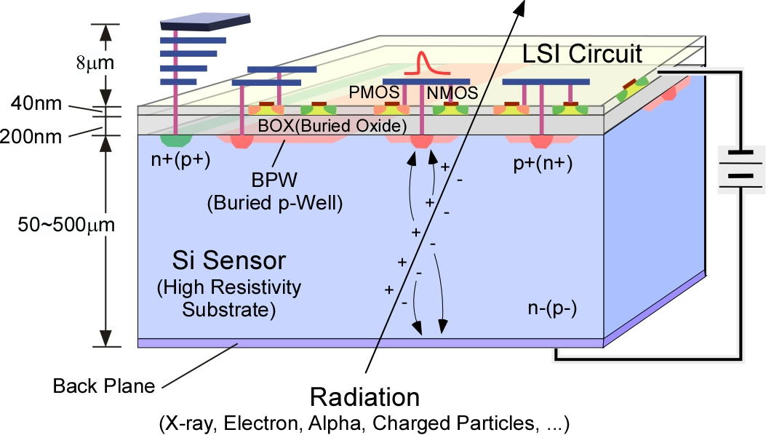
Silicon-On-Insulator Pixel Detector (SOIPIX)
Monolithic Detector having fine resolution of silicon process and high functionality of CMOS LSI by using a SOI Pixel Technology.

Slide 8
2008 US members visited OKI Electronics Co. fab. (currently Lapis Semiconductor Co.)
Marco Battaglia
Peter Denes

Slide 9
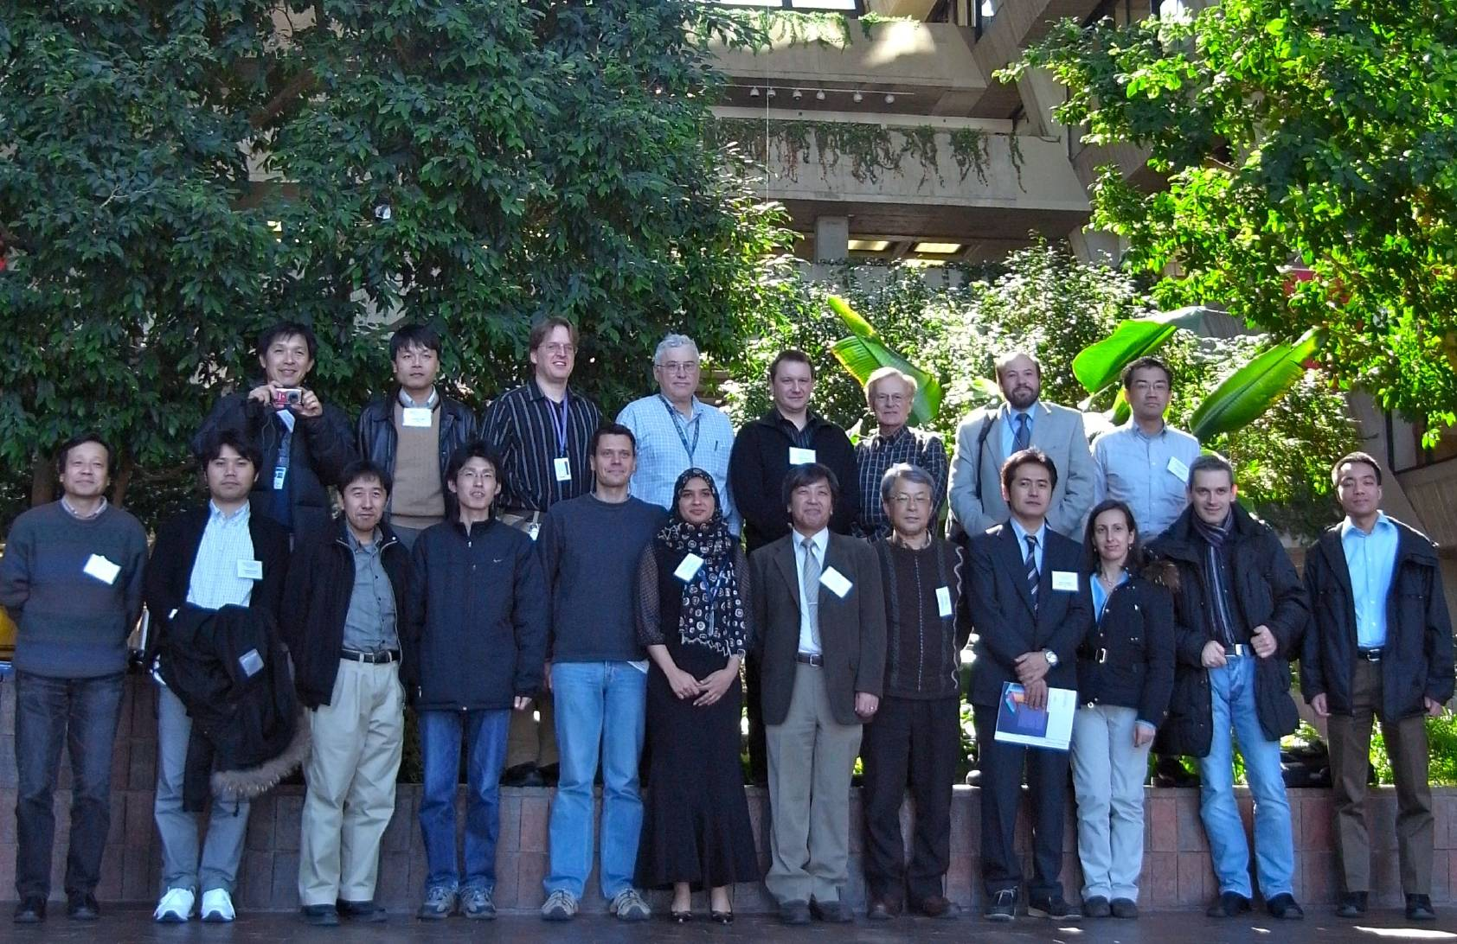
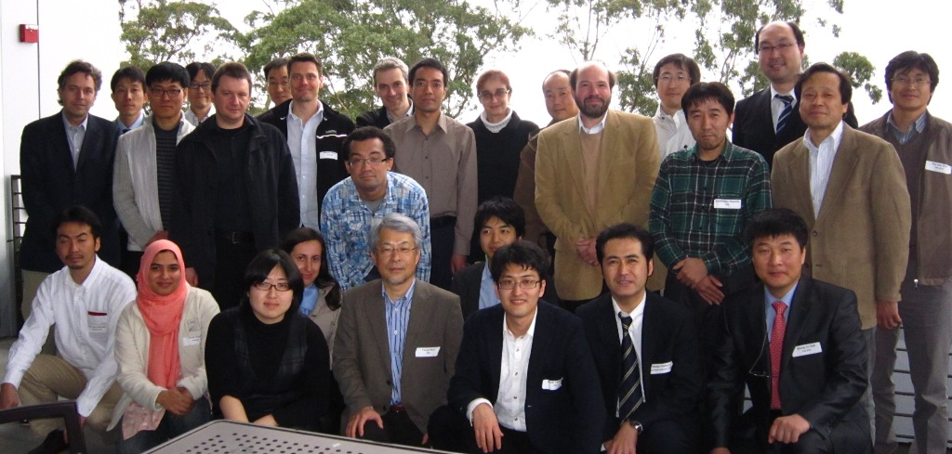
Collaboration meetings
[JAPAN]
KEK, Tsukuba Univ., Osaka Univ., Tohoku Univ., Kyoto Univ., JAXA/ISAS, Univ. of Tokyo, Riken
[US]
LBNL, FNAL, U. of Hawaii
Mar. 2010 @Fermilab
Mar. 2012 @LBNL

Slide 10
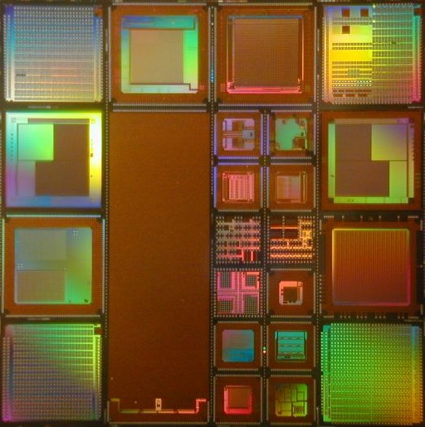
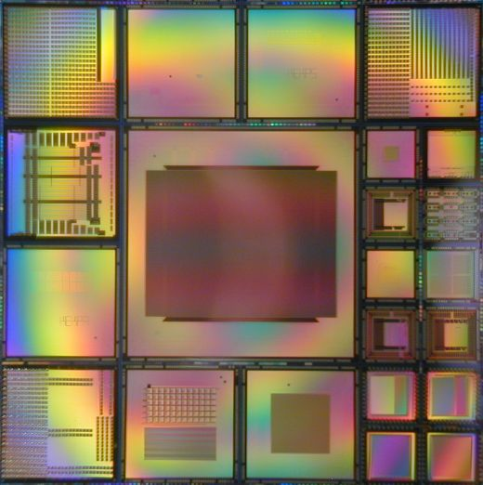
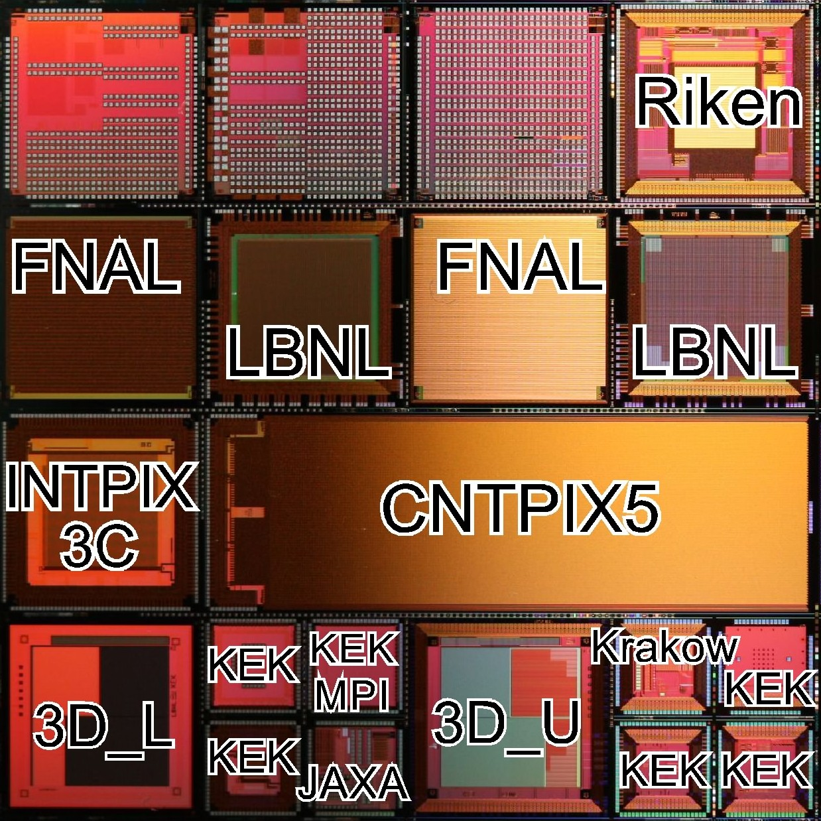
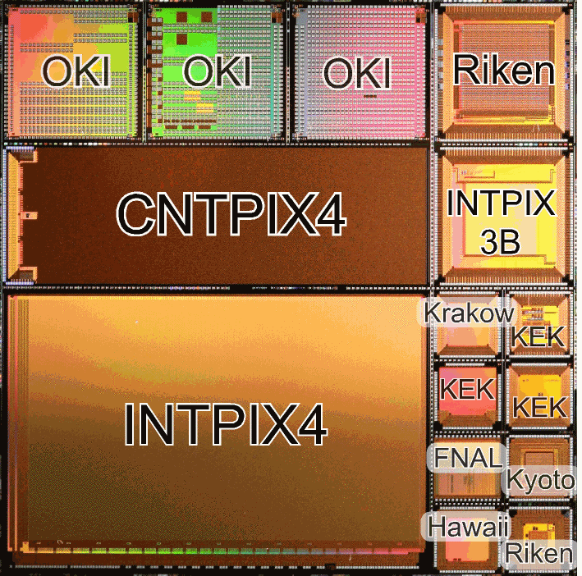
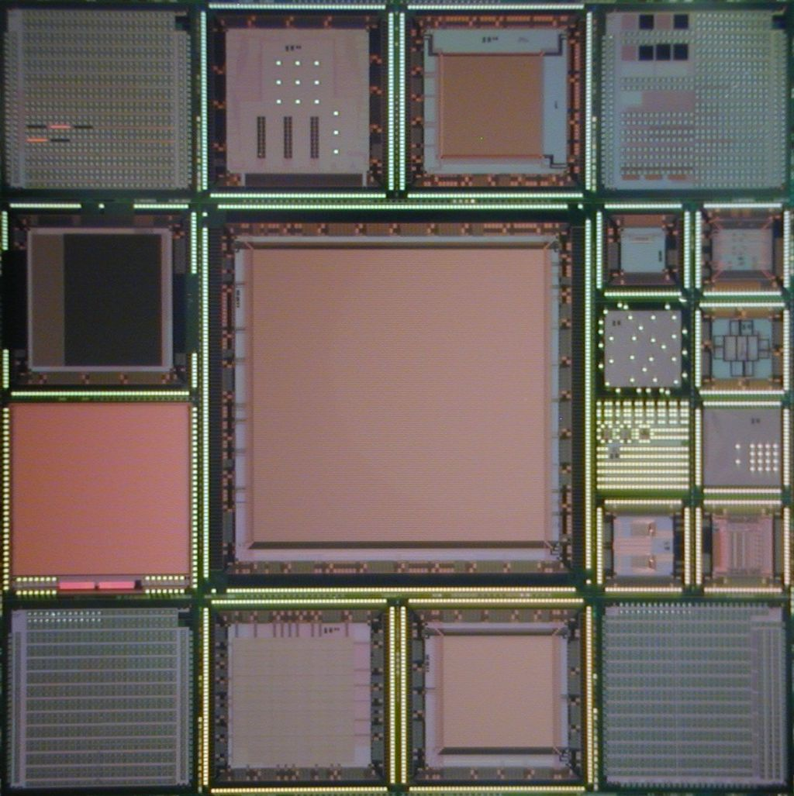
MPW (Multi Project Wafer) run
~Twice / year.
Louvain-la-Neuve Univ.
U. of Hawaii
INP Krakow
IHEP China
U. Heidelberg
U. Tohoku
Kyoto Univ.
JAXA/ISAS
Tsukuba Univ.
AIST

Slide 11
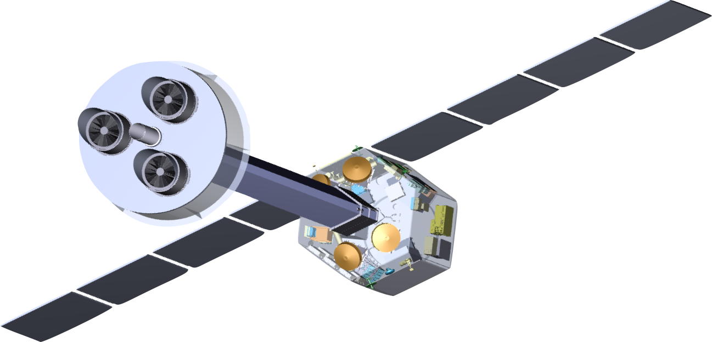
X-ray Astro Physics
XRPIX (SOIPIX-PDD)
X-ray Energy Spectrum
High Gain (70 μV/e-)
Good Energy Resolution (Noise = 11.0 e-)
High Charge Collection Efficiency (No X-ray tail)
FWHM 200 eV
No tail
(Kyoto U. , Shizuoka U., …
Notes:
This 55Fe X-ray spectrum is obtained with the SOIPIX-PDD detector. This is old spectrum obtained in previous SOI detector. By comparing the spectrum, you can find there is no tail below the peak. This implies the charge collection efficiency is almost 100%.

Slide 12
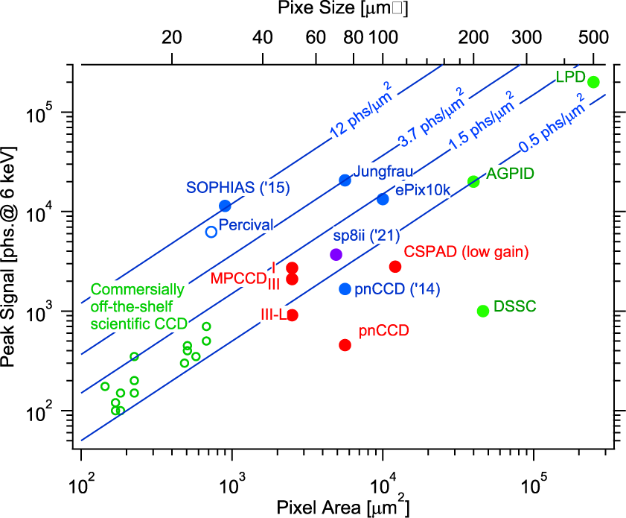
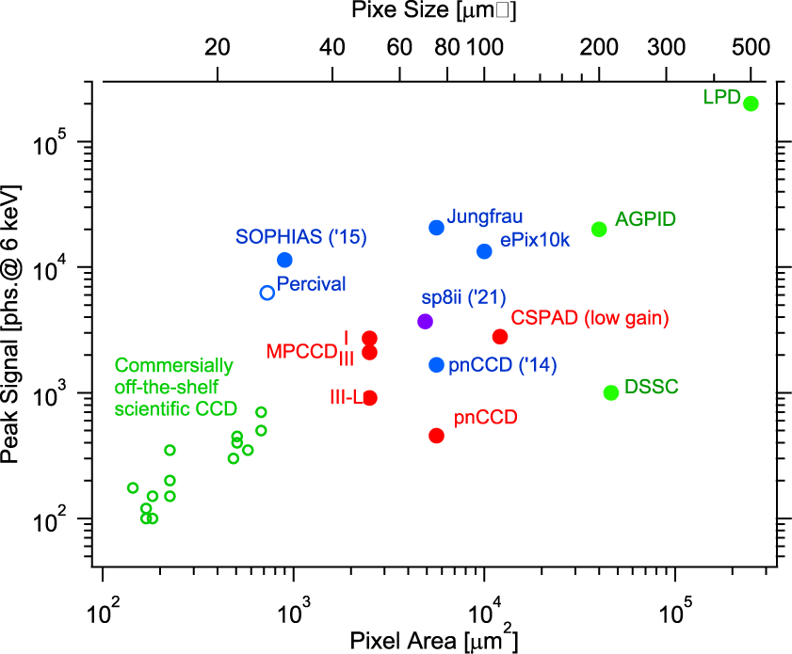
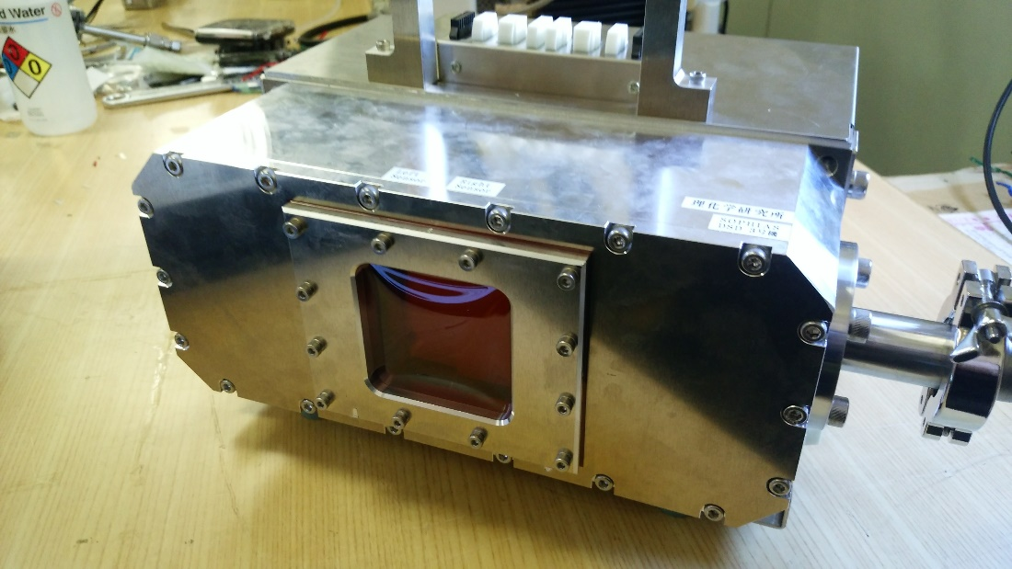
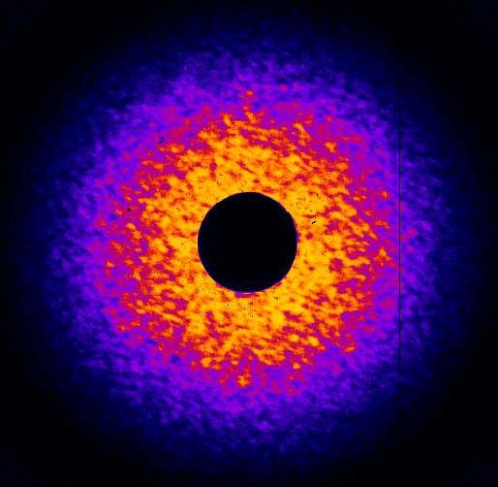
Silicon-On-Insulator PHoton Imaging Array Sensor (SOPHIAS)
○
Higher Peak Signal Density
Peak Signal[phs@6keV]
Pixel Size[μm²]
３ｍｍ
0.008 nm⁻¹
World highest peak signal density is obtained.

Slide 13
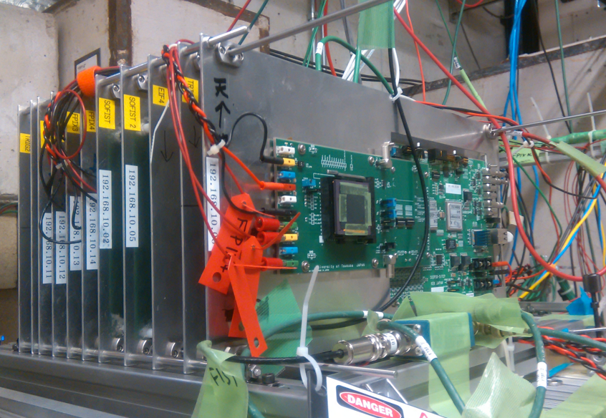
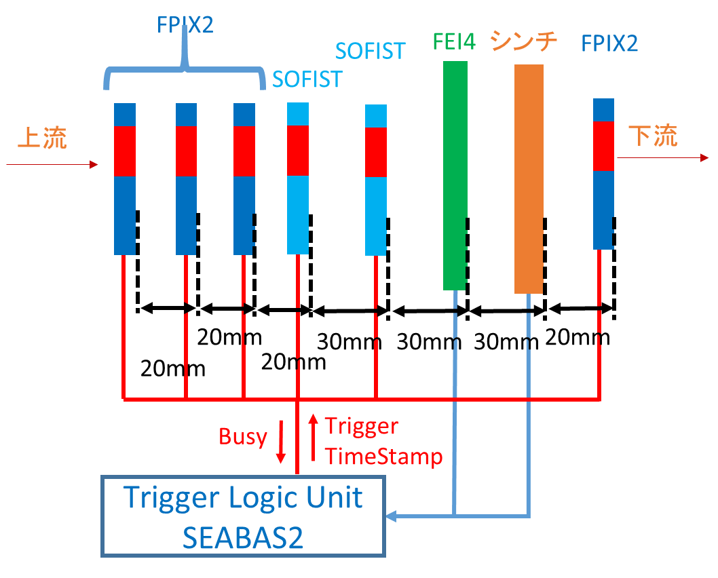
Vertex Detectors: High-Energy Beam test @Fermi Lab.
Proton
scint.
(view from downstream)
Proton Beam (120 GeV/c)
Two kinds of SOIPIX-DSOI detectors are used:
FPIX2 x 4: 8 μm square pixel detector
SOFIST(v.1 & 2) x 2: 20 μm square pixel detector
Notes:
For high-energy charged particle tracking, we have performed beam test by using 120 Gev/c Proton beam at Fermi National Laboratory at Chicago. We put 4 FPIX2 detectors and 2 SOFIST1 detectors in a line.

Slide 14
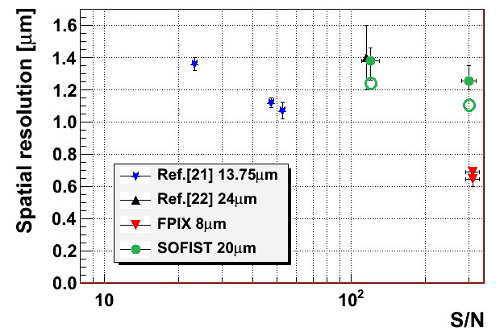
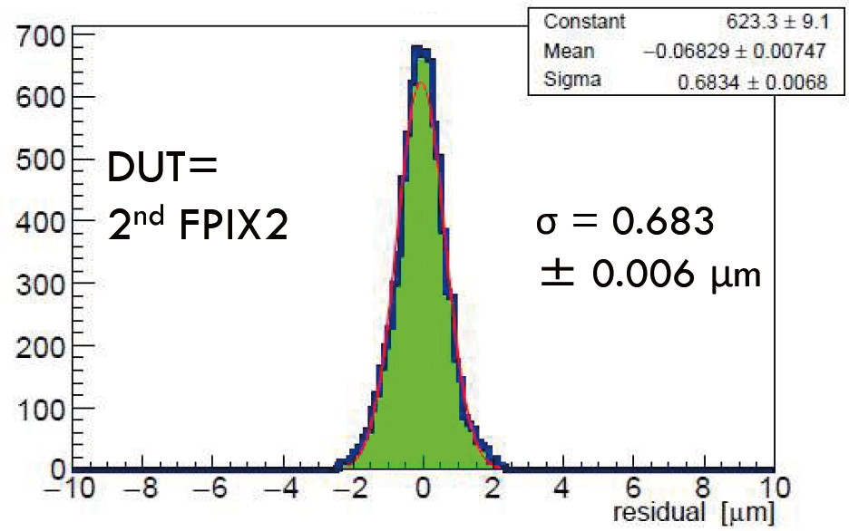
Tracking Resolution
SOFIST
Less than 1 μm Position Resolution for high-energy charged particle is achieved first in the world !
FPIX
FPIX2
Detector | Pixel size | Resolution
ATLAS Pix | 13.75 μm | 1.1 μm
DEPFET | 24 μm | 1.4 μm
SOFIST | 20 μm | 1.2 μm
FPIX | 8 μm | 0.65 μm
(K. Hara et al., Development of Silicon-on-Insulator Pixel Detectors, Proceedings of Science, to be published)
Notes:
By subtracting track position in DUT from obtained track from other detector we can make residual plot. This corresponds to position resolution of the detector. We could get less than 1 micron track resolution first in the world.

Slide 15
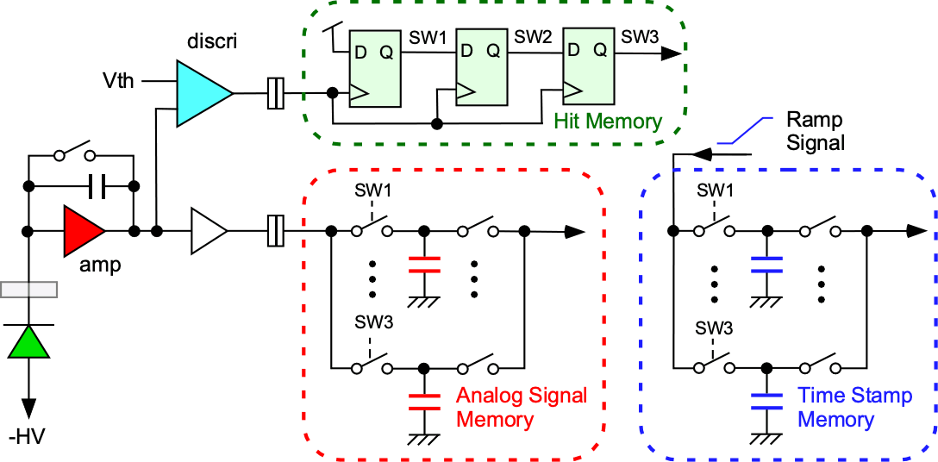
ILC Vertex Detector R&D : SOFIST
(SOI sensor for Fine measurement of Space & Time)
3 kinds of multiple memories in a pixel: Hit, Charge, Time
Gain: 32 mV/ke- (@Cf=5fF)
Analog signal memories: 3 for signal or 3 for time
Column-ADC: 8 bit
Zero Suppression Logic

Slide 16
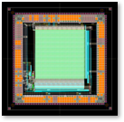
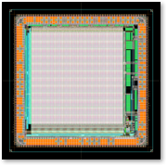
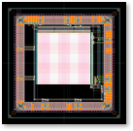
New SOFIST Chips (Ver. 3 & 4)
2D
3D
Upper
Designed at the same time.
Same circuits.
Lower
 | Ver. 3 (2D) | Ver. 4 (3D)
Chip Size | 6mm x 6mm | 4.45mm x 4.45mm
Pixel Size | 30μm x 30μm | 20μm x 20μm
Pixel Array | 128 x 128 | 104 x 104
Circuits | CSA + Comp.+ 3 Analog Mem + 3 Time Stamp Mem
Wafer | FZ p-type (3~10 kΩ•cm) Double SOI

Slide 17
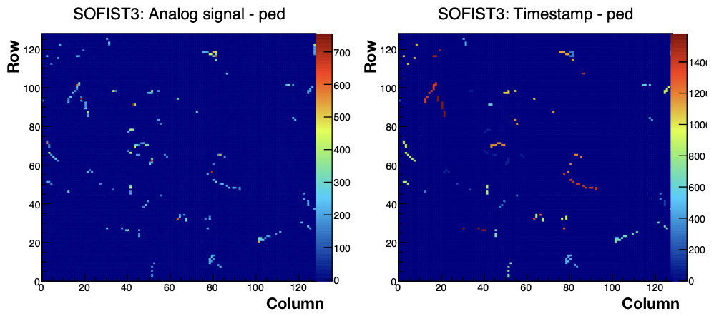
Position and Time Measurement
SOFIST Ver. 3
β –ray track from ⁹⁰Sr
Threshold: Vth = 950 mV, VRST = 900 mV
HV = -100 V
Successfully measured Charge and Time simultaneously!

Slide 18
3D Vertical Integration (SOFIST Ver. 4)
Micro Bump
Lower Tier
Upper Tier

Slide 20
3D Integration
SOFIST Ver. 4
T-Micro
Upper Tier
Bond Pad
Passivation
Back gate adjust electrode
High R-Si
High R-Si
Lower Tier
Upper and Lower Tier chips are produced in a same wafer and bonded chip to chip.

Slide 21
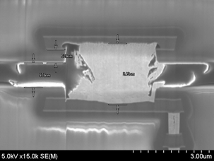
SOFIST Bump
Pixel
3.5μmφ
Cylinder bumps are successfully fabricated
COMP
Pixel array
GND
SIGNAL
VDD
bump
under bump metal
Dummy bump

Slide 22
Summary
Most of my R&D works could not be completed without support from the US-JP program. * FASTBUS → successfully used in TRISTAN * TDC VLSI → successfully used in ATLAS
My present challenge is developing SOI monolithic pixel detector for electron colliders and X-ray applications.
3D integration is promising technology for the future high-energy experiments.
Finally, I could get many US friends through US-JP program.

Slide 23
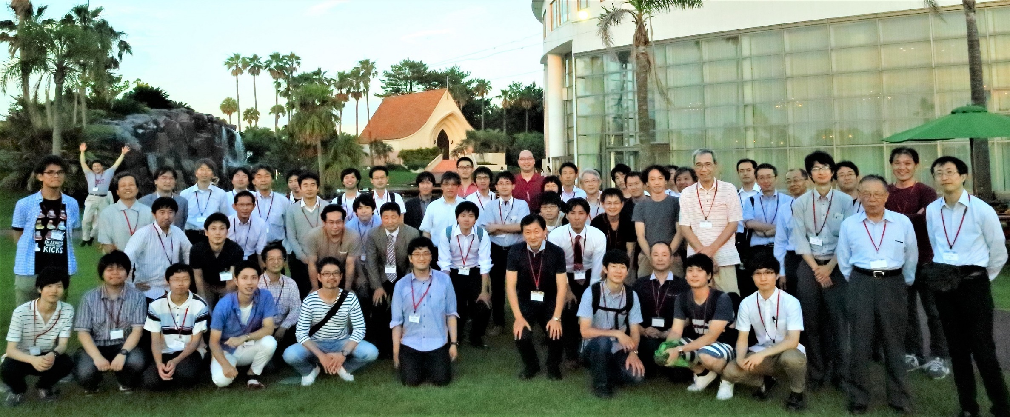
Thank You!

