Slide 1
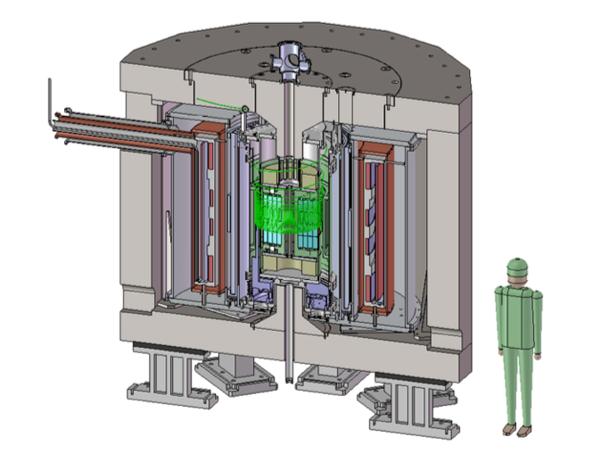
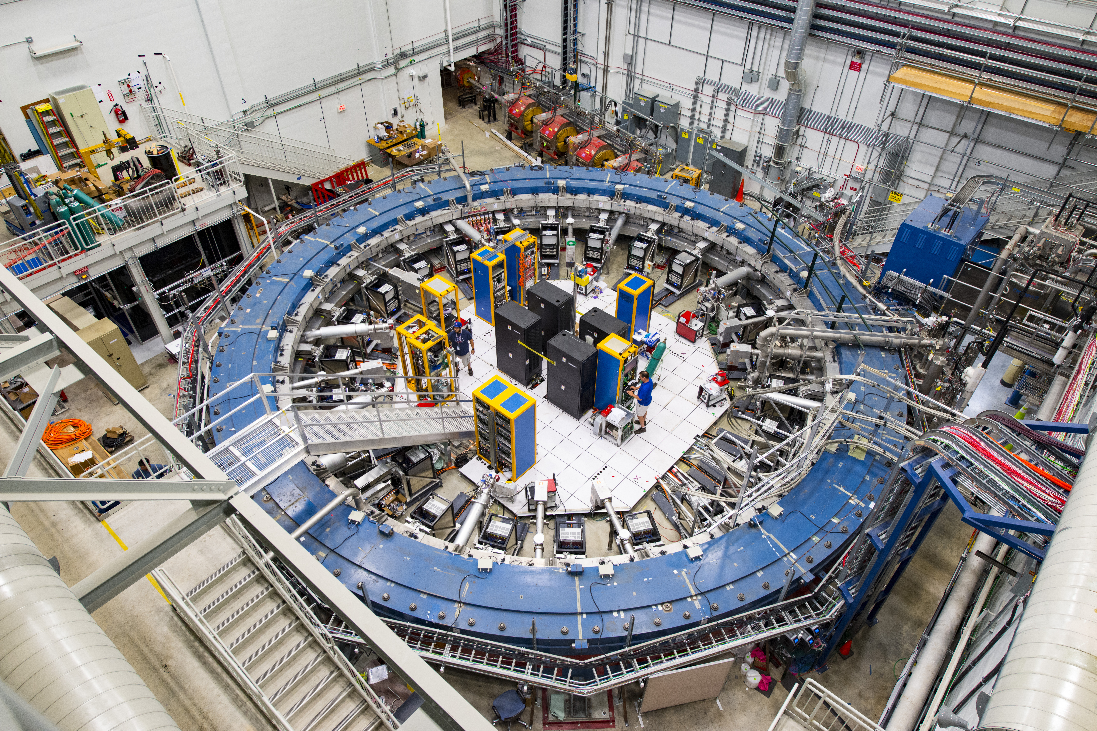

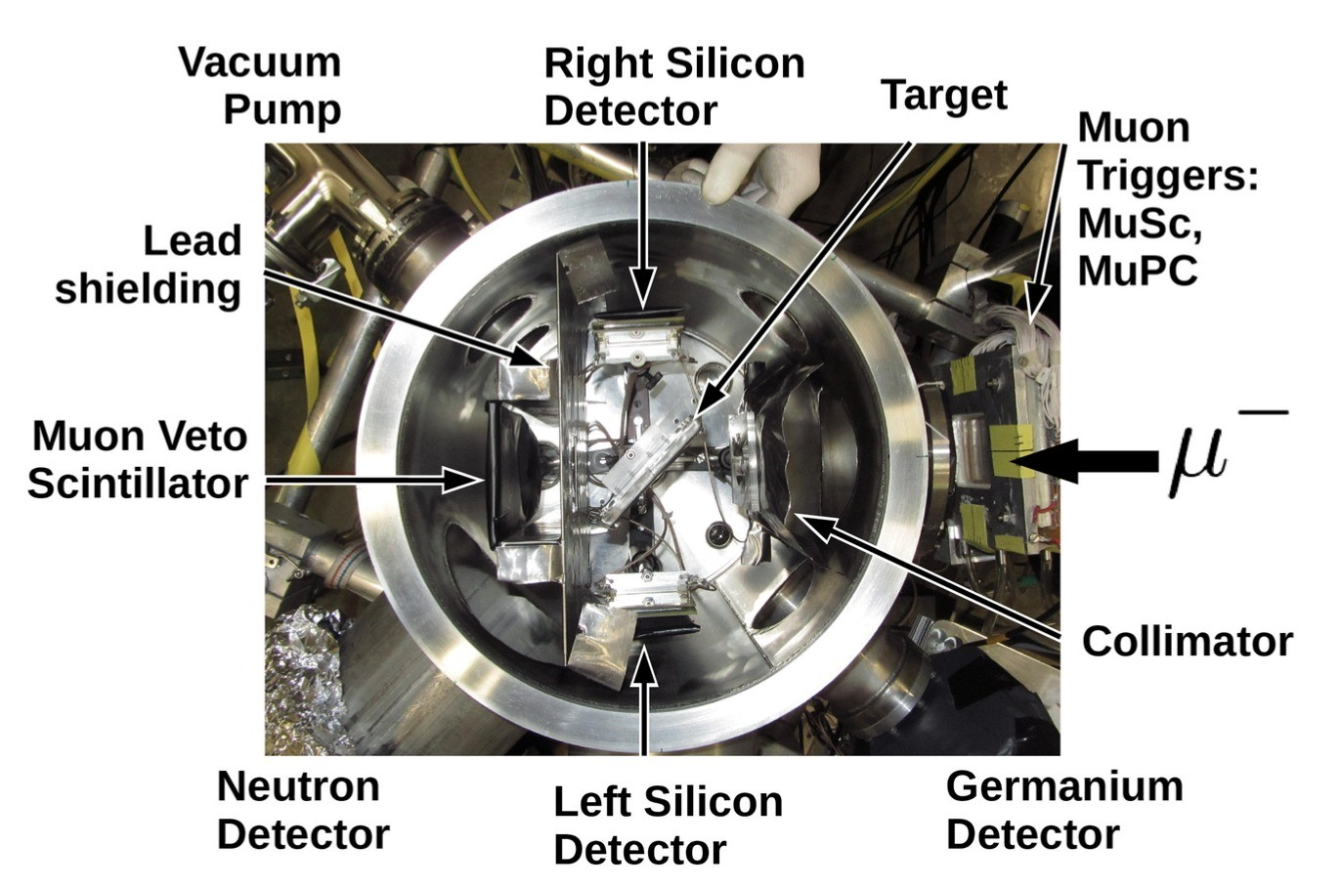
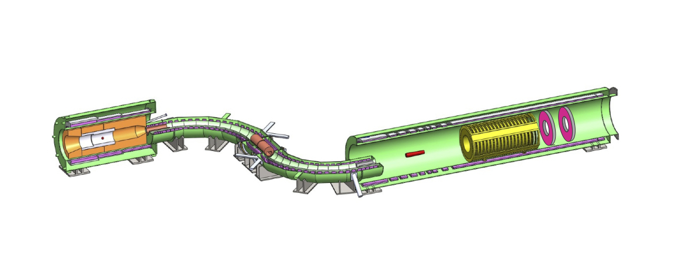
Muon projects:
Muon g-2 and
Muon to electron conversion
drhgfdjhngngfmhgmghmghjmghfmf
Muon g-2
Muon g-2
COMET
Mu2e
AlCap
Peter Winter
Physicist
Argonne National Laboratory
The 40th Anniversary Symposium of the US-Japan Science and Technology Cooperation Program in HEP
University of Hawaii, Manoa, HI

Slide 2
Overview

Slide 3




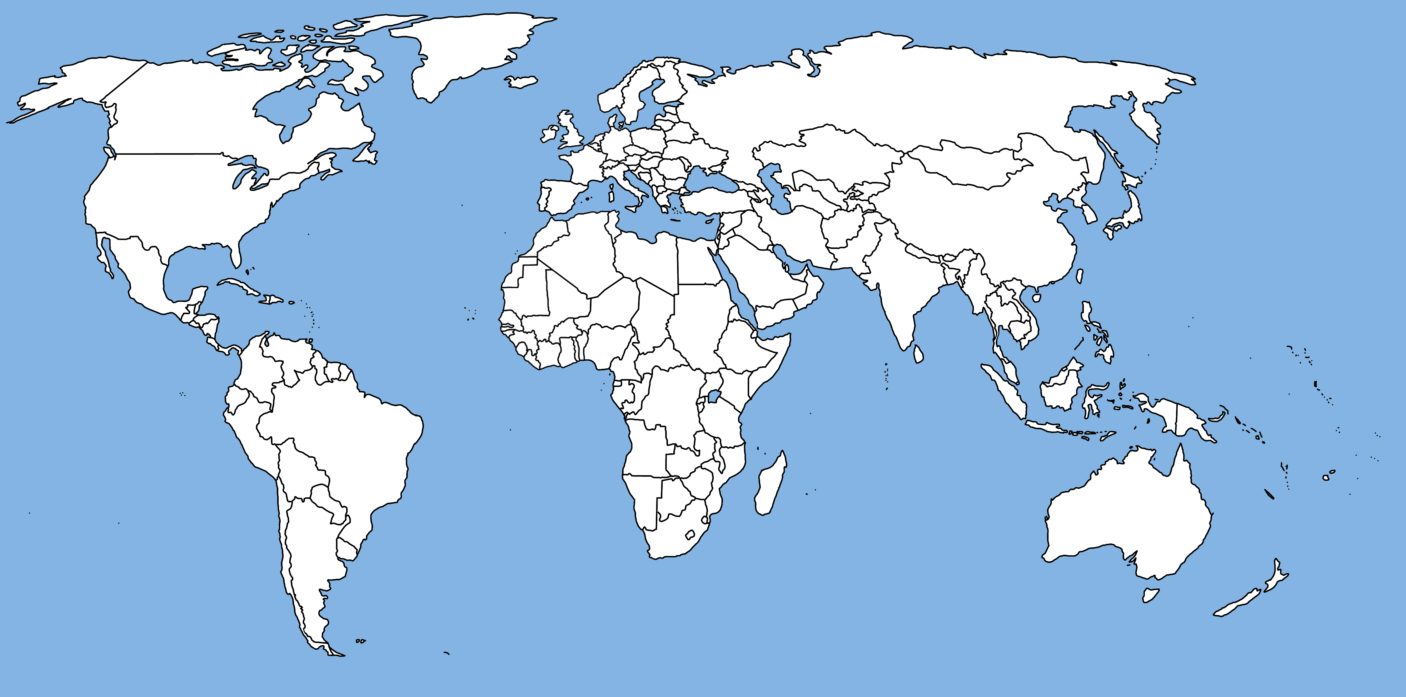



Muon Physics is a worldwide effort

Slide 4
US-JAPAN Funded Muon projects*
* to the best of my knowledge
AlCap
Mu2e
Muon g-2
Muon g-2
COMET

Slide 5
US-JAPAN Funded Muon projects: Linkage and commonalities
AlCap
Mu2e
Muon g-2
Muon g-2
COMET

Slide 6
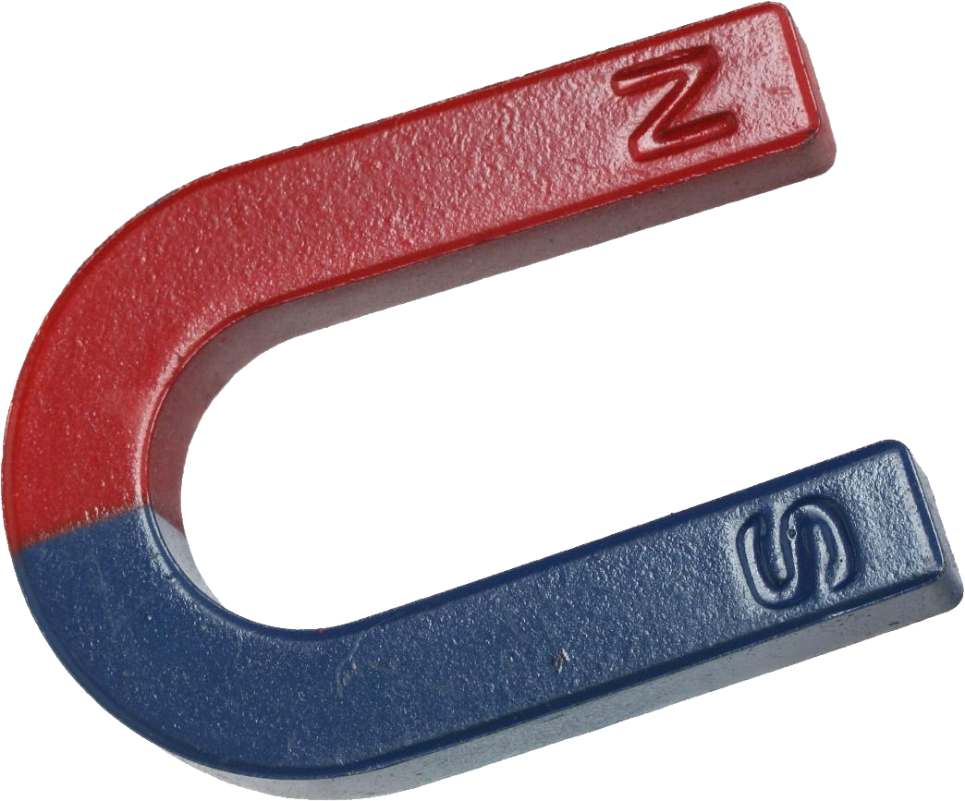
US-JAPAN Funded Muon projects: Linkage and commonalities
Mu2e
Muon g-2
Muon g-2
COMET
m_{μ}/m_{e}
p d α n ...
MuSEUM provides input to both g-2 experiments
AlCap provides input to both muon-to-electron conversion experiments
All experiments (except AlCap) use magnetic fields and need to measure them
AlCap

Slide 7
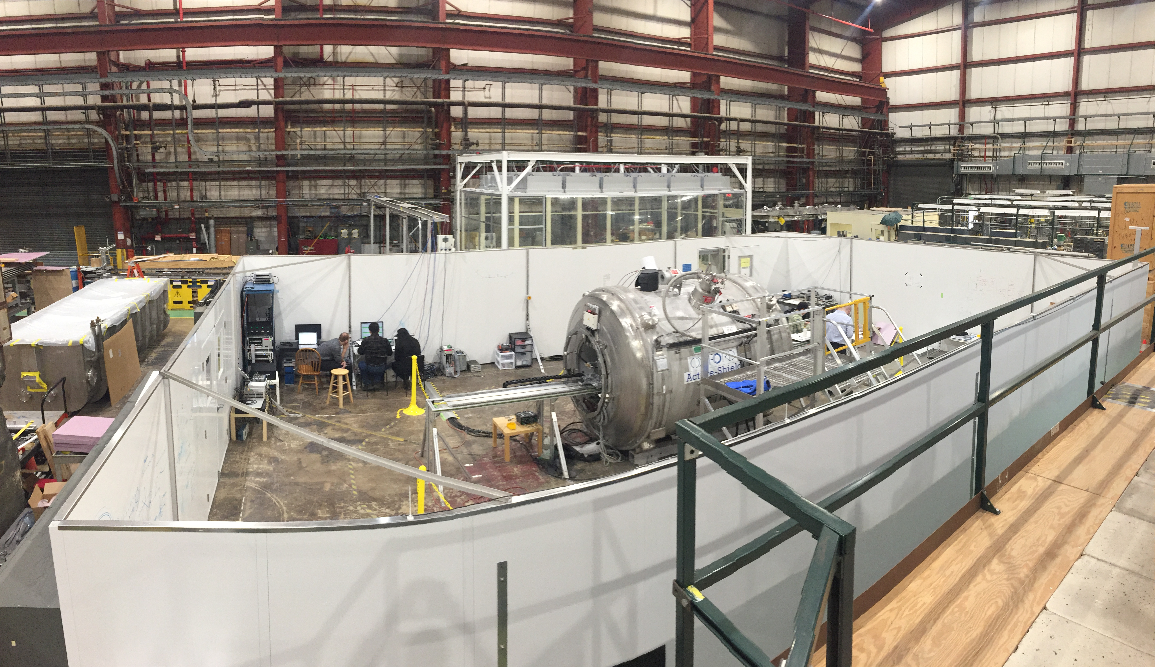
Test magnet facility at argonne: ideal for calibrations
Mu2e
Muon g-2
Muon g-2
COMET
Magnetic field: 0 – 4T
Extremely good homogeneity (gradients of < 1ppb/mm)
Low field drift (<10 ppb/h)

Slide 8
COMET / Mu2e & Alcap

Slide 9
Muon to electron conversion projects
Mu2e
Muon g-2
Muon g-2
COMET
m_{μ}/m_{e}
p d α n ...
AlCap

Slide 10
Muon to electron conversion projects
Advanced Intense Muon Source and Initiative of Muon Particle Physics
  Radiation hard superconducting magnets for Mu2e / COMET
  AlCap: Particle emission from muon capture on aluminum
Development of a 3D magnetic field measurement system
Mu2e

Slide 11
Advanced Intense Muon Source and Initiative of Muon Particle Physics
Challenge: Superconducting magnets must withstand high radiation environment in COMET and Mu2e
Opportunity: Aluminum-stabilized superconductor (AL-SC) is radiation hard and it can be recovered with annealing
Goal:
  Develop aluminum-stabilized superconductors (AL-SC)
  Prototype coil using AL-SC
  Investigate radiation hardness of AL-SC and other magnet materials

Slide 12
Some project highlights
Production of AL-SC conductors
Indirect cooling test bench at Fermilab
2011
2012
Production of AL-SC prototype coil
Neutron irradiation tests at KURRI
2012
2011 and 2012
RESMM-2012 (FNAL) workshop

Slide 13
AlCAP
Challenge: Emitted particles from muon capture can be backgrounds or cause detector saturation or false vetoes for Mu2e / COMET
Goal: Measure energy spectra and rates for these emitted particles and use characteristic X-rays to normalize muon rate
Three data taking periods at PSI with different focus:
  2013: Charged particles and photons
  2015a: Neutrons and photons
  2015b: Charged particles and photons

Slide 14
AlCAP

Slide 15
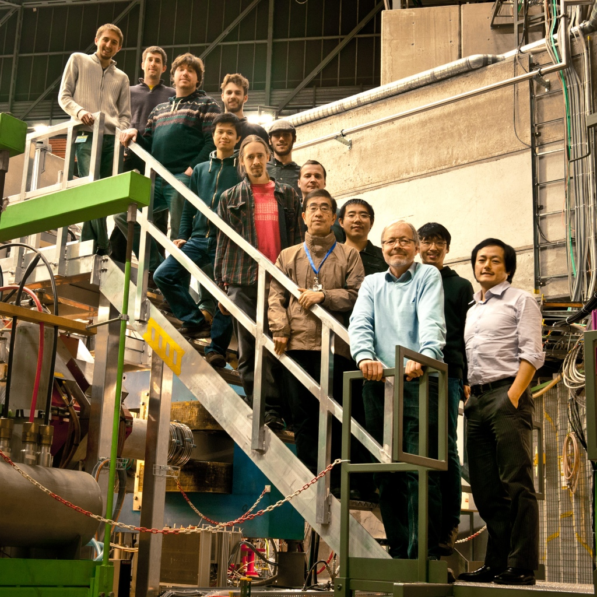
AlCAP
M
C
C
C
M
M
C
M
C
M
C
M
C
C
M

Slide 16
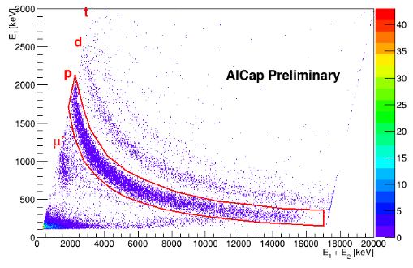
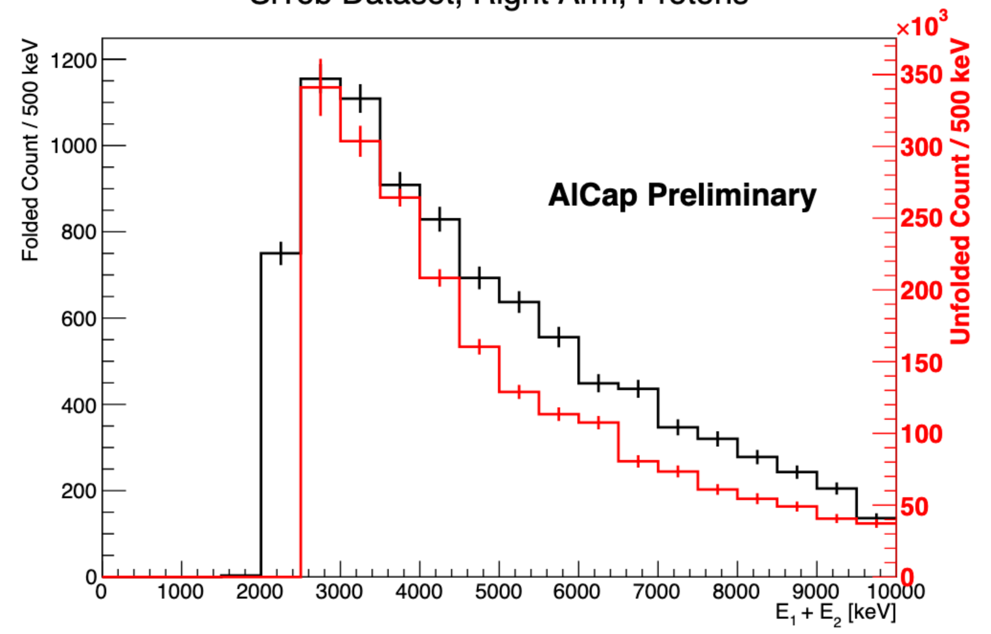
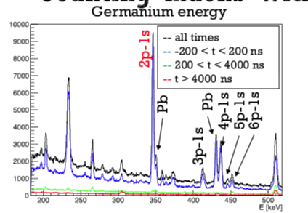
Alcap: research Highlights
Clear particle identification with dE / E
Ongoing analysis to obtain unfolded
energy spectra for charged particles
Muon rate normalization with 2p-1s X-ray

Slide 17
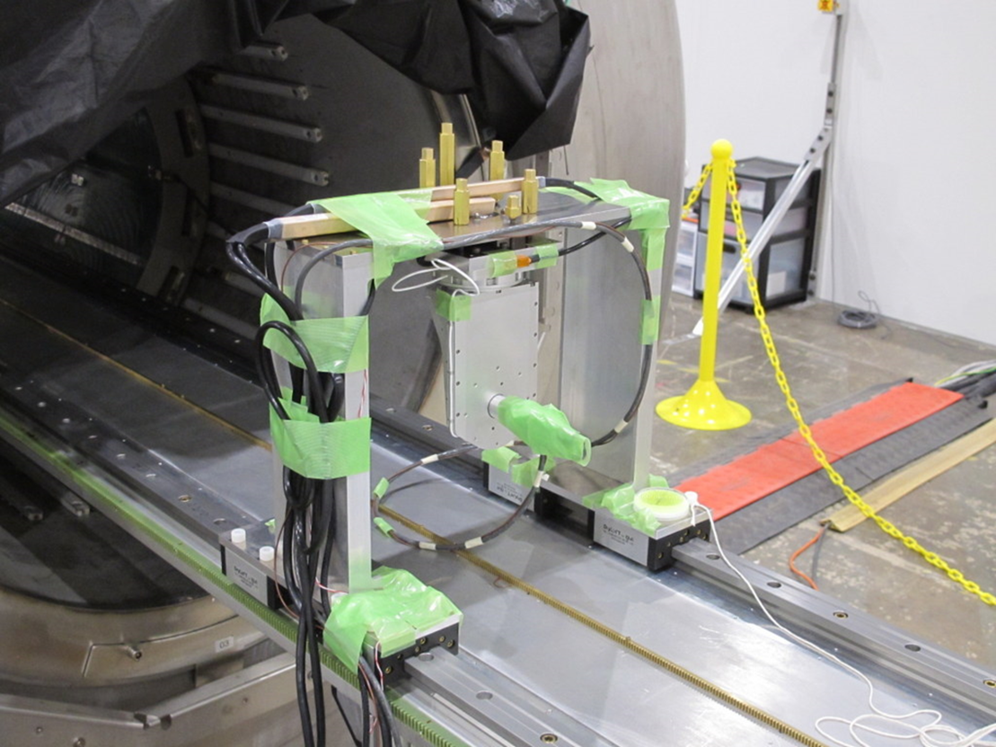
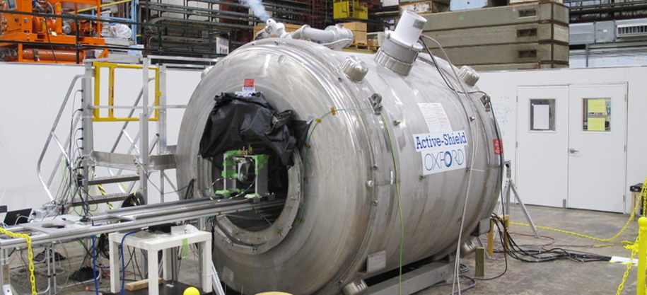
Development of 3D Magnetic Field Measurement System
Challenge: 3D Hall probe for SuperKEKB (and COMET) needs calibration better than specified by vendor.
Goal: Verify and improve the calibration of the SuperKEKB Hall probe in the Argonne test solenoid and then use knowledge transfer towards COMET field mapping
KEK Hall probe calibrated against NMR at
0.5T 1.0T 1.5T 2.0T 2.5T 3.0T.

Slide 18
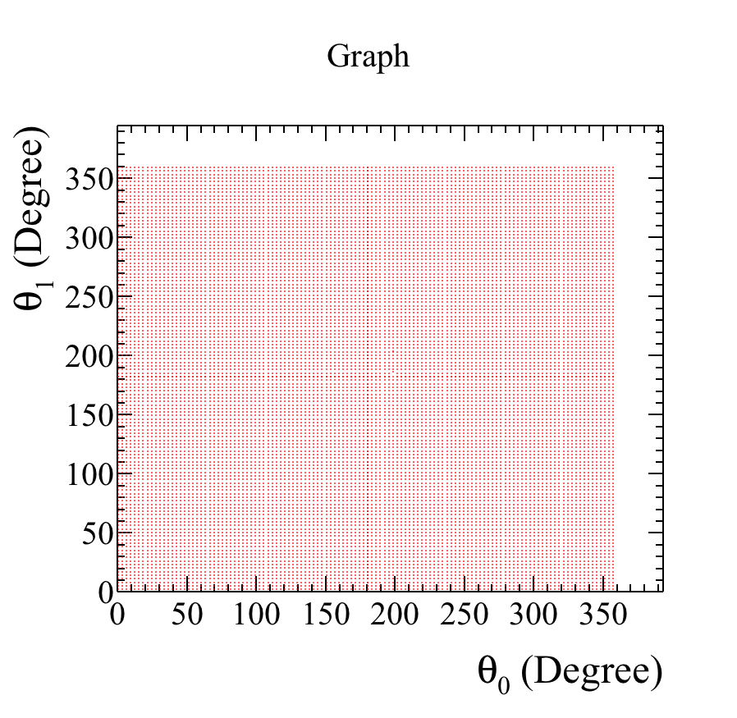
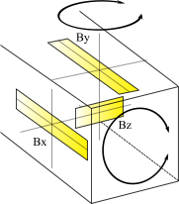
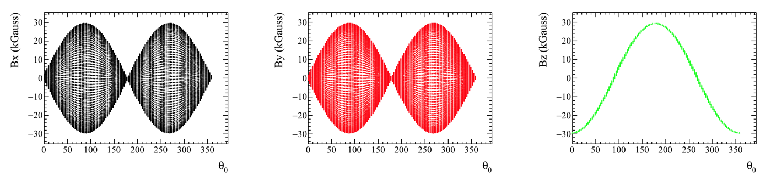
Research highlights: Hall probe calibrated with 14600 points of 2D map
θ0
Measurement points
θ1

Slide 19

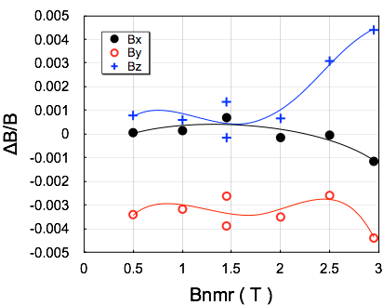
Research highlights: Hall probe performance
Catalog specification
0.5 %
0.25 %
Bx, B_{z}: within the specification
By : out of the specification <2T
Repeatability at B=1.45T: ~0.15%

Slide 20
Next steps
Repeat Hall probe calibration with improved fixture out of G10 for better magnetic footprint
Measurement of the absolute seating angle of Hall elements in the probe
Design and construction of a Hall probe for up to 3T range for the measurement of the COMET transport solenoid
Calibration of COMET Hall probe in ANL magnet (setup will also be used for Mu2e Hall probe calibration)

Slide 21
Muon g-2 (J-PARC & Fermilab)
&
MuSEUM

Slide 22
Muon to electron conversion projects
Mu2e
Muon g-2
Muon g-2
COMET
m_{μ}/m_{e}
p d α n ...
AlCap

Slide 23
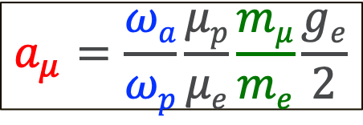
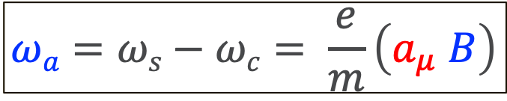
Muons in a magnetic field B (no E field)
Cyclotron frequency:
Spin precession frequency:
$$ωa=ωs−ωc= \frac{e}{m}\left(a_{μ} B\right)$$
We can rewrite this to:
$$a_{μ}=\frac{ωa}{ωp}\frac{μp}{μe}\frac{mμ}{me}\frac{ge}{2}$$
ω_{p}: Proton Larmor frequency measured in the same B field
ω_{a}: Spin precession frequency measured with decay positrons
m_{μ}/m_{e}: Ratio known from muonium hyperfine measurement

Slide 24
 | E34 @ JPARC | E989 @ Fermilab
Beam | High-rate, ultra-cold muon beam (p = 300 MeV/c) | High-rate, magic-momentum muons (p = 3.094 GeV/c)
Polarization | P_{max} = 50-90% (spin reversal possible) | P ≈ 97% (no spin reversal)
Magnet | MRI-like solenoid (r_{storage} = 33cm) | Storage ring (7m radius)
B-field | 3 Tesla | 1.45 Tesla
B-field gradients | Small gradients for focusing | Try to eliminate
E-field | None | Electrostatic quadrupole
Injection | Inflector + kicker (~5% efficiency) | Spiral + kicker (~90% efficiency)
Electron detector | Silicon vanes for tracking | Lead-fluoride calorimeter
B-field measurement | Continuous wave NMR | Pulsed NMR
Current sensitivity goal | 400 ppb (ultimate 100 ppb) | 140 ppb

Slide 25
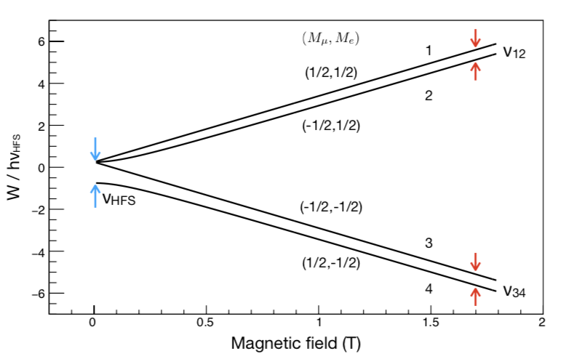
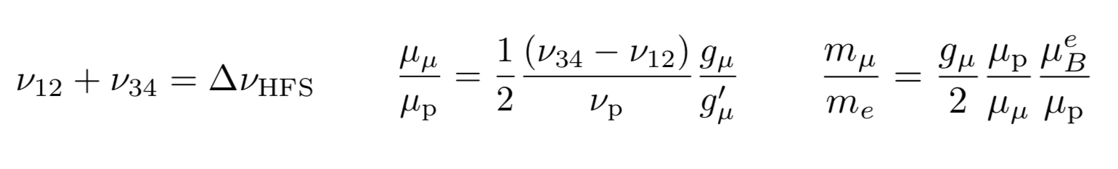
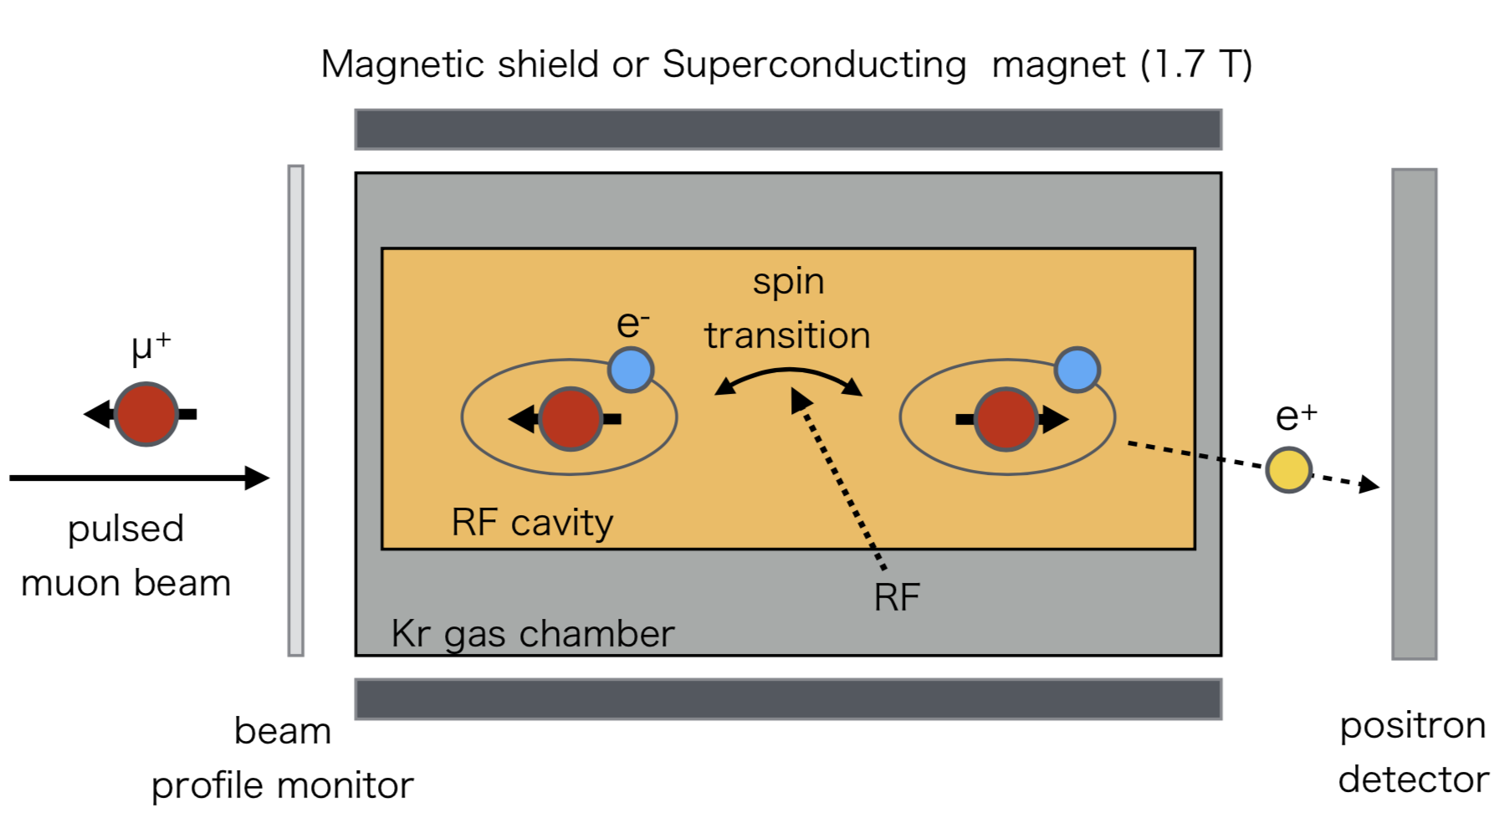
Muonium Spectroscopy experiment using microwave

Slide 26
Water-based NMR probe(s) for absolute calibration
Purpose: Special water probe(s) deliver the absolute calibration in terms of the free proton precession frequency ω_{p}
Challenge: Shift from field felt by free protons compared to protons in water.
Goal: Perform cross-calibration of J-PARC and Fermilab water-based NMR probes to better than 30ppb at 1.45T, 1.7T, and 3T

Slide 27
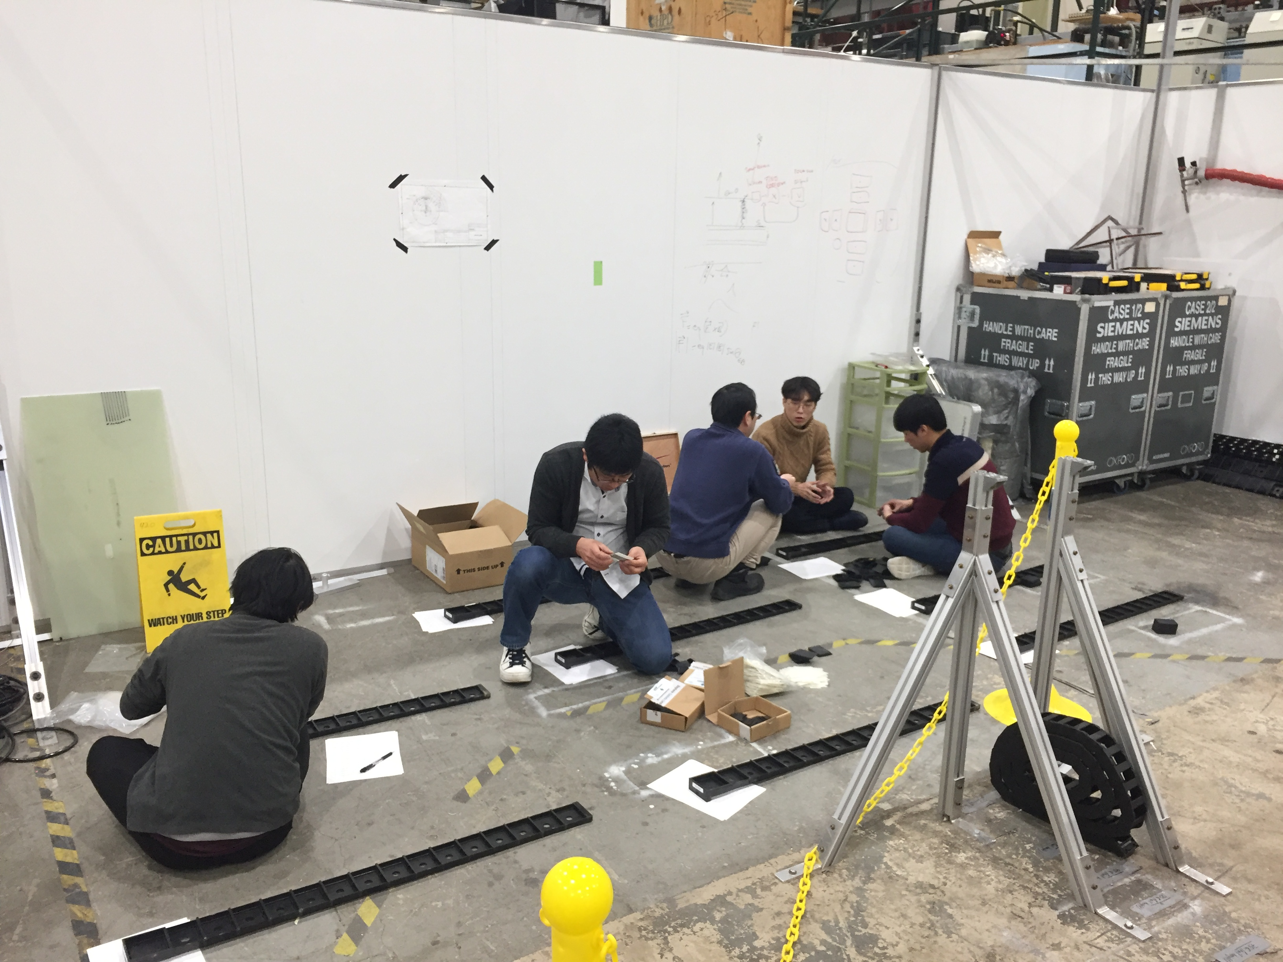
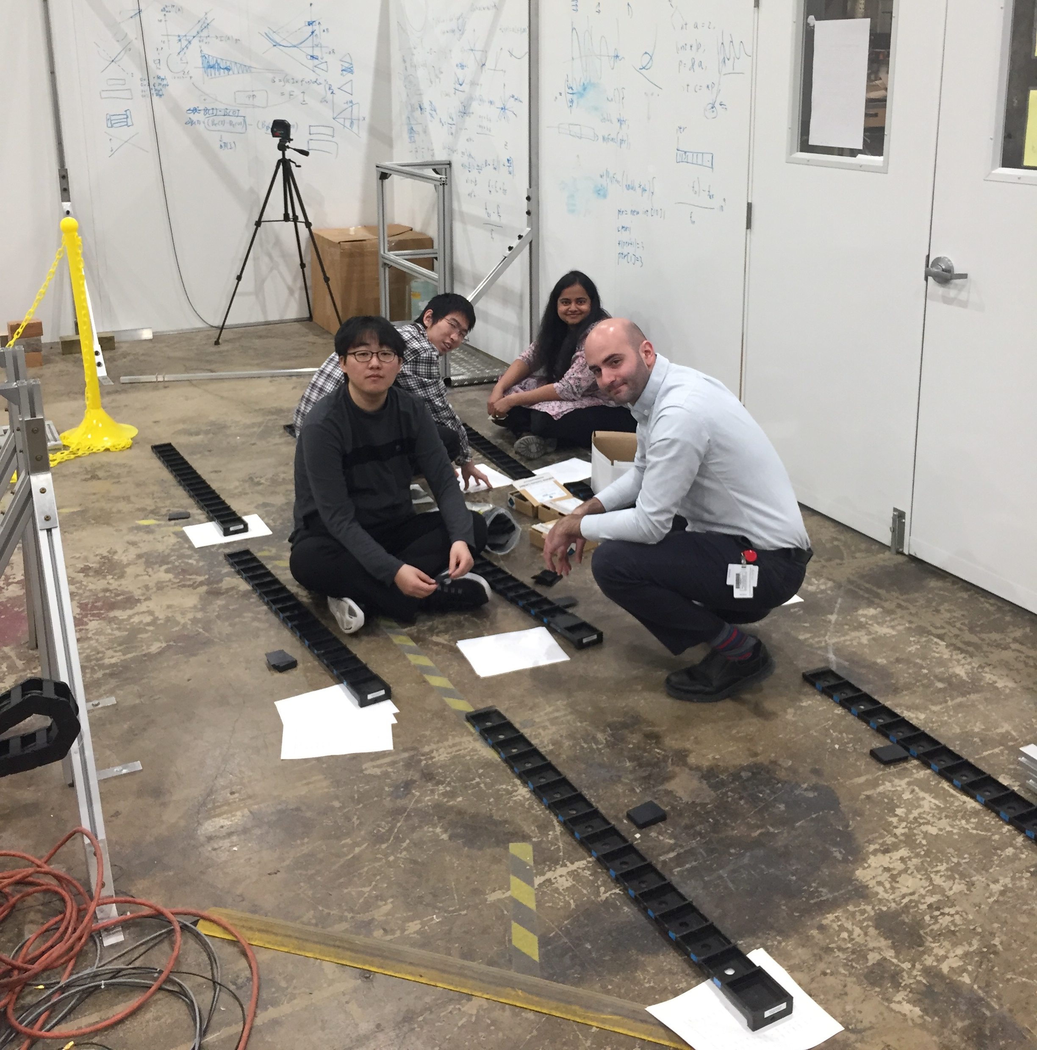
Research highlights: Highly shimmed field and precise positioning
Iterative shimming improved homogeneity by more than a factor of 30
Additional active shimming with gradient coils results in <1ppb/mm
Use linear gradients to measure probe positions to ≪1mm

Slide 28
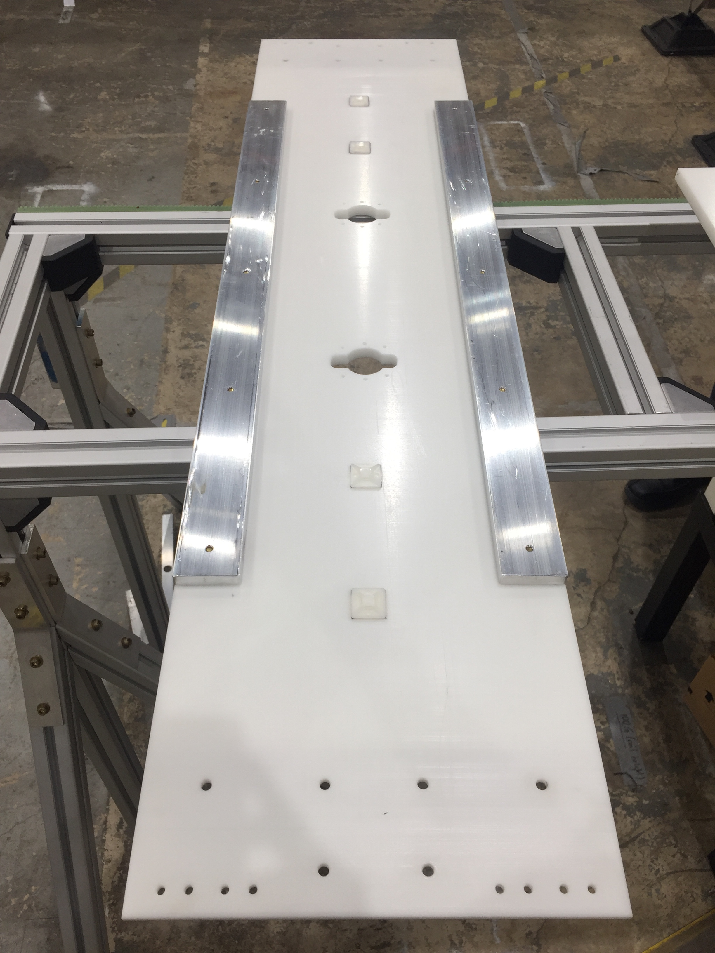
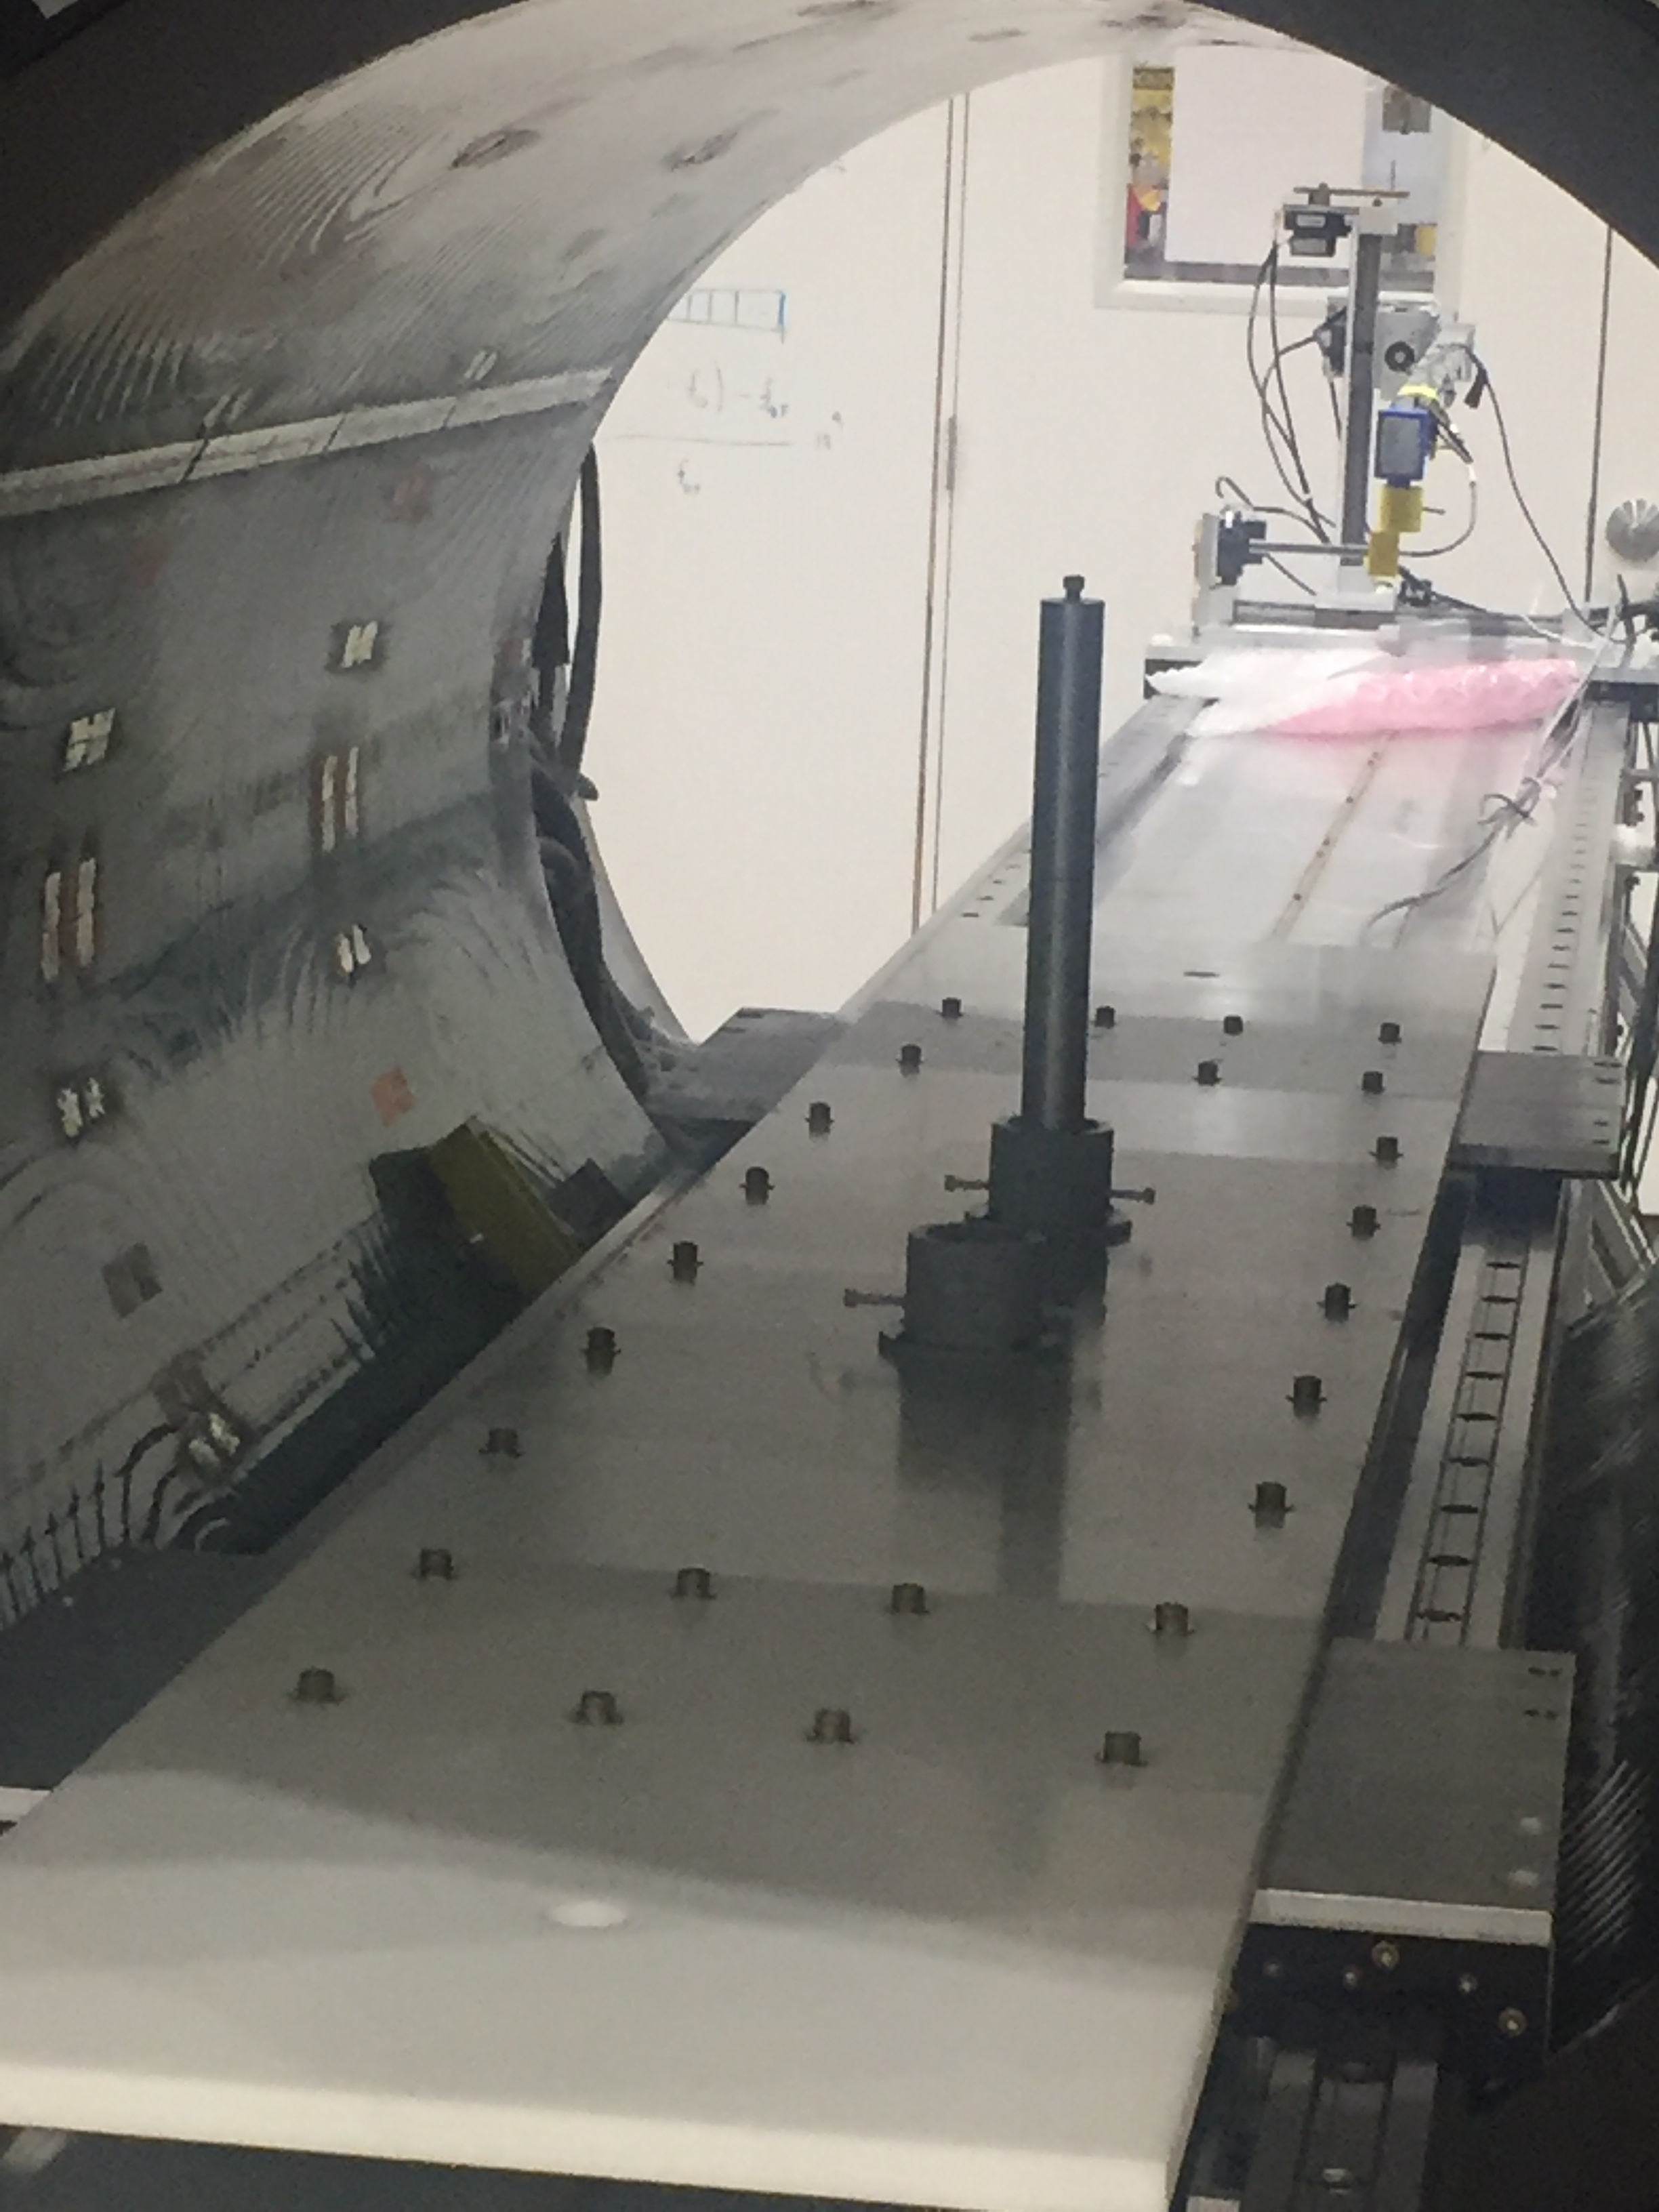
Research highlights: platform to rapidly swap calibration probes
Special stage with minimal magnetic materials
Symmetric design to minimize effect of stage

Slide 29
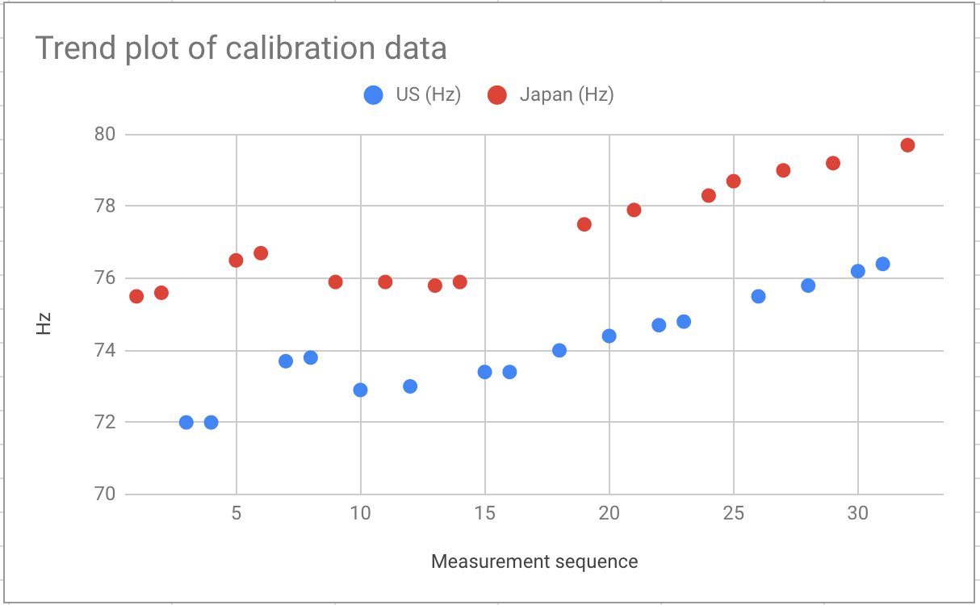
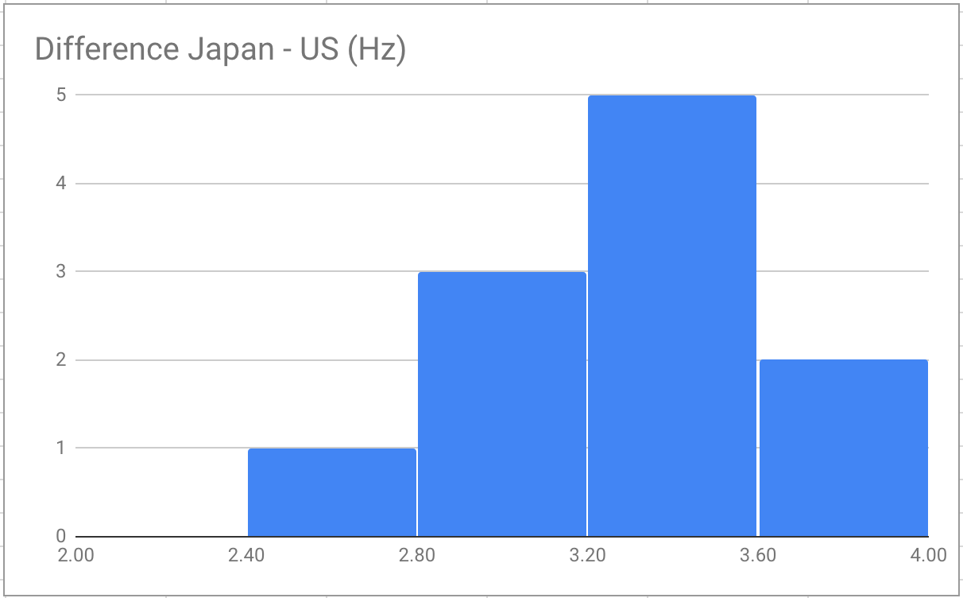
Research highlights: cross-calibration
Performed successful calibrations at 1.45T and 1.7T over 1 week each
Two probes are tracking each other very well (~6 ppb)
Absolute difference is arbitrary since blinded clock frequency (unblinding in summer after evaluation of systematic)
Final calibration at 3T in Fall 2019
RMS ~ 6ppb (0.4Hz)

Slide 30
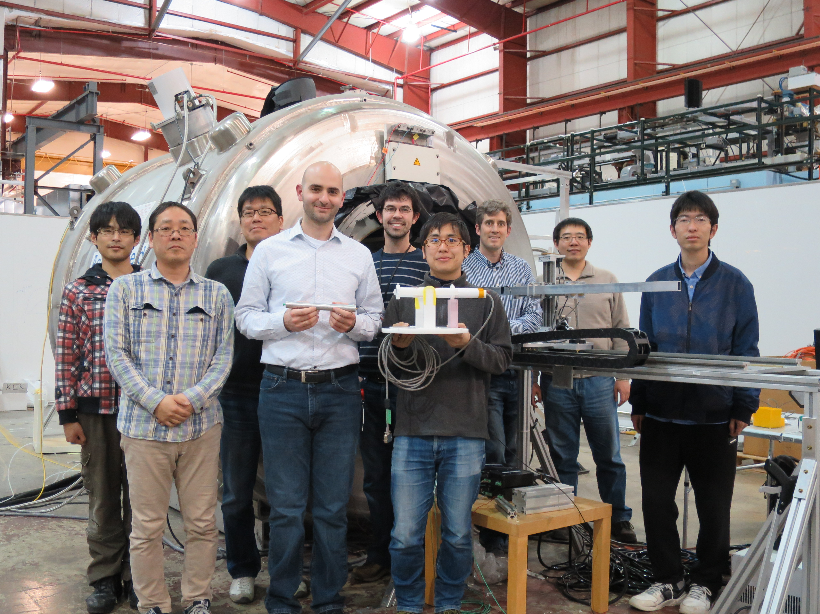
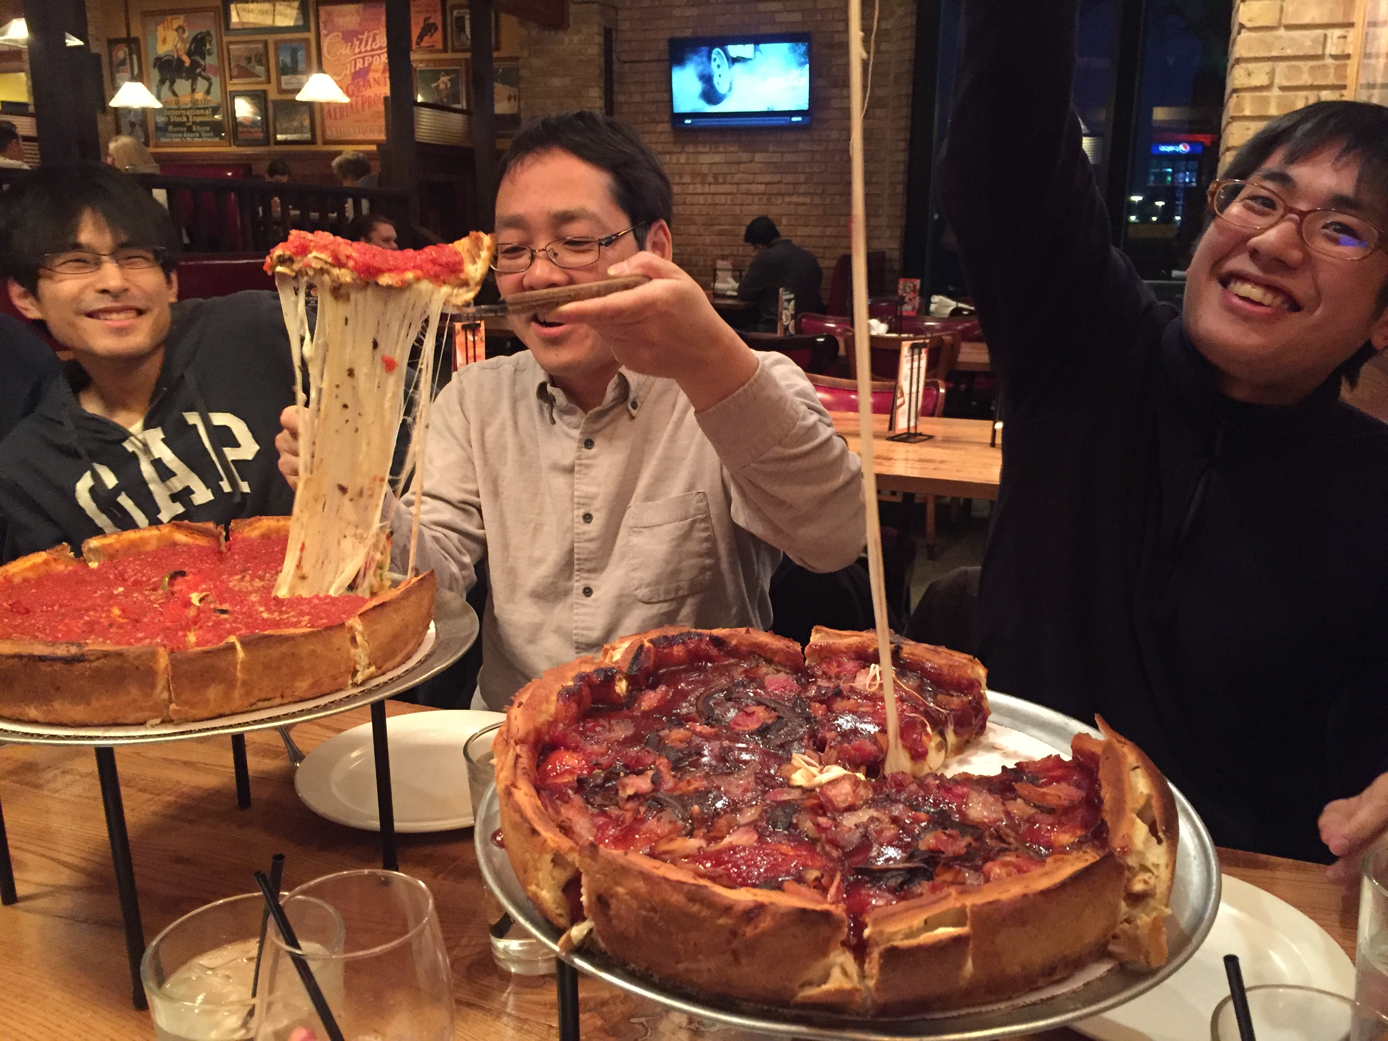
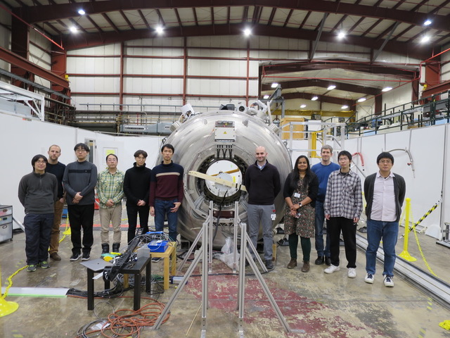
2018
2018
2019

Slide 31
closing remarks

Slide 32


Muon projects Summary
Successful muon collaborations for:
  Development of superconducting magnets (COMET, Mu2e)
  Magnetic field calibrations (NMR: g-2 & MuSEUM, Hall probe: COMET, Mu2e)
Very stable and homogeneous 4T test solenoid essential tool
Successful collaborations create synergies and help strengthen scientific results for the experiments at J-PARC & Fermilab.
Impact of US-Japan collaborations go beyond the science as they also connect culturally

Slide 33
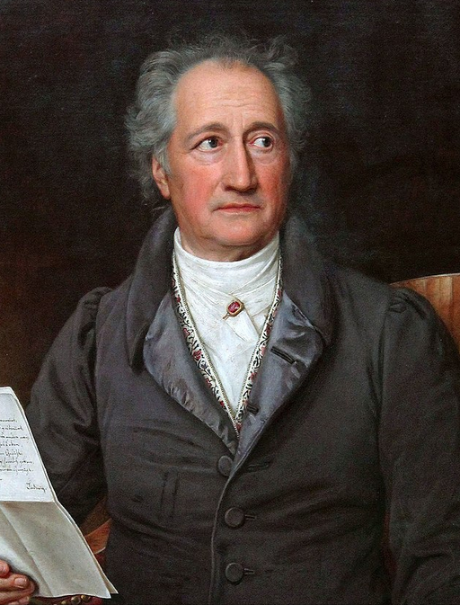
“
Wissenschaft und Kunst
gehören der Welt an
und vor ihnen verschwinden
die Schranken der Nationalität.
J. W. von Goethe
“
Science and art
belong to the world
and before them vanish
the borders of nationality.
ありがとうございます
for your attention!

