Slide 1
SuperKEKB
R&D for SuperKEKB and the next generation high luminosity colliders
M. Tobiyama(KEK), J. Seeman(SLAC)
A 3D Point Scan Magnetic Field Measurement System for Accelerator and Detector Magnets
N. Ohuchi(KEK), T. Strauss(FNAL) , P. Winter(ANL)
Construction of superconducting coils for the interaction region of SuperKEKB and magnetic field measurements for the nano-beam accelerator
N. Ohuchi(KEK), B. Parker(BNL)
Makoto Tobiyama(KEK Accelerator Laboratory)

Slide 2

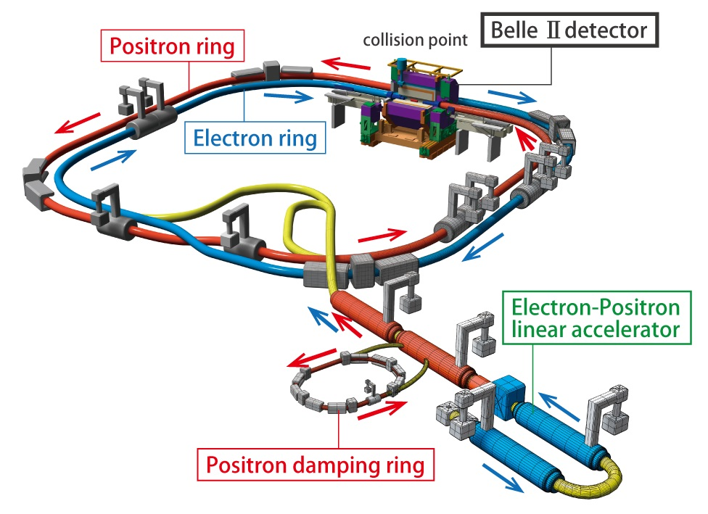
SuperKEKB, the first new collider in particle physics since the LHC in 2008 (electron-positron (e⁺e⁻) rather than proton-proton (pp))
Some items to note:
Brand-new positron damping ring (commissioned spring 2018).
2) New 3 km positron ring vacuum chamber (commissioned in 2016). Optics and vacuum scrubbing this spring.
3) New complex superconducting final focus (commissioned this spring 2018).

Slide 3
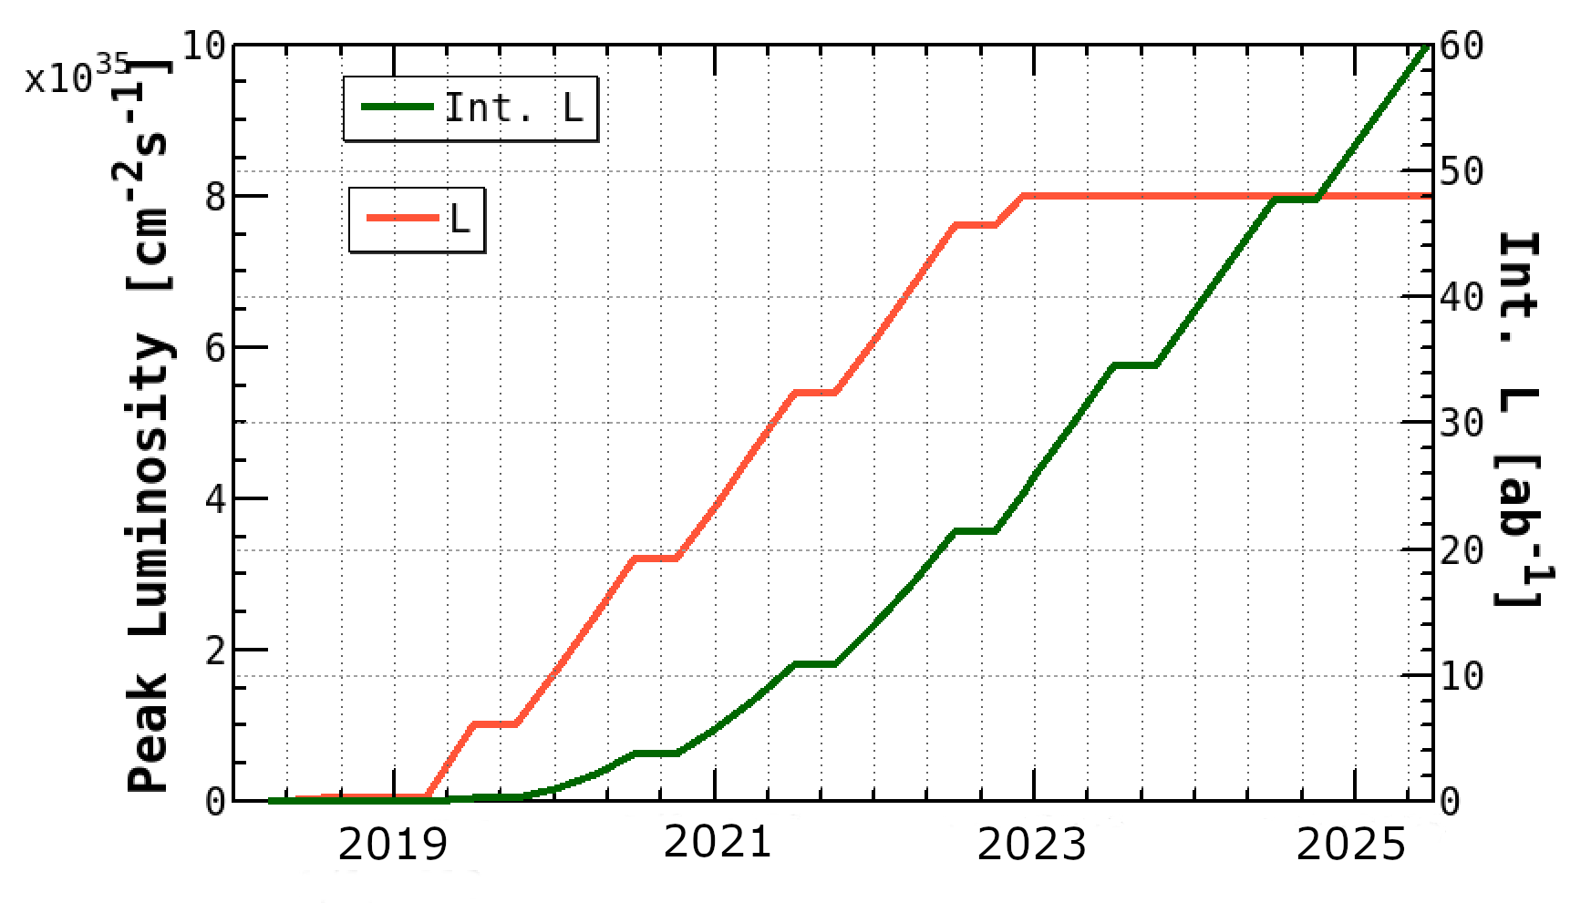
SuperKEKB/Belle II Luminosity Profile
Belle/KEKB recorded ~1000 fb⁻¹ . Now have to change units on the y-axis to ab⁻¹
Beam currents only a
factor of two higher
than KEKB (~PEPII)
“nano-beams” are the key; vertical beam size is 50nm at the IP
N.B. To realize this steep turn-on, requires close cooperation and planning between Belle II and SuperKEKB
[and some international collaboration on the accelerator, including the US and Europe e.g. BNL built the corrector coils for the SuperKEKB superconducting final focus].
Notes:
And full funding of operations is needed !

Slide 4
Introduction
Development and fabrication of accelerator components important to the construction and operation of the SuperKEKB accelerators.
  Next generation Bunch feedback
  IP collision feedback
  X-ray beam size monitor
  Large Angle Beamstrahlung Monitor
  Beam collimators
  E-cloud study and cure
  LLRF modeling
  Accelerator Physics
  High quality injector
  Superconducting final quadrupole (QCS)
Achieve SuperKEKB design luminosity faster!
  Education of young scientists/engineers for future accelerators
Supported by US-Japan Collaboration since JFY2003

Slide 5
Example of Achievements (long term)
General purpose bunch-by-bunch feedback processors (iGp) and tuning tools for BxB feedback.
  Understanding of electron-cloud instabilities, fast ion instabilities
  Widely used on the light sources
  Intra-bunch feedback for proton accelerators (J-PARC, SPS)
Surface treatments of vacuum chambers (TiN, DLC coating, Grooved surface, etc) to suppress electron-cloud instabilities.
Improvement of beam-beam related simulations.
Superconducting final quadruples (QCSs) for SuperKEKB

Slide 6
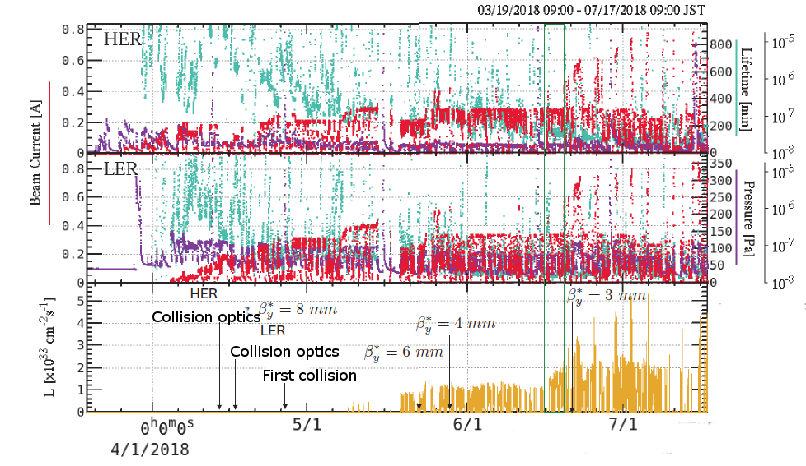
History of Phase 2 operation
Peak luminosity > 5x10³³ /cm²/s

Slide 7
First hadronic event on 26/Apr/2018

Slide 8
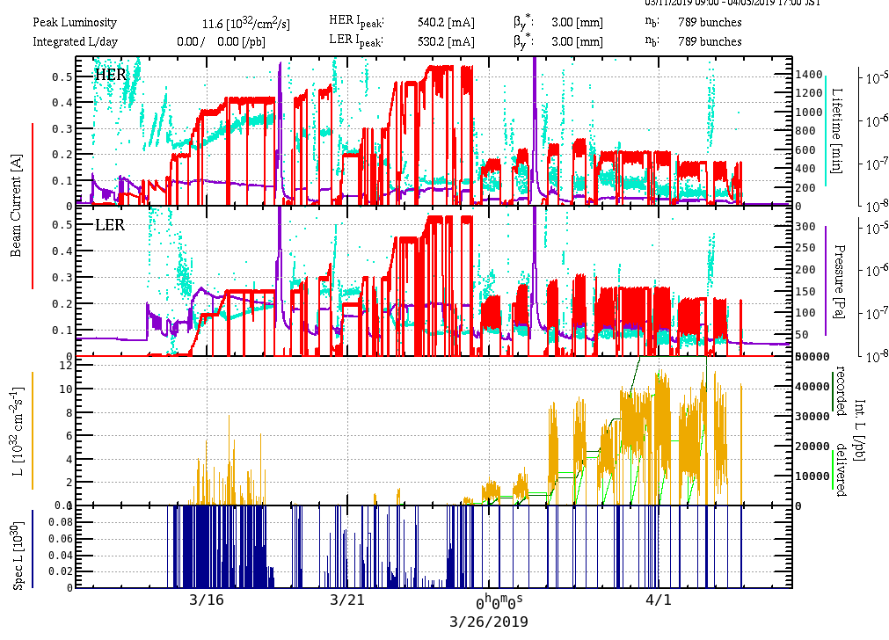
Phase 3 operation

Slide 10
Phase 3 status
Started positron damping ring on 18/Feb, HER/LER on 11/Mar.
Successfully restored βy*=3 mm colliding optics after 3 weeks of operation.
Concentrating the beam background studies to establish luminosity run with continuous injection state.

Slide 11

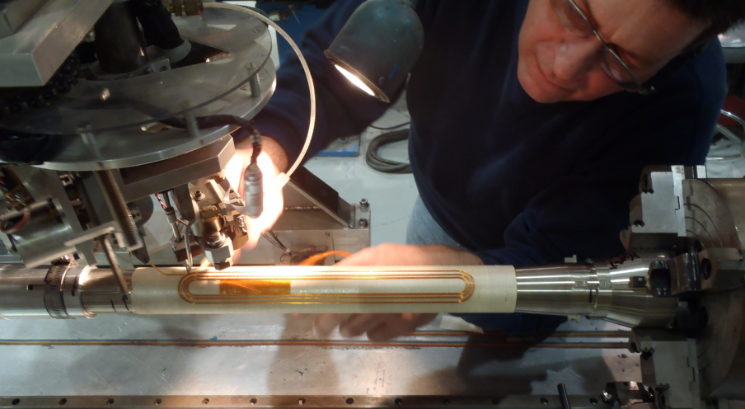
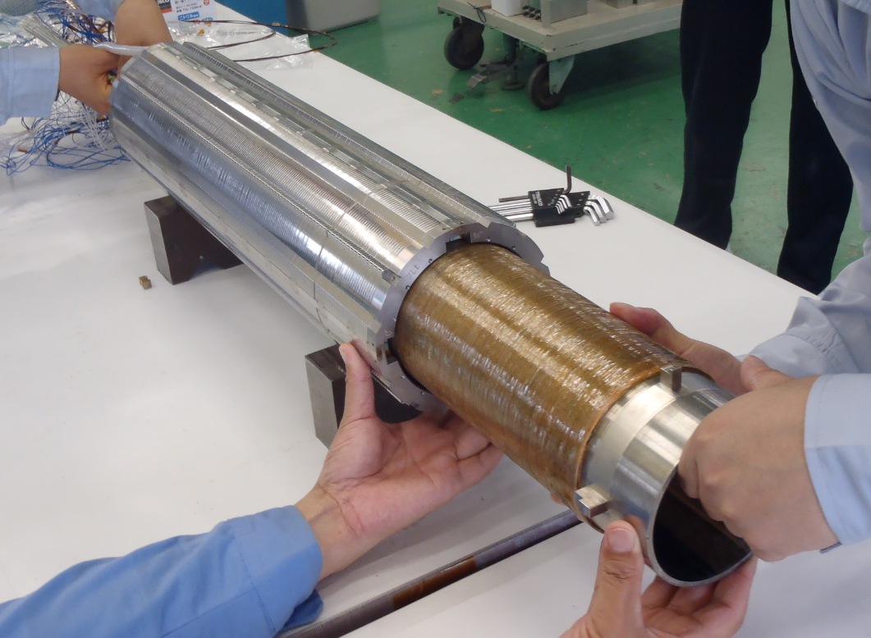
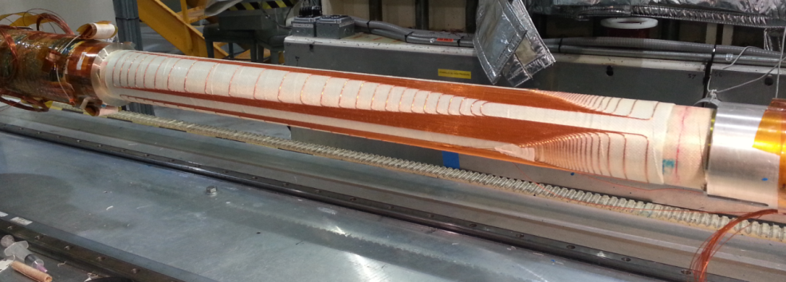
Superconducting Corrector Development
  Direct winding SC Corrector by BNL (2013-2015)
      The SC correctors were designed and directly wound on the support bobbin (helium inner vessel) by BNL under the US-Japan research collaboration
        Direct winding method: BNL special technique using SC wire bonding to the bobbin with ultrasonic heating
        Multi-layer coil [maximum layer=4 by limiting with the gap distance between the main quadrupole magnet and the helium inner vessel]
        Some correctors were assembled on the outer surface of the main quadrupole magnets.
Collared QC2LE
a₁ corrector winding for QC1LP @BNL
4 SC corrector magnets
Assembly of QC2LE and correctors
Special shape SC corrector magnet for cancelling the leak magnetic field on the HER beam line from QC1LP quadrupole magnet(LER)

Slide 12
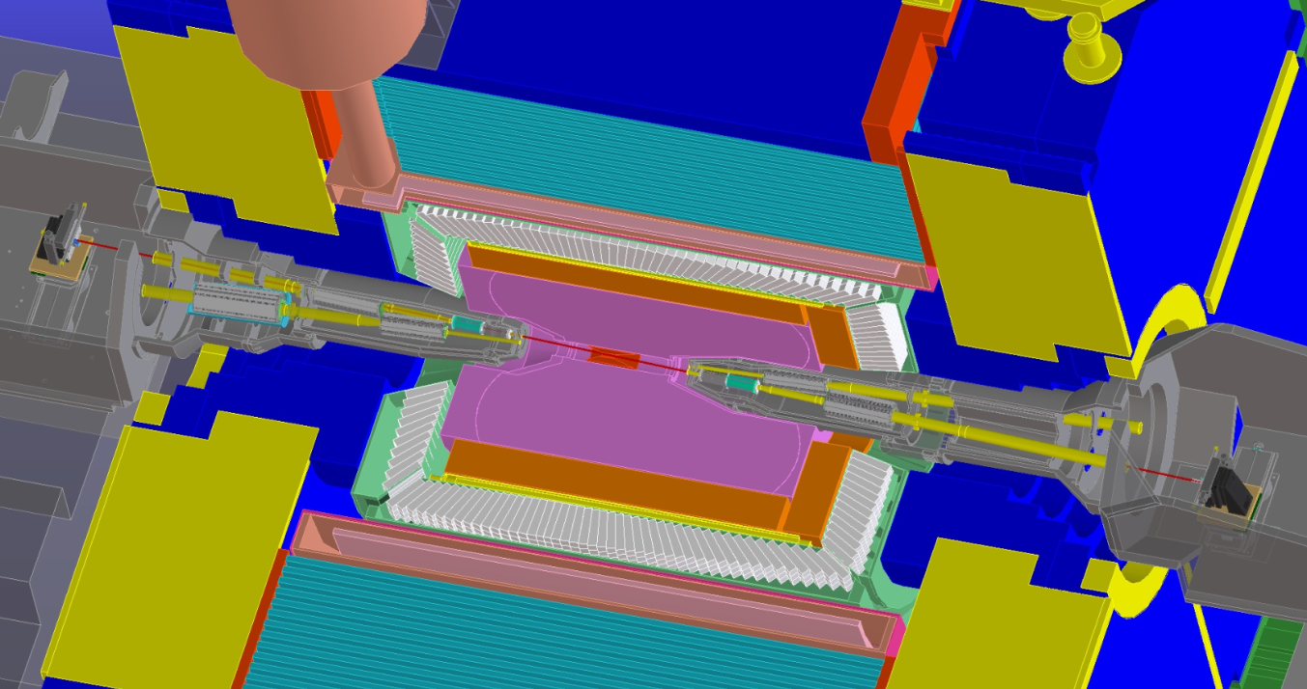
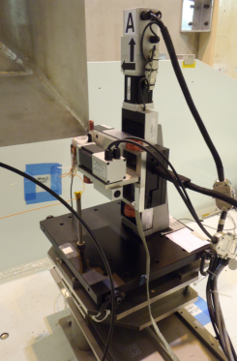
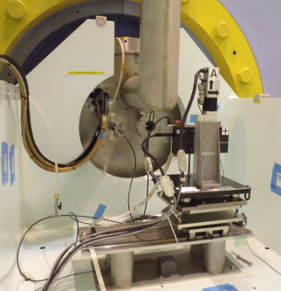
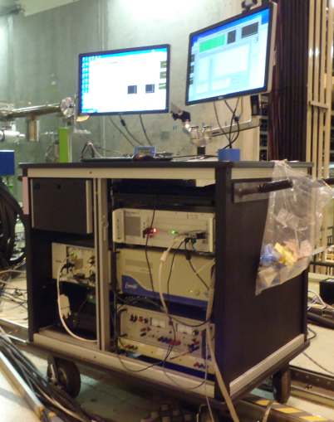
Single Stretched Wire (SSW) System
Development of the SSW system in SuperKEKB IR by FNAL (2013-2017)
  The system design started from 2013 for the direct measurements of the field center and the field angle of 8 SC quadrupole magnets. The system was completed in 2015, and it was transferred from FNAL to KEK in 2016.
    The SSW system directly measures the quadrupole field centers and angles with respect to the beam lines with the precision of ±0.1 mm for the 8 SC quadrupole magnet. The wire is stretched along the ideal beam line which goes through IP.
    The field measurements of the SC quadrupole magnets in the Experimental Hall and on the beam line were performed with FNAL and KEK collaboratively.
The measured magnetic field alignment data was included in the beam operation.

Slide 13
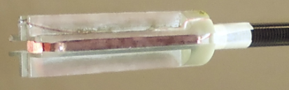
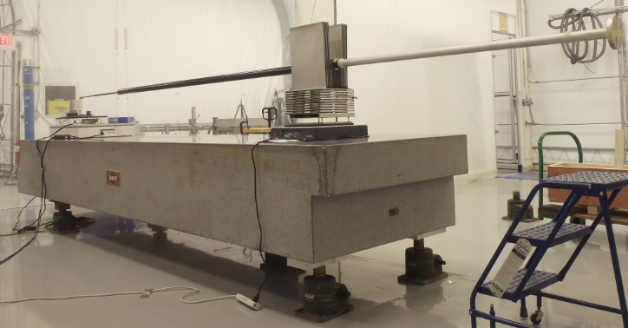
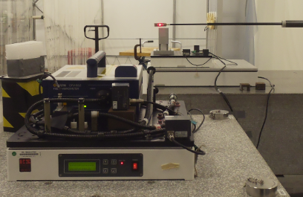
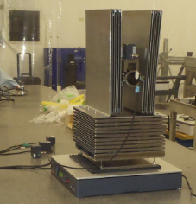
For the future operation of SuperKEKB
Development of the quadrupole field vibration measurement system by BNL and KEK (2013-2017)
  The measurement of the quadrupole field vibration was originally proposed for the ILC interaction region by BNL. The target beam size of SuperKEKB at the beam interaction point is about 50 nm. The influence of the field vibrations of the final focus quadrupoles was studied, and the luminosity degradation was confirmed.
    BNL and KEK started the development of the measurement system based on the BNL method with a pick-up coil over 1000 turns.
Vibration measurement probe
Support rod
KEK probe coil (2000 turns)
BNL Laser vibrometer
The test room and the granite table were prepared by BNL.
The vibration of the probe in the system was measured by the BNL laser vibrometer. The measured vibration of the probe was about 3 nm.
Vibration dumping support

Slide 14
Dithering base IP orbit feedback
Constructing Dithering feedback systems collaborating with SLAC
  Modulate IP positions and angles with a sinusoidal signal (~60Hz) and detect the frequency and phase response of luminosity monitor using lock-in amplifiers.

Slide 15
Progress of FY2018
Commissioned the IP dithering system using Phase 2 beam.
  U. Wienands (ANL) and A. Fisher (SLAC) joined the commissioning of the systems.
    Will also join the Phase 3 operation soon.
  LAL group had contributed the fast luminosity monitor (MNPP-01 project).
  Bump orbit check, calibration.
  Selection of dithering frequency
  Interference with other systems, such as slow orbit feedback, fast beam-beam kick based system, etc.

Slide 16
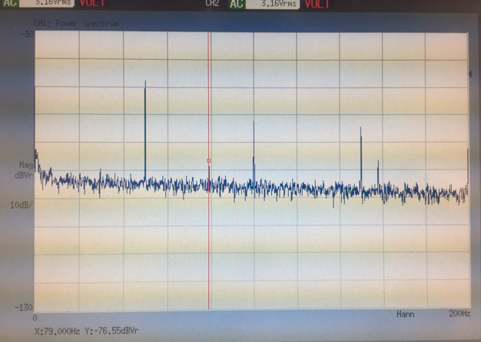
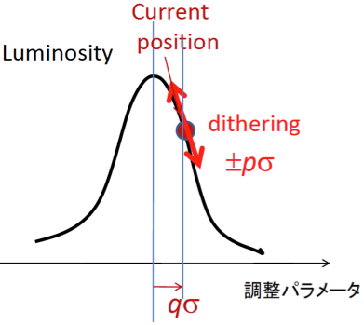
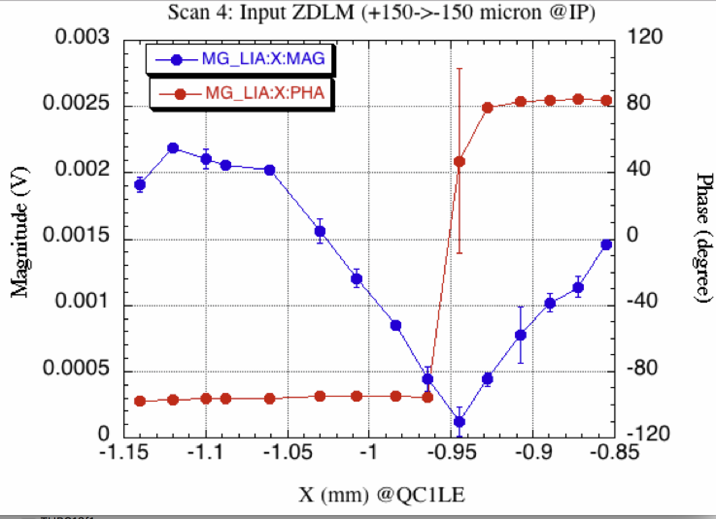
Evaluated dithering system with colliding beam
Beam dither test
The dither feedback system finds the optimum horizontal offset between the LER and HER to maximize luminosity by determining the minimum V_{x}

Slide 17

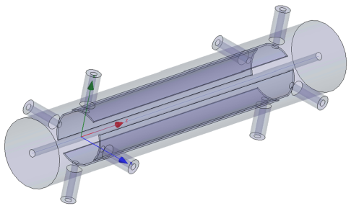
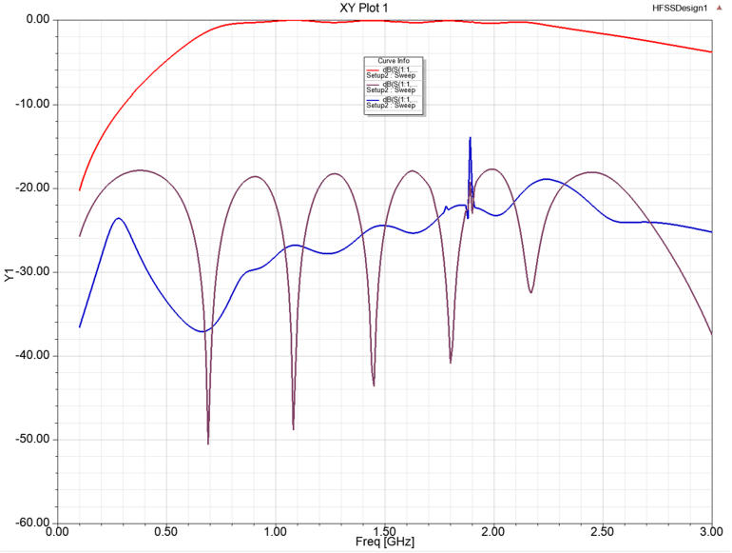
SuperKEKB: High-Current Feedback Kickers (JFY2015-19)
SLAC (A. Krasnykh, A. Benwell, J. Seeman) started on the design, together with KEK, of the transverse feedback kickers able to withstand > 3.5 A beam current at 5 mm bunch length.
  based on the successful kickers from KEKB (1.6A)
  and PEP-II kickers (3.2 A).
  adapted to SuperKEKB (both x-y rather than
  single-plane).
SLAC would be willing to build the units.
Long-standing interest by KEK in this project.
SLAC plans to participate in SuperKEKB beam
commissioning as funding allows.
Received DOE funding to work on this project in FY2018-2019.
Transfer kicker
Kicker frequency response
(A. Krasnykh)

Slide 18
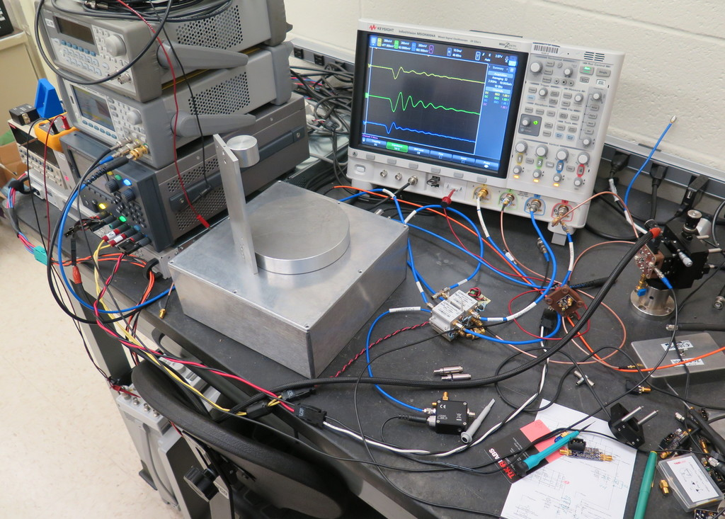
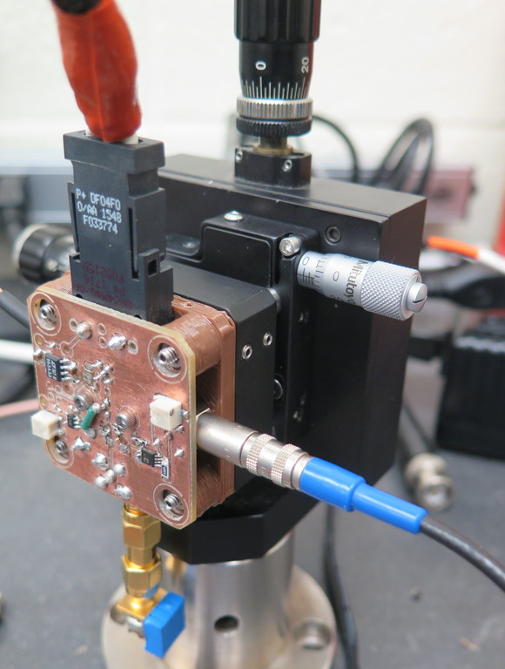
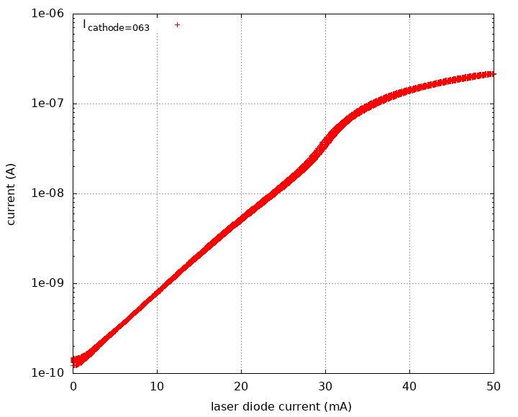
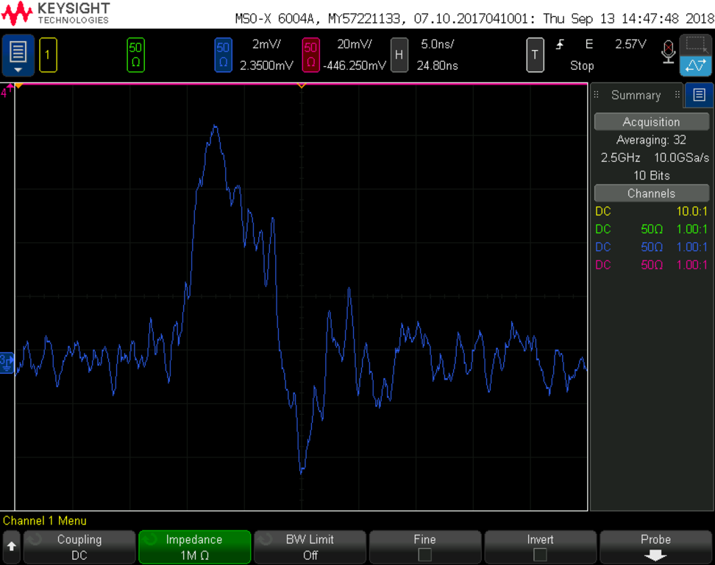
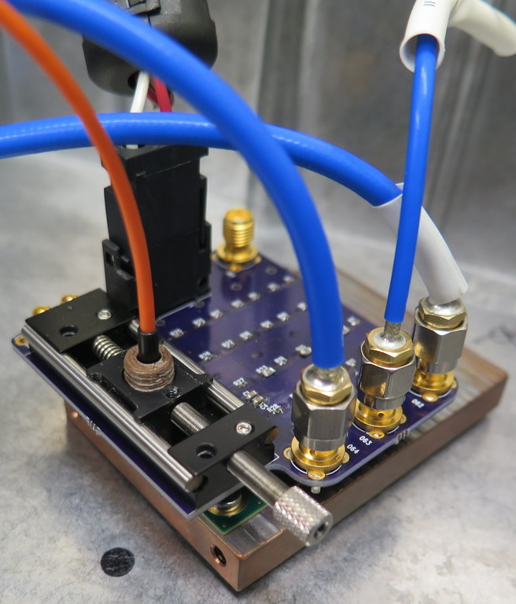




SuperKEKB X-Ray Monitor
Detector response to Laser Diode input (red line)
characterizing sensor to find operating point
first light!

Slide 19
SuperKEKB X-Ray Monitor 2018
Amplifier chain:
  Carefully designing preamp+gain stages
  Calculation/simulation (noise/gain/recovery time)
  Prototyping/measurement (network analyzer)
Firmware/readout:
  Modified BelleII/TOP firmware to (re)support gigabit ethernet
  Common ancestor with previous XRM firmware
  Retains compatibility with Belle-II/TOP firmware and readout software
  Adding needed XRM functionality to the firmware
  Beamline and studies:
    Replaced scintillator readout cameras with higher-resolution cameras
    Implemented horizontal beam size measurements
    Installed improved helium-delivery system for detector box
    Replaced beryllium extraction windows

Slide 20
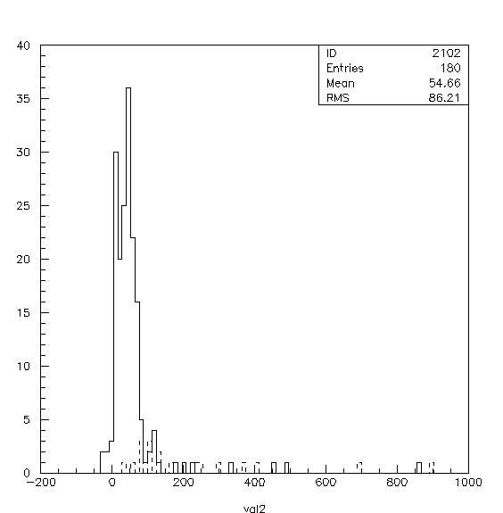
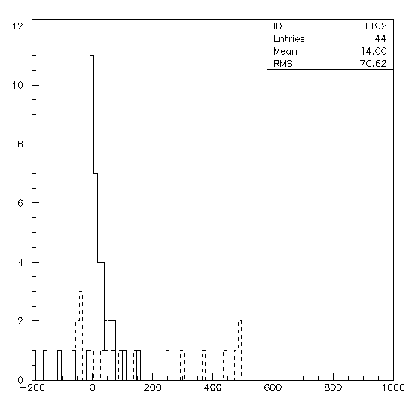
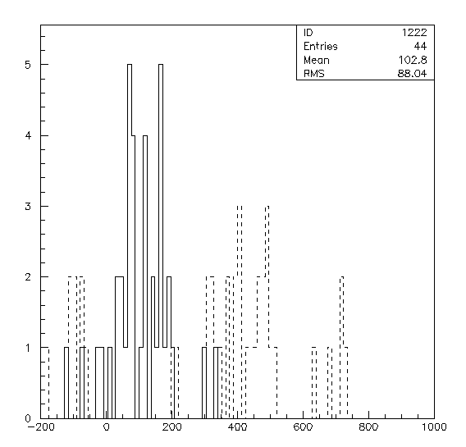
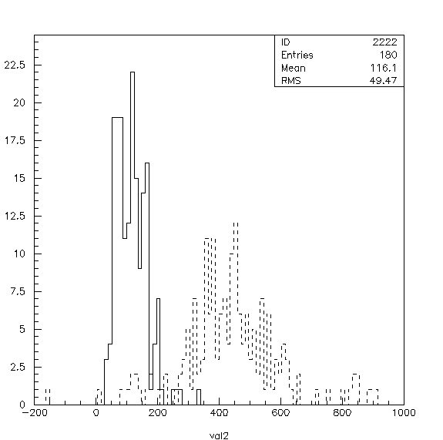
LABM in 2018-2019 (KEK, Puebla, Sinaloa, Tabuk, WSU)
1) Beamstrahlung clearly seen in both DOWN detectors based on good fills in both polarizations.
Oho Down (e-)
Pol-x and Pol-y
(1576 and 789
Bunches)
Nikko Down
(e+) P-x and
P-y (1576,789)

Slide 21
2018 Fall activities -Plans for 2019
The two UP telescopes did not see the beam in 2018
Parts were sent to WSU for refurbishing
Shipped back Jan.23 for re-installing Feb. 3
Some changes in Pipes and alignment to half installation time
Braced all non-moving mirrors to improve earthquake resistance
New primary mirrors with bigger mirrors and new transmission
Non-reflective Beam Pipe connectors
Detector to be installed by Feb. 14, expect full functionality this year
With a much more complete event record

Slide 22
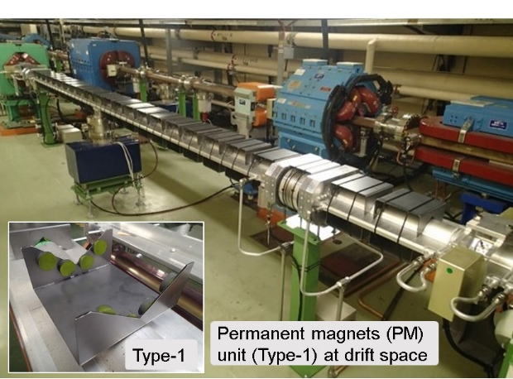
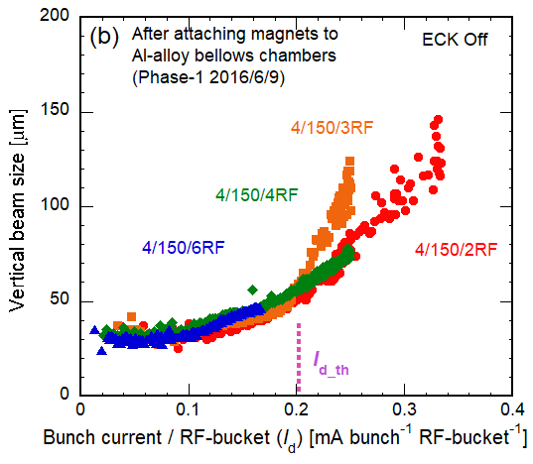
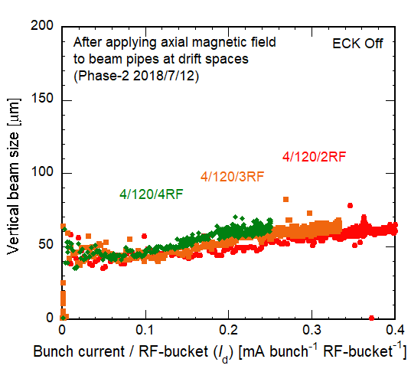
Study on electron cloud (EC)
Results of FY2018 (1)
  As a countermeasure against the EC problem observed in Phase-1 commissioning of SuperKEKB LER, units of permanent magnets (PMs) were attached to the beam pipes at drift space of the ring before starting Phase-2, which produce a weak magnetic field in the beam direction.
  The beam size was measured during Phase-2, and the blow up was not observed up to a linear current density of 0.4 mA bunch⁻¹ RF-bucket⁻¹, which was the twice of that in Phase-1 [1].
[1] Y. Suetsugu et al., PRAB, 22 (2019) 023201.
Permanent magnets around beam pipes
Blow-up of vertical beam seizes in Phase-1 and Phase-2
Suppressed!
Phase-1
Phase-2

Slide 23
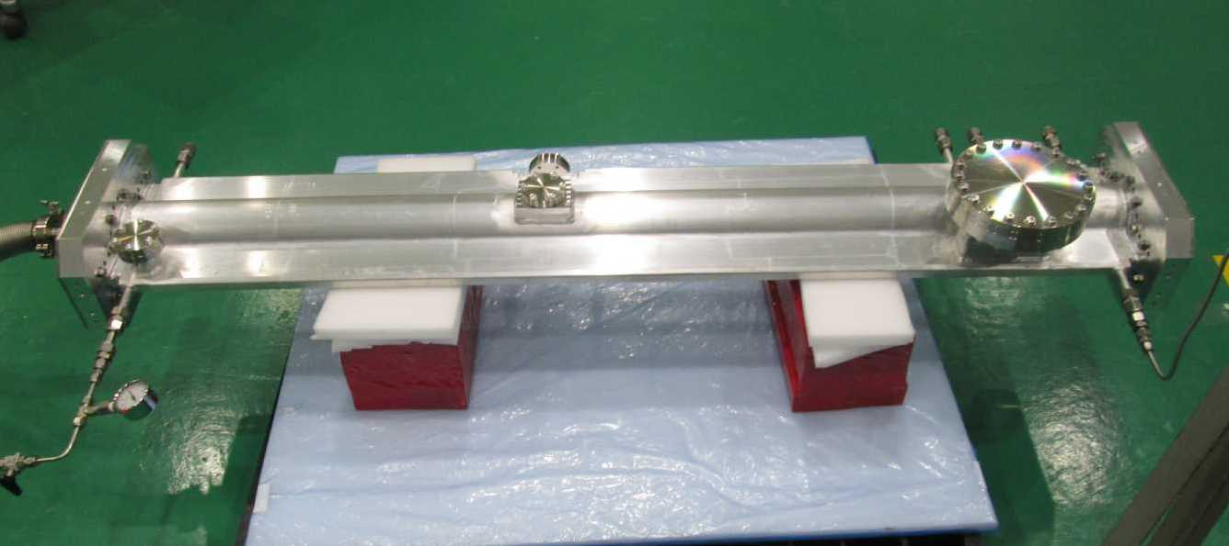
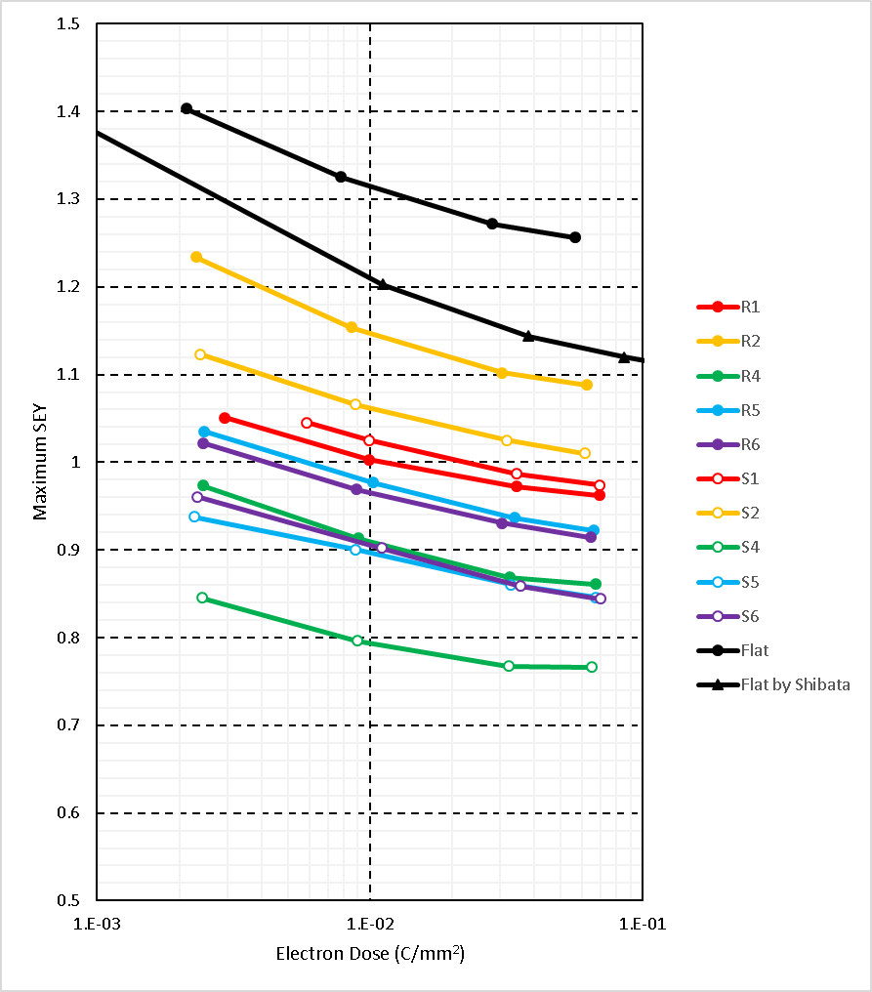
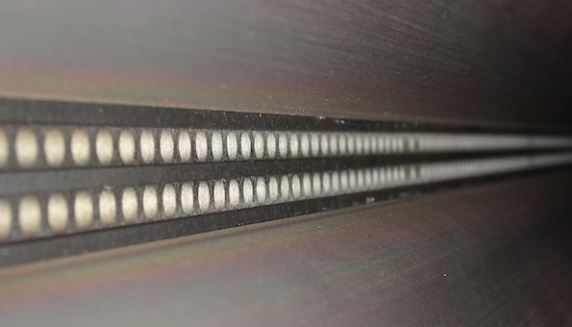
Study on electron cloud (EC)
Results of FY2018 (2)
  Beam test of a DLC-coated beam pipe at FNAL was finished.
  Manufacturing of a DLC-coated test beam pipe for SuperKEKB was completed in KEK.
  Manufacturing of a copper beam pipe for test with a chemically-etched inner surface has started in KEK.
  Secondary electron yields (SEYs) from rough surfaces formed by thermal spray have been continuously measured in a laboratory at KEK. Analysis of the results is on going.
DLC coated beam pipe
Measurement of SEY from rough surfaces
Flat
SEY
Rough
Electron dose

Slide 24
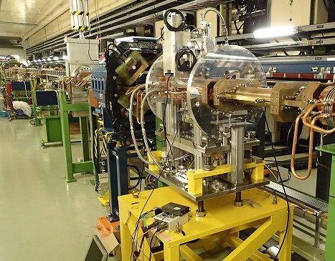
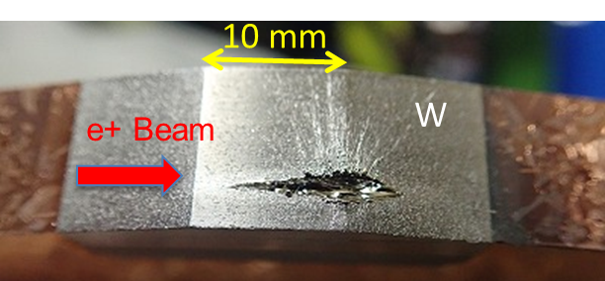
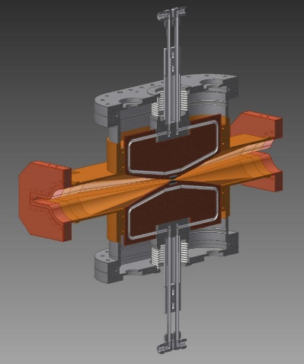
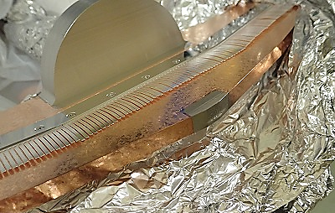
Development of beam collimators and their related instruments
Beam collimators: Results of FY2018
  Beam collimators, which were designed based on the SLAC-type and developed in KEK, have been installed into the SuperKEKB ring.
  These worked very well during Phase-2 commissioning not only for reducing the background of Belle II, but also for protecting the final-focusing quadrupole magnets (QCS) from the quench.
  However, the collimator heads were damaged during Phase-2, and the countermeasures are to be considered in the future [1].
[1] Y. Suetsugu et al., JVST-A, 37 (2019) 021602.
Vertical type collimator (D02_V1) installed in the tunnel
Damage of head (D02_V1)

Slide 25
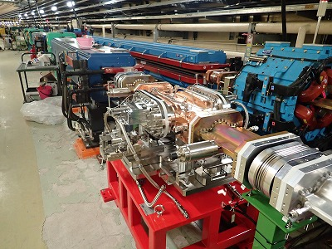
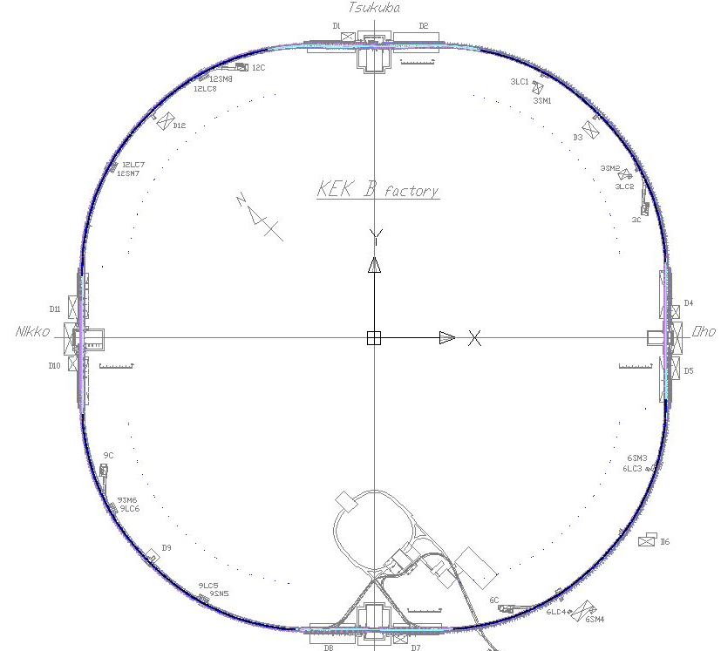
Development of beam collimators and their related instruments
Beam collimators: Plan of FY2019
  Five new beam collimators were installed for Phase-3. The performance will be continuously checked.
  Instabilities caused by collimators, such as the transvers coupled bunch instability, will be studied during Phase-3.
  R&Ds on materials and structures to relieve the head damage will start.
Horizontal type collimator (D02_H1) installed in the tunnel
Collimator system in Phase-3 (Mar.- Jun. 2019)
New
HER D01_H3
New
LER D02_H1, H2
e⁻
e⁺
LER D03_H1
Phase 3 (Spring 2019)
: H type
: V type
LER D06_V2
LER D06_H1

Slide 26
Accelerator physics activity 2018-
Coherent beam-beam instability (KEK-US-CERN-China)
  Beam measurements and simulations have been done in SuperKEKB.
  Simulations for Future colliders have been done.
Optics aberration at IP and its correction (KEK-SLAC-BNL)
  Optics measurement has been done in SuperKEKB.
  Simulation has shown luminosity degradation for several optics aberrations.
Beam-beam effects in Electron-Ion Collider (KEK-BNL)
  Coherent instability
  Slow Emittance growth of proton beam
Code development for GPU (KEK-BNL)
  The beam-beam code is expected 10 times faster in GPU.
Spin polarization at SuperKEKB (KEK-US)
  Design of spin rotator using combined magnet has been done. Feasibility study starts.
  Develop spin tracking code using Bmad.

Slide 27
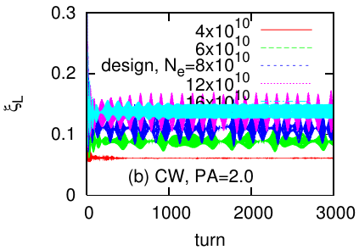
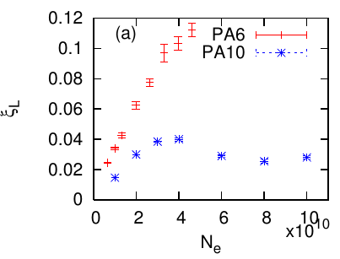
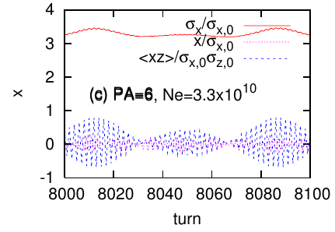
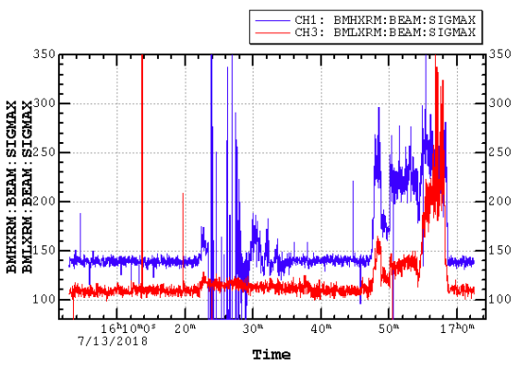
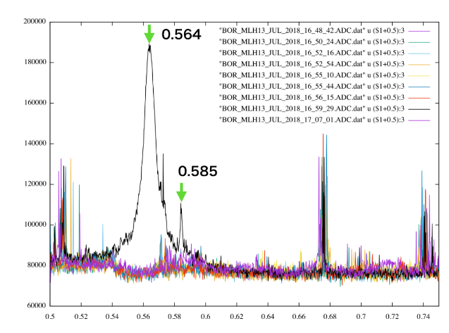
Beam-beam effects in nano-beam collision- Accelerator physics activity
KEK-CERN-BINP-SLAC-BNL-Fermilab
FCC-ee strong coherent beam-beam instability has been seen in strong-strong simulation for FCC-ee and SuperKEKB
The instability has been observed in commissioning of SuperKEKB
Beam-beam limitation at very low ξ for high Piwinski angle,
Fluctuation in luminosity was seen in strong-strongsimulation
Coherent motion in <xz> was seen.
Horizontal beam size blow up was seen in νx scan. Beam size of two beams increase simultaneously.
At the size blowup, an oscillation of beam was observed.

Slide 28
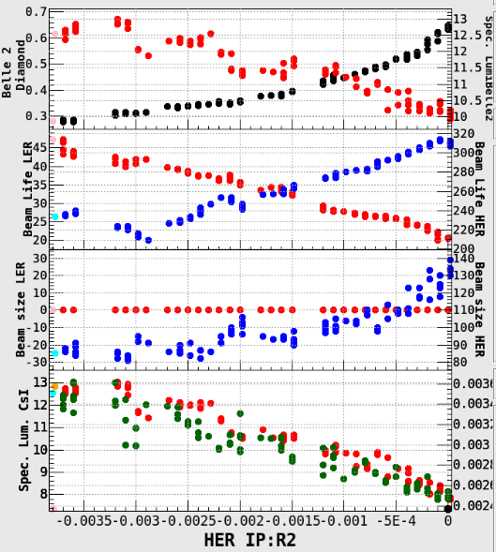
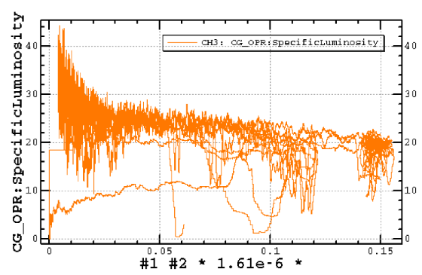
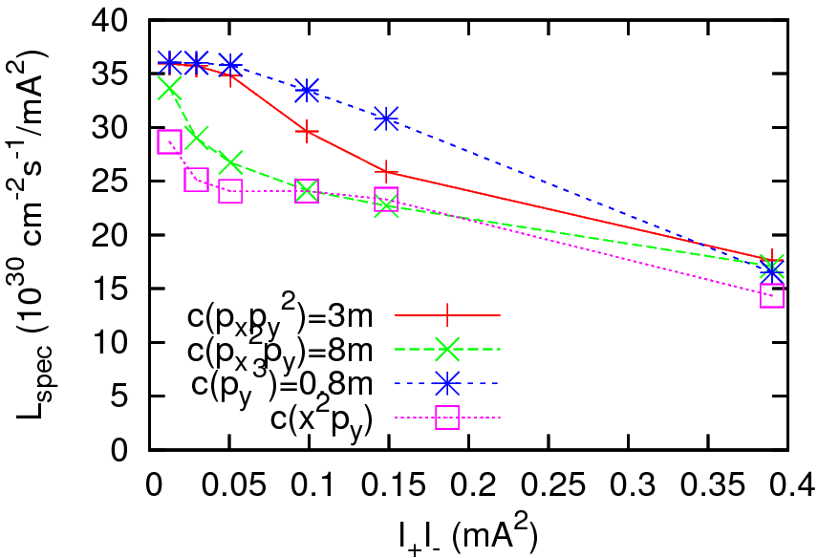
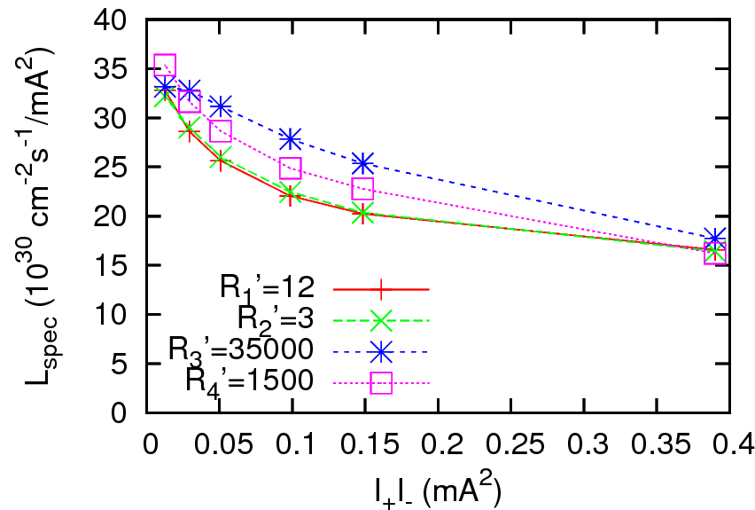
Optics aberration at IP and its correction in SuperKEKB
  Linear coupling (R₂) correction at SuperKEKB
Errors in QCS and local chromatic correction section
First finding- R2(x-y coupling) at IP due to QCS rotation
  Luminosity increase twice after correction
Next step toward higher luminosity
  Measured luminosity is limited at high current
  Possible errors are chromatic coupling or skew sextupole component at IP
Measured specific lum.
Simulation for chromatic coupling
Simulation for nonlinear aberration

Slide 29



Research highlight
Code development for GPU (KEK-BNL)
  BNL cluster equips NVIDIA GPU
  The beam-beam code is expected 10 times faster in GPU.
Spin polarization at SuperKEKB (KEK-ANL-Canada)

Slide 30
Overall FY2019 plan
Phase 3 commissioning of SuperKEKB
  Expecting contributions from SLAC, LAL, IHEP under Multi-National Partnership Laboratory.
Extend collaboration with SLAC
  Collaboration of FY2013-FY2018 was so successful.
  SLAC has outstanding experience:
    PEP-II design and construction.
    PEP-II high current operation.
    Strong history of collaboration with KEK
      NLC/JLC/ILC
      Bunch feedback and beam diagnostics systems
      Beam dynamics, beam-beam, electron cloud, CSR, etc.
    Strong team of accelerator physicists and engineers
Continue collaboration with other laboratories
  Cornell, U. Hawaii, FNAL, BNL, Wayne State. Univ. Cal. Pol. JLAB

Slide 31




Ongoing SLAC Collaborations: US-Japan (KEK)
US-Japan:
SuperKEKB (2012-2019):
IP dither commissioning (commissioned at SuperKEKB in 2018)
IP backgrounds (helping with observed background issues)
Transverse feedback kicker, bunch by-bunch feedback,
8 GHz beam design and data/analysis, x-ray beam size
monitors, electron cloud effects, beam-beam effects
Transverse kicker design
for SuperKEKB
June 2018 (A., Krasnykh)
Dither IP feedback
Commissioning in SuperKEKB May 2018 (A. Fisher)
IP beam loss calculations (M. Sullivan)
Backgrounds in SuperKEKB (M. Sullivan)

Slide 32
Backup

Slide 33


SLAC help with SuperKEKB (2018-2019)
John Dusatko: Bunch-by-bunch feedback work
Alan Fisher: IP dither feedback commissioning
Anatoly Krasnykh: High beam-current transverse bunch-by-bunch feedback kickers
John Seeman: Collaboration discussions, transverse feedback kickers
SuperKEKB Accelerator Review Committee, US-Japan global activities
Michael Sullivan: IR design and background suppression, commissioning
Belle-2 B-PAC Review Committee
Focus Review on Belle-2 Vertex Detector
SuperKEKB Accelerator Review Committee
Alexander Novokhatski: Higher Order Mode HOM Calculations for Interaction
Region and vacuum chambers
Glen White: Collider IR optics issues
IR bunch HOM simulations and heating estimations (A. Novokhatski)
SuperKEKB IR chamber

Slide 34

Integrated beam dose of Phase 3

Slide 35

Study on electron cloud (EC)
Plan of FY2019
  Experimental and theoretical studies on EC in the SuperKEKB LER will be continued at higher beam currents. For example, the effect of grooves will be checked by measuring the electron density in a test beam pipe, and the net electron current of clearing electrodes will be measured during Phase-3.
  Influence of permanent magnets on the beam optics will be studied during Phase-3.
  A copper beam pipe for test with a chemically-etched inner surface for SuperKEKB will be completed.
  SEYs from rough surfaces and also grooved surfaces, and their analysis will be continuingly measured in a laboratory at KEK.
Beam pipe for electron density measurement

Slide 36



Development of beam collimators and their related instruments
HOM absorbers: Results of 2018 and plan of FY2019
  R&Ds on HOM absorber materials, such as ferrites and SiC, were continuously proceeded.
  High-power tests using 1.25 GHz microwave were performed using improved ferrite-copper blocks again, but conclusive results have not been obtained yet.
  Serious consideration of SiC as a HOM absorber material has begun, from a basic brazing test, and will be proceeded further.
Setup for high-power test (Ferrite)
Brazing test of SiC
Ferrite
Cu block
Succeeded!
SiC block

Slide 37



SLAC Accelerator Research Division ARD: High Energy Collider Accelerators
Local SLAC experts to help with worldwide collider designs and commissioning.
SLAC (2015-2019): Design of e+ Damping Ring and storage ring commissioning
SuperKEKB commissioning (2017-2019): IP dither commissioning, IP backgrounds, transverse feedback kicker, bunch by-bunch feedback, 8 GHz beam data/analysis, x-ray beam size monitors, IP HOM design, IR backgrounds, injection, lattice design
Participants: Y. Cai, A. Fischer, A. Krasnykh, Y. Nosochkov, A. Novokhatski, J. Seeman, M. Sullivan
Publications (selected):
M. Boscolo, M. Sullivan, “Interaction Region Design”, PR-AB in process (2018).
A. Novokhatski, M. Sullivan, et al, "Unavoidable trapped mode in the interaction region of colliding beams", PR-AB 20, 111005 (2017) 22, November 2017.
J. Seeman, “ Top-Up Injection for a Future Electron-Positron Collider”, Proc. of ICFA Workshop ee-Factory”, January 2017.
IR HOM Models (A. Novokhatski) (2018)
SuperKEKB dither feedback (A. Fisher)
SPS bunch-by-bunch feedback
(J. Fox, C. Rivetta)

Slide 38




SLAC ARD: Support of SuperKEKB, Circular Colliders, US-Japan Contributions
A) Motivation: Help SuperKEKB commissioning with hope that integrated luminosity will advance faster.
B) SLAC-AD: Support of SuperKEKB for commissioning, IP dither feedback, collimator, IP backgrounds, beam dynamics (CSR, ECI, beam-beam)
C) SLAC US-Japan funding from DOE and KEK to work on high power feedback kickers, bunch-by-bunch feedback, x-ray size monitors, commissioning, SRF guns.
D) SLAC Participants: Y. Cai, J. Dusatko, A. Fisher, A. Krasnykh, A. Novokhatski, J. Seeman, M. Sullivan
IP dither feedback electronics
High power (~4 A) feedback kicker design
IP dither feedback coils
Bunch-by-bunch feedback

Slide 39


SLAC Contribution to US-Japan R&D Program (June 2018-May 2019)
A) High speed bunch-by-bunch x-ray beam diagnostics (C. Kenney):
  Development of high-speed, bunch-by-bunch x-ray beam diagnostics needed for measuring
  low-emittance beams and studying beam blow-up due to, for example, electron cloud.
B) Low level RF control and beam loading (J. Dusatko):
LLRF analysis tools and system development, beam dynamics estimation for circular
accelerators with high beam loading with train gaps.
C) Bunch-by-bunch instability feedback (J. Dusatko):
Development of the next generation of bunch-by-bunch feedback and related systems, including technology for instability control.
(D) IP dither feedback commissioning (A. Fisher):
Assist in the tune-up stages of IP collision feedback with hardware supplied by US collaborators (SLAC) and
new spare components.
(E) SuperKEKB and background commissioning (M. Sullivan):
Assist general commissioning of the Super KEKB collider including diagnosis of beam instabilities with cures and luminosity
optimization.
F) High power transverse kicker (A. Krasnykh, J. Seeman):
Study low impedance, high beam power feedback kickers.
X-ray beam size sensors illuminated
edge on (C. Kenney)
Kicker HOM
Measurements
(A. Krasnykh)

Slide 40

Interaction Region and IP Beam Pipe
M. Sullivan is on the BPAC review panel and specializes in reviewing the SuperKEKB IR design with reference to beam backgrounds and detector interface.
He carefully monitored the commissioning plans and reviews the BELLE-II planning for initial background measurements.
He goes to KEK about two to four times per year: when the accelerator is starting up, was present in the control room when positrons were being injected into the main ring, and attends two to three technical reviews per year.
Picture on right is of the collision point with the beam pipe for early running. The review committee advice was used to place the initial running detectors shown.
Early SuperKEKB IR background tests

