Slide 1
Advanced and Novel Accelerators
“It is Difficult to Make Predictions, Especially About the Future”
Niels Bohr
“The Best Way to Predict the Future
is to Create it”
Abraham Lincoln
Andrei Seryi
Associate Director for Accelerator Operations and R&D

Slide 2
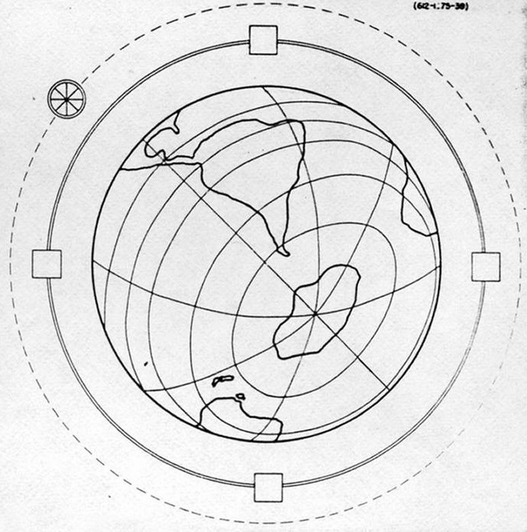
Evolution of accelerators
In 1954 Enrico Fermi presented, in his lecture, a vision of an accelerator that would encircle the Earth, and would attain highest possible energies
Would this be indeed a natural evolution of accelerators?

Slide 3
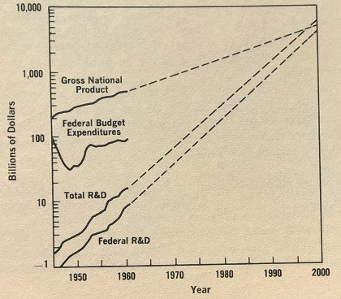

Evolution of accelerators
Enrico Fermi Earth accelerator, 1954
Fig 6, GNP and R&D: Failure of naïve extrapolation. “The Year 2000”, 1968, K. Herman, A. Wiener
Would this be indeed a natural evolution of accelerators?
No. And not only because R&D budget is now not growing faster than GDP

Slide 4
Evolution of accelerators
Would this be indeed a natural evolution of accelerators?
No.
Increasing the size or base of the experiment, to increase precision, with proportional or event faster increase of the cost, would unlikely be accepted by governments and society
Breakthroughs are needed to take us to new technologies
Enrico Fermi Earth accelerator, 1954

Slide 5
CPA invention: exponential growth of laser power
Intensity (W/cm²)
10²³
10²⁰
Relativistic regime : E ~ mc² in one cycle
Atomic intensity
10¹⁵
CPA
Typical S-curve: Saturation of previous technology
Breakthrough
At some point, new saturation
New breakthrough
Field ionization
of hydrogen
10¹⁰
Year
1960
1970
1980
1990
2000
2010
Progress in peak intensity since laser invention in 1960

Slide 6
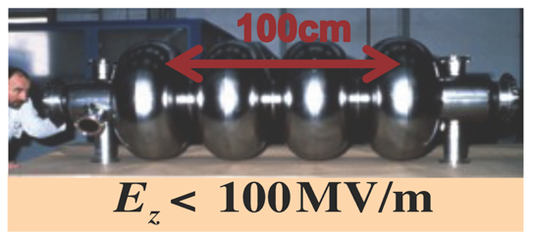
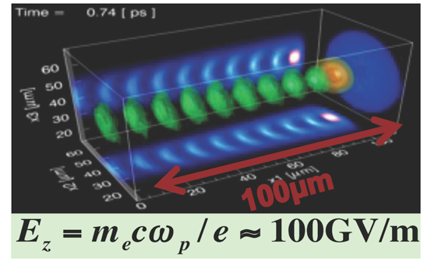
Plasma acceleration
Accelerating structure, metal (normal conductive
or super-conductive)
“Accelerating structure” produced on-the-fly in plasma by laser pulse

Slide 7
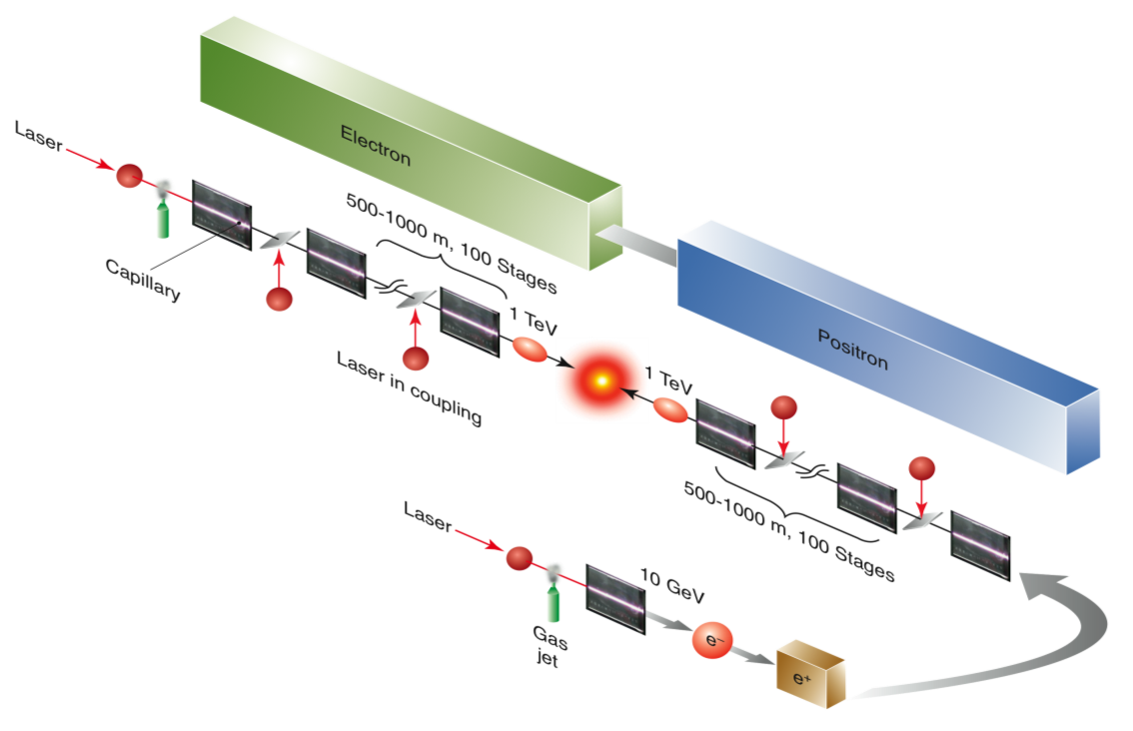
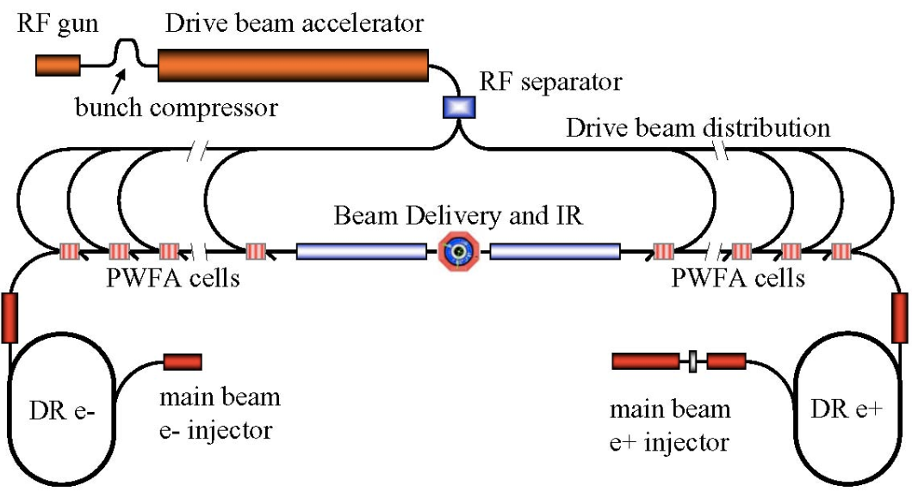
Can linear collider be built with plasma acceleration?
Laser-driven
Beam-driven
Esarey et al, Rev. Mod. Phys. (2009)
A. Seryi et al, SLAC-PUB-13766, 2009

Slide 8
The answer depends on our work.
Advanced accelerator community developing roadmaps toward plasma-based collider
Laser-driven
Concepts of plasma-based colliders
Beam-driven
Esarey et al, Rev. Mod. Phys. (2009)
A. Seryi et al, SLAC-PUB-13766, 2009

Slide 9
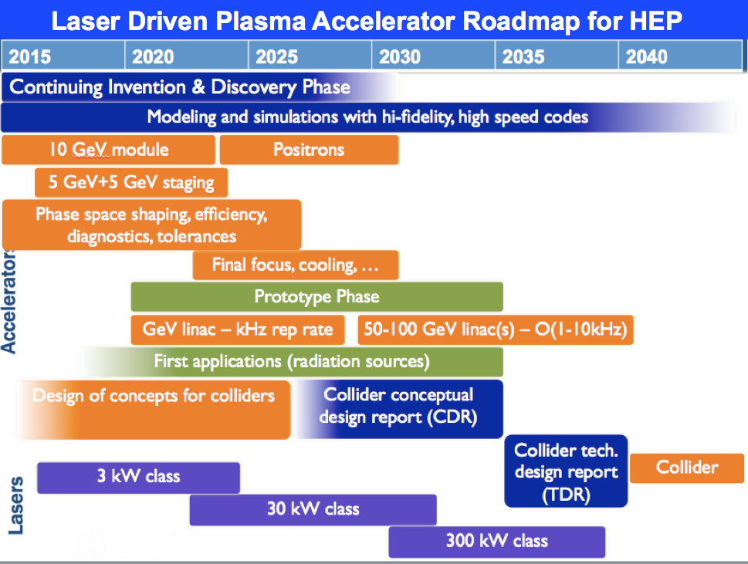
Advanced accelerator community developing roadmaps toward plasma-based collider
Laser-driven
Concepts of plasma-based colliders
Beam-driven
Esarey et al, Rev. Mod. Phys. (2009)
A. Seryi et al, SLAC-PUB-13766, 2009

Slide 10
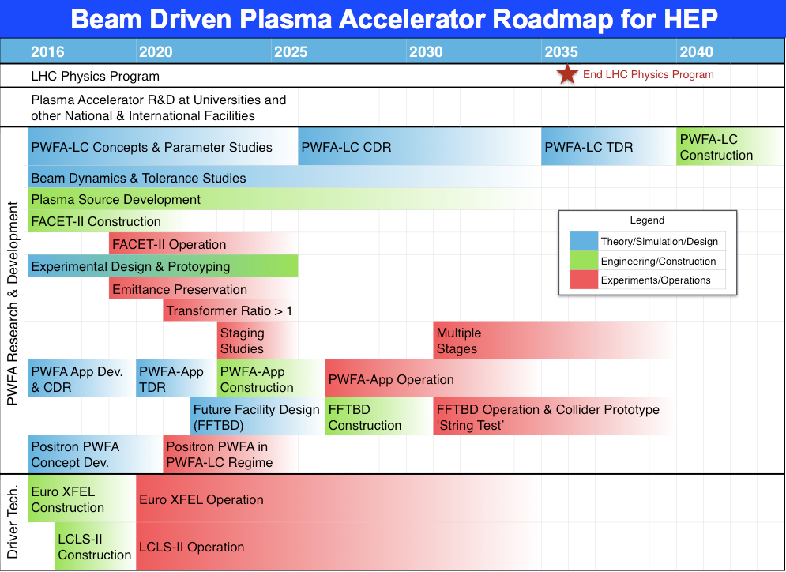
Advanced accelerator community developing roadmaps toward plasma-based collider
Laser-driven
Concepts of plasma-based colliders
Beam-driven
Esarey et al, Rev. Mod. Phys. (2009)
A. Seryi et al, SLAC-PUB-13766, 2009

Slide 11
Advanced accelerator community developing roadmaps toward plasma-based collider
Laser-driven
Concepts of plasma-based colliders
Beam-driven
Esarey et al, Rev. Mod. Phys. (2009)
A. Seryi et al, SLAC-PUB-13766, 2009

Slide 12
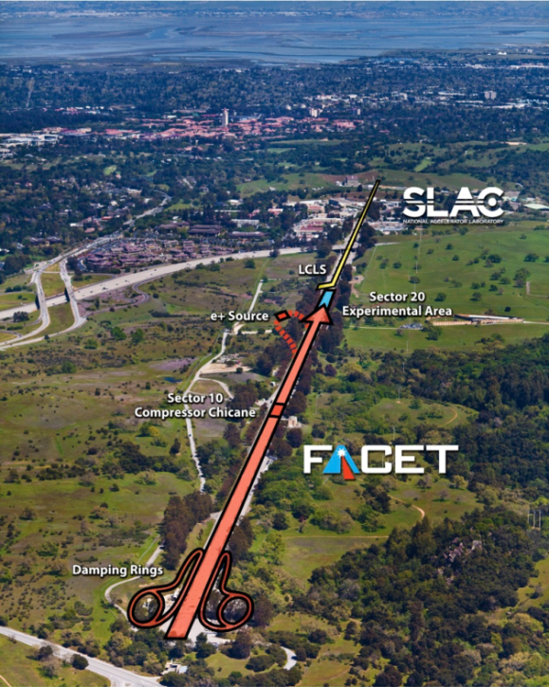
FACET plasma acceleration facility
20GeV, 3nC, 20µm³, e⁻ & e⁺
Primary Goal:
  Demonstrate a single-stage high-energy plasma accelerator for electrons
Timeline:
  CD-0 2008
  CD-4 2012, Commissioning (2011)
  Experimental program (2012-2016)
A National User Facility:
  Externally reviewed experimental program
  Per year: 200 Users, 25 experiments, 8 months operation
Key PWFA Milestones:
  Mono-energetic e⁻ acceleration
  High efficiency e⁻ acceleration (Nature 515, Nov. 2014)
  First high-gradient e⁺ PWFA (Nature 524, Aug. 2015)
  Demonstrate required emittance, energy spread
20GeV, 3nC, 20µm³, e⁻ & e⁺
Premier R&D facility for PWFA: Only facility capable of e+ acceleration
Vitaly Yakimenko and Mark Hogan, SLAC
Notes:
25 experiments 150 users – half time to PWFA
Key PWFA Milestones:
Mono-energetic e- acceleration
High efficiency e⁻ acceleration
First high-gradient e⁺ PWFA
Demonstrate required emittance, energy spread (FY16)

Slide 13
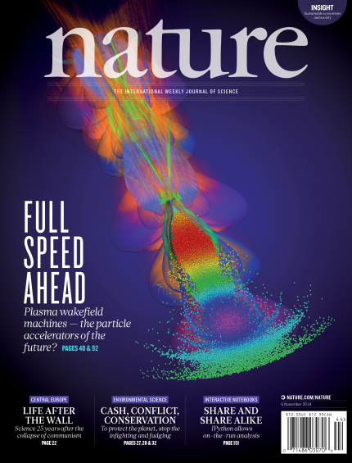

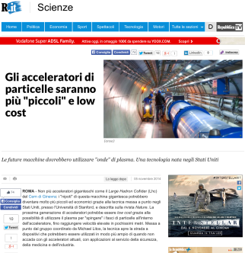
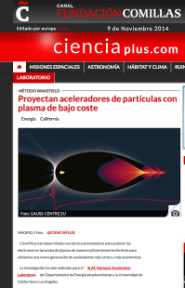
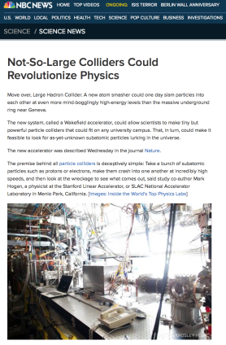
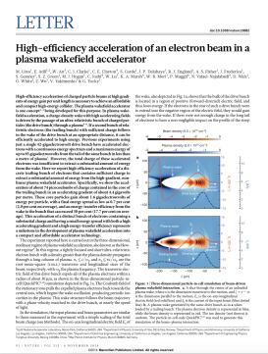
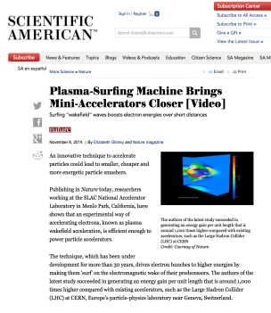
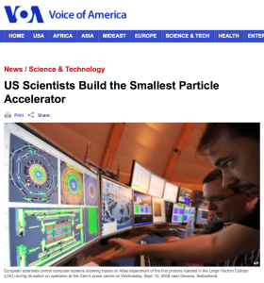
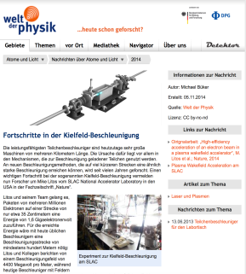
FACET: A National User Facility based on high-energy beams and their interaction with plasmas and lasers
Facility hosted more than 200 users, 25 experiments
One high profile result a year
Priorities balanced between focused plasma wakefield acceleration research and diverse user programs with ultra-high fields
Unique opportunity to develop future leaders
Notes:
Balance between PWFA & diverse community
FACET generates High impact results that reach into mainstream media and get picked up Nationally and Internationally
Expose a broad audience to accelerator science and beautiful physics enabled by accelerators

Slide 14
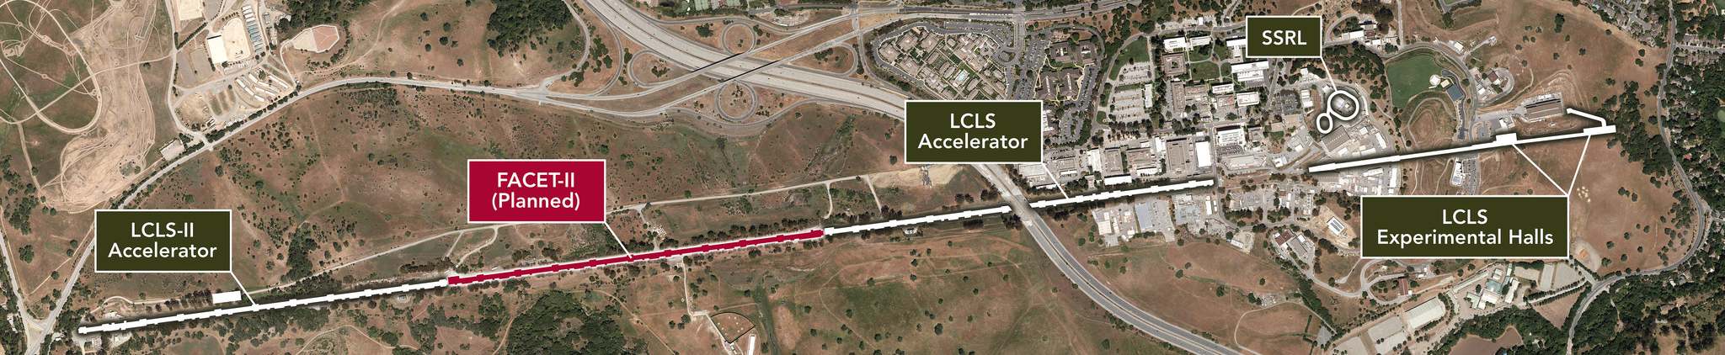
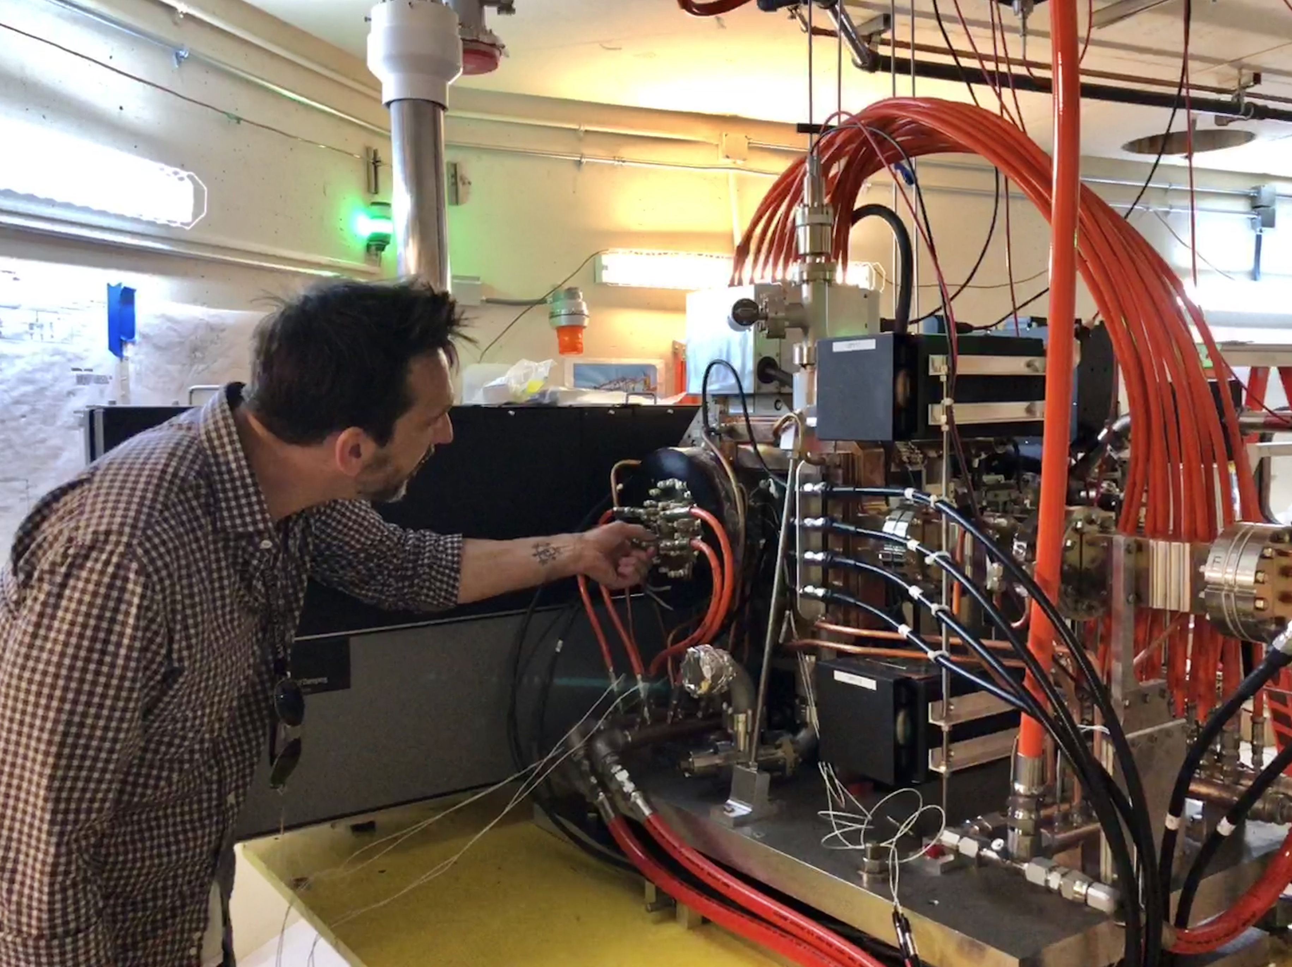
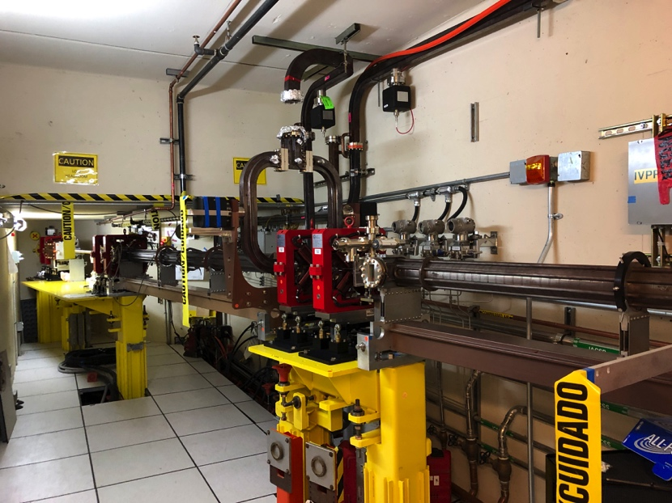
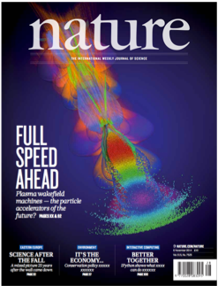
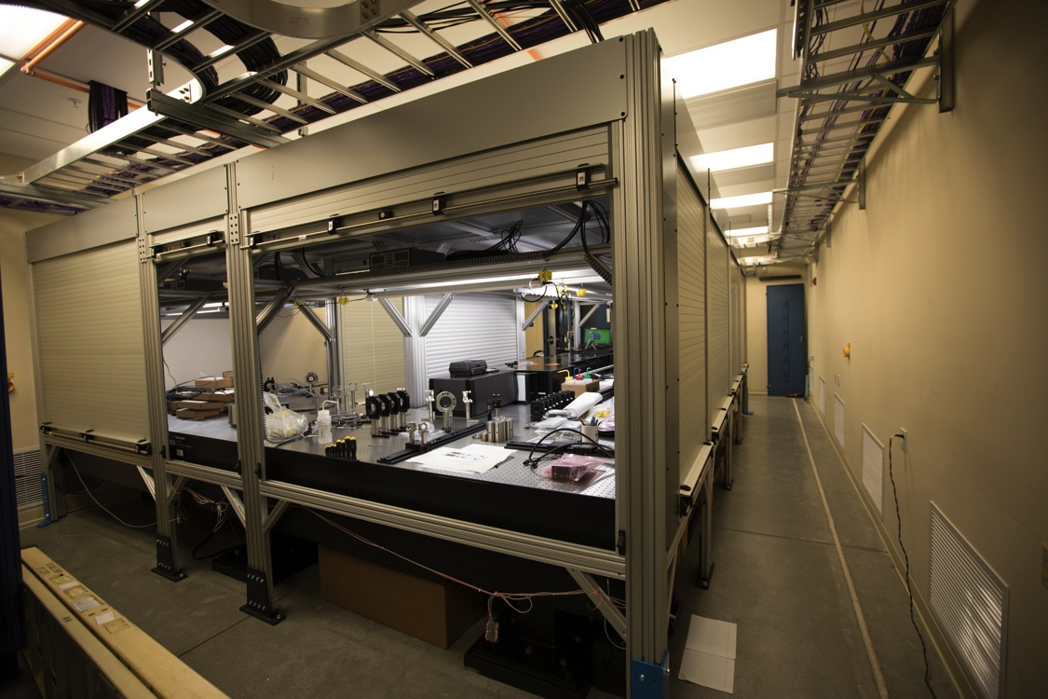
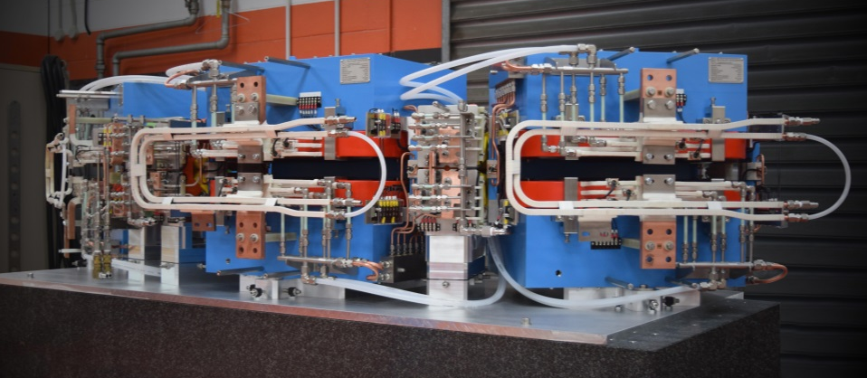
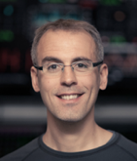
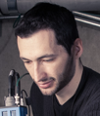
FACET-II:
Premier R&D facility for PWFA Following Success of FACET
10GeV, 5nC, 10µm³, e⁻ & e⁺
FACET-II Timeline:
  Nov. 2013, FACET-II proposal, Comparative review
  CD-0 Aug., 2015
  CD-1 Review Oct., 2015
  CD-2/3A Sep. 2016
  CD-4 2022
Four FACET researchers became professors
FACET-II will operate as a National User Facility
with experimental program between 2019 and 2026
Notes:
Pictures are: Mike Litos (Prof. Univ. of Colorado Boulder) Navid Vafaei-Najafabadi (Professor Stony Brook University)
Eric Adli (Prof. Univ. of Oslo); Sebastian Corde (Prof. Ecole Polytechnique),
3D design for positron damping arc magnets
S10 Injector AIP: Mechanics installing cooling water systems in S10 Injector vault; Racks installed in S10 gallery

Slide 15
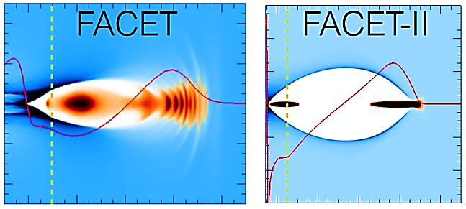
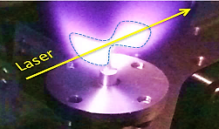
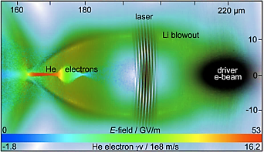
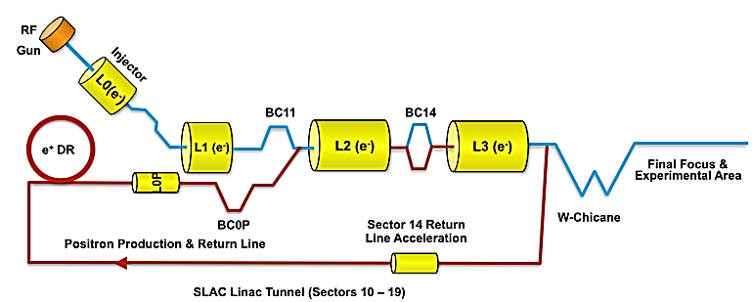
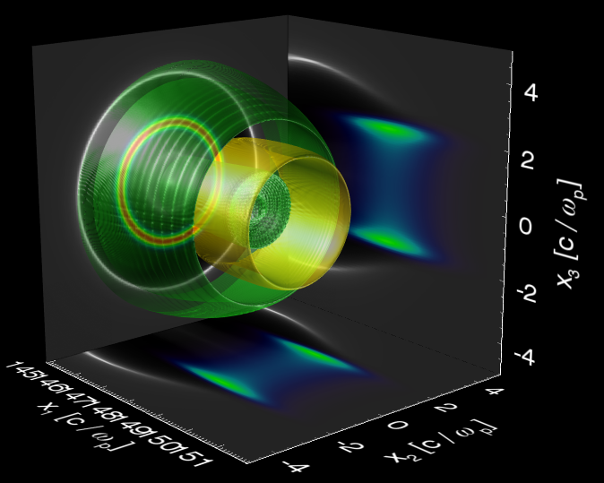
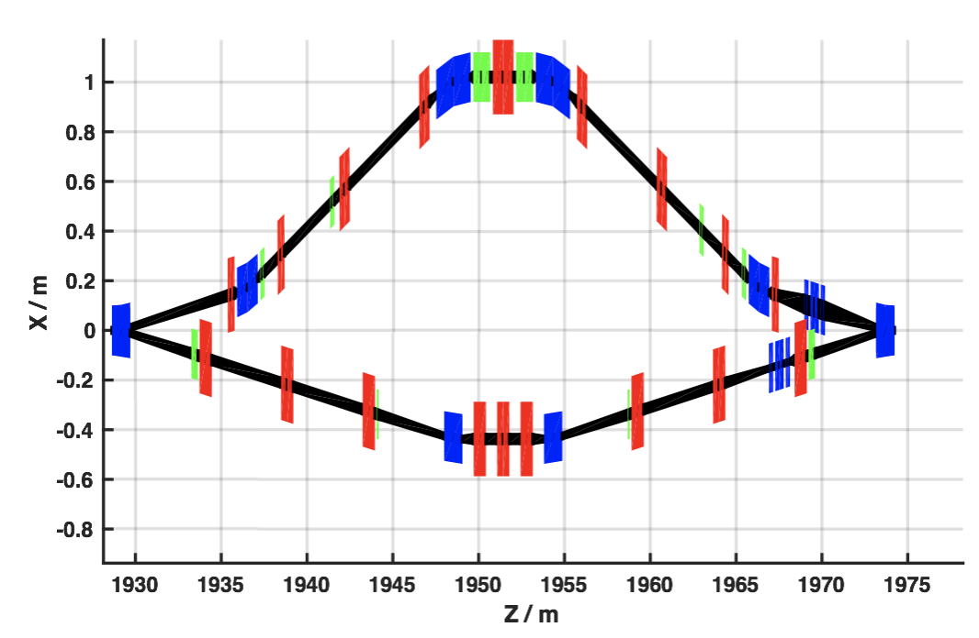
PWFA Research Priorities at FACET-II
Emittance Preservation with Efficient Acceleration
FY19-21
High Brightness Beam Generation & Characterization
FY20-22
High-gradient high-efficiency (instantaneous) acceleration has been demonstrated @ FACET
10’s nm emittance preservation is necessary for collider apps
Ultra-high brightness plasma injectors may lead to first apps
Full pump-depletion and Emittance preservation at µm level planned as first experiment
Stage 1
Stage 1
Positron Acceleration
FY21-24
Simultaneous Deliver of Electrons & Positrons
FY22-25
Only high-current positron capability in the world for PWFA research will be enabled by Phase II
Positron Acceleration on Electron Beam Driven Wakefields
Develop techniques for positron acceleration in PWFA stages
Stage 2
Stage 3
Substantial Growth of Science Program:
35 Proposals reviewed at 2018 Program Advisory Committee Meeting
Notes:
Gradual introduction of capabilities works well with level of demand for FACET-II

Slide 16

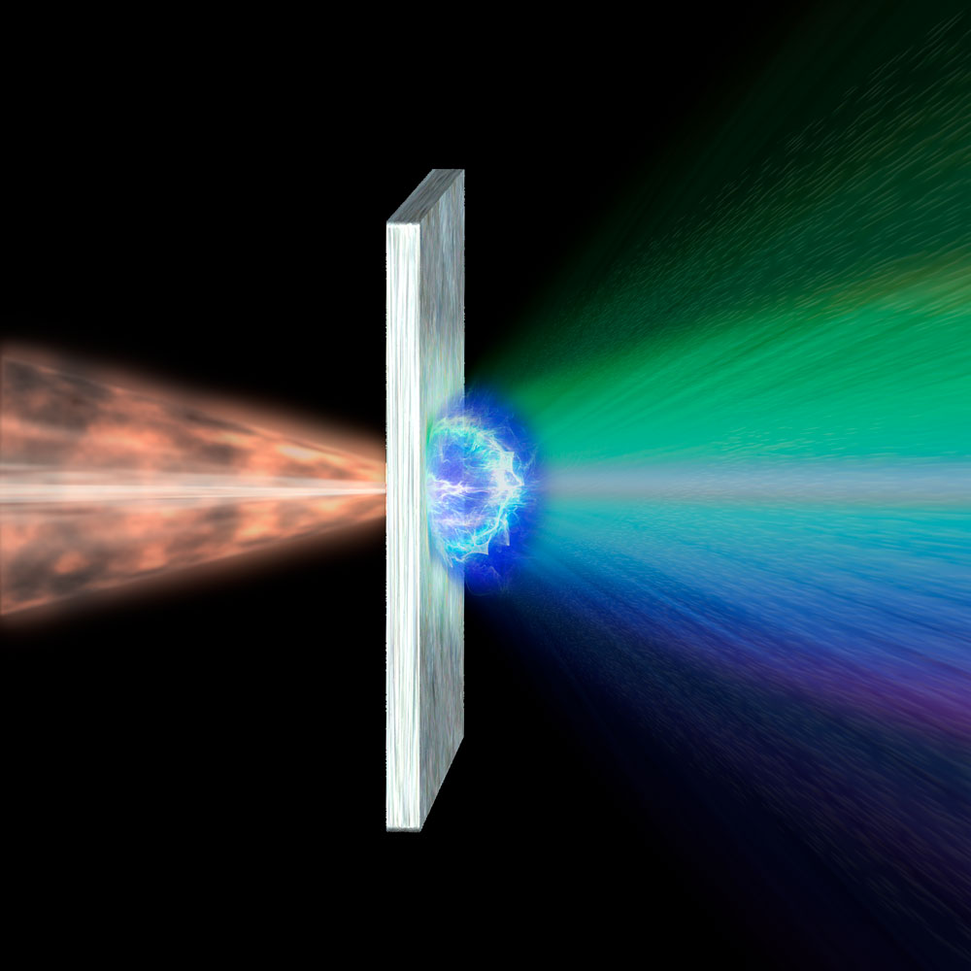
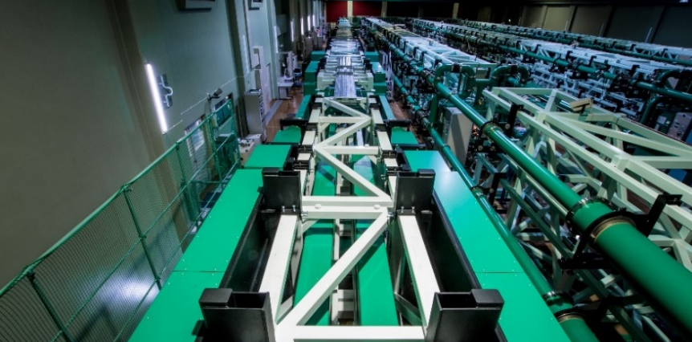
Laser-driven Ion acceleration at ILE, Osaka Univ.
A. Yogo et al, Sci. Rep. 7, 42451 (2017)
MV/µm
Laser
Ions
Thin foil
µm thickness
Multi-ps laser boosts ion acceleration by a nonlinear mechanism.
Ion acceleration from a µm-size field.
LFEX
Maximum Ion Energy at ILE: 52 MeV/u for protons
(A. Yogo et al, unpublished)
Multi-picosecond, Multi-beam laser achieving relativistic intensity
Pulse duration: 1-10 ps, Intensity ~10¹⁹ Wcm⁻², Pulse energy: 1 kJ
Akifumi Yogo, Institute of Laser Engineering, Osaka University

Slide 17
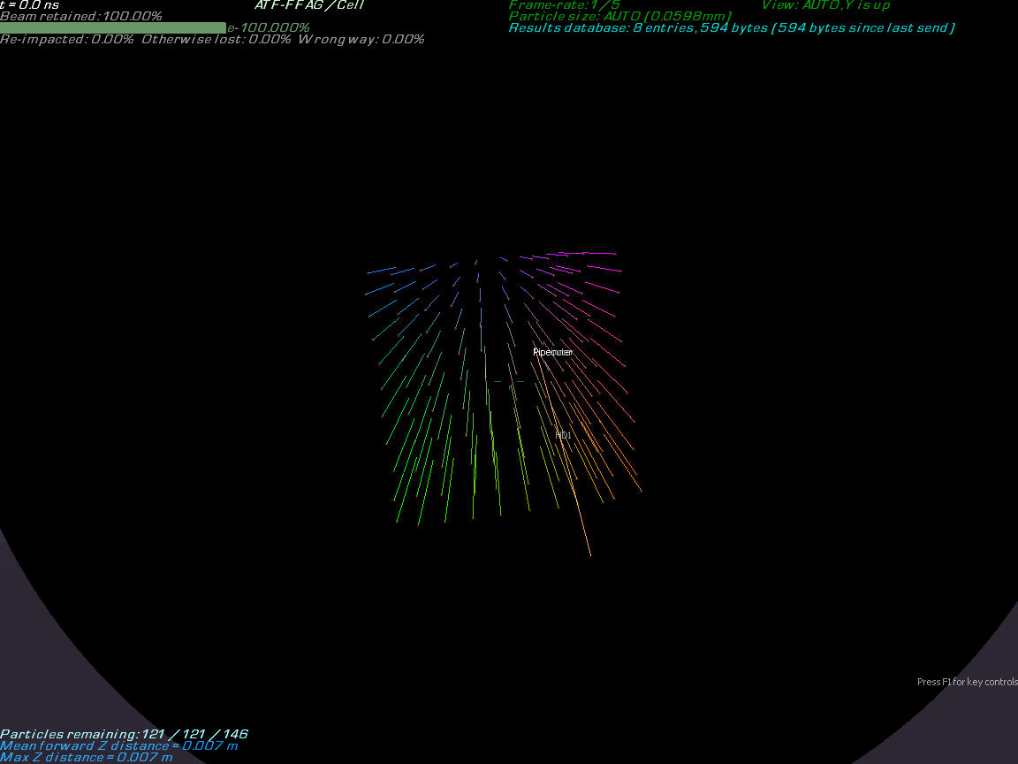
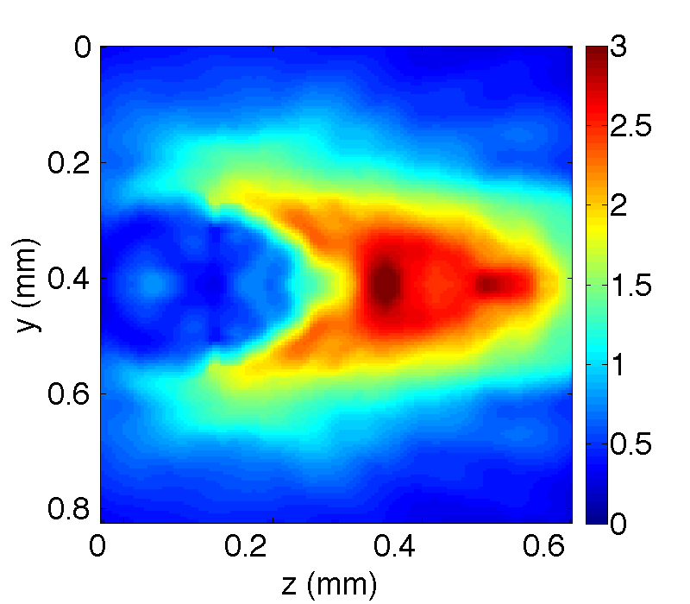
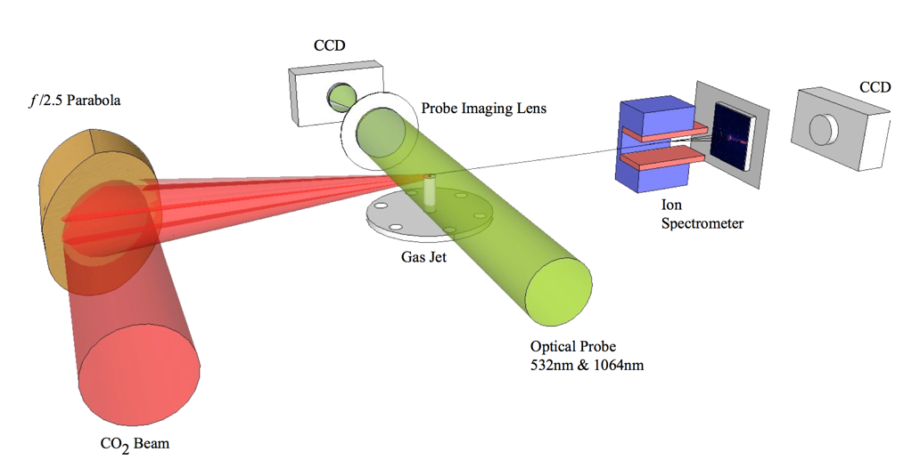
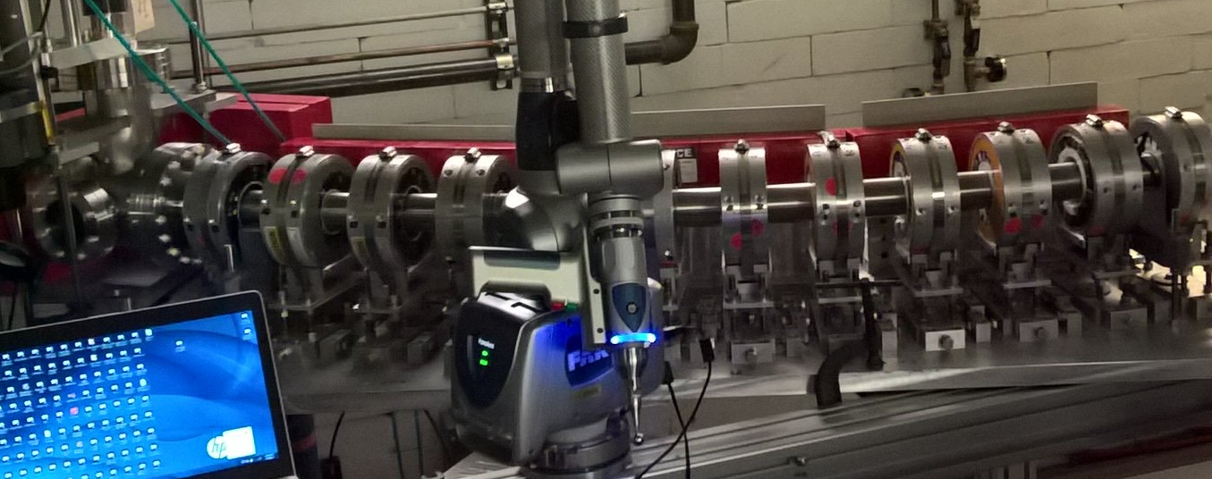
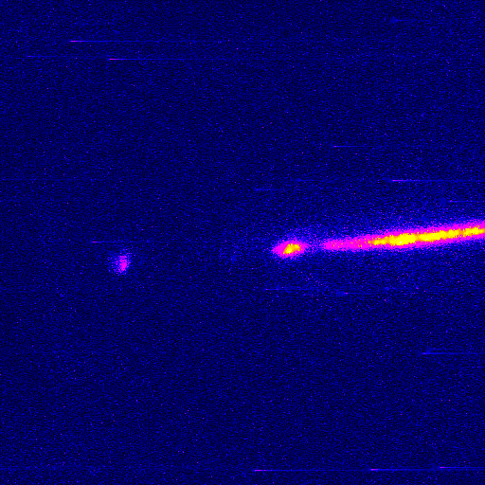
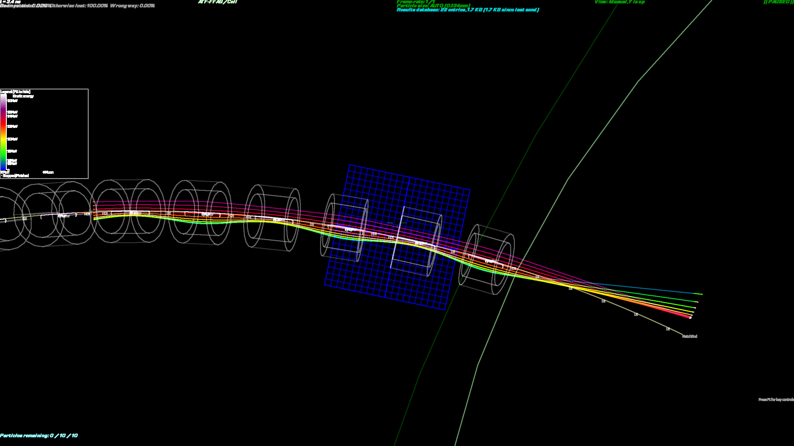
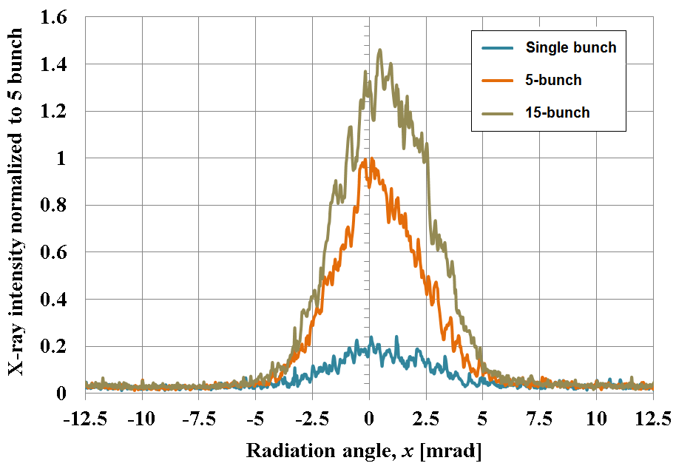
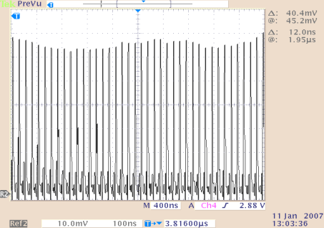
Brookhaven’s Accelerator Test Facility
Electron Beam Capability
Testing new technology for
advanced accelerators
LWIR Laser Capability
Shock Wave Ion Acceleration
laser
protons
LWFA
plasma
Combined Capabilities
Hydrogen
30∘ Arc Cell Test at the BNL-ATF
Transmission over 3.8x energy range
Intra-cavity ICS
AE-59
Radiabeam
DOE SBIR
AE-66
NRL, Imperial
College, ONR,
MURI
Multiplication of
x-ray yield by reusing a laser pulse multiple times
Zero point
3.2 MeV mono-energetic bunch
Thermal tail
Monoenergetic protons from supersonic H₂ jet via shock wave acceleration
Halbach Fixed Field Alternating Gradient Lattice now commissioning in CBeta, the Cornell-Brookhaven Electron Test Accelerator, ERL
Phys. Rev. Lett. 115, 9 (2015)
Applied Physics Letters
109, 253504 (2017)
Mark Palmer, BNL

Slide 18
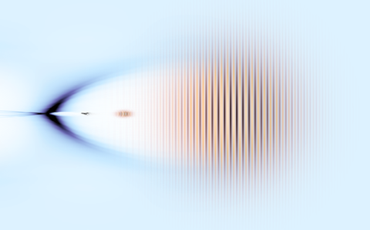
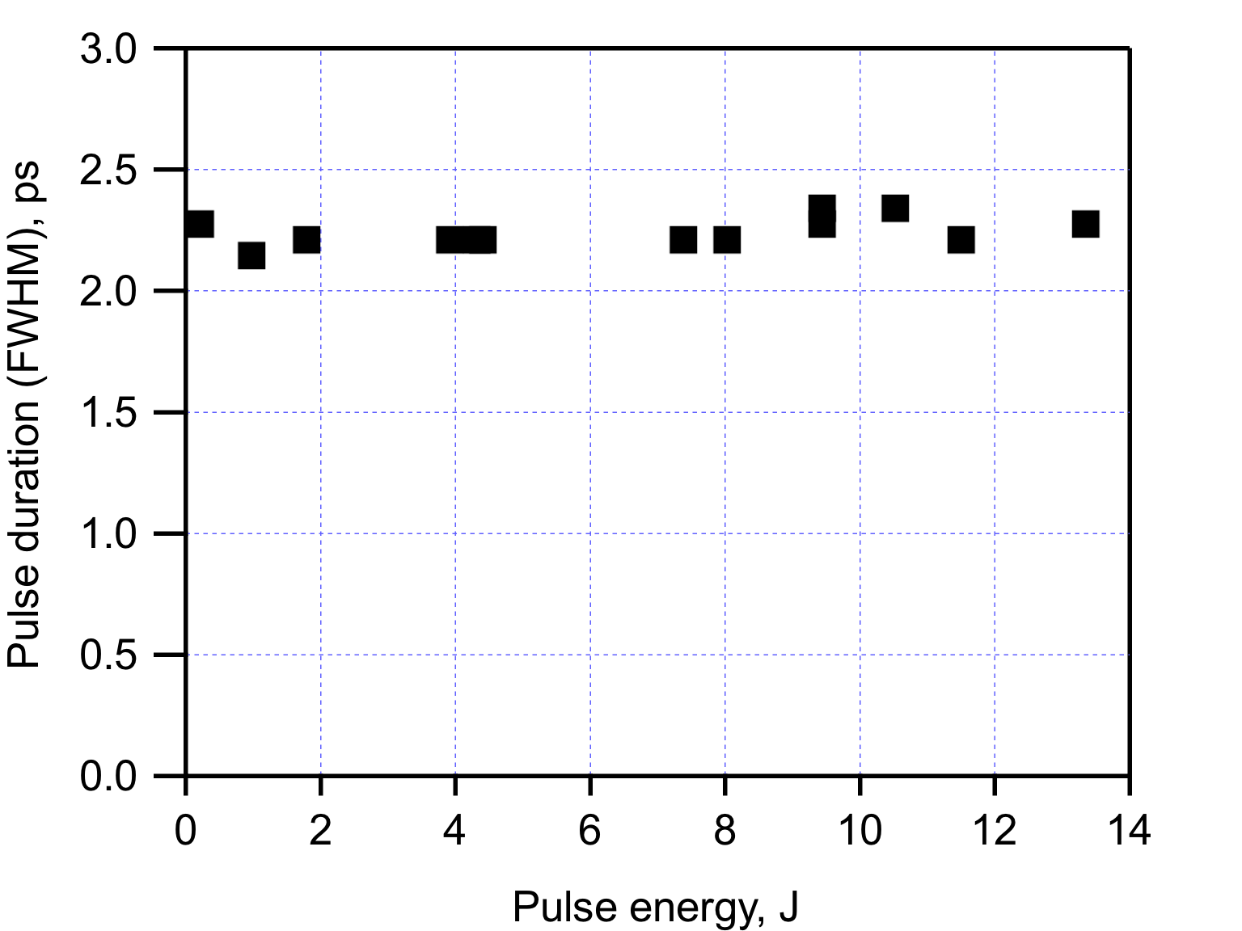
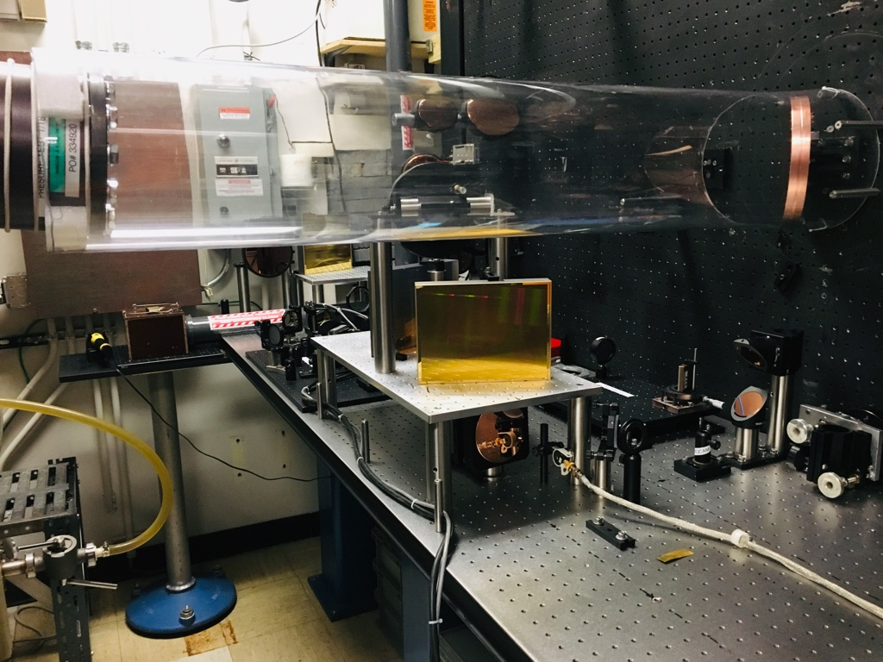
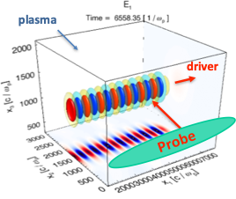
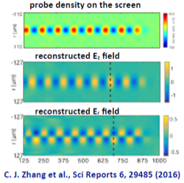
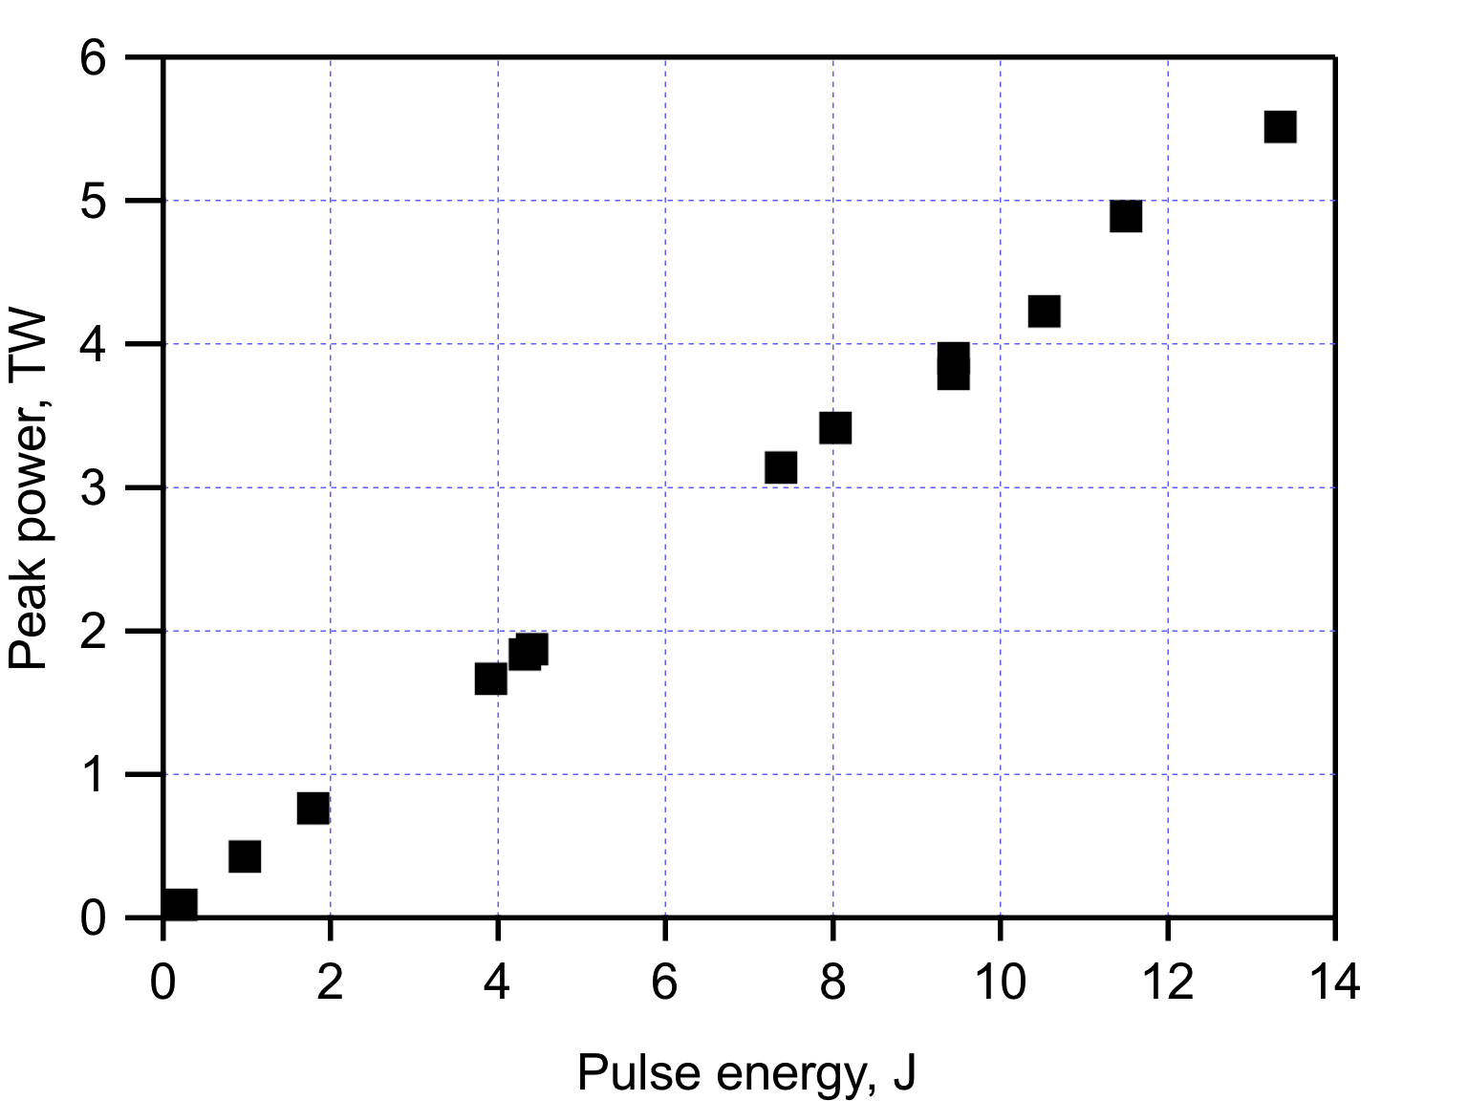




Brookhaven’s Accelerator Test Facility
Long Wavelength IR Laser (9.2 μm) Development
  Delivery of world-record 2.3 ps LWIR pulse
Program of improvements to provide 10s of Terawatts to enable unique LWFA research program and extend the reach of current experiments
  Improved gain media
  First full implementation of CPA in LWIR regime
  Technology Development
Combined with high ATF’s
high brightness electron
beam, it enables:
  Unique diagnostics
  External injection capabilities
LWFA Thrusts
AE-71 and successor experiments Self-modulated a Bubble Regime
Bubble:
>300 μm transverse dimension
>1 ps duration
Suitable for external injection studies (with ATF e-beam)
Suitable for 2-color ionization injection studies (AE-88)
Utilize ATF’s e-beam as a probe
Wei Lu
a₀ = 1.4
500 fs pulse
ρ = 1.1x10¹⁶ cm⁻³
March 2019: >5 TW

Slide 19
BELLA Center
BELLA PW being extended with second beamline (staging), high intensity IP (ions) projects
Two new 100 TW systems commissioned for Thomson and FEL photon sources
Potential collaboration in broad space of LPA, beam manipulation, and photon source physics
Cameron Geddes, BELLA, LBNL

Slide 20
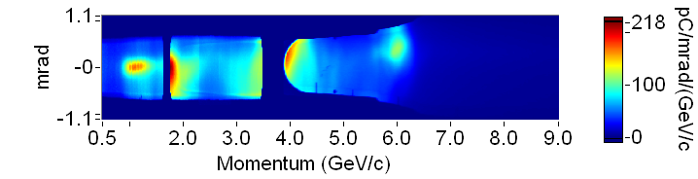
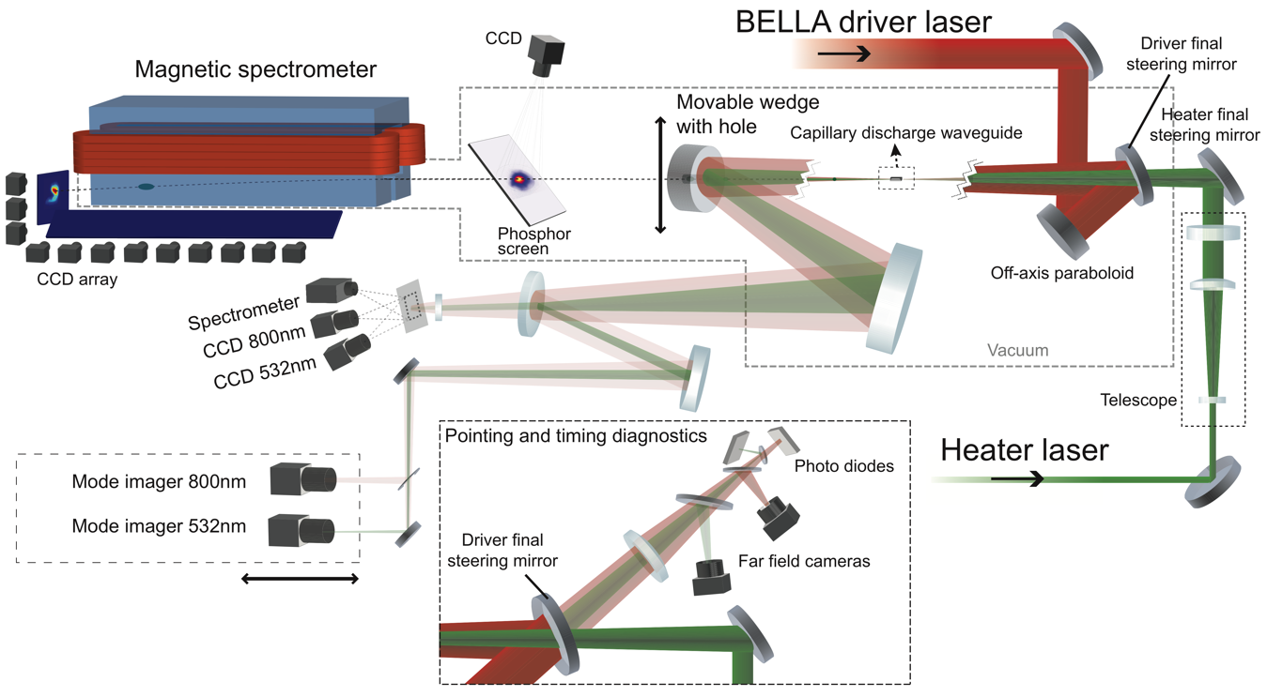

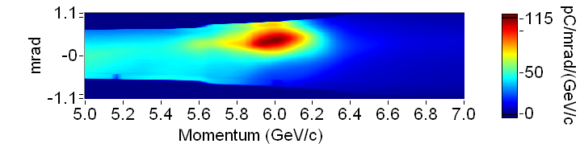

BELLA Center Research Highlights: Laser heated capillary plasma
Improved guiding allows 7.8 GeV, ~double previous 4.25 GeV record
Laser heater
added to capillary
Electron spectra, up to 6- 8 GeV
>210pC
)
~75pC of >210pC
)
Gonsalves et al., PRL 2019
Path to 10 GeV with continued improvement of guiding, in progress

Slide 21


J-KAREN-P Laser at KPSI, QST, JAPAN
0
0.54
r_{eff} = 1.0 μm
10 μm
30 m x 15 m
The focused intensity is ~ 10²² W/cm²
Ti: sapphire, double-CPA laser
OPCPA front-end
Contrast ratio: ~10⁻¹²@ns
0.1 Hz, 15-20 J, 30-40 fs
User facility, operated 4days/week
Measurement at 300 TW (10 wedges)
Strehl ratio = 0.46±0.6
A. Pirozhkov et al. Opt Express 25, 20486 (2017).
H. Kiriyama et al. Opt. Lett. 43, 2595 (2018).
H. Kiriyama et al. IEEE J. Sel. Top. Quant. 21, 232 (2015).
Tetsuya Kawachi, Kansai Photon Science Institute (KPSI), National Institutes for Quantum and Radiological Science and Technology (QST)
Pirozhkov et al. Symp. Photon Beam Sci. (2016)
Pirozhkov et al.“Approaching the diffraction-limited, bandwidth-limited Petawatt” (submitted)

Slide 22





One of application: Stable electron generation
Single-stage nonlinear laser wakefield acceleration at KPSI-QST
e-beam spatial profile
e-beam energy spectrum
2017 Run
E_{peak}=600 MeV
~mrad divergence
He+Ne or N₂ gas-jet
L=10mm
10 J, 40 fs
Laser
Recently, 1GeV, high charge is observed.
Multi-stage laser wakefield acceleration (with Osaka U, RIKEN,KEK, Tohoku U)
Observed
staging acc.
175 MeV

Slide 23

Efficient and Cost-Effective High-Gradient Normal Conducting Accelerators
Optimizing the cost of NCRF technology a fundamental requirement for its implementation for future facilities
Explore technology thrusts for major cost reduction
  RF source cost, RF source efficiency, temperature, frequency, RF structure performance
Tetsuo Abe and Toshiyasu Higo
@ KEK w/ SLAC Team
KEK Distribute Coupled Structure Test –
Implemented Feed Forward Waveform
Building on a Strong History of Collaboration with KEK
Understand the Impact on Advanced Collider Concept Enabled by the Goals Defined in the DOE GARD RF Decadal Roadmap
https://science.energy.gov/~/media/hep/pdf/Reports/DOE_HEP_GARD_RF_Research_Roadmap_Report.pdf
Sami Tantawi, Emilio Nanni, SLAC

Slide 24




Cryogenic-Copper Accelerating Structures: New Frontier for Beam Brightness, Efficiency and Cost-Capability
Increased conductivity and hardness enables higher gradients
Dramatic reduction in cost of system including cryogenics at 77K
2.5X less power establishing gradient allows for heavy beam loading even at high gradient – improving system efficiency
Cryostat w/ Structure
M. Nasr, S. Tantawi, E. Nanni, et el.,
T decrease
Operating Test Structure at Design Gradient
Increase in $Q_{0}$ by a factor of 2.5
Impact of novel structures and temperatures → order of magnitude increased performance

Slide 25



An Advanced NCRF Linac Concept for Future High Energy Accelerators
Cryomodule design developed for cryoplant layout to cool 24 MW/linac thermal load at 77K
Optimizing for C-band (5.712 GHz) linac design w/ ~90% Fill Factor
Shared nitrogen supply and return
~8.9m Cryomodule
Bane et al., ArXiv 1807.10195 (2018)
Moving Forward: Innovative NCRF Technologies Can Yield Major Advances in Cost-Capability

Slide 26



Advanced Accelerator R&D at the
Argonne Wakefield Accelerator (AWA) Facility
Argonne Wakefield Accelerator
Electron beam-driven wakefield acceleration (AAC)
  Structure WakeField Acceleration (SWFA)
    Two-beam Acceleration (TBA)
    Collinear Wakefield Acceleration (CWA)
  Plasma Wakefield Acceleration (PWFA)
Accelerator and Beam Physics (ABP)
  Longitudinal Bunch Shaping with Emittance Exchange (EEX)
  Damping Ring Free Linear Collider with flat beam and EEX.
Electron sources
  Novel photocathodes
  Novel field emission cathodes
drive beam
main beam
Ultra Carbon Nanocrystalline Diamond (UNCD)
John Power, ANL
Notes:
These are the 3 main areas of R&D by the Argonne Wakefield Accelerator group.

Slide 27

Development of dual-axis cavity for ERL applications
Jean Delayen and Subashini De Silva, JLAB and ODU

Slide 28







Advanced Accelerator R&D at the
Argonne Wakefield Accelerator (AWA) Facility
Argonne Wakefield Accelerator
I. Dielectric and hybrid structure R&D
- Dielectric-loaded structure:
Baseline design for Argonne Flexible Linear Collider (AFLC)
- Dielectric-disk structure:
Alternative design for AFLC
- High shunt impedance with high group velocity, ~50% efficiency improvement
- Simple geometry, low cost with moderate shunt impedance
J. Shao et al., to be submitted
C. Jing et al., AAC 2018
II. rf breakdown study for high gradient acceleration
In-situ field emission imaging
700 MV/m surface field
J. Shao et al., PRL 117, 084801 (2016)
J. Shao et al., PRL 115, 264802 (2015)
Notes:
These 2 AWA efforts are also under development in Japan. Effort I, on dielectric structures, is also being done by Satoh (reference#). Effort II is aligned with the ongoing effort at KEK on the development of high gradient metallic cavities.

Slide 29








Beam manipulations with relevance to future advanced linear colliders
Argonne Wakefield Accelerator
I. Longitudinal Bunch Shaping w/ EEX
Horizontal
triangle
y
G. Ha et al., PRAB 19, 121301 (2016)
G. Ha et al., PRL 118, 104801 (2017)
z
EEX
Longitudinal
triangle
Q. Gao et al., PRAB 21, 062801 (2018)
R. Roussel et al., NIMA 909, 130 (2018)
Q. Gao et al, PRL 120, 114801 (2018)
RFBT
II. Damping Ring Free w/ RFBT + EEX
Flat-beam generation in progress at AWA:
emittance ratio ~100 achieved at 1 nC.
Measured beam
after of RFBT
Notes:
AWA’s effort on 6D phase space manipulation (effort II) has funding from the US-Japan collaboration (for $20K in FY19) and includes four institutions: Argonne, NIU, KEK, and Hiroshima University.

Slide 30
Kiyoshi Kubo, Toshiyuki Okugi, KEK

Slide 31


IP beam size trend of ATF2 beam size
Minimum beam size at ATF2 IP
41.1±1.8 nm
ATF design beam size is 37 nm.
The beam jitter was subtracted
with FONT^{(*)} feedback
^{(*)} Feedback On a Nanosecond Time scale,
developing by Oxford Univ.
presented by Y. Kano and T. Okugi
at ECFA LC workshop 2016.
Kiyoshi Kubo, Toshiyuki Okugi, KEK

Slide 32
Source of intensity dependence of ATF2 IP beam size
Static wakefield effect
Generated by vacuum component misalignment
The effect can be reduced by fine tuning of beam orbit w.r.t. the component center.
Dynamic wakefield effect
Generated by orbit jitter in IP angle phase
even if the vacuum components are well aligned.
The effect can be reduced only by reduction of orbit jitter.
Orbit jitter will be small at ILC, with fast (bunch by bunch) feedback.
Kiyoshi Kubo, Toshiyuki Okugi, KEK

Slide 33

Electron Ion Collider – next collider in US
Requirements established in Community White Paper*, re-emphasized in 2015 NSAC LRP, and recent National Academies of Sciences report
Polarized ( ~70%) electrons, protons, and light nuclei
Ion beams from deuterons to the heaviest stable nuclei
Variable center of mass energies ~20-100 GeV, upgradable to ~140 GeV
High collision luminosity ~10³³⁻³⁴ cm⁻² s⁻¹
  “Factory”-like luminosity, factor of 100-1000 beyond HERA
Possibly have more than one interaction region
This will be definitely an advanced and novel collider
Taking the best from e+e- factories and hadron colliders, which will use advanced techniques (energy recovery, electron cooling)

Slide 34
Lessons from B factories - KEK B and PEP-II
When B factories design started ~1990, e+e- colliders barely reached 10³² cm⁻²s⁻¹
Aim: PEP-II and KEKB aimed in their design to luminosity of 0.3 – 1 x 10³⁴ cm⁻² s⁻¹
Approach: build-in necessary features to achieve high Lumi into the design
  Crossing angle and crab cavity; Local chromaticity correction; RF cavities and vacuum chamber compatible with ampere-scale beams; Bunch-by-bunch feedback; Continuous top-up injection
Result: fast start-up – achieve design Lumi in 1.5-3 years
with further efforts exceed design Lumi x2-4 times
Lesson for EIC:
  Despite of challenging requirements, it should be possible to design machine that will allow fast ramp-up to design luminosity
  Should set a goal to achieve EIC design Lumi soon after the start
  Necessary provisions/systems required for luminosity should be built-in into the design

Slide 35





US-Based EIC Proposals
Accelerator R&D going on with strong cooperation between several DOE labs under DOE NP guidance
Brookhaven Lab
Long Island, NY

Slide 36


EIC design features enabling high Lumi and high polarization
Crab crossing
Crossing angle and crab cavities
  Enables strong focusing at IP, control background
Hadron beam cooling
  Combat Intra-Beam Scattering, reduce and preserve emittance
Use of Siberian snakes or figure-8 topology
  Preserve high polarization of beams
Electron cooling & energy recovery
IBS
Factor γ in Δp

Slide 37
Electron Colling and energy recovery
Proton beam
Standard electron cooling use energy recovery
E.g., if we need 1A @ 1MeV electron beam, it does not mean we need 1 MW power supply
B
B
P
B
P
B
B
1A @ 50 kV
e-beam
U⁻
Cathode
Collector
1mA @ 1 MV
Energy recovery is even more important for high energy electron cooling
Fermilab 4.3MeV electron cooling system

Slide 38


CBETA, the 4-turn SRF ERL with an FFA return loop
CBETA has beam power and energy relevant for EIC cooling (6MW at 150MeV)
1) ERL operation for high-power beams
2) High-power beam propagation
3) High-brightness beam production
4) Low-emittance-growth beam propagation
Other ERL applications will benefit too
High-power FELs
Coherent light sources
Lithography for chip production
Compton backscattering sources
High energy colliders, e.g. LHeC
Georg Hoffstaetter, Cornell
cERL 125 MeV, KEK
Tsukasa Miyajima, KEK

Slide 39




Fully installed, from SRF linac to
permanent magnet FFA return loop

Slide 40






The compact ERL (cERL) at KEK
Compact ERL (cERL) has been constructed in 2013 at KEK to demonstrate energy recovery with low-emittance, high-current CW beams of more than 10 mA for future multi-GeV ERL.
Compact ERL (cERL)
Circumference: ~ 90 m
Beam Dump
Circumference ~ 90m
Main LINAC
Marger
9-cell SC cavity x 2
RF frequency= 1.3 GHz
17.7 MeV
Injector LINAC
Design parameters of the cERL
Nominal beam energy | 35 MeV → 20MeV
Nominal Injector energy | 5 MeV →2.9MeV
Beam current | 10 mA (initial goal) 100mA (final)
Normalized emittance | 0.1 ‒ 1 mm⋅mrad
Bunch length (bunch compressed) | 1-3ps (usual) 100fs (short bunch)
©Rey.Hori/KEK
2-cell SC cavity x 3
Photocathode DC gun
(Not SRF gun)
Buncher
Tsukasa Miyajima, KEK

Slide 41




IOTA/FAST Facility: a center for Acc. and Beam Physics
IOTA/FAST establishes a capability at FNAL, unique in the world, to address frontier topics in Accelerator and Beam Physics
~30 Collaborating institutions, including KEK and JPARC
Many opportunities for R&D:
  SC Linacs
  High-intensity proton rings
Integrable optics
Sergei Nagaitsev, FNAL

Slide 42

RHIC and Electron Cooling
RHIC: First run in 3-year Precision Au+Au Beam Energy Scan program
Beam Energy Scan II (2019-21):
  Low energy (√sNN = 7.7, 9.1, 11.5, 14.5, 19.6 GeV) Au+Au runs using electron cooling to increase luminosity
Berndt Mueller, BNL

Slide 43

Low-Energy RHIC electron Cooler (LEReC) at BNL:
first e-cooler based on the RF acceleration of e-beam.
Commissioning of cooling of Au ions in RHIC started in March of 2019.
Observation of first cooling using bunched electron beam on April 5, 2019.
Cooling using bunched electron beam produced with RF acceleration is new, and opens the possibility of electron cooling at high beam energies.
Many challenges still remain to make such new cooling technique operational in RHIC.
Alexei Fedotov, BNL

Slide 44


Predictions made in 1968 for the year 2000, examples:
F
U
T
U
R
E
58- Chemical methods for improving memory and learning
67- Commercial extraction of oil from shale
81- Personal “pagers” and perhaps even two-way pocket phones
99- Artificial moon for lighting large areas at night
~✓
1- Multiple applications of lasers for sensing, communication, cutting, welding…
31- Some control of weather and/or climate
35 – human hibernation for extensive periods (months to years)
✓
✓
✓
Some predictions were accurate, some not
“The Year 2000”, 1968
K. Herman, A. Wiener
ISBN 978-0025604407

Slide 45


Predictions in the spirit of “The Year 2000”
The Year 2051: FEL evolution forecast
Past
Present
Future
10 m
1 m ?
2 km
Laser-Plasma X-rays
FEL
Laser-Plasma FEL
FEL will be so compact and developed that it can become part of another system, and that system in turn part of super-system
“The Year 2000”, 1968
K. Herman, A. Wiener
ISBN 978-0025604407

Slide 46

Predictions in the spirit of “The Year 2000”
The Year 2051: FEL evolution forecast
“The Year 2000”, 1968
K. Herman, A. Wiener
ISBN 978-0025604407
Laser plasma FEL is part of super-system where it analyses proteins synthesized by molecular machine, while the entire super-system produces patient-tailored molecular machines for DNA repair

Slide 47
Predictions in the spirit of “The Year 2000”
The Year 2051:
Plasma acceleration integrated to HEP machines
Advanced accelerating structures are ubiquitous in scientific and industrial applications
Advanced methods (cooling, energy recovery, beam manipulation) employed in colliders such as EIC, taking it to unprecedented level of performance
Advanced methods (cooling, optics, beam manipulations) allow to make two orders of magnitude jumps in peak current, time resolution, emittance, stability
“The Year 2000”, 1968
K. Herman, A. Wiener
ISBN 978-0025604407

Slide 48

“The greater danger for most of us lies not in setting our aim too high and falling short; but in setting our aim too low, and achieving our mark”
Michelangelo
Thank you for your attention!
Thanks to many colleagues for materials for this talk!

