Slide 1
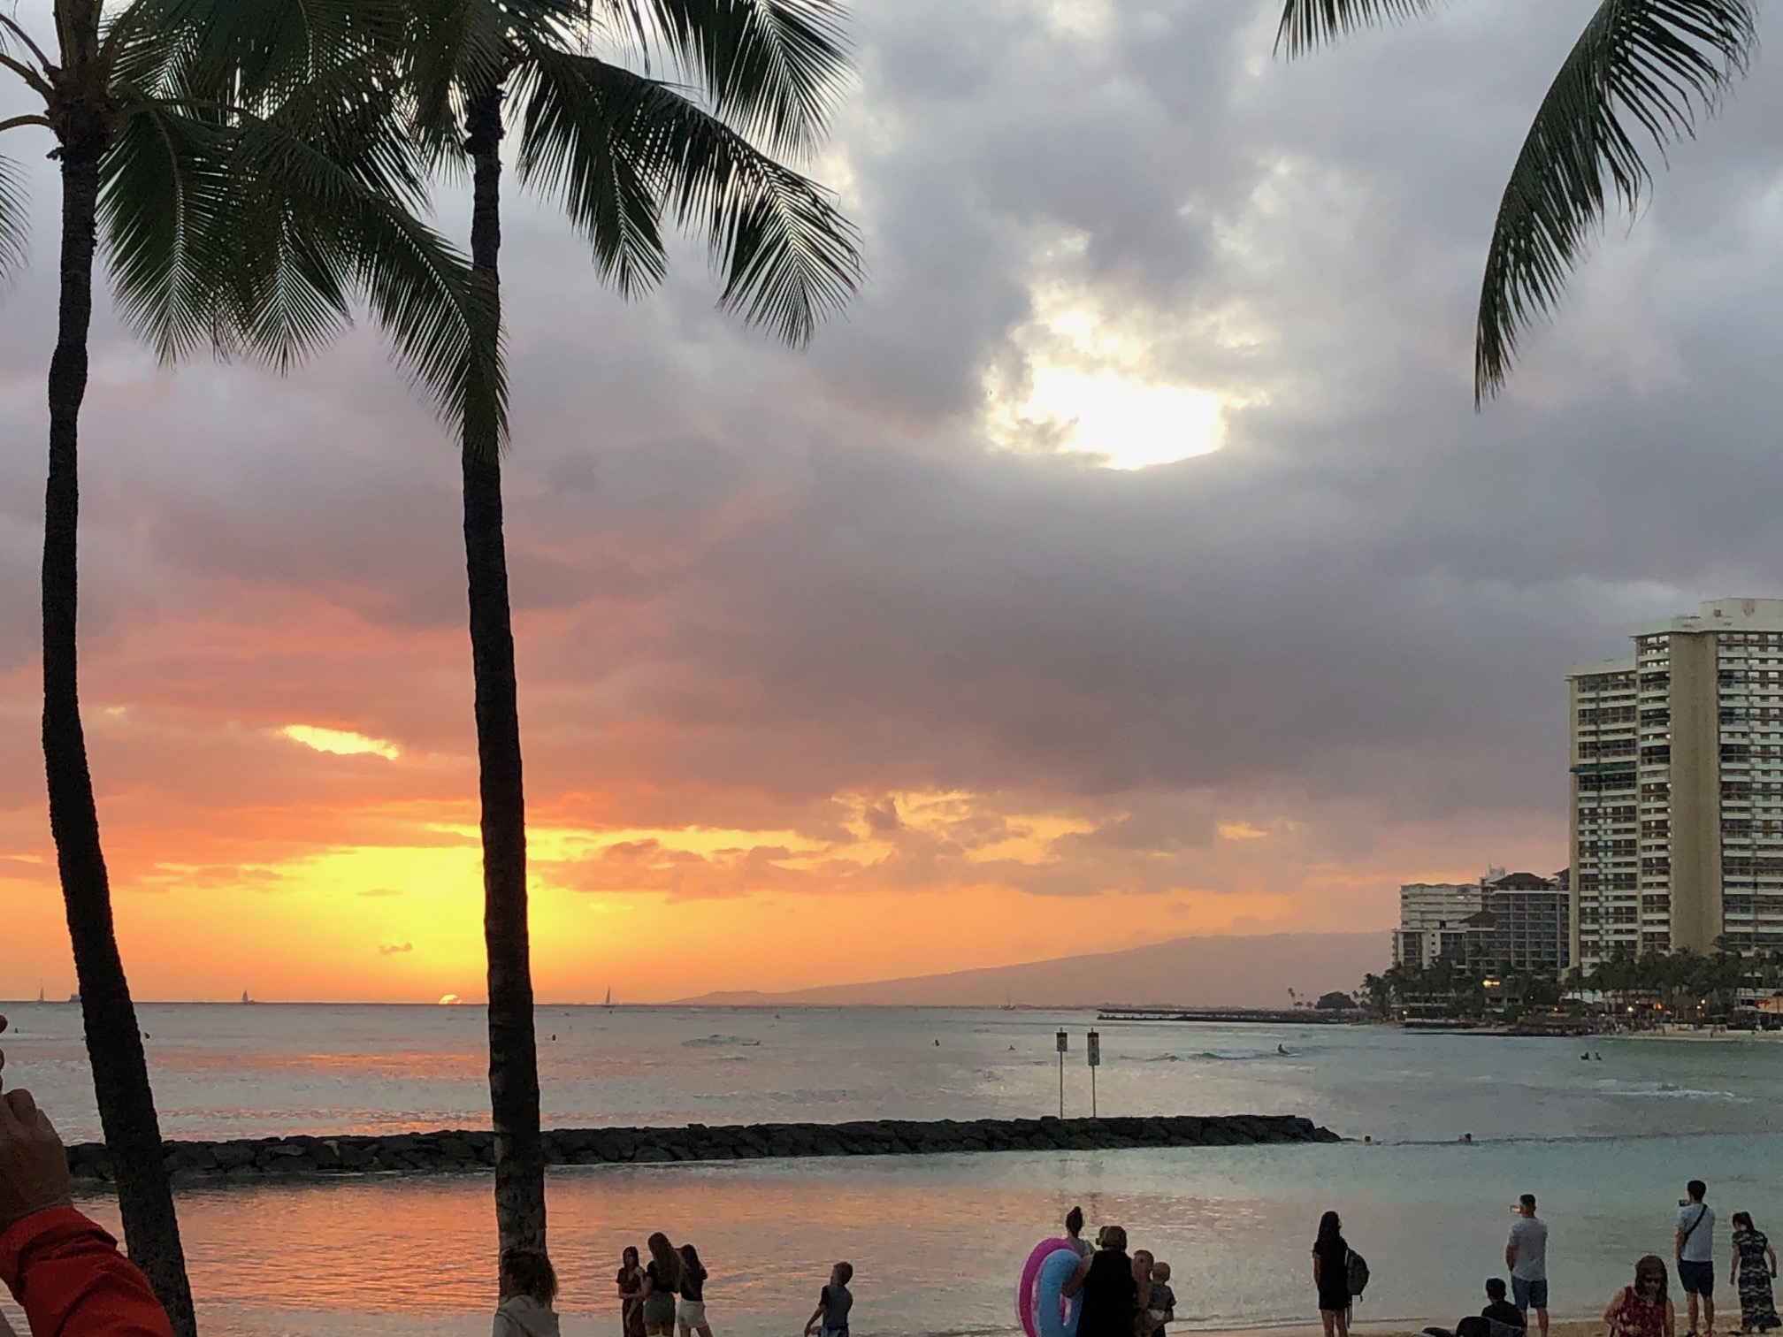
PROSPECT OF
Long Baseline
NEUTRINO Oscillation
EXPERIMENTS
A.K.Ichikiawa, Kyoto University
Notes:
質疑込みで45分。

Slide 2
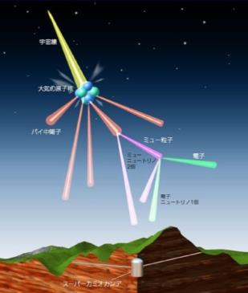
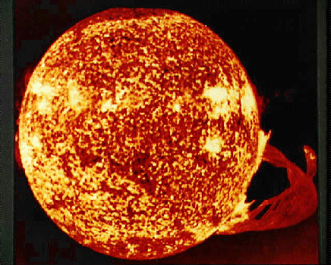
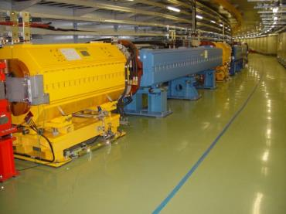
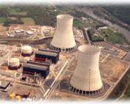

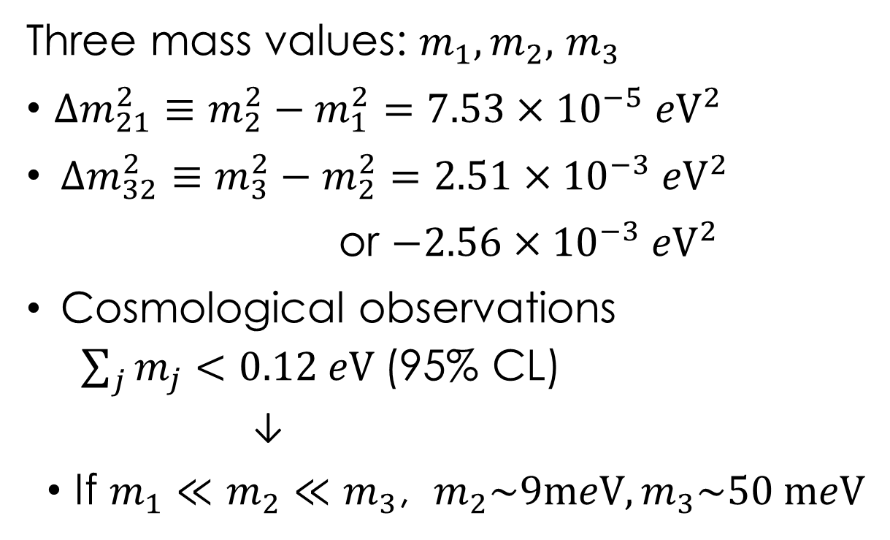



What we know about neutrino mass
Three mass values: $m_{1},m_{2},$ $m_{3}$
$Δm_{21}^{2}≡m_{2}^{2}−m_{1}^{2}=7.53×{10}^{−5} {e\text{V}}^{2}$
$Δm_{32}^{2}≡m_{3}^{2}−m_{2}^{2}=2.51×{10}^{−3} {e\text{V}}^{2}$
or $−2.56×{10}^{−3} {e\text{V}}^{2}$
Cosmological observations
  $\sum_{j}{m_{j}<0.12 e\text{V} }$(95% CL)
  ↓
If $m_{1}≪m_{2}≪m_{3}$, $m_{2}\sim 9\text{m}e\text{V}, m_{3}\sim 50 \text{m}e\text{V}$
Atmospheric
$ν_{μ}$/ ${\overline{ν}}_{μ}$ /$ν_{e}$/ ${\overline{ν}}_{e}$
Solar $ν_{e}$
Accelerator $ν_{μ}$/ ${\overline{ν}}_{μ}$
Reactor ${\overline{ν}}_{e}$

Slide 3
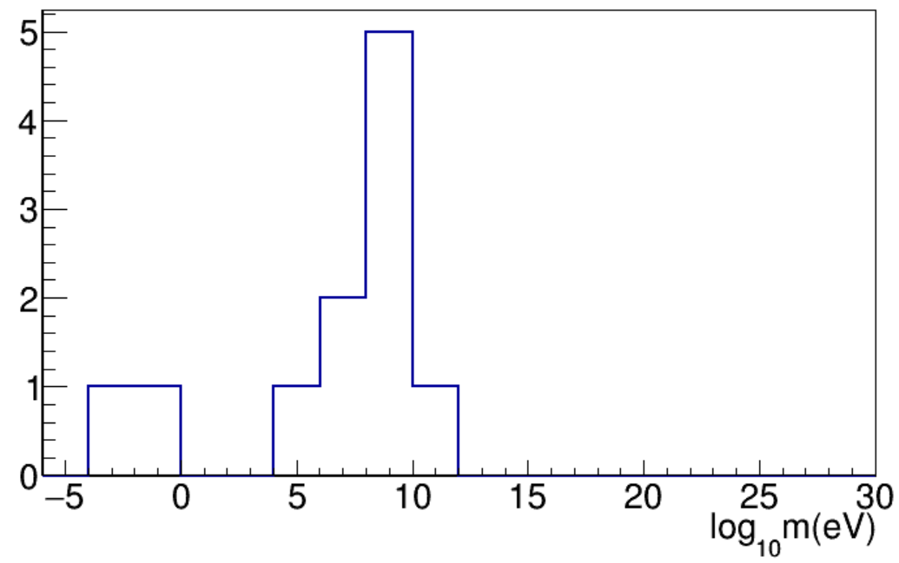
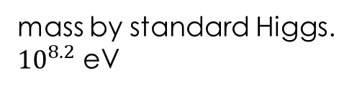
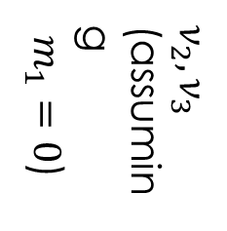


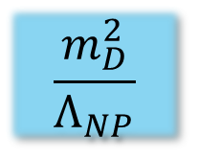



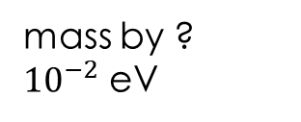
Neutrino mass
is suppressed by very high energy physics?
mass by ?
${10}^{−2}$ eV
mass by standard Higgs.
${10}^{8.2}$ eV
mass by Higgs
$$\frac{m_{D}^{2}}{Λ_{NP}}$$
$$s,μ,c,τ,b$$
$ν_{2},ν_{3}$
(assuming
$m_{1}=0$)
Higgs
Planck
$N_{R}$?
GUT?
$$u,d$$
$$e$$
$$t$$

Slide 4
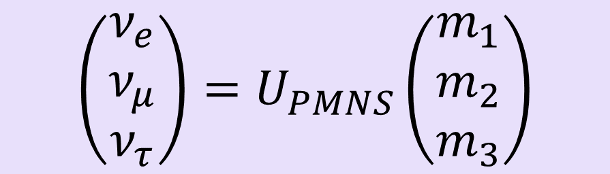
Mixing between flavor and mass
Flavor eigenstates Mass eigenstates
$$\left(\begin{matrix}ν_{e} \\ ν_{μ} \\ ν_{τ}\end{matrix}\right)=U_{PMNS}\left(\begin{matrix}m_{1} \\ m_{2} \\ m_{3}\end{matrix}\right)$$

Slide 5
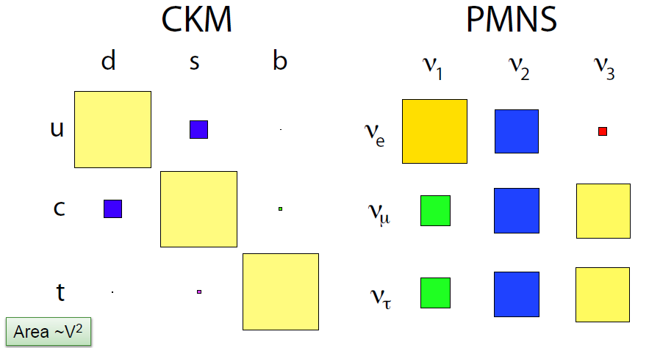
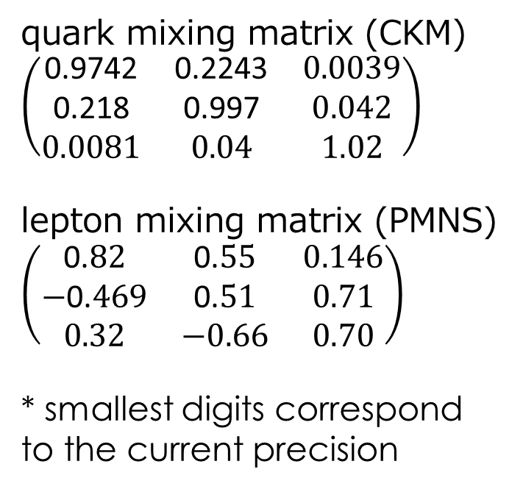
What we know about mixing
quark mixing matrix (CKM)
$\left(\begin{matrix}\text{0.9742} & \text{0.2243} & 0.0039 \\ \text{0.218} & \text{0.997} & 0.042 \\ 0.0081 & 0.0\text{4} & 1.02\end{matrix}\right)$
lepton mixing matrix (PMNS)
$$\left(\begin{matrix}\text{0.}82 & \text{0.}55 & 0.146 \\ \text{−}\text{0.}469 & \text{0.}51 & 0.71 \\ 0.32 & −0.66 & 0.70\end{matrix}\right)$$
* smallest digits correspond
to the current precision
mass eigenstate
S. Stone, ICHEP2012
weak partner

Slide 6
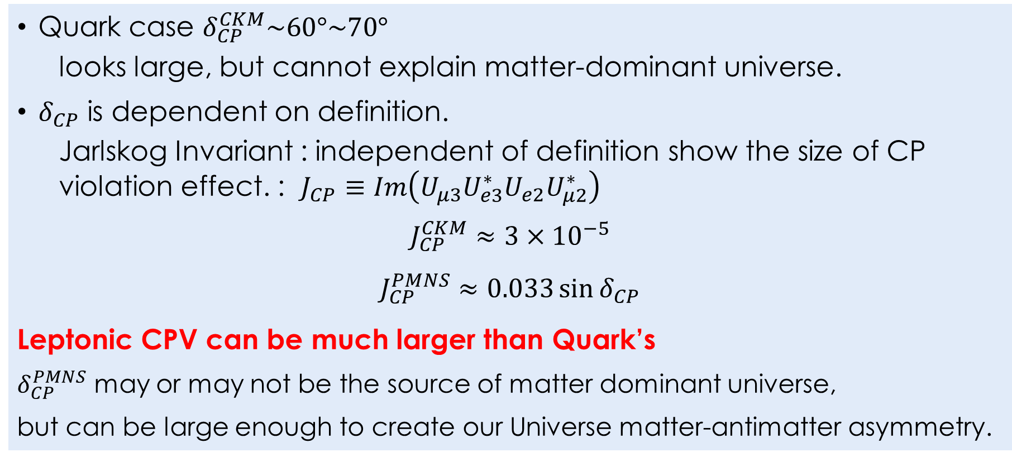
Dirac CP phase, source of CPV
Quark case $δ_{CP}^{CKM}\sim 60°\sim 70°$
  looks large, but cannot explain matter-dominant universe.
$δ_{CP}$ is dependent on definition.
  Jarlskog Invariant : independent of definition show the size of CP violation effect. : $J_{CP}≡Im\left(U_{μ3}U_{e3}^{∗}U_{e2}U_{μ2}^{∗}\right)$
$$J_{CP}^{CKM}≈3×{10}^{−5}$$
$$J_{CP}^{PMNS}≈0.033\sin{δ_{CP}}$$
Leptonic CPV can be much larger than Quark’s
$δ_{CP}^{PMNS}$ may or may not be the source of matter dominant universe,
but can be large enough to create our Universe matter-antimatter asymmetry.

Slide 7
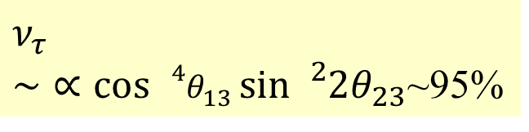
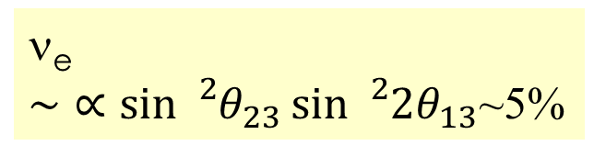



Oscillations peculiar to the long baseline experiment
$$ν_{μ}$$
ν_{μ} disappearance $∼∝\sin{{}_{}^{2}{2θ_{23}}}\sim 1$00% at right energy
ν_{e}
$\sim ∝\sin{{}_{}^{2}{θ_{23}}}\sin{{}_{}^{2}{2θ_{13}}}$~5%
$ν_{τ}$
$\sim ∝\cos{{}_{}^{4}{θ_{13}}}sin{{}_{}^{2}{2θ_{23}}}$~95%
$$ν_{e}$$
$$ν_{τ}$$

Slide 8
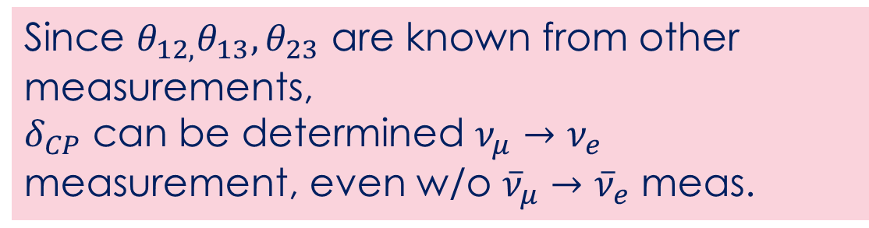

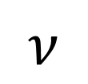
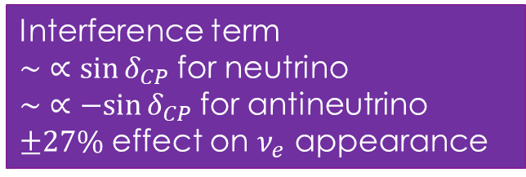
Oscillations peculiar to the long baseline experiment
Since $θ_{12,}θ_{13}, θ_{23}$ are known from other measurements,
$δ_{CP}$ can be determined $ν_{μ}→ν_{e}$ measurement, even w/o ${\overline{ν}}_{μ}→{\overline{ν}}_{e}$ meas.
$$ν_{μ}$$
ν_{μ} disappearance $∼∝\sin{{}_{}^{2}{2θ_{23}}}\sim 1$00% at right energy
ν_{e}
$\sim ∝\sin{{}_{}^{2}{θ_{23}}}\sin{{}_{}^{2}{2θ_{13}}}$~5%
$ν_{τ}$
$\sim ∝\cos{{}_{}^{4}{θ_{13}}}sin{{}_{}^{2}{2θ_{23}}}$~95%
$$ν$$
$$\overline{ν}$$
$$ν_{e}$$
$$ν_{τ}$$
Interference term
$\sim ∝\sin{δ_{CP}}$ for neutrino
$\sim ∝−sin{δ_{CP}}$ for antineutrino
$±27\%$ effect on $ν_{e}$ appearance

Slide 9

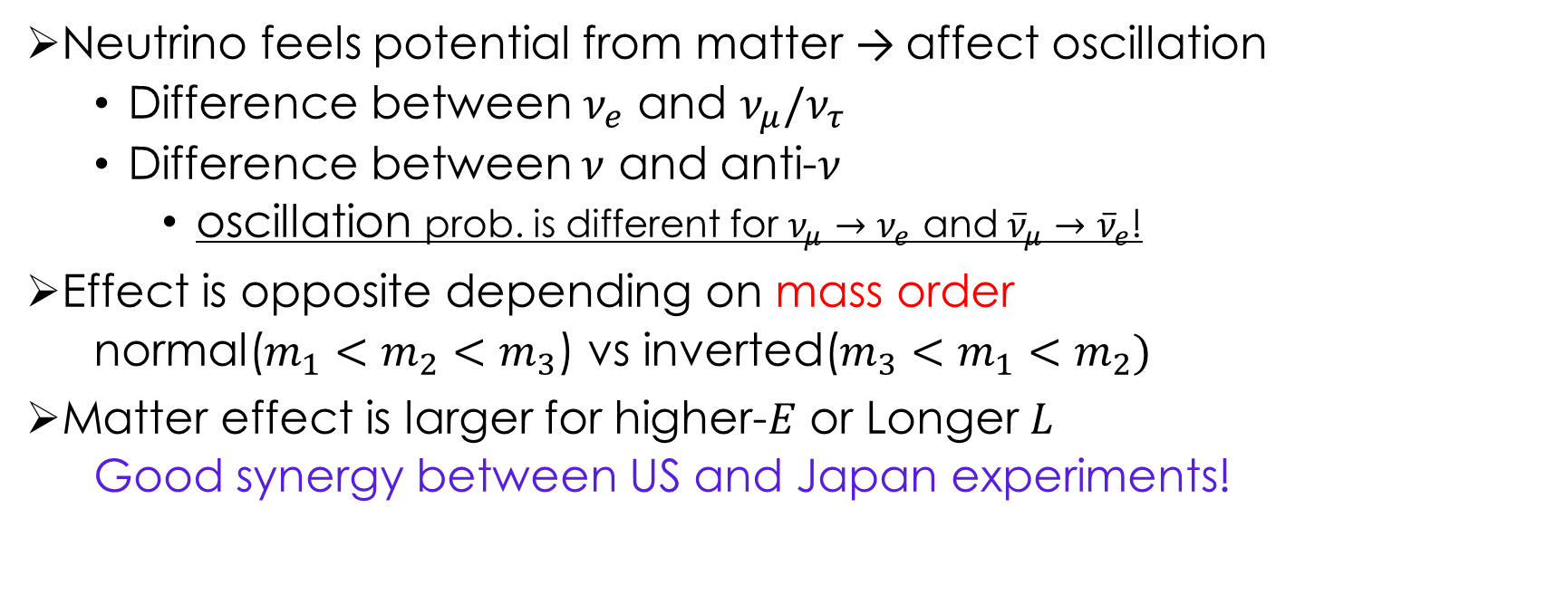
Some complexity from matter effect
“Earth is not symmetric about flavor nor CP”
Neutrino feels potential from matter → affect oscillation
  Difference between $ν_{e}$ and $ν_{μ}/ν_{τ}$
  Difference between $ν$ and anti-$ν$
    oscillation prob. is different for $ν_{μ}→ν_{e}$ and ${\overline{ν}}_{μ}→{\overline{ν}}_{e}$!
Effect is opposite depending on mass order
  normal($m_{1}<m_{2}<m_{3}$) vs inverted($m_{3}<m_{1}<m_{2})$
Matter effect is larger for higher-$E$ or Longer $L$
  Good synergy between US and Japan experiments!
Super-Kamiokande
J-PARC
1,700 m below sea level
Neutrino Beam
295 km

Slide 10
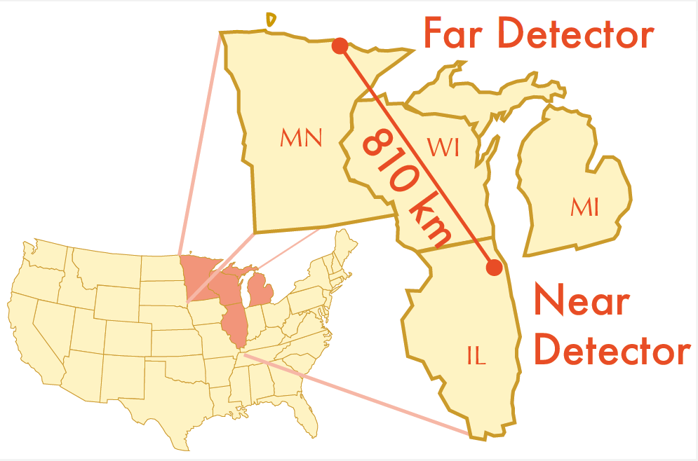
Running Accelerator long baseline experiments
T2K and NOvA
T2K
since 2009
NOvA
since 2014
Matter effect ~10% for T2K and ~30% for NOvA
(Important to resolve degeneracies)

Slide 11
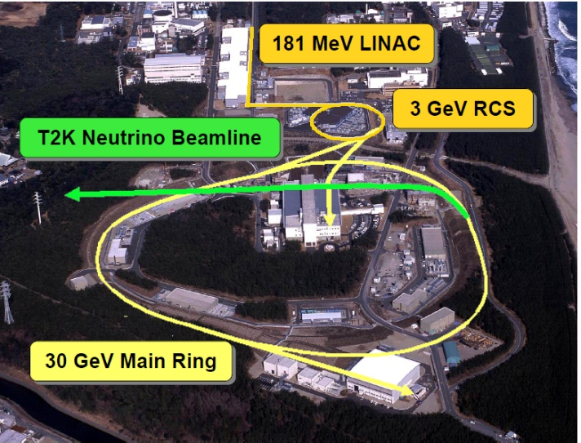
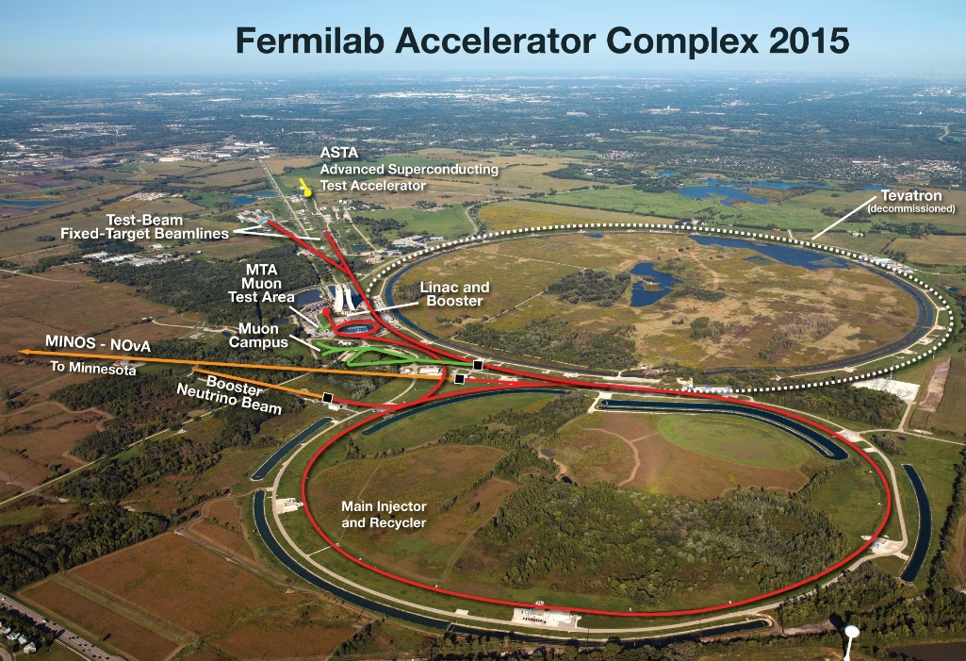
Running Accelerator long baseline experiments
T2K and NOvA
T2K
NOvA
J-PARC
120GeV
~500kW
~750kW

Slide 12
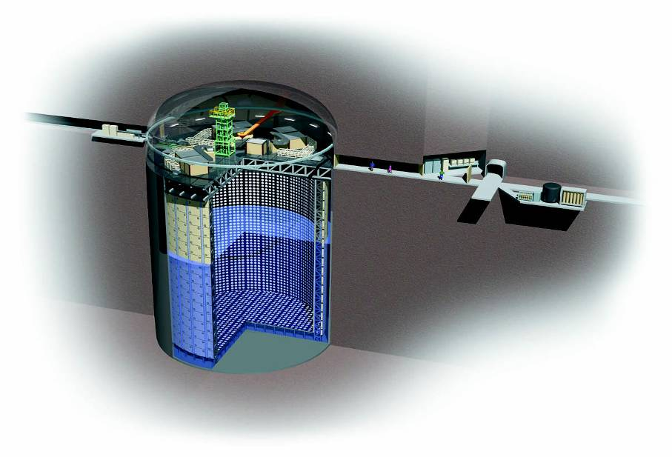
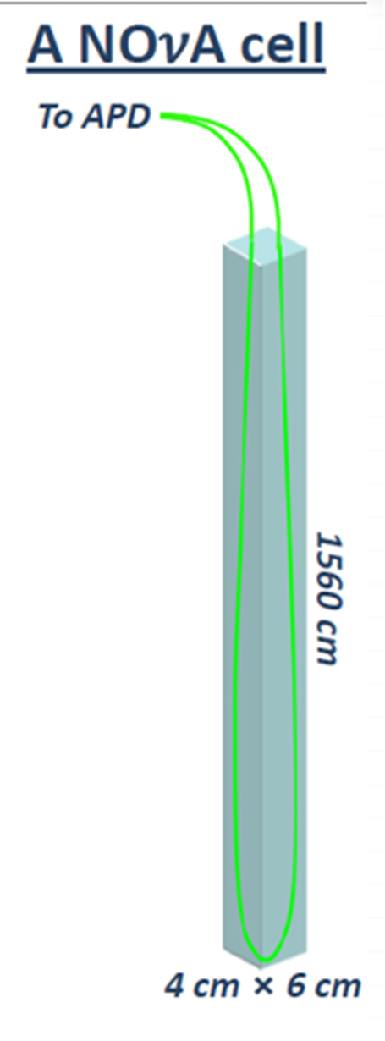
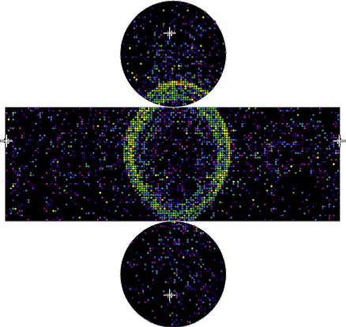
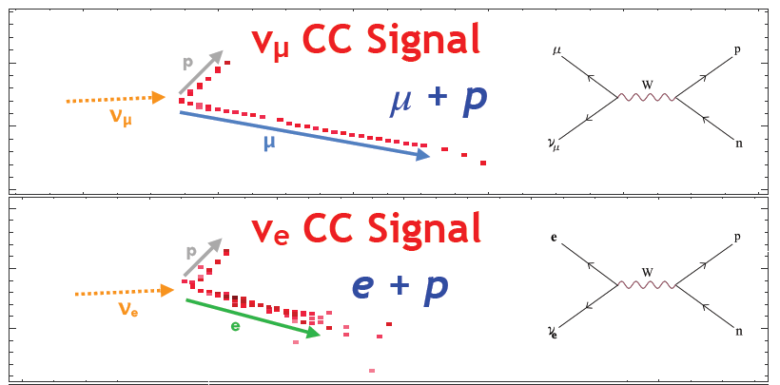
Running Accelerator long baseline experiments
T2K and NOvA
T2K
NOvA
14kt segmented liquid scintillator
Super-Kamiokande
50 kt Water Cherenkov detector
μ
e

Slide 13
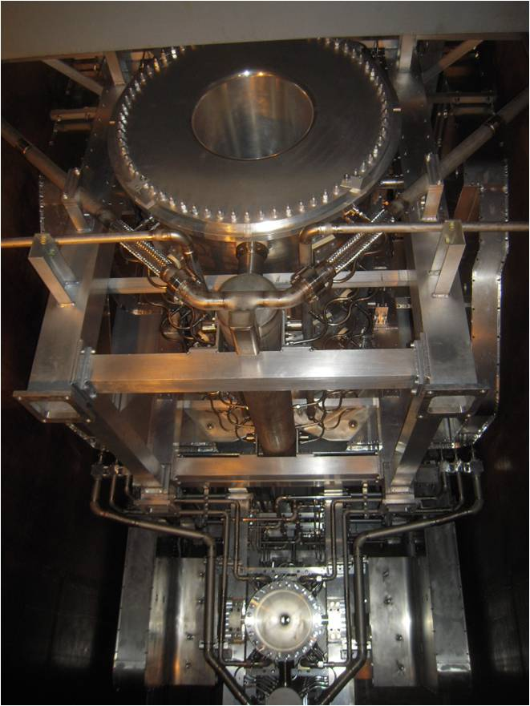
US Contributions to T2K
Many advices on neutrino beamline from FNAL NuMI
Electromagnetic horns
GPS system
P0D in near detector complex
neutrino flux, interaction and cross section analysis
Brand-new reconstruction software at Super-K
Various oscillation analyses
Various key leadership positions
etc. etc.

Slide 14
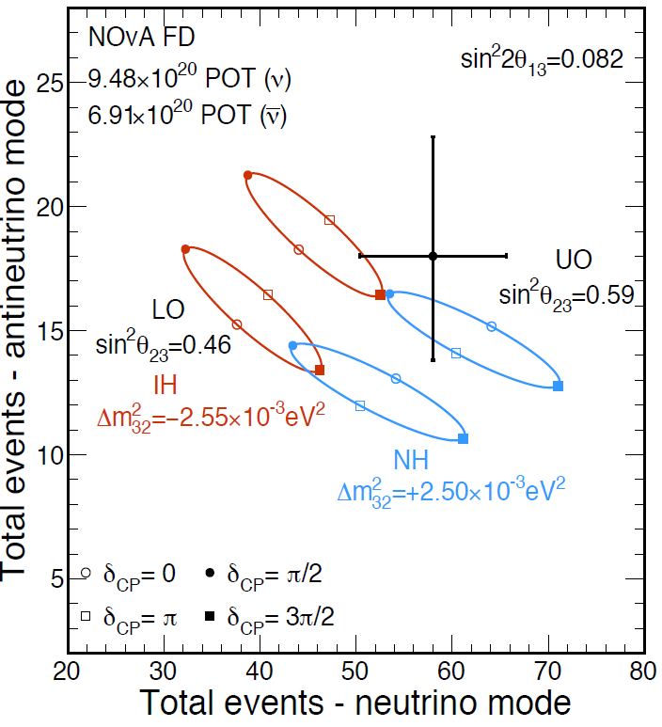
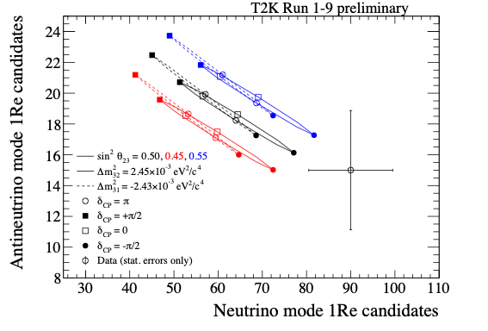
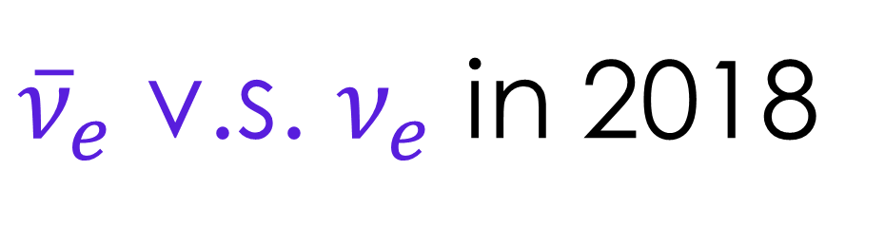
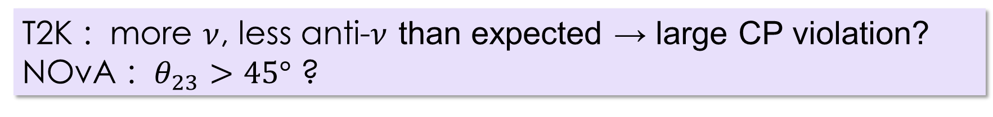
${\overline{ν}}_{e}$ v.s. $ν_{e}$ in 2018
T2K
NOvA
T2K : more $ν$, less anti-$ν$ than expected → large CP violation?
NOvA : $θ_{23}>45°$ ?

Slide 15
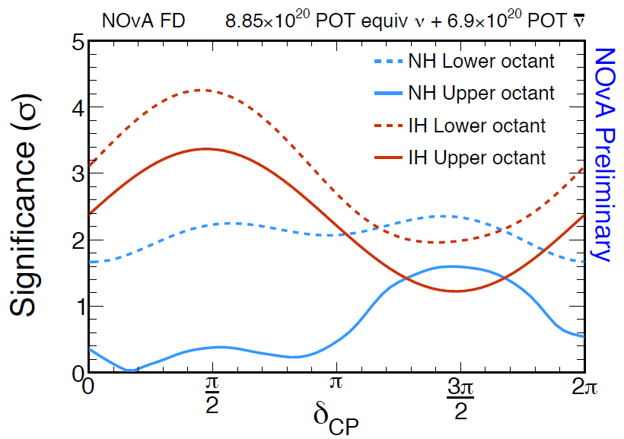
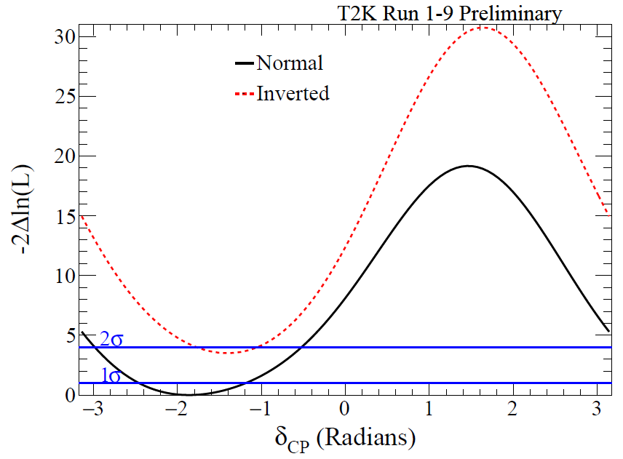

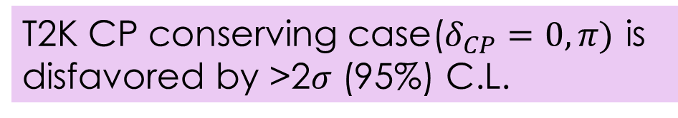




Hint of large CP violation by T2K
NOvA
T2K
$∆χ^{2}$ v.s. $δ_{CP}$
$$≈σ^{2}$$
2$σ$
2$σ$ C.L. allowed regions
T2K CP conserving case($δ_{CP}=0, π)$ is disfavored by >2$σ$ (95%) C.L.
~2$σ$
T2K posterior probability for mass ordering :
Normal 89%, Inverted 11%

Slide 16
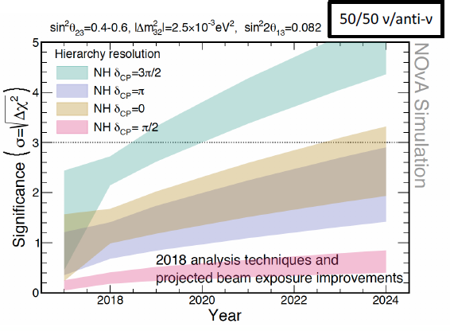
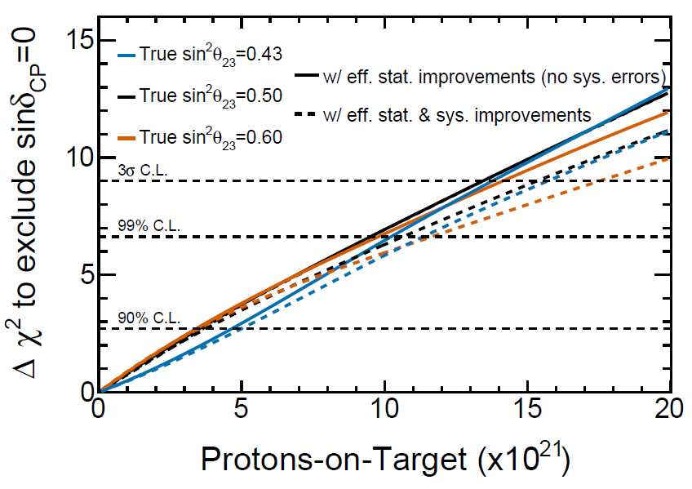
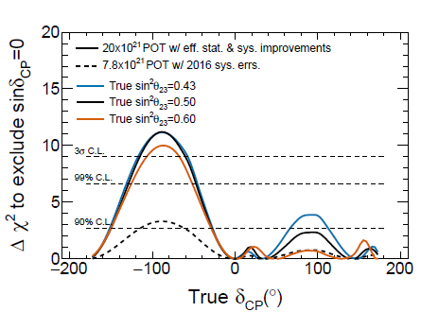
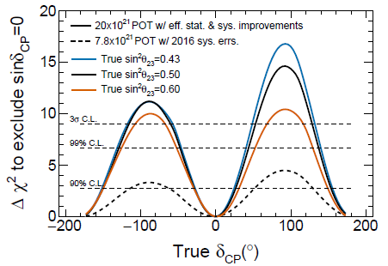
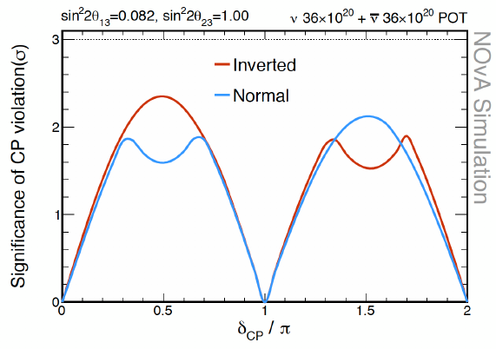
T2K and NOvA future prospects
NOvA
T2K
CPV sensitivity
mass hierarchy sensitivity
Both experiments are proposing extensions.
T2K and/or NOvA may show CPV and mass order by 3σ.
CPV sensitivity
Mass order unknown
Mass order known

Slide 17
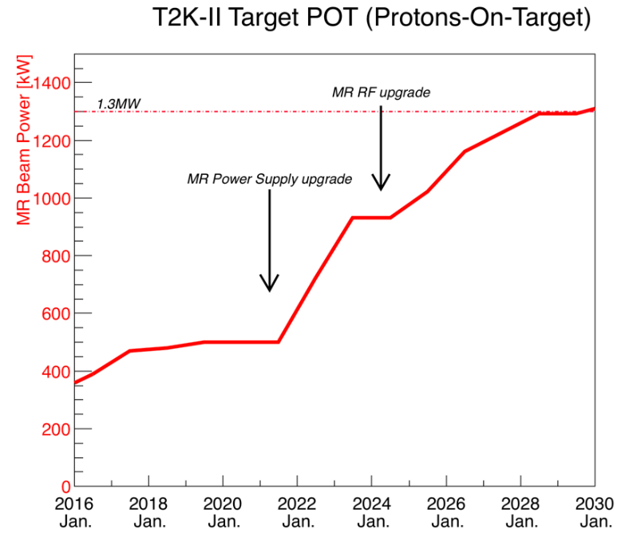
NOvA plan and
T2K Upgrades plan
T2K
Beam power 500 kW → 750 kW → 1.1 MW → 1.3 MW
Near detector upgrades to reduce systematic error
NOvA
Accelerator and beamline improvement: 750 kW → 900+ kW
high-power target in summer 2019
Booster work as part of PIP-II over the next 1~3 years (Schedule TBD).
Run to 2025
MR RF upgrade
MR power supply upgrade

Slide 18
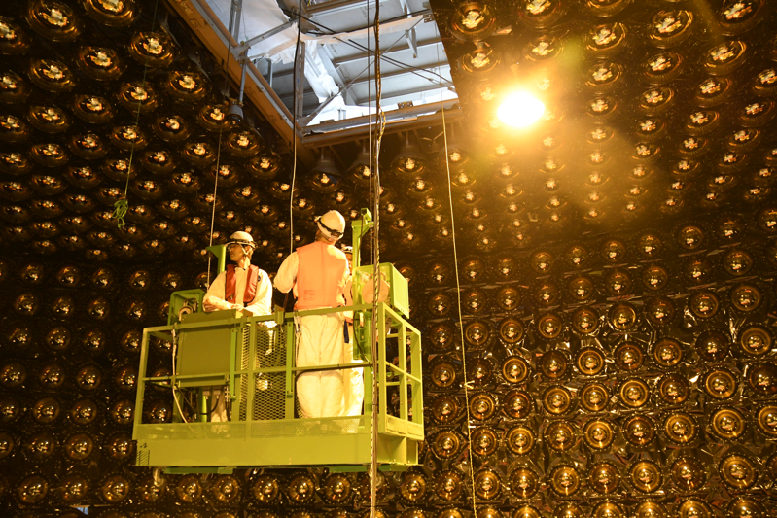
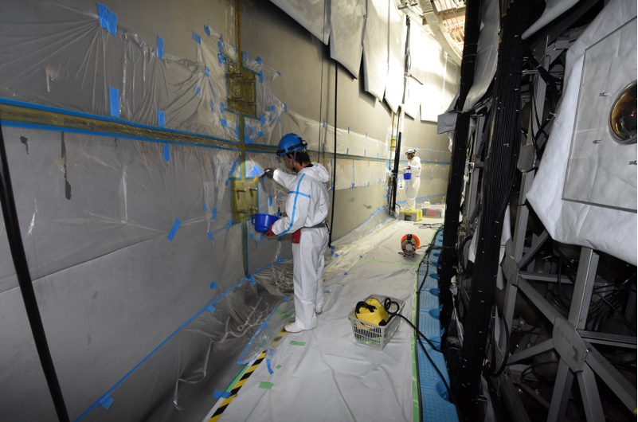
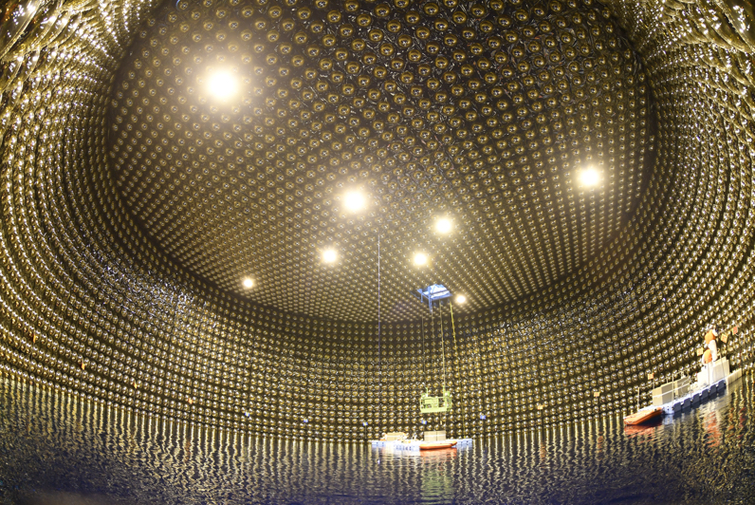
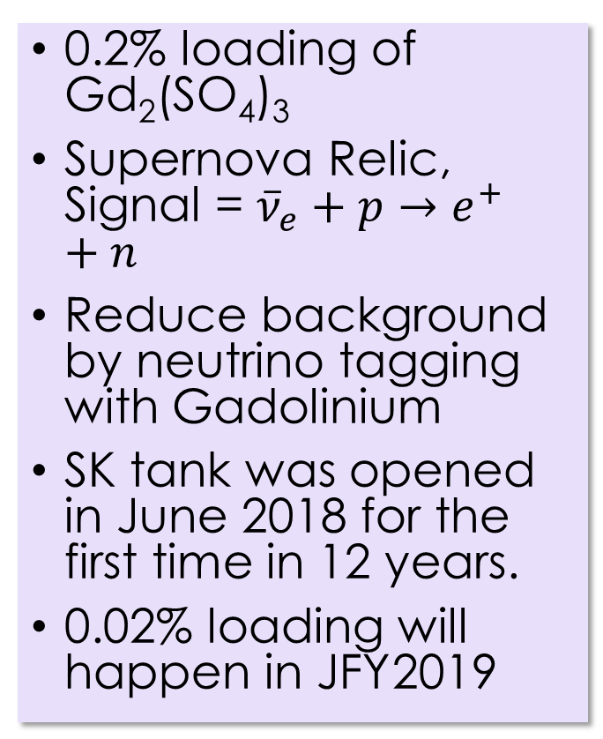
SK-Gd
-dissolve Gd to SK water for neutron tagging -
0.2% loading of Gd₂(SO₄)₃
Supernova Relic, Signal = ${\overline{ν}}_{e}+p→e^{+}+n$
Reduce background by neutrino tagging with Gadolinium
SK tank was opened in June 2018 for the first time in 12 years.
0.02% loading will happen in JFY2019

Slide 19
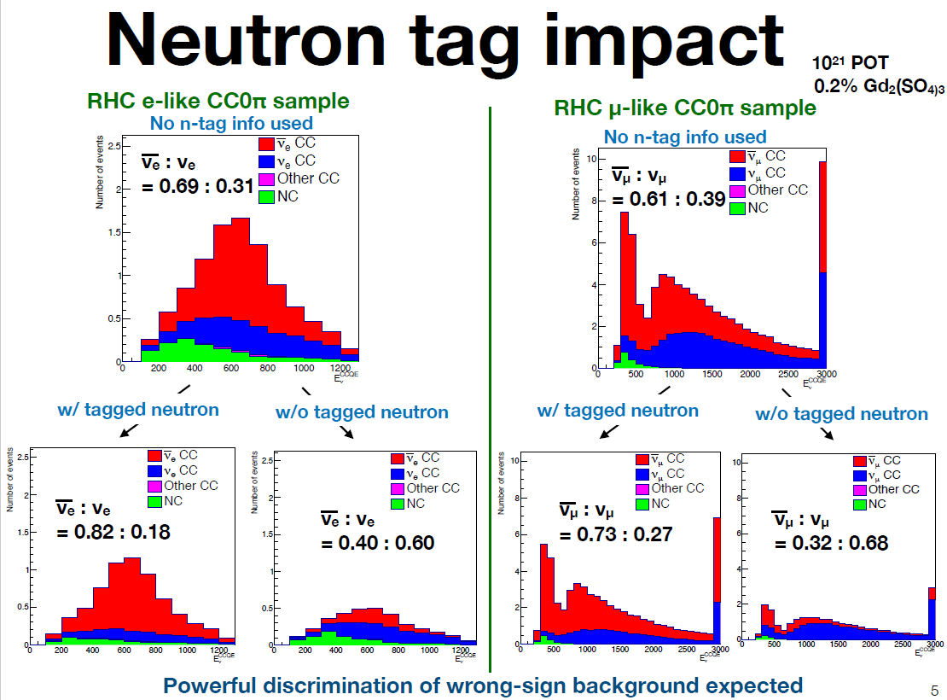
Neutron tag impact on T2K
wrong sign
T2K work-in-progress

Slide 20
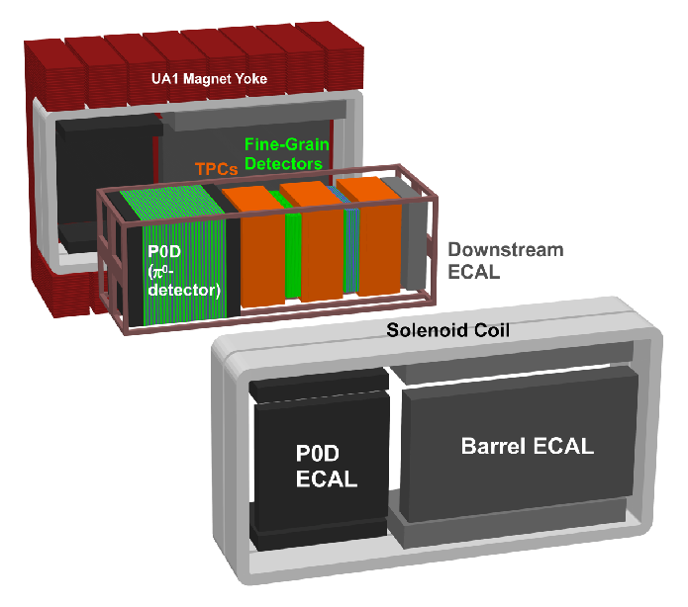
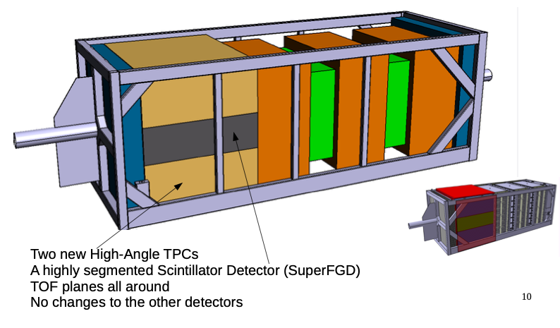


ND280 upgrade
Current ND280
T2K

Slide 21
Next generation Accelerator long baseline experiments
Hyper-Kamiokande and DUNE
Hyper-K
DUNE
1,300 km
South Dakota
Fermilab
Both experiments are aiming to start around 2026.
Matter effect ~10% for T2HK and ~45% for DUNE

Slide 22

Next generation Accelerator long baseline experiments
Hyper-Kamiokande and DUNE
Hyper-K
DUNE
J-PARC
120GeV
current(~700 kW)
→ 1.2 MW by upgrading LINAC etc.
(→ 2.4 MW)
current(~500 kW)
→ 1.3 MW by upgrading RF etc.

Slide 23



Next generation Accelerator long baseline experiments
Hyper-Kamiokande and DUNE
Liquid Ar Time Projection Chamber
DUNE
Hyper-K
Water Cherenkov Detector
60 m
60 m
260 kton
Fid. V.> SK $×$ 8
17 kt $×$ 4
74 m
Multipurpose
Acc. long baseline neutrino oscillation
atmospheric neutrino
Solar neutrino
Supernovae neutrino
proton decay
etc.

Slide 24





Cutting Edge technologies of next generation experiments
Hyper-K
DUNE
New 50cm PMT
$×$2 efficiency
$×$2 timing resolution
$×$2 pressure tolerance
800 ton ProtoDUNE in 2018
Large commercial-scale cryostat
single-phase/double-phase options
Thin photon sensor for 127nm scintillation

Slide 25


Next generation Accelerator long baseline experiments
Hyper-Kamiokande and DUNE
Hyper-K
DUNE

Slide 26


Prospect of mixing angle determination
High precision and redundant measurements
* might not be precise comparison
PDG18
~2020
future
~2025?
~2027?
~2030?
assuming maximal mixing
Ploted $\sin{{}_{}^{2}θ}$ to see the size of mixing

Slide 27


Prospect of $Δm^{2}$ determination
High precision and redundant measurements
* might not be precise comparison
(NO case)
PDG18
~2025?
similar for NOvA?
~2027?
future
0.4%
~2027?
~2030?
<1%

Slide 28

Prospect of Mass Ordering determination
if 𝛿=−𝜋/2 and NO
(if not, NOvA+T2K)
* may not be precise comparison
sensitivity
current result

Slide 29

Summary
Mixing in the lepton sector has been established by neutrinos from atmospheric, Solar, reactor and accelerator.
Remaining's are CP-violation phase and mass ordering
  T2K 2σ confidence interval$−170°<δ_{CP}<−36°$, CP conserving case ($δ_{CP}=0°,180°$) is outside.
  Normal mass ordering is preferred by $≳$ 90%
  NOvA (combined w/ T2K) may resolve mass ordering at 3σ before the next generation experiments.
Next generation experiments will fully explore CP-violation phase, mass ordering, and also start exploring beyond the three-generation mixing.
  Hyper-Kamiokande, DUNE etc.

