Slide 1
Cold Mass Alignment Tooling
A Vouris
Cold Mass Structure Interface Meeting
27 Sept. 2018

Slide 2
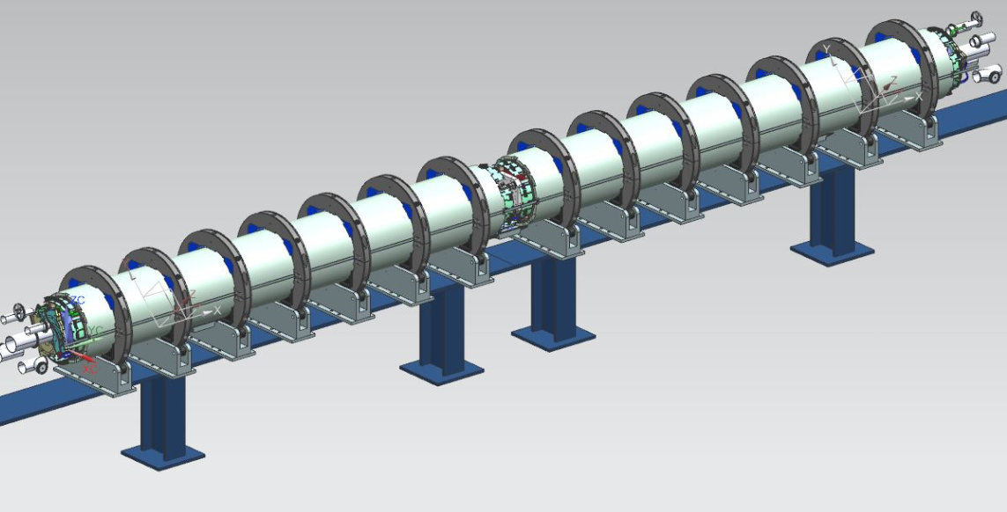
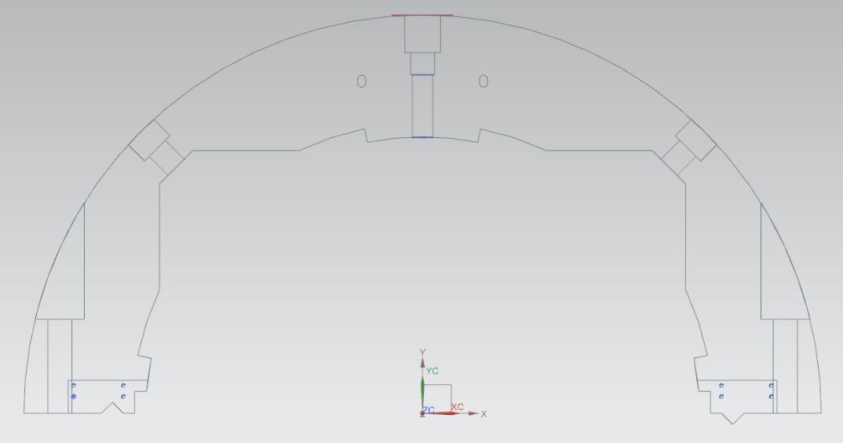
Alignment and Rolling Tooling

Slide 3
