Slide 1
Discussion on
MQXFA Coldmass Alignment
Dan Cheng, et al
9/27/2018

Slide 2
MQXFA Yoke and Shell assembly
Yokes
Incoming laminations are inspected
Key Yoke laminations are measured with the fiducial targets
Stacked in half-length assemblies
Shell-Yoke
Stacked in half-lengths
Joined into full-length assembly
Fiducialized after magnet assembly

Slide 3
Assessing the Straightness of the Assembly
Limited data at the moment
Fiducialization data has not been fully processed
Data from yoke measurements
Data from magnetic measurements
Performed lifting operation in MQXFAP1
Measured max. deflection on the order of 0.001” (4 point pick)

Slide 4
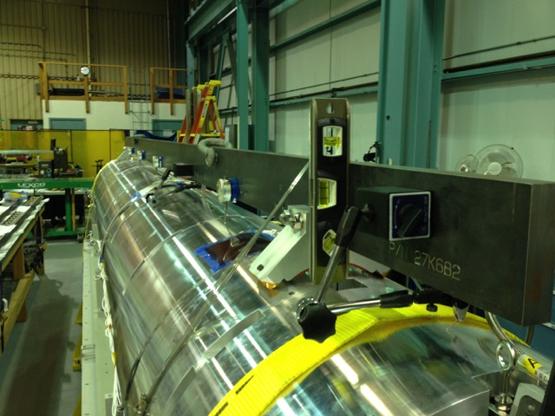
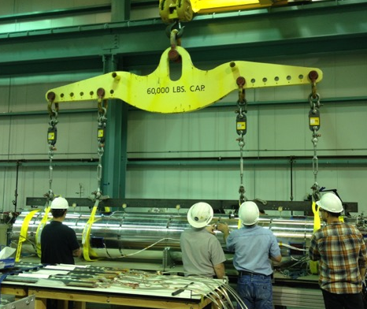
Magnet Lifting Operations
MQXFAP1 was used to test the magnet lifting operation with deflection measurements
Used simply supported beam with dial indicators
~0.001” deflections recorded

Slide 5
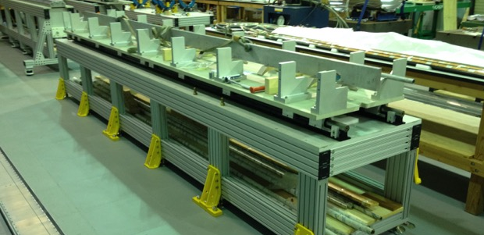
Magnet Integration Table
Table was leveled (with a digital/bubble level to ~0.1°)
Yoke resting points are these upper surfaces (total 5 locations for full-length magnet)

Slide 6
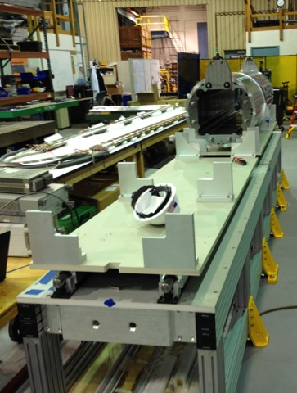
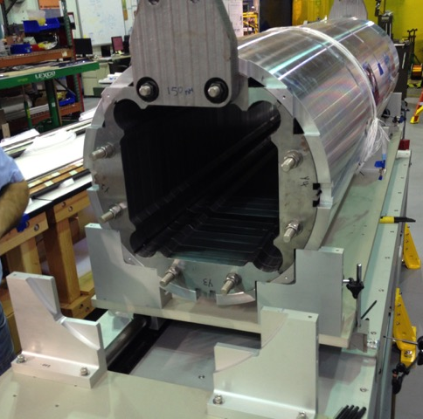
Magnet Integration Table
Yoke resting points are these upper surfaces of the pedestals
3 locations per half-length
5 locations for full-length magnet (center ones joined together)
Horizontal position is aligned to left pedestal (when viewed from the Lead End)

Slide 7
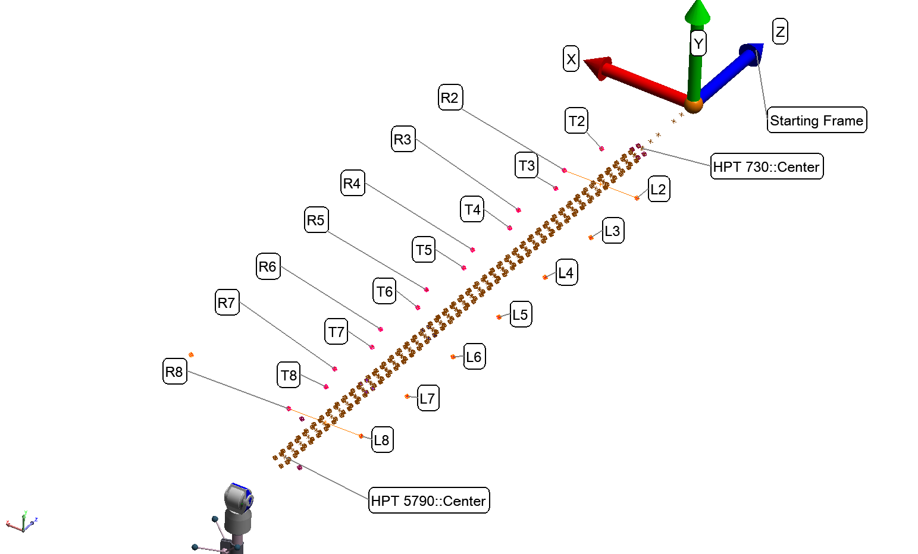
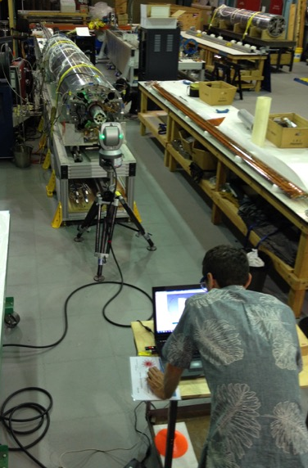
MQXFAP2 Fiducial Data (still in Process)
Fiducial measurements were taken during the magnetic measurements operations
Data is still being processed, so conclusions yet

Slide 8
Additional Slides

Slide 9
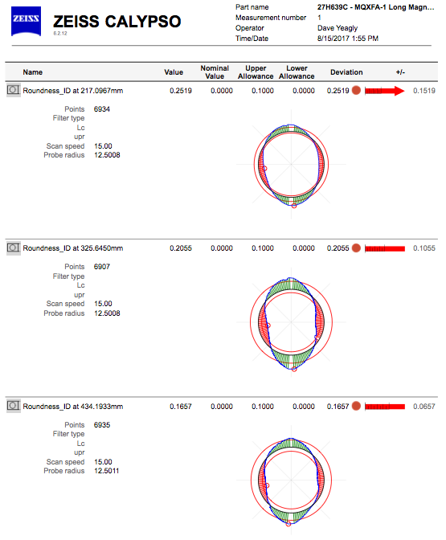
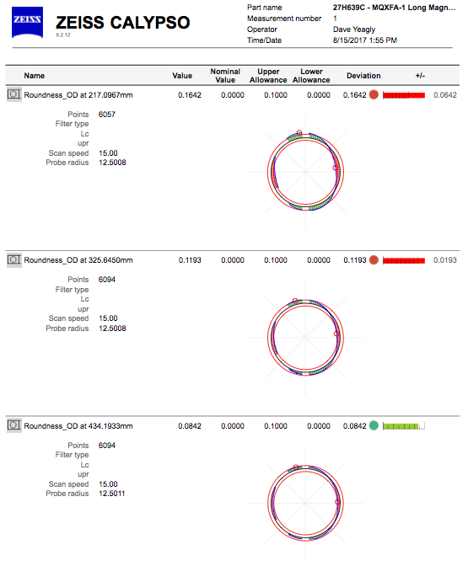
Example of Shell ID/OD comparisons (free state)
ID
OD

