Slide 1
Accelerator Status Report
Wednesday 9/26//2018

Slide 2
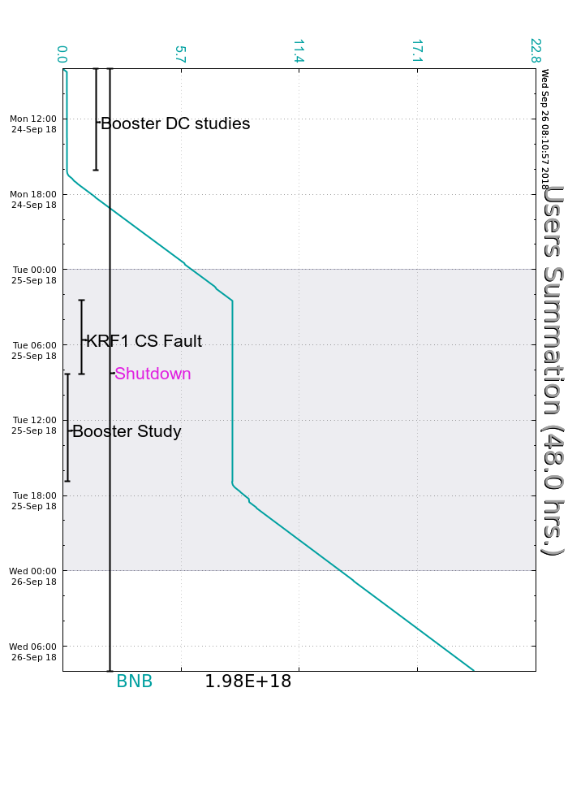
MONDAY
Booster DC studies
M02-M05 ODH system restored
Remnant LCW system turned on
BNB beam evening
TUESDAY
KRF1 CS fault (experts called in)
CUB ICW short glitch
Booster DC studies
BNB beam (15 turns!)
Klystron Vernier water valve stuck
WEDNESDAY
Quiet night.
Booster DC studies NOW.
Your Shift Plot
could be here!
Ask me how!
Wednesday Update

