Slide 1
Muon g-2 Shutdown Overview
Peter Winter, Jarek Kaspar (Shutdown Coordinators)
Argonne National Laboratory

Slide 2
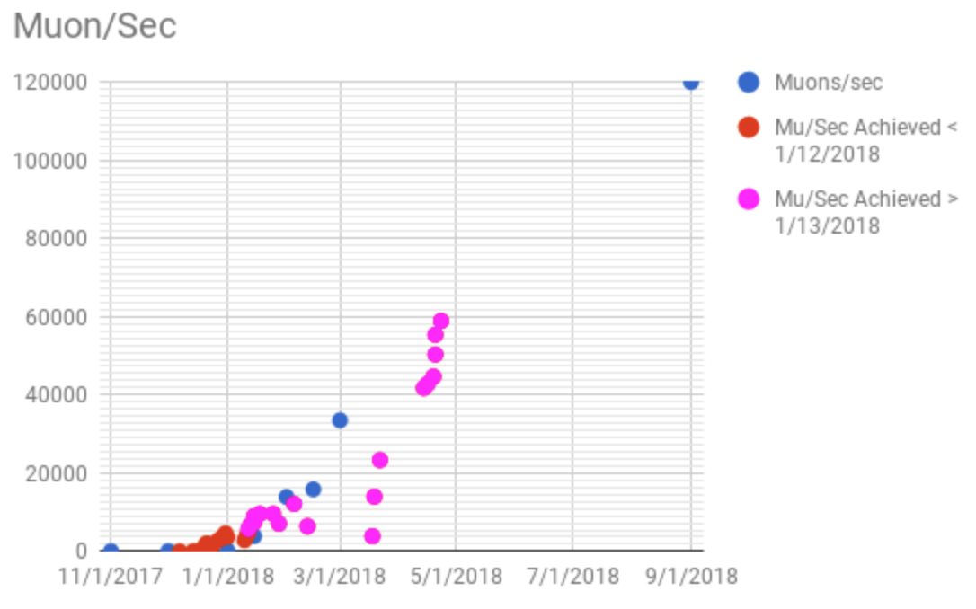
Physic Priorities
Top areas for FY18 shutdown
Increased reliability / stability of pulsed injection systems
Improved momentum distribution (needs stronger kick)
Obtaining higher muon flux
TDR Goal
Achieved 50%

Slide 3
Muon Flux
Have achieved 50% of design flux
Not any one problem…many compounding factors
TDR Goal
Known contributing factors
Factor | Cause | Fixable
0.90 | Target Yield | Hard
0.90 | Muon transport | Maybe
0.90 | Bunch width | No
0.90 | Kicker amplitude | Yes
0.85 | Kicker shape | Hard
0.90 | Quad voltage | Yes
0.83 | 12 Hz vs 10 Hz | No
Peak Rate Achieved 50%
Product = 0.42

Slide 4
Path to higher flux
Focusing on Reliability and Safety for Cryo, Kicker, Quads this year
Summer 2018 upgrades expected to yield 50% more flux
Gain | Upgrade | Shutdown
1.20 | Installation of momentum-collimating wedges in beamline | 2018
1.10 | Higher kicker voltages and more reliability of kicker | 2018
1.10 | More reliable operation of electrostatic quads at higher voltage | 2018
1.05 | Installation of 2 faster-switching PS in upstream beamline | 2018
1.5 | TOTAL Product for Run-2 | 2018
1.40 | Installation of new open-ended inflector | 2019
2.1 | TOTAL Product for Run-3 and beyond | 2019
Notes:
Add why are we at 50%

Slide 5
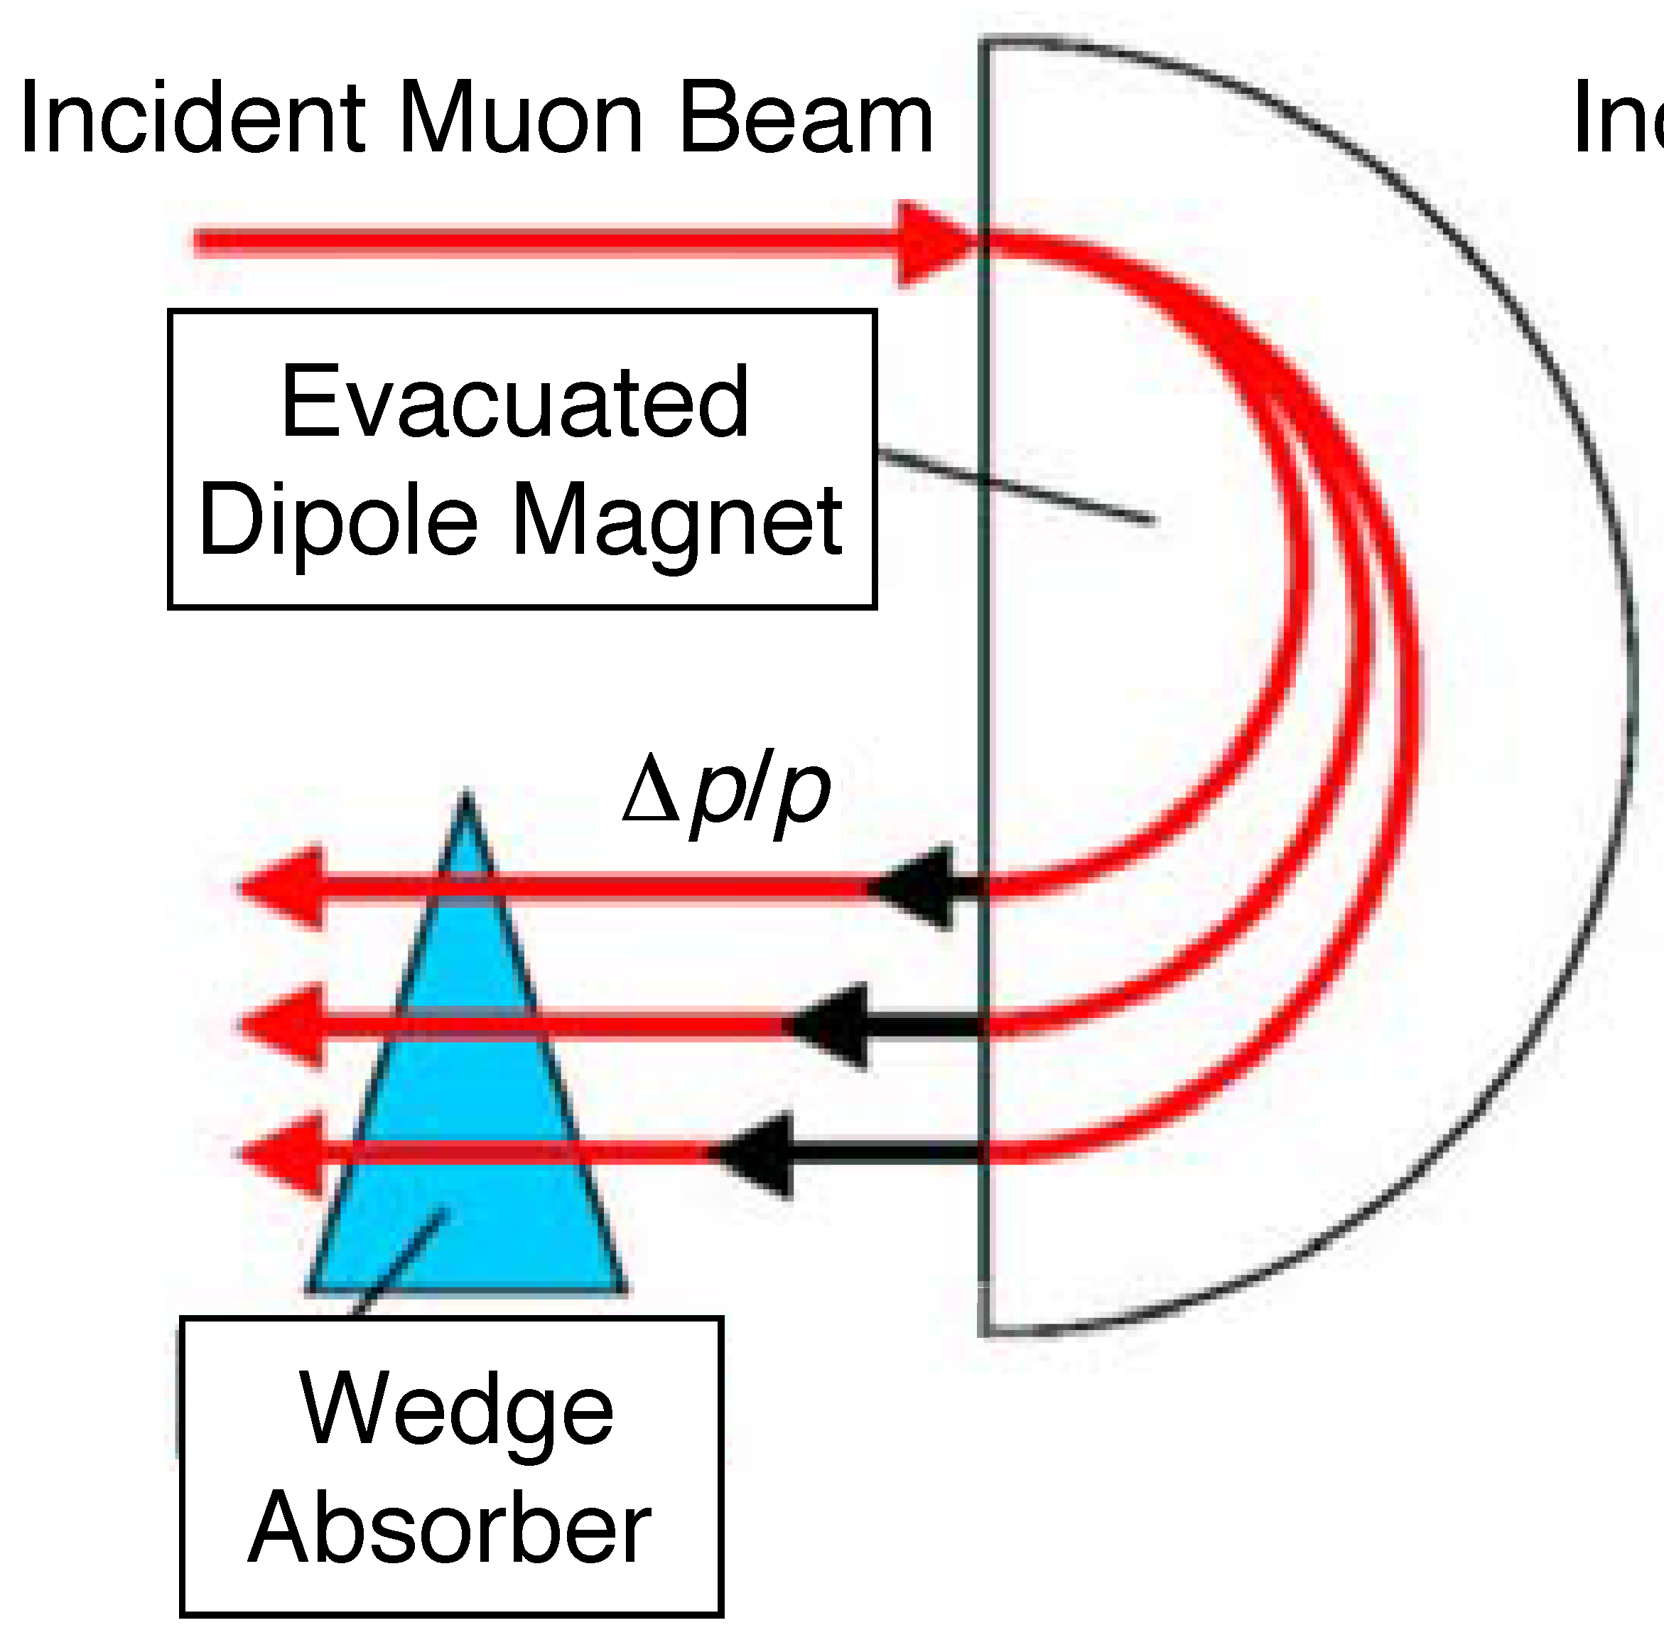
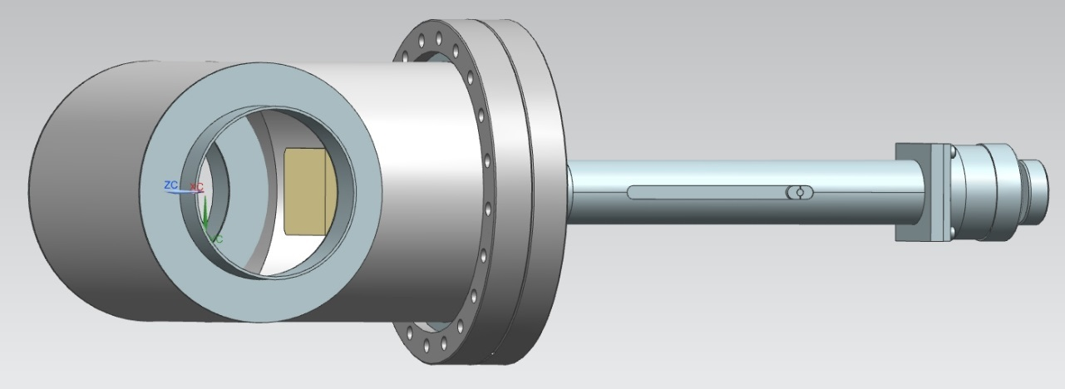
Beamline Wedges
Wedges in region with dispersion to compactify momentum
Simulations indicate gain of ~20%
They are installed and ready for testing with beam

Slide 6
Cryo main upgrades
*recommendation from a former review
Safeguards and reliability:
Compressor Trip Cryo Response (CTCR) for zero-quench mode*
Compressor interlock switches for more reliability*
Redundant PLC at A0 (redundant to MC-1) for compressors*
Redundant communication between MC-1 and A0*
Pneumatic actuators replacing old electric ones for more reliable valve operation
System maintenance (purification, pumps, ...)
Status:
CTCR installation done, safety review and commissioning ongoing
Redundant PLC done
Implementation of new alarms and actuator replacement still ongoing

Slide 7
Kicker Upgrades
Reliability
Redesign Bazookas and vacuum feedthrough for better mechanics and reduce sparking
Refurbish Blumleins for more reliability
Rewire thyratron heating circuit for improved reliability
New electronics for better control
Improve spare pool (spare, connectorized cable assembly)
Kicker strength
Replace charging power supplies
Redesign feedthrough to accommodate higher wattage resistors
Status:
Refurbished old feedthroughs for beam commissioning Oct/early November
Fabrication of new Bazookas and feedthroughs is coming along
Blumleins fully refurbished, currently reinstalling in MC1 hall
PS racks assembled, need power upgrade in hall to operate all 3 kickers

Slide 8
Quadrupole Reliability Upgrades
New insulator plate (batman) to stabilize leads
Survey and possibly realign quad plates
New electronics for better operation
Install new RF system to reduce Coherent Betatron Oscillation
Status:
All new Batman installed and leads realigned
Preliminary test indicate ability to operate more reliable at higher voltages
Performing long quad test next week
New electronics ready for commissioning
RF system installed, not needed for start of data taking, commission at a later time

Slide 9
Outlook for next weeks
October 8-15: Quad and kicker testing plus Eddy current measurement
October 15: Ready for first beam commissioning with old kicker
November 8-15: Install new kickers
November 15: Start data taking with new kickers

