Slide 1
Cryo-Assembly Shipping
Roger Rabehl
October 1, 2018

Slide 2
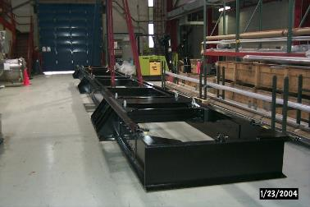
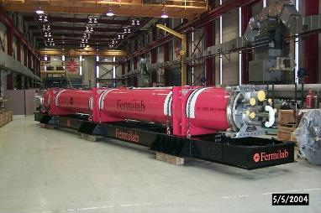
Preliminary design of the shipping frame has been completed.

Slide 3
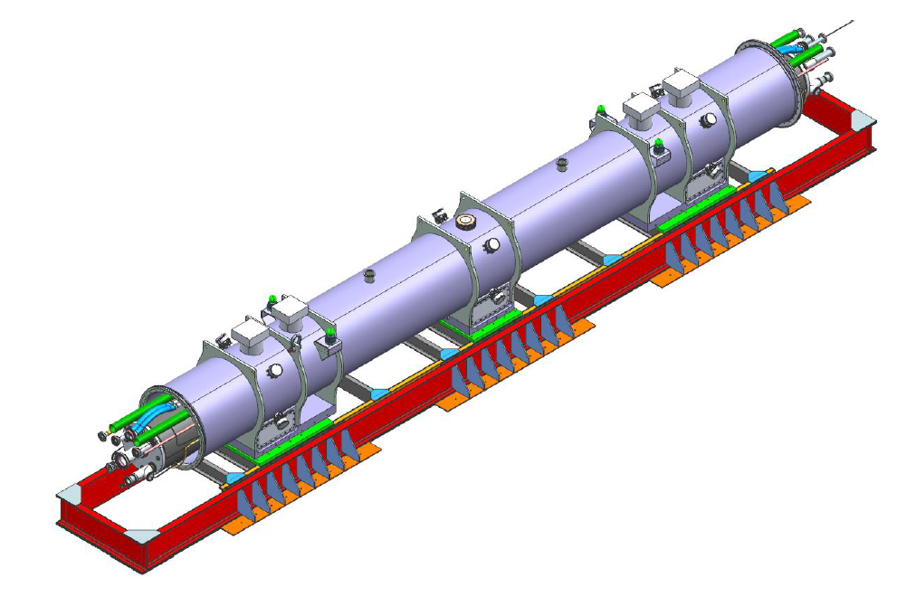
Preliminary design of the shipping frame has been completed.

Slide 4
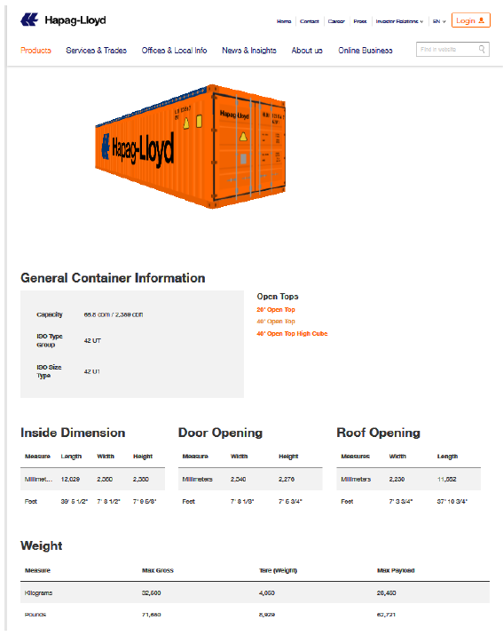
Other aspects of the shipping system are just underway.

Slide 5
Future tasks have been scheduled out to the April 2020 prototype shipment.

Slide 6
Future tasks have been scheduled out to the April 2020 prototype shipment.
Shipping Frame mechanical/structural analysis when loaded with Cryo-Assembly
Stress analysis of individual members based on shear and bending moments
Stress analysis of lifting lugs and welds
Shipping Frame + Cryo-Assembly vibration/resonance analysis
Determine damping ratio
Determine resonant frequencies, compare to typical transport resonant frequencies
Finalize quantity of isolators
Cryo-Assembly vibration/resonance analysis
Determine resonant frequencies, compare to typical transport resonant frequencies and resonant frequencies of Shipping Frame + Cryo-Assembly

Slide 7
Future tasks have been scheduled out to the April 2020 prototype shipment.

Slide 8
Future tasks have been scheduled out to the April 2020 prototype shipment.

Slide 9
Future tasks have been scheduled out to the April 2020 prototype shipment.
Vendor identification for DOT testing of shipping frame
A market survey conducted by Fermilab Procurement to identify vendors who can test large shipping fixtures
Profit from past experience, such as the g-2 magnet shipping fixture

Slide 10
Future tasks have been scheduled out to the April 2020 prototype shipment.

