Slide 1
MQXFAP2 SG Readings in Cooldown
H. Pan
10/01/2018
LBNL

Slide 2
MQXFAP2 SG Gauges Overview
LE
MID
RE
Shell 2
Shell 4
Shell 6
Shell:HBM
Coil: HBM
Shell:HBM, Vishay
Coil: HBM, Vishay
Shell:HBM
Coil: Vishay
Three axial locations:
Shell gauges (T & Z): on shell 2, 4 & 6
HBM gauges: Shell 2,4,6
Vishay gauges: Shell 4
Coil gauges (T & Z): on axial location of 740 mm (LE), 1940 mm (MID) and 3140 mm (RE) from LE.
HBM gauges: Coil LE and MID
Vishay gauges: Coil MID and RE
Most of the strain gauges stay alive in this cool-down.
HBM shell 5 Top axial, Coil 102 azimuthal LE initially were found wire broken before cool-down.

Slide 3
Cooldown SG Readings
The Targets set for MQXFAP2
The TF plots of MQXFAP2
The stresses are average stress: (MPa)
 |  | MQXFAP1 (Meas.) | MQXFAP2 (Target) | MQXFAP2 (Meas.)
RT | Coil | -75 | -88 | -74
 | Shell | 72 | 84 | 83
CD | Coil | -88 (simulation) | -100 | -91
 | Shell | 140 | 154 | 153
TF function is calculated based on the HBM gauge readings
The magnet behaved as expected in general from the SG readings.
Some gauges show illogical readings, more data is needed to understand
HBM Rod 1 T & Z.
Vishay Coil Azimuthal gauges.

Slide 4
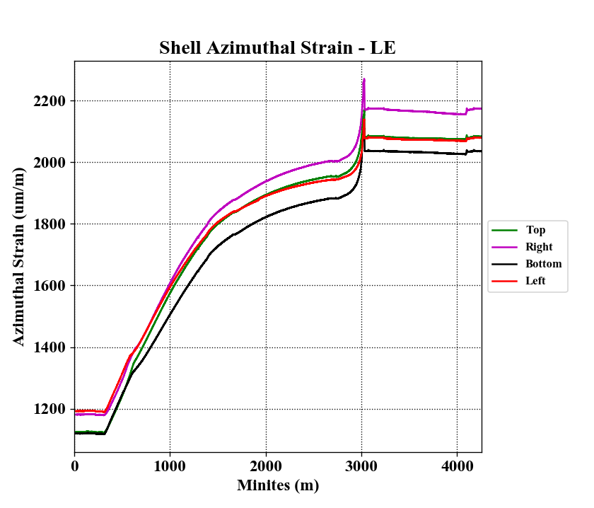
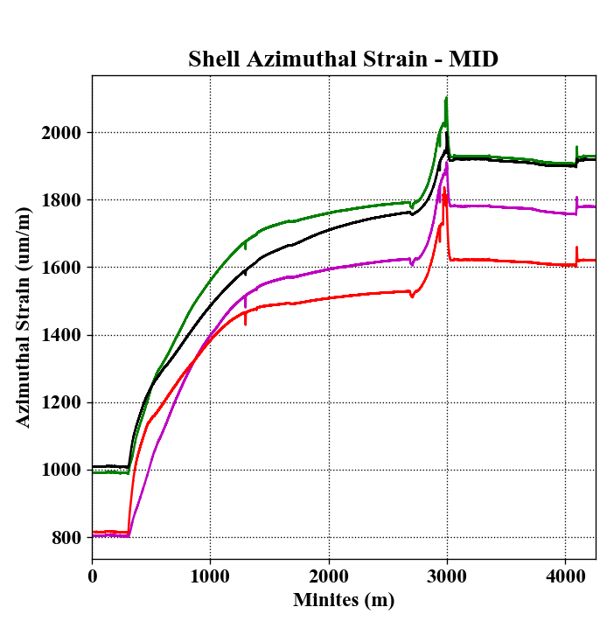
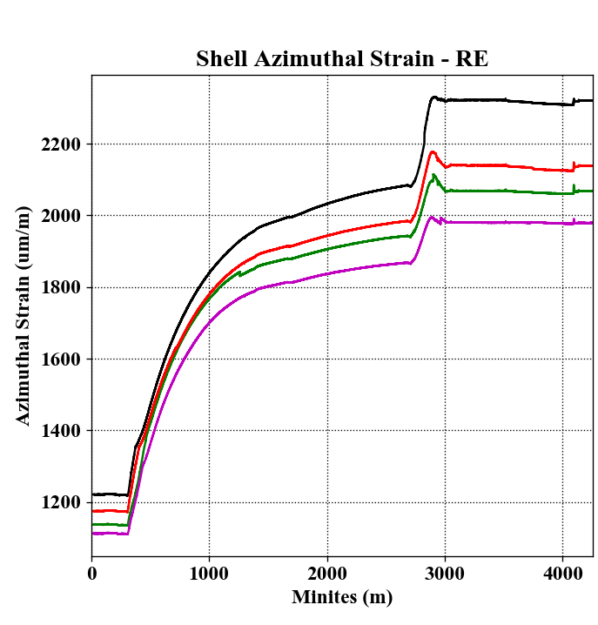
HBM Gauge Readings---Shell azimuthal
Target @ 1.9 K 1990 um/m
Target @ 1.9 K 1990 um/m
Target @ 1.9 K 1990 um/m
LE
RE
HBM shell azimuthal gauges behave as expected in general.
There is no temperature data recorded in the HBM system.
Peaks in the curves seem to indicate the magnet started to see liquid at that moment.

Slide 5
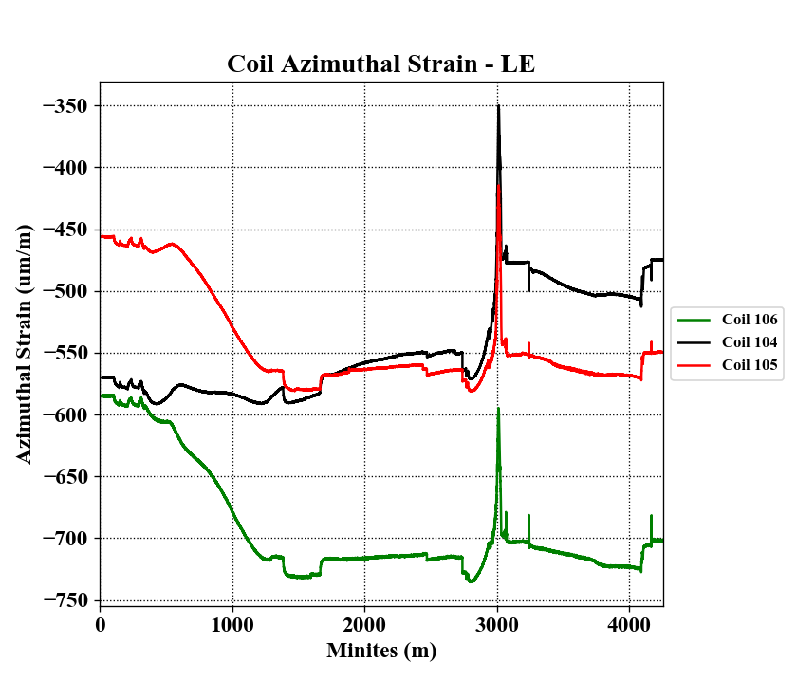
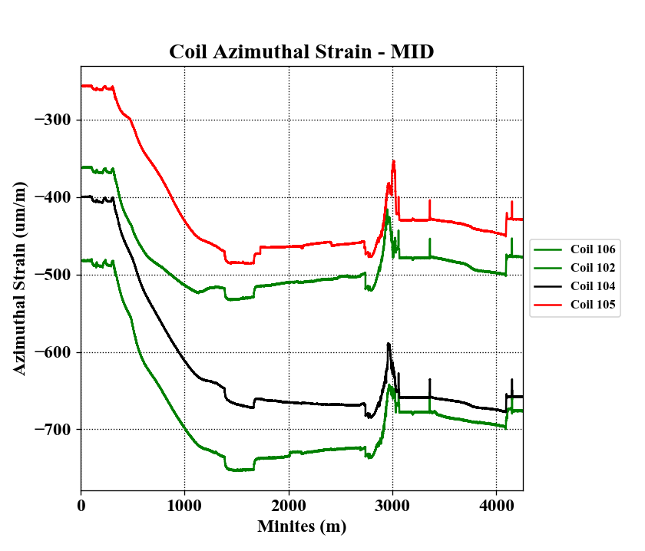
HBM Gauge Readings---Coil Azimuthal
Target @ 1.9 K -670 um/m
Target @ 1.9 K -670 um/m
LE
RE
Coil 102 azimuthal LE initially were found wire broken before cool-down.
HBM coil azimuthal gauges behave as expected in general.
Coil gauges also show the similar peak at the same moment as seen in shell strain plots.

Slide 6
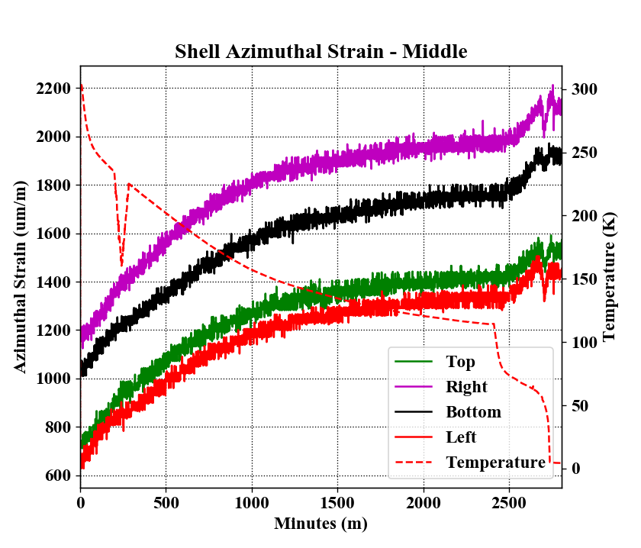
Vishay Gauge Readings---Shell azimuthal
Target @ 1.9 K 1990 um/m
LE
RE
Vishay shell azimuthal gauges Top and Left ware read initially low before cooldown. They were reading close to 1000 um/m before shipment. Otherwise the shells behaved as expected.
Expected delta strain of 700 – 800 με were achieved in all shells stations.

Slide 7
Vishay Gauge Readings---Coil Middle
Vishay coil azimuthal strain readings are in the opposite direction as HBM coil readings and the FE prediction during cooldown.
The following 6000A ramp test proved the Vishay coil gauges seemed to work properly.
Additional quench data is needed to verify that the gauges readings.

Slide 8
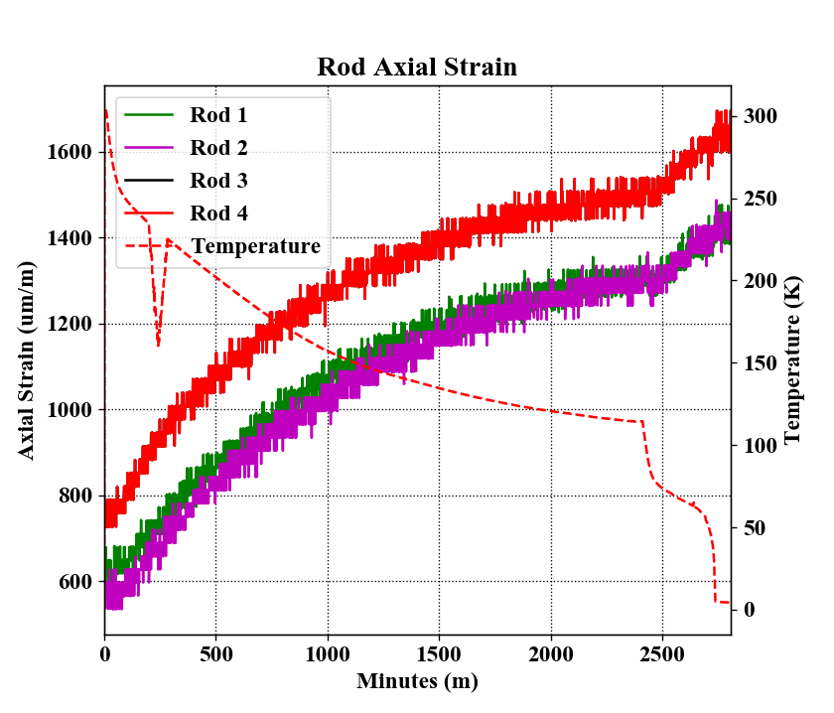
Vishay Gauge Readings---Rods
Target @ 1.9 K 1200 um/m
The rods strain are reading higher than the calculations.
The initial readings from the plot are higher than the ones been taken before cooldown.
There might be offsets in these readings because the post-shipping readings of the rods were 513 με.

