Slide 1
NuMI Target Stationing Investigation
Marty Murphy & Cory Crowley.
AD-Operations Scheduling Meeting

Slide 2
MET-03 Target-Module Misalignment Investigation
There was a 235 MIL (1/1000 inch) longitudinal off-set between the NuMI Target Position and the Module
Several days of investigation by Alignment and TSD did not yield any obvious cause for the descrepency.
Absent a cause, we decided to translate the Target position forward (in beam direction) by 235 MIL. See picture at right.
We believe we found the cause of the problem during the process of mating the Target to the Module on Thursday (10/4/18).

Slide 3
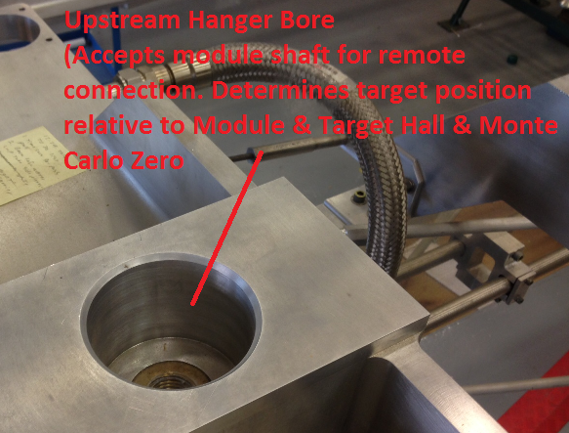
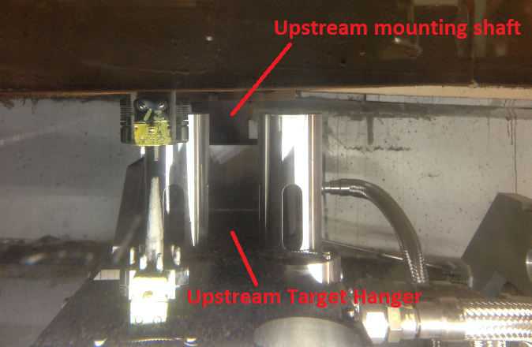
NuMI Target Alignment Issue
Initial Hook-up
Draw bar & utility lines would connect, but sticky (not particularly odd given age of module components).
Upstream hanger (what sets target position) seated and draw bar torqued.
Module moves to position in chase for survey, showing target survey monuments are ~1/4” upstream.
Interface believed to be OK, as has not had issue for 9 target installations prior.
During troubleshooting, a slight angle is observed between hanger & mounting shaft (picture on right below), but no prior reference for perpendicularity to mounting shaft is known. Was not considered to be immediate issue at the time.

Slide 4
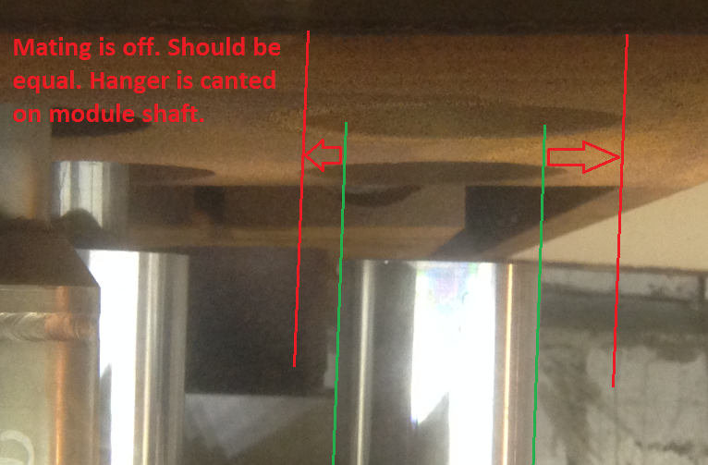
NuMI Target Alignment Issue
Attempted Correction / Proposed Root Cause
After days of troubleshooting, best course of action with knowledge on hand was to adjust target to correct position and reinstall onto module.
When attempting re-installation, angle between hanger and shaft became more noticeable.
We believe root cause is upstream target hanger bore was canted on module shaft from day 1 of changeout.
Additionally validated when draw bar & utility lines would not connect / thread together with target on second attempt.

Slide 5
NuMI Target Alignment Issue
Attempted Correction / Confirmation of Root Cause
Found out that:
Beamline component to module mounting repeatability is not good.
Cannot rely solely on remote handling table to allow for good fit.
Cannot rely solely on draw bar to freely pull target into position & maintain accuracy / good fitment.
Must now use both remote handling table to visually set position + draw bar to pull up in order to make sure shaft seating is correct and perpendicularity is maintained.
Summary:
Module shaft to hanger fitment (design / tolerances / condition) allows for poor connection repeatability. Can try to adjust on future targets / horns, but module shaft dimensions cannot change without major work.
Issue is solved with diligent attention to connection points during future changeouts. Will not rely on support structure to beamline component interface to be perfect.
Can perform in-situ survey monument checks from top of NuMI work cell to verify connection.
TSD has list of lessons learned & corrective actions to avoid this problem in the future.
*Root cause will be confirmed on Monday if target is surveyed in chase and upstream survey monuments are found to be in correct station.

