Slide 1
Muon Campus Status
Jim Morgan
Shutdown week 13
October 5, 2018

Slide 2
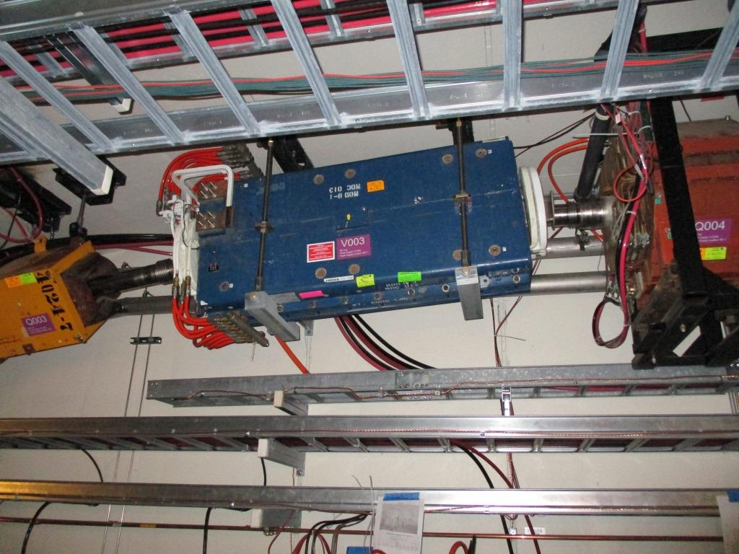
Week 13 tunnel activities
V003 awaiting reconnection of power cable and LCW hoses
Vacuum pipe welded in last Friday
M4 (to Mu2e) and M5 vacuum work continued
M4 Line from V907 to Mu2e Shield Wall under rough vacuum
M5 Line under vacuum
Ionization Cooling Wedges
Final wiring terminations underway, motion check-out to follow
V003 back in place

Slide 3
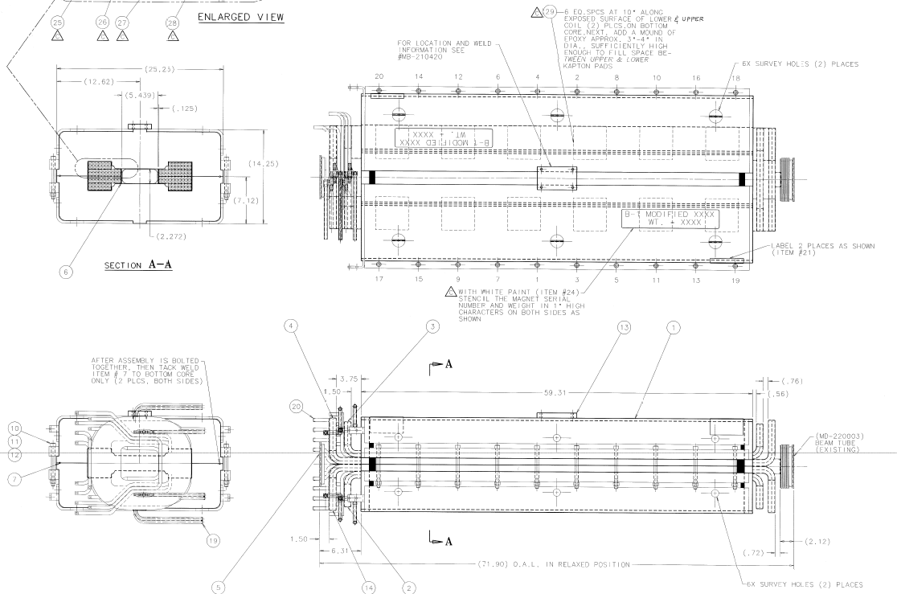
MDC dipole – Type used at H748
68 turns

Slide 4
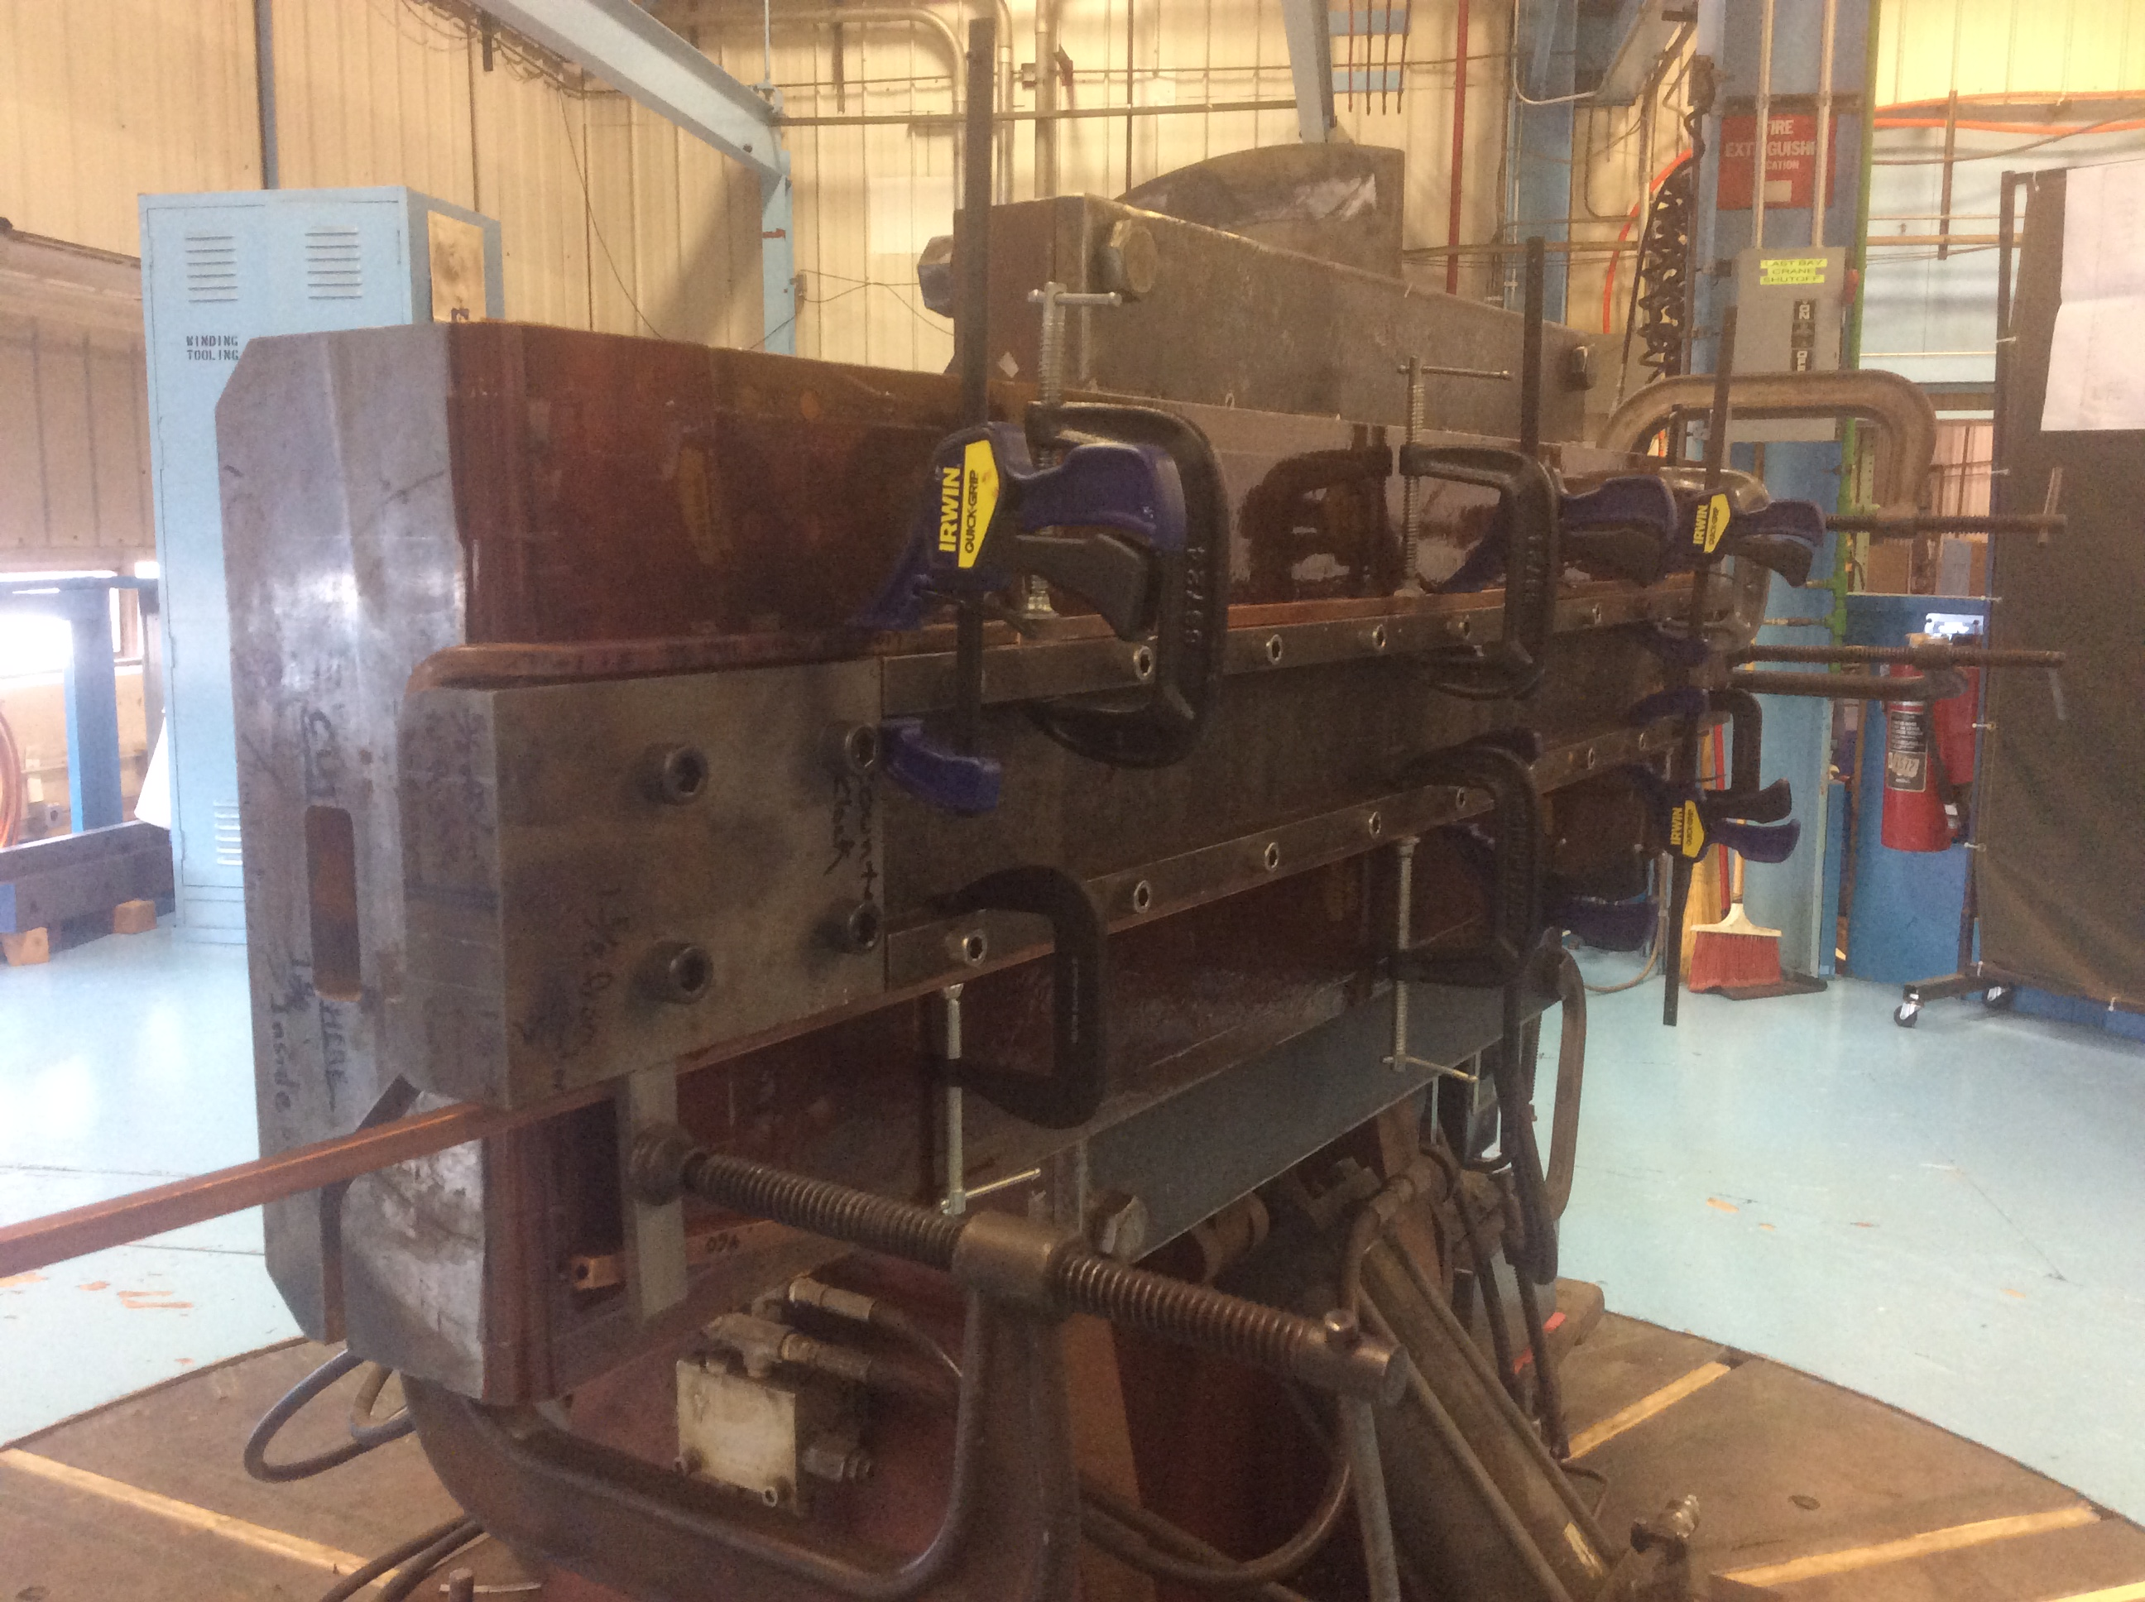
MDC007 coil winding (replacement for H748)

Slide 5
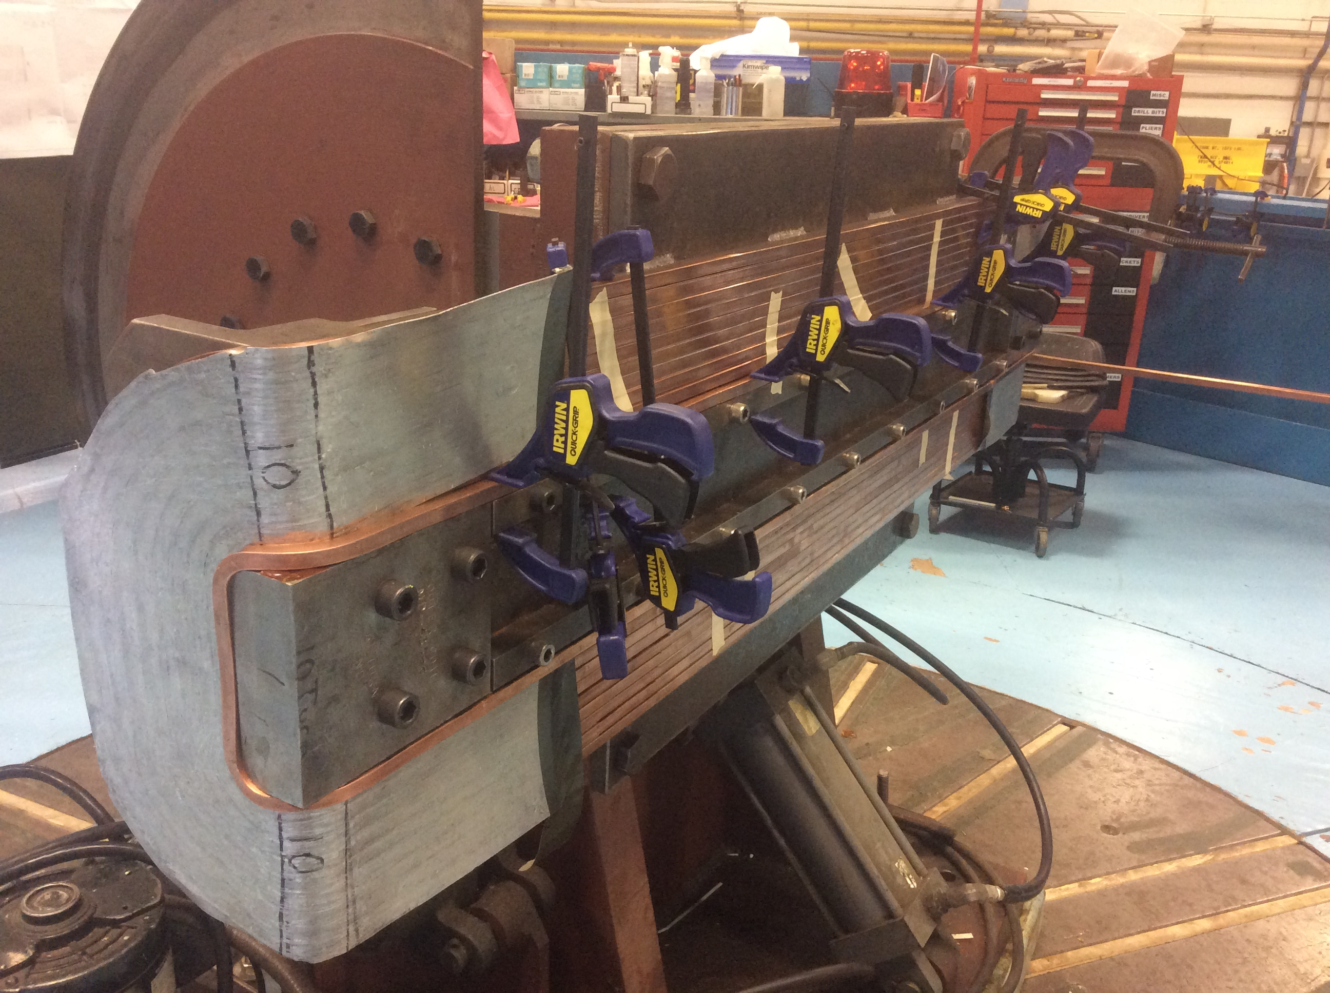
MDC007 coil winding

Slide 6
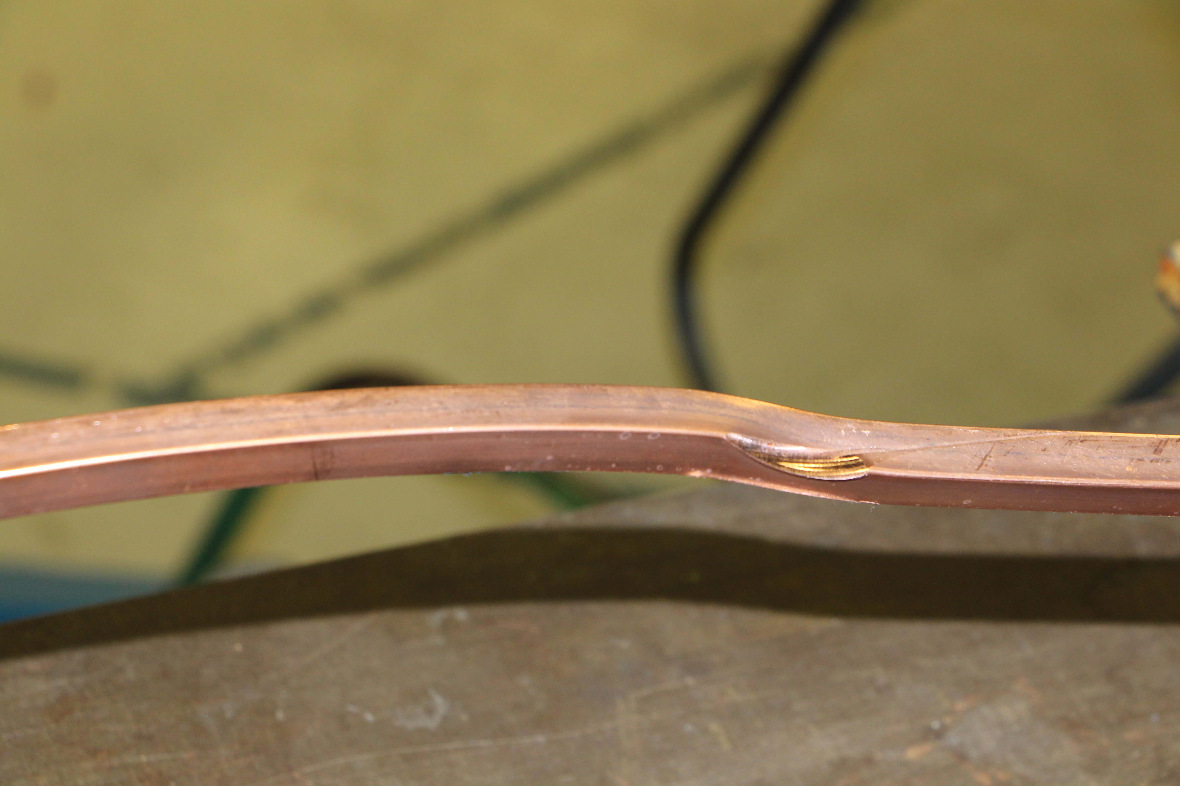
MDC007 coil winding – the first snag
Damaged conductor

Slide 7
Upcoming
Transition to operation – tentative plan
Mock secure this weekend
Change back to safety system keys Tuesday afternoon
Search and secure Tuesday afternoon
Perform annual safety system tests early Wednesday
Ops unlock power supplies and E.E. Support tests D:IB
General power supply testing Wednesday and Thursday
H748 repair
Updated schedule has magnet completion on approximately October 29 (was October 24 on first rough estimate)
Several more days needed for transport and installation
Will continue to explore “double-swap” with MDC at V907 and spare CDC-103 at low level

