Slide 1


MQXFA Mechanical Design Criteria
Setting the context:
The magnet structure and load cases
Soren Prestemon, Lawrence Berkeley National Laboratory
LBNL Coordinator & L3 Control Account Manager for Structures
LHC AUP Project
LBNL – October 5th, 2018

Slide 2
Agenda
Project introduction & Charge to the review team [SP; 15 minutes]
Setting the context: the magnet structure and load cases [SP; 40 minutes]
Structure design criteria – overview [EA; 35 minutes]
Design Criteria for Al-7075-T65 components [EA; 30 minutes]
Discussion [30 minutes]
Closed session [30 minutes]
Closeout [30 minutes]

Slide 3
Charge to the review committee
1. Are the Design Criteria used for Al-7075-T65 appropriate to specify the design guidelines and develop a methodology to assess components for the MQXFA magnets
2. Are safety factor levels applied to Al-7075-T65 appropriate for the MQXFA Magnets
3. Are data and/or sources of information related to the use of Al-7075-T65 properly documented in the definition of the Design Criteria
Review committee members:
Raymond K. Yee, Ph.D., P.E.
Professor and Associate Chair
Director of Product Design Lab
Mechanical Engineering Department
San Jose State University
Dr. Manuchehr Shirmohamadi
Professor (Part-time)
San Francisco State University

Slide 4

Outline
Short overview of project
Overview of structural components in the magnet
General considerations:
  Loading cases and anticipated cycles
General Analysis analysis considerations
Process for plastic failure modes
  Grade 1
  Grade 2
  Grade 3
Analysis process for fracture failure modes
  Grade 4
Documentation

Slide 5
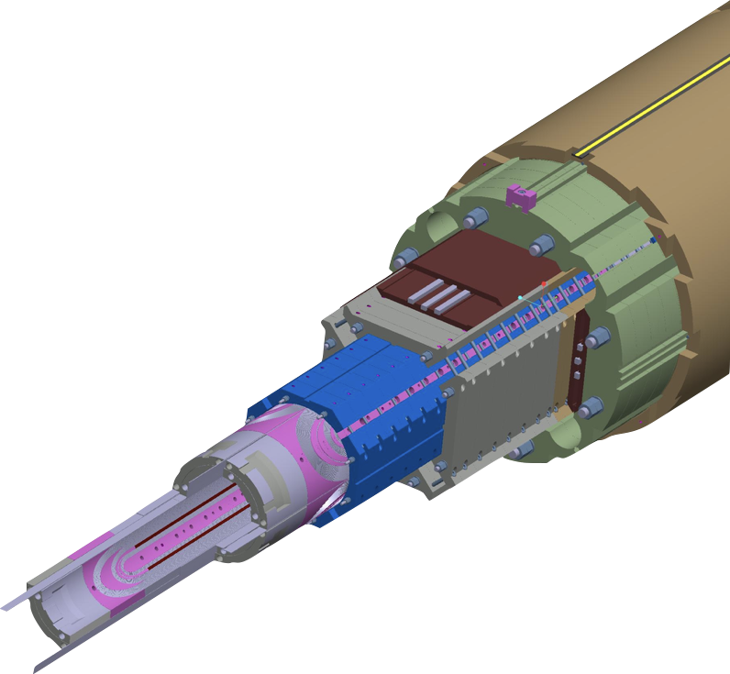
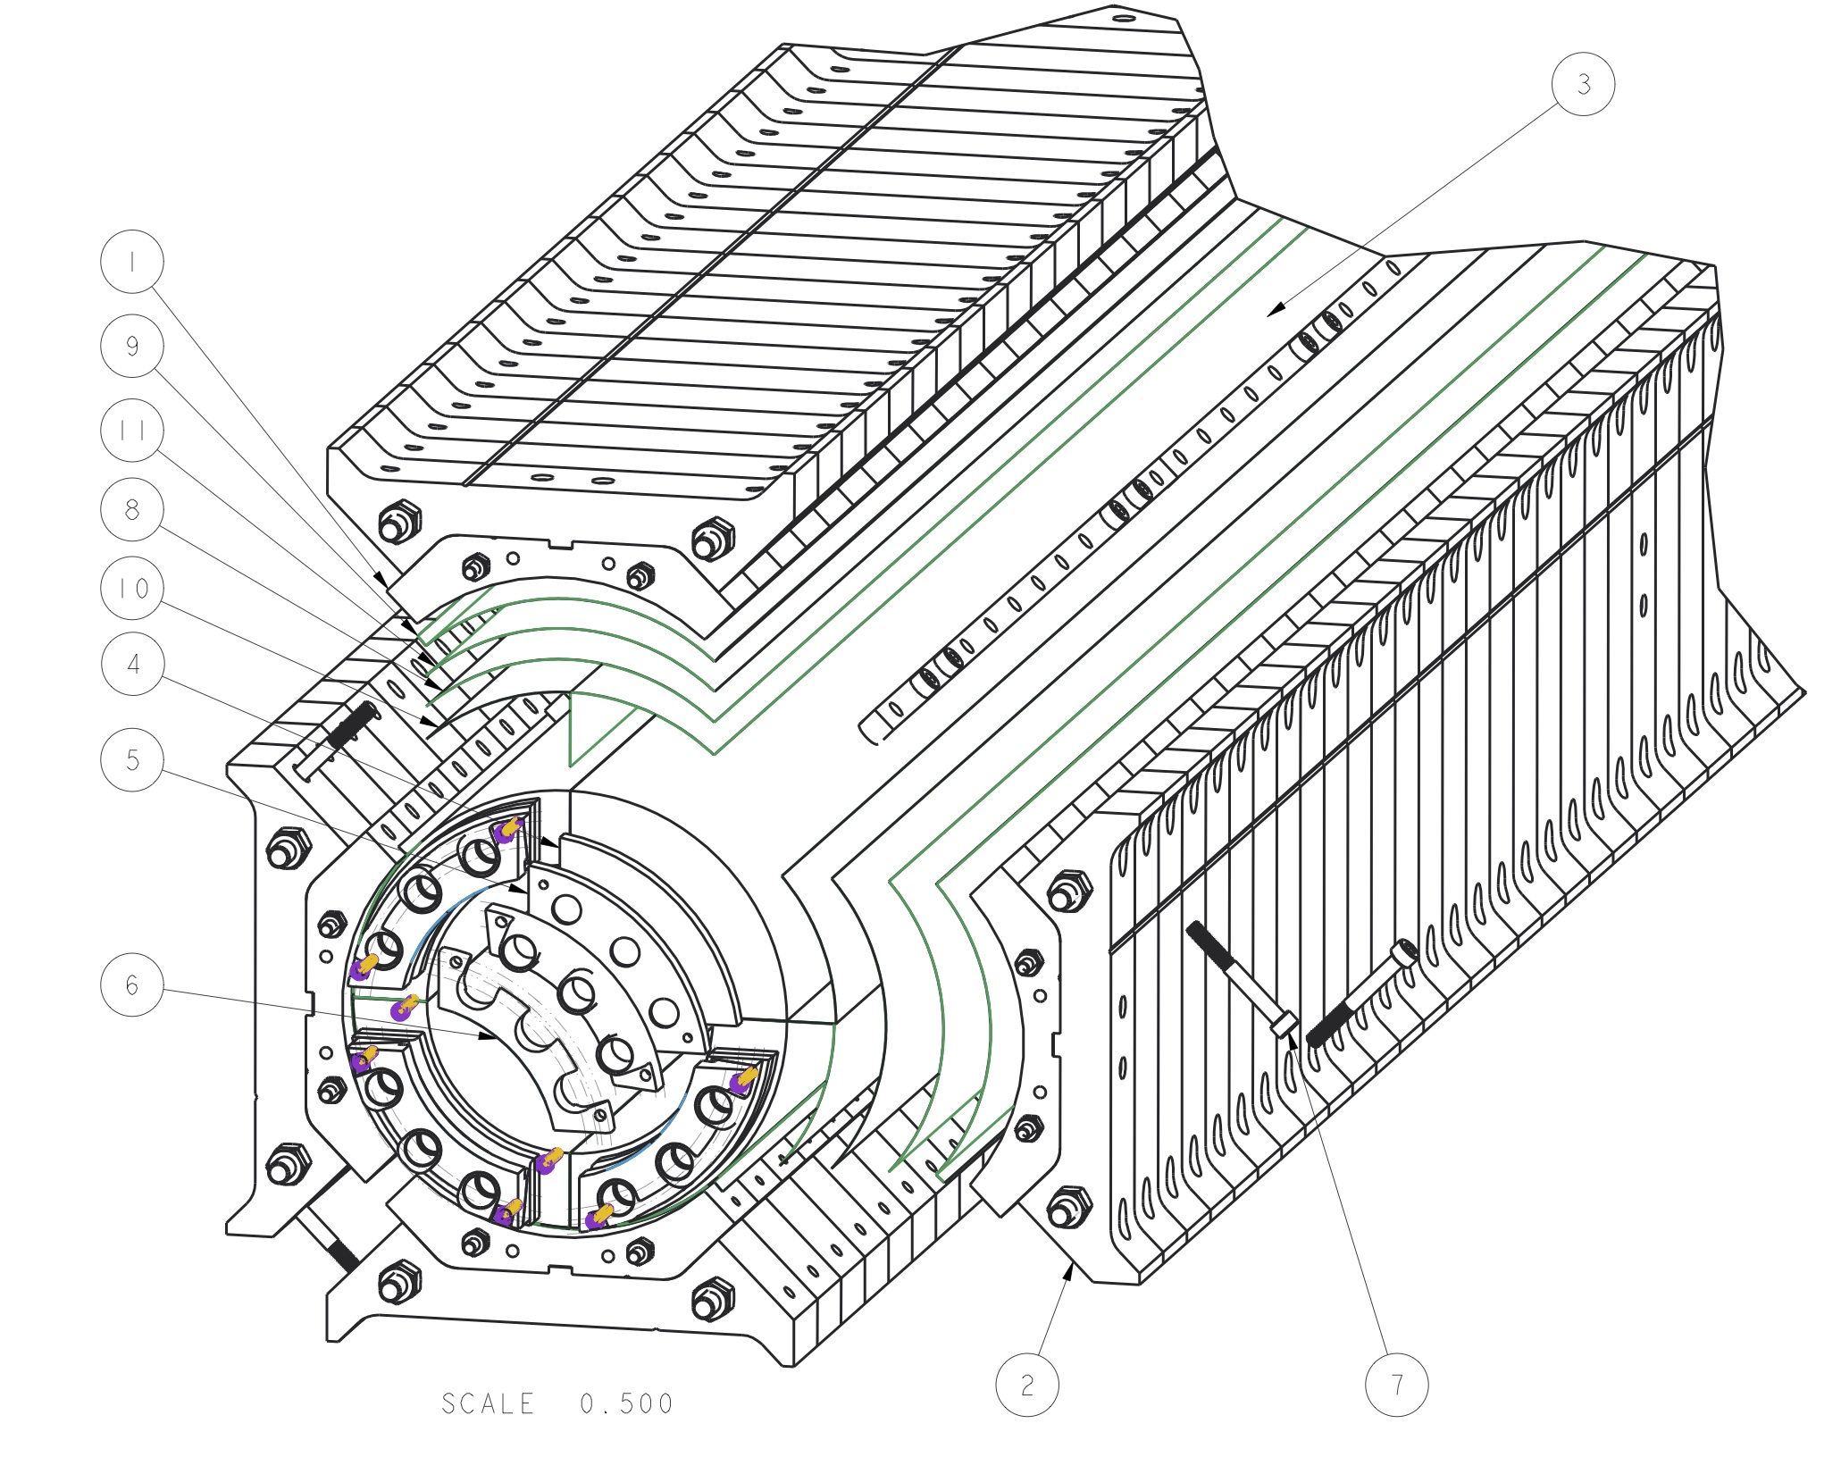
Exploded views of the MQXFA magnet structure

Slide 6
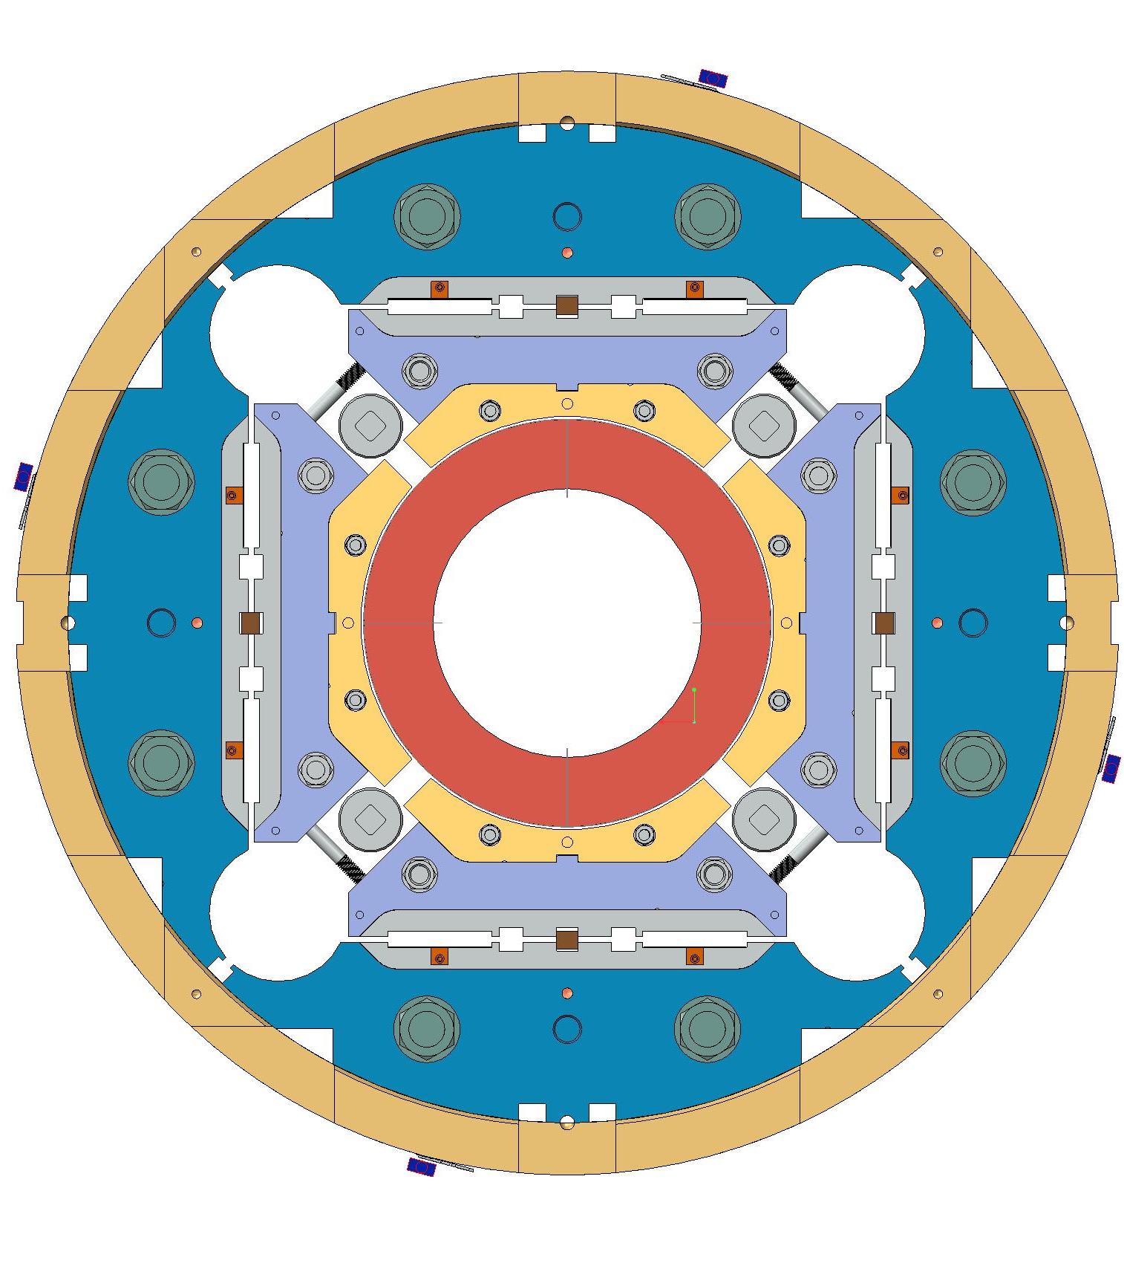
Primary MQXFA Structure Subassemblies
Shell-Yoke Structure
  Half-length subassemblies
  Joined shell-yoke subassembly, full-length
Coilpack
  Coil pack subassembly
    Load pad stacks
  Collar pack subassembly
    Collar stacks
    Instrumented and GPI wrapped coils
Master Key packages
  Alignment keys
  Load keys
  Bladders
Axial load
  Axial rods, [end plates, wire guides]
Splice Connection box
Magnet support ring
  Instrumentation connector skirt

Slide 7
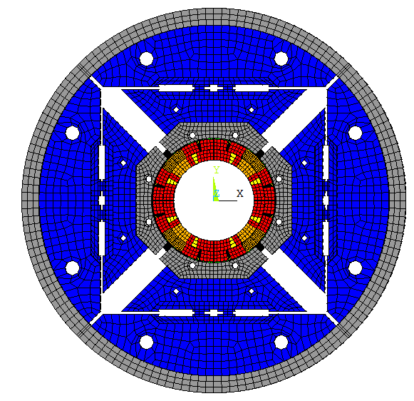
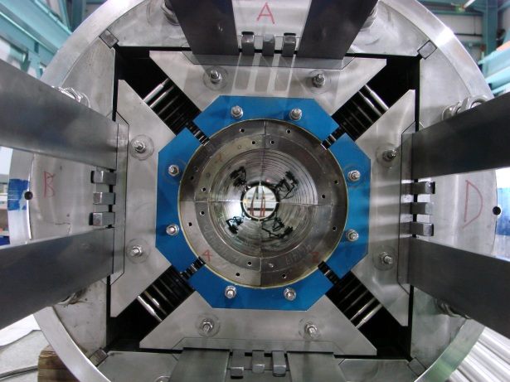
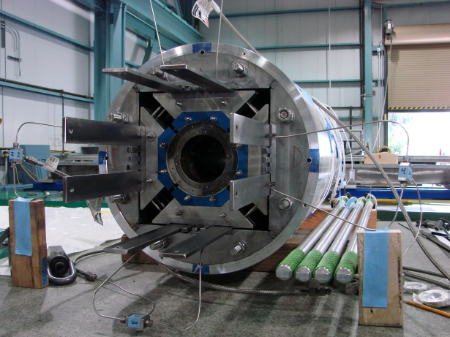
Shell –based support structure concept
Shown here on HQ
Slide by Helene Felice
Shell-based support structure often referred as
“bladder and keys” structure developed at LBNL for strain sensitive material
coil
pad
shell
yoke

Slide 8
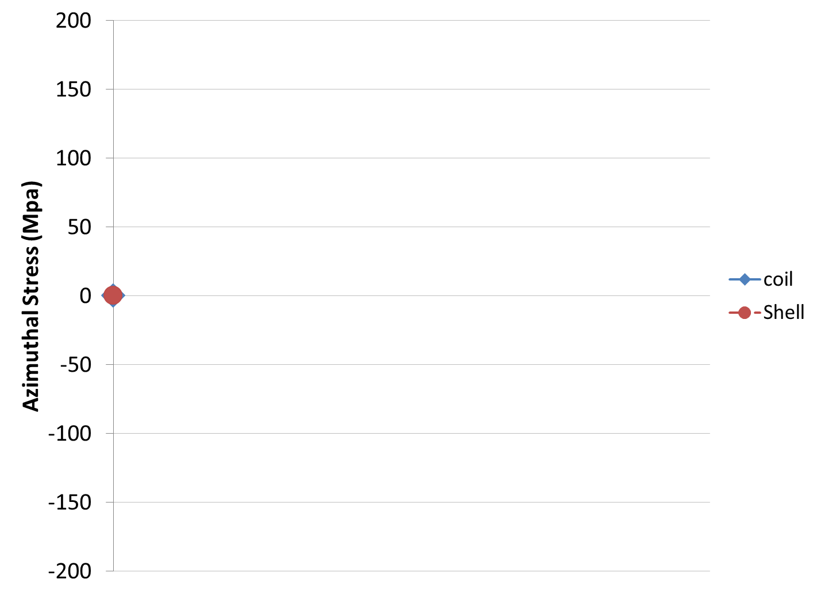
Shell-based support structure
Concept
Slide by Helene Felice
Shell-based support structure often referred as
“bladder and keys” structure developed at LBNL for strain sensitive material

Slide 9
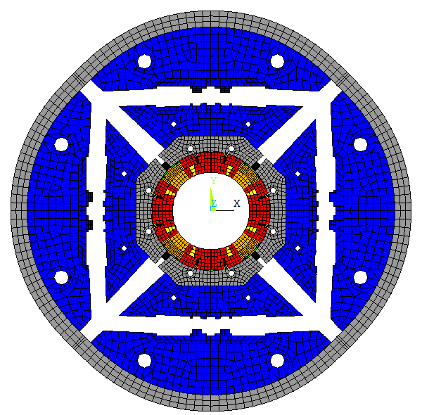
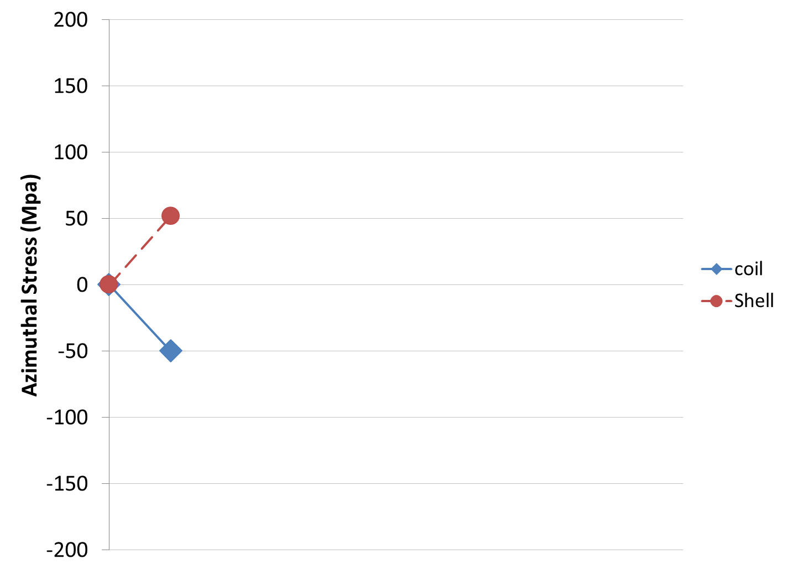
Shell-based support structure
Concept
Inflated Bladders
Slide by Helene Felice
Shell-based support structure often referred as
“bladder and keys” structure developed at LBNL for strain sensitive material
Bladder
Displacement scaling 30

Slide 10
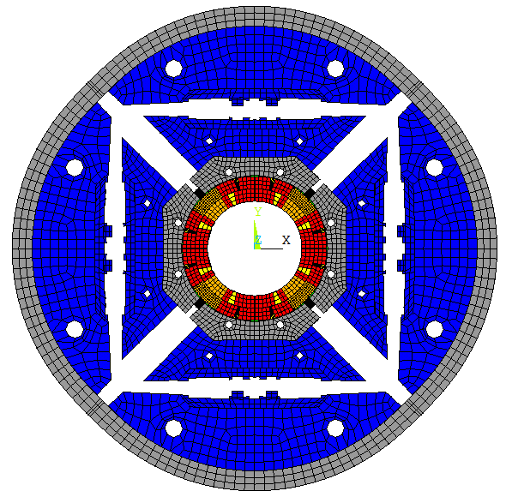
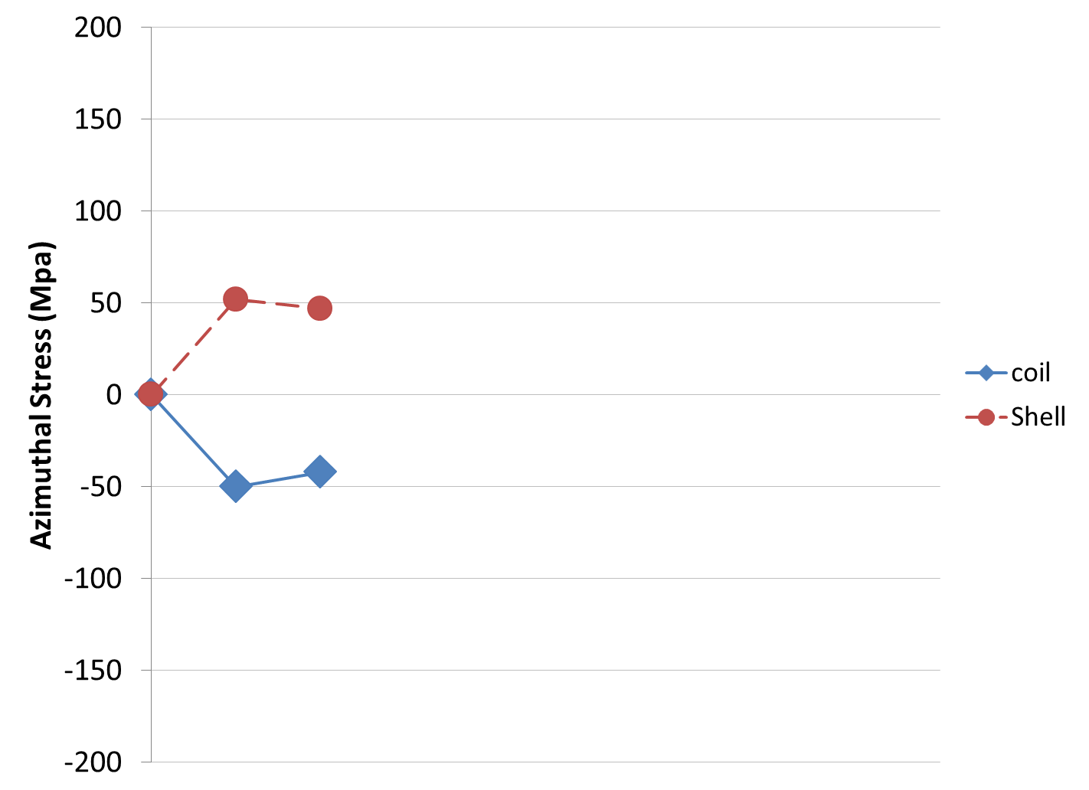
Shell-based support structure
Concept
Shimming of the load leys
Slide by Helene Felice
Shell-based support structure often referred as
“bladder and keys” structure developed at LBNL for strain sensitive material
Load case 1a
Load case 1b
Bladder
Keys
Displacement scaling 30

Slide 11
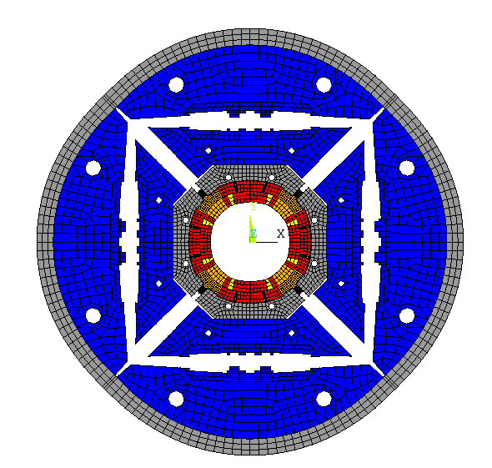
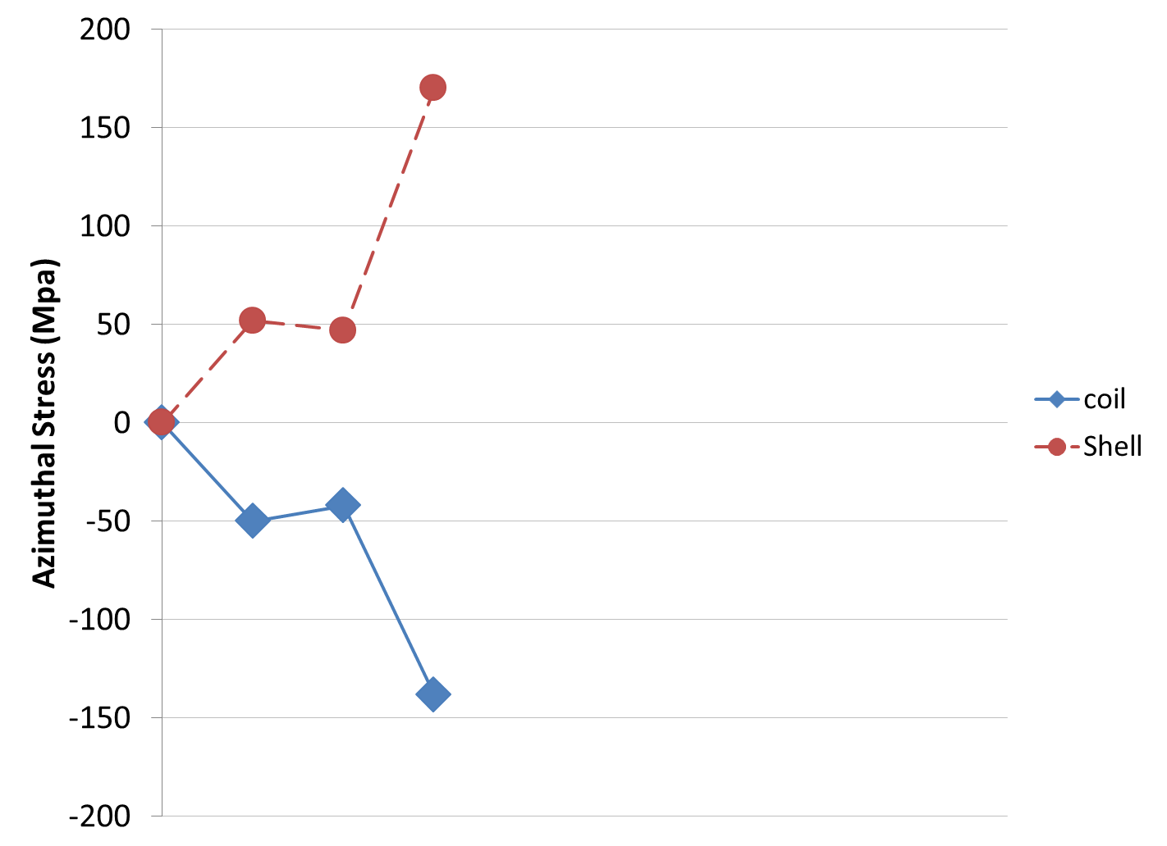
Shell-based support structure
Concept
Cool-down
Slide by Helene Felice
Shell-based support structure often referred as
“bladder and keys” structure developed at LBNL for strain sensitive material
Load case 2
Cool-down
Bladder
Keys
Displacement scaling 30

Slide 12
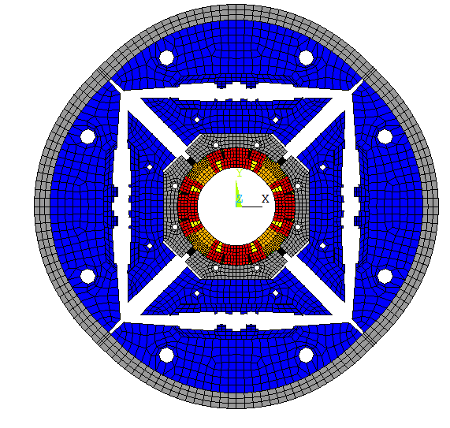
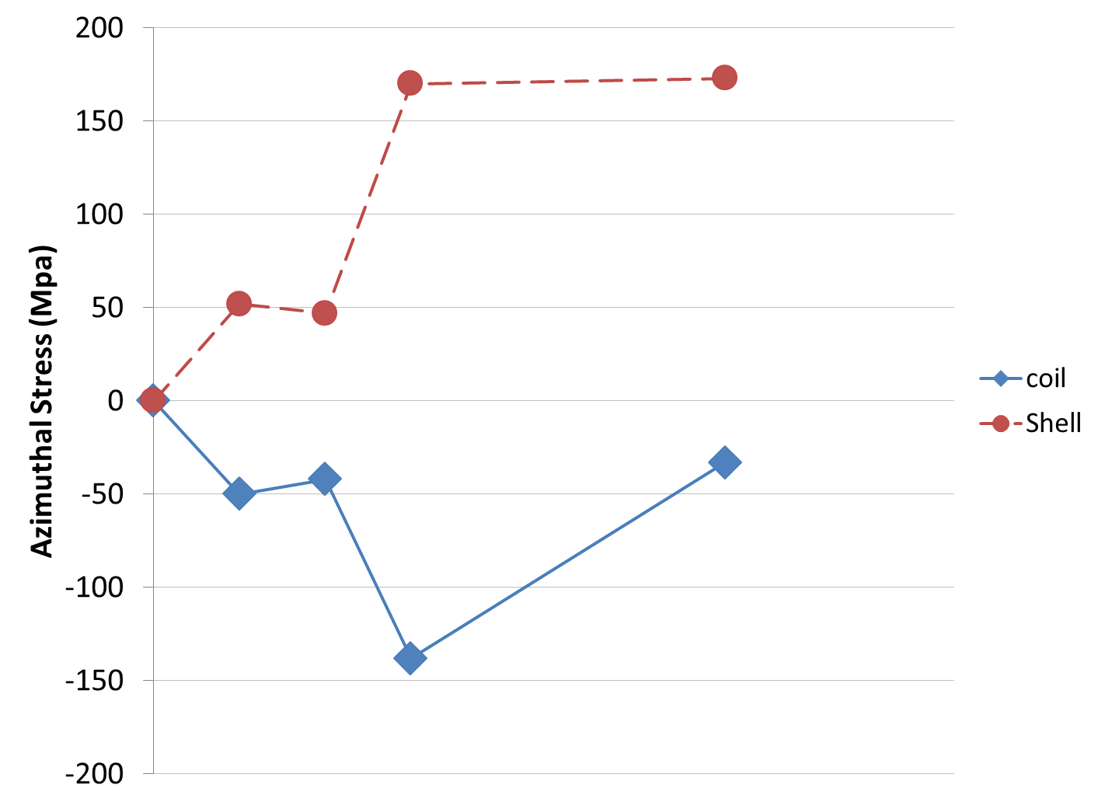
Shell-based support structure
Concept
Energized
Slide by Helene Felice
Shell-based support structure often referred as
“bladder and keys” structure developed at LBNL for strain sensitive material
Area under consideration today
Load case 3
With shell structure
Cool-down
Lorentz forces
Bladder
Keys
Support structure allowing fine tuning of the pre-stress
Displacement scaling 30

Slide 13
Summary of load cases
Load case | Load description
1 | Assembly loading (1a) and room-temperature load (1b)
2 | Cool-down to cryogenic temperature, typically 4.2K or 1.8K
3 | Operation, i.e. the system is subjected to full Lorentz forces during normal operation
4 | Fault Loads, i.e. loads outside of usual fabrication and operation
1
2
3
4
Note:
“operation” load cycle results in negligible change in stress state of components beyond coilpack subassembly

Slide 14
The graded approach
Concept is to use a consecutively more advanced and detailed analysis as the component and load case are found to result in reduced margin with respect to relevant mechanical figures of merit
Analysis should report the primary stress and the peak stress
  either maximum principle stress or von Mises stress depending on criteria
Plastic collapse failure mode will be analyzed using grades I-III, essentially analytic formulae or FEA
  Most MQXF components will be subjected to FEA
Linear elastic failure mode (grade IV) will be analyzed using the “Load Factor”, which is a function of the critical stress intensity K_{1c}
Failure modes that consist of a combination of the above will be analyzed using the Failure Assessment Diagram

Slide 15
General considerations
Material properties must be obtained either by measured data on representative material samples, or from documented literature from material of the same composition
Analysis should use material strength data at the temperature of the load case where possible
  Conservative material properties data is allowed when data at actual temperature is not available, as long as documentation is provided verifying they are conservative
Analysis should always err on the conservative side
  For analysis at intermediate temperatures, a linear interpolation of properties is deemed acceptable as that is generally considered conservative
The analysis process described in our document is tailored to the general design process that has been successfully used to date for LARP, with some important stipulations:
  Application of specific criteria is required
  Materials properties used in the analysis must be fully documented and based on the specific chemistry of the material used for the component
  Submodeling is expected under specific conditions, and the validity of the submodel size and boundary conditions must be demonstrated

Slide 16
Analysis process: grade I
Use analytic or approximate formulae under appropriate conditions to estimate stresses
Compare to criteria for grade I analysis
  If necessary, determine if mitigation is possible/desired or proceed to grade II
If design criteria are satisfied, proceed to document the analysis in a design report
This grade of analysis will only be applied to a few components of MQXFA

Slide 17
Analysis process: Grade II
Assumes FEA is applied to the component under study
Boundary conditions must be properly applied and fully documented
Proper convergence of the FEA model must be demonstrated
  Local stress concentrations in other components do not need to be resolved if it can be shown that their resolution will not impact the stress state of the part under consideration (effectively applying a variant of St. Venants principle)
Most structural elements of MQXFA are subjected to at least a grade II analysis
Mitigation measures can be applied

Slide 18
Analysis process: Grade III
For components exhibiting stress concentrations that cannot be resolved via routine mesh refinement studies
  “Advanced” FEA is applied to the component under study: stress concentrations are resolved via sub-modeling
Boundary conditions must be properly applied and fully documented
Mitigation measures should be pursued where necessary
  Component modification to reduce stresses (e.g. fillets)

Slide 19
Submodeling approach
Identify a local region of the model containing the stress concentration
  Region should extend some multiple of the characteristic length of the concentration zone in order for St. Venant’s principle to be applicable
Identify the displacements and/or tractions from the original FEA model on the sub-model boundary surface
Apply the displacements/tractions as boundary conditions on the submodel
  Good practice: Evaluate the submodel with original mesh size and verify that original stress distribution is found
Refine the submodel mesh until convergence is obtained
  Convergence monitored by ||σ_{vm}||_{max}
Monitor submodel interface stresses to verify St. Venant’s principle remains valid, using following FoM:

Slide 20
Analysis process: Grade IV
For materials that exhibit fracture failure modes a systematic and sufficiently conservative approach must be taken
We apply the ”R6” formulation*:
  Use the mode I stress intensity
  Flaw size (a) is a “variable”; goal is to have a design that meets criteria with a dimension (a) that can be achieved in inspection
  Approach: identify critical flaw size “a_{c}”, e.g. where K_{I} just meets criteria
  Verify that component inspection will identify flaws smaller than “a_{c}”
“Influence Coefficients” G_{i} are tabulated
*British Energy Generation Limited, "Assessment of the Integrity of Structures Containing Defects", 678 R6 Revision 4, Amendment 7, April 2009.

Slide 21
Example clarifying notation
Take into consideration stress distribution in component to 3rd order (beyond membrane and bending)
Where possible it is recommended to modify the design to either avoid stress concentrations resulting in plastic deformations, or limit the size of the plastic region for subsequent analyses.

Slide 22
Determination of load point in the Failure Assessment Diagram
For a given component & load:
  Evaluate critical intensity K_{ic}
    Measured data
  Evaluate flow stress σ_{c}
  Evaluate/estimate K_{I} and σ,
  Find (S’_{r},K’_{r})
  Evaluate (S_{r},K_{r})
  Determine the Load Factor:
  The Load Factor is then used for design criteria assessment

Slide 23
Grade IV analysis – additional elements
If there is stress concentration that exceeds yield strength
  Perform bi-linear (i.e. conservative) elasto-plastic simulation and verify that plastic region (defined by 3% coincidence definition) is not larger than the critical flaw size identified by the FAD process
Any allowed K_{I} must be in the elastic regime
  Mitigation measures must be implemented to address this criteria

Slide 24
Documentation
Each structural component of the MQXFA magnet is expected to have a document detailing application of the design criteria
  A single document may address more than one component
  The document must address the following elements:
    Design Data – e.g. material properties used in the analysis, and how they were obtained
    Graded Analysis - application of the graded approach, e.g. equations used, boundary conditions applied, transition from one grade to the next, etc
    Assessment of Analysis – application of any mitigation measures, details of FEA, demonstration of convergence, etc
    Application of Design Criteria - confirmation that final design meets criteria

Slide 25
MQXFS – Magnet Powering
Courtesy Giorgio Vallone
~2-5% of σ_{φ,max}
Delta of stress: rods
Delta of stress: shell
Shell azim. stress variation during powering:
  Very small/negligible until pole/coil unloading
  At ultimate current, lower than 10 MPa (<5% of the stress after C.D.)
Rod long. stress variation during powering:
  Function of the structure (thin/thick iron laminations)
  At ultimate current, equal to about 5 or 7 MPa.
  Strain signals can be used to extract the coil elongation (<0.01%)

Slide 26
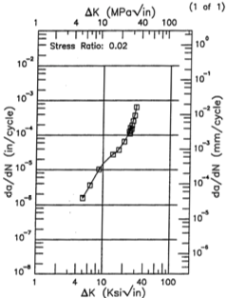
Application of Paris Law integration suggests negligible crack growth in Al-7075-T65 shells
Paris law is applied to verify that crack growth is negligible for the 5000 cycles required by the Functional Requirements (suggestion from a reviewer)
 | M (MPa) | B+M (MPa)
B=0 | 319 | 382
Norminal | 330 | 401
Ultimate | 337 | 409
Note: measured yield strength at 4.2K is ~635MPa
(469MPa at RT)
M-- Membrane stress;
B+M --- Bending + Membrane stress
Note: Values are in stress concentration region;
In main shell area the values are 171MPa & 181MPa
ΔK for the 7075-T65 Al shell under cyclic loading from 0<I<I_{ult}
=> Below threshold (~2.3)
At this growth rate, 5000 cycles results in 0.15mm growth

Slide 27
Extra - Shell

