Slide 1
Structural Criteria
Eric Anderssen
HL-LHC AUP Magnets, LBNL
Review of Structural Design Criteria for Al-7075

Slide 2
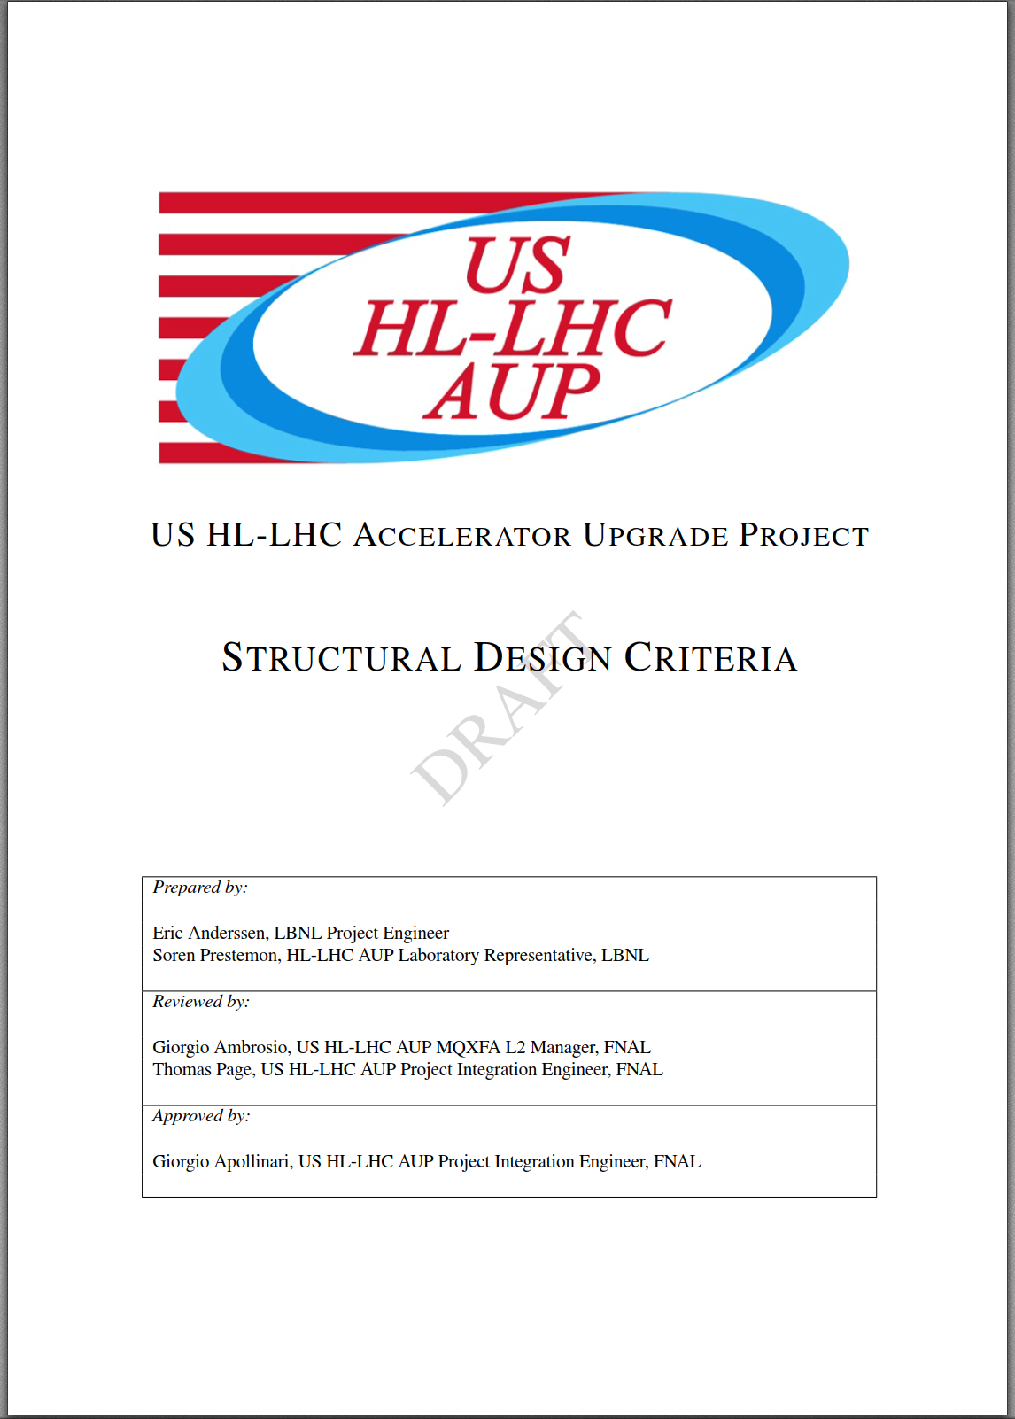
Outline
Metallic Component Criteria
Scope
Static Stress Limits
Limiting Stress Values
Fracture Assessment
Conclusion

Slide 3
Scope of this Structural Design Criteria
This Structural Design Criteria does not include the welded pressure vessels of the LHe containment vessel or cryostat
These are treated by either the B&PVC and the PED, homogenization of the two is beyond scope of this review
Scope here is to define Static Stress Limits using values consistent with the FAD, using language similar to the B&PVC for plastic limits and some conservatism on fast fracture limits

Slide 4
Static Stress Limits
Static Stress limit represents a catastrophic failure of the component limiting it’s ability provide required loads
Failure can occur by Plastic Collapse or Fast Fracture
The design criteria presented in this document approach those presented in the B&PVC for Plastic Collapse
Load factors for Fast Fracture approach those presented in FFS-1

Slide 5
Limiting Stress Values (1)
Plastic collapse assumes the formation of a plastic hinge through the component cross-section (non localized as might occur at a peak stress location)
For this document onset of yield at 0.2% offset is used as an assessment criteria unless relevant data is available to calculate the flow stress at cryogenic temperatures
Serrated yielding may make yield stress the most reliable value
Conservatism presented in the codes, e.g. limiting primary stress (σ_{m} + σ_{b}) to 2/3 σ_{y} predates extensive use of FEA and material databases
In the codes, S_{m} the limiting stress value is limited to 2/3 σ_{y} or 1/3 σ_{u} . (we do not use σ_{u}, except in context of σ_{c} )
We use S_{m} = 0.8 σ_{y} or σ_{c} here to be more consistent with the FAD, and modify enhancement factors (‘K-Factors’ in the code) accordingly

Slide 6
Limiting Stress Values (2)
The choice of 0.8 also relates to the load factor for fracture assessment
K_{Ic} is used as the primary fracture assessment value, but a load factor equivalent of 0.8 on the yield axis for the FAD is also applied for fracture—presented later.
Material properties have been largely determined by LARP/CERN while some will be furnished by AUP
Use of 0.8 versus 2/3 is commensurate with the more extended use of FEA and availability of material test data at relevant temperatures

Slide 7
A comment on Material Properties used for Assessment Criteria
Limiting stress values described before use so-called ‘A-Basis’ properties where available
A-Basis is where at least 99% of the population equals or exceeds value with 95% confidence
For normally distributed population, this is mean minus 3 sigma
MIL-HDBK-5 reports A-Basis properties at Room and Elevated temps (some down to LH2)
Some less common materials use B-Basis (90% pop at 95% CL
Will test materials at 4K and generate A-Basis values for use
MIL-HDBK-5 and other standards have methods to handle non-normally distributed data
Defined tests for Normality, and/or use of Weibull Distribution to establish similar confidence limits
Assessment values in this design criteria do not include additional factors of safety above this confidence limit

Slide 8
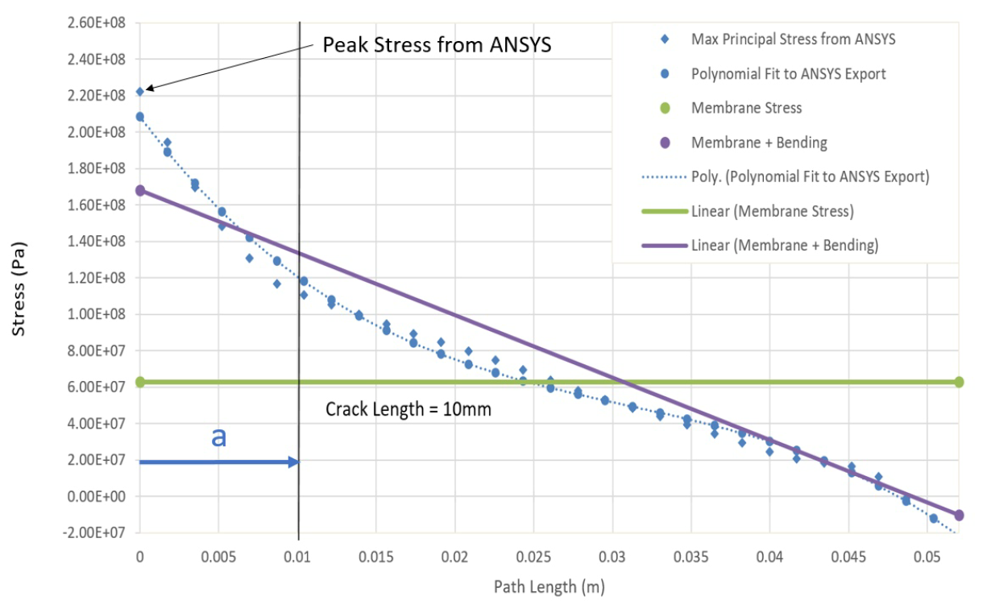
Distortion energy limit for Peak Stress
‘Peak’ Local Primary Stress
Membrane
Note ‘Peak’ here means ‘maximum,’ not the ‘peak stress’—likely need to update section heading…
Based on elastic stress analysis with limited plasticity, uses linear decomposition of stresses
Membrane stress shall not exceed 1.0 K S_{m} .
Local Primary stress shall not exceed 1.20 K S_{m} .
K-factors shown next—modified from standards such that ‘Local Primary’ limit is the yield stress

Slide 9
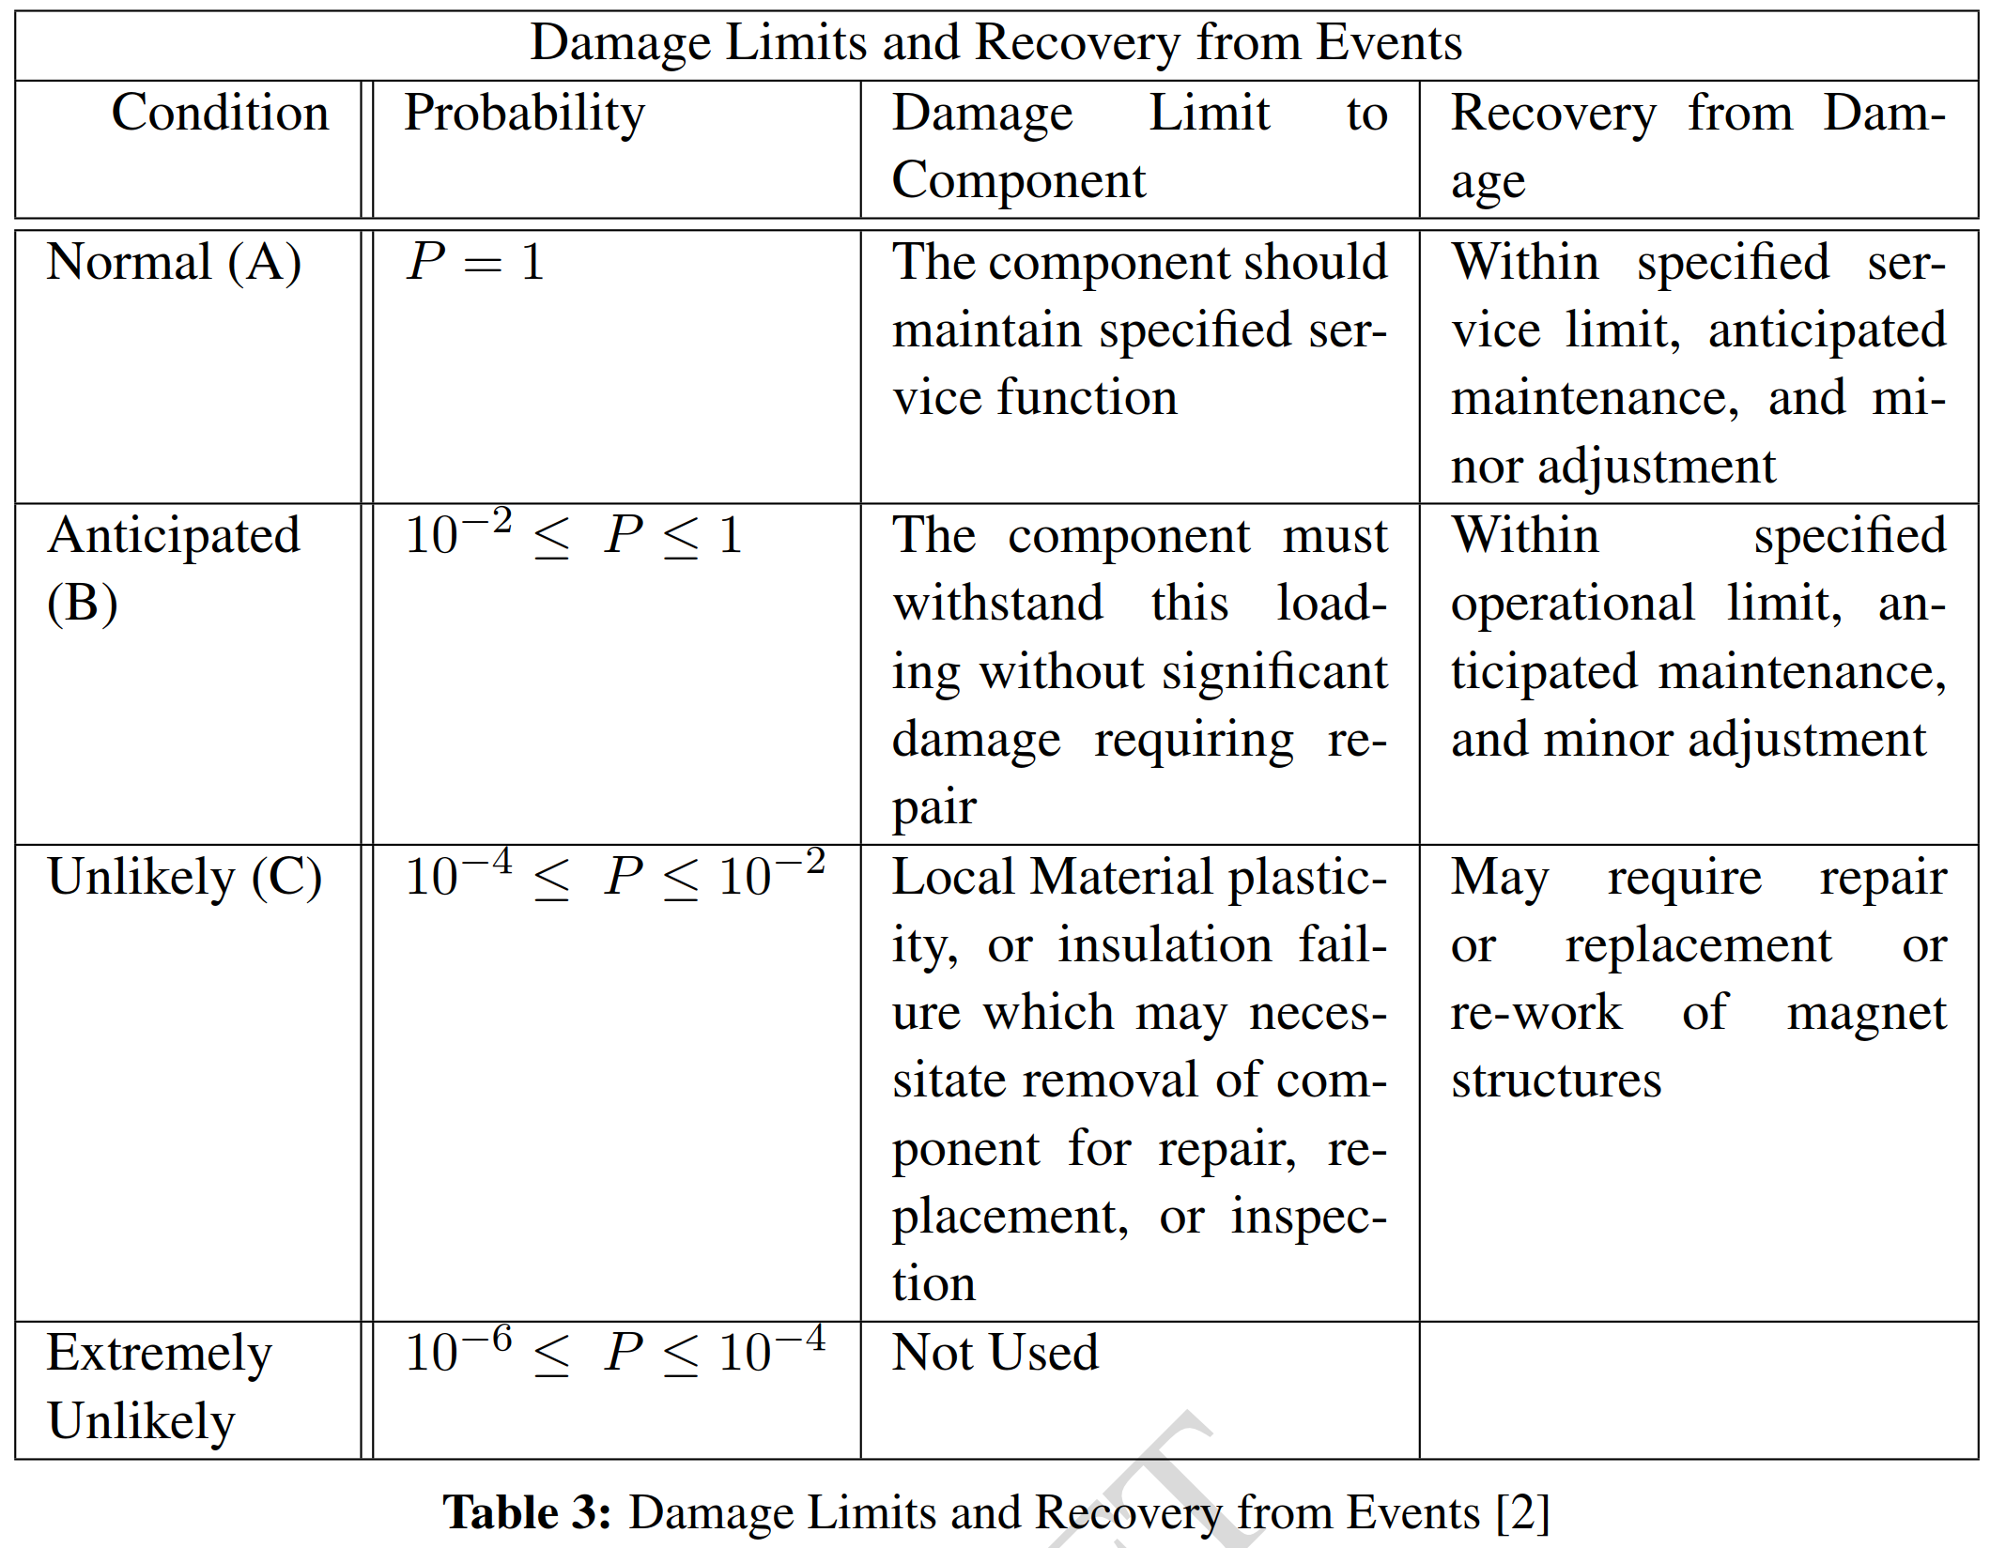
K-Factor Comparison
K-Factor: | Applies to Load case:
K= 1.00 | 1b, 2(cold) 3(operation)
K= 1.10 | 1a (loading)
K= 1.20 | 4(Fault) requires assessment after occurrence
K= 1.35 | unrepairable
Comparing (A) to Primary stress criteria, limit stress is 1.0 σ_{y} .
Comparing (B) to Primary stress criteria, limit stress is 1.1 σ_{y} .
Comparing (C) to Primary stress criteria, limit stress is 1.2 σ_{y} .
In Condition (C) Membrane stress never exceeds 0.96 σ_{y} .
[2] NSTX Structural Design Criteria

Slide 10
Load Factor versus Factor of Safety
Iron
$$K_{I}=Yσ\sqrt{a}$$
Load point moves on 45deg line for increasing stress in FAD space, not along load line
Load point trajectory of a propagating crack depends on stress field it propagates into
Stress Increase
Stainless
$$K_{Ic}=150 MPa\sqrt{m} \left(SS\right)$$
$$K_{Ic} = 30 MPa\sqrt{m} \left(iron\right)$$
For the same component made of iron or stainless steel with similar σ_{y}, but differing K_{Ic}, the load factor can vary substantially for the same flaw
Here 0.33 σ/σ_{y} (FoS= 3), is clearly sufficient for a component in SS, but inadequate if made of Iron, with identical flaw
The Load factor for Iron is already less than one, but > 2 for SS—note that this ratio is not the ratios of respective K_{Ic}, so Load Factor is not FoS

Slide 11
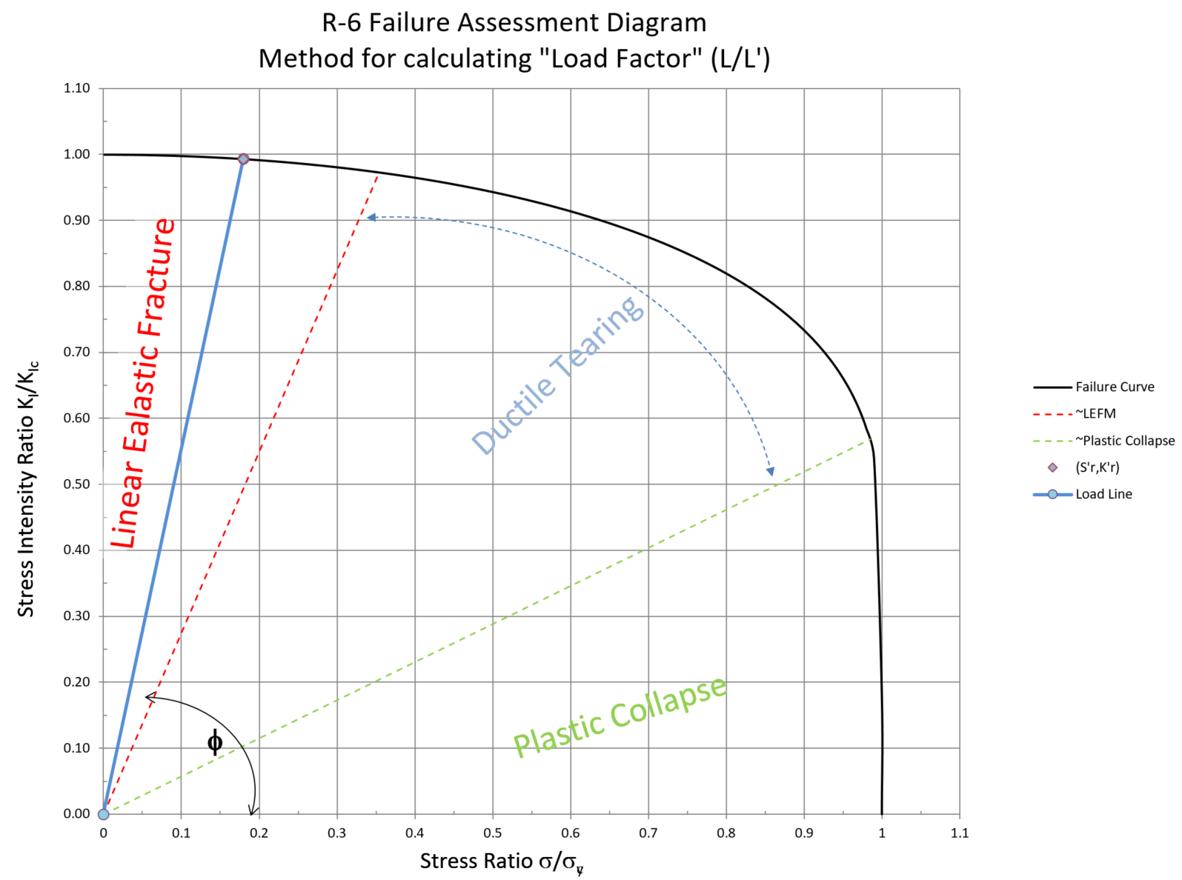
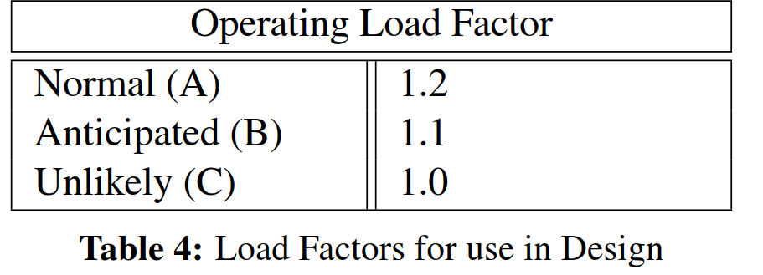
Limits for Fast Fracture and Comparison to other Design Criteria
K_{Ic} as a sole criteria against fracture is valid at low stress ratios and becomes less conservative above 0.4 σ/σ_{y} .
Factor of safety of 1.5 used in ITER against fast fracture
At this limit, σ_{y} and K_{Ic} do not interact
We will use the range of the FAD above (K_{Ic} /1.5) described in FFS-1 which can allow load factors of up to 1
We use more conservative values shown in table to right
Number in brackets is equivalent ratio along axes in FAD, i.e. equivalent to a FOS of 1.2 for an un-flawed structure
For MQXFA, (A) contains the peak loads at cold
K_{Ic} alone becomes less valid
(K_{Ic} / 1.5) or Plastic Limit Dominate
Failure Assessment Diagram
[0.83]
[0.91]
[1.00]

Slide 12
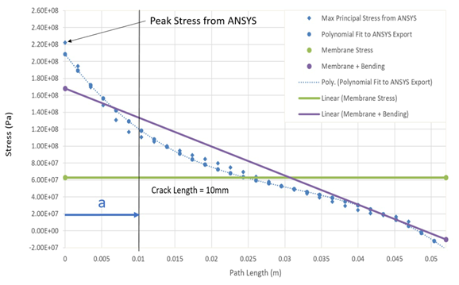
Critical Crack and Self Arrest
It is possible that a crack may propagate in our structures particularly near discontinuities
If the crack propagates to a region of lower stress it is possible that it will self arrest
Less conservative than no stable growth, but criteria allows demonstrating arrest
Locus of points shown schematically of a critical flaw growing to a region of lower stress ratio

Slide 13
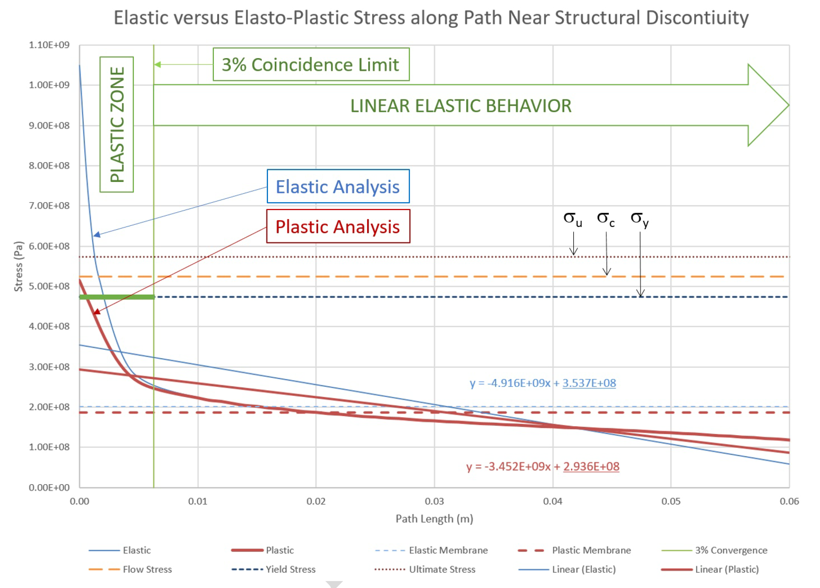
Elasto-Plastic Analysis applicable for both Plastic Collapse and Fast Fracture
Elasto-Plastic analysis with limited yielding also uses the von Mises limits
Local primary stress decreases, with only small changes to membrane stress
Case above would have passed criteria without the inclusion of the elasto-plastic results, e.g. 480/350 =1.37; EP analysis makes this factor 1.6
Analysis above required for Fracture assessment, with post-mitigation steps limiting the size of the plastic zone to be under the critical flaw size

Slide 14
Flaw Assessment Caveats
Should note that we colloquially say a crack may grow—sub-critical cracks do not grow
We ignore any initiation phenomena by way of stating that we inspect for flaws that may grow to critical size and limit size of plastic zone to same
We ignore crack coalescence as each of these smaller cracks should be sub-critical and should not interact
Fatigue using da/dN rates assumes a load that allows cracks to become critical (grow) cyclically; we design against stable crack growth, so expect no fatigue behavior in our structures
A da/dN analysis for nominal material values shows this is true

Slide 15
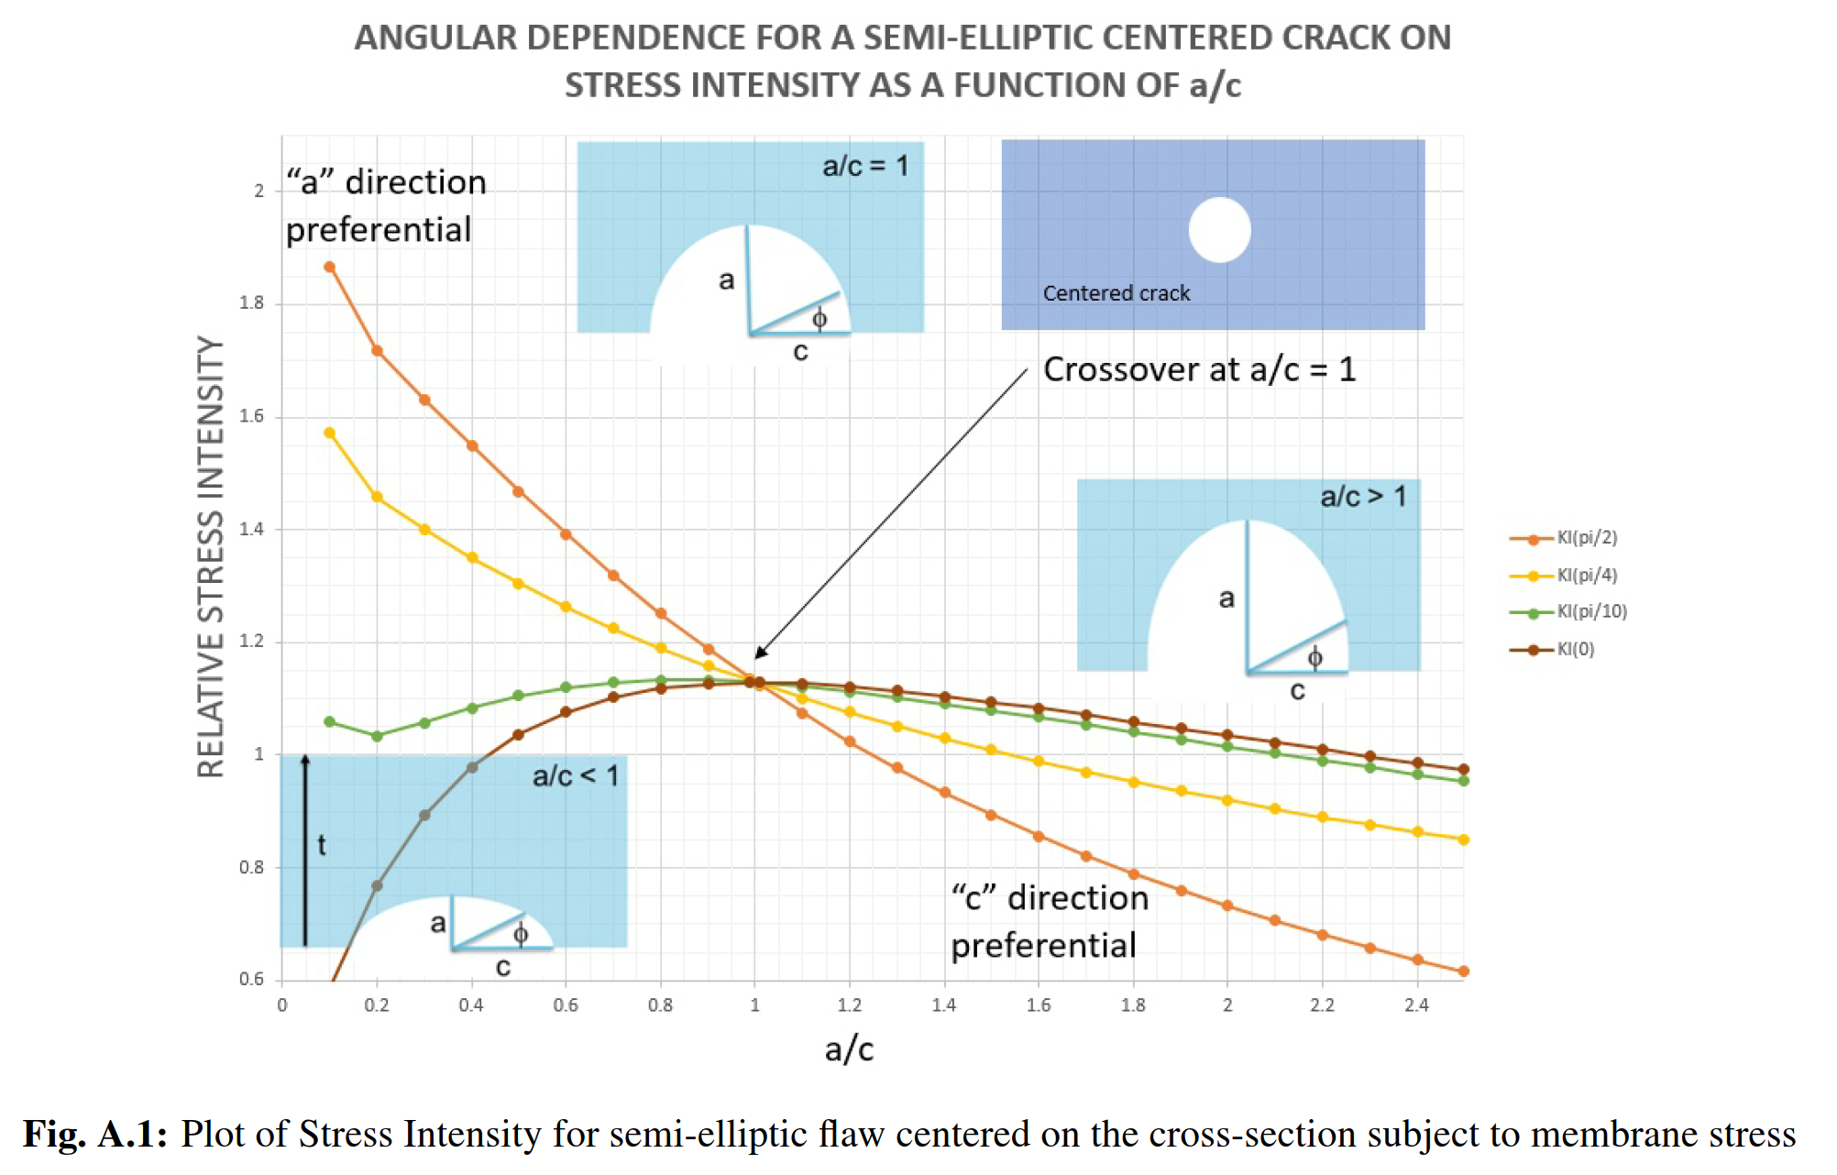
Flaw Shape used in Assessment
A hypothetical ‘critical’ crack that is not round will grow in the ‘a’ or ‘c’ directions until a=c
For an edge crack, a/c approaches 0.8 (other plot in appendix)
Influence coefficients do not vary much between these two cases
Will always use a/c = 1 in Grade IV analysis for this reason

Slide 16
Critical Flaw Size Assessment by Analysis
A thumbnail crack with geometry a/c=1 will be used in the location of peak stress
K_{I} will be assessed with increasing flaw size ‘propagating’ along the stress path
The crack length will be called ‘critical’ when the load factor approaches unity (or the margins now stated for load severity)
Note that the stress path is required to assess the stress ratio σ/σ_{y} on the FAD, and assure that the assessed length is within the elastic zone—if not, mitigation steps in Grade II or III are required for validity of LEFM
This ‘critical crack length’ will then be used to determine required inspection limits for components

Slide 17
Calculated Critical Flaw versus Inspection
Intention is to tie the ‘critical’ semi-circular flaw size determined in analysis to irregular flaw geometries likely encountered during inspection
In the case of Appendix B, specifically for the 7075 Shell, which is most critical
For Yoke components (many smaller components) they can more easily be rejected if surface flaws are detected in relevant regions, or accepted if ‘consequence of through crack’ is small (TBD)

Slide 18
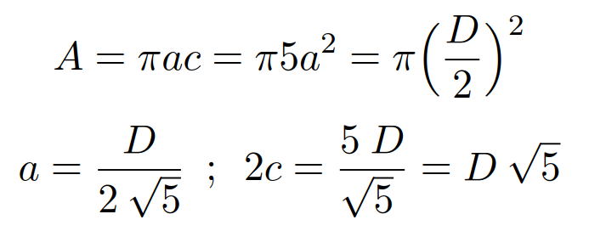
Assumed Flaw Geometry for Inspection
Critical Geometry
Inspected Geometry
Typical inspection in B&PVC used c/a ratio of 3, we have chosen 5 to be conservative
Ultrasonic inspection responds to area, not geometry so a flaw with a length to width ratio of 5 may grow to a circular flaw upon loading
We take the analyzed circular critical flaw dimension ‘a’, and map to a similar area flaw with a/c=0.2, then assume it will grow to a circular flaw
Above assumption is conservative as actual growth requires criticality
This factor of root-5 (2.23) decreases the inspection limit, i.e. for a 2mm flaw, an inspection limit of 0.9mm is required

Slide 19
Example for Shell using ASTM B594
ASTM B 594 does not specify resolution, simply calibration standards which are assumed to be the sensitive limit
The different inspection classes specify a given flat bottomed hole as a calibration
As such, critical flaws (2a) are related to the calibrated hole via the table above (note factor of 2.23)
Relative cost of Class A vs AA is negligible, AAA is full immersion testing of the shell forging

Slide 20
Conclusion
Presented a conservative methodology similar to B&PVC and other SC Magnet design criteria for assessment of plastic failure of MQXFA structures
Fracture geometries used are relevant and conservative
Inspection limits are tied to critical flaw size analysis
A well defined inspection regimen following this design criteria should allow use of brittle materials in MQXFA

Slide 21
Backup Slides

Slide 22
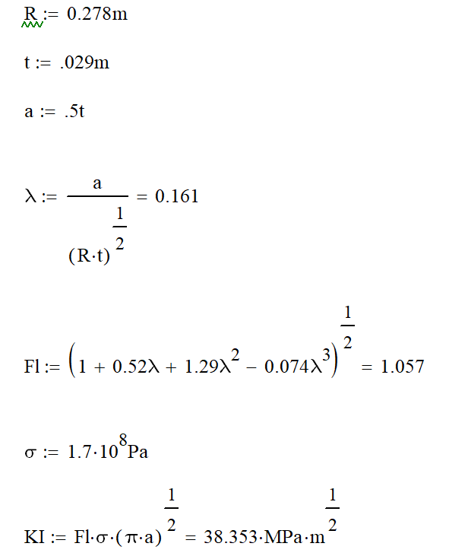
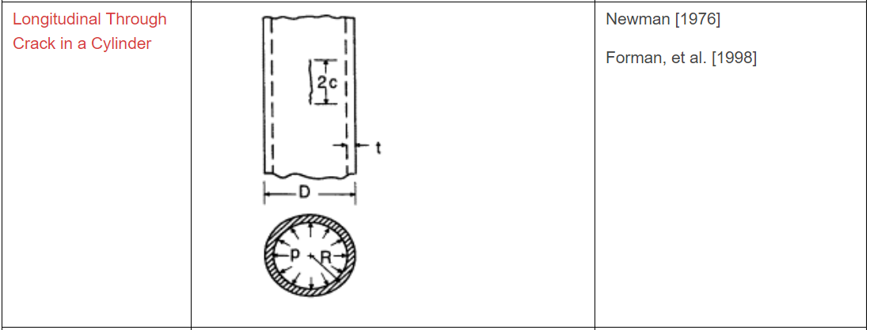
Through Shell Crack Calculation
A thru-crack equal to the thickness in length could be critical—awaiting data on K_{Ic} at 4K
Ranging from 20-60 MPa-m^{1/2} in literature
Would have rejected shell with detectable flaw
da/dN is small, perhaps below initiation limit

Slide 23
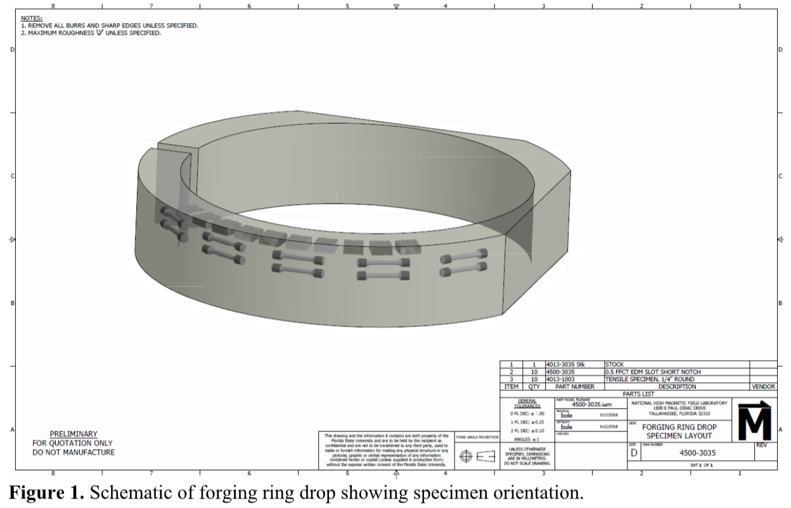
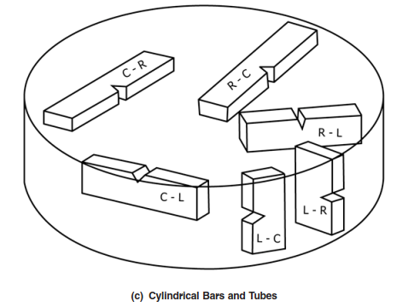
Tensile and Fracture Samples
Using forging drop from shell with same %work and heat treat
Tensile properties in crack-opening direction of C-R sample orientation
Dual Purpose CT specimen used for both Fatigue Crack Growth Rate and K_{Ic} after FCGR has been measured

Slide 24
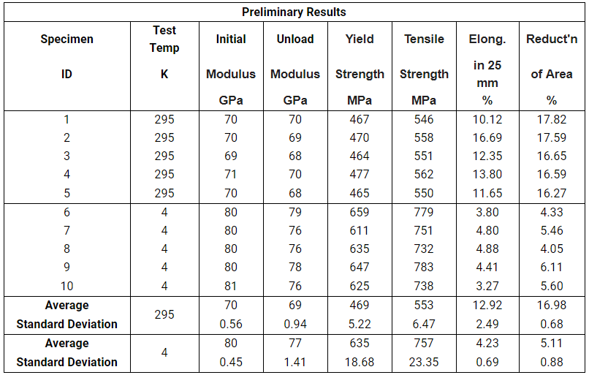
Preliminary Tensile Results 4K and 295K
Data is preliminary, Fracture samples run next week
Ultimate is ~18% higher at both temperatures
Yield and Ultimate are enhanced 35% at 4k

Slide 25
Fracture testing plan
Initial contract is for 10 Dual-purpose Compact Test specimens, 5 at 295K and 5 at 4K
Additional 20 CT samples procured if initial testing shows variability (non-normality)
Extend testing to additional samples to gain sufficient statistics for accurate Normal or Weibull confidence limit analysis

