Slide 1


Introduction
Soren Prestemon
HL-LHC AUP Magnets L3 CAM - Structures, LBNL
Review of Structural Design Criteria for Al-7075
LBNL October 5th, 2018

Slide 2
Outline
High Luminosity - LHC
US Magnets Deliverables
CD-1 Review Recommendations
Design Criteria Review Recommendations
Review Charge
Review agenda

Slide 3
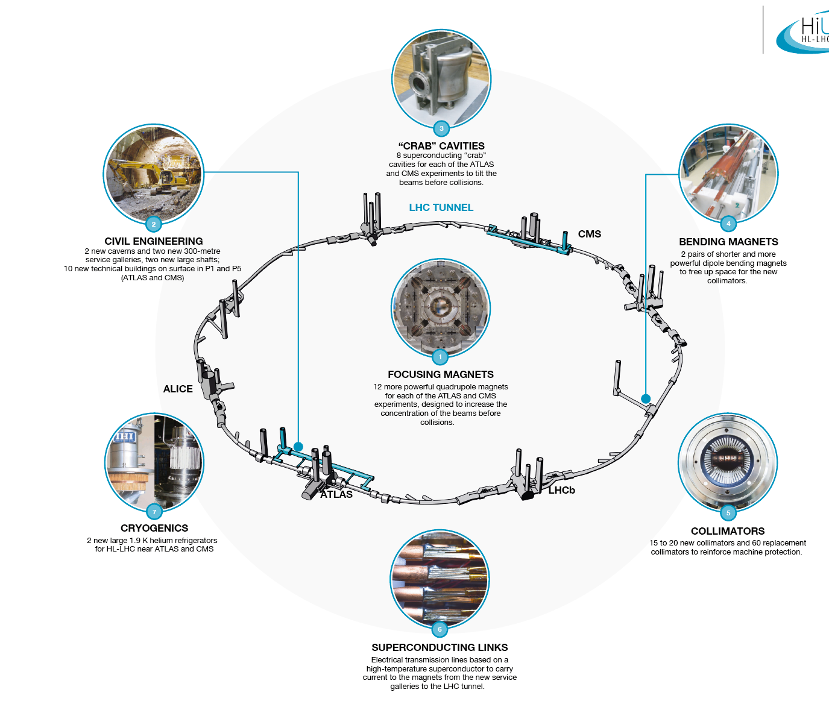
High Luminosity LHC
Large Aperture IR Quadrupoles:
From 70 mm MQXA/B to 150 mm MQXF
From NbTi to Nb₃Sn for higher field/gradient
Minimum β* from 0.55 m to 0.15 m
Compatible with 10x integrated luminosity
From L. Rossi

Slide 4
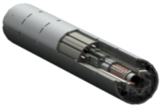
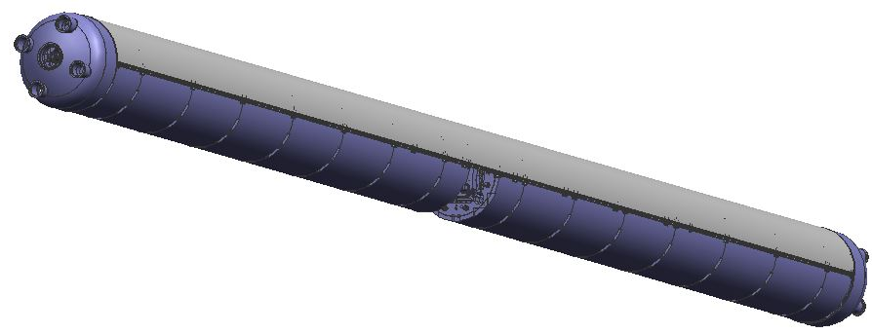
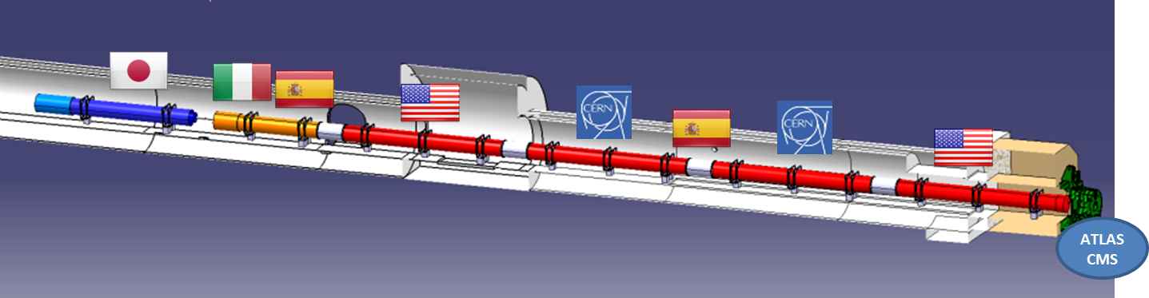
US Deliverables and main components
11 Q1/Q3 Cryostated Magnets (Cryo-assembly)
  Cold mass with two 4.2 m magnets (MQXFA)
  Cryostat parts provided by CERN (kit)
  10 Q1/Q3 + 1 Prototype
Magnet
(MQXFA)
Cryo-assembly
(LQXFA)
Cold Mass
(LMQXFA)

Slide 5
Project management structure
CAM (14)

Slide 6
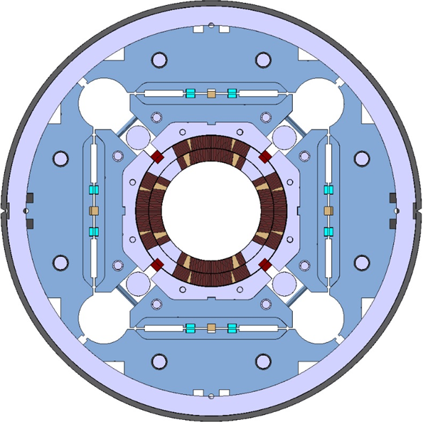
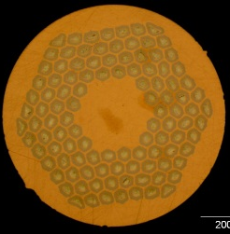
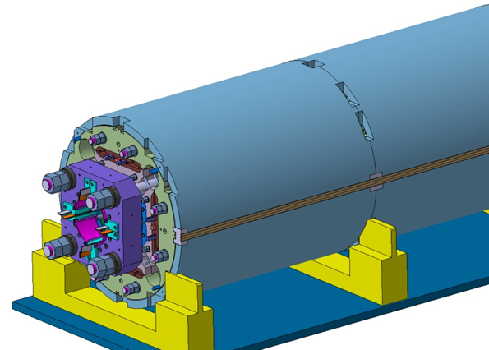
MQXFA Design
Parameter | Unit | MQXFA
Coil aperture | mm | 150
Magnetic length | m | 4.2
N. of layers |  | 2
N. of turns Inner-Outer layer |  | 22-28
Operation temperature | K | 1.9
Nominal gradient | T/m | 132.6
Nominal current | kA | 16.5
Peak field at nom. current | T | 11.4
Stored energy at nom. curr. | MJ/m | 1.2
Diff. inductance | mH/m | 8.2
Strand diameter | mm | 0.85
Strand number |  | 40
Cable width | mm | 18.15
Cable mid thickness | mm | 1.525
Keystone angle |  | 0.4
Nb₃Sn Conductor
P. Ferracin et al., “Development of MQXF, the Nb₃Sn Low-β Quadrupole for the HiLumi LHC ” IEEE Trans App. Supercond. Vol. 26, no. 4, 4000207
G. Ambrosio et al., “First Test Results of the 150 mm Aperture IR Quadrupole Models for the High Luminosity LHC” NAPAC16, FERMILAB-CONF-16-440-TD

Slide 7
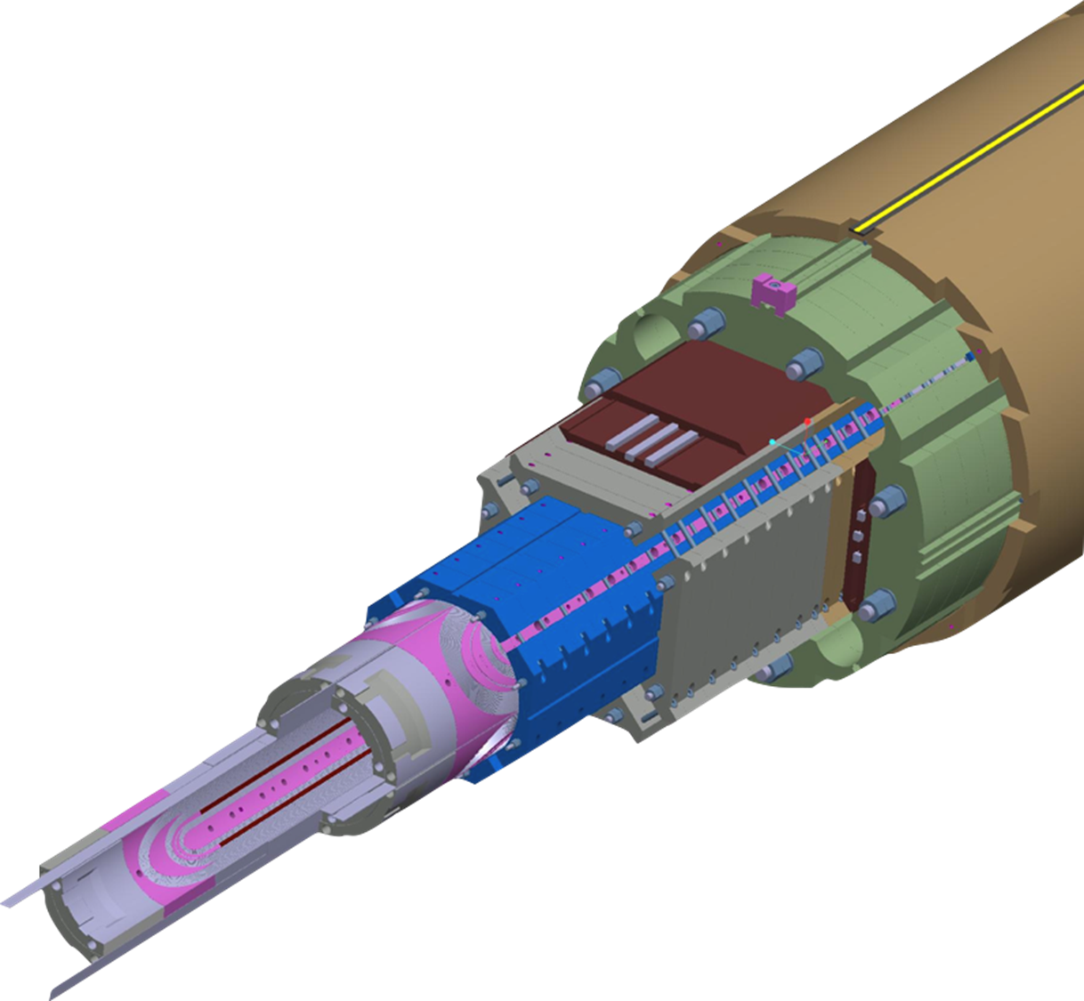
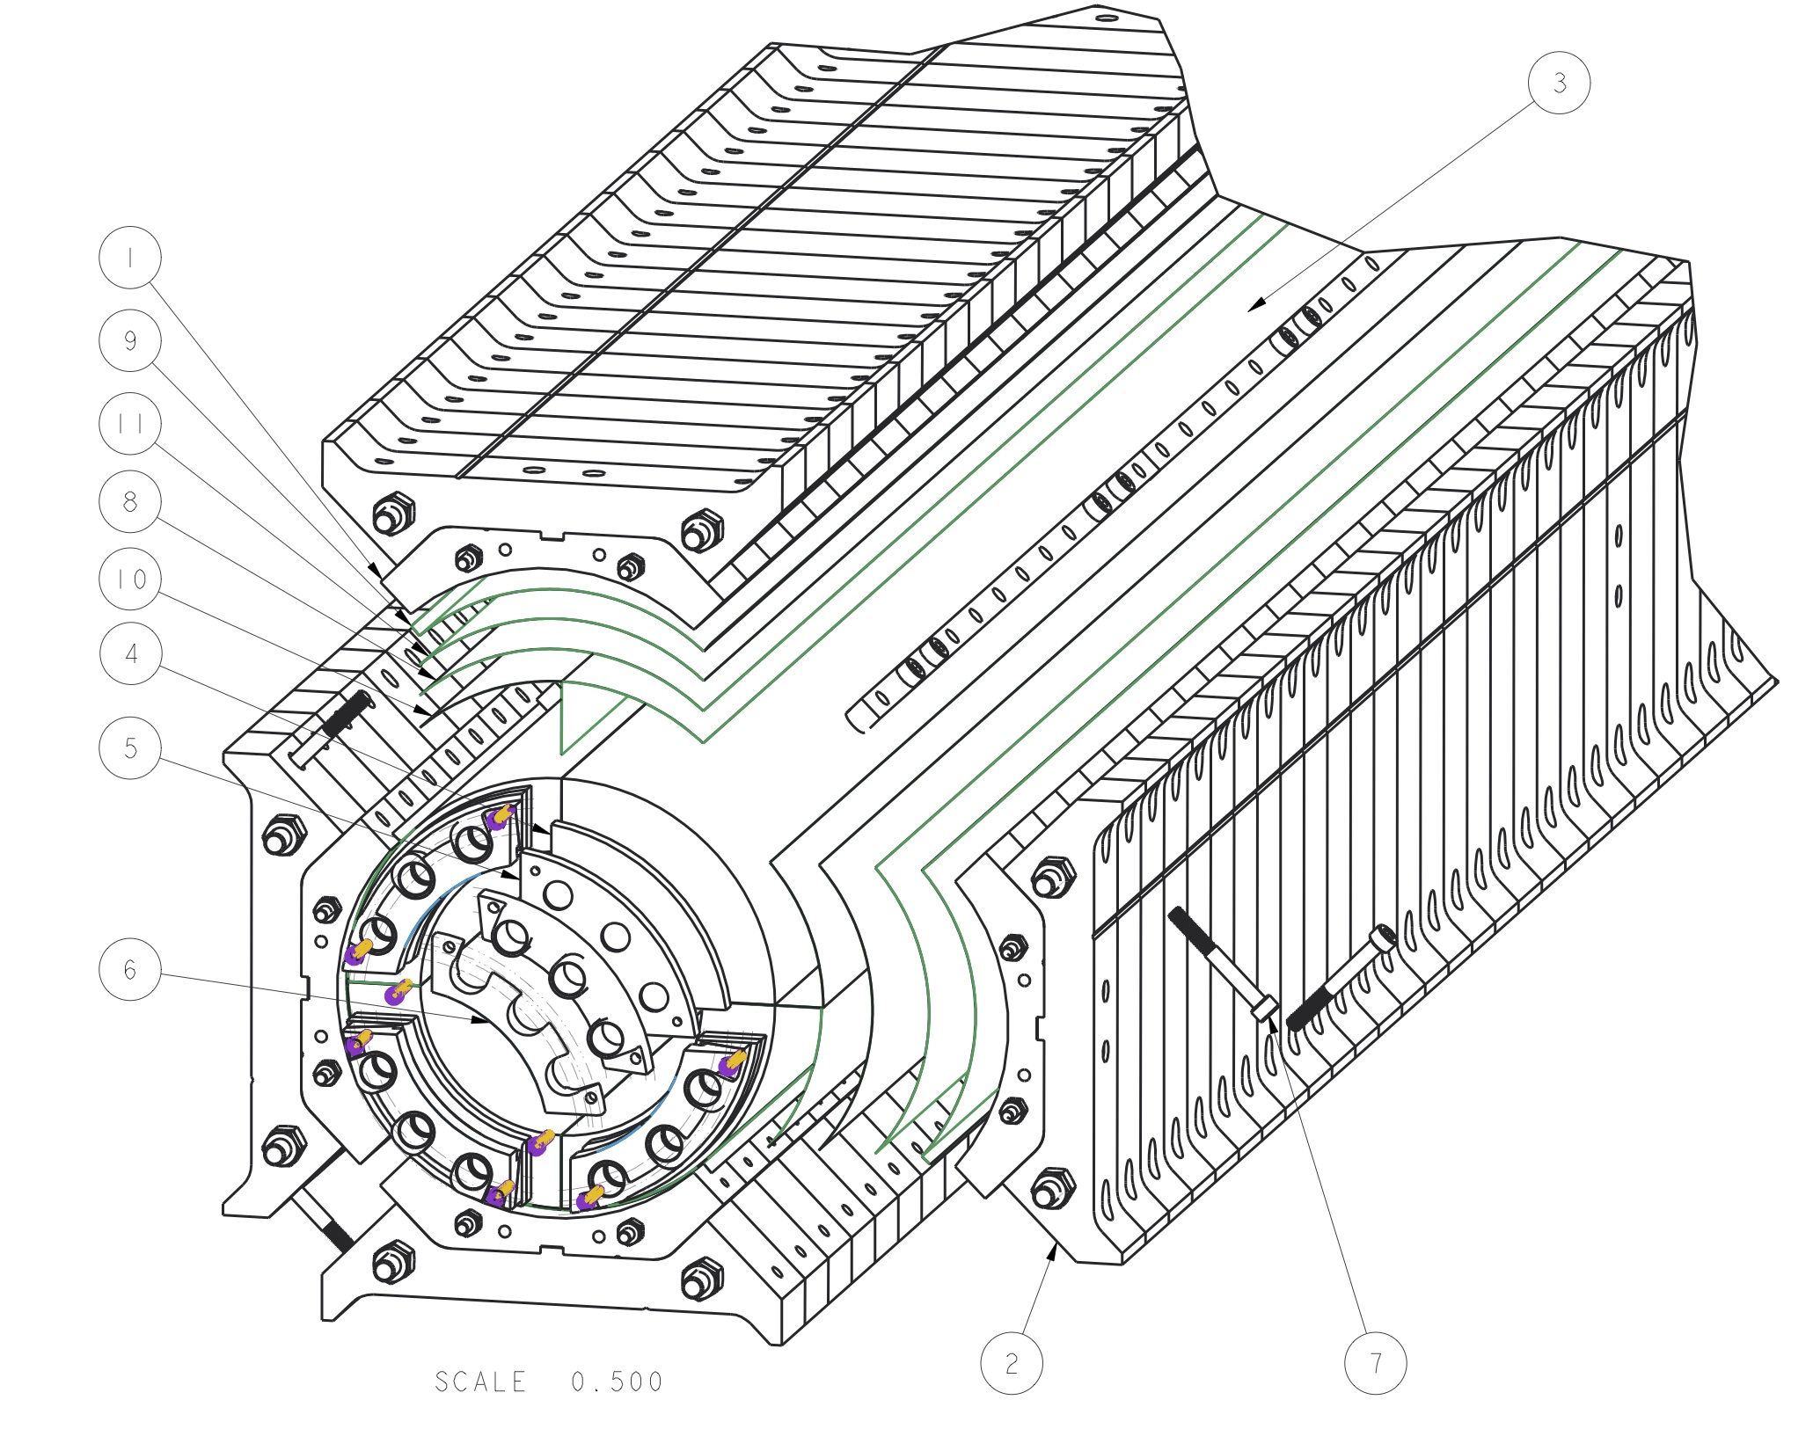
Exploded views of the MQXFA magnet structure

Slide 8
CD-1 Review (Aug 8-10, 2017)
Magnet System Recommendations:
1. Approve CD-1 by October 1, 2017.
2. Approve CD-3a (Early Approval of purchasing of Nb3Sn strand) by October 1, 2017.
3. Create and Approve (Structural and Electrical) Design Criteria, including criteria for brittle materials, prior to CD-2/3b.
4. Secure external review of these criteria prior to or during CD-2/3b.

Slide 9
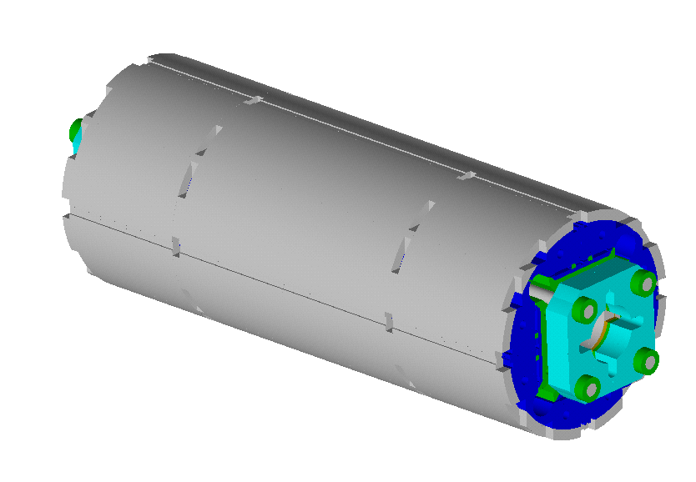
FDR: MQXF Major Design Features
Cooling holes: 77 mm ID (R12)
Assembly alignment cut-outs
Shell slot for backing strip
Shell cut-out for alignment
Cross-section similar to HQ
  Al collar
  Pads, masters, yoke
Additional features for integration
  Yoke /shell cut outs
  Still under development at CERN
3 short models MQXFS1, 3, 5:
  MQXFS1 at LBNL
  MQXFS3&5 at CERN
Mid-plane yoke cut-out for assembly alignment
P. Ferracin et al., “Development of MQXF, the Nb₃Sn Low-β Quadrupole for the HiLumi LHC ” IEEE Trans App. Supercond. Vol. 26, no. 4, 4000207
G. Ambrosio et al., “First Test Results of the 150 mm Aperture IR Quadrupole Models for the High Luminosity LHC” NAPAC16, FERMILAB-CONF-16-440-TD

Slide 10
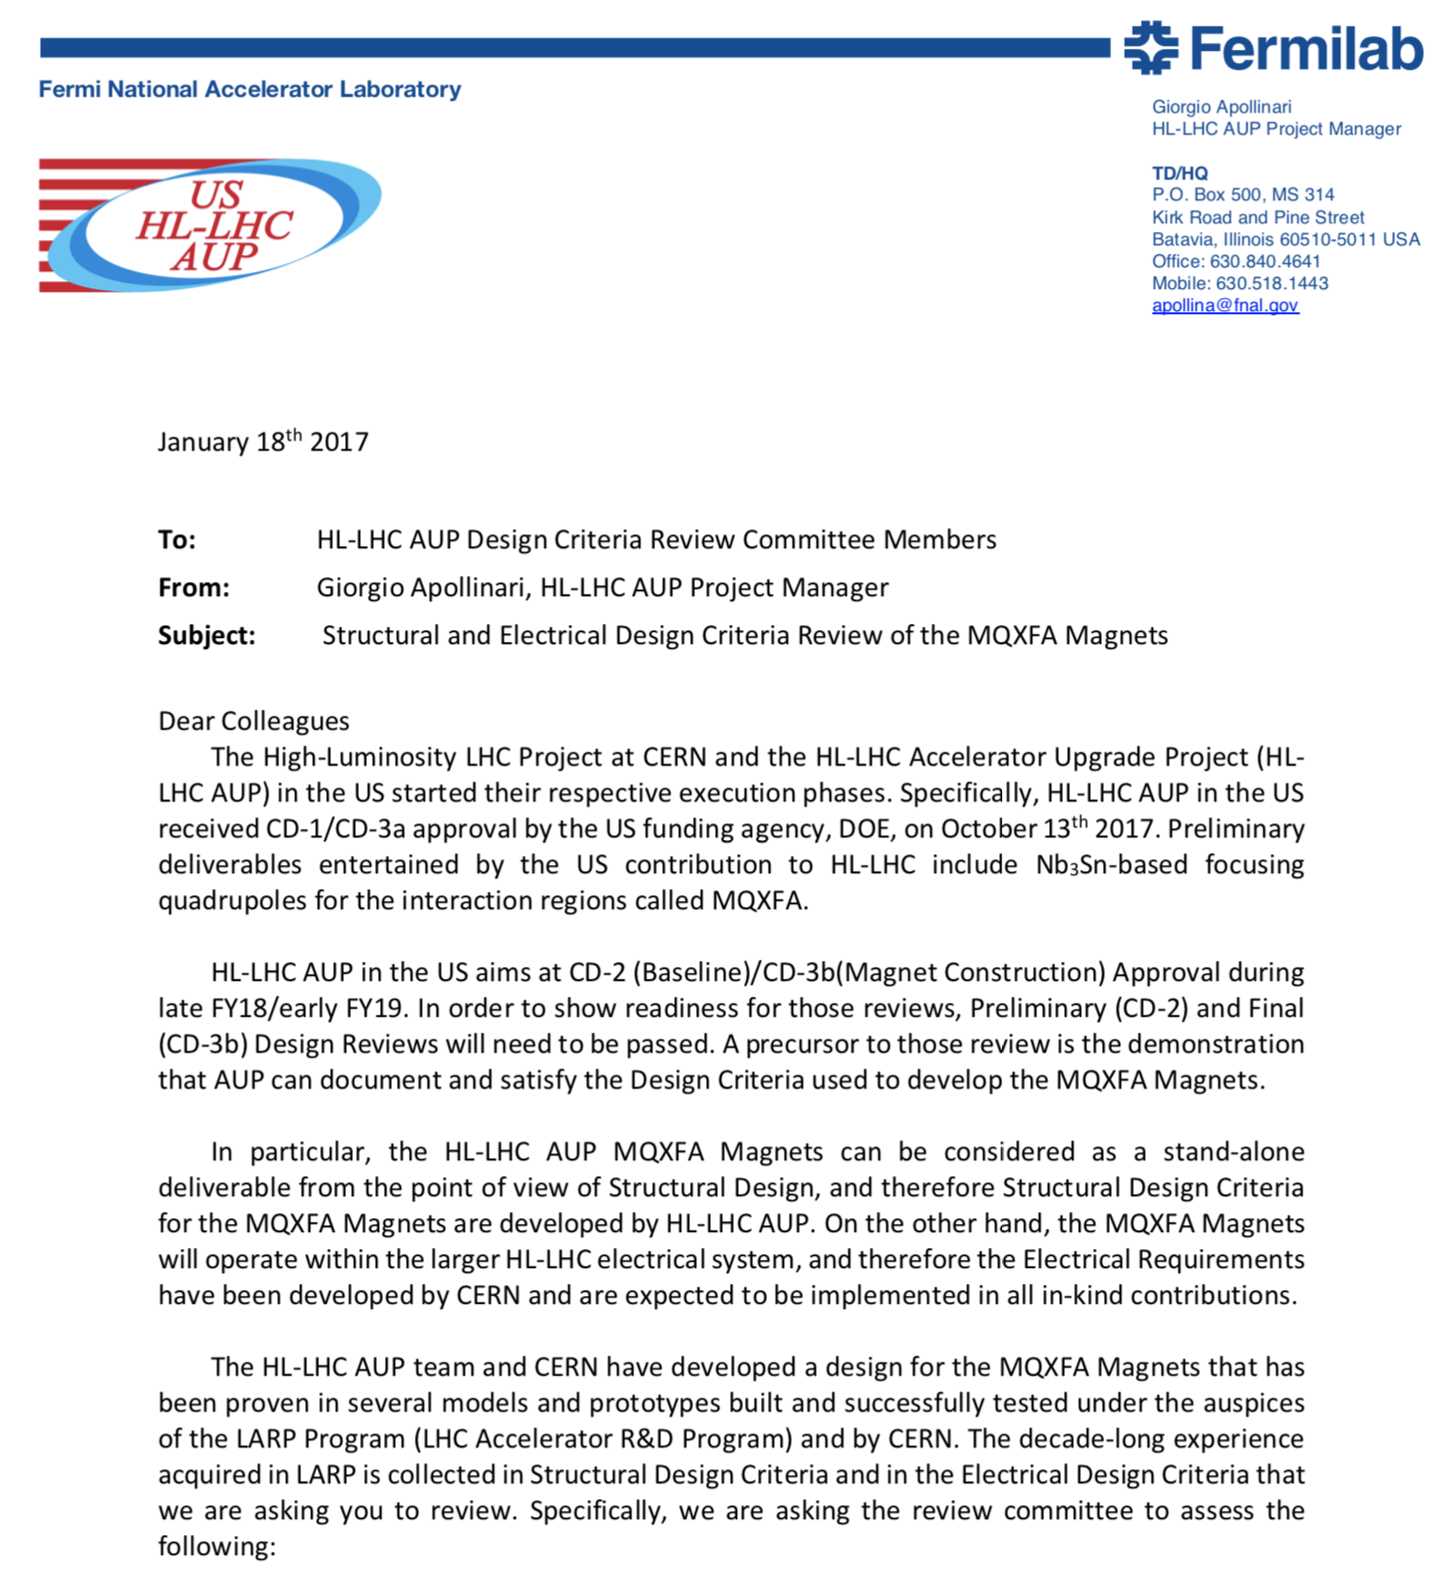
The MQXFA structural elements are designed in accordance with Design Criteria
Reviewed April 23rd, 2018

Slide 11
CD1 recommendation: Create Design Criteria
Create and approve (structural and electrical) design criteria, including criteria for brittle materials, prior to CD-2/3b.
Electrical Design Criteria:
US-HiLumi-doc-826
Design Criteria for MQXFA Superconducting Elements:
US-HiLumi-doc-885
Structural Design Criteria:
US-HiLumi-doc-909
Secure external review of these criteria prior to or during CD-2/3b.
Design Criteria Review resulted in recommendations that are being addressed:
Clarify criteria for use of Al-7075-T65
Work performed, under review Oct 5th, 2018
Write section on use of non-metallic materials
In progress
Define the expected handling, operational and accidental faulty load conditions (LC) which refer to different design criteria at RT and cold operating temperature.
Improved descriptions have been incorporated
Clarify use of statistics and margins in criteria. They should be self-consistent.
Improved descriptions have been incorporated

Slide 12
Review Charge
One important element that the Design Criteria review committee recommended external guidance on relates to the design criteria used for Al-7075-T65 material. Specifically, the recommendation stated:
Clarify criteria for use of Al-7075-T65(1).
a) It is not allowed by ASME B&PVC or fusion community due to low fracture toughness and elongation to failure.
b) It has been used extensively in aerospace community.
c) If it is to be used based on rules used in aerospace community, the design criteria should explicitly state what those rules are and the criteria should be reviewed by personnel external to the project who are familiar with aerospace practices in using this and similar materials.
Due to your expertise with the material and in the area of fracture mechanics, we would like to validate the proposed Design Criteria for brittle materials through a dedicate review addressing the following charge questions:
Are the Design Criteria used for Al-7075-T65 appropriate to specify the design guidelines and develop a methodology to assess components for the MQXFA magnets
Are safety factor levels applied to Al-7075-T65 appropriate for the MQXFA Magnets
Are data and/or sources of information related to the use of Al-7075-T65 properly documented in the definition of the Design Criteria

Slide 13
Addressing feedback provided by Professor Yee from the first Design Criteria Review (I)
Comments on Structural Design Criteria document
Raymond K. Yee (San Jose State University)
The graded analysis approaches, application of the R6 method, the crack geometries used, and the approximated stress profiles described seem rational and reasonable (thru 4.4.2).
The materials such as 316SS, aluminum 7075 and Nitronic 50 etc. used for magnet components are FCC and their failure mode tend to be between brittle failure and plastic collapse under loading. In this report, the analysis was based on static evaluation only. Plastic collapse was stated as the major concern, and fatigue was not expected to be an issue. Yet Table 2 reports that there is about 5,000 loading cycles during operation. Will this cyclic loading trigger crack growth from a small flaw within the material? Any analysis can be used to verify the assumption on fatigue crack growth is indeed negligible?
We have further documented the conditions associated with the 5000 loading cycles, in particular the fairly small ΔK. We applied the Paris Law approach and estimates indicate that crack growth for flaws below our detection limit will not grow.
Are any of the materials used susceptible to thermal/mechanical cyclic fatigue?
Most load cases involve low cycle numbers; the exception is the operating load, with up to 5000 cycles. As described above, the materials that may be susceptible to fracture/cycle fatique are subjected to modest ΔK in these load cycles.
What are the anticipated defect size in materials and what is their distribution within them? If minute flaws are within certain close proximity to each other, they need to be combined and treated as one equivalent initial flaw in size.
We are imposing ASTM-B594-02 Class AA specification for defect detection.

Slide 14
Addressing feedback provided by Professor Yee from the first Design Criteria Review (II)
Comments on Structural Design Criteria document
Raymond K. Yee (San Jose State University)
Components made of heat-treated aluminum plate or forgings and iron, the post forming processes may induce residual stresses, which could have a significant influence on crack growth within the structure under cyclic loading. Furthermore, unless high quality surface machining is specified in component fabrication, machining on SS components would generate certain level of surface roughness which may initiate surface crack easily. The answers to the above questions may affect the approach taken to assure structural integrity.
We have chosen Al07075-T65 specifically to minimize the residual stresses in the forged materials.
The surface texture is specified per ASME B46,1 for surface texture. The drawings furthermore call out a smooth transition to adjacent surfaces at Chamfer/radii.
In the report, part-through semi-elliptical surface flaw geometry was assumed to be the initial flaw size and this geometry may eventually grow to semi-circular flaw during operation using equations (4.4) and (4.5). To be conservative, would it be feasible to consider two limiting cases (through-walled crack and edge crack) for structural integrity assessment?
We are evaluating for the through-wall crack case.
Fracture toughness values was used based on Minimum of three equivalent (MOTE) as listed in Table 5. For MOTE approach, though it is acceptable, it may not be the most conservative for fracture property. More conservative approach is recommended.
We will have 10 samples measured to determine baseline statistics. More samples may be measured if variations indicate the need.
Finally, from what is written, it appears that much about the analysis approach is decided by the consequence of failure for various parts, assemblies, etc. How is this consequence determined? Does it only assume single point failure or does it consider cascading failures?
We have considered various component failure consequences. Shell failure is expected to result in quench and the magnet would no longer be operational. Failure of internal components such as a yoke lamination may induce a quench, but would likely not jeopardize further magnet operation.

Slide 15
Agenda
Project introduction & Charge to the review team [SP; 15 minutes]
Setting the context: the magnet structure and load cases [SP; 40 minutes]
Structure design criteria – overview [EA; 45 minutes]
Design Criteria for Al-7075-T65 components [EA; 15 minutes]
Discussion [30 minutes]
Closed session [30 minutes]
Closeout [30 minutes]

