Slide 1
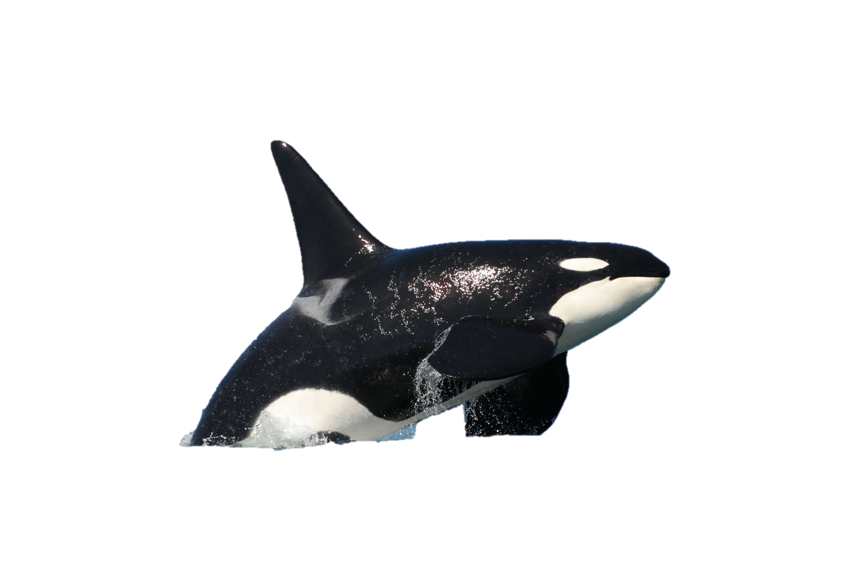
ORCA Stand Design for PIP-II Cryomodules
Table-top review of drawings and CAD model
Scott Oplt
7 November 2018

Slide 2
Relevant Teamcenter items
No slides will be presented, but we will walk through models “live” and look at paper drawings
Some relevant models for subject design and context:
F10104381 – Top level assembly for stand
F10001748 - PIP2IT
F10101499 – PIP-II

