Slide 1
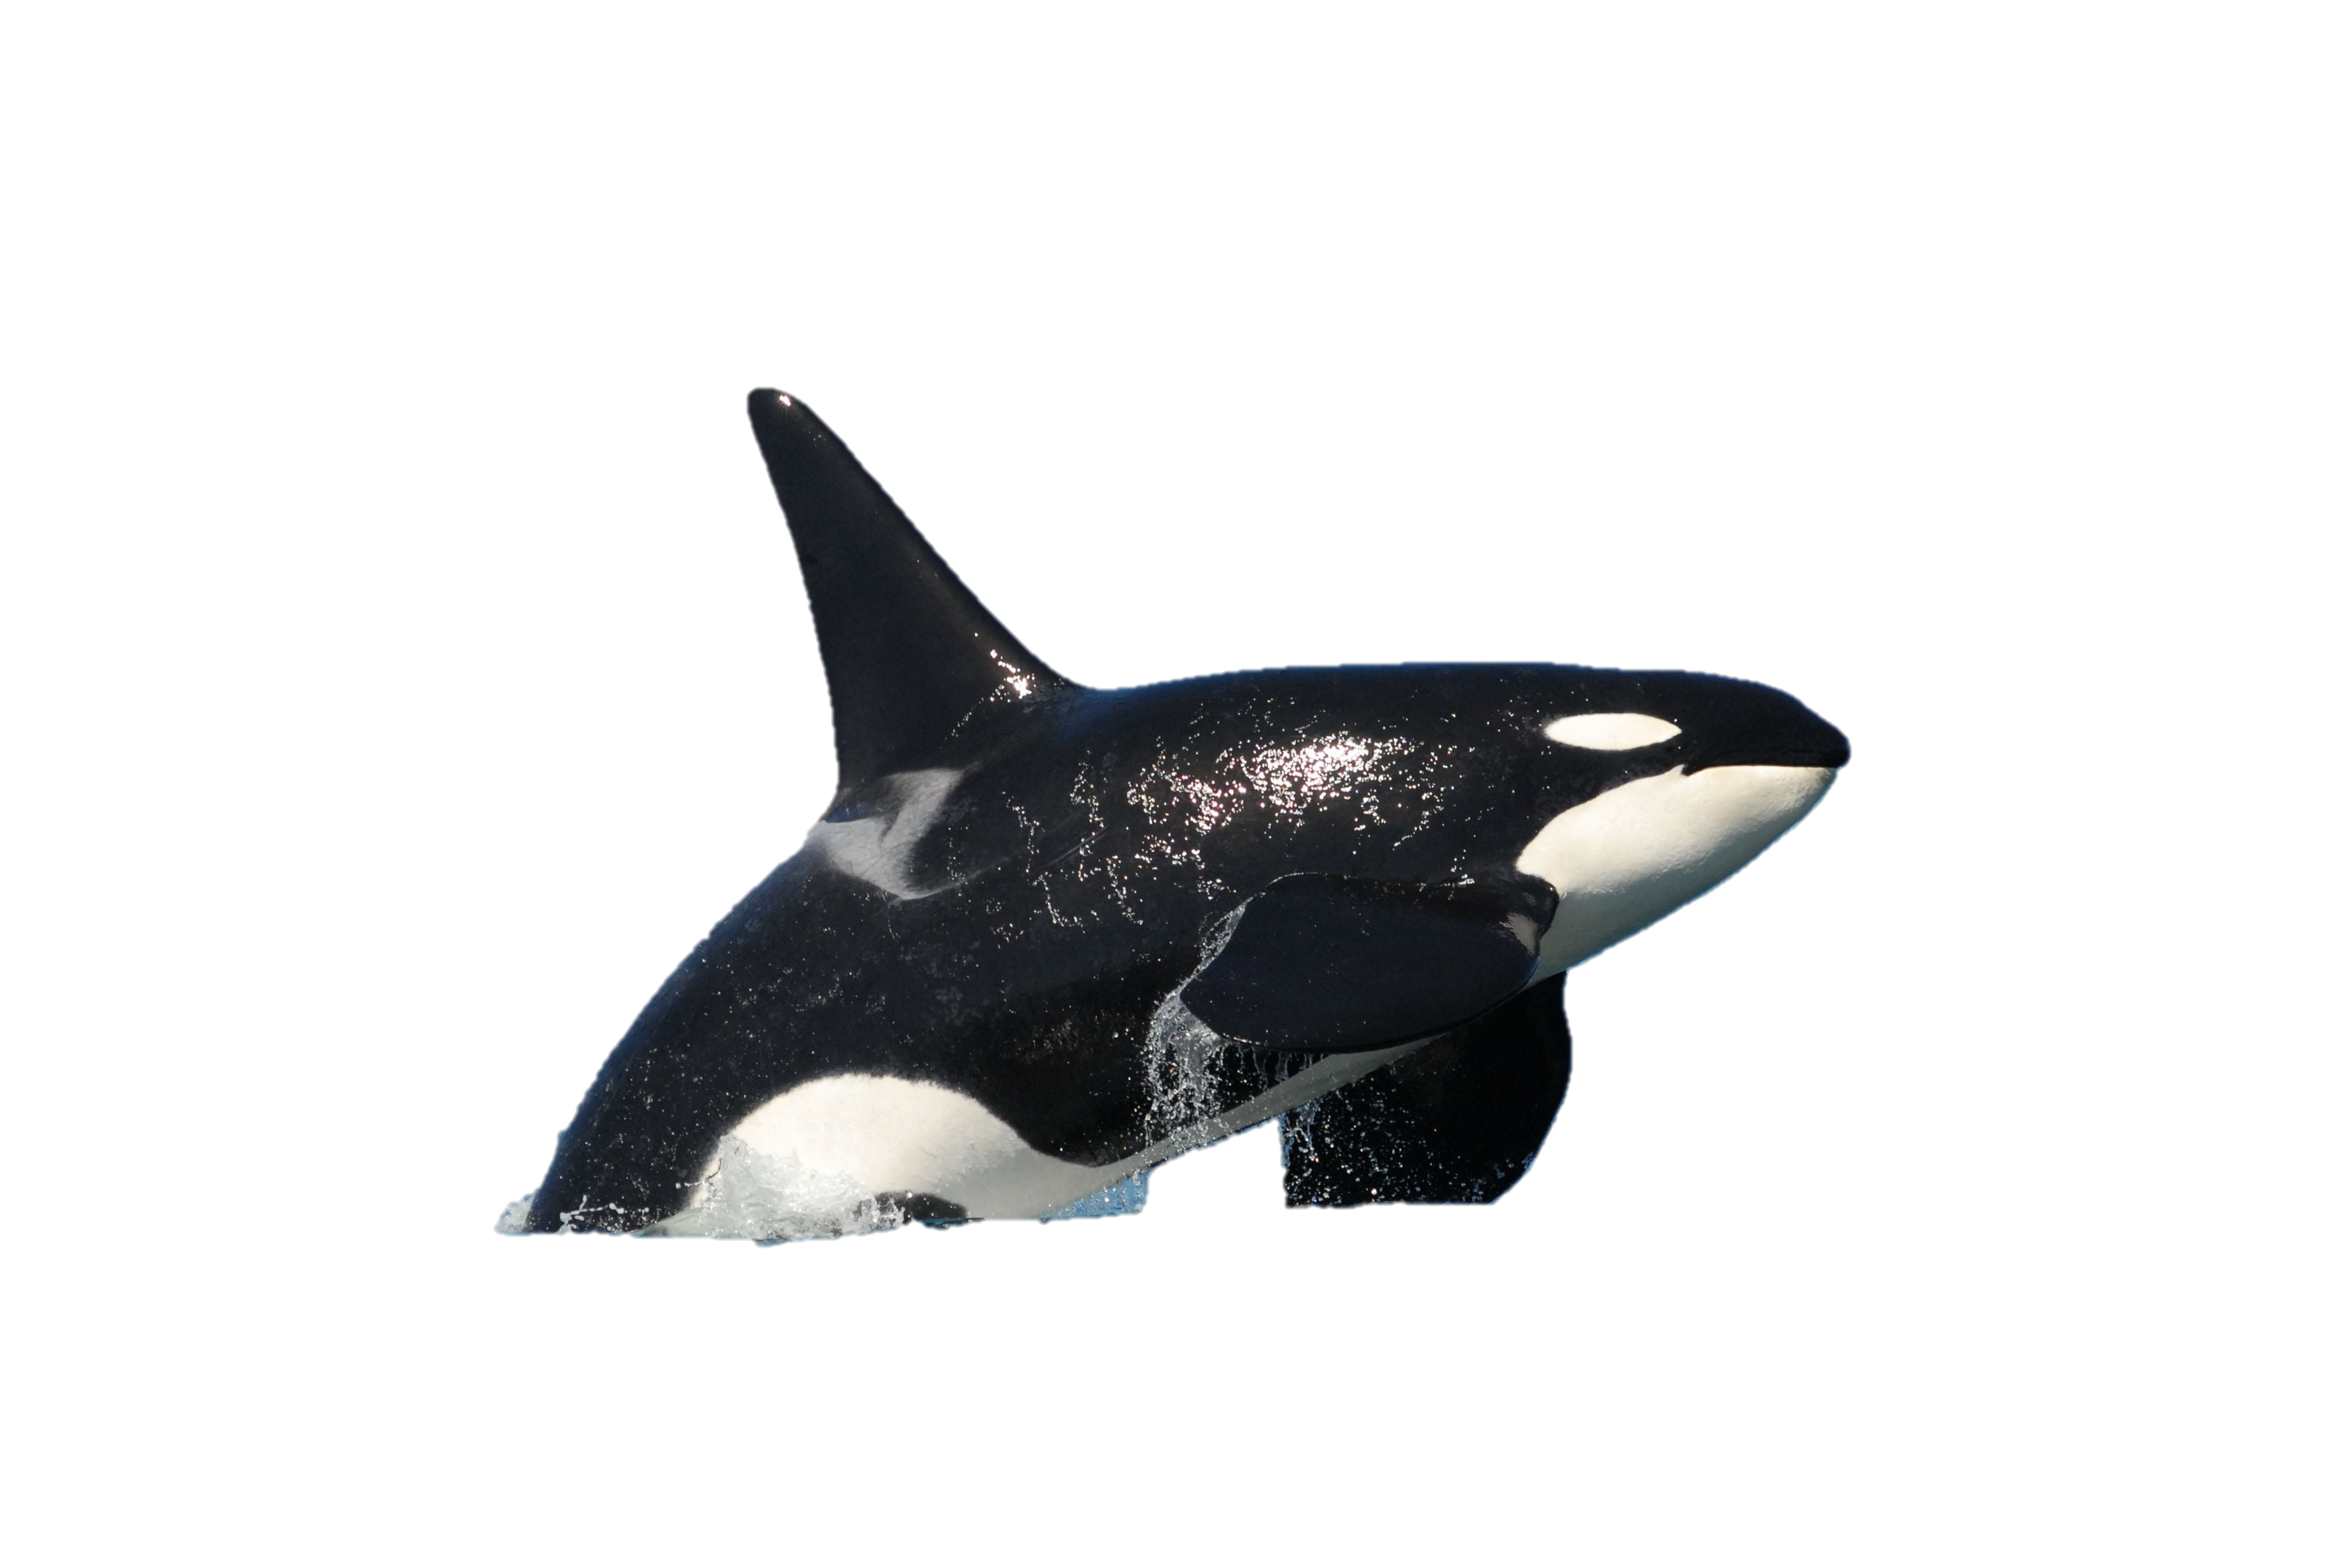
ORCA Stand Design for PIP-II Cryomodules
Introduction and Charge
Curt Baffes
7 November 2018

Slide 2
PIP-II: A new linac for Fermilab
25 cryomodules
5 designs

Slide 3
PIP-II: A new linac for Fermilab
Cryomodules have
-Individual cryostats
-Individual supports
~5-10m
Depending on type

Slide 4
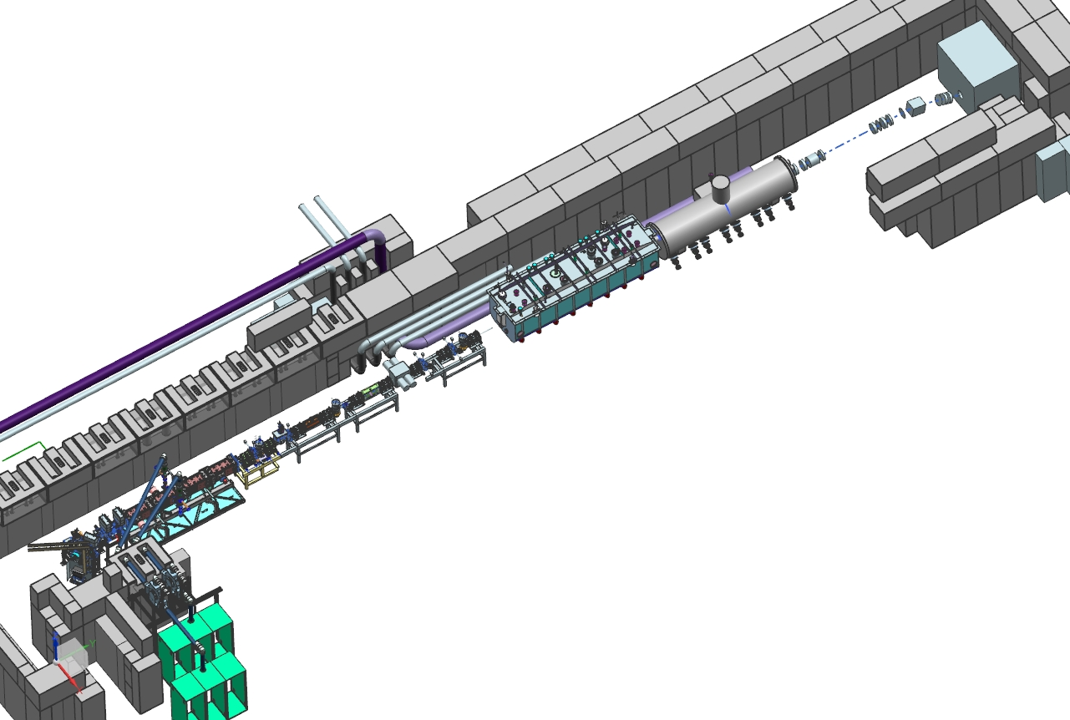
PIP2IT: A testbed for PIP-II
SSR1 Cryomodule
HWR Cryomodule
Phase 1:
Test HWR and SSR1 CM
with beam

Slide 5
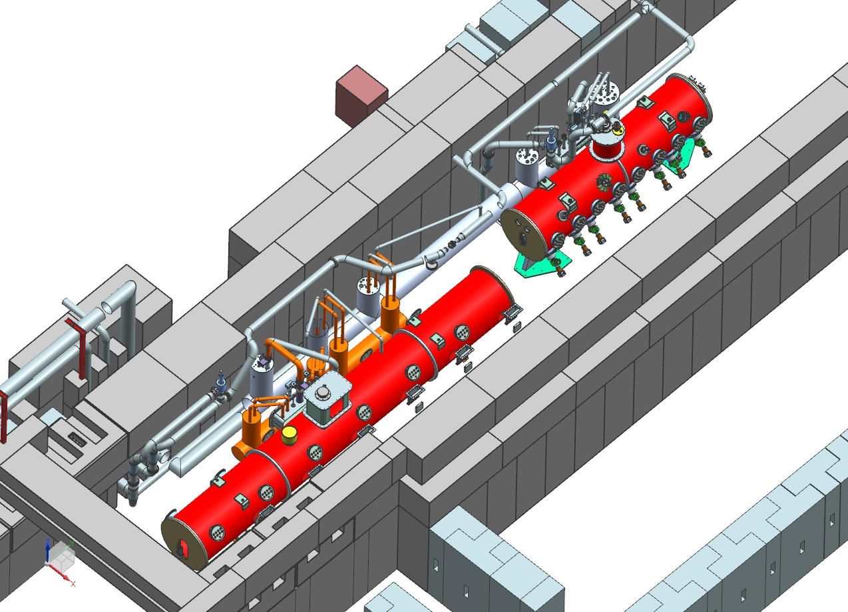
PIP2IT: A testbed for PIP-II
Phase 2:
No-beam RF test stand for all PIP-II Cryomodules
SSR1 or 2 Cryomodule
LB or HB650 Cryomodule

Slide 6
Cryomodule Stand - ORCA
6-strut kinematic system
2 stand modules per cryomodule
Today’s review is a Preliminary Design Review
Prototypes will be built for PIP2IT soon
Production units will be built for PIP-II in the 2020s

Slide 7
Team Organization
Stands, Installation, PIP2IT all live here

Slide 8
Team Organization
Jesse Batko – Stand responsible engineer
Scott Oplt – Stand designer
Curt Baffes – PIP-II Linac Installation lead (LI owns stand design)
Jerry Leibfritz – Test Infrastructure lead (TI owns PIP2IT)
Fernanda G. Garcia – L2 manager for all of the above

Slide 9
Review Charge
This is a Preliminary Design Review
See PIP-II Design Review Plan – ED0008163
PDR = ~30-50% Design Maturity
The design is not done
The idea is to leave room for course corrections
But, we intend to build prototypes for PIP2IT based on the preliminary design
Will require an expedient path to >50% maturity in some areas
Per AD/MSD department procedure, will need an approved note prior to installation in PIP2IT

Slide 10
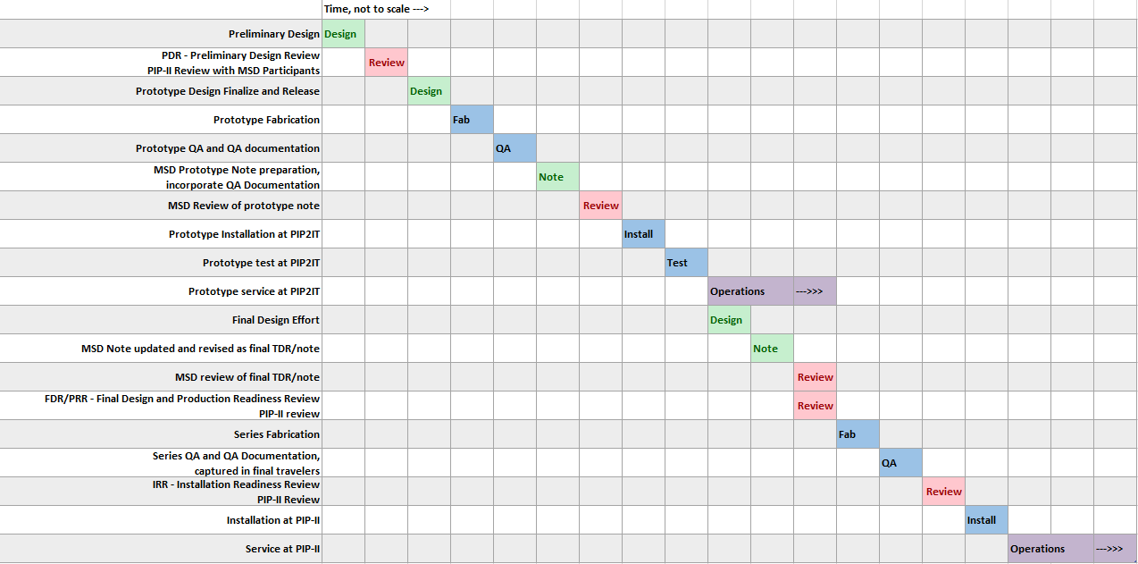
Design Review Map
You are here

Slide 11
Which review process?
PIP-II Reviews
PIP-II process
MSD reviewers,
PIP-II Process
MSD process
MSD Reviews
Coordinated to avoid conflicting conclusions

Slide 12
Document Evolution
Prototype drawings released for fab, revised for final design
Prototype note released,
revised into final TDR/note

Slide 13
Schedule (but not a Gantt chart – time not to scale)
You are here
2/2019
3/2019
7/2019
12/2018
2021
2023
2023
2027

Slide 14
Review Charge – ED0008410
Are the requirements documented, clear, complete and appropriate?
Is the design likely to meet the requirements? Explain any concerns.
Has the Cryomodule Stand design advanced to the “Preliminary Design” level, as defined in the PIP-II Project Review Plan?
Are there any features present (or absent) that threaten the intended function and performance of this design?
Have safety and environmental aspects been appropriately considered?
Have quality aspects been appropriately considered?
Assuming drawing completion and release following the review, is the stand design appropriately mature for the construction of prototypes to be used in PIP2IT?
Are costs and schedule estimation methodologies for PIP2IT and PIP-II appropriate?

Slide 15
Review Charge – ED0008410
Reviewers are asked to write down:
Findings – statement of what was presented and general reactions
Comments – design advice not requiring formal response
Recommendations – design advice requiring formal response and tracking

