Slide 1
Muon Campus Status
Jim Morgan
Transition from shut-down to operation
October 12, 2018

Slide 2
Activities last week
Finished remaining shutdown-related tasks
V003 dipole power cable and LCW hoses reconnected
Final wiring of ionization cooling wedges
Larger D:Q012 and D:Q013 power supplies connected to loads
LCW headers for M4 Line to Mu2e connected into system
Transition to operation
Mock secure completed Monday evening
Ring and Extraction enclosures changed back to safety system keys Tuesday afternoon
Ops followed with search and secure late Tuesday afternoon
Performed annual safety system tests Wednesday morning
Ops unlocked power supplies Wednesday
E.E. Support tested D:IB (new switch gear) Wed/Thu

Slide 3
H748 MDC dipole repair
MDCC007 repair
Formerly used at V742 in M3 Line, replacement for leaking coil used to repair V003
Considered best option for H748 due to lower risk of schedule slip
Only enough annealed conductor available to make one coil set
Estimate for completion of magnet repair was 10/29
Several more days needed for transport and installation
MDCE001 repair
Dipole that came from H748 and was received at T.D. 9/25
Dismantled as time allowed, insulation was damaged during coil separation as expected
Was not expected internal coil leak, tube from manifold was cracked
Technical experts were able to drill out the old tube and install a new one, priority shifted to finishing repair of this dipole after hydro test
Estimated completion date of 10/19

Slide 4
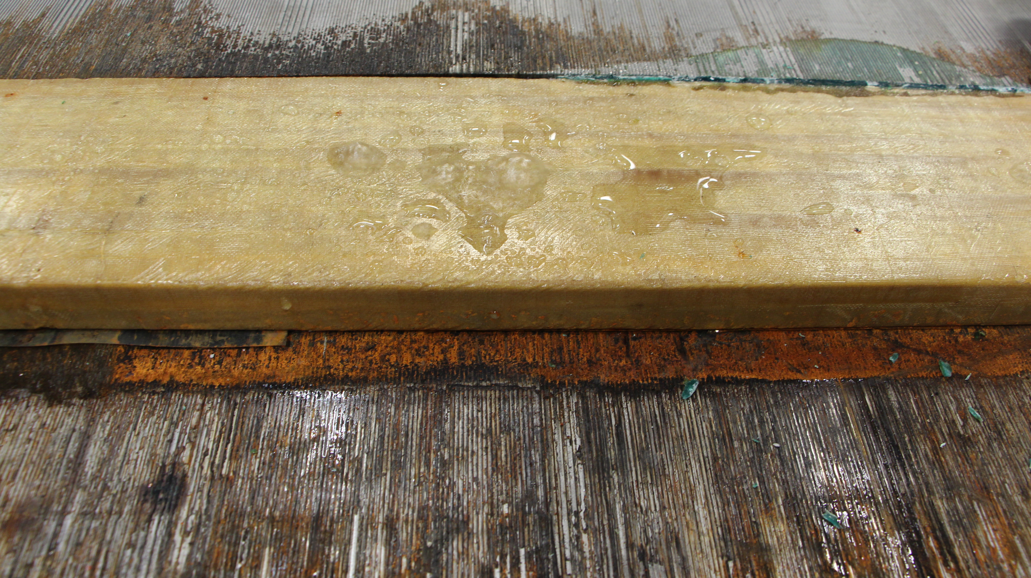
MDC dipole – MDCC007 internal coil leak
Water bubbling up out of coil

Slide 5
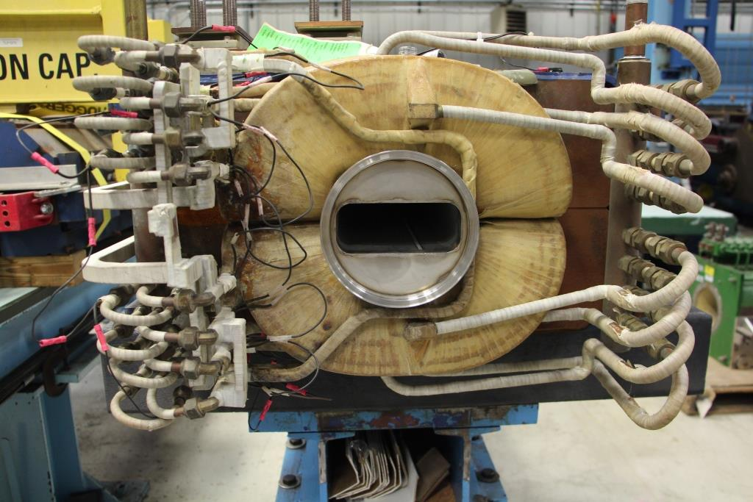
MDCE001 – on arrival at T.D.

Slide 6
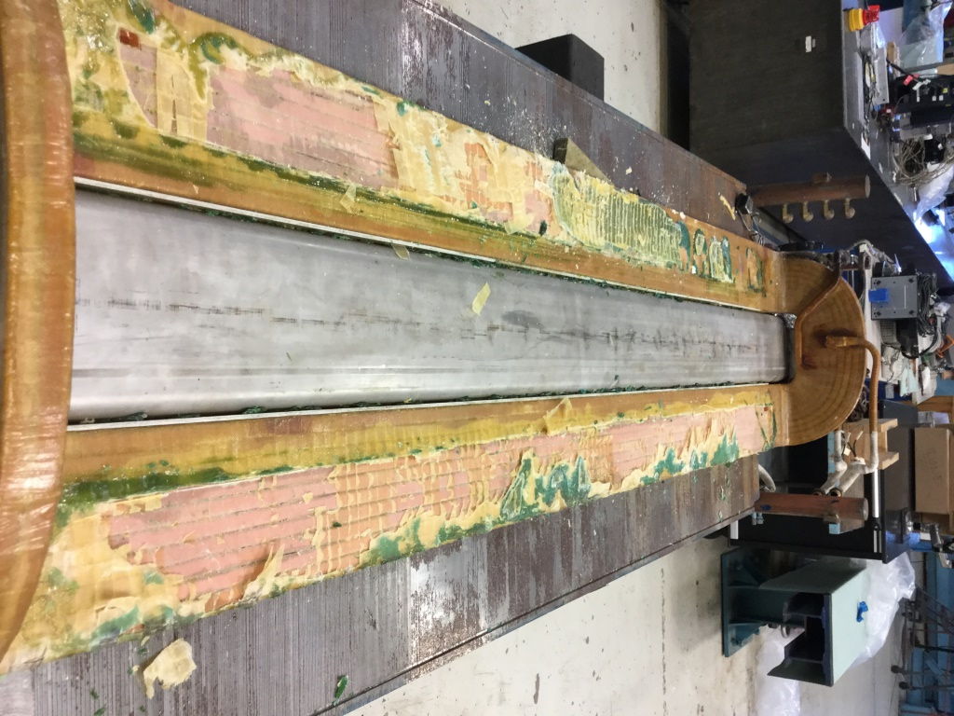
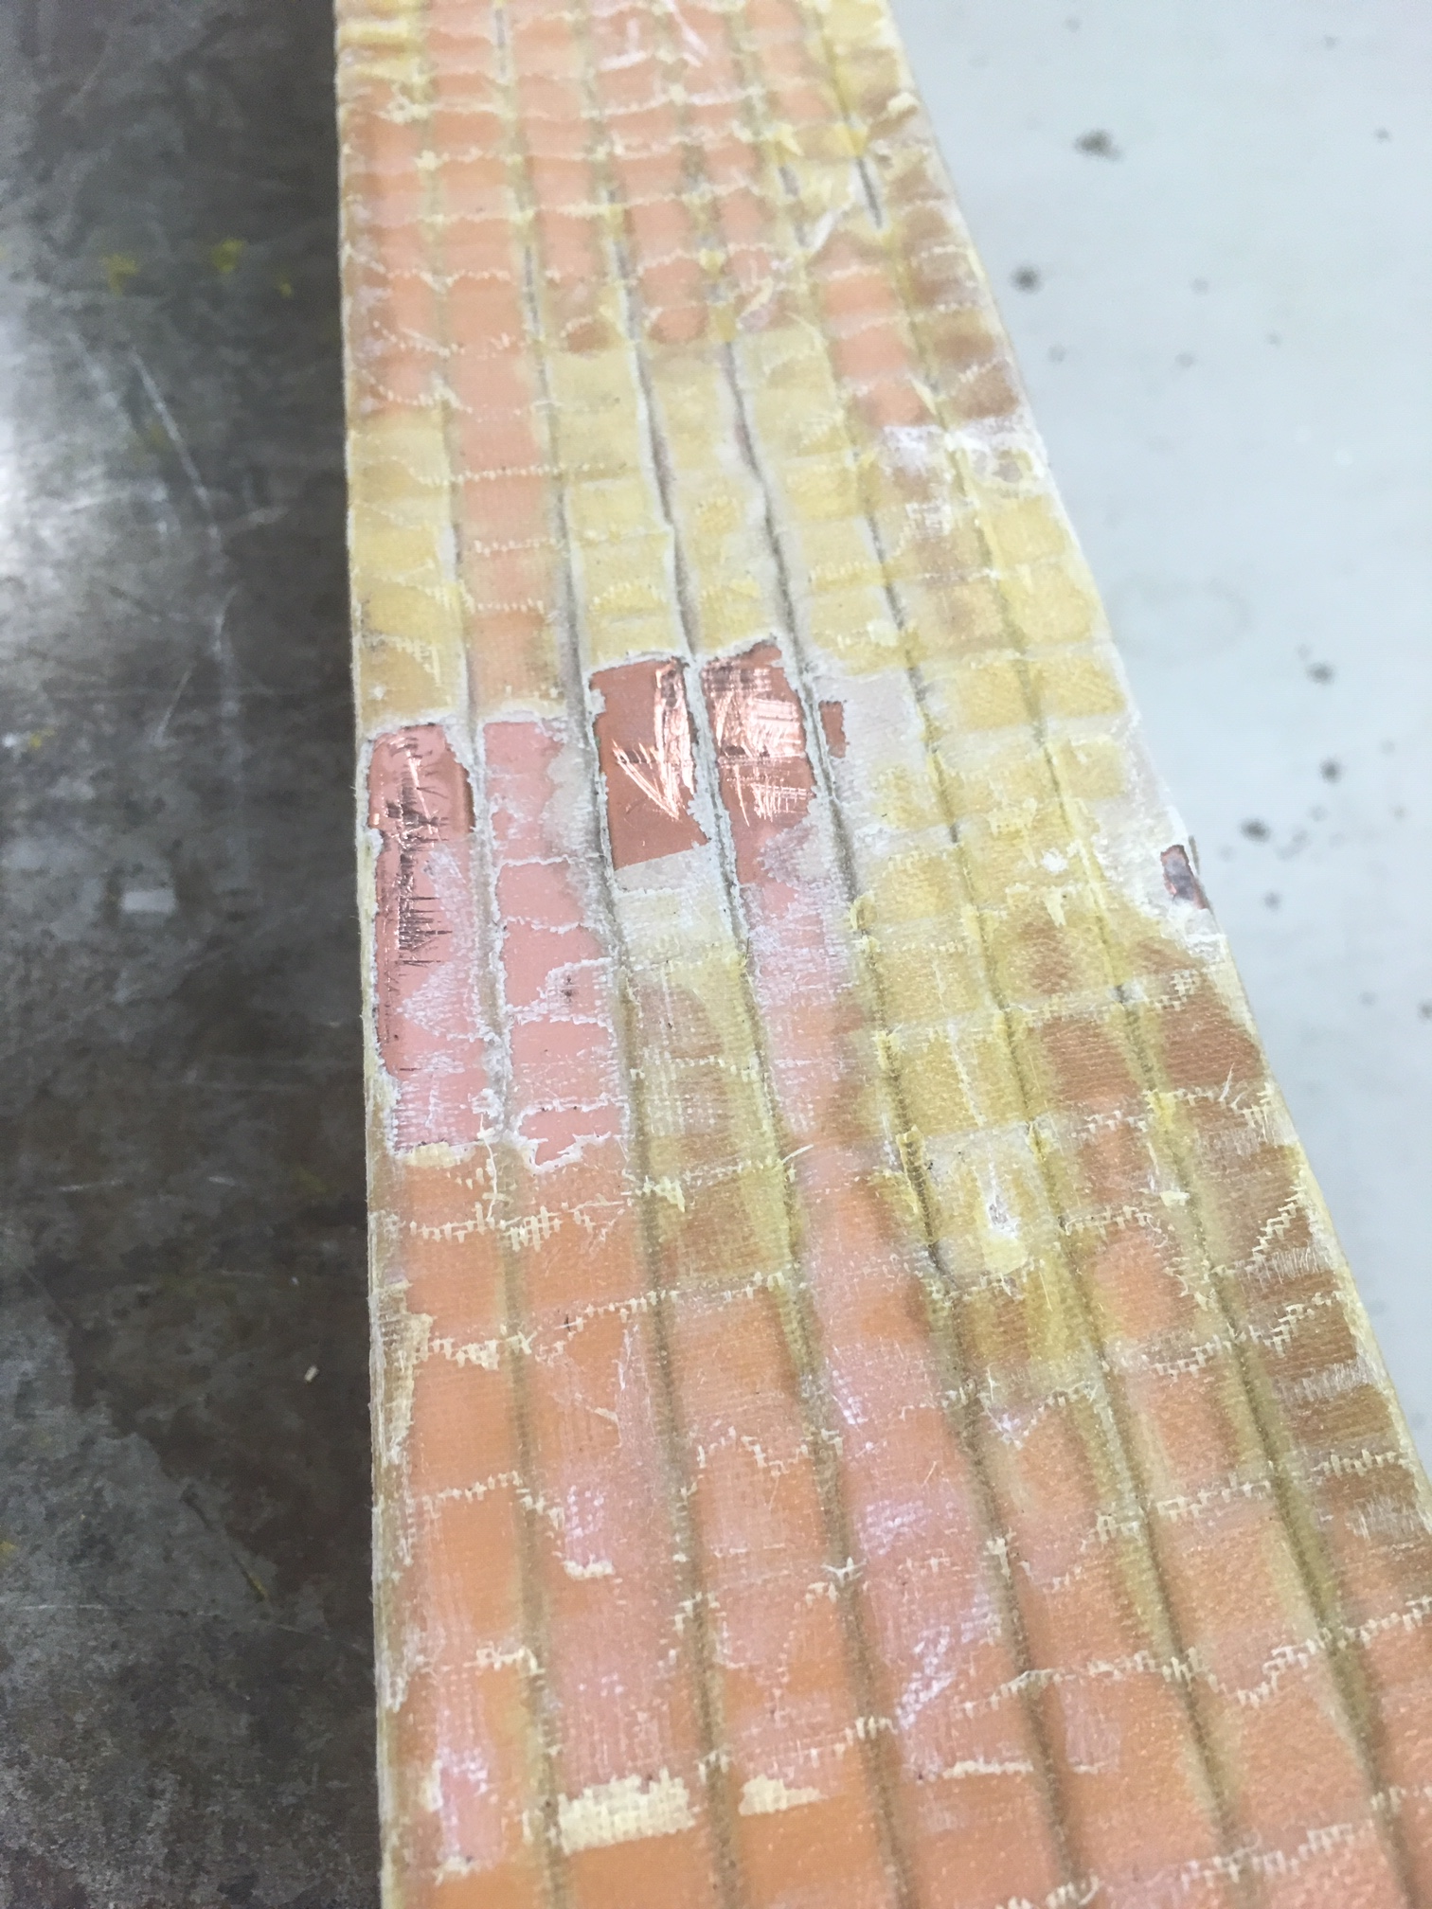
MDCE001 – opened up
Damaged conductor insulation

Slide 7
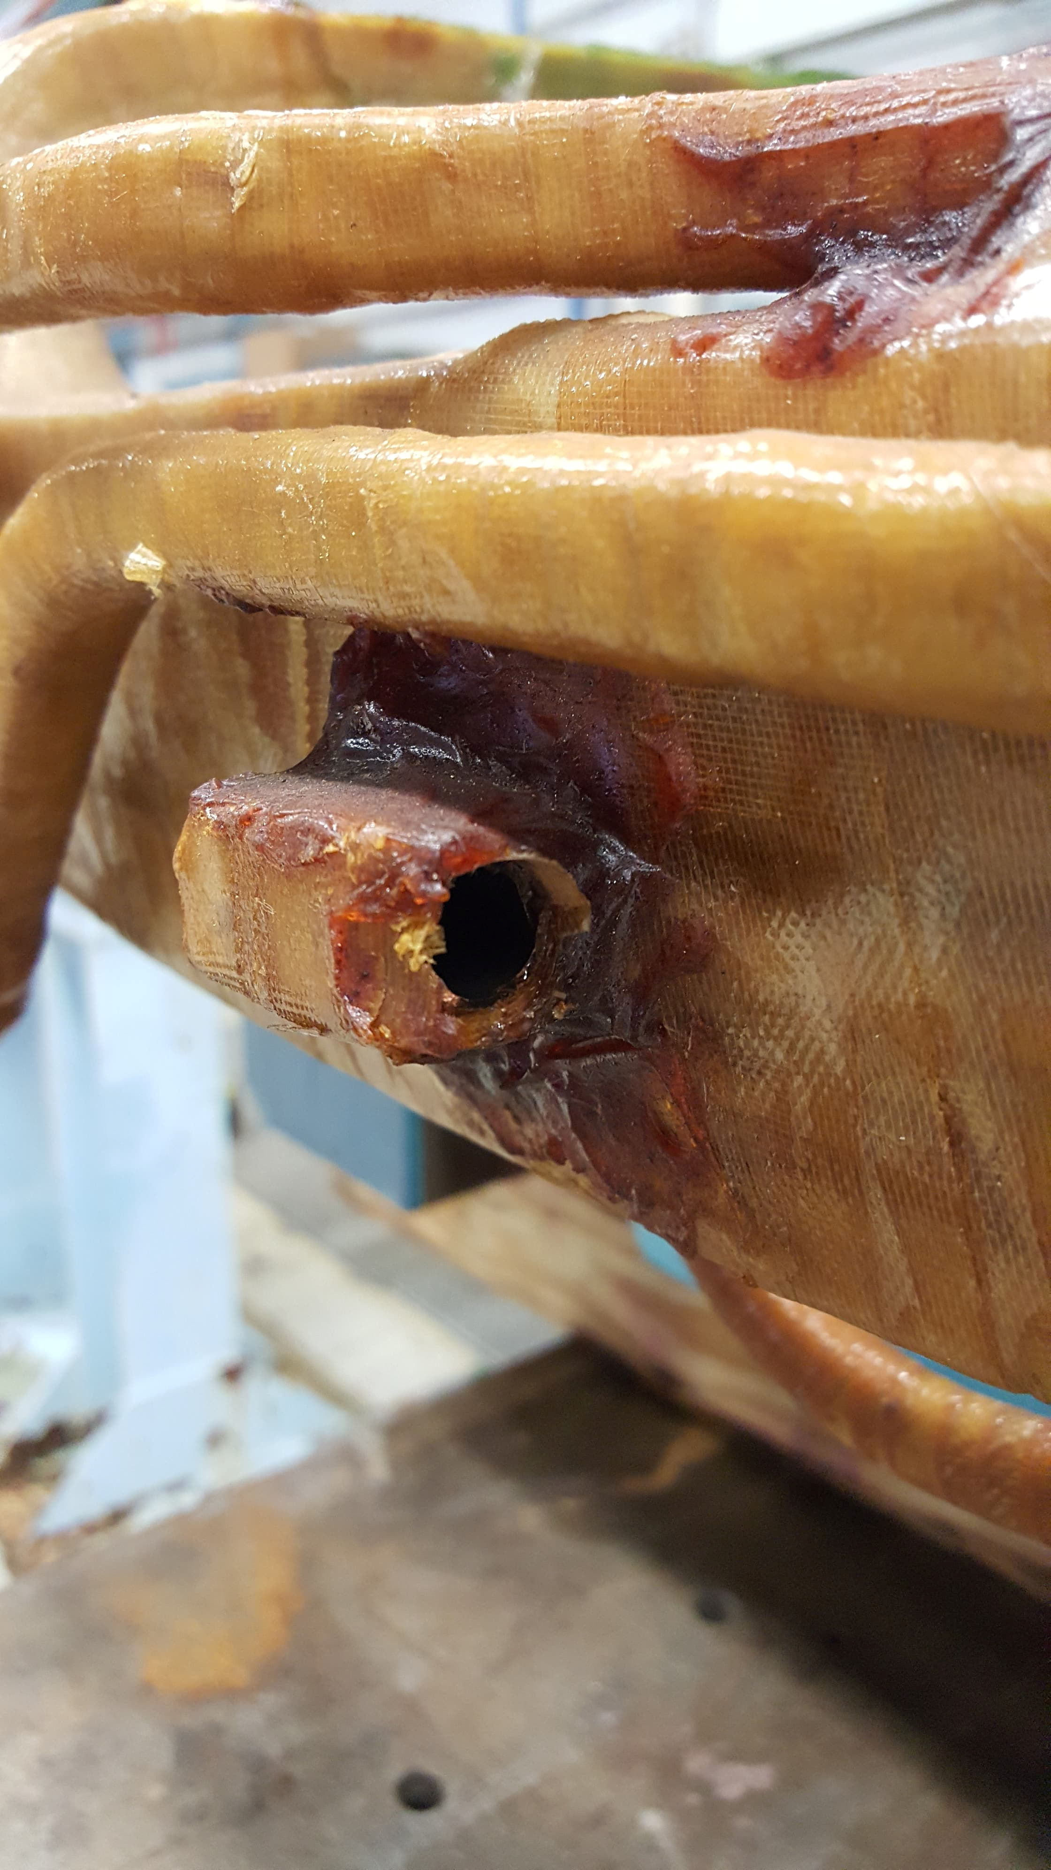
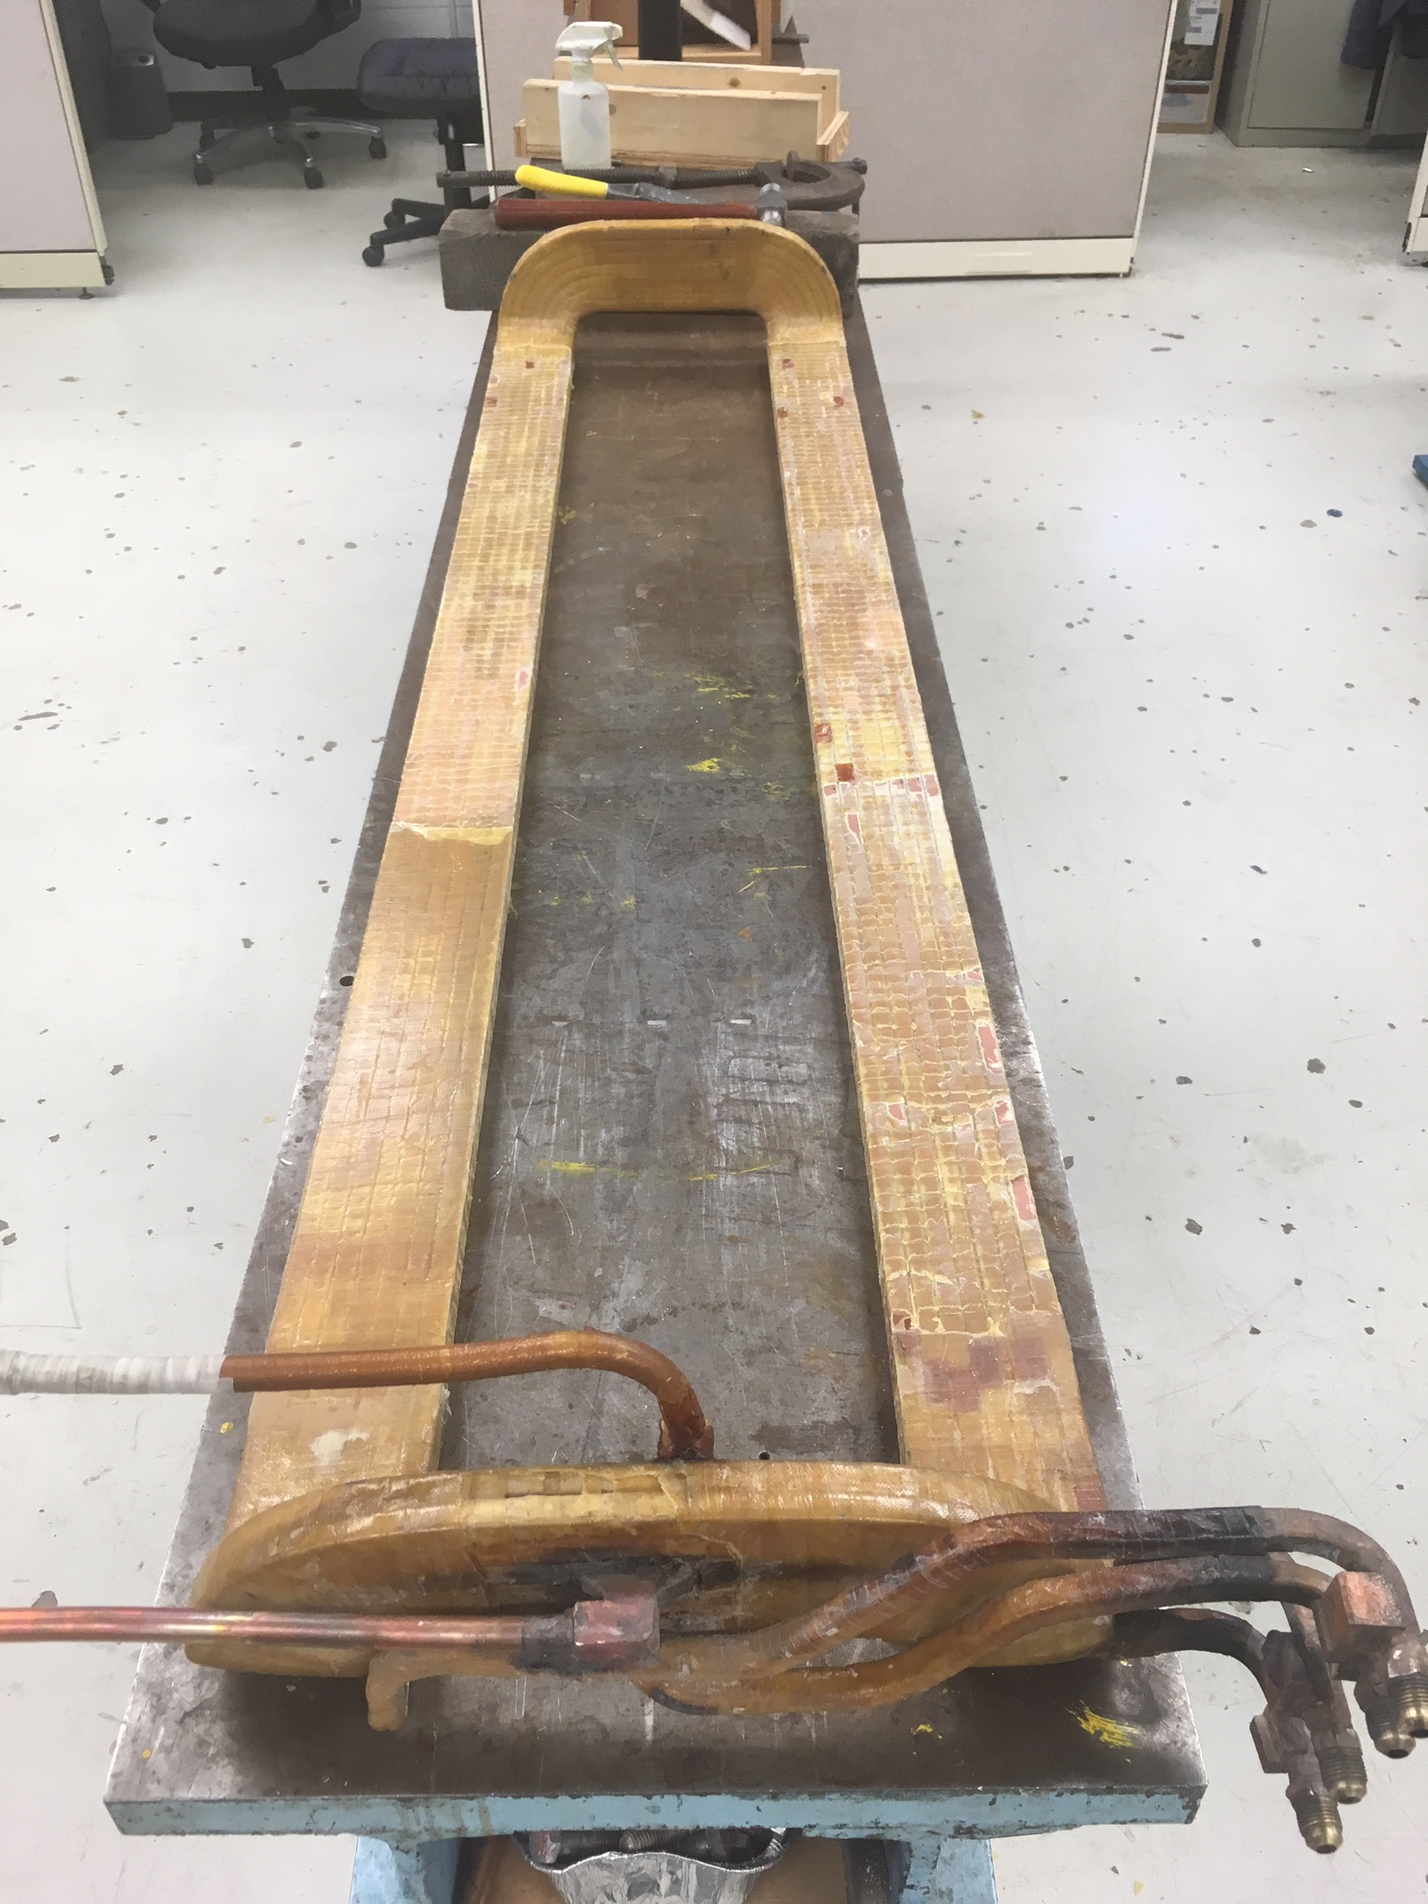
MDCE001 – failed tube and repaired coil ready for insulation

Slide 8
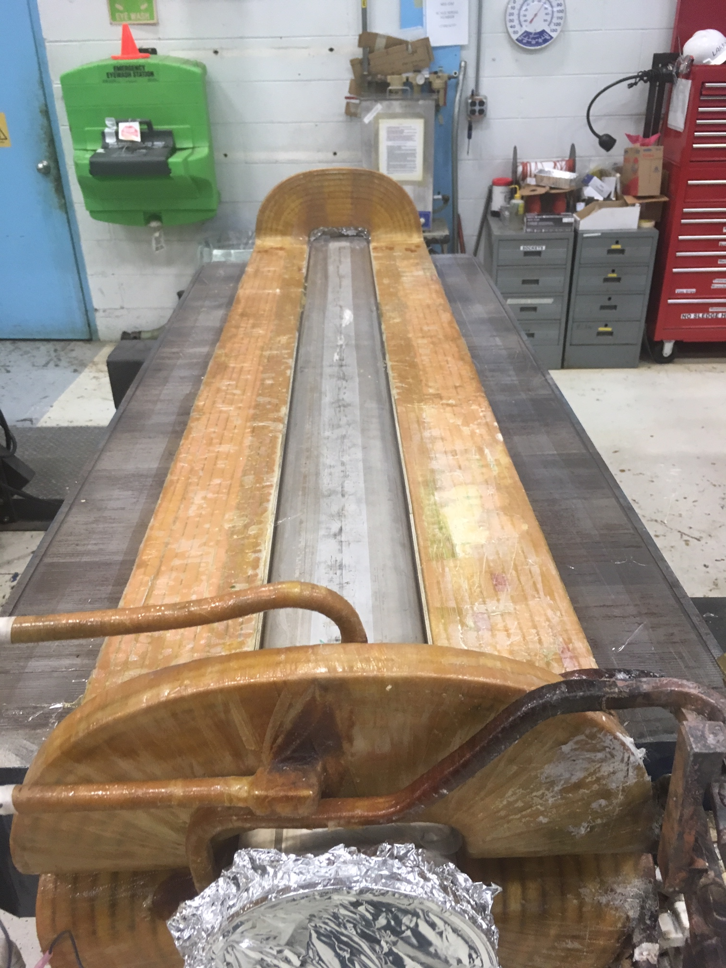
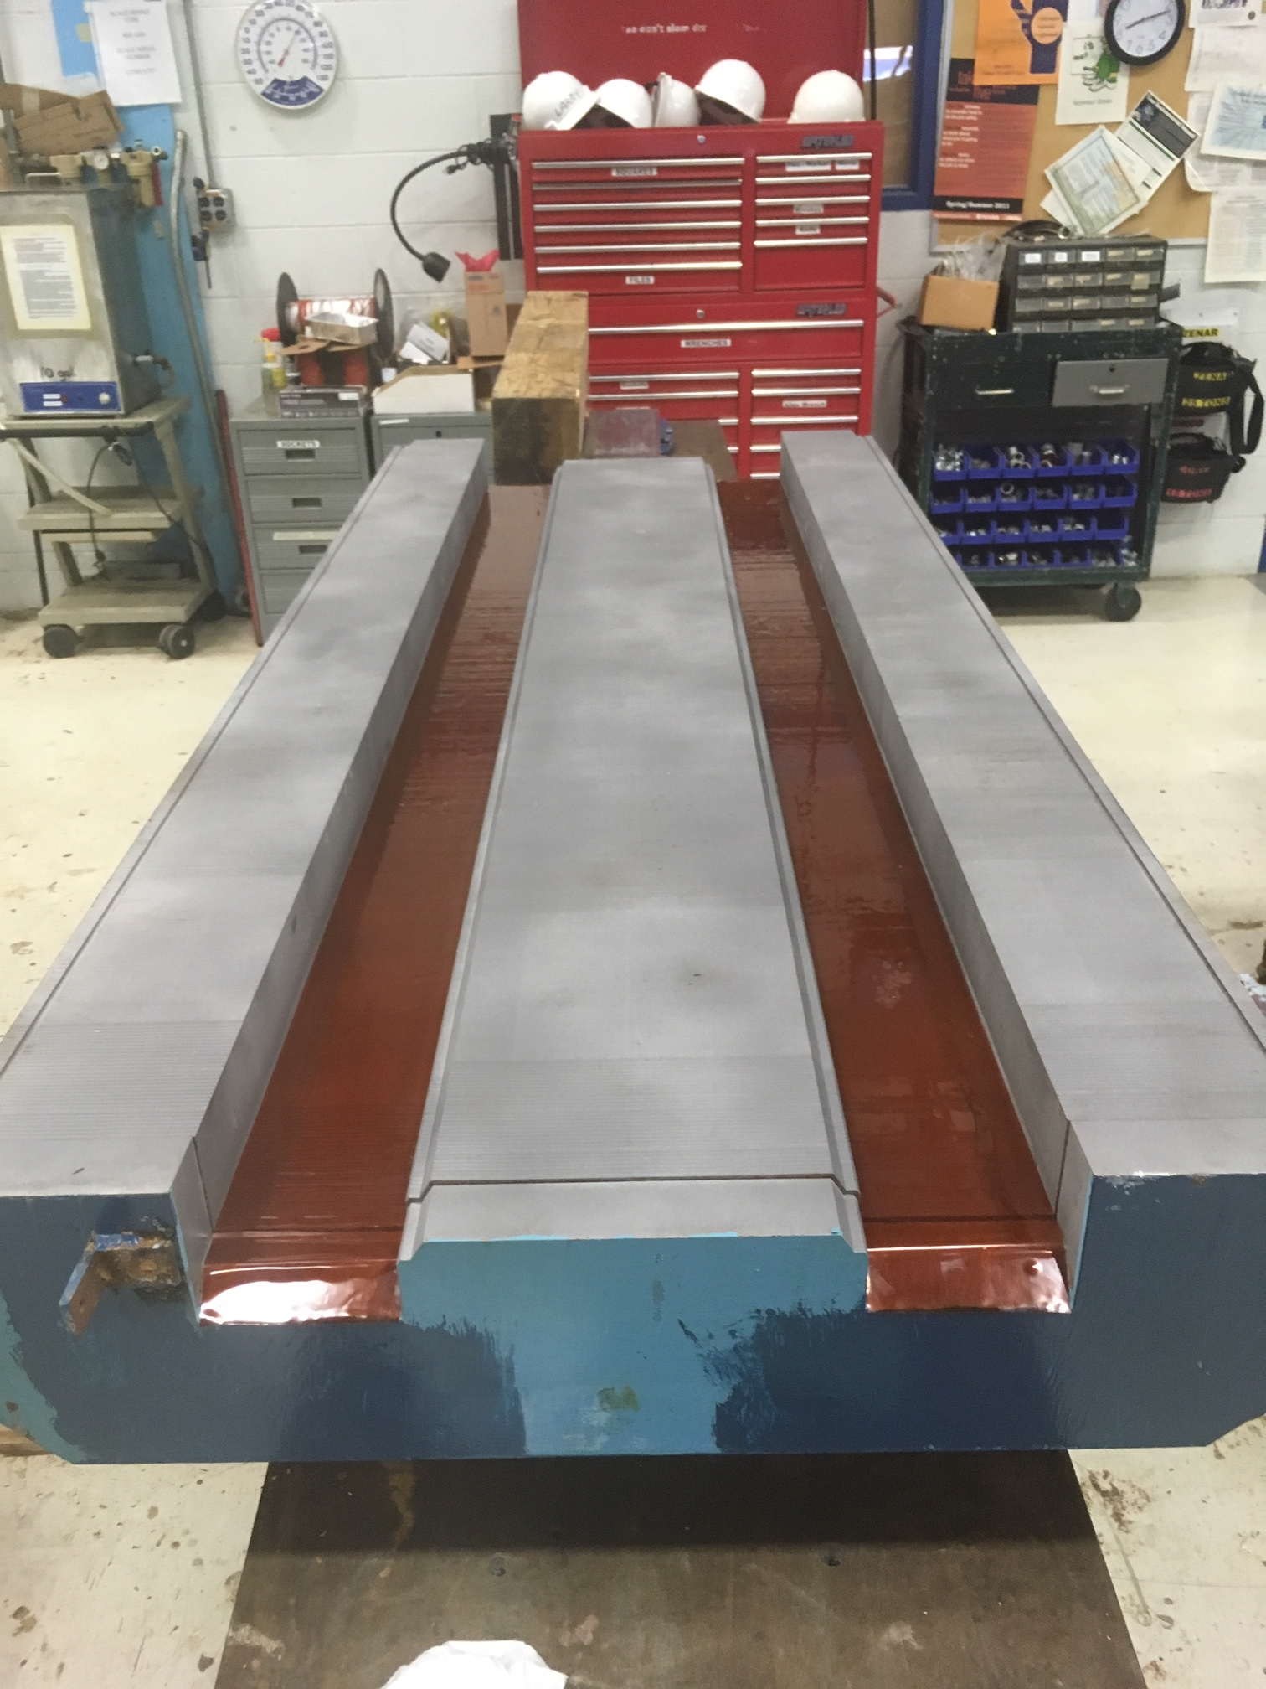
MDCE001 – insulation repair and core prep

Slide 9
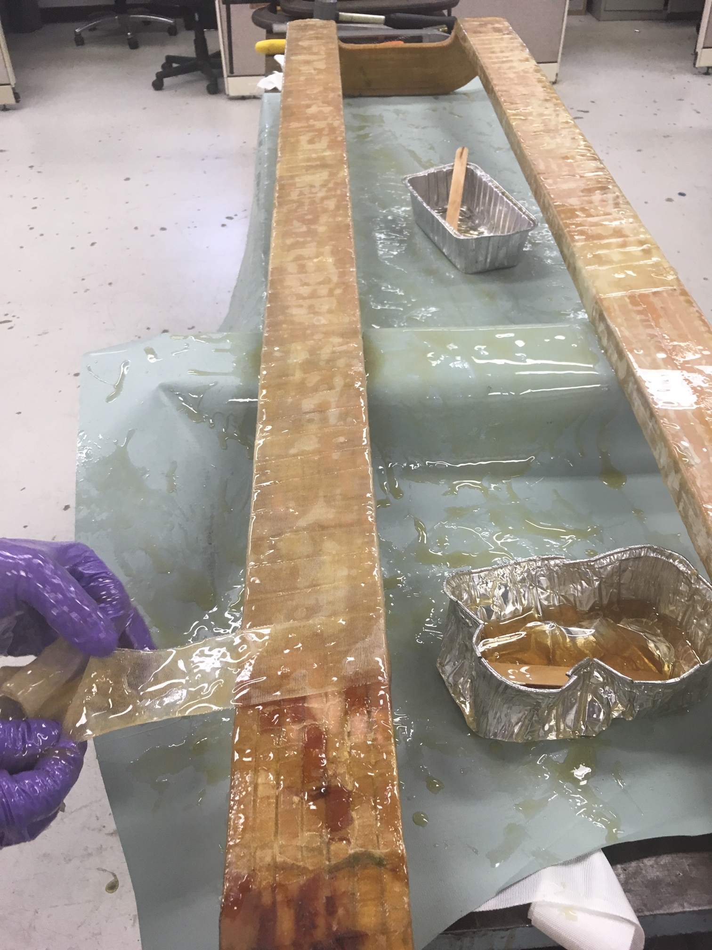
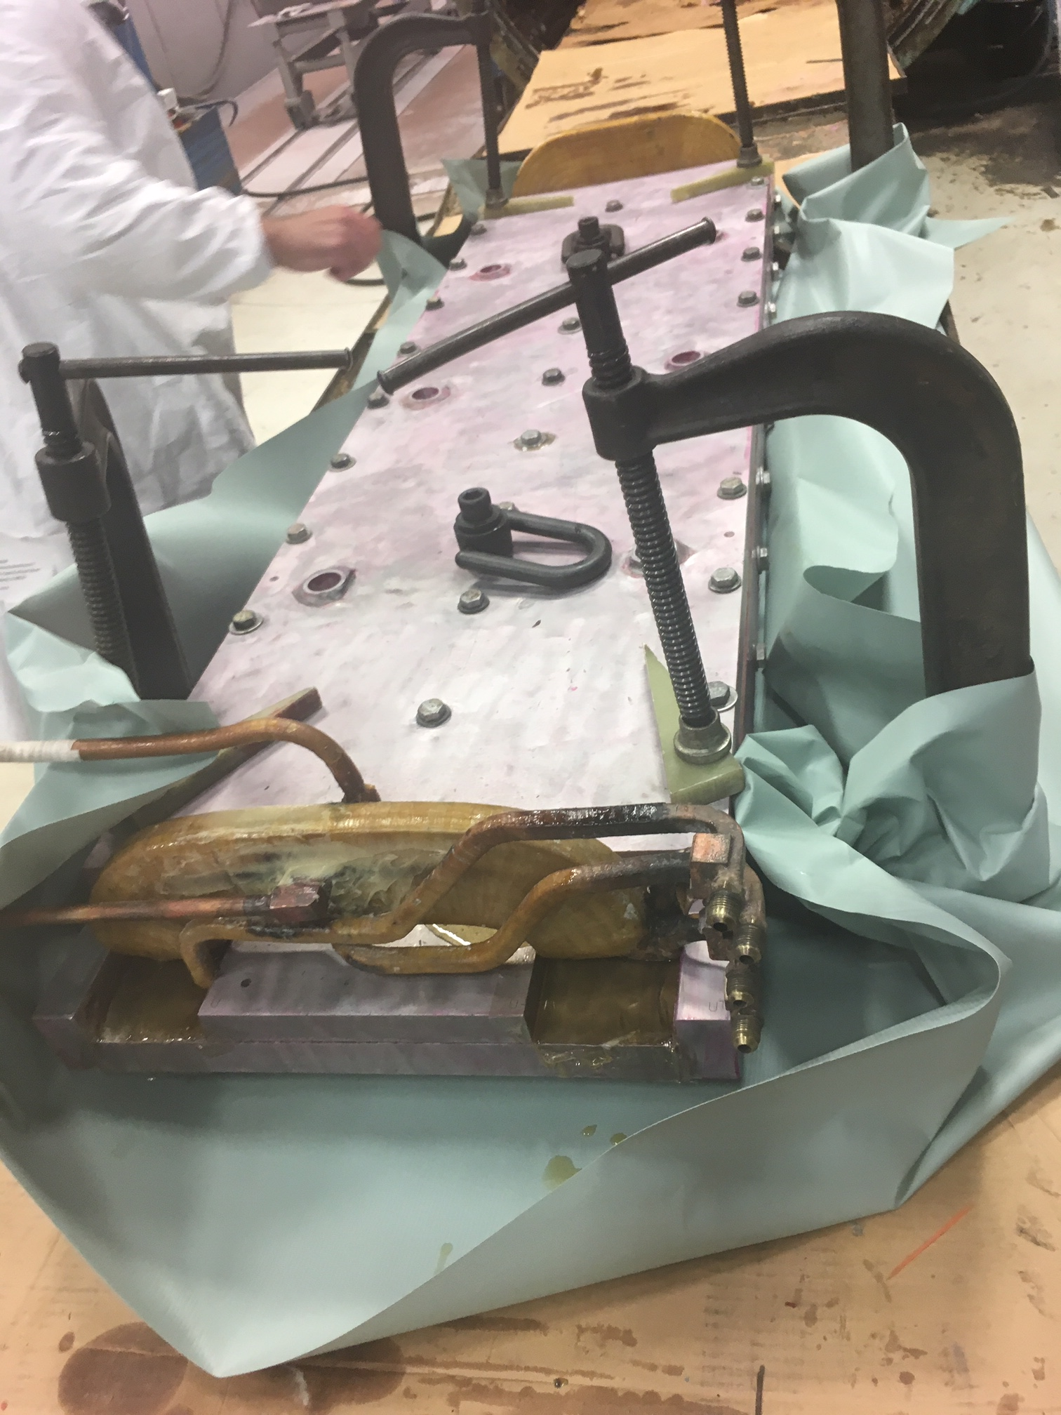
MDCE001 – Applying epoxy and clamping in mold

Slide 10
Upcoming
Transition to operation – tentative plan
Continue power supply testing today
Thermal scans of magnets after more general power supply testing early next week
Access opportunities next week, hope to receive MDCE001
Prepare for resuming beam operation
H748 repair
Magnet completion (MDCE001) now estimated for 10/19, then several more days for transport and installation
MDCC007 repairs (will be spare) completed in November

