Slide 1
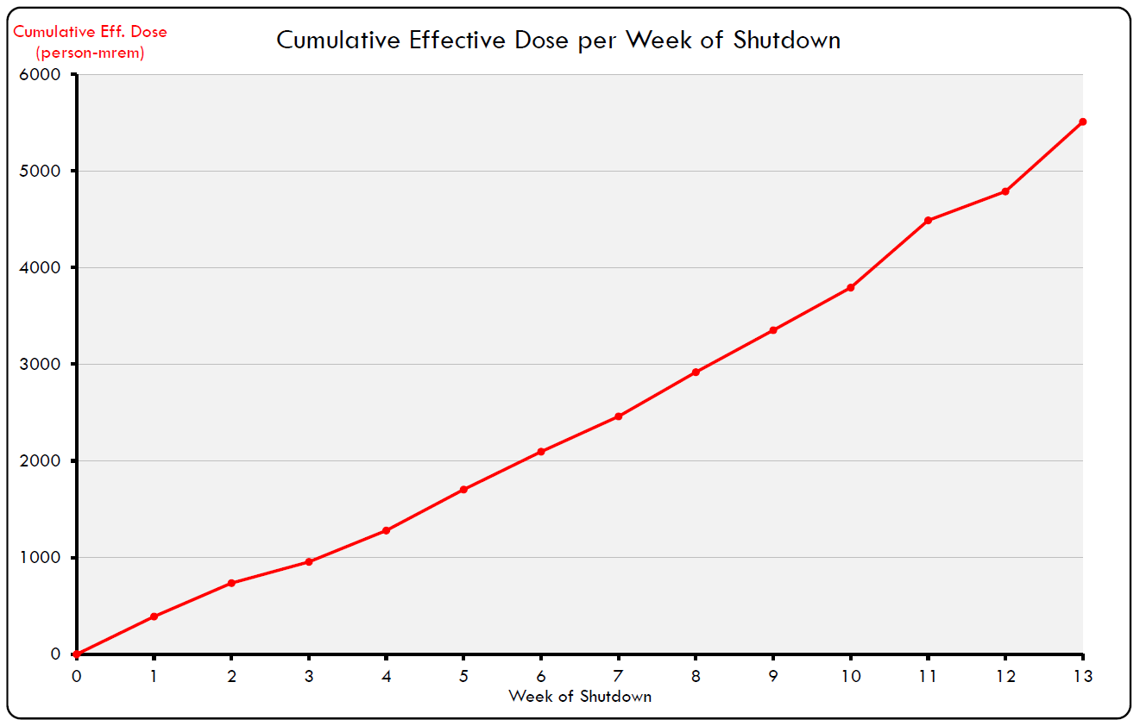
2018 Shutdown Pocket Dosimeter Reports – Week 13
WEEK 13
720 person-mrem
50 people reported some dose, with average dose of 14.40 mrem
SHUTDOWN SO FAR:
5,507 person-mrem
171 people reported some dose, with average dose of 32.20 mrem
Total shutdown dose estimate: 6,800 person-mrem

